Slide 1
Effect of gain in dispersion relation

Slide 2
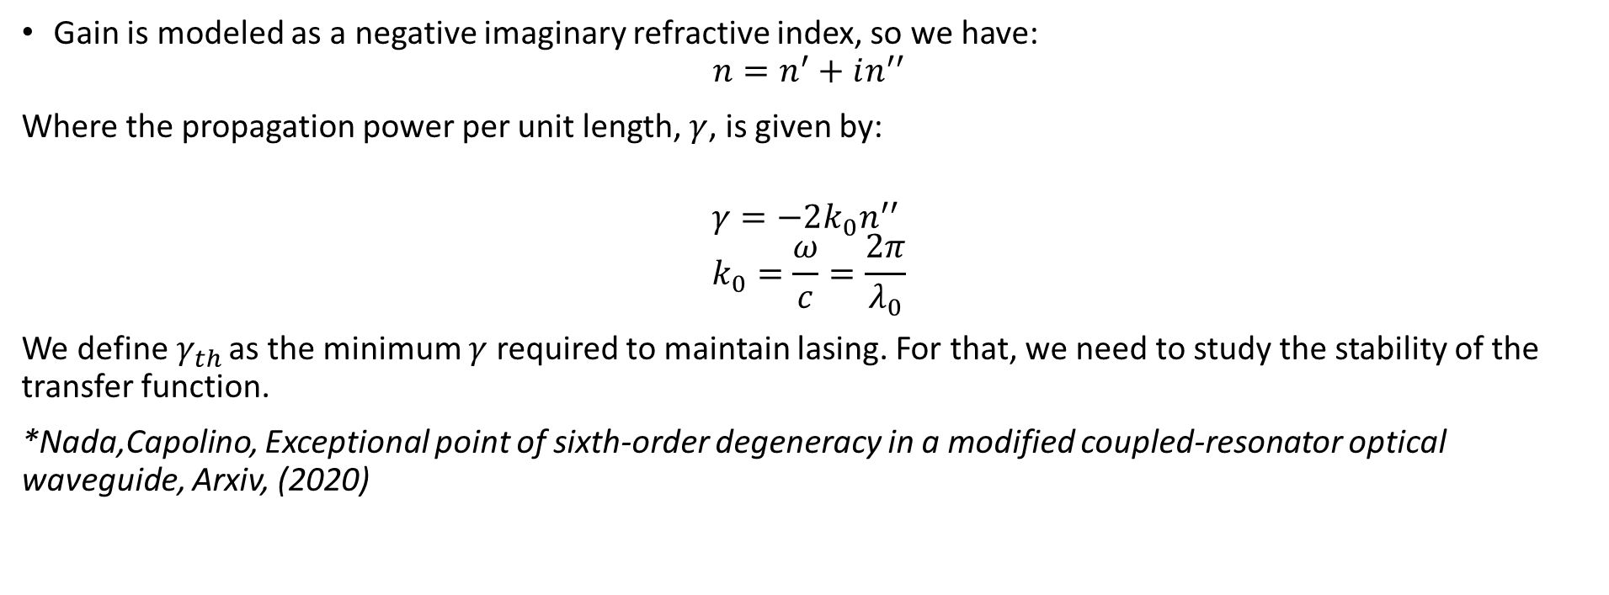
Lasing basics
Gain is modeled as a negative imaginary refractive index, so we have:
$$n=n^{′}+in^{′′}$$
Where the propagation power per unit length, $γ$, is given by:
$$γ=−2k_{0}n^{′′} \\ k_{0}=\frac{ω}{c}=\frac{2π}{λ_{0}}$$
We define$γ_{th}$ as the minimum $γ$ required to maintain lasing. For that, we need to study the stability of the transfer function.
*Nada,Capolino, Exceptional point of sixth-order degeneracy in a modified coupled-resonator optical waveguide, Arxiv, (2020)
Any perturbation changes the quality of the SIP

Slide 3

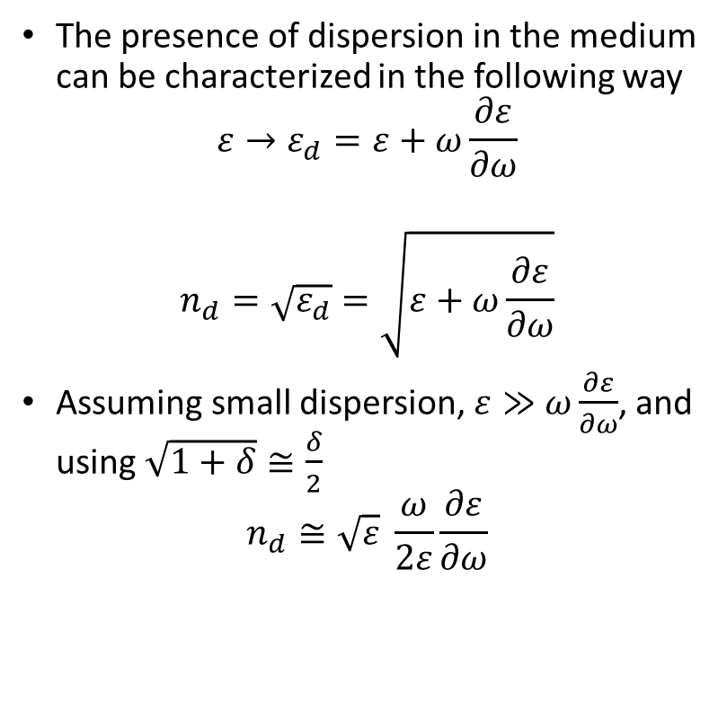
Dispersion modeling
The presence of dispersion in the medium can be characterized in the following way
$$ε→ε_{d}=ε+ω\frac{∂ε}{∂ω}$$
$$n_{d}=\sqrt{ε_{d}}=\sqrt{ε+ω\frac{∂ε}{∂ω}}$$
Assuming small dispersion, $ε≫$ $ω\frac{∂ε}{∂ω}$, and using $\sqrt{1+δ}≅\frac{δ}{2}$
$$n_{d}≅\sqrt{ε} \frac{ω}{2ε}\frac{∂ε}{∂ω}$$
We also have that:
$$\frac{∂ε}{∂ω}=\frac{∂ε}{∂n} \frac{∂n}{∂ω}=2\sqrt{ε}\frac{∂n}{∂ω}$$
Then:
$$n_{d}=ω\frac{∂n}{∂ω}$$
There’s more

Slide 4
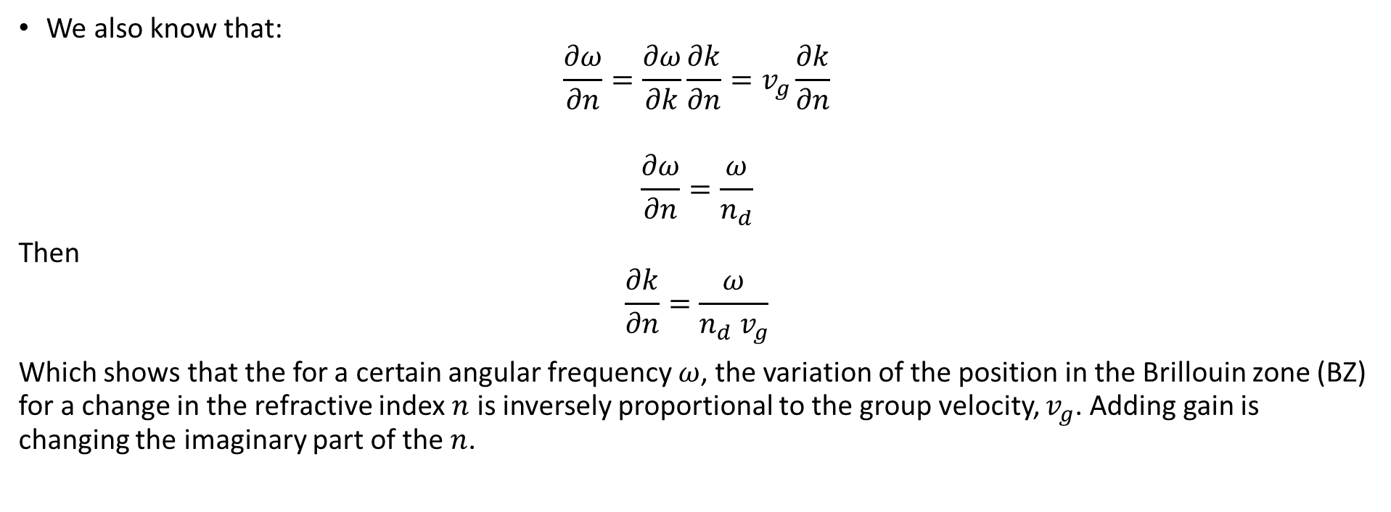
Dispersion modeling
We also know that:
$$\frac{∂ω}{∂n}=\frac{∂ω}{∂k}\frac{∂k}{∂n}=v_{g}\frac{∂k}{∂n}$$
$$\frac{∂ω}{∂n}=\frac{ω}{n_{d}}$$
Then
$$\frac{∂k}{∂n}=\frac{ω}{n_{d} v_{g}}$$
Which shows that the for a certain angular frequency $ω$, the variation of the position in the Brillouin zone (BZ) for a change in the refractive index $n$ is inversely proportional to the group velocity, $v_{g}$. Adding gain is changing the imaginary part of the $n$.
There is a stronger change at the EPD

Slide 5
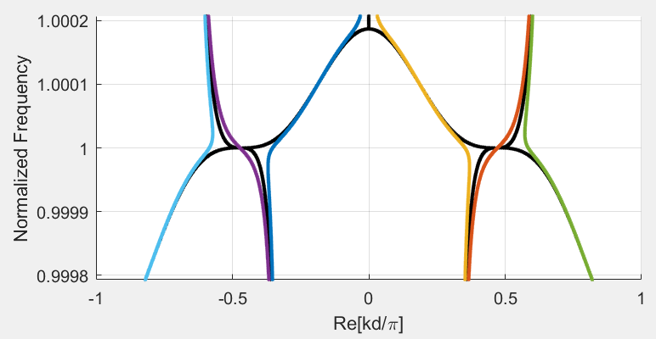
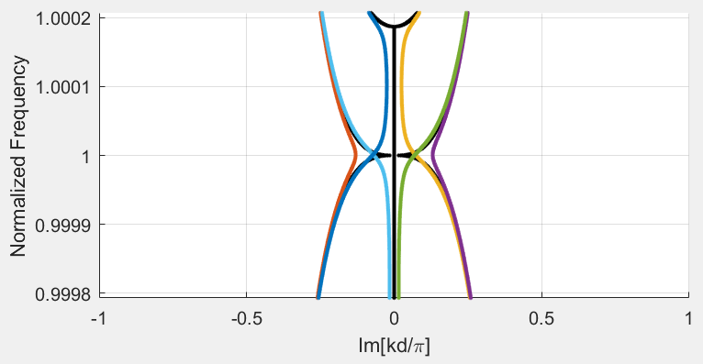
Gain in SIP-ASOW
Here we show the dispersion relation for the lossless and gainless SIP (in black) and the dispersion relation for a complex refractive index with $n=2.632 −j4.27×{10}^{−5}$ (threshold value for a finite-length structure with $N=5$).
The biggest change occurs around EPDs, where $v_{g}→0$

