Slide 1
Lasing Threshold in SIP-ASOW

Slide 2
Goal
Previous week:
Was asked to investigate threshold gain to have lasing
Objective for this week:
I show the theory for modeling the gain as a negative imaginary refractive index & find the threshold values
I show how the change of the dispersion relation with added gain
Finished so far:
Lasing theory & fitting with waveguide length
Basic equations that relate dispersion and gain
Lasing in ASOW, perturbation of disp. diagram and scaling with length

Slide 3
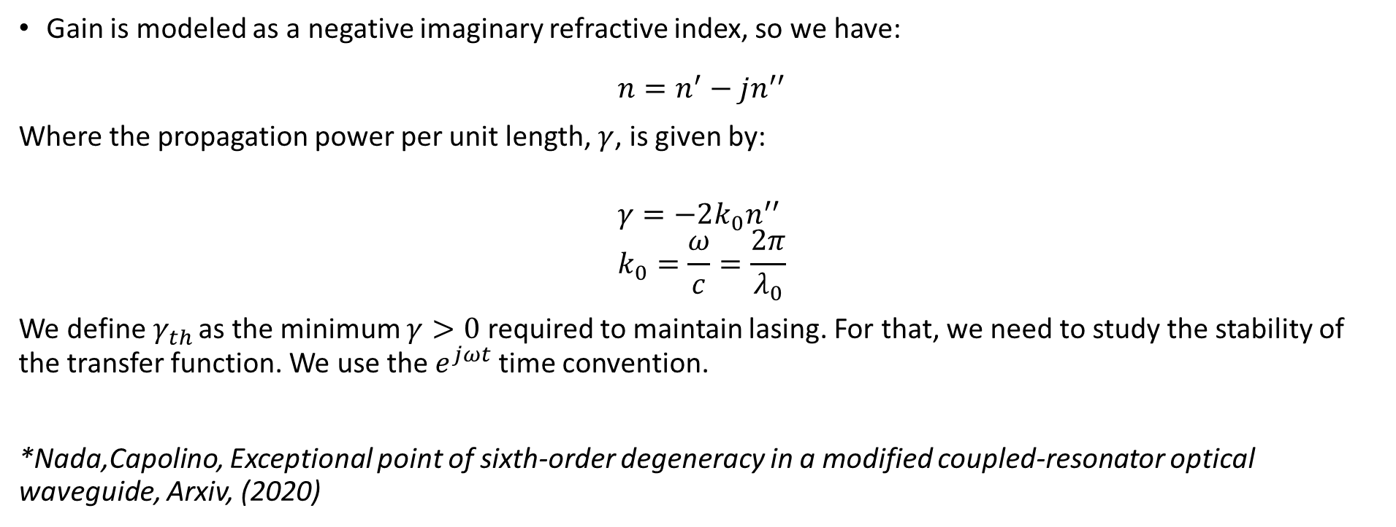
Lasing basics
Gain is modeled as a negative imaginary refractive index, so we have:
$$n=n^{′}−jn^{′′}$$
Where the propagation power per unit length, $γ$, is given by:
$$γ=−2k_{0}n^{′′} \\ k_{0}=\frac{ω}{c}=\frac{2π}{λ_{0}}$$
We define$γ_{th}$ as the minimum $γ>0$ required to maintain lasing. For that, we need to study the stability of the transfer function. We use the $e^{jωt}$ time convention.
*Nada,Capolino, Exceptional point of sixth-order degeneracy in a modified coupled-resonator optical waveguide, Arxiv, (2020)
Any perturbation changes the quality of the SIP. As we want the smallest perturbation, we want to work at $γ_{th}$

Slide 4
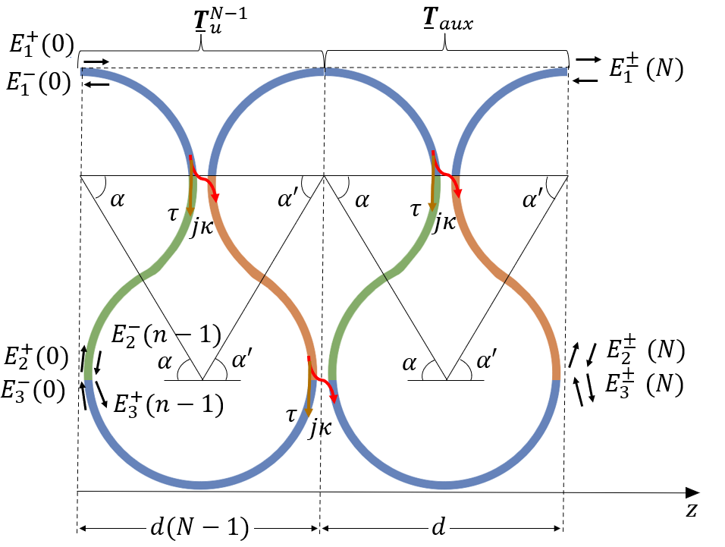
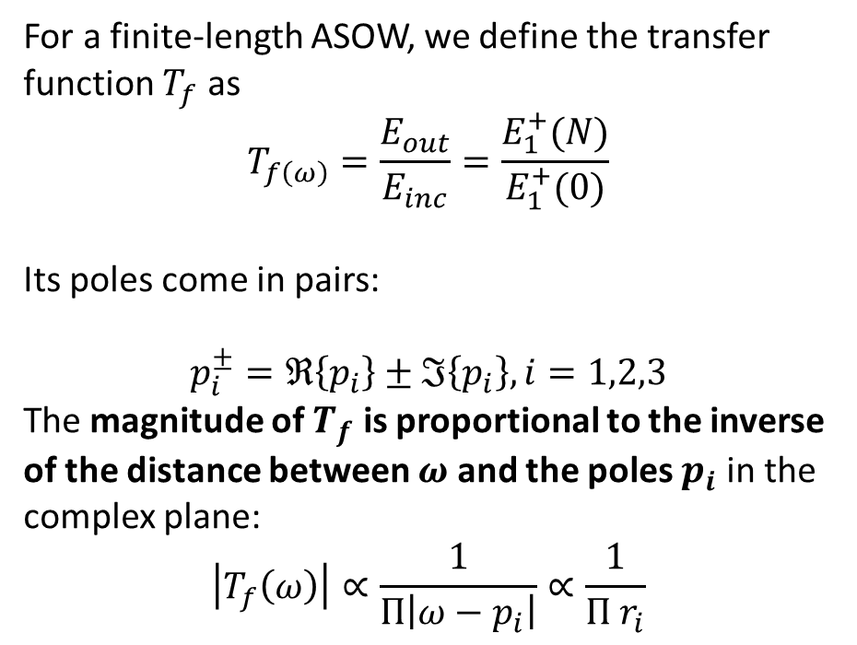
Transfer Function
For a finite-length ASOW, we define the transfer function $T_{f}$ as
$$T_{f\left(ω\right)}=\frac{E_{out}}{E_{inc}}=\frac{E_{1}^{+}(N)}{E_{1}^{+}(0)}$$
Its poles come in pairs:
$$p_{i}^{±}=ℜ\left\{p_{i}\right\}±ℑ\left\{p_{i}\right\},i=1,2,3$$
The magnitude of $T_{f}$ is proportional to the inverse of the distance between $ω$ and the poles $p_{i}$ in the complex plane:
$$\left|T_{f}\left(ω\right)\right|∝\frac{1}{Π\left|ω−p_{i}\right|}∝\frac{1}{Π r_{i}}$$
*Nada,Capolino, Exceptional point of sixth-order degeneracy in a modified coupled-resonator optical waveguide, Arxiv, (2020)
The active medium is assumed uniformly distributed and pumped

Slide 5
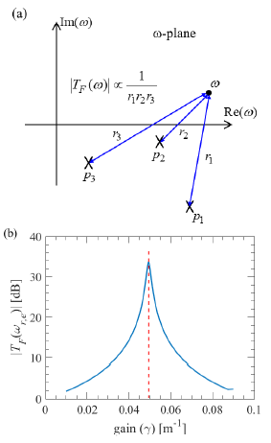
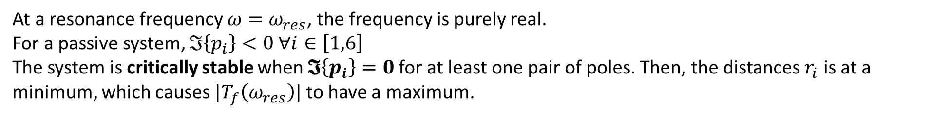

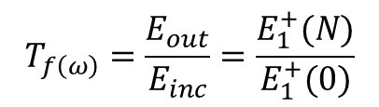
Poles of the transfer function
At a resonance frequency $ω=ω_{res}$, the frequency is purely real.
For a passive system, $ℑ\left\{p_{i}\right\}<0 ∀i∈\left[1,6\right]$ The system is critically stable when $𝕴\left\{p_{i}\right\}=0$for at least one pair of poles. Then, the distances $r_{i}$ is at a minimum, which causes $|T_{f}\left(ω_{res}\right)|$ to have a maximum.
$$T_{f\left(ω\right)}=\frac{E_{out}}{E_{inc}}=\frac{E_{1}^{+}(N)}{E_{1}^{+}(0)}$$
$$γ_{th}$$
The goal is to do this for the SIP-ASOW
*Nada,Capolino, Exceptional point of sixth-order degeneracy in a modified coupled-resonator optical waveguide, Arxiv, (2020)

Slide 6
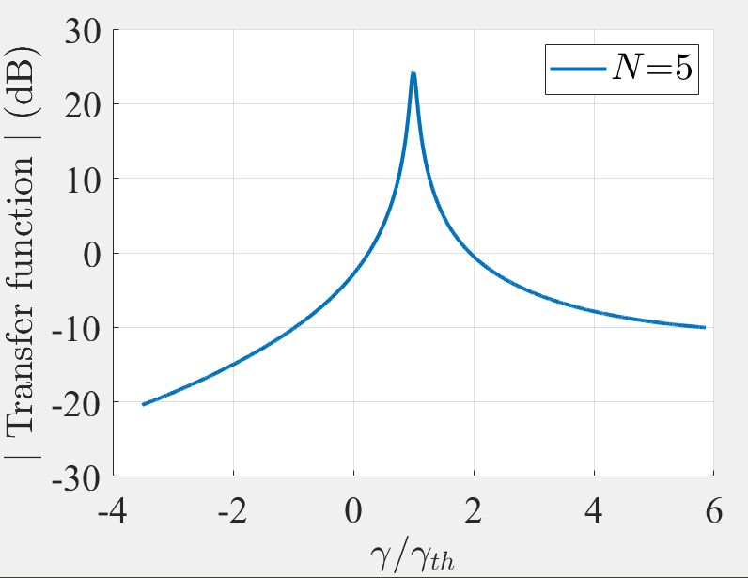
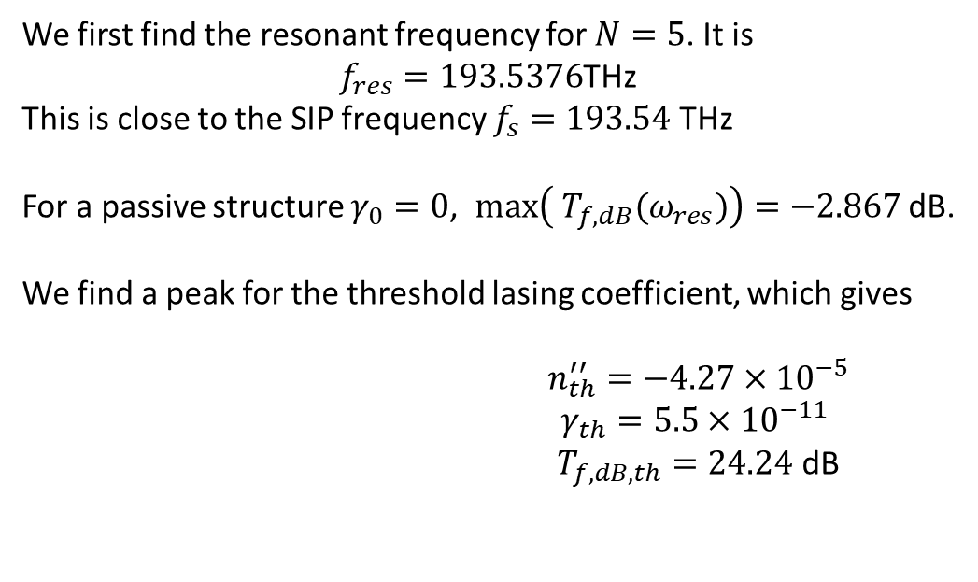

Lasing threshold at SIP-ASOW
We first find the resonant frequency for $N=5$. It is
$f_{res}=193.5376$THz
This is close to the SIP frequency $f_{s}=193.54$ THz
For a passive structure $γ_{0}=0$, $max\left({ T}_{f,dB}(ω_{res})\right)=−2.867$ dB.
We find a peak for the threshold lasing coefficient, which gives
$n_{th}^{′′}=−4.27×{10}^{−5}$ $γ_{th}=5.5×{10}^{−11}$ $T_{f,dB,th}=24.24$ dB
$$1$$
There is gain

Slide 7
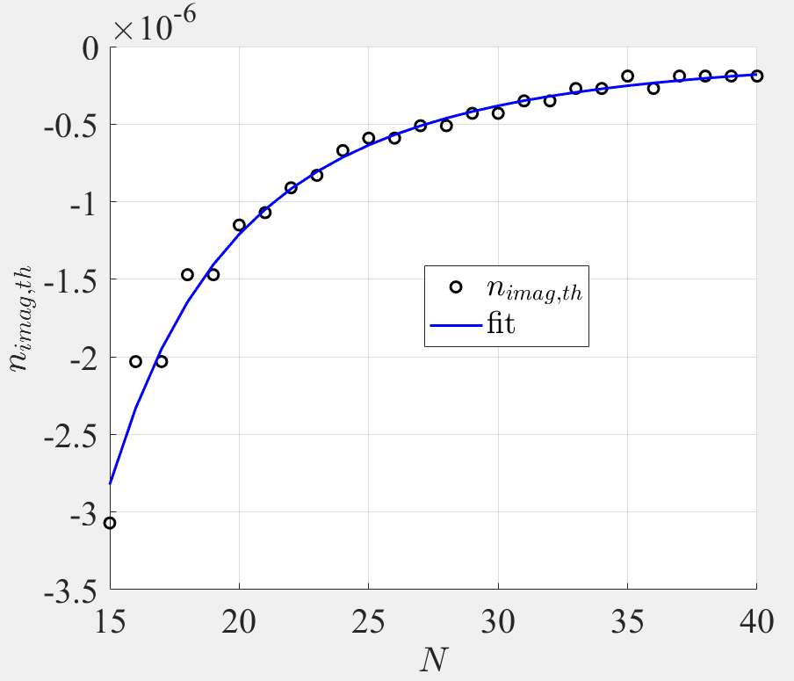
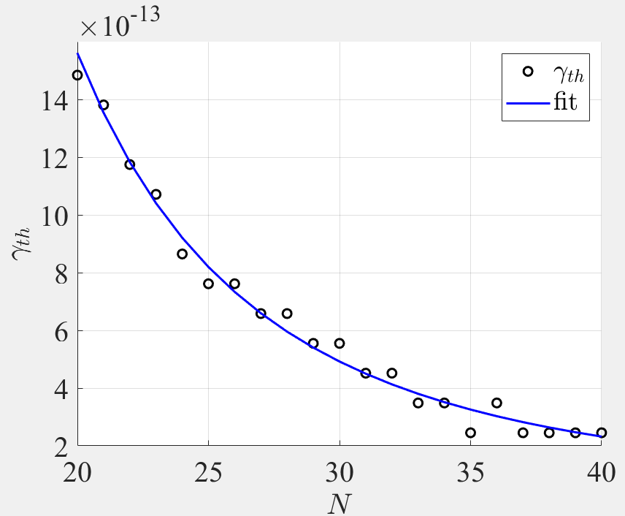


Lasing threshold with N
Our goal is to fit the trend for the imaginary component of the refractive index, $n_{th}′′$, and the lasing coefficient $γ_{th}$. Plotting the results against the number of unit cells $N$, we find the following fit, for $N∈[20,40]$:
$$n_{th, fit}^{′′}=−9.4×{10}^{−3}N^{−3}−3.283×{10}^{−8}$$
$$γ_{th,fit}=−2\frac{ω_{s}}{c}n_{th,fit}^{′′}$$
$∗ω_{s} \sim$SIP frequency

Slide 8
Effect of gain in dispersion relation

Slide 9

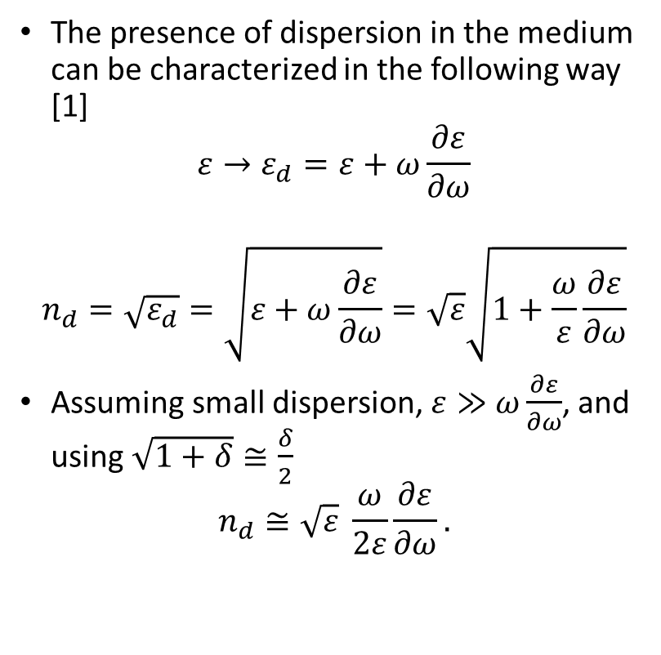
Dispersion modeling
The presence of dispersion in the medium can be characterized in the following way [1]
$$ε→ε_{d}=ε+ω\frac{∂ε}{∂ω}$$
$$n_{d}=\sqrt{ε_{d}}=\sqrt{ε+ω\frac{∂ε}{∂ω}}=\sqrt{ε}\sqrt{1+\frac{ω}{ε}\frac{∂ε}{∂ω}}$$
Assuming small dispersion, $ε≫$ $ω\frac{∂ε}{∂ω}$, and using $\sqrt{1+δ}≅\frac{δ}{2}$
$$n_{d}≅\sqrt{ε} \frac{ω}{2ε}\frac{∂ε}{∂ω}.$$
We also have that
$$\frac{∂ε}{∂ω}=\frac{∂ε}{∂n} \frac{∂n}{∂ω}=2\sqrt{ε}\frac{∂n}{∂ω},$$
then
$$n_{d}=ω\frac{∂n}{∂ω}$$
or $$\frac{∂ω}{∂n}=\frac{ω}{n_{d}}$$
There’s more
[1] Angelsky et al, Structured Light: Ideas and Concepts, Frontiers in physics, 8, (2020)

Slide 10
Dispersion modeling
We also know that:
$$\frac{∂ω}{∂n}=\frac{∂ω}{∂k}\frac{∂k}{∂n}=v_{g}\frac{∂k}{∂n}$$
$$\frac{∂ω}{∂n}=\frac{ω}{n_{d}}$$
Then
$$\frac{∂k}{∂n}=\frac{ω}{n_{d} v_{g}}$$
Which shows that the for a certain angular frequency $ω$, the variation of the position in the Brillouin zone (BZ) for a change in the refractive index $n$ is inversely proportional to the group velocity, $v_{g}$. Adding gain is changing the imaginary part of the $n$.
There is a stronger change of $k(n)$ at the EPD frequency $ω_{s}$

Slide 11
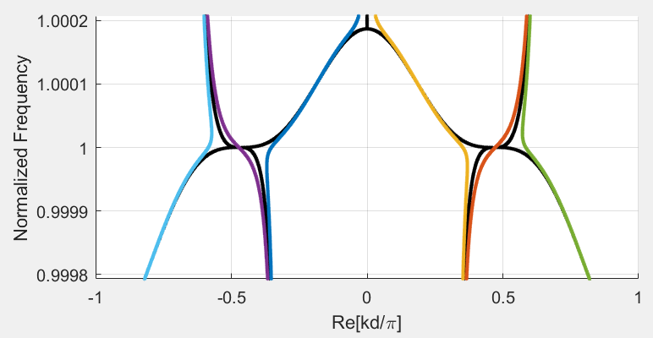
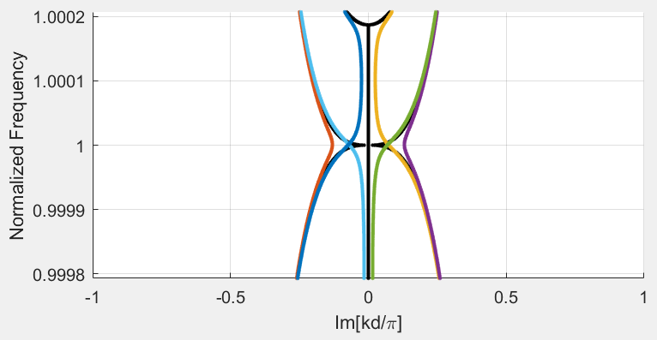

Gain in SIP-ASOW
Here we show the dispersion relation for the lossless and gainless SIP (in black) and the dispersion relation for a complex refractive index with $n=2.632 −j4.27×{10}^{−5}$ (threshold value for a finite-length structure with $N=5$).
Black: SIP with no gain Color: SIP with gain (perturbed)
$$\frac{∂k}{∂n}=\frac{ω}{n_{d} v_{g}}$$
The biggest change occurs around EPDs, where $v_{g}→0$

Slide 12
Discussion
Presumably, the perturbation of the dispersion relation with gain increases with the frequency (I haven’t checked).
If we have a simple structure with a simple analytic dispersion relation or group velocity, I can investigate if this is accurate.
Happy new year!

