Slide 1
Lasing Threshold in SIP-ASOW

Slide 2
Goal
Previous week:
Correct the errors: time convention and fitting
Check why the poles of the transfer matrix come in symmetric pairs wrt the imaginary axis
Start writing the SIP laser paper
Objective for this week:
Overcome covid-19
Improve Q calculations (with Tarek)
Finished so far:
Overcome covid-19
Corrected errors from last week
Improve Q calculations (with Tarek)
Propose the slow-light optical diode
Time convention, accurate Q, slow-light optical diode

Slide 3
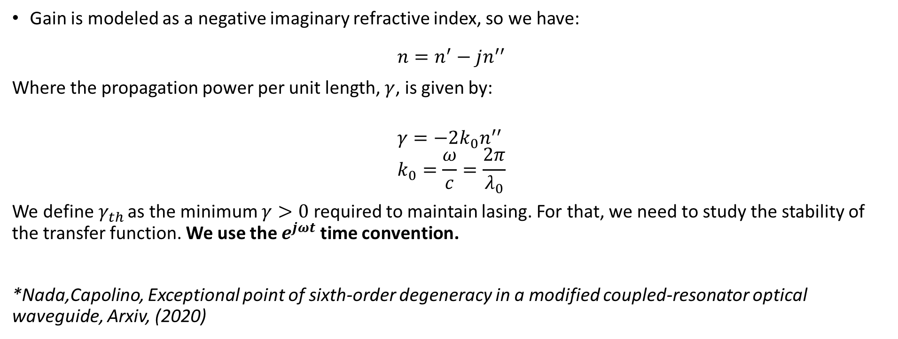
Lasing basics
Gain is modeled as a negative imaginary refractive index, so we have:
$$n=n^{′}−jn^{′′}$$
Where the propagation power per unit length, $γ$, is given by:
$$γ=−2k_{0}n^{′′} \\ k_{0}=\frac{ω}{c}=\frac{2π}{λ_{0}}$$
We define$γ_{th}$ as the minimum $γ>0$ required to maintain lasing. For that, we need to study the stability of the transfer function. We use the $e^{jωt}$ time convention.
*Nada,Capolino, Exceptional point of sixth-order degeneracy in a modified coupled-resonator optical waveguide, Arxiv, (2020)
Any perturbation changes the quality of the SIP. As we want the smallest perturbation, we want to work at $γ_{th}$

Slide 4
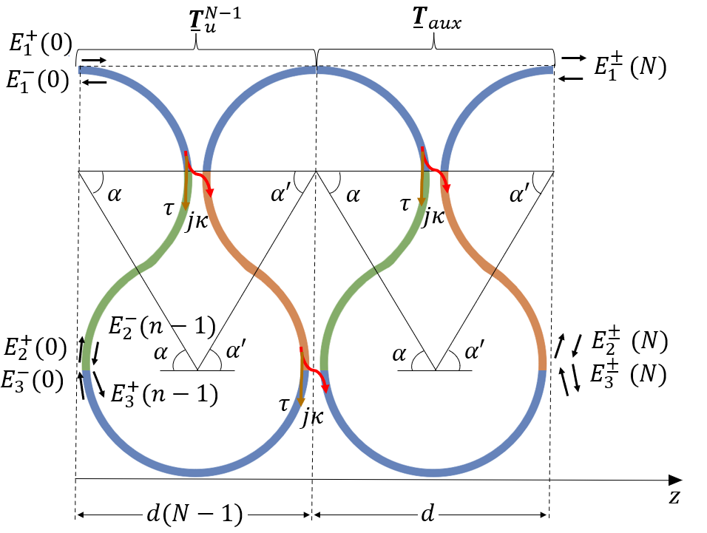
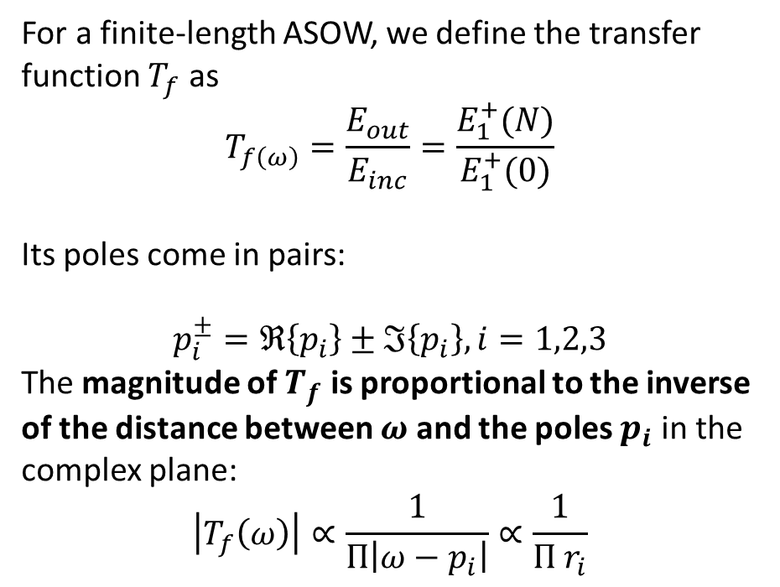
Transfer Function
For a finite-length ASOW, we define the transfer function $T_{f}$ as
$$T_{f\left(ω\right)}=\frac{E_{out}}{E_{inc}}=\frac{E_{1}^{+}(N)}{E_{1}^{+}(0)}$$
Its poles come in pairs:
$$p_{i}^{±}=ℜ\left\{p_{i}\right\}±ℑ\left\{p_{i}\right\},i=1,2,3$$
The magnitude of $T_{f}$ is proportional to the inverse of the distance between $ω$ and the poles $p_{i}$ in the complex plane:
$$\left|T_{f}\left(ω\right)\right|∝\frac{1}{Π\left|ω−p_{i}\right|}∝\frac{1}{Π r_{i}}$$
*Nada,Capolino, Exceptional point of sixth-order degeneracy in a modified coupled-resonator optical waveguide, Arxiv, (2020)
The active medium is assumed uniformly distributed and pumped

Slide 5
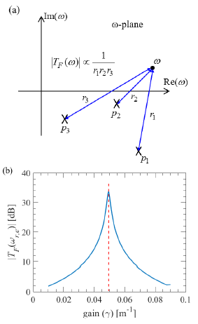
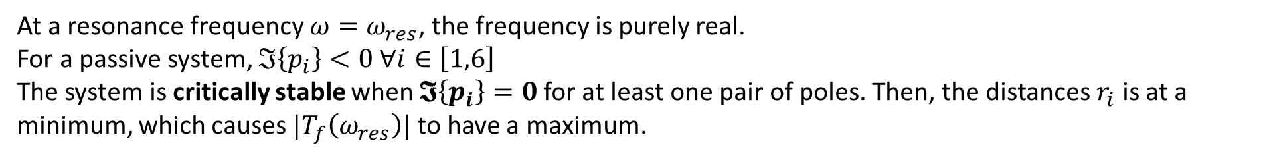

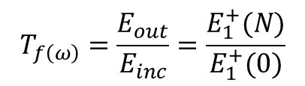
Poles of the transfer function
At a resonance frequency $ω=ω_{res}$, the frequency is purely real.
For a passive system, $ℑ\left\{p_{i}\right\}<0 ∀i∈\left[1,6\right]$ The system is critically stable when $𝕴\left\{p_{i}\right\}=0$for at least one pair of poles. Then, the distances $r_{i}$ is at a minimum, which causes $|T_{f}\left(ω_{res}\right)|$ to have a maximum.
$$T_{f\left(ω\right)}=\frac{E_{out}}{E_{inc}}=\frac{E_{1}^{+}(N)}{E_{1}^{+}(0)}$$
$$γ_{th}$$
The goal is to do this for the SIP-ASOW
*Nada,Capolino, Exceptional point of sixth-order degeneracy in a modified coupled-resonator optical waveguide, Arxiv, (2020)

Slide 6
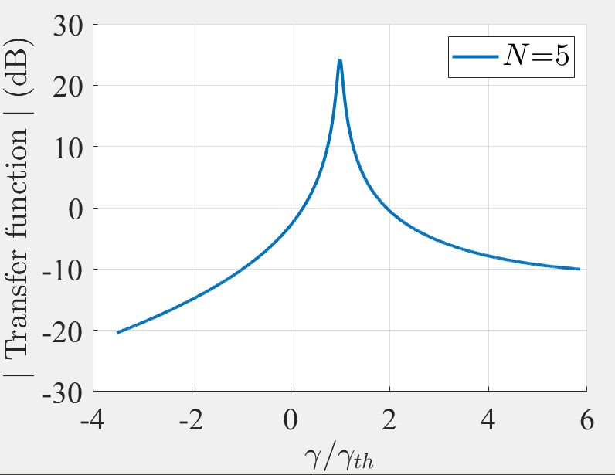
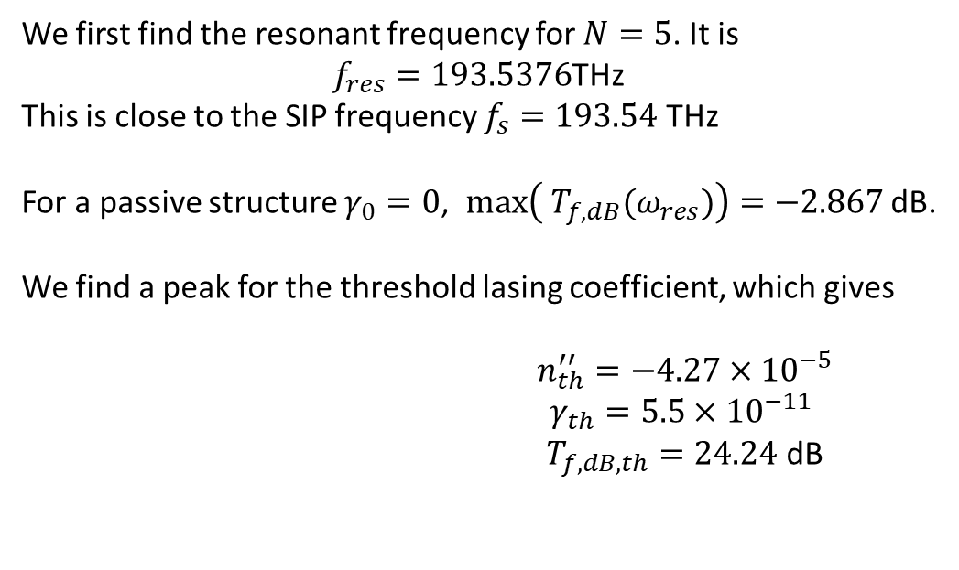

Lasing threshold at SIP-ASOW
We first find the resonant frequency for $N=5$. It is
$f_{res}=193.5376$THz
This is close to the SIP frequency $f_{s}=193.54$ THz
For a passive structure $γ_{0}=0$, $max\left({ T}_{f,dB}(ω_{res})\right)=−2.867$ dB.
We find a peak for the threshold lasing coefficient, which gives
$n_{th}^{′′}=−4.27×{10}^{−5}$ $γ_{th}=5.5×{10}^{−11}$ $T_{f,dB,th}=24.24$ dB
$$1$$
There is gain

Slide 7
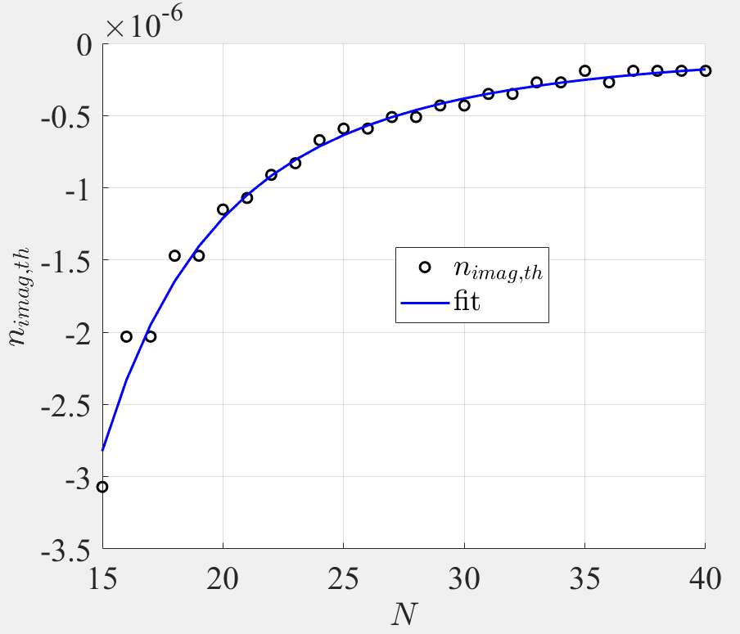
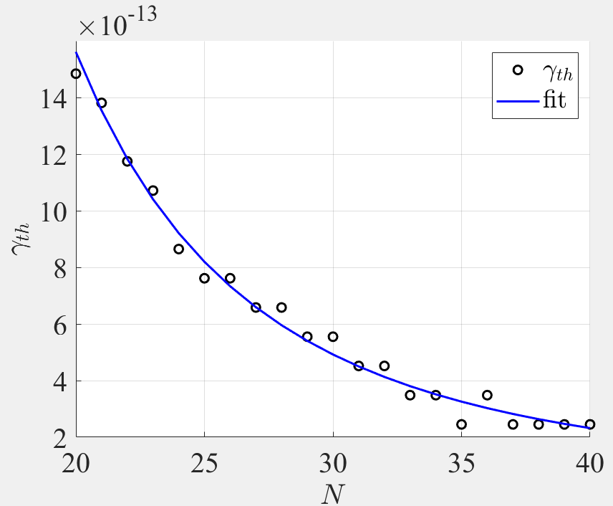


Lasing threshold with N
Our goal is to fit the trend for the imaginary component of the refractive index, $n_{th}′′$, and the lasing coefficient $γ_{th}$. Plotting the results against the number of unit cells $N$, we find the following fit, for $N∈[20,40]$:
$$n_{th, fit}^{′′}=−9.4×{10}^{−3}N^{−3}−3.283×{10}^{−8}$$
$$γ_{th,fit}=−2\frac{ω_{s}}{c}n_{th,fit}^{′′}$$
$∗ω_{s} \sim$SIP frequency

Slide 8
Improving quality factor calculations
And Tarek Measly

Slide 9
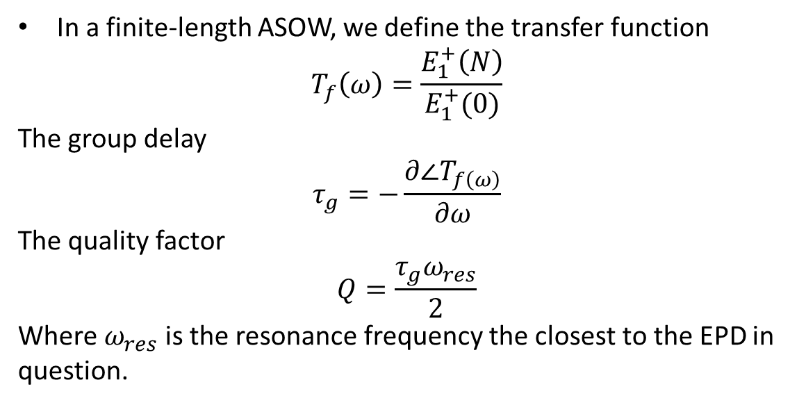
Quality Factor
In a finite-length ASOW, we define the transfer function
$$T_{f}\left(ω\right)=\frac{E_{1}^{+}\left(N\right)}{E_{1}^{+}(0)}$$
The group delay
$$τ_{g}=−\frac{∂∠T_{f\left(ω\right)}}{∂ω}$$
The quality factor
$$Q=\frac{τ_{g}ω_{res}}{2}$$
Where $ω_{res}$ is the resonance frequency the closest to the EPD in question.
The quality factor depends on the group delay

Slide 10
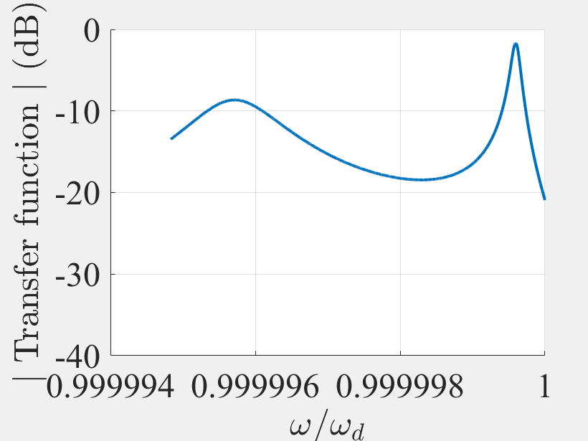
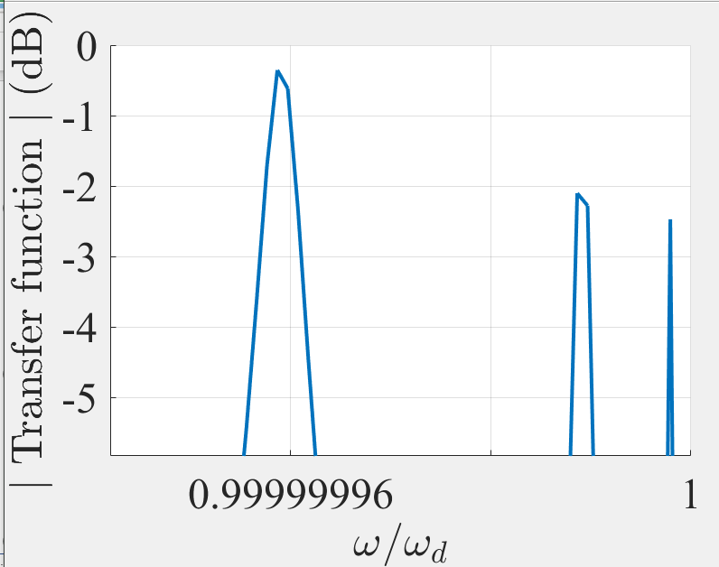


Calculations
In MATLAB, you set a frequency range and the size of the frequency step you do your calculations with. If your frequency array is not fine enough, you cannot properly resolve the peaks of the transfer function:
$$N=10$$
$$N=40$$
We need to adapt the frequency range to the number of unit cells

Slide 11
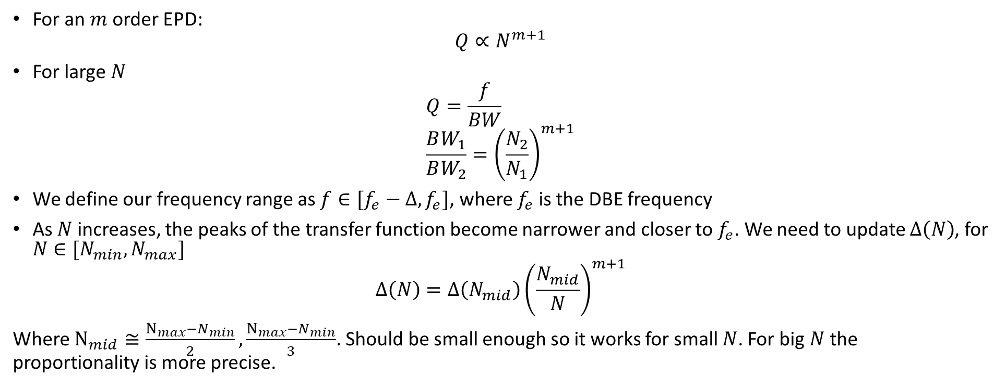
Quality factor and frequency range
For an $m$ order EPD:
$$Q∝N^{m+1}$$
For large $N$
$$Q=\frac{f}{BW} \\ \frac{BW_{1}}{BW_{2}}={\left(\frac{N_{2}}{N_{1}}\right)}^{m+1}$$
We define our frequency range as $f∈[f_{e}−Δ, f_{e}]$, where $f_{e}$ is the DBE frequency
As $N$ increases, the peaks of the transfer function become narrower and closer to $f_{e}$. We need to update $Δ\left(N\right)$, for $N∈[N_{min},N_{max}]$
$$Δ\left(N\right)=Δ\left(N_{mid}\right){\left(\frac{N_{mid}}{N}\right)}^{m+1}$$
Where $N_{mid}≅\frac{N_{max}−N_{min}}{2},\frac{N_{max}−N_{min}}{3}$. Should be small enough so it works for small $N$. For big $N$ the proportionality is more precise.
$Δ$ is updated inversely proportional to $Q$

Slide 12
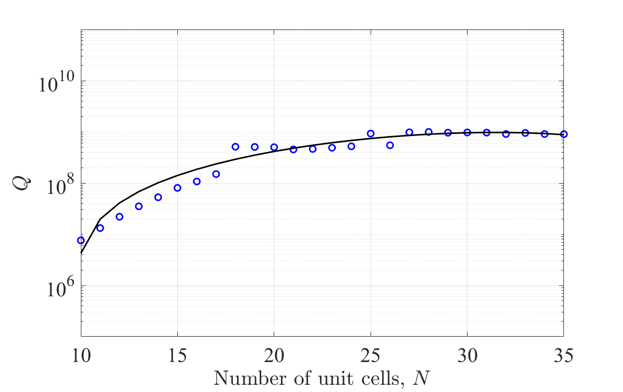
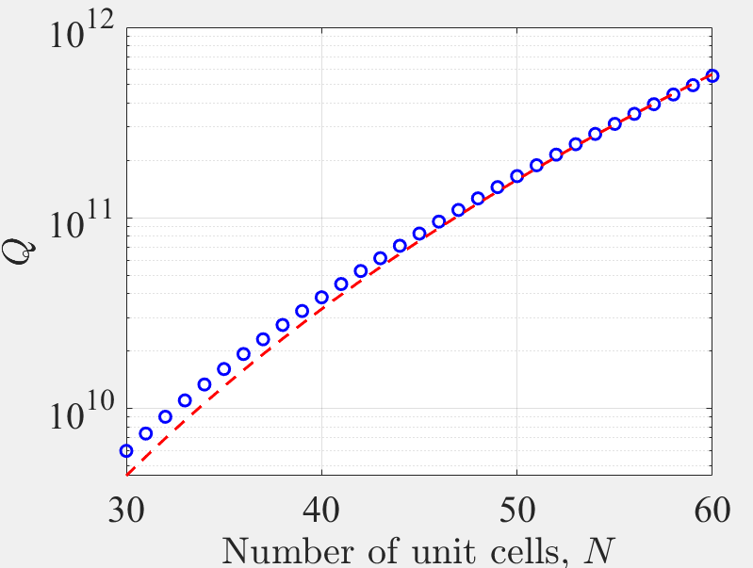

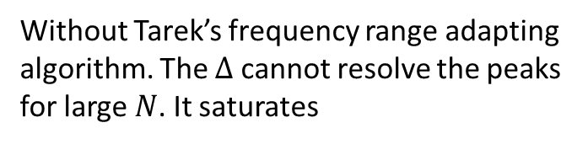
Example for the 6DBE-ASOW
Without Tarek’s frequency range adapting algorithm. The $Δ$ cannot resolve the peaks for large $N$. It saturates
With Tarek’s frequency range adapting algorithm
$$Δ\left(N\right)=1×{10}^{−4}{\left(\frac{20}{N}\right)}^{7}$$
The fitting is $N=aN^{7}+b$

Slide 13

Slow-light optical diode
A. Herrero and F. Capolino
Department of Electrical Engineering and Computer Science

Slide 14
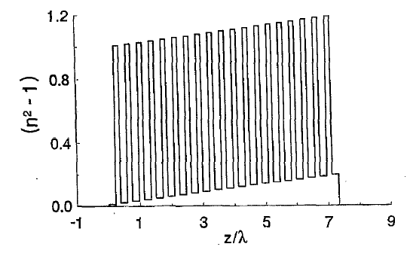


Partial Transmission
$$ω$$
A pulse tuned around the band gap frequency will have partial transmission when crossing the photonic crystal.
*Scalora, Bloemer, “The photonic band edge optical diode”, Journal of Applied Physics, 76,4 (1994).
$$k$$
The authors use the partial transmission design a stack of isotropic photonic crystals, with alternated layers doped with a nonlinear material to create an optical diode.
Longitudinal index profile

Slide 15
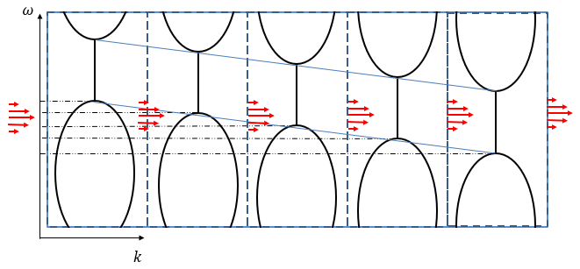
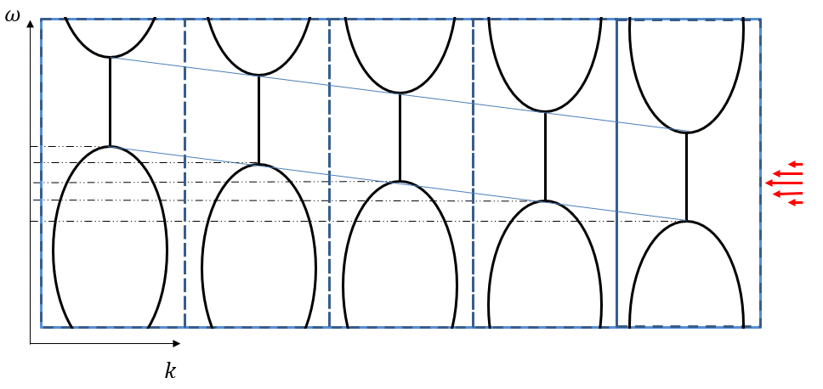

Slow-light photonic diode
The authors use the partial transmission design a stack of isotropic photonic crystals, with alternated layers doped with a nonlinear material to create an optical diode.
Left-to-right propagation: Because of the nonlinear material, the intensity pulse inside the crystal is magnified, so that it can “push through” the bandgap.
Right-to-left propagation: Immediate reflection. No opportunity for the pulse’s intensity to increase.
Scalora, Bloemer, “The photonic band edge optical diode”, Journal of Applied Physics, 76,4 (1994).
Left-to-right propagation
Right-to-left propagation
$$k$$
Can we do this with frozen mode?

Slide 16
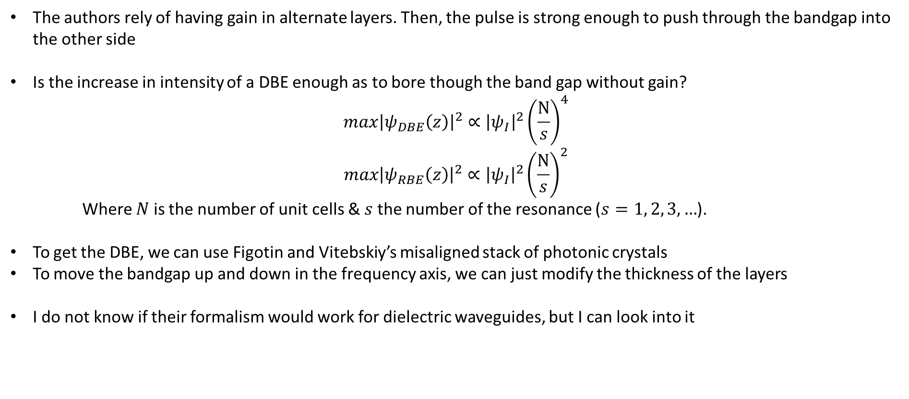
Slow-light photonic diode proposal
The authors rely of having gain in alternate layers. Then, the pulse is strong enough to push through the bandgap into the other side
Is the increase in intensity of a DBE enough as to bore though the band gap without gain?
$$max{\left|ψ_{DBE}\left(z\right)\right|}^{2}∝{\left|ψ_{I}\right|}^{2}{\left(\frac{N}{s}\right)}^{4}$$
$$max{\left|ψ_{RBE}\left(z\right)\right|}^{2}∝{\left|ψ_{I}\right|}^{2}{\left(\frac{N}{s}\right)}^{2}$$
Where $N$ is the number of unit cells & $s$ the number of the resonance ($s=1, 2, 3, …$).
To get the DBE, we can use Figotin and Vitebskiy’s misaligned stack of photonic crystals
To move the bandgap up and down in the frequency axis, we can just modify the thickness of the layers
I do not know if their formalism would work for dielectric waveguides, but I can look into it

Slide 17
Chirality meeting
When do you want to have a meeting to discuss chirality?

