Slide 1
Lasing Threshold and refractive index lineshape

Slide 2
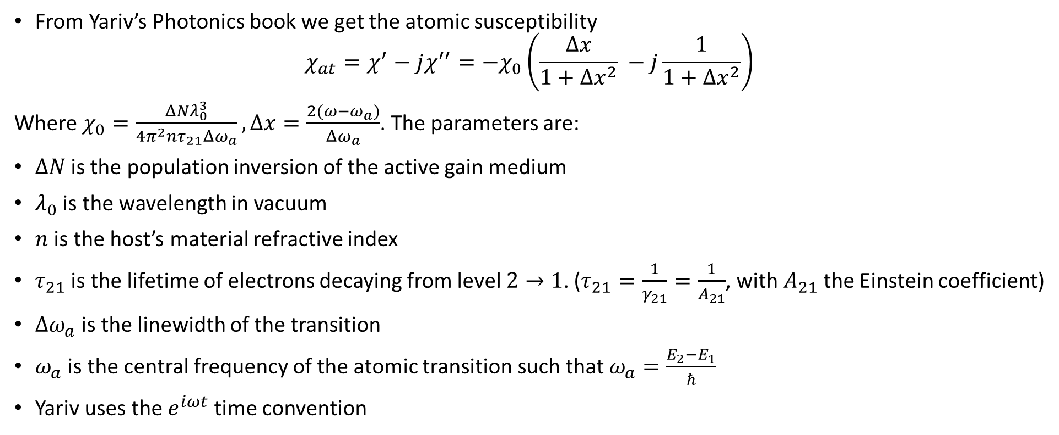
Atomic susceptibility
From Yariv’s Photonics book we get the atomic susceptibility
$$χ_{at}=χ^{′}−jχ^{′′}=−χ_{0}\left(\frac{Δx}{1+Δx^{2}} −j\frac{1}{1+Δx^{2}}\right)$$
Where $χ_{0}=\frac{ΔNλ_{0}^{3}}{4π^{2}nτ_{21}Δω_{a}}, Δx=\frac{2(ω−ω_{a})}{Δω_{a}}$. The parameters are:
$ΔN$is the population inversion of the active gain medium
$λ_{0}$ is the wavelength in vacuum
$n$ is the host’s material refractive index
$τ_{21}$ is the lifetime of electrons decaying from level $2→1$. ($τ_{21}=\frac{1}{γ_{21}}=\frac{1}{A_{21}}$, with $A_{21}$ the Einstein coefficient)
$Δω_{a}$ is the linewidth of the transition
$ω_{a}$ is the central frequency of the atomic transition such that $ω_{a}=\frac{E_{2}−E_{1}}{ℏ}$
Yariv uses the $e^{iωt}$ time convention
Adapted Yariv’s notation to conform with Siegman’s and mine
*Yariv, Photonics: Optical electronics in modern communication, Oxford university press, (2007)

Slide 3
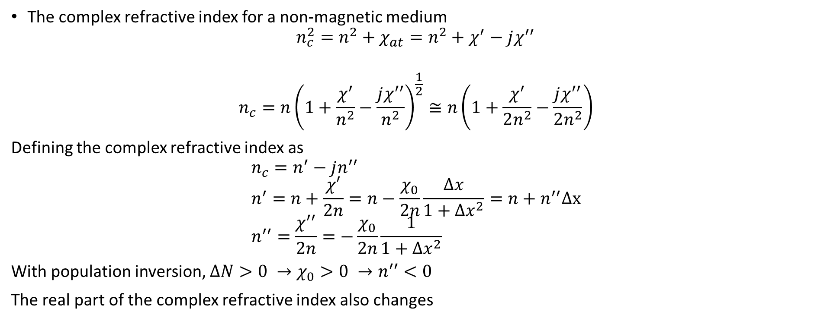

Complex refractive index
$$\sqrt{1+δ}≅1+\frac{δ}{2}$$
The complex refractive index for a non-magnetic medium
$$n_{c}^{2}=n^{2}+χ_{at}=n^{2}+χ^{′}−jχ^{′′}$$
$$n_{c}=n{\left(1+\frac{χ^{′}}{n^{2}}−\frac{jχ^{′′}}{n^{2}}\right)}^{\frac{1}{2}}≅n\left(1+\frac{χ^{′}}{2n^{2}}−\frac{jχ^{′′}}{2n^{2}}\right)$$
Defining the complex refractive index as
$$n_{c}=n^{′}−jn^{′′} \\ n^{′}=n+\frac{χ′}{2n}=n−\frac{χ_{0}}{2n}\frac{Δx}{1+Δx^{2}}=n+n^{′′}Δx \\ n^{′′}=\frac{χ^{′′}}{2n}=−\frac{χ_{0}}{2n}\frac{1}{1+Δx^{2}}$$
With population inversion, $ΔN>0 →χ_{0}>0 →n^{′′}<0$
The real part of the complex refractive index also changes
With population inversion, $n^{′′}<0$

Slide 4
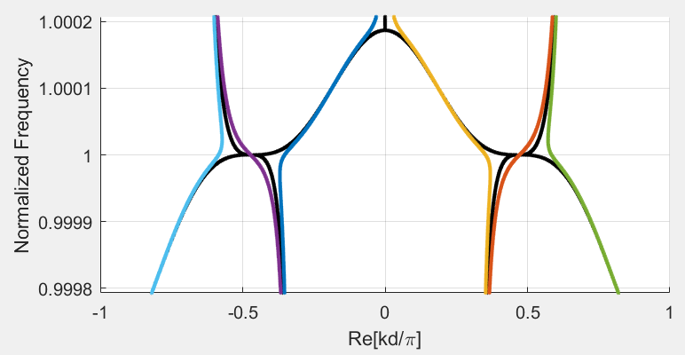
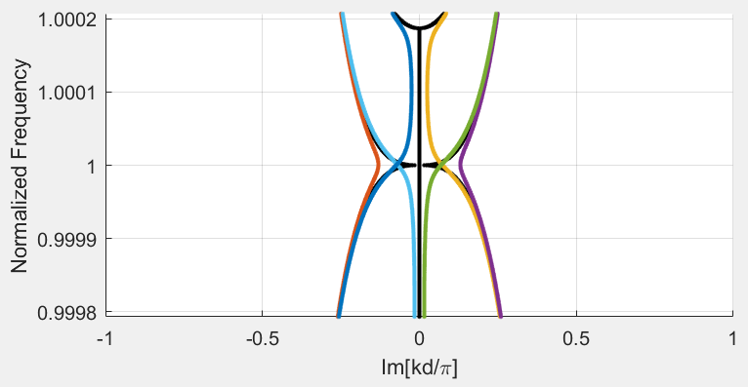

Linewidth and lineshape
$$n_{c}=n^{′}−jn^{′′}=n+n^{′′}Δx −jn′′$$
The change in the real part is ${|n}^{′}−n|=|n′′Δx|<0.001$
This means that the change in the dispersion diagram when adding the change in $n′$ (and not only $n^{′}′$) is negligible
Black: SIP with no gain
Color: SIP with gain (perturbed)
The dispersion diagram is perturbed by the change in the imaginary refractive index

Slide 5
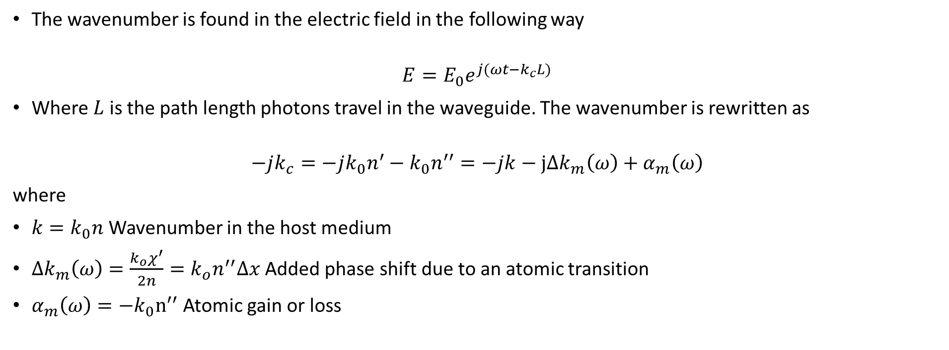
Wavenumber
The wavenumber is found in the electric field in the following way
$$E=E_{0}e^{j(ωt−k_{c}L)}$$
Where $L$ is the path length photons travel in the waveguide. The wavenumber is rewritten as
$$−jk_{c}=−jk_{0}n^{′}−k_{0}n^{′′}=−jk−jΔk_{m}\left(ω\right)+α_{m}\left(ω\right)$$
where
$k=k_{0}n$ Wavenumber in the host medium
$Δk_{m}\left(ω\right)=\frac{{k_{o}χ}^{′}}{2n}={k_{o}n}^{′′}Δx$ Added phase shift due to an atomic transition
$α_{m}\left(ω\right)=−k_{0}n^{′′}$ Atomic gain or loss
As $n^{′′}<0$, there is gain
*Siegman, Lasers, University Science Books, (1986), $e^{jωt}$time convention

Slide 6
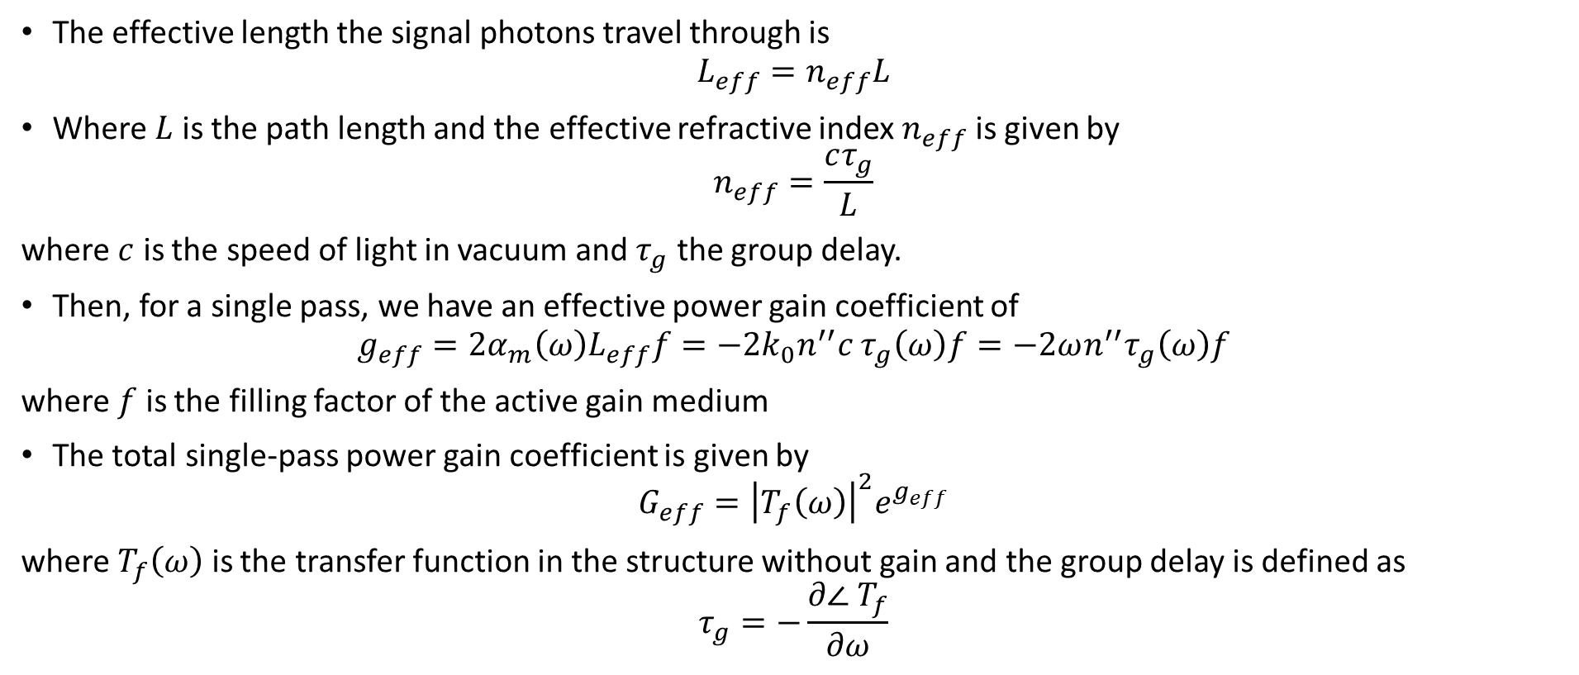
Effective lengths and single pass length
The effective length the signal photons travel through is
$$L_{eff}=n_{eff}L$$
Where $L$ is the path length and the effective refractive index $n_{eff}$ is given by
$$n_{eff}=\frac{cτ_{g}}{L}$$
where $c$ is the speed of light in vacuum and $τ_{g}$ the group delay.
Then, for a single pass, we have an effective power gain coefficient of
$$g_{eff}={2α}_{m}\left(ω\right)L_{eff}f=−{2k}_{0}n^{′′}c τ_{g}\left(ω\right)f=−2ωn^{′′}τ_{g}\left(ω\right)f$$
where $f$ is the filling factor of the active gain medium
The total single-pass power gain coefficient is given by
$$G_{eff}={\left|T_{f}\left(ω\right)\right|}^{2}e^{g_{eff}}$$
where $T_{f}\left(ω\right)$ is the transfer function in the structure without gain and the group delay is defined as
$$τ_{g}=−\frac{∂∠ T_{f}}{∂ω}$$
The power gain has a strong dependence on the transfer function
*Othman, Figotin, Capolino, Giant gain enhancement in photonic crystals with a degenerate band edge, Physical Review B, 93, 2, (2016)

Slide 7
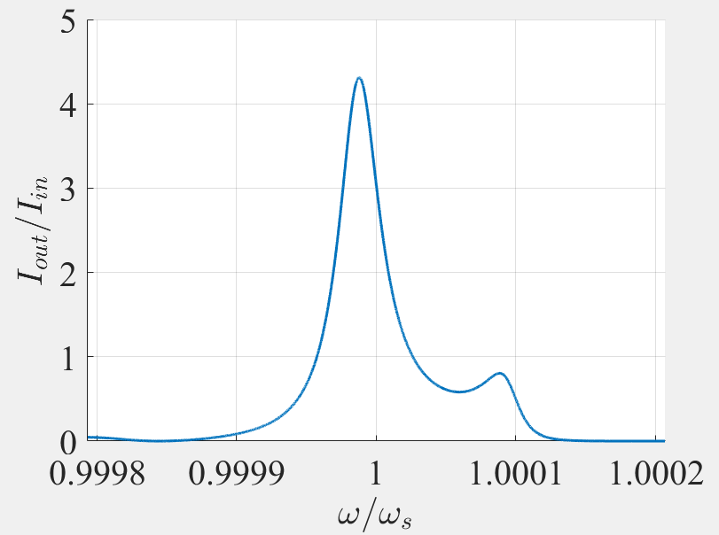
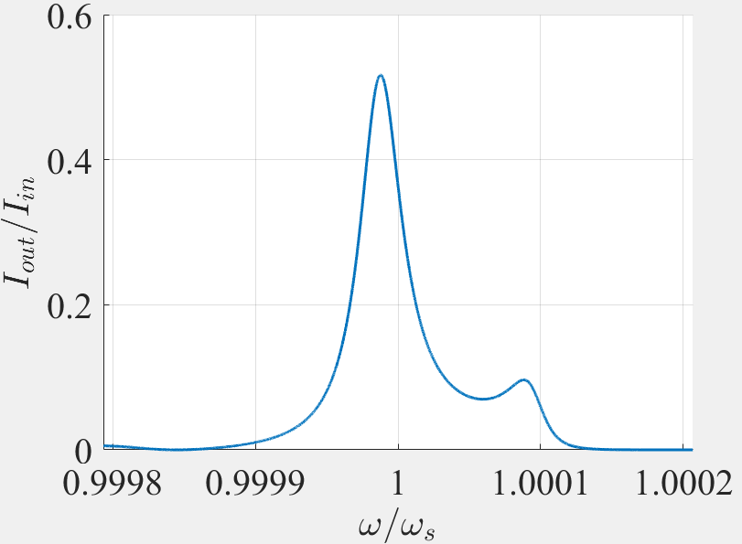
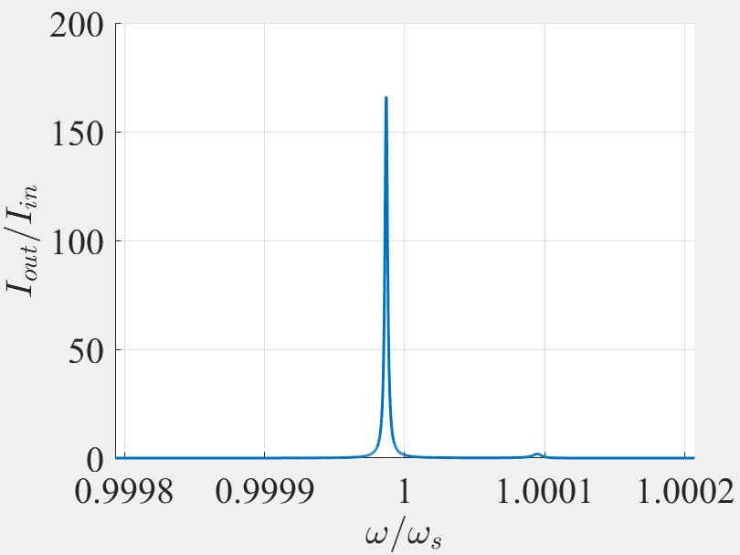
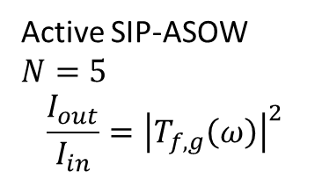
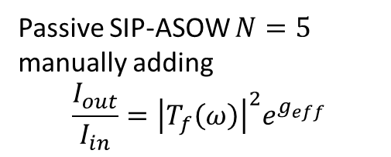

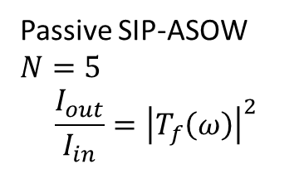
Power gain check
Theoretically, we have
$$\frac{I_{out}}{I_{in}}={\left|T_{f,g}\left(ω\right)\right|}^{2}e^{g_{eff}}$$
Where without gain we simply have
$$\frac{I_{out}}{I_{in}}={\left|T_{f}\left(ω\right)\right|}^{2}$$
Passive SIP-ASOW $N=5$ manually adding
$$\frac{I_{out}}{I_{in}}={\left|T_{f}\left(ω\right)\right|}^{2}e^{g_{eff}}$$
Passive SIP-ASOW $N=5$
$$\frac{I_{out}}{I_{in}}={\left|T_{f}\left(ω\right)\right|}^{2}$$
Active SIP-ASOW $N=5$
$$\frac{I_{out}}{I_{in}}={\left|T_{f,g}\left(ω\right)\right|}^{2}$$
They are clearly not the same

Slide 8
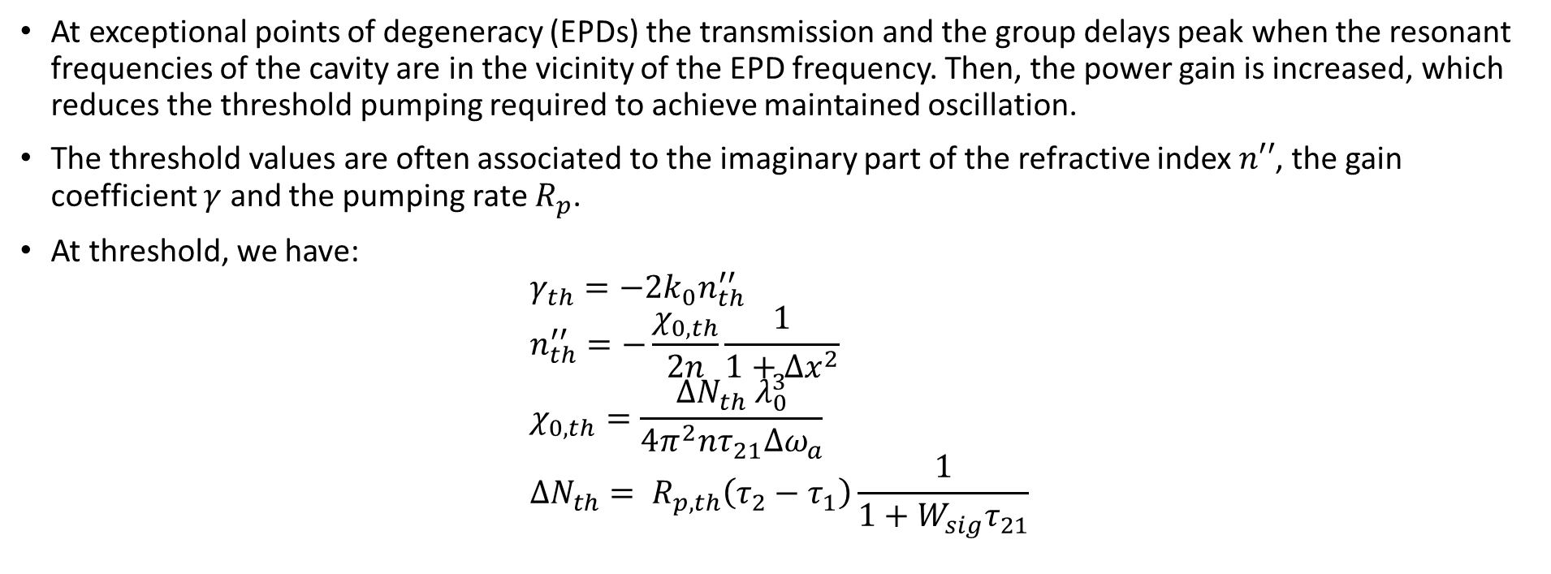
EPD lasing and threshold values
At exceptional points of degeneracy (EPDs) the transmission and the group delays peak when the resonant frequencies of the cavity are in the vicinity of the EPD frequency. Then, the power gain is increased, which reduces the threshold pumping required to achieve maintained oscillation.
The threshold values are often associated to the imaginary part of the refractive index $n′′$, the gain coefficient $γ$ and the pumping rate $R_{p}$.
At threshold, we have:
$$γ_{th}=−2k_{0}n_{th}^{′′} \\ n_{th}^{′′}=−\frac{χ_{0,th}}{2n}\frac{1}{1+Δx^{2}} \\ χ_{0,th}=\frac{ΔN_{th}{ λ}_{0}^{3}}{4π^{2}nτ_{21}Δω_{a}} \\ ΔN_{th}= R_{p,th}\left(τ_{2}−τ_{1}\right)\frac{1}{1+W_{sig}τ_{21}}$$
At the threshold, the oscillation is maintained

Slide 9
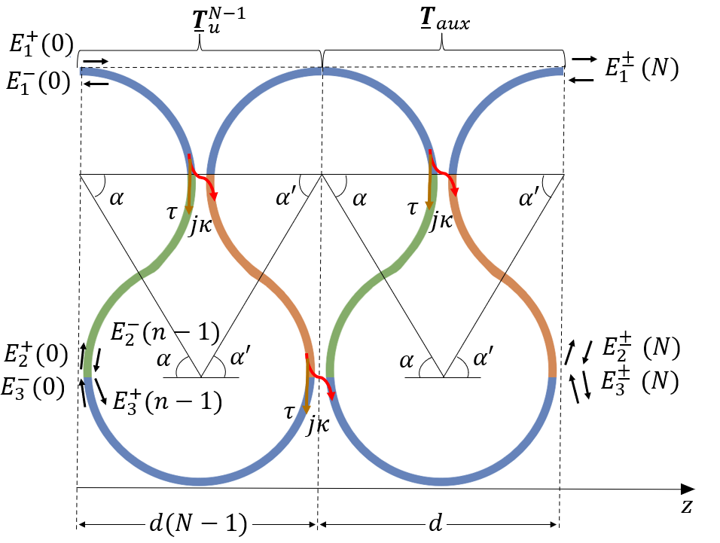
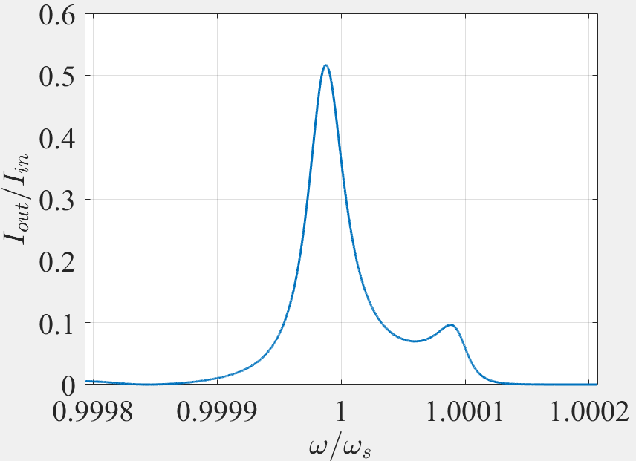
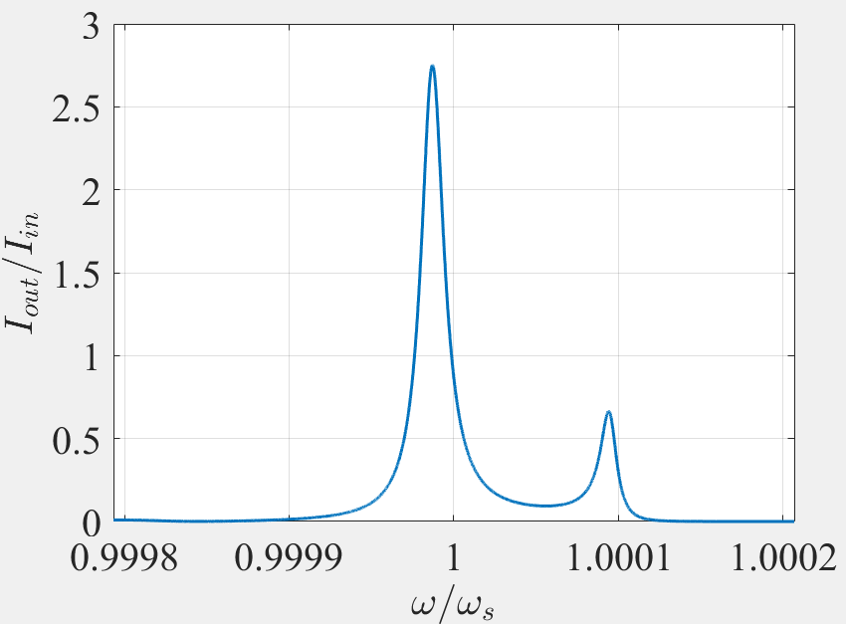
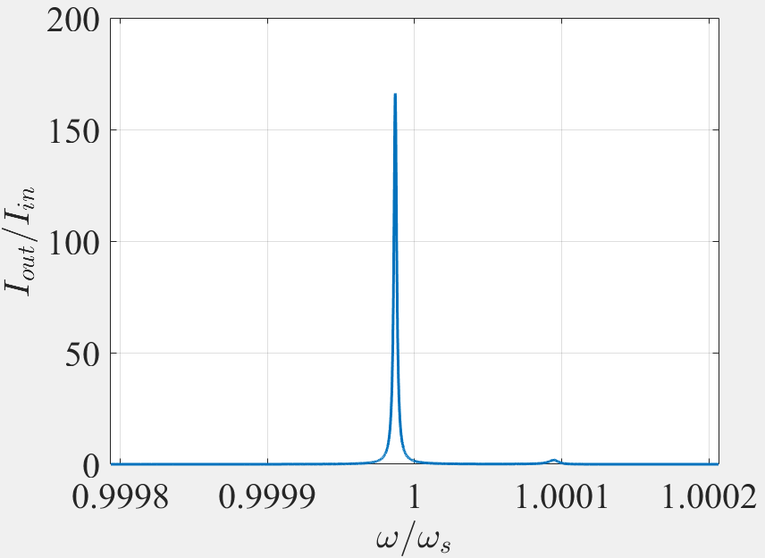




Intensity increase for a single pass
Here we define the output intensity $I_{out}\left(ω\right)={\left|T_{f}\left(ω\right)\right|}^{2}={\left|\frac{E_{1}^{+}\left(N\right)}{E_{1}^{+}\left(0\right)}\right|}^{2}$
For $N=5$:
$$n^{′′}=0$$
$$n^{′′}=\frac{n_{th}^{′′}}{2}$$
$$n^{′′}=n_{th}^{′′}$$
We have gain for $n^{′′}<n_{th}^{′′}$, but the oscillation would not be maintained

Slide 10
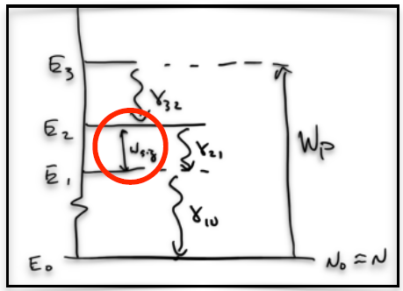
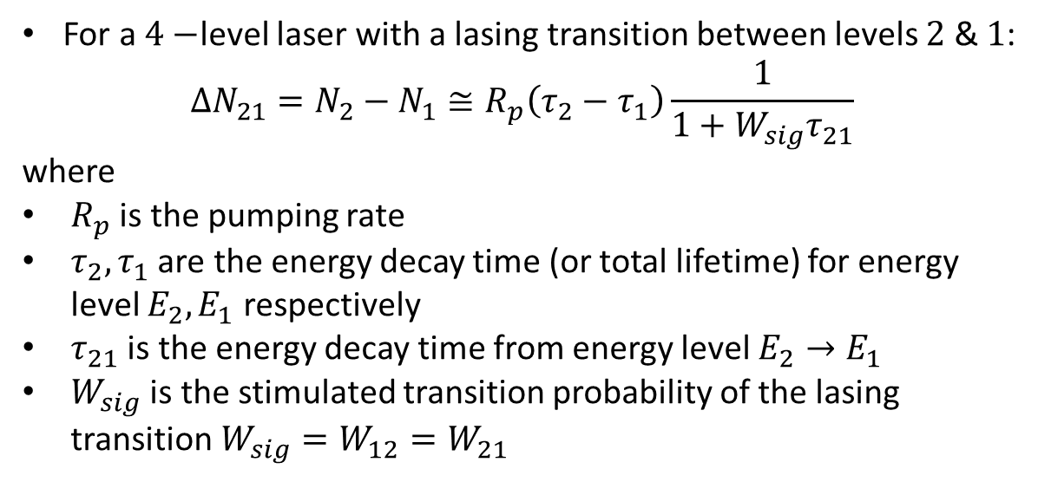
Population inversion
For a $4−$level laser with a lasing transition between levels $2$ & $1$:
$$ΔN_{21}=N_{2}−N_{1}≅R_{p}\left(τ_{2}−τ_{1}\right)\frac{1}{1+W_{sig}τ_{21}}$$
where
$R_{p}$ is the pumping rate
$τ_{2},τ_{1}$ are the energy decay time (or total lifetime) for energy level $E_{2},E_{1}$ respectively
$τ_{21}$ is the energy decay time from energy level $E_{2}→E_{1}$
$W_{sig}$ is the stimulated transition probability of the lasing transition $W_{sig}=W_{12}=W_{21}$
The inversion does not depend on the pump intensity
*Siegman, Lasers, University Science Books, (1986), $e^{jωt}$time convention

Slide 11
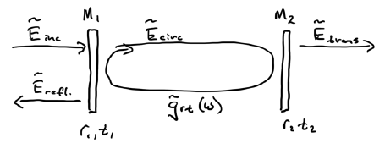
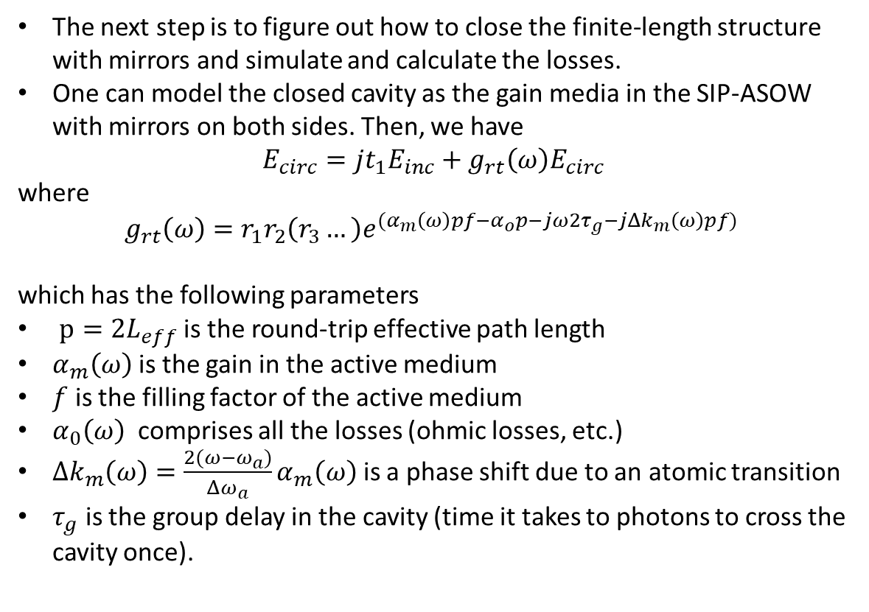

How do we close the cavity?
The next step is to figure out how to close the finite-length structure with mirrors and simulate and calculate the losses.
One can model the closed cavity as the gain media in the SIP-ASOW with mirrors on both sides. Then, we have
$$E_{circ}=jt_{1}E_{inc}+g_{rt}\left(ω\right)E_{circ}$$
where
$$g_{rt}\left(ω\right)=r_{1}r_{2}\left(r_{3}…\right)e^{{(α}_{m}\left(ω\right)pf−α_{o}p−j{ω2τ}_{g}−jΔk_{m}\left(ω\right)pf) }$$
which has the following parameters
$p=2L_{eff}$ is the round-trip effective path length
$α_{m}\left(ω\right)$is the gain in the active medium
$f$ is the filling factor of the active medium
$α_{0}\left(ω\right)$ comprises all the losses (ohmic losses, etc.)
$Δk_{m}\left(ω\right)={\frac{2(ω−ω_{a})}{Δω_{a}}α}_{m}\left(ω\right)$ is a phase shift due to an atomic transition
$τ_{g}$ is the group delay in the cavity (time it takes to photons to cross the cavity once).
$$E_{inc}=E_{1}^{+\left(0\right)} \\ {E_{refl}=E}_{1}^{−}\left(0\right)$$ $E_{trans}=E_{1}^{+}\left(N\right)$
The cavity is closed with two mirrors on port $1$
*Siegman, Lasers, University Science Books, (1986), $e^{jωt}$time convention

Slide 12
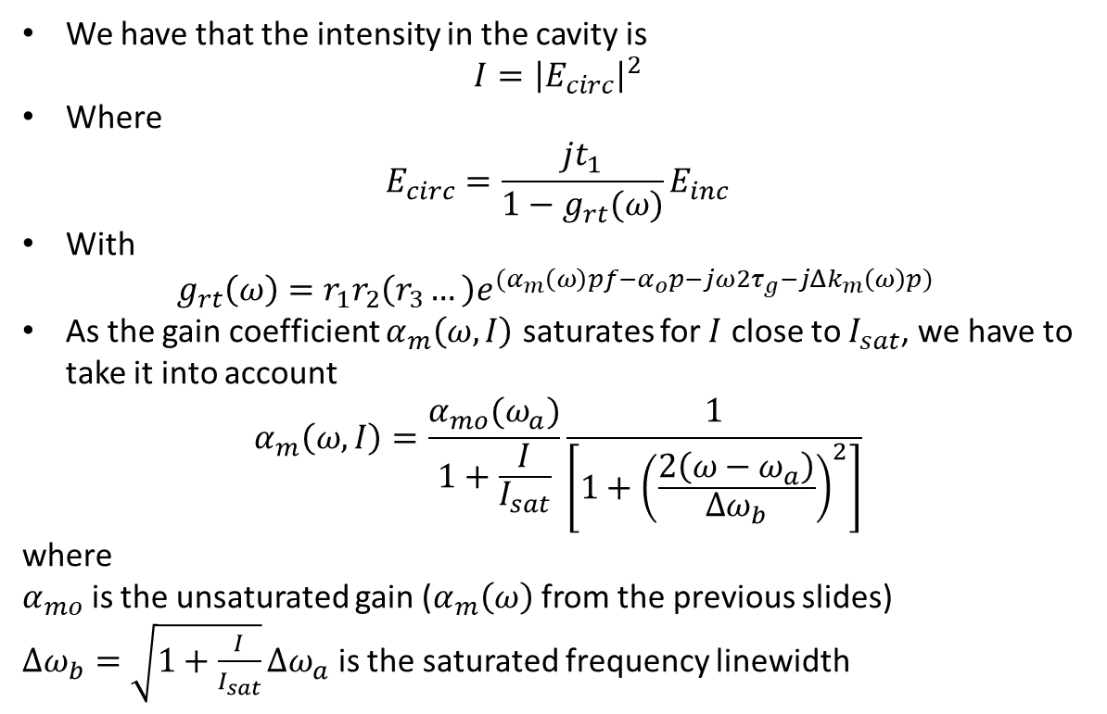
Intensity saturation
We have that the intensity in the cavity is
$$I={\left|E_{circ}\right|}^{2}$$
Where
$$E_{circ}=\frac{jt_{1}}{1−g_{rt}(ω)}E_{inc}$$
With
$$g_{rt}\left(ω\right)=r_{1}r_{2}\left(r_{3}…\right)e^{{(α}_{m}\left(ω\right)pf−α_{o}p−j{ω2τ}_{g}−jΔk_{m}\left(ω\right)p) }$$
As the gain coefficient $α_{m}\left(ω,I\right)$ saturates for $I$ close to $I_{sat}$, we have to take it into account
$$α_{m}\left(ω, I\right)=\frac{α_{mo}(ω_{a})}{1+\frac{I}{I_{sat}}}\frac{1}{\left[1+{\left(\frac{2\left(ω−ω_{a}\right)}{Δω_{b}}\right)}^{2}\right]}$$
where
$α_{mo}$ is the unsaturated gain ($α_{m}\left(ω\right)$ from the previous slides)
$Δω_{b}=\sqrt{1+\frac{I}{I_{sat}}}Δω_{a}$ is the saturated frequency linewidth
Intensity saturation cannot be ignored. We must iterate
*Siegman, Lasers, University Science Books, (1986), $e^{jωt}$time convention

Slide 13
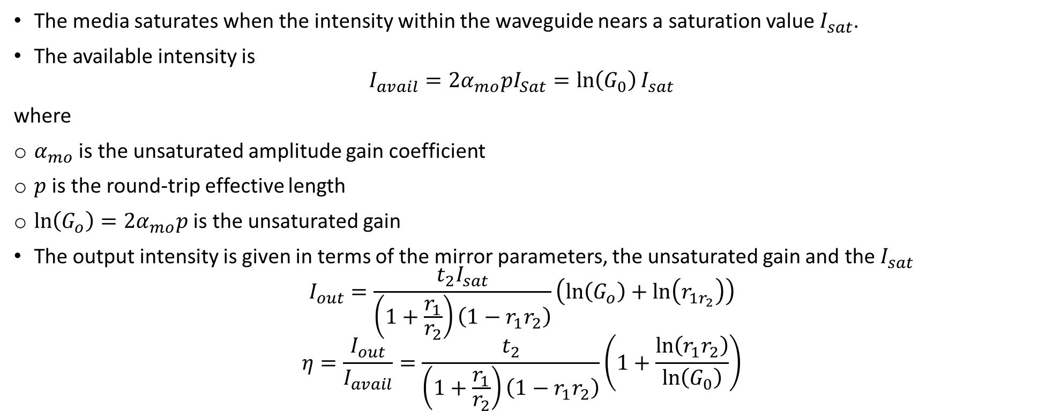
Power efficiency
The media saturates when the intensity within the waveguide nears a saturation value $I_{sat}$.
The available intensity is
$$I_{avail}=2α_{mo}pI_{Sat}=\ln\left(G_{0}\right)I_{sat}$$
where
$α_{mo}$ is the unsaturated amplitude gain coefficient
$p$ is the round-trip effective length
$\ln\left(G_{o}\right)=2α_{mo}p$ is the unsaturated gain
The output intensity is given in terms of the mirror parameters, the unsaturated gain and the $I_{sat}$
$$I_{out}=\frac{t_{2}I_{sat}}{\left(1+\frac{r_{1}}{r_{2}}\right)\left(1−r_{1}r_{2}\right)}\left(\ln\left(G_{o}\right)+\ln\left(r_{1r_{2}}\right)\right)$$
$$η=\frac{I_{out}}{I_{avail}}=\frac{t_{2}}{\left(1+\frac{r_{1}}{r_{2}}\right)\left(1−r_{1}r_{2}\right)}\left(1+\frac{\ln\left(r_{1}r_{2}\right)}{\ln\left(G_{0}\right)}\right)$$
The power efficiency depends on the mirrors and the unsaturated gain
*Siegman, Lasers, University Science Books, (1986), $e^{jωt}$time convention

Slide 14
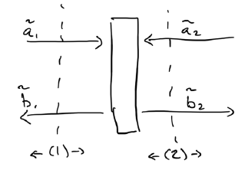
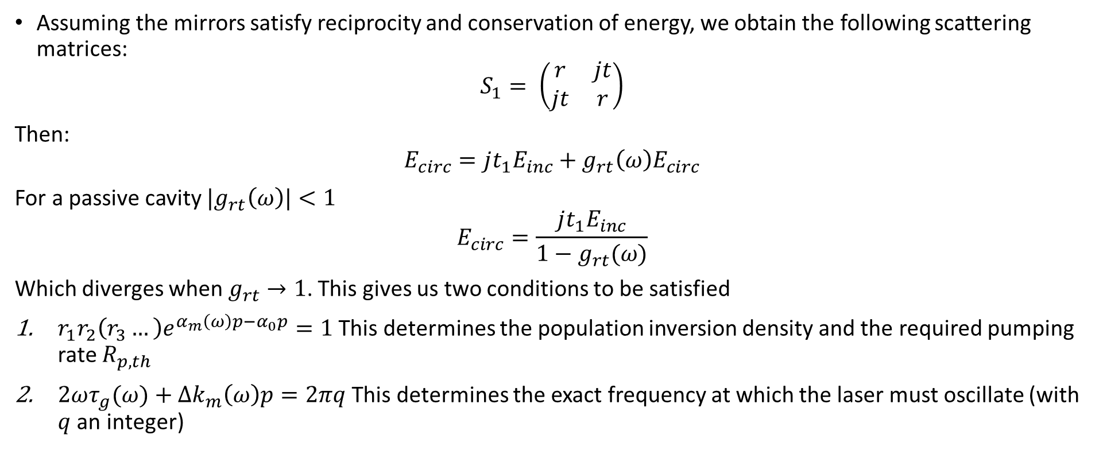
Laser cavity
Assuming the mirrors satisfy reciprocity and conservation of energy, we obtain the following scattering matrices:
$$S_{1}= \left(\begin{matrix}r & jt \\ jt & r\end{matrix}\right)$$
Then:
$$E_{circ}=jt_{1}E_{inc}+g_{rt}\left(ω\right)E_{circ}$$
For a passive cavity ${|g}_{rt}\left(ω\right)|<1$
$$E_{circ}=\frac{jt_{1}E_{inc}}{1−g_{rt}(ω)}$$
Which diverges when $g_{rt}→1$. This gives us two conditions to be satisfied
$r_{1}r_{2}\left(r_{3}…\right)e^{α_{m}\left(ω\right)p−α_{0}p}=1$ This determines the population inversion density and the required pumping rate $R_{p,th}$
$2ωτ_{g}(ω)+Δk_{m}\left(ω\right)p=2πq$ This determines the exact frequency at which the laser must oscillate (with $q$ an integer)
I am not so sure about the second condition at EPD
*Siegman, Lasers, University Science Books, (1986)

