Slide 1
Lasing Threshold and refractive index lineshape

Slide 2

Goal
Previous week:
Start writing the SIP laser paper
Objective for this week:
Develop SIP lasing theory
Finished so far:
Developed some SIP lasing theory, especially atomic transition lineshape
Plotted $Q$vs $N$for 6DBE-ASOW, with $N∈[12,36]$
Not done yet:
Intensity saturation and single-mode lasing
This is tentative work based on Yariv and Siegman’s books

Slide 3
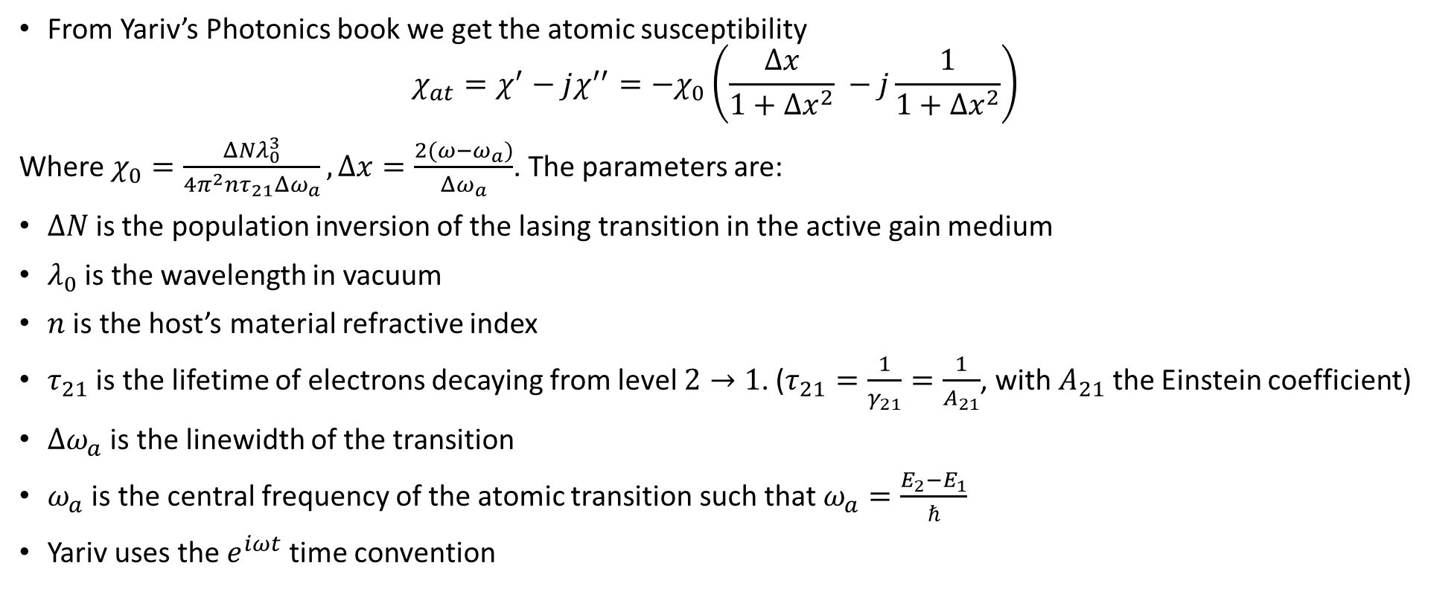
Atomic susceptibility
From Yariv’s Photonics book we get the atomic susceptibility
$$χ_{at}=χ^{′}−jχ^{′′}=−χ_{0}\left(\frac{Δx}{1+Δx^{2}} −j\frac{1}{1+Δx^{2}}\right)$$
Where $χ_{0}=\frac{ΔNλ_{0}^{3}}{4π^{2}nτ_{21}Δω_{a}}, Δx=\frac{2(ω−ω_{a})}{Δω_{a}}$. The parameters are:
$ΔN$is the population inversion of the lasing transition in the active gain medium
$λ_{0}$ is the wavelength in vacuum
$n$ is the host’s material refractive index
$τ_{21}$ is the lifetime of electrons decaying from level $2→1$. ($τ_{21}=\frac{1}{γ_{21}}=\frac{1}{A_{21}}$, with $A_{21}$ the Einstein coefficient)
$Δω_{a}$ is the linewidth of the transition
$ω_{a}$ is the central frequency of the atomic transition such that $ω_{a}=\frac{E_{2}−E_{1}}{ℏ}$
Yariv uses the $e^{iωt}$ time convention
Adapted Yariv’s notation to conform with Siegman’s and mine
*Yariv, Photonics: Optical electronics in modern communication, Oxford university press, (2007)

Slide 4
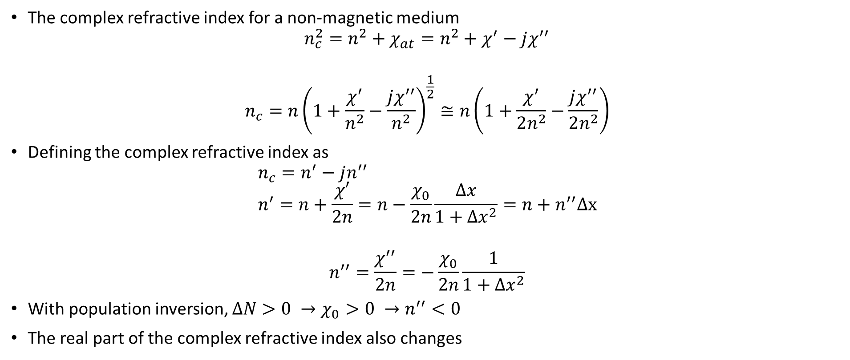

Complex refractive index
$$\sqrt{1+δ}≅1+\frac{δ}{2}$$
The complex refractive index for a non-magnetic medium
$$n_{c}^{2}=n^{2}+χ_{at}=n^{2}+χ^{′}−jχ^{′′}$$
$$n_{c}=n{\left(1+\frac{χ^{′}}{n^{2}}−\frac{jχ^{′′}}{n^{2}}\right)}^{\frac{1}{2}}≅n\left(1+\frac{χ^{′}}{2n^{2}}−\frac{jχ^{′′}}{2n^{2}}\right)$$
Defining the complex refractive index as
$$n_{c}=n^{′}−jn^{′′} \\ n^{′}=n+\frac{χ′}{2n}=n−\frac{χ_{0}}{2n}\frac{Δx}{1+Δx^{2}}=n+n^{′′}Δx$$
$$n^{′′}=\frac{χ^{′′}}{2n}=−\frac{χ_{0}}{2n}\frac{1}{1+Δx^{2}}$$
With population inversion, $ΔN>0 →χ_{0}>0 →n^{′′}<0$
The real part of the complex refractive index also changes
With population inversion, $n^{′′}<0$

Slide 5
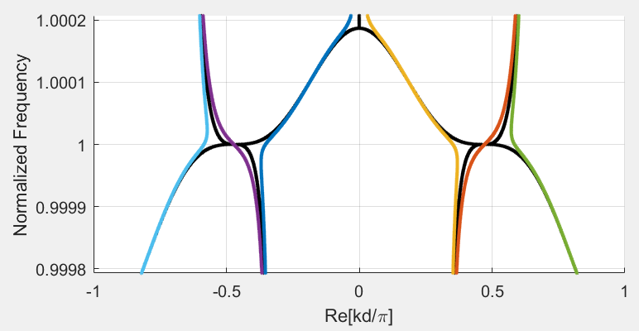
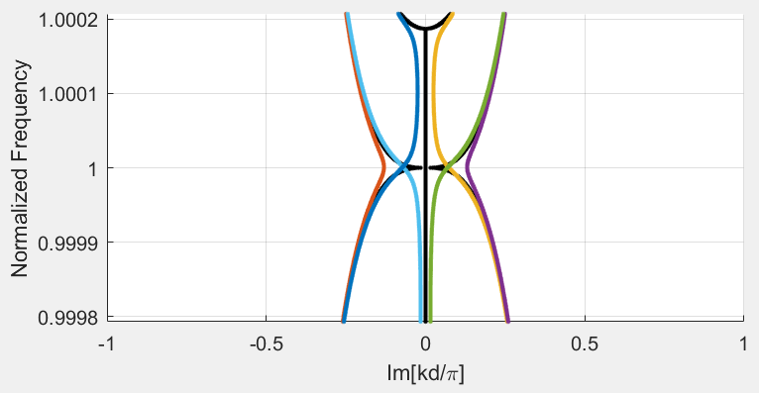

Linewidth and lineshape
$$n_{c}=n^{′}−jn^{′′}=n+n^{′′}Δx −jn′′$$
The change in the real part is ${|n}^{′}−n|=|n′′Δx|<0.001$
This means that the change in the dispersion diagram when adding the change in $n′$ (and not only $n^{′}′$) is negligible
Black: SIP with no gain
Color: SIP with gain (perturbed)
We already discussed this

Slide 6
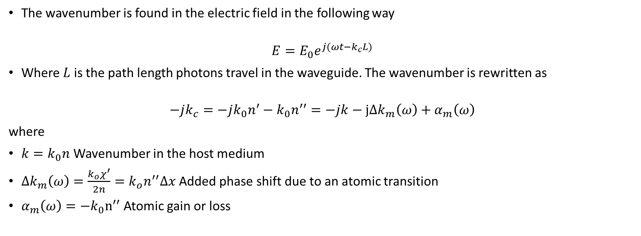
Wavenumber
The wavenumber is found in the electric field in the following way
$$E=E_{0}e^{j(ωt−k_{c}L)}$$
Where $L$ is the path length photons travel in the waveguide. The wavenumber is rewritten as
$$−jk_{c}=−jk_{0}n^{′}−k_{0}n^{′′}=−jk−jΔk_{m}\left(ω\right)+α_{m}\left(ω\right)$$
where
$k=k_{0}n$ Wavenumber in the host medium
$Δk_{m}\left(ω\right)=\frac{{k_{o}χ}^{′}}{2n}={k_{o}n}^{′′}Δx$ Added phase shift due to an atomic transition
$α_{m}\left(ω\right)=−k_{0}n^{′′}$ Atomic gain or loss
As $n^{′′}<0$, there is gain
*Siegman, Lasers, University Science Books, (1986), $e^{jωt}$time convention

Slide 7
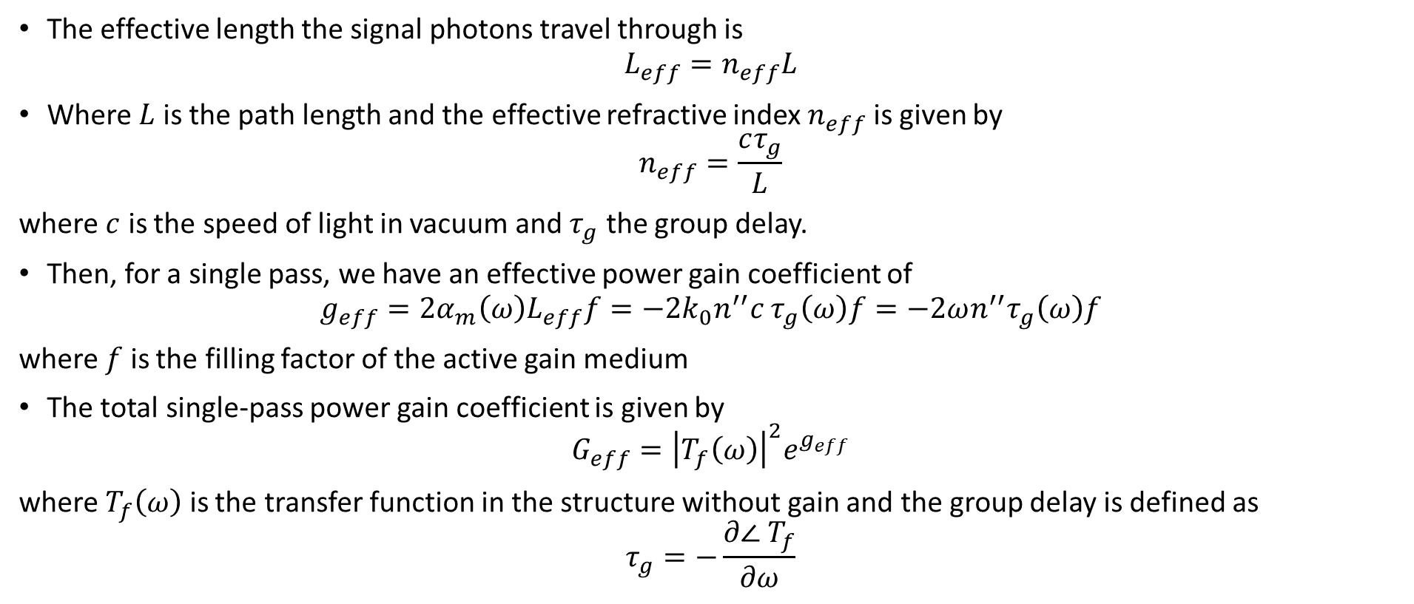
Effective lengths and single pass gain
The effective length the signal photons travel through is
$$L_{eff}=n_{eff}L$$
Where $L$ is the path length and the effective refractive index $n_{eff}$ is given by
$$n_{eff}=\frac{cτ_{g}}{L}$$
where $c$ is the speed of light in vacuum and $τ_{g}$ the group delay.
Then, for a single pass, we have an effective power gain coefficient of
$$g_{eff}={2α}_{m}\left(ω\right)L_{eff}f=−{2k}_{0}n^{′′}c τ_{g}\left(ω\right)f=−2ωn^{′′}τ_{g}\left(ω\right)f$$
where $f$ is the filling factor of the active gain medium
The total single-pass power gain coefficient is given by
$$G_{eff}={\left|T_{f}\left(ω\right)\right|}^{2}e^{g_{eff}}$$
where $T_{f}\left(ω\right)$ is the transfer function in the structure without gain and the group delay is defined as
$$τ_{g}=−\frac{∂∠ T_{f}}{∂ω}$$
The power gain has a strong dependence on the transfer function
*Othman, Figotin, Capolino, Giant gain enhancement in photonic crystals with a degenerate band edge, Physical Review B, 93, 2, (2016)

Slide 8
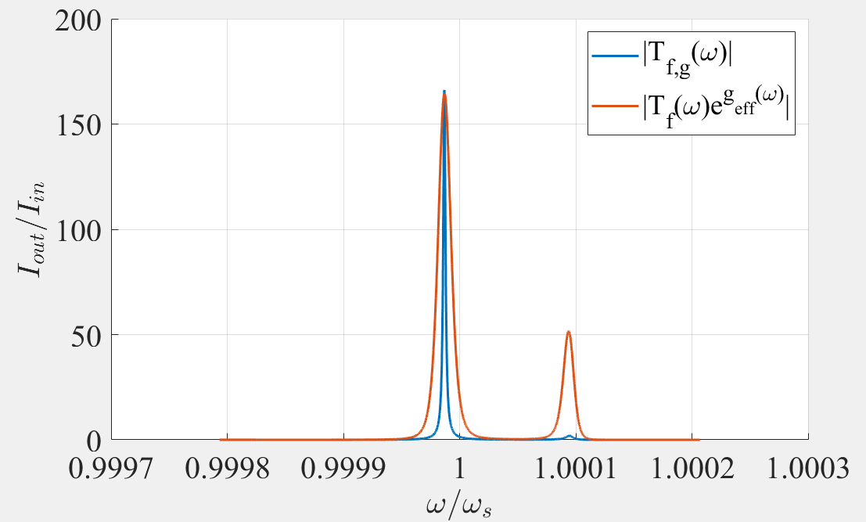
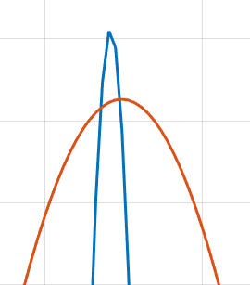
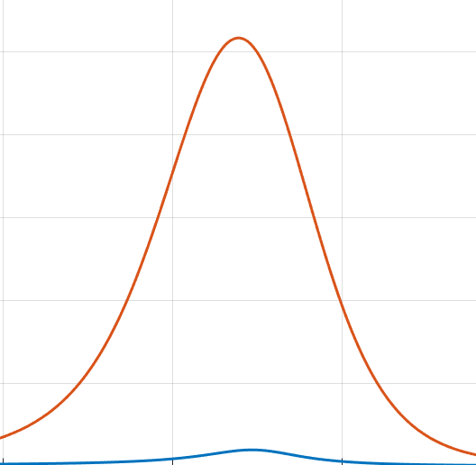

Single-pass gain
The transfer function without gain is $T_{f}(ω)$, while with gain it is $T_{f,g}\left(ω\right)$
It follows that we should have:
${\left|T_{f,g}\left(ω\right)\right|}^{2}≅\left|T_{f}\left(ω\right)\right|e^{g_{eff}(ω)}$,
where
$g_{eff}\left(ω\right)=−2ωn^{′′}\left(ω\right)τ_{g}\left(ω\right)f$
The difference comes from the distortion of the SIP, which we have neglected
There is a difference in the peak, presumably due to the SIP-distortion
There is a missing peak, probably for the same reason
$ω_{a}=ω_{s}≠ω_{res}$ (the frequency of the transition is the SIP frequency)
The approximation holds within a reasonable level

Slide 9
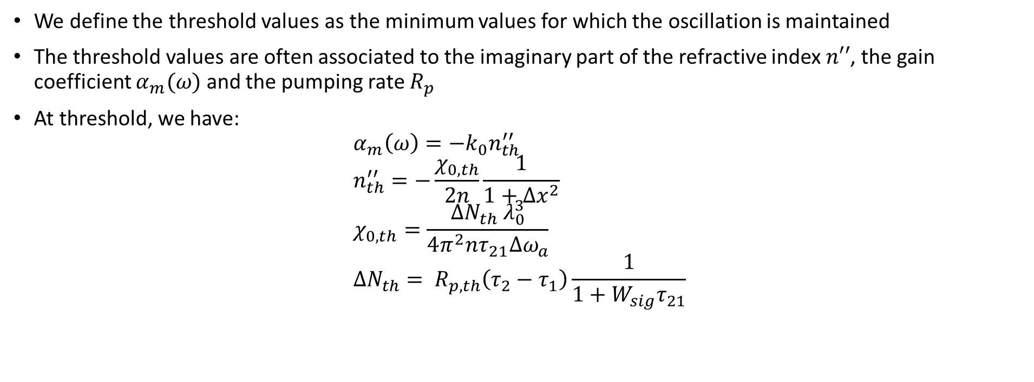
EPD lasing and threshold values
We define the threshold values as the minimum values for which the oscillation is maintained
The threshold values are often associated to the imaginary part of the refractive index $n′′$, the gain coefficient $α_{m}(ω)$ and the pumping rate $R_{p}$
At threshold, we have:
$$α_{m}\left(ω\right)=−k_{0}n_{th}^{′′} \\ n_{th}^{′′}=−\frac{χ_{0,th}}{2n}\frac{1}{1+Δx^{2}} \\ χ_{0,th}=\frac{ΔN_{th}{ λ}_{0}^{3}}{4π^{2}nτ_{21}Δω_{a}} \\ ΔN_{th}= R_{p,th}\left(τ_{2}−τ_{1}\right)\frac{1}{1+W_{sig}τ_{21}}$$
At the threshold, the oscillation is maintained

Slide 10
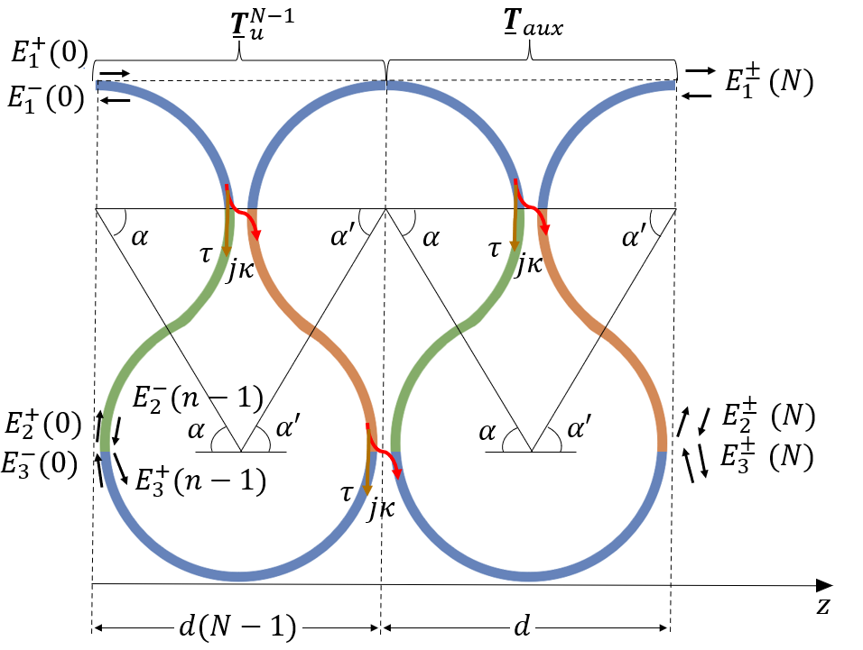
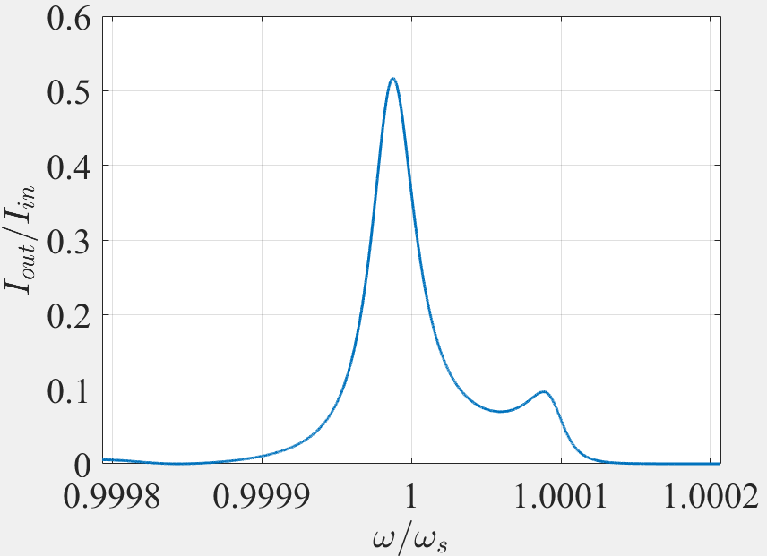
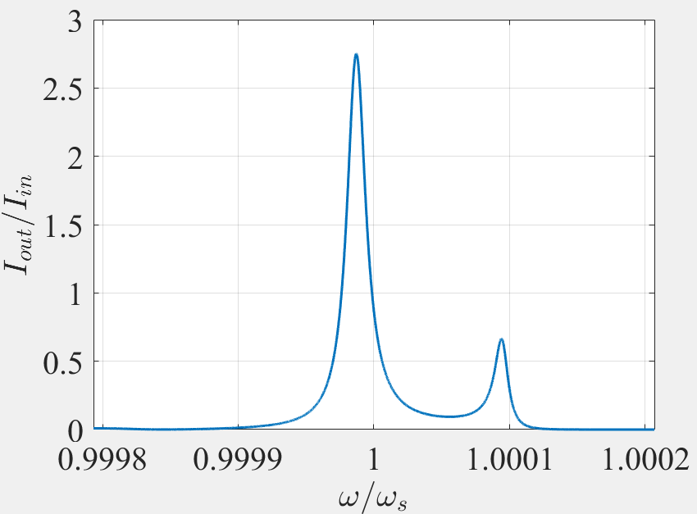
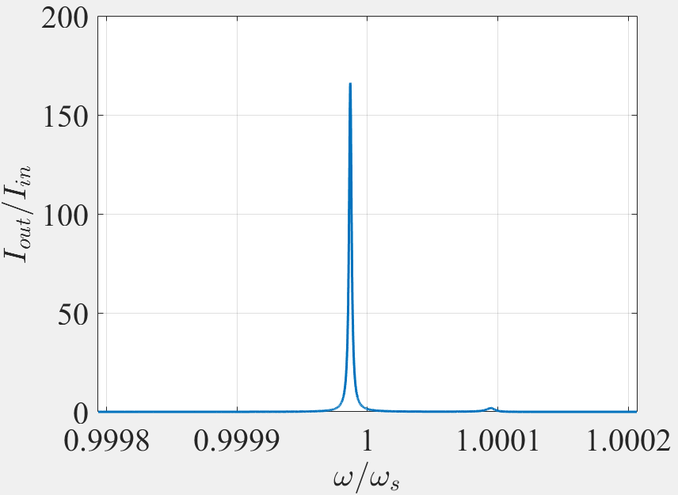




Intensity increase for a single pass
Here we define the output intensity $I_{out}\left(ω\right)={\left|T_{f}\left(ω\right)\right|}^{2}={\left|\frac{E_{1}^{+}\left(N\right)}{E_{1}^{+}\left(0\right)}\right|}^{2}$
For $N=5$:
$$n^{′′}=0$$
$$n^{′′}=\frac{n_{th}^{′′}}{2}$$
$$n^{′′}=n_{th}^{′′}$$
We have gain for $n^{′′}<n_{th}^{′′}$, but the oscillation would not be maintained for a closed cavity

Slide 11
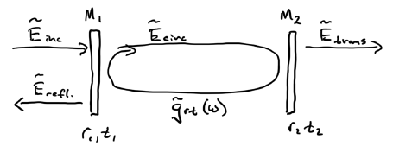
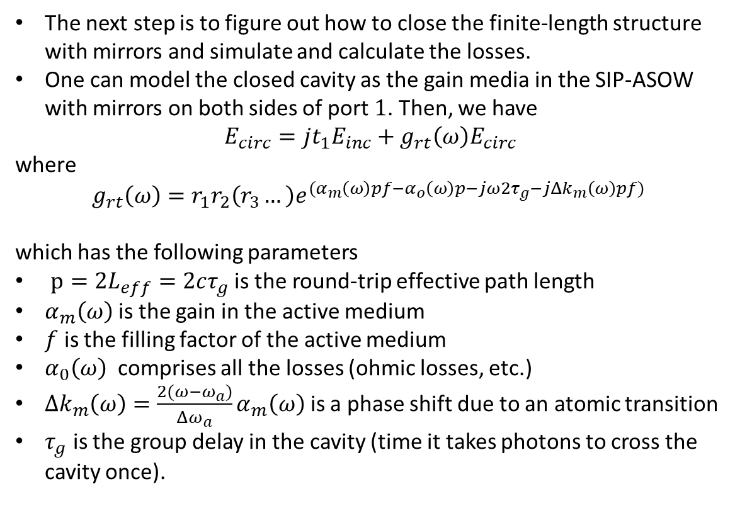

How do we close the cavity?
The next step is to figure out how to close the finite-length structure with mirrors and simulate and calculate the losses.
One can model the closed cavity as the gain media in the SIP-ASOW with mirrors on both sides of port $1$. Then, we have
$$E_{circ}=jt_{1}E_{inc}+g_{rt}\left(ω\right)E_{circ}$$
where
$$g_{rt}\left(ω\right)=r_{1}r_{2}\left(r_{3}…\right)e^{{(α}_{m}\left(ω\right)pf−α_{o}\left(ω\right)p−j{ω2τ}_{g}−jΔk_{m}\left(ω\right)pf) }$$
which has the following parameters
$p=2L_{eff}=2cτ_{g}$ is the round-trip effective path length
$α_{m}\left(ω\right)$is the gain in the active medium
$f$ is the filling factor of the active medium
$α_{0}\left(ω\right)$ comprises all the losses (ohmic losses, etc.)
$Δk_{m}\left(ω\right)={\frac{2(ω−ω_{a})}{Δω_{a}}α}_{m}\left(ω\right)$ is a phase shift due to an atomic transition
$τ_{g}$ is the group delay in the cavity (time it takes photons to cross the cavity once).
$$E_{inc}=E_{1}^{+\left(0\right)} \\ {E_{refl}=E}_{1}^{−}\left(0\right)$$ $E_{trans}=E_{1}^{+}\left(N\right)$
The cavity is closed with two mirrors on port $1$
*Siegman, Lasers, University Science Books, (1986), $e^{jωt}$time convention

Slide 12
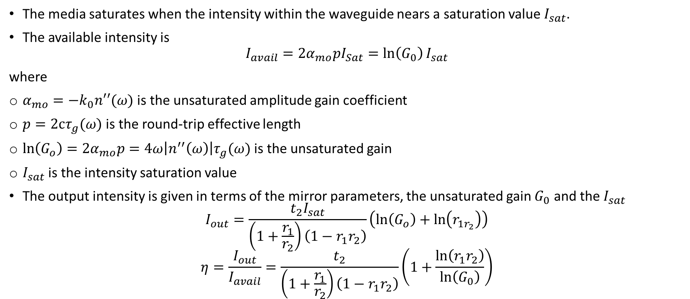
Power efficiency
The media saturates when the intensity within the waveguide nears a saturation value $I_{sat}$.
The available intensity is
$$I_{avail}=2α_{mo}pI_{Sat}=\ln\left(G_{0}\right)I_{sat}$$
where
$α_{mo}=−k_{0}n′′(ω)$ is the unsaturated amplitude gain coefficient
$p=2cτ_{g}(ω)$ is the round-trip effective length
$\ln\left(G_{o}\right)=2α_{mo}p=4ω\left|n^{′′}\left(ω\right)\right|τ_{g}(ω)$ is the unsaturated gain
$I_{sat}$ is the intensity saturation value
The output intensity is given in terms of the mirror parameters, the unsaturated gain $G_{0}$ and the $I_{sat}$
$$I_{out}=\frac{t_{2}I_{sat}}{\left(1+\frac{r_{1}}{r_{2}}\right)\left(1−r_{1}r_{2}\right)}\left(\ln\left(G_{o}\right)+\ln\left(r_{1r_{2}}\right)\right)$$
$$η=\frac{I_{out}}{I_{avail}}=\frac{t_{2}}{\left(1+\frac{r_{1}}{r_{2}}\right)\left(1−r_{1}r_{2}\right)}\left(1+\frac{\ln\left(r_{1}r_{2}\right)}{\ln\left(G_{0}\right)}\right)$$
The power efficiency depends on the mirrors and the unsaturated gain
*Siegman, Lasers, University Science Books, (1986), $e^{jωt}$time convention, page 513 pdf

