Slide 1
Lasing Threshold in SIP-ASOW

Slide 2
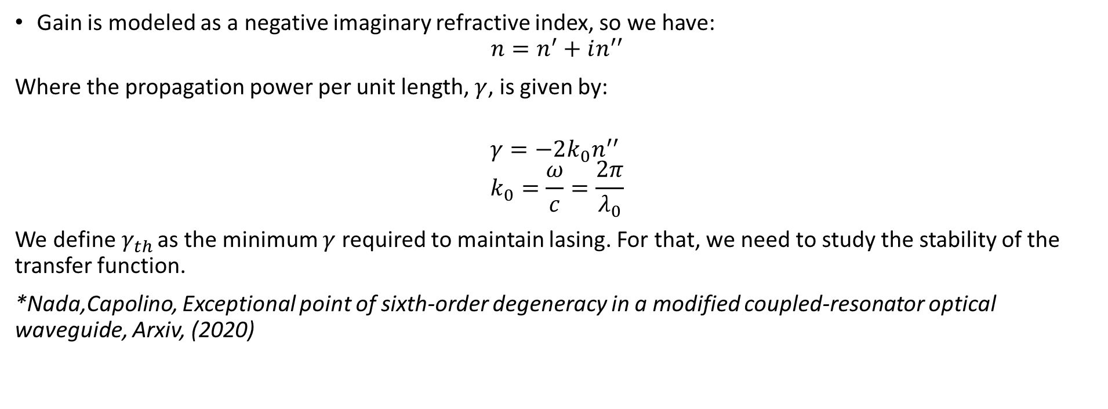
Lasing basics
Gain is modeled as a negative imaginary refractive index, so we have:
$$n=n^{′}+in^{′′}$$
Where the propagation power per unit length, $γ$, is given by:
$$γ=−2k_{0}n^{′′} \\ k_{0}=\frac{ω}{c}=\frac{2π}{λ_{0}}$$
We define$γ_{th}$ as the minimum $γ$ required to maintain lasing. For that, we need to study the stability of the transfer function.
*Nada,Capolino, Exceptional point of sixth-order degeneracy in a modified coupled-resonator optical waveguide, Arxiv, (2020)
Any perturbation changes the quality of the SIP. As we want the smallest perturbation, we want to work at $γ_{th}$

Slide 3
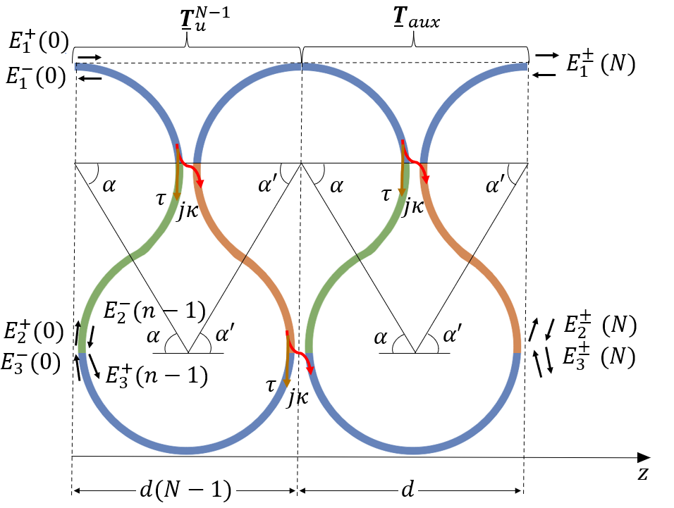
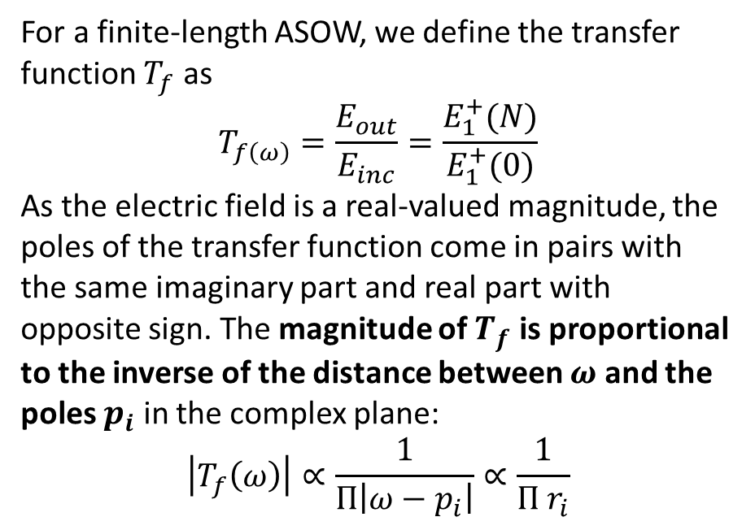
Transfer Function
For a finite-length ASOW, we define the transfer function $T_{f}$ as
$$T_{f\left(ω\right)}=\frac{E_{out}}{E_{inc}}=\frac{E_{1}^{+}(N)}{E_{1}^{+}(0)}$$
As the electric field is a real-valued magnitude, the poles of the transfer function come in pairs with the same imaginary part and real part with opposite sign. The magnitude of $T_{f}$ is proportional to the inverse of the distance between $ω$ and the poles $p_{i}$ in the complex plane:
$$\left|T_{f}\left(ω\right)\right|∝\frac{1}{Π\left|ω−p_{i}\right|}∝\frac{1}{Π r_{i}}$$
*Nada,Capolino, Exceptional point of sixth-order degeneracy in a modified coupled-resonator optical waveguide, Arxiv, (2020)
The active medium is assumed uniformly distributed and pumped

Slide 4
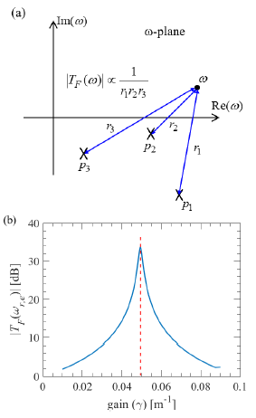
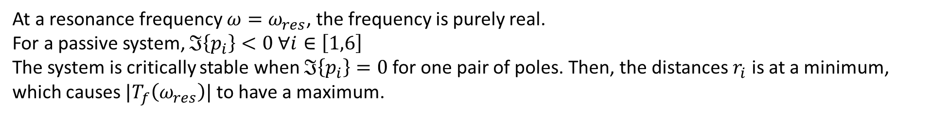
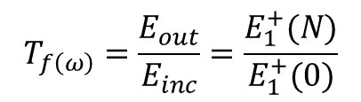
Poles of the transfer function
At a resonance frequency $ω=ω_{res}$, the frequency is purely real.
For a passive system, $ℑ\left\{p_{i}\right\}<0 ∀i∈\left[1,6\right]$ The system is critically stable when $ℑ\left\{p_{i}\right\}=0$for one pair of poles. Then, the distances $r_{i}$ is at a minimum, which causes $|T_{f}\left(ω_{res}\right)|$ to have a maximum.
$$T_{f\left(ω\right)}=\frac{E_{out}}{E_{inc}}=\frac{E_{1}^{+}(N)}{E_{1}^{+}(0)}$$
The goal is to do this for the SIP-ASOW

Slide 5
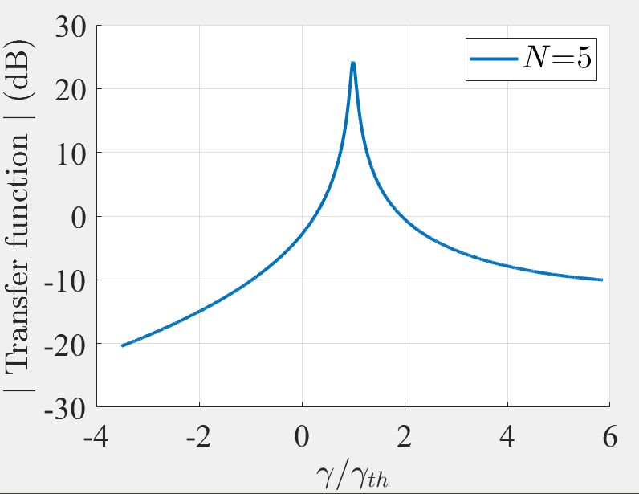
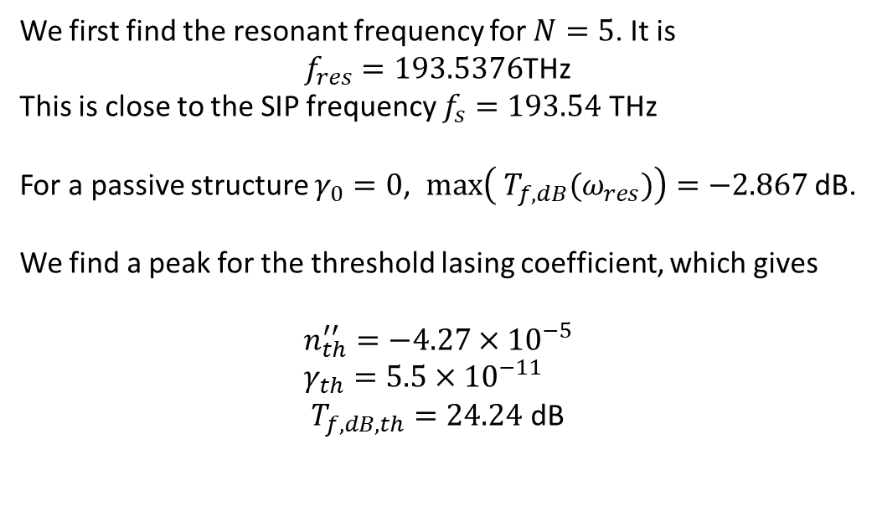

Lasing threshold
We first find the resonant frequency for $N=5$. It is
$f_{res}=193.5376$THz
This is close to the SIP frequency $f_{s}=193.54$ THz
For a passive structure $γ_{0}=0$, $max\left({ T}_{f,dB}(ω_{res})\right)=−2.867$ dB.
We find a peak for the threshold lasing coefficient, which gives
$$n_{th}^{′′}=−4.27×{10}^{−5} \\ γ_{th}=5.5×{10}^{−11}$$ $T_{f,dB,th}=24.24$ dB
$$1$$
The gain is obvious

Slide 6
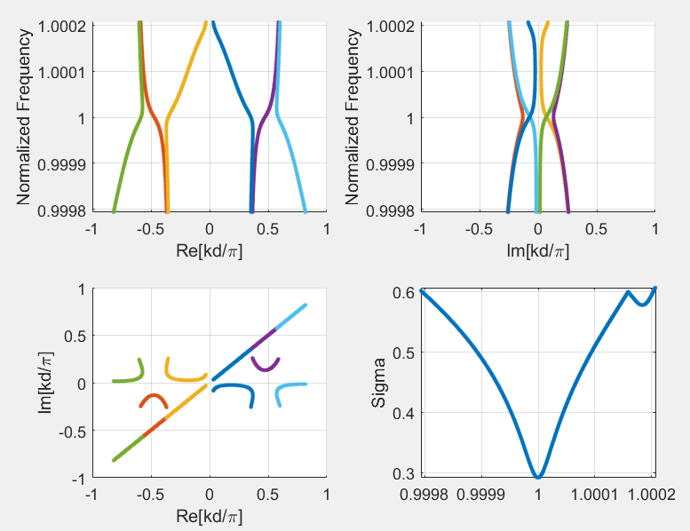
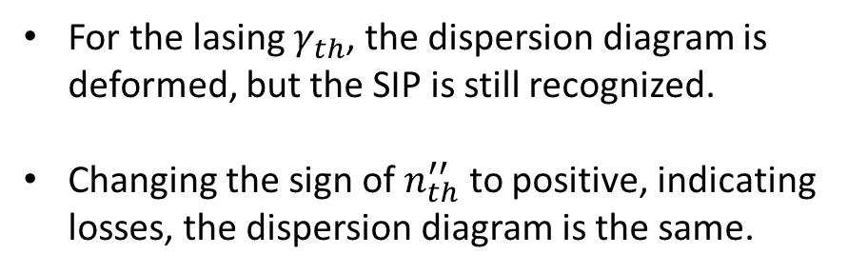
Dispersion diagram with gain
For the lasing $γ_{th}$, the dispersion diagram is deformed, but the SIP is still recognized.
Changing the sign of $n_{th}^{′′}$ to positive, indicating losses, the dispersion diagram is the same.
The lasing threshold is low enough that the dispersion diagram still resembles an SIP

Slide 7
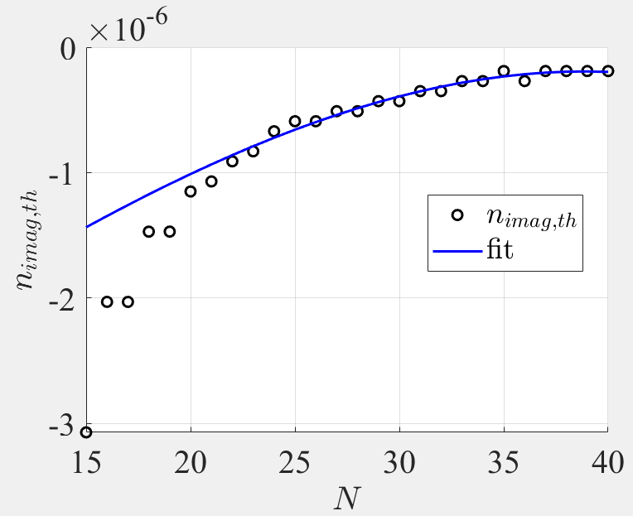
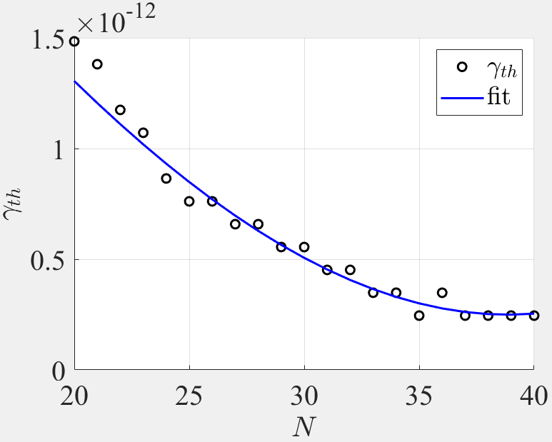


Lasing threshold with N
Our goal is to fit the trend for the imaginary component of the refractive index, $n_{th}′′$, and the lasing coefficient $γ_{th}$. Plotting the results against the number of unit cells $N$, we find the following fit:
$$n_{th, fit}^{′′}=−2.35×{10}^{−11}N^{3}+1.07×{10}^{−7}N −2.96×{10}^{−6}$$
$$γ_{th,fit}=−2\frac{ω_{s}}{c}n_{th,fit}^{′′}$$
$∗ω_{s} \sim$SIP frequency

Slide 8
Discussion
Happy new year!

