Slide 1
Comparison between SIP,RBE,DBE,6DBE-ASOW

Slide 2
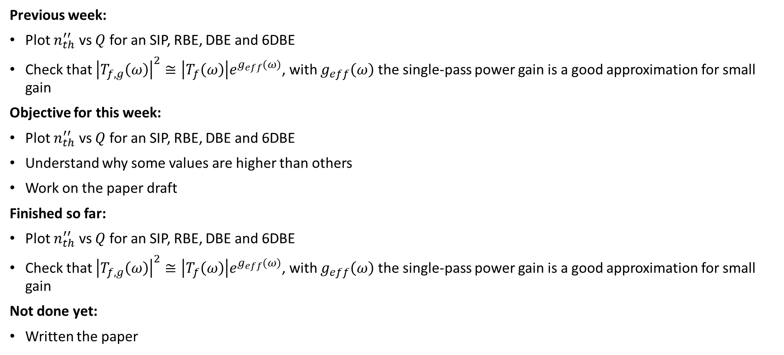
Goal
Previous week:
Plot $n_{th}^{′′}$ vs $Q$ for an SIP, RBE, DBE and 6DBE
Check that ${\left|T_{f,g}\left(ω\right)\right|}^{2}≅\left|T_{f}\left(ω\right)\right|e^{g_{eff}(ω)}$, with $g_{eff}\left(ω\right)$ the single-pass power gain is a good approximation for small gain
Objective for this week:
Plot $n_{th}^{′′}$ vs $Q$ for an SIP, RBE, DBE and 6DBE
Understand why some values are higher than others
Work on the paper draft
Finished so far:
Plot $n_{th}^{′′}$ vs $Q$ for an SIP, RBE, DBE and 6DBE
Check that ${\left|T_{f,g}\left(ω\right)\right|}^{2}≅\left|T_{f}\left(ω\right)\right|e^{g_{eff}(ω)}$, with $g_{eff}\left(ω\right)$ the single-pass power gain is a good approximation for small gain
Not done yet:
Written the paper
This week I do have some results to show

Slide 3
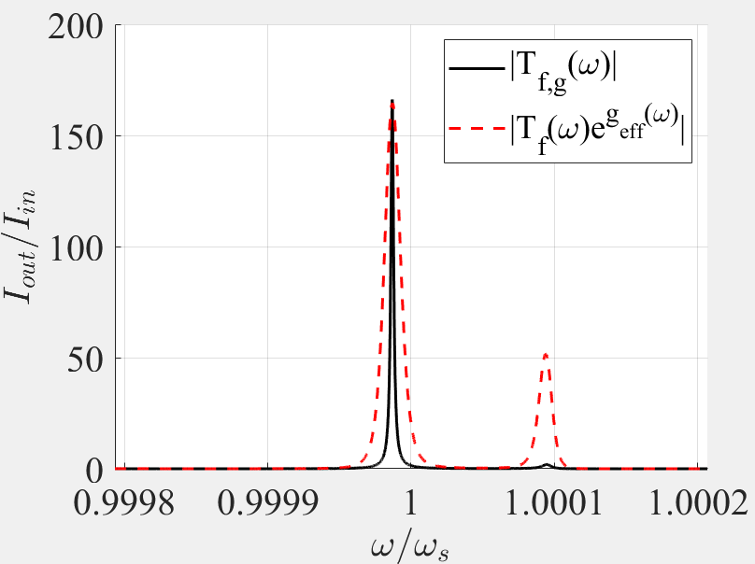
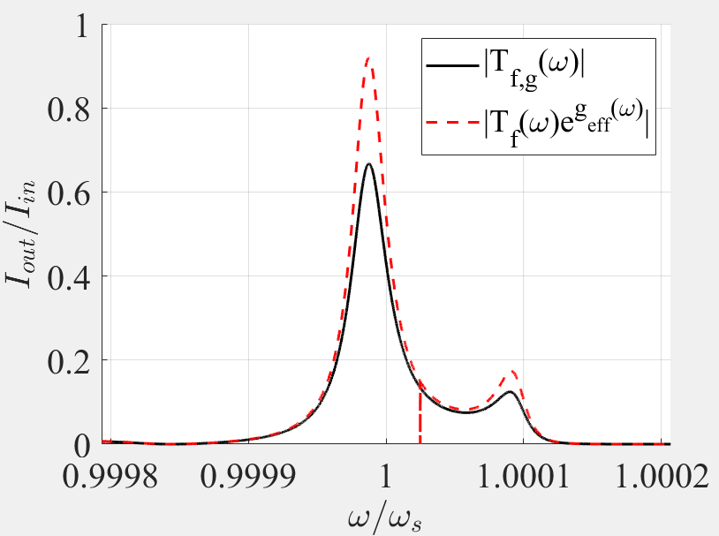
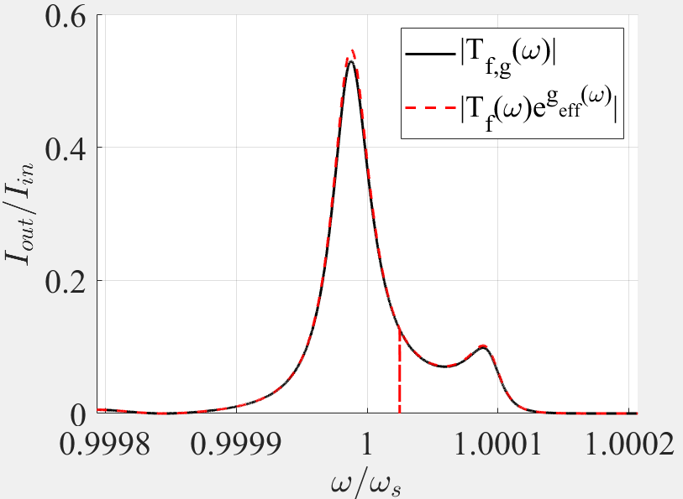
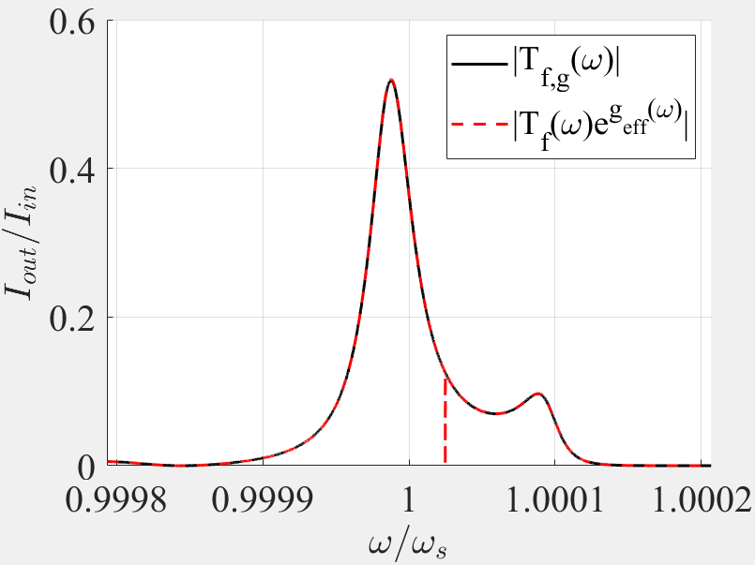





Single-pass gain: A closer look
The approximation fails as $n^{′′}→n_{th}$. What happens for $n^{′′}→0$? The difference between the actual transfer function and the approximate transfer function is the same.
$$n^{′′}=n_{th}∝{10}^{−5}$$
$$n^{′′}=n_{th}×{10}^{−1}$$
$$n^{′′}=n_{th}×{10}^{−2}$$
$$n^{′′}=n_{th}×{10}^{−3}$$
As $n^{′′}→0$, $|T_{f,g}\left(ω\right)−T_{f}\left(ω\right)| →0$

Slide 4
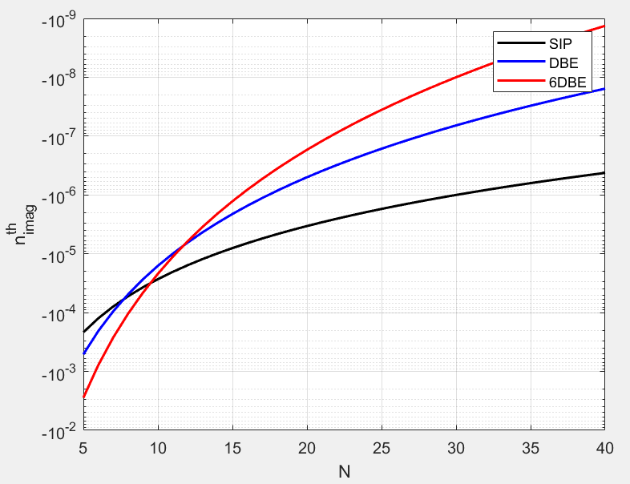
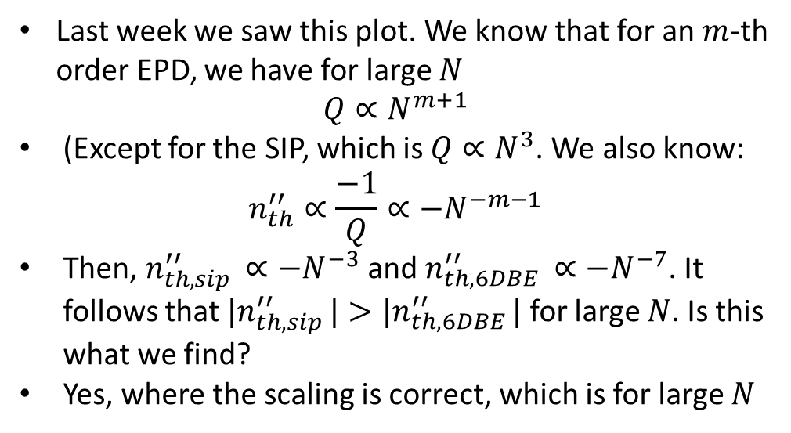
From last week: $n_{th}^{′′}$ vs $N$
Last week we saw this plot. We know that for an $m$-th order EPD, we have for large $N$
$$Q∝N^{m+1}$$
(Except for the SIP, which is $Q∝N^{3}$. We also know:
$$n_{th}^{′′}∝\frac{−1}{Q}∝{−N}^{−m−1}$$
Then, $n_{th,sip }^{′′}∝−N^{−3}$ and $n_{th,6DBE }^{′′}∝−N^{−7}$. It follows that ${|n}_{th,sip }^{′′}|>|n_{th,6DBE }^{′′}|$ for large $N$. Is this what we find?
Yes, where the scaling is correct, which is for large $N$
For small $N$, ${|n}_{th,sip }^{′′}|<|n_{th,6DBE }^{′′}|$. For big $N$, ${|n}_{th,sip }^{′′}|>|n_{th,6DBE }^{′′}|$
Surprising, but not unexpected
As expected

Slide 5
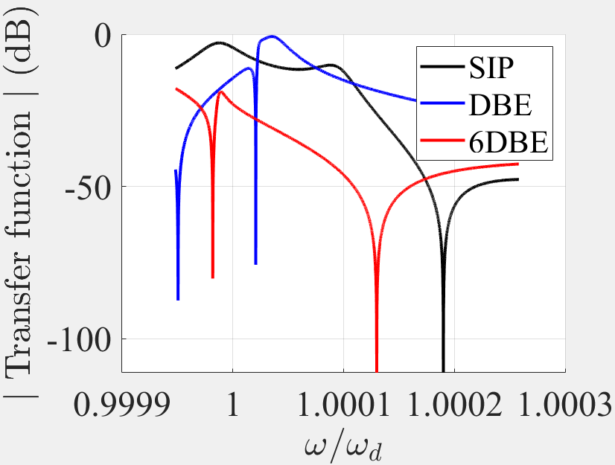
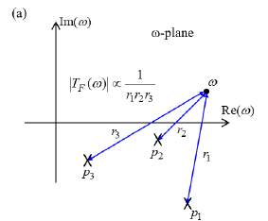
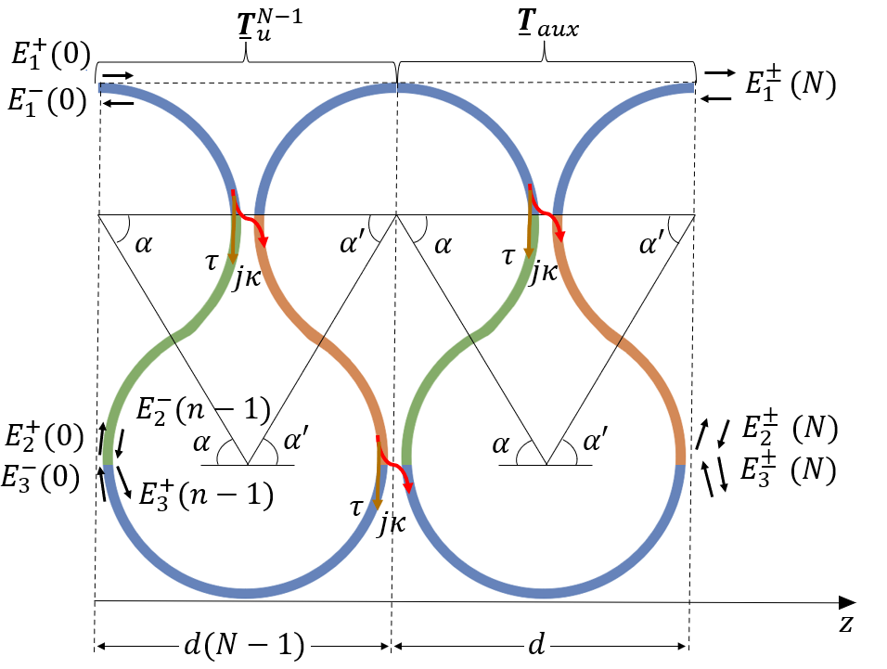
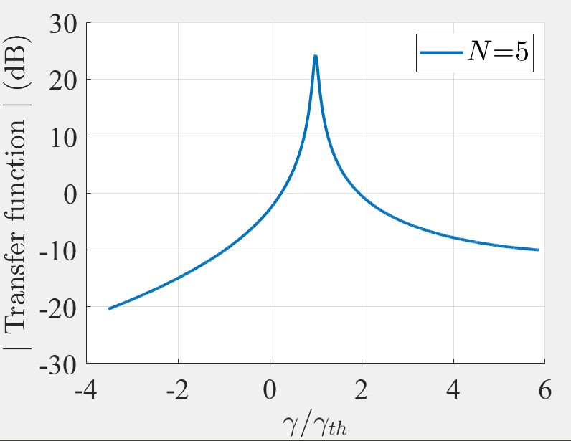


What happens for small $N$?
Let’s recall how we found $n_{th}^{′′}$: We gradually increased $n′′$ and monitored the maximum in $|T_{f}\left(ω\right)|$
We see that for $N=5$, $T_{f,6 }<T_{f,s}<T_{f,d}$
We see that for $N=5$, $n_{th,6}^{′′}<n_{th,d}^{′′}<n_{th,s}^{′′}$
It makes sense that if you start with a higher $T_{f}$ you have to add less gain (see 6DBE) to find a maximum. Higher $T_{f}$ means its poles are closer to the $ℜ(ω)$-axis $\left(T_{f}∝\frac{1}{Π\left|p_{i}−ω\right|}\right)$
It does not explain why ${|n}_{th,sip }^{′′}|<|n_{th,DBE }^{′′}|$
$$n′′$$
For small $N$, I do not understand it as much
*Nada, Capolino, Exceptional point of sixth-order degeneracy in a modified coupled-resonator optical waveguide, JOSA B, 2020

Slide 6
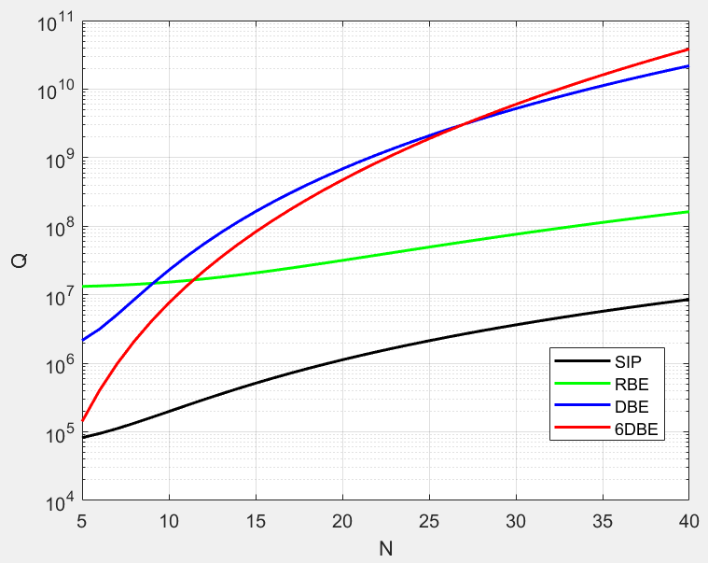
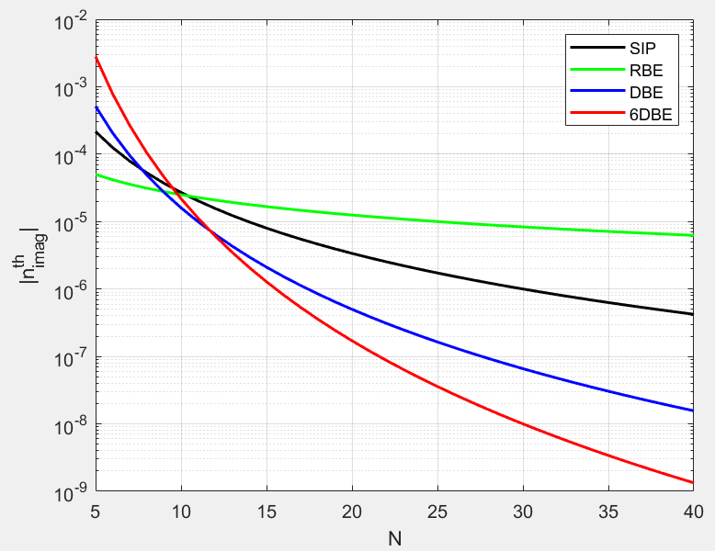
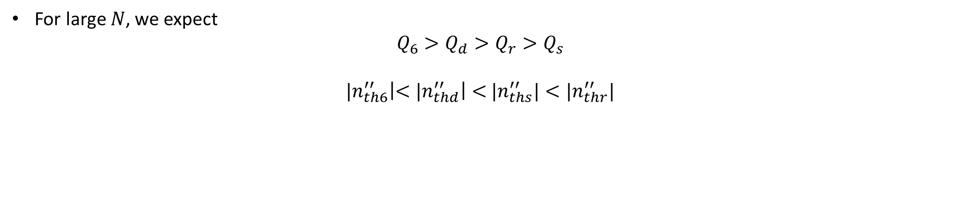
$Q, n_{th}^{′′}$ for SIP, RBE, DBE, 6DBE
For large $N$, we expect
$$Q_{6}>Q_{d}>{Q_{r}>Q}_{s}$$
${|n}_{th6}^{′′}\left|<{|n}_{thd}^{′′}\right|<$ ${|n}_{ths}^{′′}|<|n_{thr}^{′′}|$
$|n_{th}^{′′}|$ becomes smaller faster for higher-order EPDs

Slide 7
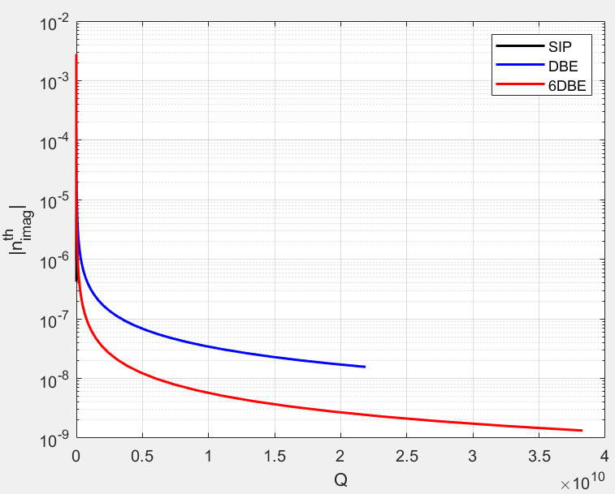
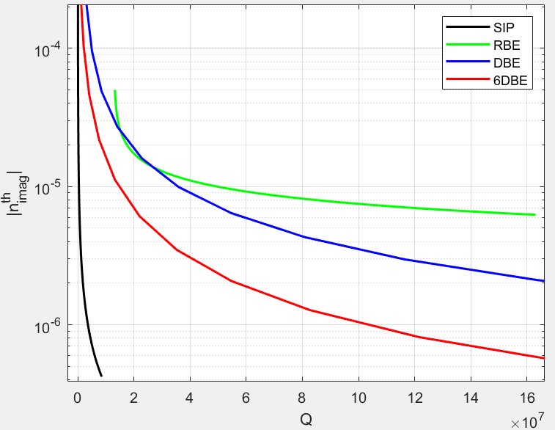
$n_{th}^{′′}$ vs $Q$ for SIP, RBE, DBE, 6DBE
The SIP requires less gain to have the same $Q$
Bonus: The 6DBE requires less gain than the DBE to have the same $Q$

Slide 8
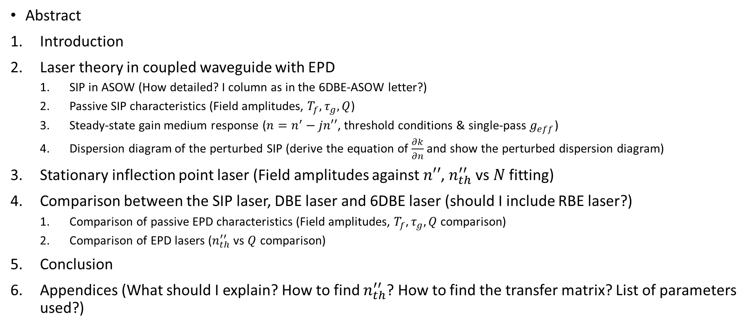
Outline of the SIP laser paper
Abstract
Introduction
Laser theory in coupled waveguide with EPD
SIP in ASOW (How detailed? I column as in the 6DBE-ASOW letter?)
Passive SIP characteristics (Field amplitudes, $T_{f}, τ_{g}, Q$)
Steady-state gain medium response ($n=n^{′}−jn′′$, threshold conditions & single-pass $g_{eff}$)
Dispersion diagram of the perturbed SIP (derive the equation of $\frac{∂k}{∂n}$ and show the perturbed dispersion diagram)
Stationary inflection point laser (Field amplitudes against $n′′$, $n_{th}^{′′}$ vs $N$ fitting)
Comparison between the SIP laser, DBE laser and 6DBE laser (should I include RBE laser?)
Comparison of passive EPD characteristics (Field amplitudes, $T_{f}, τ_{g}, Q$ comparison)
Comparison of EPD lasers ($n_{th}^{′′}$vs $Q$ comparison)
Conclusion
Appendices (What should I explain? How to find $n_{th}^{′′}$? How to find the transfer matrix? List of parameters used?)
Does this outline look good? What am I missing?

Slide 9
Discussion
Next steps:
Impedances? I do not know where to start. Are we trying to include them in the SIP-laser paper? What do you want to do?
SIP-ASOW update with reviewer’s suggestions and send back
6DBE-ASOW letter must be revised (I am not that good at writing)
Start writing SIP laser paper
Have a good day!

