Slide 1
Comparison between SIP,RBE,DBE,6DBE-ASOW

Slide 2
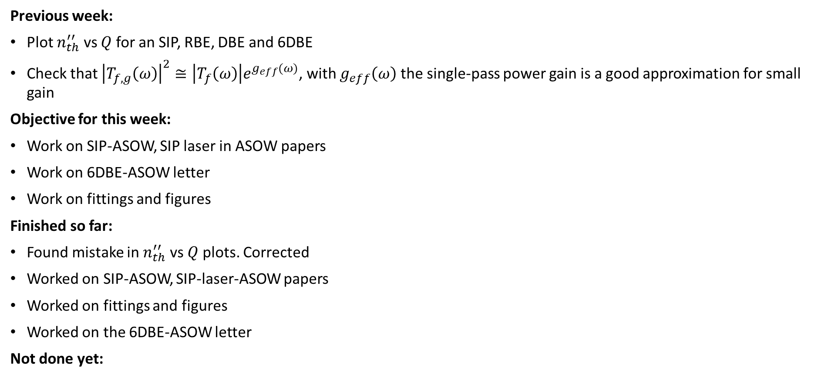
Goal
Previous week:
Plot $n_{th}^{′′}$ vs $Q$ for an SIP, RBE, DBE and 6DBE
Check that ${\left|T_{f,g}\left(ω\right)\right|}^{2}≅\left|T_{f}\left(ω\right)\right|e^{g_{eff}(ω)}$, with $g_{eff}\left(ω\right)$ the single-pass power gain is a good approximation for small gain
Objective for this week:
Work on SIP-ASOW, SIP laser in ASOW papers
Work on 6DBE-ASOW letter
Work on fittings and figures
Finished so far:
Found mistake in $n_{th}^{′′}$ vs $Q$ plots. Corrected
Worked on SIP-ASOW, SIP-laser-ASOW papers
Worked on fittings and figures
Worked on the 6DBE-ASOW letter
Not done yet:
☺

Slide 3
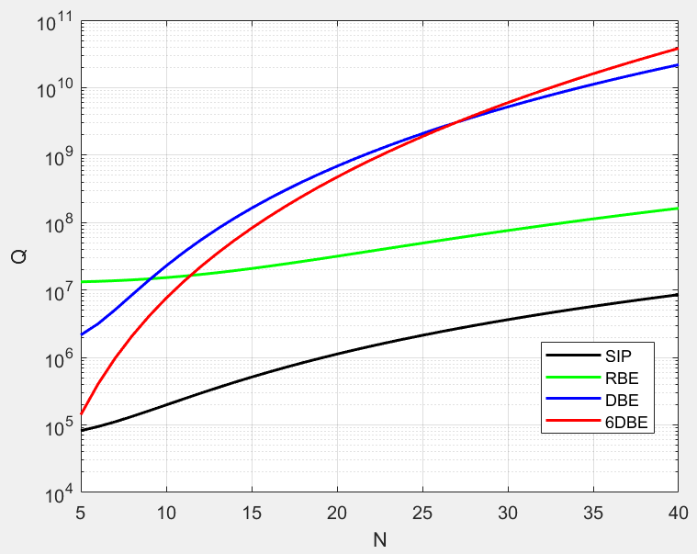
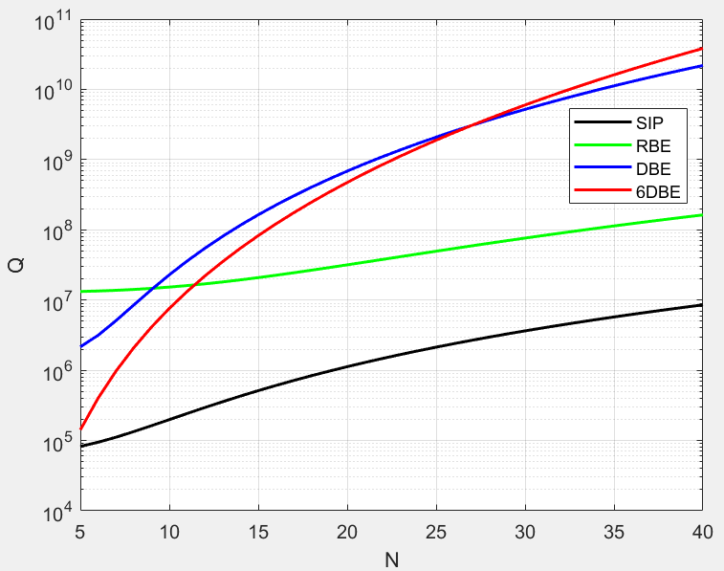
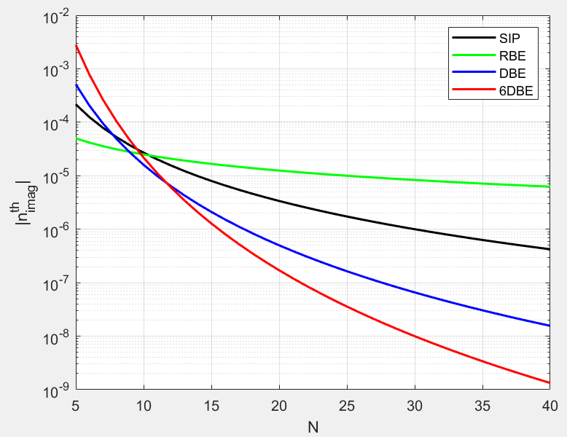
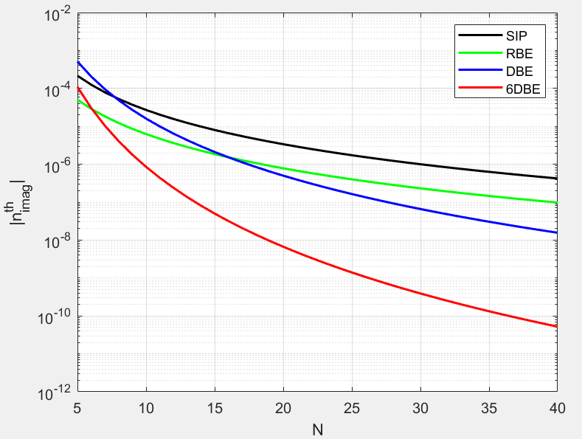
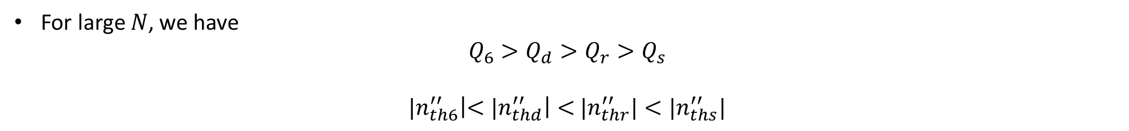
Update: $Q, n_{th}^{′′}$ for SIP, RBE, DBE, 6DBE
Old
Updated
Old
Updated
For large $N$, we have
$$Q_{6}>Q_{d}>{Q_{r}>Q}_{s}$$
${|n}_{th6}^{′′}\left|<{|n}_{thd}^{′′}\right|<$ ${|n}_{thr}^{′′}|<|n_{ths}^{′′}|$
$|n_{th}^{′′}|$ becomes smaller faster for higher-order EPDs

Slide 4
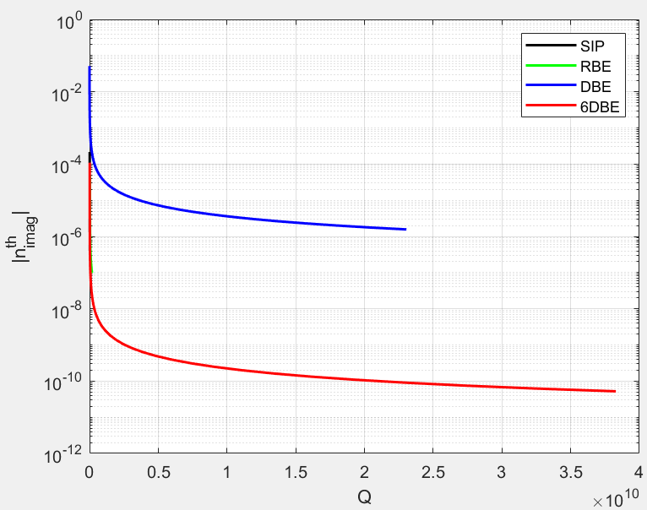
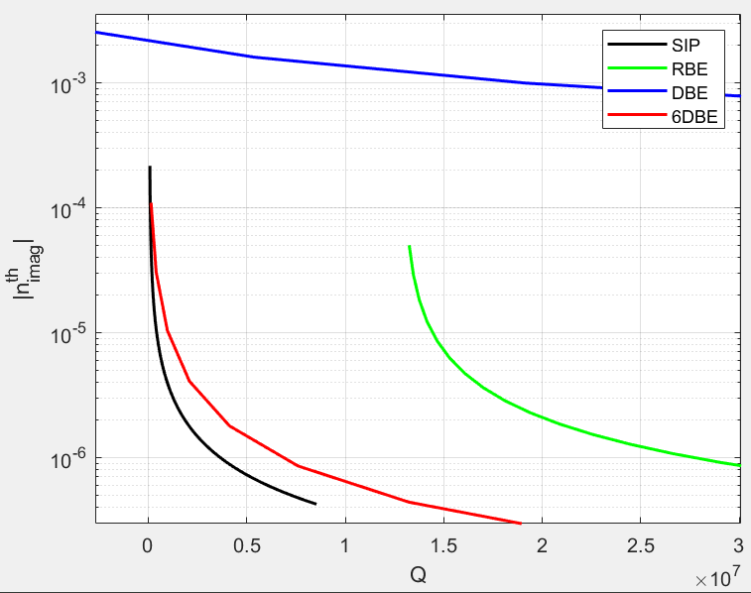
Updated: $n_{th}^{′′}$ vs $Q$ for SIP, RBE, DBE, 6DBE
The RBE performs better than the DBE!
This is in direct opposition to what Veysi found!

Slide 5
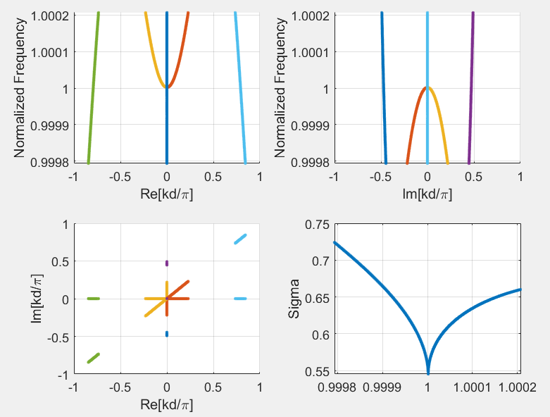
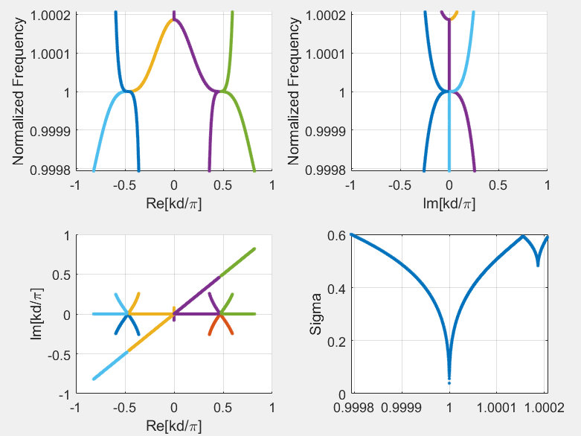
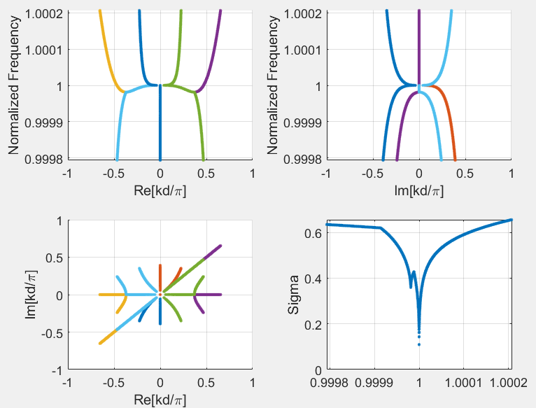
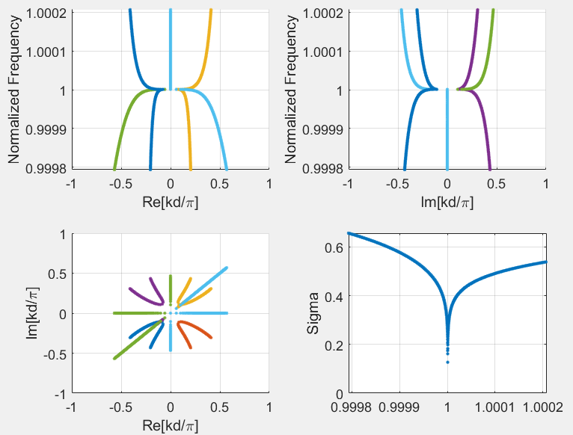
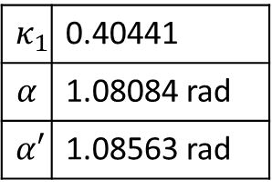
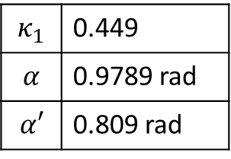
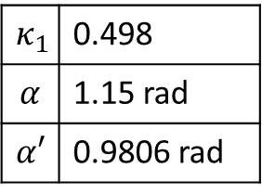
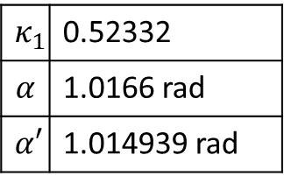
Why do I think the results are correct now?
RBE
SIP
DBE
6DBE
$$κ_{1}$$ | 0.52332
$$α$$ | 1.0166 rad
$$α′$$ | 1.014939 rad
$$κ_{1}$$ | 0.498
$$α$$ | 1.15 rad
$$α′$$ | 0.9806 rad
$$κ_{1}$$ | 0.449
$$α$$ | 0.9789 rad
$α′$ | 0.809 rad
$$κ_{1}$$ | 0.40441
$$α$$ | 1.08084 rad
$$α′$$ | 1.08563 rad
All at $λ=1550$nm

Slide 6
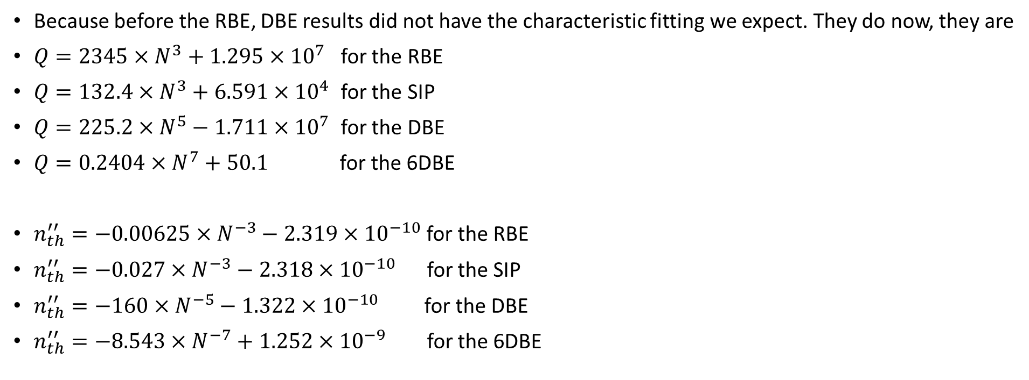
Why do I think the results are correct now?
Because before the RBE, DBE results did not have the characteristic fitting we expect. They do now, they are
$Q=2345×N^{3}+1.295×{10}^{7}$ for the RBE
$Q=132.4×N^{3}+6.591×{10}^{4}$ for the SIP
$Q=225.2×N^{5}−1.711×{10}^{7}$ for the DBE
$Q=0.2404×N^{7}+50.1$ for the 6DBE
$n_{th}^{′′}=−0.00625×N^{−3}−2.319×{10}^{−10}$ for the RBE
$n_{th}^{′′}=−0.027×N^{−3}−2.318×{10}^{−10}$ for the SIP
$n_{th}^{′′}=−160×N^{−5}−1.322×{10}^{−10}$ for the DBE
$n_{th}^{′′}=−8.543×N^{−7}+1.252×{10}^{−9}$ for the 6DBE
This is consistent with previous literature

Slide 7
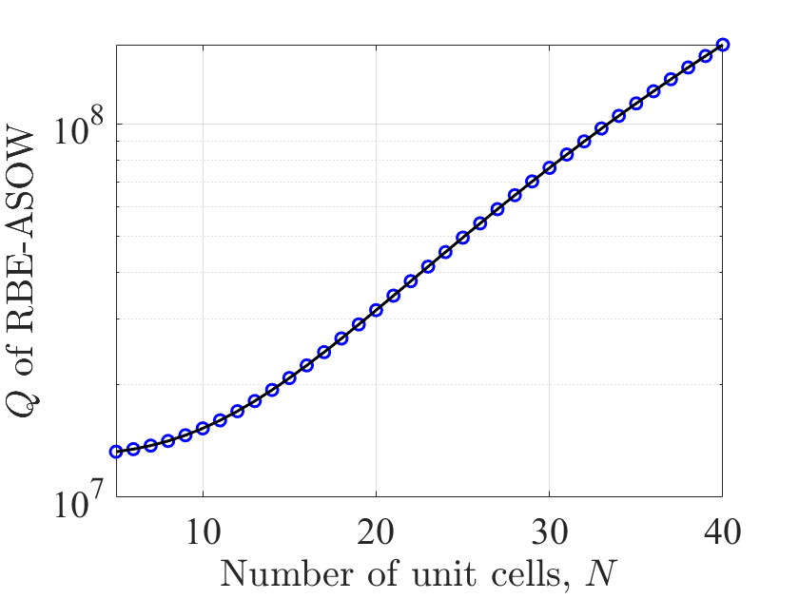
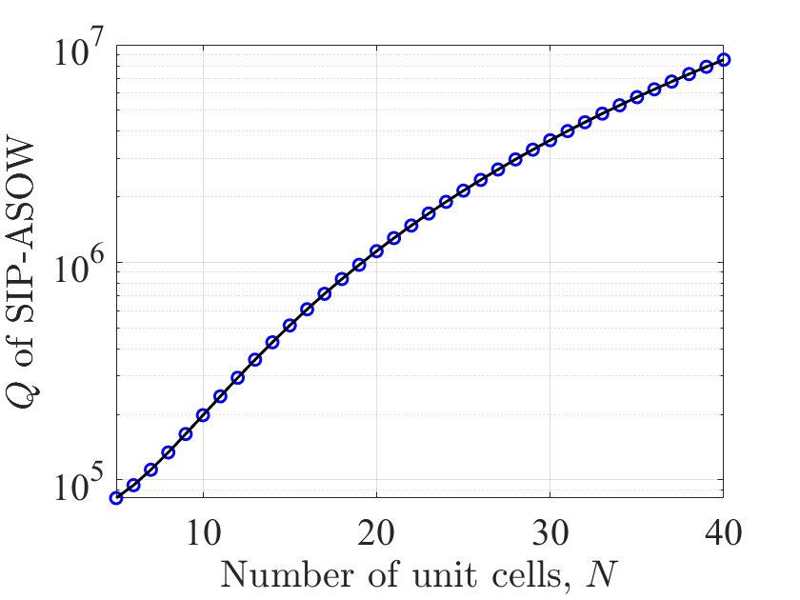
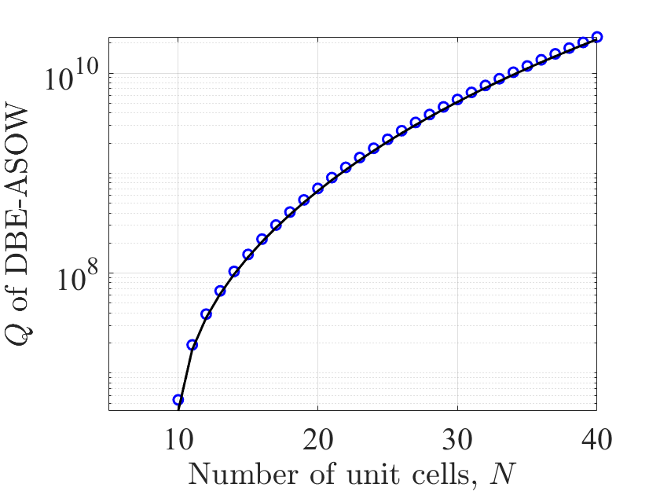
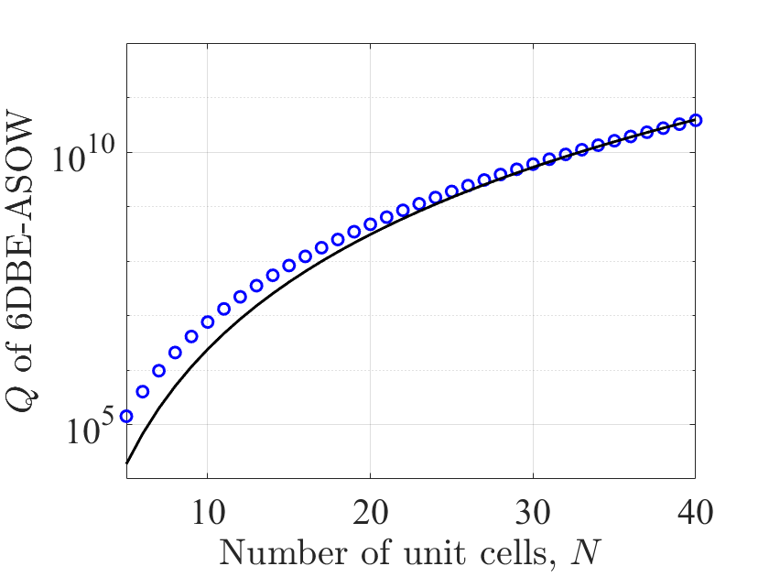
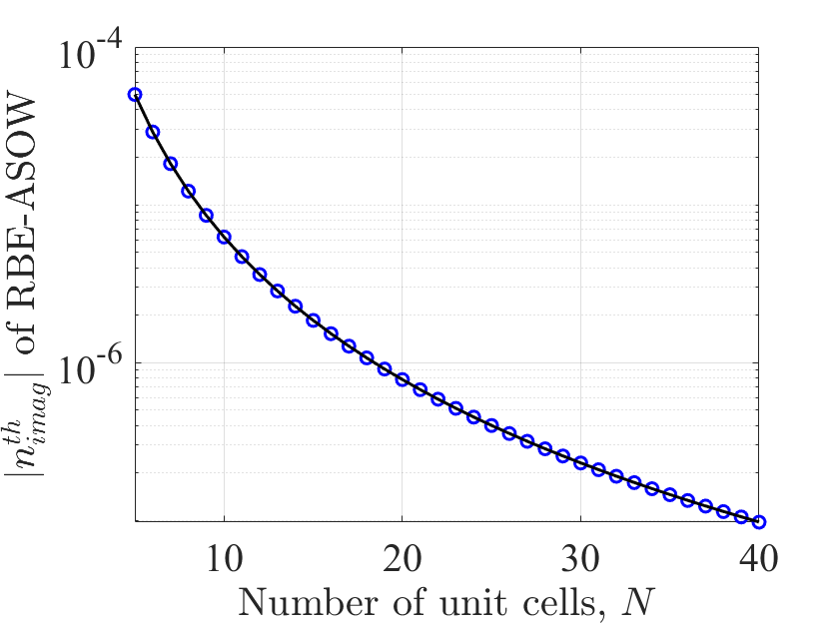
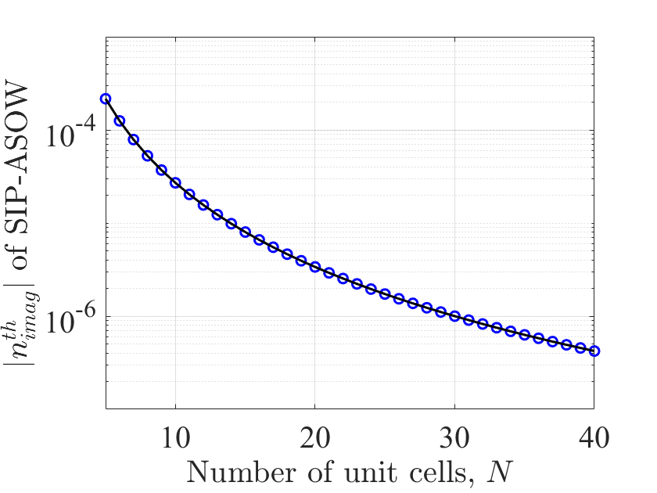
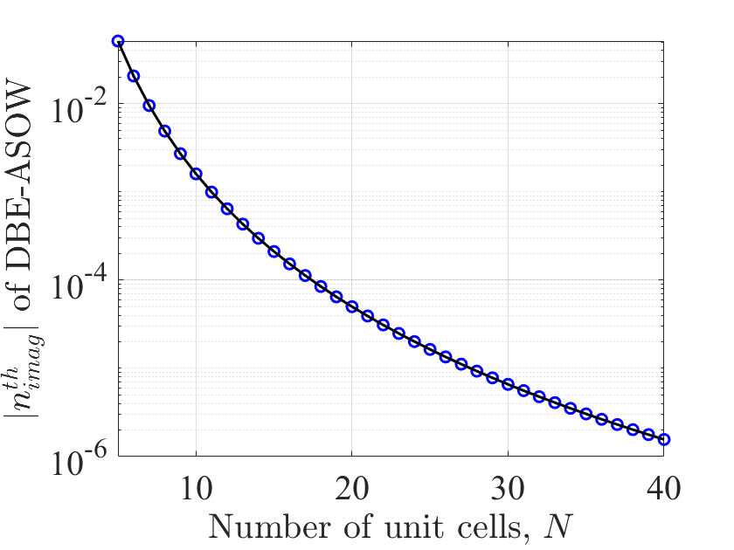
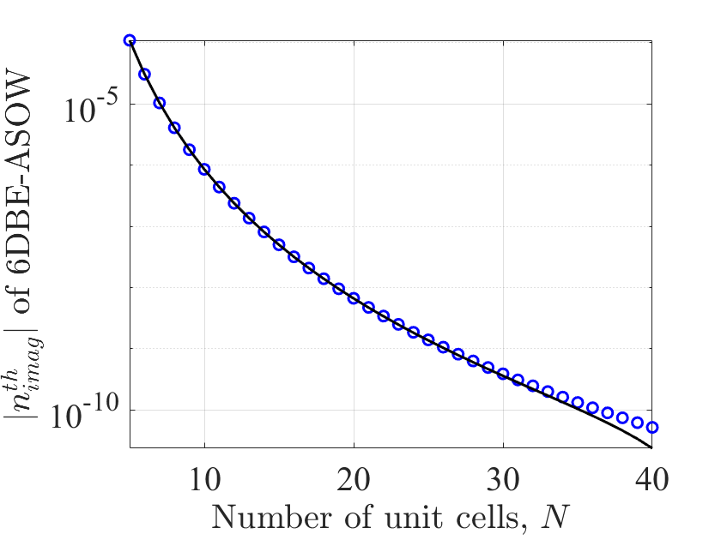

Just how good are these fittings?
RBE
SIP
DBE
6DBE
$Q=225.2×N^{5}−1.711×{10}^{7}$
$$Q=132.4×N^{3}+6.591×{10}^{4}$$
$$Q=0.2404×N^{7}+50.1$$
$$Q=2345×N^{3}+1.295×{10}^{7}$$
$$n_{th}^{′′}=−160×N^{−5}−1.322×{10}^{−10}$$
$n_{th}^{′′}=−8.543×N^{−7}+1.252×{10}^{−9}$
$n_{th}^{′′}=−0.00625×N^{−3}−2.319×{10}^{−10}$
$n_{th}^{′′}=−0.027×N^{−3}−2.318×{10}^{−10}$
I must improve the 6DBE fittings

Slide 8

$χ_{at}$: What is its definition
$$D=D_{h}+P_{at}$$
$$D_{h}=ε_{0}ε_{w}E$$
$$P_{at}=ε_{0}χ_{at}E,$$
$$D=ε_{0}\left(ε_{w}+χ_{at}\right)E=ε_{0}ε_{c}E$$
$$n_{c}^{2}=ε_{c}=ε_{w}+χ_{at}$$
$$n_{c}^{2}=n_{w}^{2}+χ_{at}$$
As defined in Yariv’s book
I think this makes sense
*Yariv, Photonics: Optical electronics in modern communication, Oxford university press, 2007

Slide 9
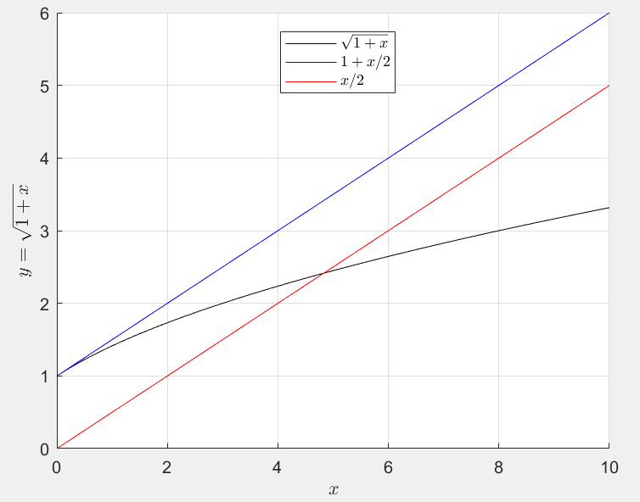
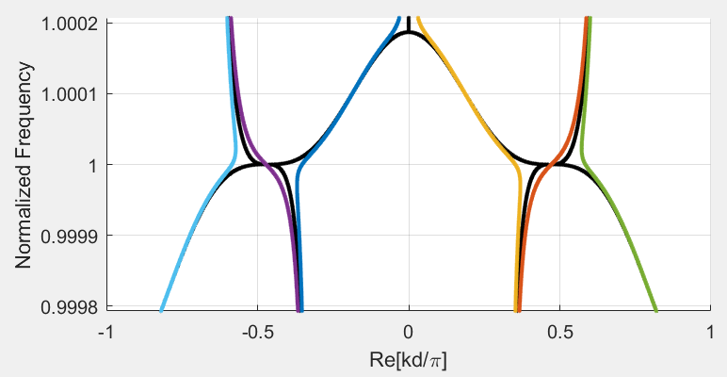
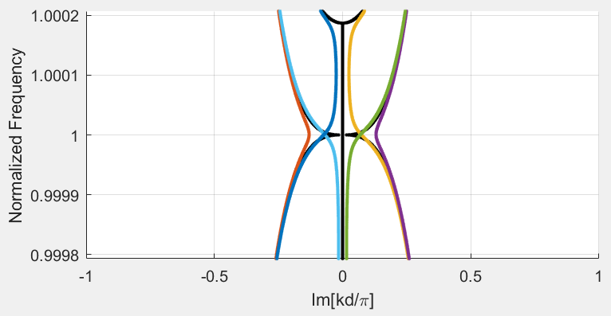

Distorted dispersion diagram due to gain
Do you remember: $\frac{∂k}{∂n}=\frac{ω}{n_{d} v_{g}}$ (from having $ε→ε_{d}=ε+ω\frac{∂ε}{∂ω}$ to account for dispersion)?
It is wrong. I did the approximation $\sqrt{1+δ}≅\frac{δ}{2}$, for $δ≪1$. It is $\sqrt{1+δ}≅1+\frac{δ}{2}$. Repeating the process, we have
$$\frac{∂k}{∂n}=\frac{ω}{v_{g}}\frac{1}{n_{d}−n}$$
where $n_{d}=\sqrt{ε_{d}}, n=\sqrt{ε}, v_{g}=\frac{∂ω}{∂k}$
I have updated the paper draft

Slide 10

Papers
SIP-ASOW:
Filippo, I emailed you a pdf with the suggestions highlighted in yellow & an early draft for the reply letter
When does it work for you to meet?
SIP laser:
Working on the text and the figures
6DBE-ASOW letter:
Must revise the draft again, see with fresher eyes (have you read it?)
RBE, SIP, DBE, 6DBE:
Dispersion diagram
Transfer function
Group delay
$Q$ vs$N$
$n_{th}^{′′}$ vs $N$
Field amplitudes ?
Improved ASOW
Improved ASOW unit cell
SIP distorted dispersion diagram
All EPD $n_{th}^{′′}$ vs $Q$ for comparison
☺

Slide 11
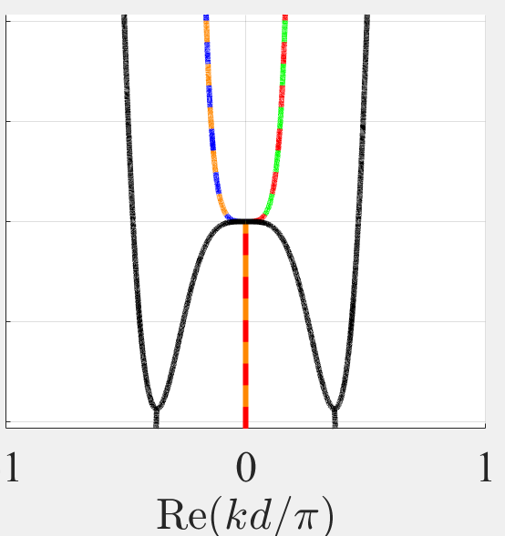
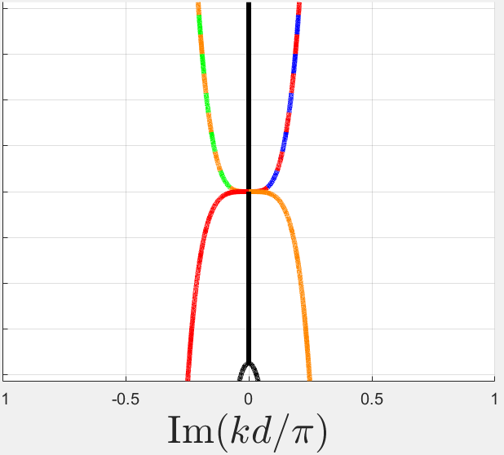
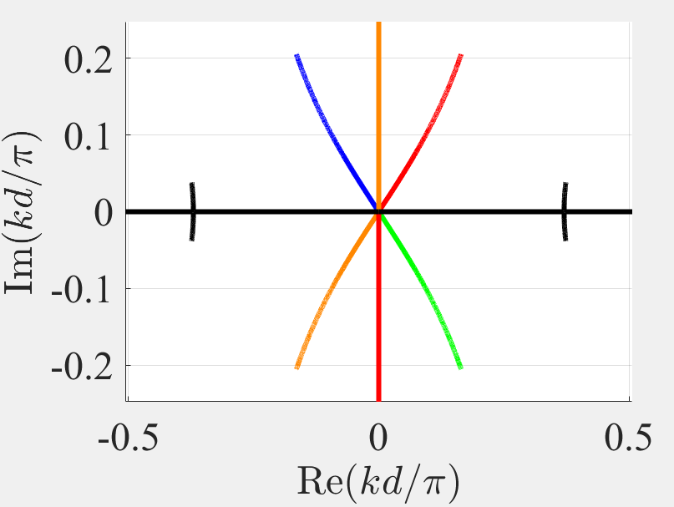

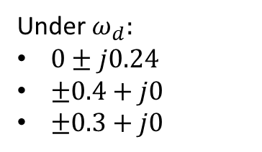
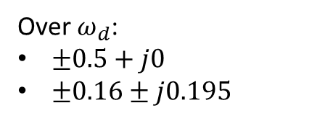

DBE Dispersion diagram
Over $ω_{d}$:
$±0.5+j0$
$±0.16±j0.195$
Under $ω_{d}:$
$0±j0.24$
$±0.4+j0$
$±0.3+j0$
$$+ \\ −$$
$$++ \\ + − \\ − + \\ − −$$
But the $ℑ\left\{k\right\}, ℜ\{k\}$ seems funny

Slide 12
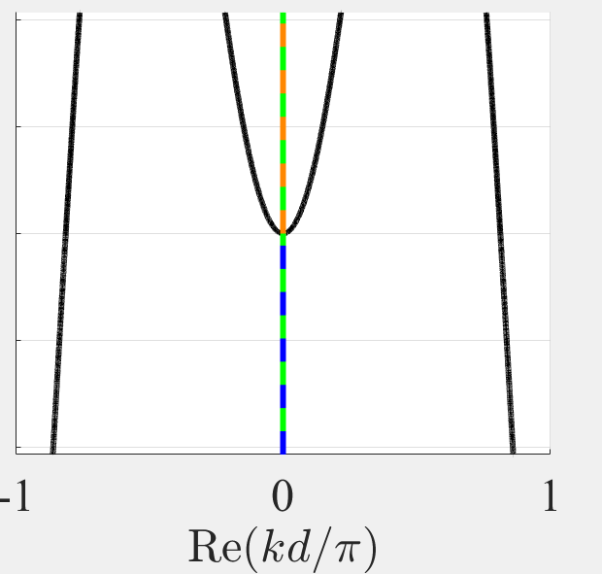
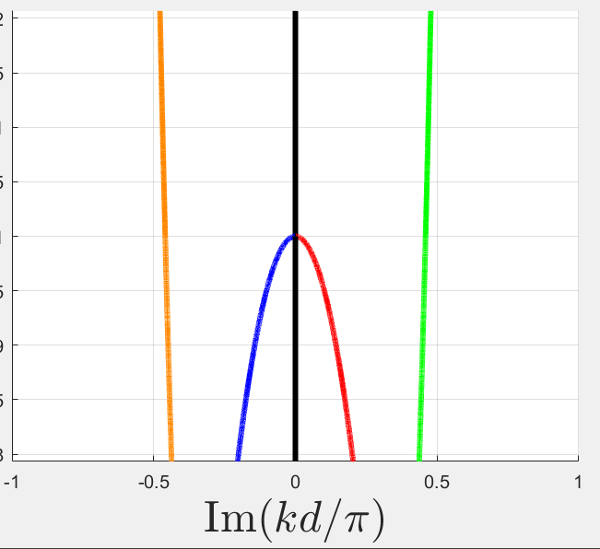
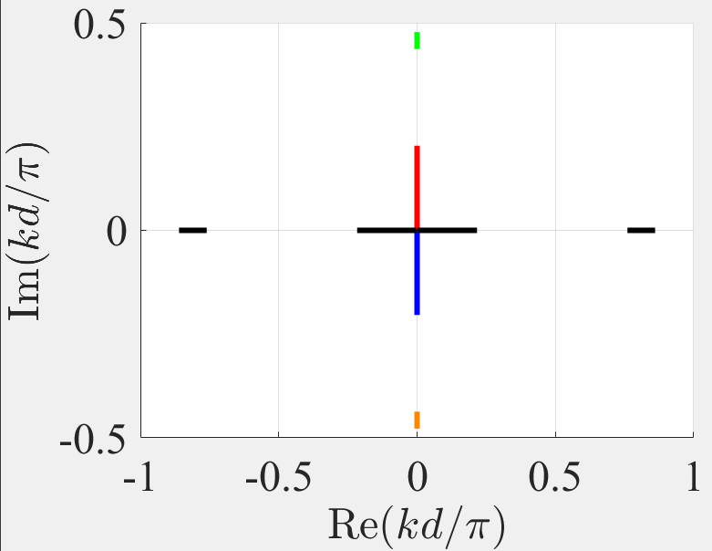

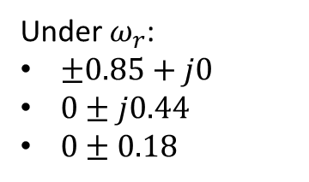
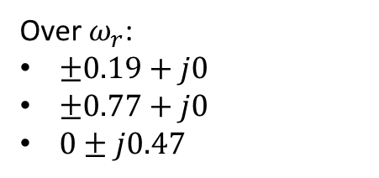


RBE Dispersion diagram
Over $ω_{r}$:
$±0.19+j0$
$±0.77+j0$
$0±j0.47$
Under $ω_{r}$:
$±0.85+j0$
$0±j0.44$
$0±0.18$
$$+ \\ −$$
$$+ \\ −$$
$$+ \\ −$$
In $ℜ\{k\}$ I need to find a way to show the four colors in the bottom center

