Slide 1
Lasing Threshold, lineshape and saturation

Slide 2


Goal
Previous week:
Start writing the SIP laser paper
Objective for this week:
Develop SIP lasing theory
Finished so far:
Developed some SIP lasing theory, especially atomic transition lineshape
Plotted $Q$vs $N$for 6DBE-ASOW, with $N∈[12,36]$
Not done yet:
Intensity saturation and single-mode lasing
$$D=ε_{host}\left(χ_{at}+1\right)E$$
This is tentative work based on Yariv and Siegman’s books

Slide 3
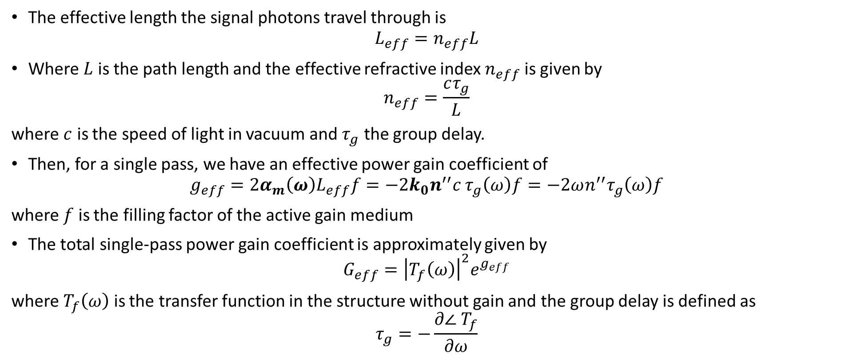
Effective lengths and single pass gain
The effective length the signal photons travel through is
$$L_{eff}=n_{eff}L$$
Where $L$ is the path length and the effective refractive index $n_{eff}$ is given by
$$n_{eff}=\frac{cτ_{g}}{L}$$
where $c$ is the speed of light in vacuum and $τ_{g}$ the group delay.
Then, for a single pass, we have an effective power gain coefficient of
$$g_{eff}={2α}_{m}\left(ω\right)L_{eff}f=−{2k}_{0}n^{′′}c τ_{g}\left(ω\right)f=−2ωn^{′′}τ_{g}\left(ω\right)f$$
where $f$ is the filling factor of the active gain medium
The total single-pass power gain coefficient is approximately given by
$$G_{eff}={\left|T_{f}\left(ω\right)\right|}^{2}e^{g_{eff}}$$
where $T_{f}\left(ω\right)$ is the transfer function in the structure without gain and the group delay is defined as
$$τ_{g}=−\frac{∂∠ T_{f}}{∂ω}$$
The power gain has a strong dependence on the transfer function
*Othman, Figotin, Capolino, Giant gain enhancement in photonic crystals with a degenerate band edge, Physical Review B, 93, 2, (2016)

Slide 4
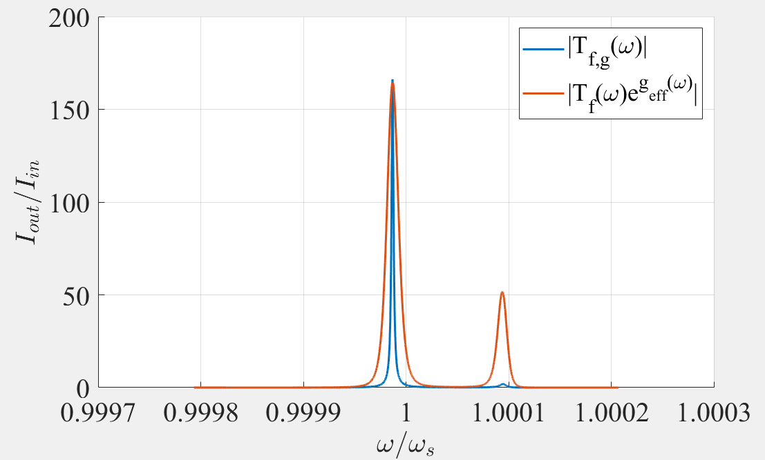
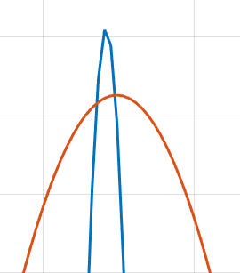
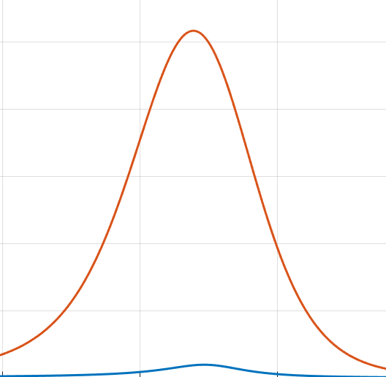

Single-pass gain
The transfer function without gain is $T_{f}(ω)$, while with gain it is $T_{f,g}\left(ω\right)$
It follows that we should have:
${\left|T_{f,g}\left(ω\right)\right|}^{2}≅\left|T_{f}\left(ω\right)\right|e^{g_{eff}(ω)}$,
where
$g_{eff}\left(ω\right)=−2ωn^{′′}\left(ω\right)τ_{g}\left(ω\right)f$
We have neglected the distortion of the SIP when adding gain. This is likely the cause of:
The difference in the main peak
The missing peak on the right
$ω_{a}=ω_{s}≠ω_{res}$ (the frequency of the transition is the SIP frequency)
The approximation holds within a reasonable level

Slide 5
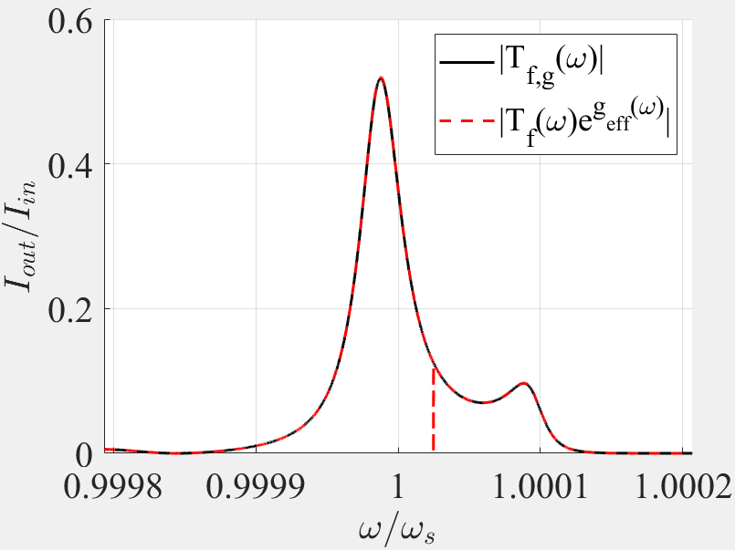



Single-pass gain
The approximation fails as $n^{′′}→n_{th}$. What happens for $n^{′′}→0$? The difference between the actual transfer function and the approximate transfer function is the same.
$$n^{′′}=n_{th}∝{10}^{−5}$$
$$n^{′′}=n_{th}×{10}^{−3}$$
As $n^{′′}→0$, $|T_{f,g}\left(ω\right)−T_{f}\left(ω\right)| →0$

Slide 6
RBE,DBE,6DBE-ASOW scaling

Slide 7
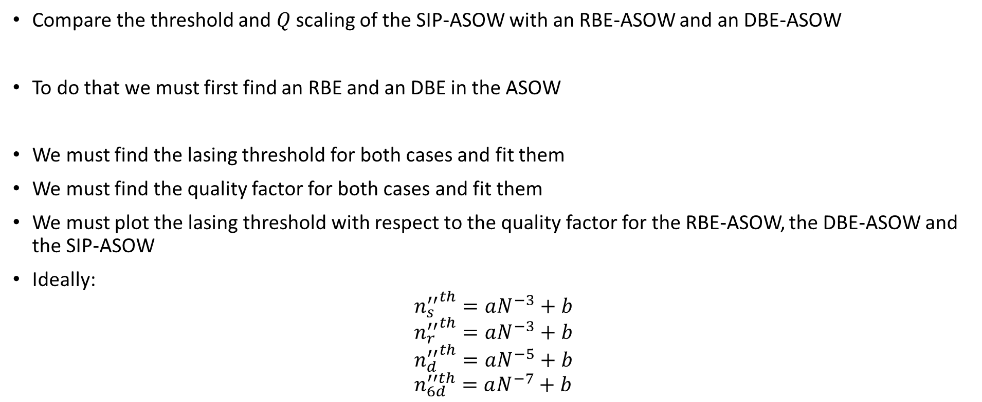
Goal
Compare the threshold and $Q$ scaling of the SIP-ASOW with an RBE-ASOW and an DBE-ASOW
To do that we must first find an RBE and an DBE in the ASOW
We must find the lasing threshold for both cases and fit them
We must find the quality factor for both cases and fit them
We must plot the lasing threshold with respect to the quality factor for the RBE-ASOW, the DBE-ASOW and the SIP-ASOW
Ideally:
$${n_{s}^{′′}}^{th}=aN^{−3}+b \\ {n_{r}^{′′}}^{th}=aN^{−3}+b \\ {n_{d}^{′′}}^{th}=aN^{−5}+b \\ n_{6d}^{′′th}=aN^{−7}+b$$
We want low $n’’$ for any $Q$

Slide 8
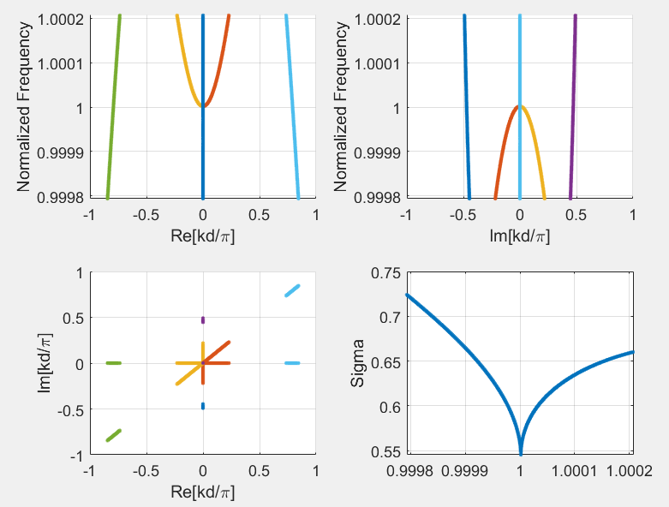
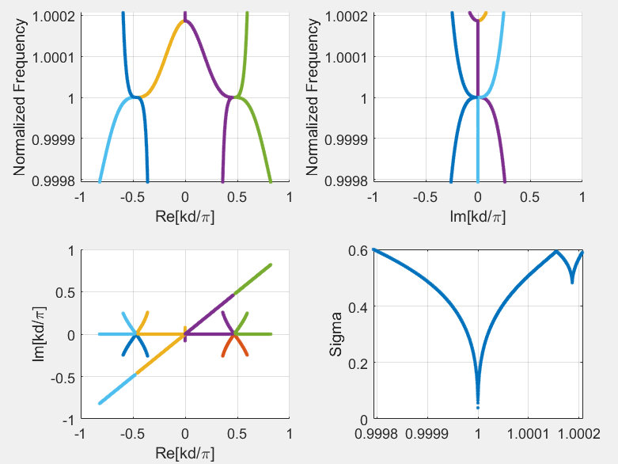
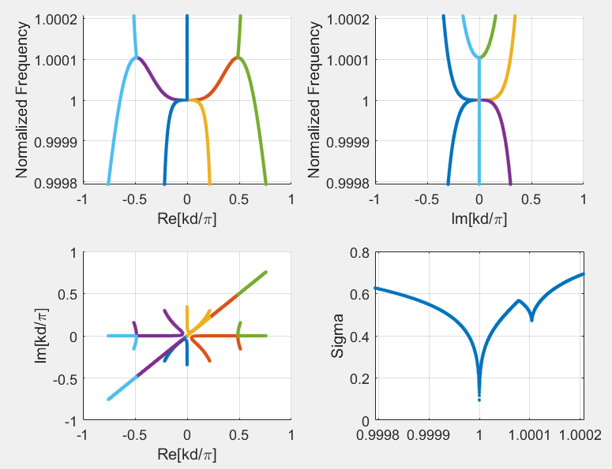
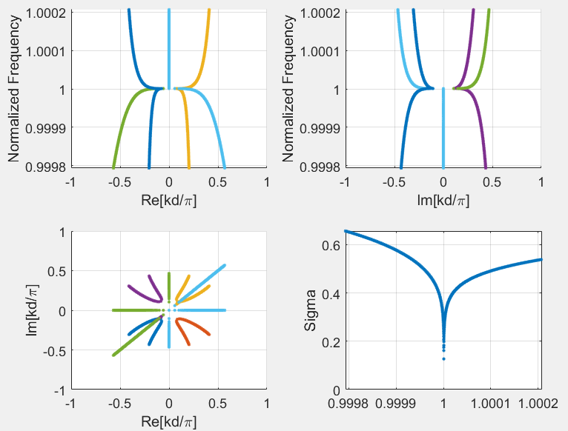
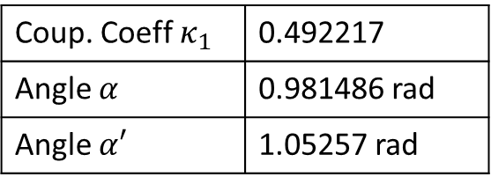
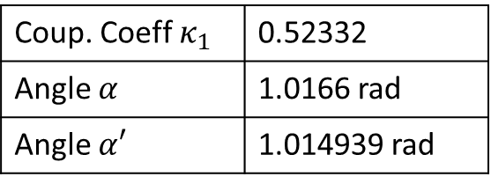
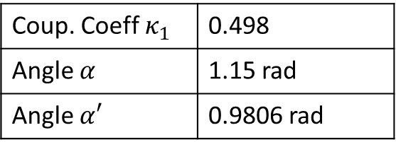
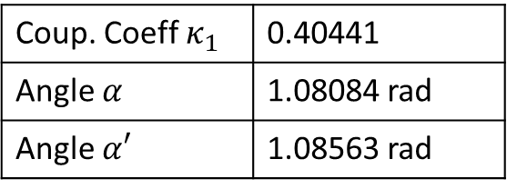
Find RBE, DBE, 6DBE
RBE
DBE
RBE
Coup. Coeff $κ_{1}$ | 0.52332
Angle $α$ | 1.0166 rad
Angle $α′$ | 1.014939 rad
Coup. Coeff $κ_{1}$ | 0.498
Angle $α$ | 1.15 rad
Angle $α′$ | 0.9806 rad
Coup. Coeff $κ_{1}$ | 0.492217
Angle $α$ | 0.981486 rad
Angle $α′$ | 1.05257 rad
Coup. Coeff $κ_{1}$ | 0.40441
Angle $α$ | 1.08084 rad
Angle $α′$ | 1.08563 rad
All at $λ=1550$nm

Slide 9
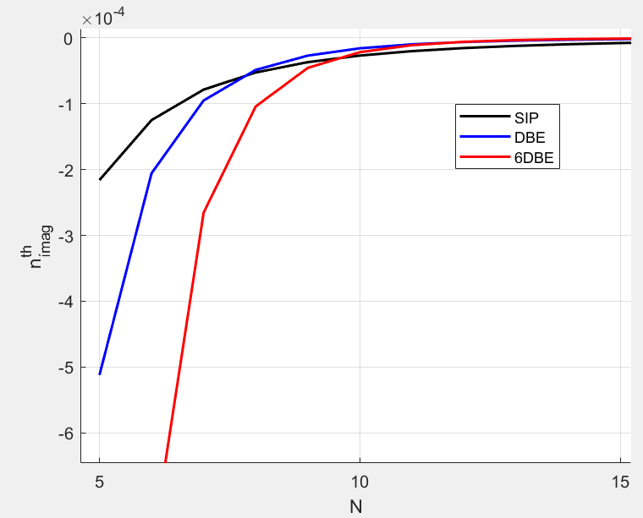
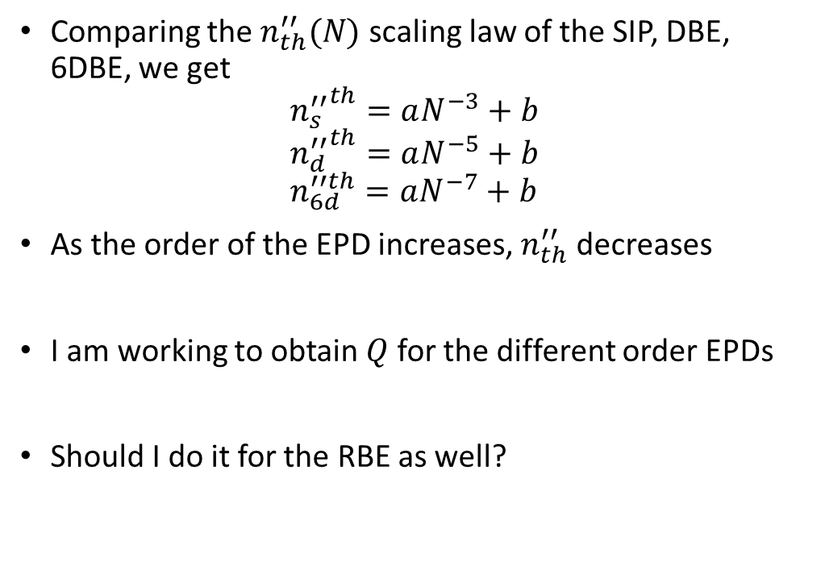
Scaling of threshold values with $N$
Comparing the $n_{th}^{′′}(N)$ scaling law of the SIP, DBE, 6DBE, we get
$${n_{s}^{′′}}^{th}=aN^{−3}+b \\ {n_{d}^{′′}}^{th}=aN^{−5}+b \\ n_{6d}^{′′th}=aN^{−7}+b$$
As the order of the EPD increases, $n_{th}^{′′}$ decreases
I am working to obtain $Q$ for the different order EPDs
Should I do it for the RBE as well?
This result is not surprising

Slide 10
Diagonalization technique for transfer matrix

Slide 11
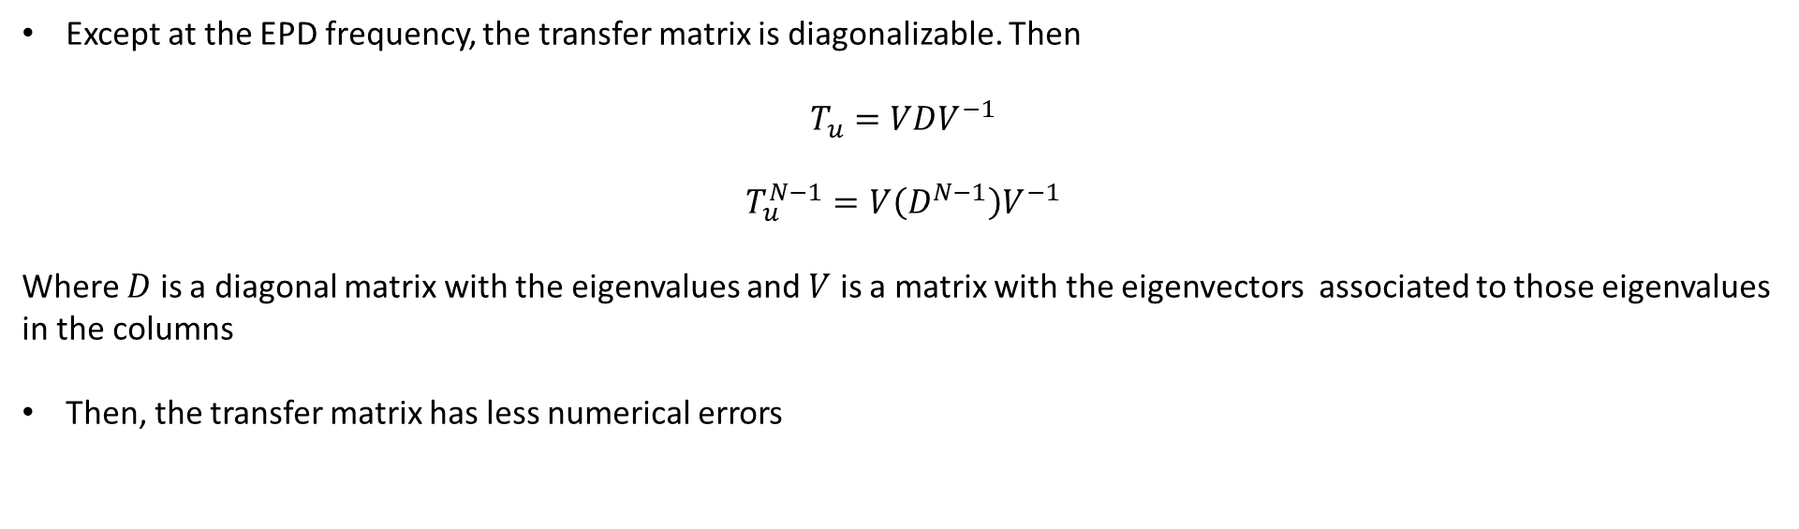
Multiplication of transfer matrices
Except at the EPD frequency, the transfer matrix is diagonalizable. Then
$$T_{u}=VDV^{−1}$$
$$T_{u}^{N−1}=V\left(D^{N−1}\right)V^{−1}$$
Where $D$ is a diagonal matrix with the eigenvalues and $V$ is a matrix with the eigenvectors associated to those eigenvalues in the columns
Then, the transfer matrix has less numerical errors

Slide 12
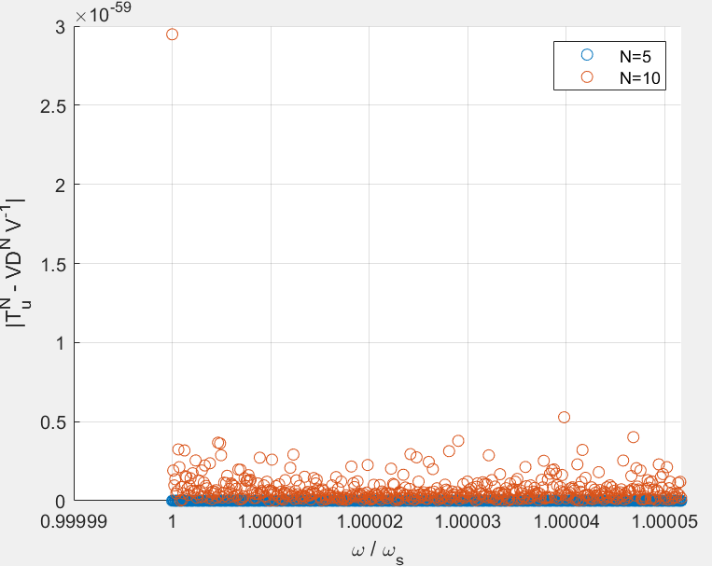
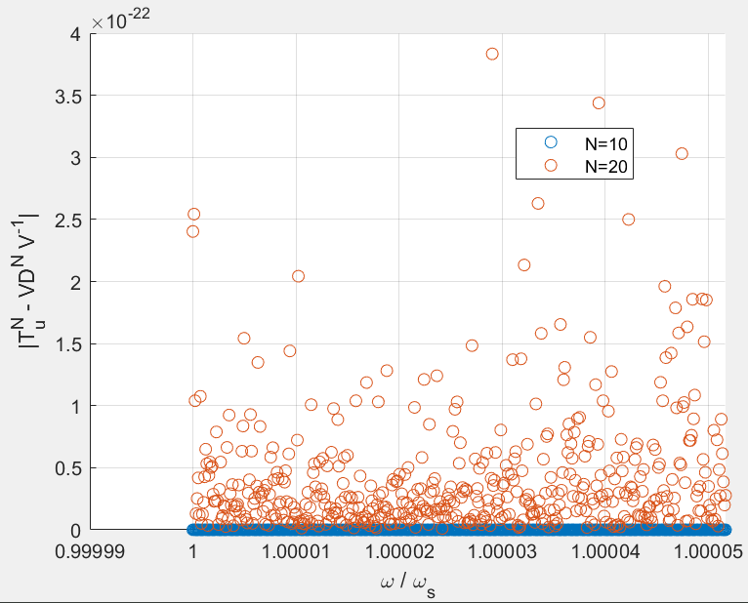
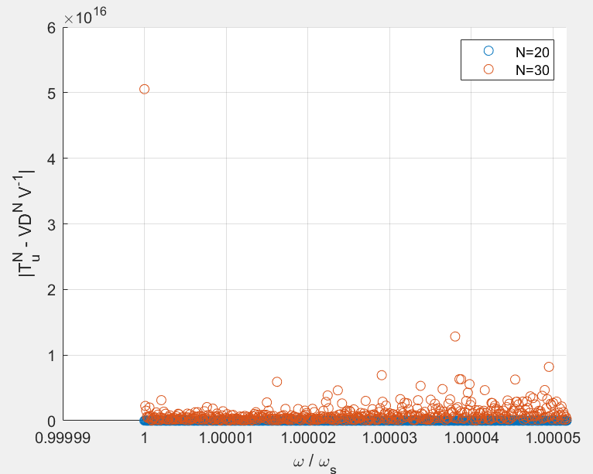

Multiplication of transfer matrices at the EPD
At the EPD frequency, the transfer matrix is not diagonalizable
This causes a numerical error at the EPD frequency. It becomes more and more relevant as $N$ increases

