Slide 1
SIP-ASOW laser
Albert Herrero Parareda F.Capolino (remove)

Slide 2
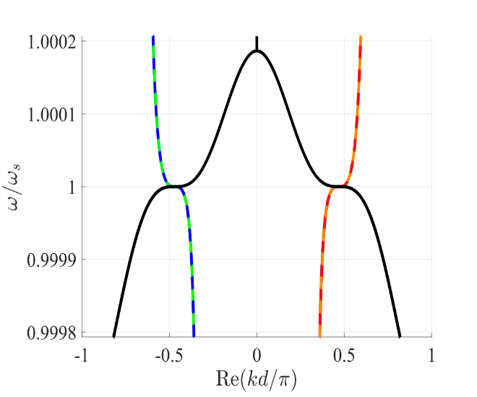
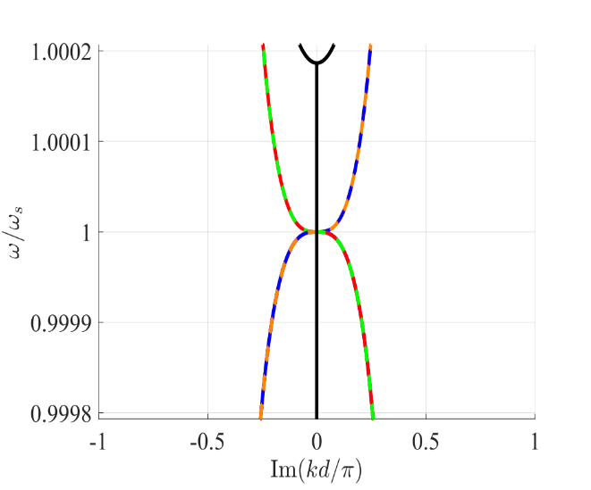
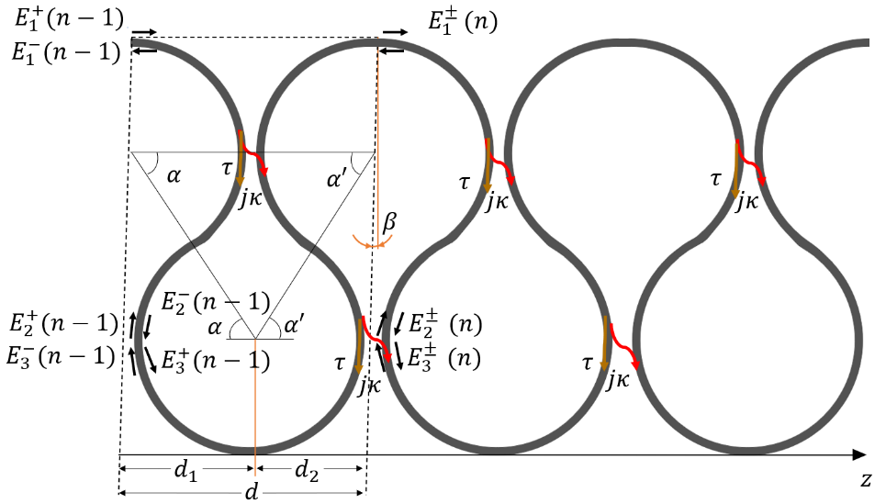
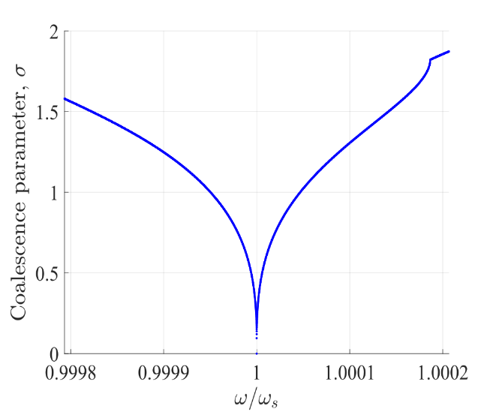
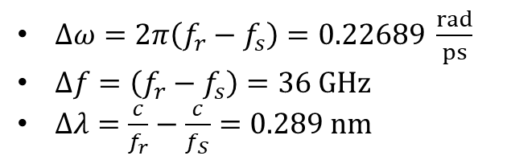
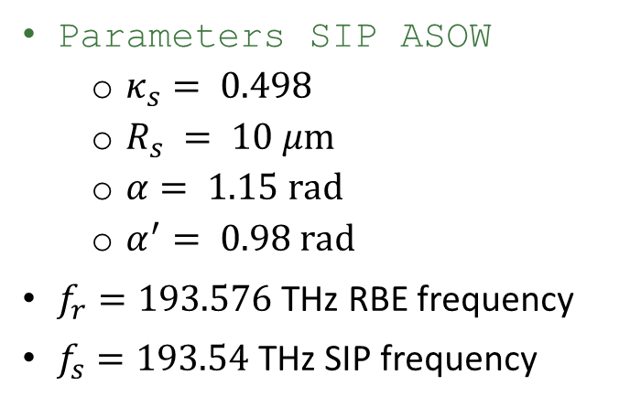
RBE-SIP distance in SIP-ASOW
- Blue line: SIP frequency - Red line: RBE frequency
Parameters SIP ASOW
$κ_{s}= 0.498$
$R_{s} = 10 μm$
$α= 1.15 rad$
$α^{′}= 0.98 rad$
$f_{r}=193.576$ THz RBE frequency
$f_{s}=193.54$THz SIP frequency
$Δω=2π\left(f_{r}−f_{s}\right)=0.22689 \frac{rad}{ps}$
$Δf=\left(f_{r}−f_{s}\right)=36 GHz$
$Δλ=\frac{c}{f_{r}}−\frac{c}{f_{S}}=0.289 nm$

Slide 3
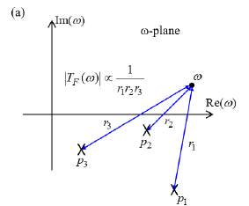
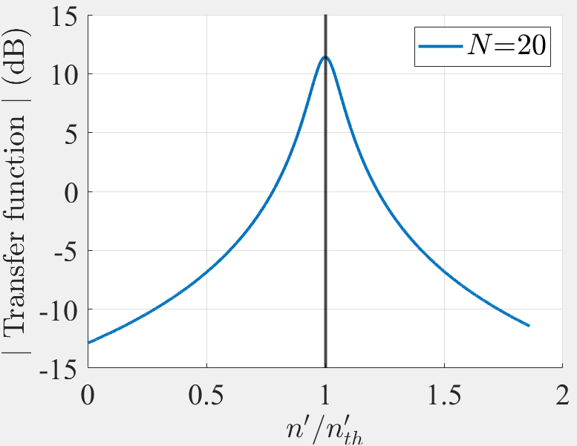
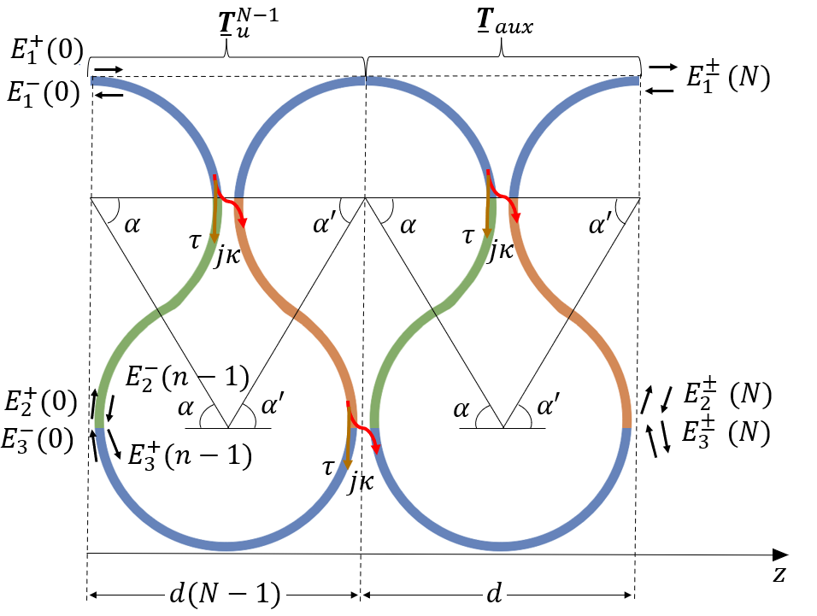
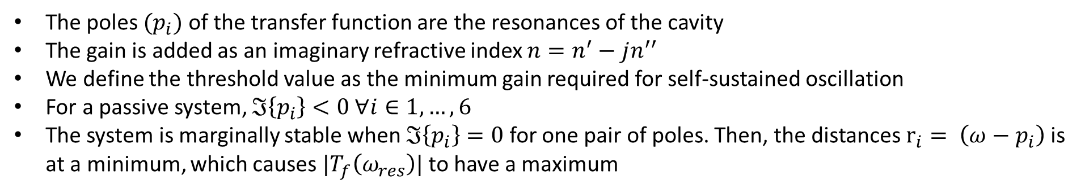

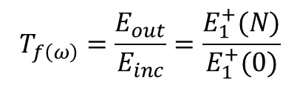
Lasing threshold
The poles $(p_{i})$ of the transfer function are the resonances of the cavity
The gain is added as an imaginary refractive index $n=n^{′}−jn^{′′}$
We define the threshold value as the minimum gain required for self-sustained oscillation
For a passive system, $ℑ\left\{p_{i}\right\}<0 ∀i∈1, …, 6$
The system is marginally stable when $ℑ\left\{p_{i}\right\}=0$for one pair of poles. Then, the distances $r_{i}= \left(ω−p_{i}\right)$ is at a minimum, which causes $|T_{f}\left(ω_{res}\right)|$ to have a maximum
$$T_{f\left(ω\right)}=\frac{E_{out}}{E_{inc}}=\frac{E_{1}^{+}(N)}{E_{1}^{+}(0)}$$
$$n_{th}^{′′}=\text{−1.12}×{10}^{−6}$$

Slide 4
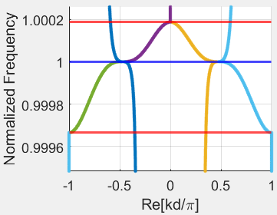
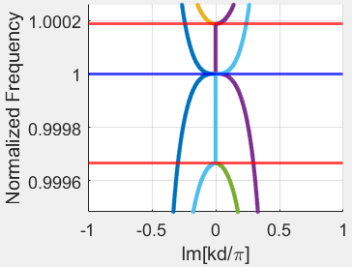
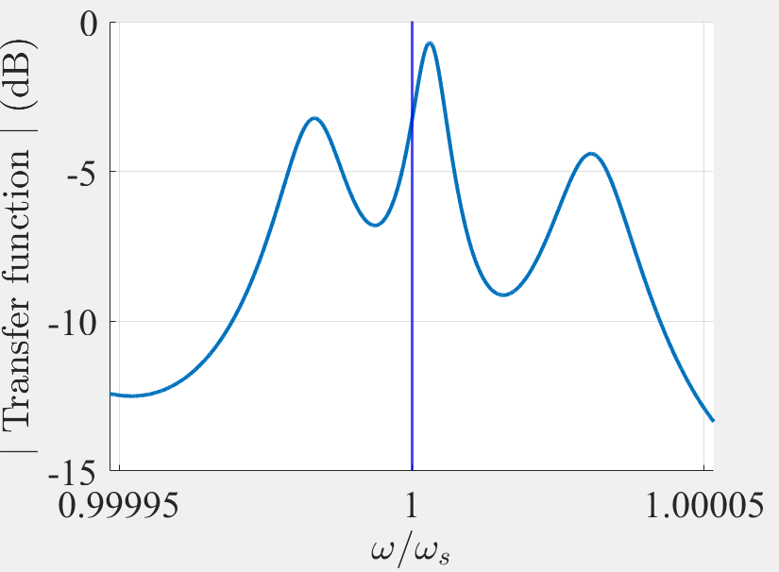
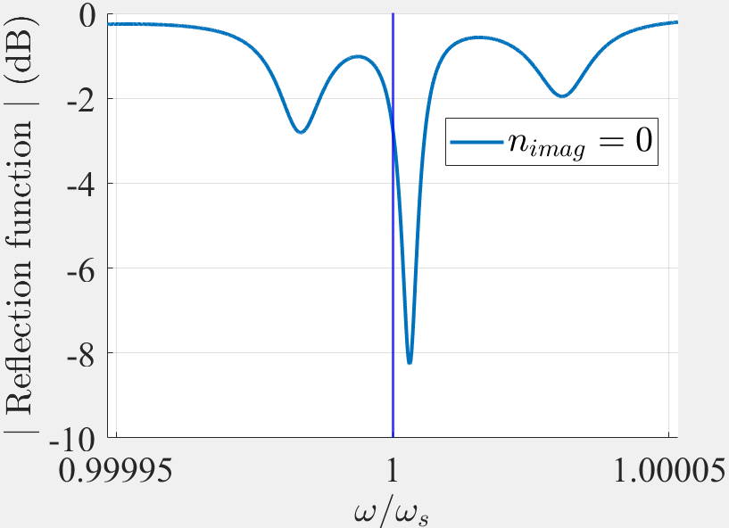
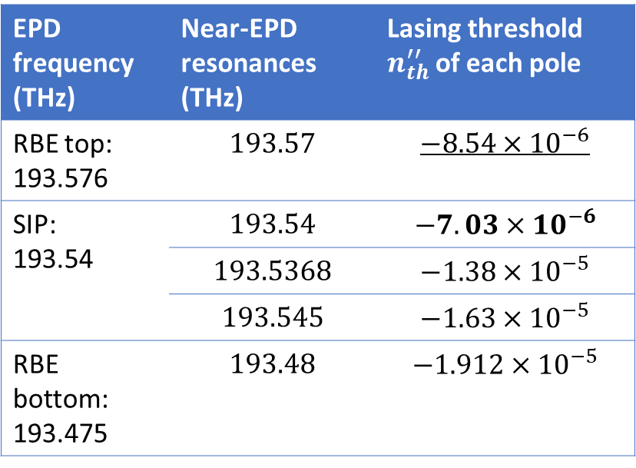
Resonances and lasing thresholds
We find the resonances and then the lasing threshold of each resonance for $N=10$
EPD frequency (THz) | Near-EPD resonances (THz) | Lasing threshold $n_{th}^{′′}$ of each pole
RBE top: 193.576 | $$193.57$$ | $$−8.54×{10}^{−6}$$
SIP: 193.54 | $$193.54$$ | $$−7.03×{10}^{−6}$$
 | $$193.5368$$ | $$−1.38×{10}^{−5}$$
 | $$193.545$$ | $$−1.63×{10}^{−5}$$
RBE bottom: 193.475 | $$193.48$$ | $$−1.912×{10}^{−5}$$
The second pole smallest lasing threshold is the RBE resonance

Slide 5
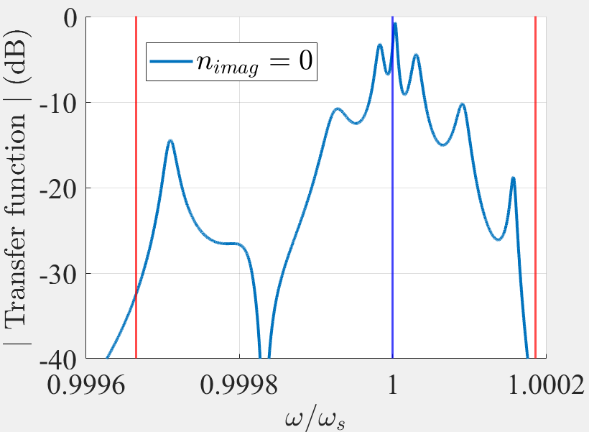
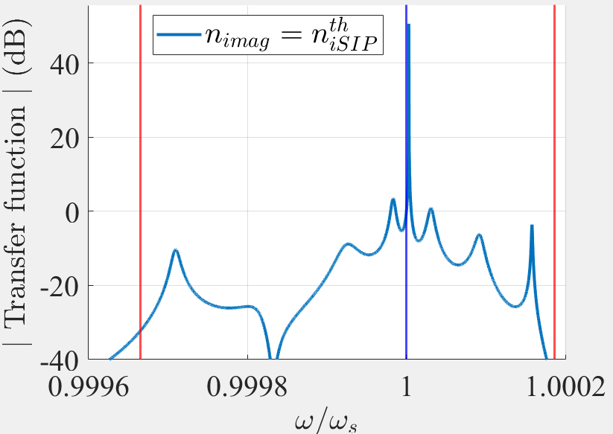
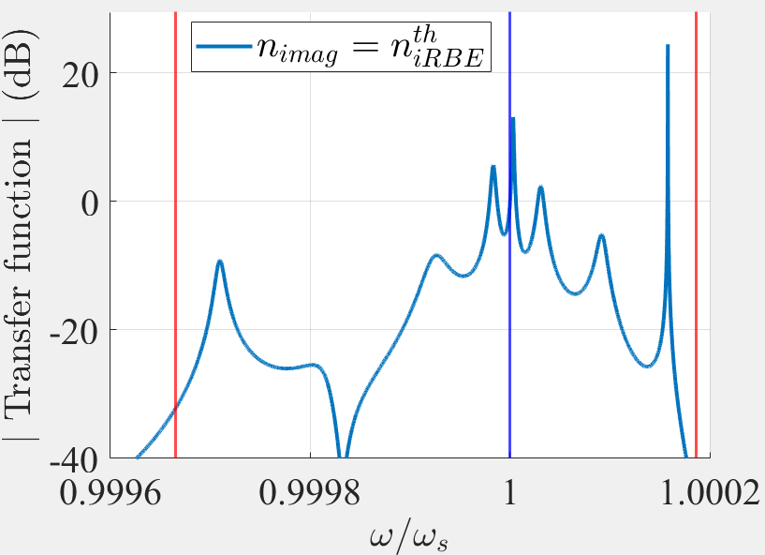








Resonances and lasing thresholds for $N=10$
$$n^{′′}=0$$
$$n^{′′}=n_{SIPth}^{′′}=\text{−7.03}×{10}^{−6}$$
$$n^{′′}=n_{RBEth}^{′′}=\text{−8.54}×{10}^{−6}$$
$$ℑ\{ω\}$$
Marginally stable poles for increasing gain:
SIP resonance
RBE resonance
2nd SIP resonance (second resonance the closest to the SIP frequency)
Blue line: SIP frequency
Red line: RBE frequency
$$x$$
$$ℜ\{ω\}$$
$$x$$
$$x$$
Position of the $3$ closest poles to $ℜ\{ω\}$
The second pole to become marginally stable is the RBE resonance

Slide 6
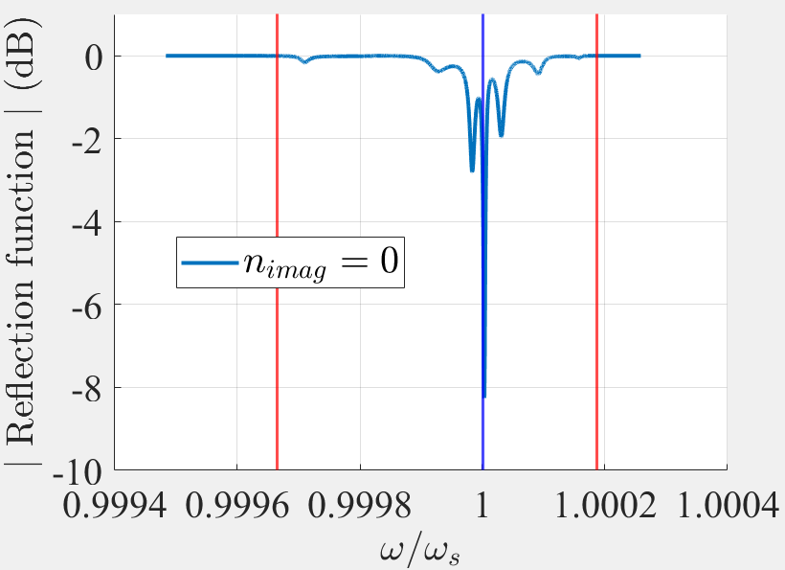
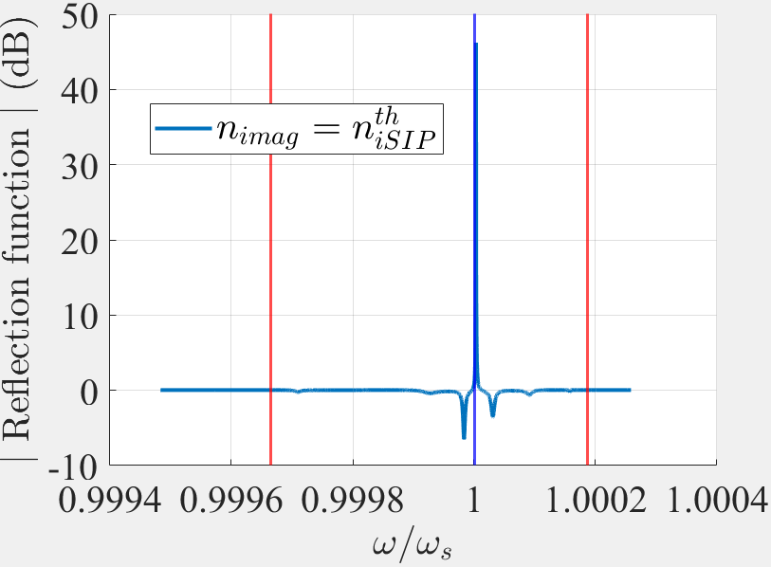
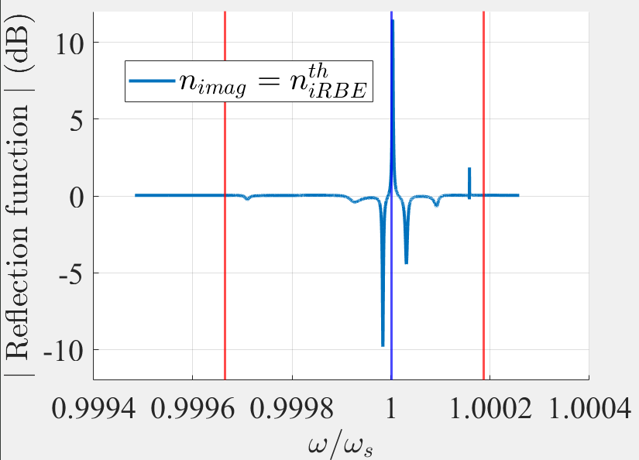






Resonances and lasing thresholds for $N=10$
$$n^{′′}=0$$
$$n^{′′}=n_{SIPth}^{′′}=\text{−7.031}×{10}^{−6}$$
$$n^{′′}=n_{RBEth}^{′′}=\text{−8.54}×{10}^{−6}$$
$${\left|T_{f}\right|}^{2}+{\left|R_{f}\right|}^{2}=1 ∀ω$$
$${\left|T_{f}\right|}^{2}+{\left|R_{f}\right|}^{2}=1.0075 ∀ω$$
$${\left|T_{f}\right|}^{2}+{\left|R_{f}\right|}^{2}=1.0091 ∀ω$$
Lossless condition
With gain
With more gain

Slide 7
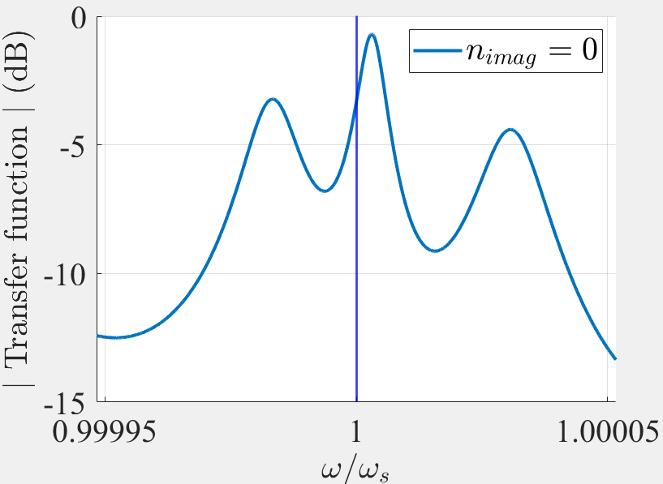
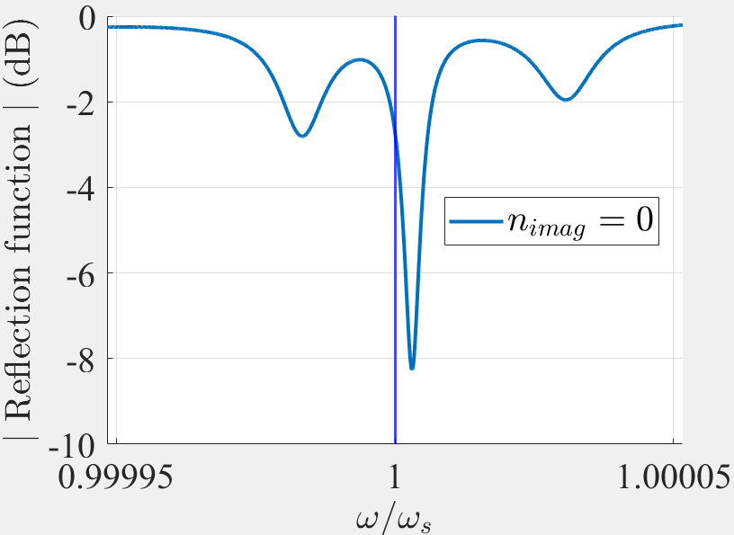
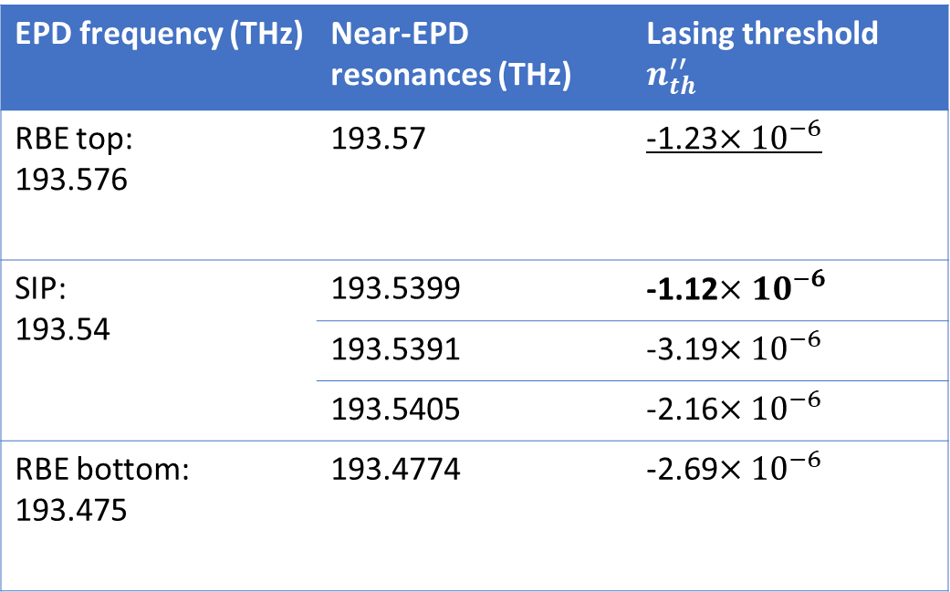

Longer waveguides
We find the resonances and then the lasing threshold of each resonance for $N=20$
EPD frequency (THz) | Near-EPD resonances (THz) | Lasing threshold $n_{th}^{′′}$
RBE top: 193.576 | 193.57 | -1.23$×{10}^{−6}$
SIP: 193.54 | 193.5399 | -1.12$×{10}^{−6}$
 | 193.5391 | -3.19$×{10}^{−6}$
 | 193.5405 | -2.16$×{10}^{−6}$
RBE bottom: 193.475 | 193.4774 | -2.69$×{10}^{−6}$
The second pole smallest lasing threshold is the RBE resonance

Slide 8
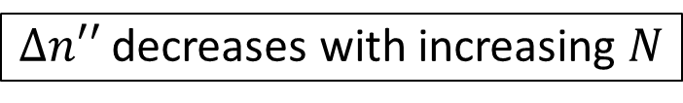
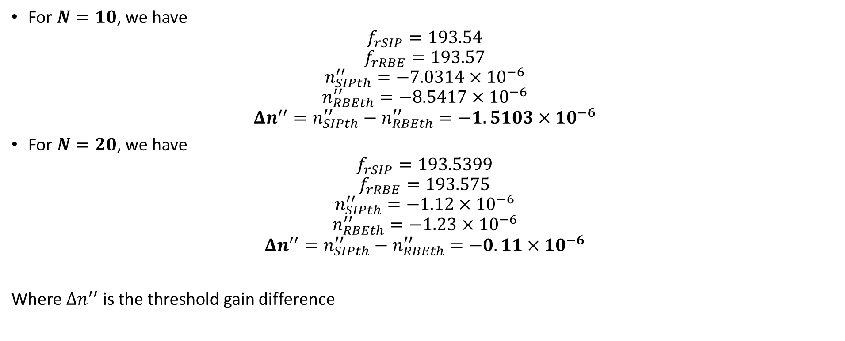
SIP resonance dominance and waveguide length
For $N=10$, we have
$$f_{rSIP}=\text{193.54}$$
$$f_{rRBE}=\text{193.57}$$
$$n_{SIPth}^{′′}=−\text{7.0314}×{10}^{−6}$$
$$n_{RBEth}^{′′}=−\text{8.5417}×{10}^{−6}$$
$$Δn^{′′}=n_{SIPth}^{′′}−n_{RBEth}^{′′}=−1.5103×{10}^{−6}$$
For $N=20$, we have
$$f_{rSIP}=\text{193.5399}$$
$$f_{rRBE}=\text{193.57}\text{5}$$
$$n_{SIPth}^{′′}=−\text{1.12}×{10}^{−6}$$
$$n_{RBEth}^{′′}=−\text{1.23}×{10}^{−6}$$
$$Δn^{′′}=n_{SIPth}^{′′}−n_{RBEth}^{′′}=−0.11×{10}^{−6}$$
Where $Δn^{′′}$ is the threshold gain difference
$Δn′′$ decreases with increasing $N$

Slide 9
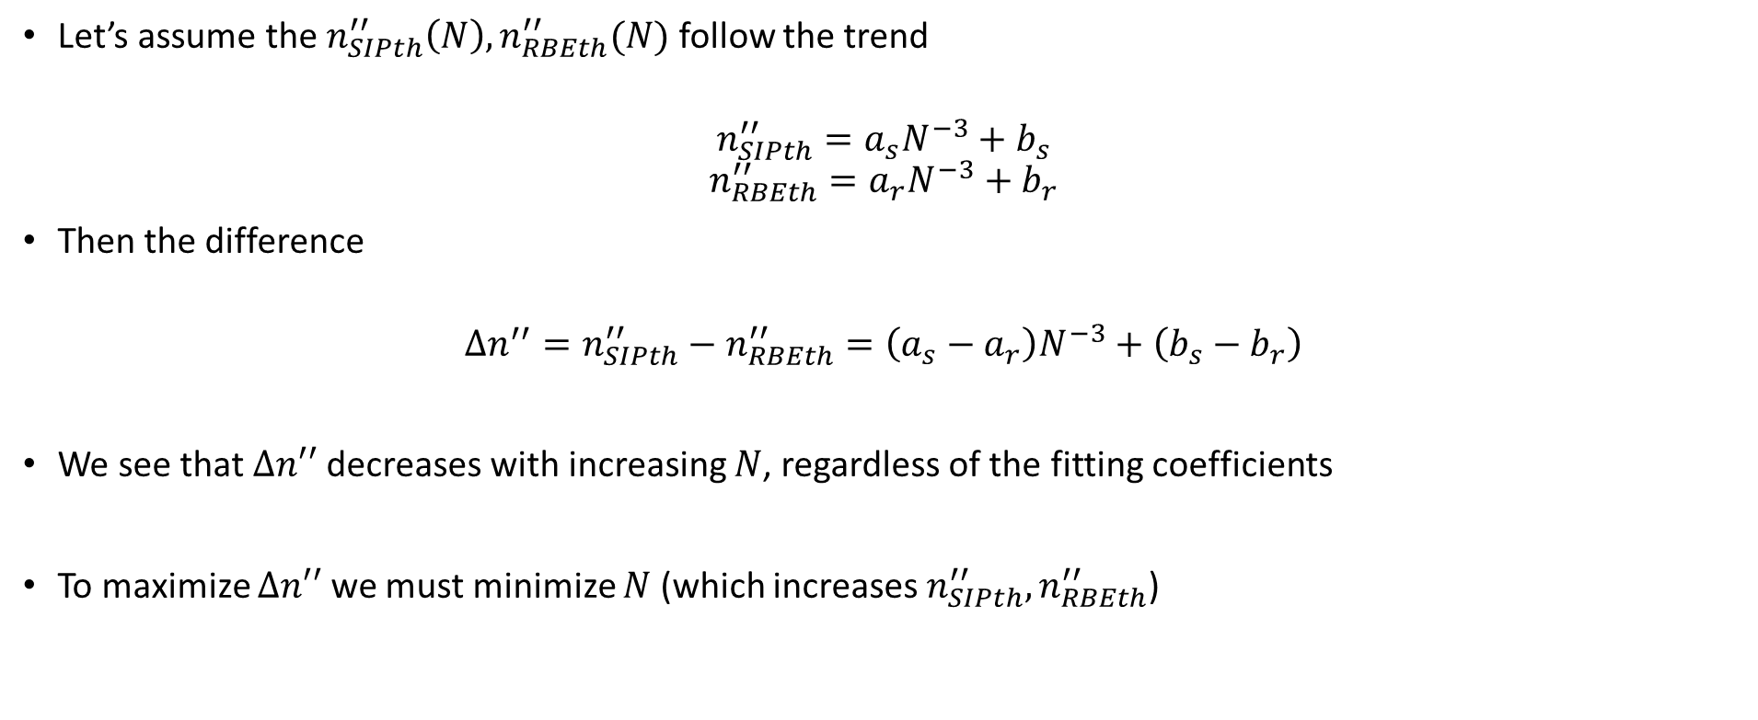
Why?
Let’s assume the $n_{SIPth}^{′′}\left(N\right), n_{RBEth}^{′′}(N)$ follow the trend
$$n_{SIPth}^{′′}=a_{s}N^{−3}+b_{s}$$
$$n_{RBEth}^{′′}=a_{r}N^{−3}+b_{r}$$
Then the difference
$$Δn^{′′}=n_{SIPth}^{′′}−n_{RBEth}^{′′}=\left(a_{s}−a_{r}\right)N^{−3}+\left(b_{s}−b_{r}\right)$$
We see that $Δn′′$ decreases with increasing $N$, regardless of the fitting coefficients
To maximize $Δn′′$ we must minimize $N$ (which increases $n_{SIPth}^{′′}, n_{RBEth}^{′′}$)
This is generic for all SIP, RBE

