Slide 1
SIP laser in ASOW: Update

Slide 2

Goal
Previous week:
$n_{th}^{′′}$ vs $Q$ corrections and fittings
$χ_{at}$ definition
Objective for this week:
Slides on SIP-RBE distance
Follow-ups
Finished so far:
Follow-ups
Slides on SIP-RBE distance
Not done yet:
Control $Q$ with mirrors (in progress)
☺

Slide 3
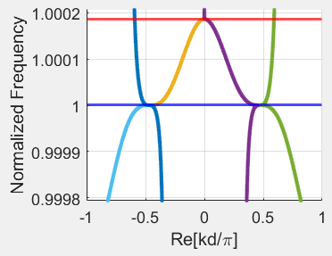
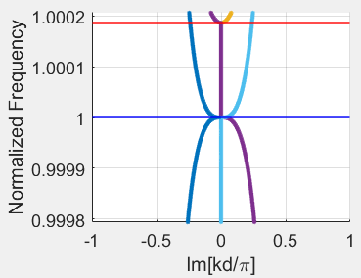
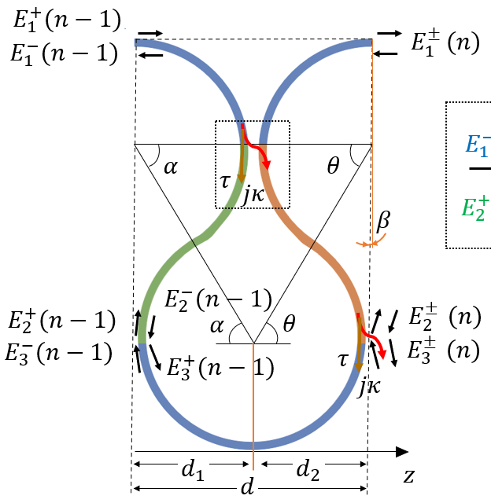
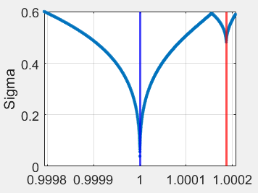

RBE-SIP distance
Blue line: SIP frequency
Red line: RBE frequency
$f_{r}=193.576$ THz
$f_{s}=193.54$ THz
$Δω=2π\left(f_{r}−f_{s}\right)=0.22689\frac{rad}{ps}$
$Δf=\left(f_{r}−f_{s}\right)=36 GHz$
Parameters SIP ASOW
$κ_{s}= 0.498$
$R_{s} = 10e−6;$
$α= 1.15$
$α′= 0.98$
I have slides on how to tweak these values

Slide 4

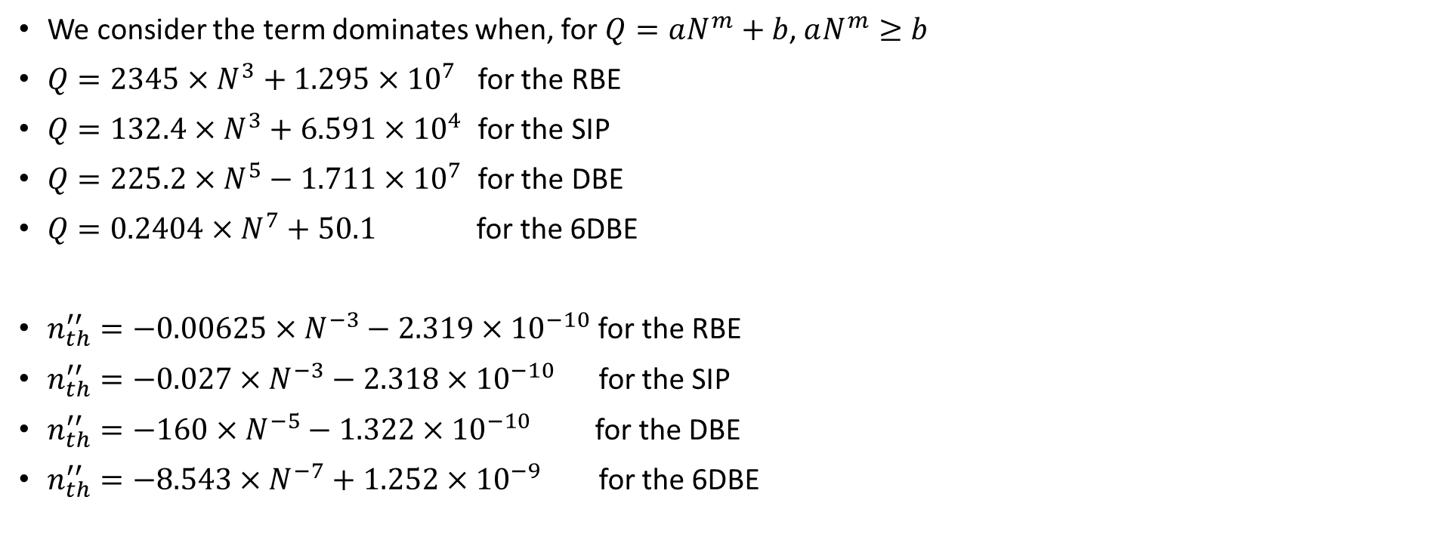

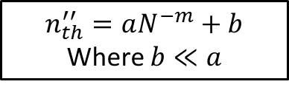






When does the $aN^{m}$ term become dominant in the fittings?
We consider the term dominates when, for $Q=aN^{m}+b$, $aN^{m}≥b$
$Q=2345×N^{3}+1.295×{10}^{7}$ for the RBE
$Q=132.4×N^{3}+6.591×{10}^{4}$ for the SIP
$Q=225.2×N^{5}−1.711×{10}^{7}$ for the DBE
$Q=0.2404×N^{7}+50.1$ for the 6DBE
$n_{th}^{′′}=−0.00625×N^{−3}−2.319×{10}^{−10}$ for the RBE
$n_{th}^{′′}=−0.027×N^{−3}−2.318×{10}^{−10}$ for the SIP
$n_{th}^{′′}=−160×N^{−5}−1.322×{10}^{−10}$ for the DBE
$n_{th}^{′′}=−8.543×N^{−7}+1.252×{10}^{−9}$ for the 6DBE
Dominant for $N>18$
Dominant for $N>8$
Dominant for $N>1$0
Dominant for $N>2$
Dominant for $N>1$
Dominant for $N>1$
$$n_{th}^{′′}=aN^{−m}+b$$
Where $b≪a$
Dominant for $N>1$
Dominant for $N>1$
These are good results

Slide 5
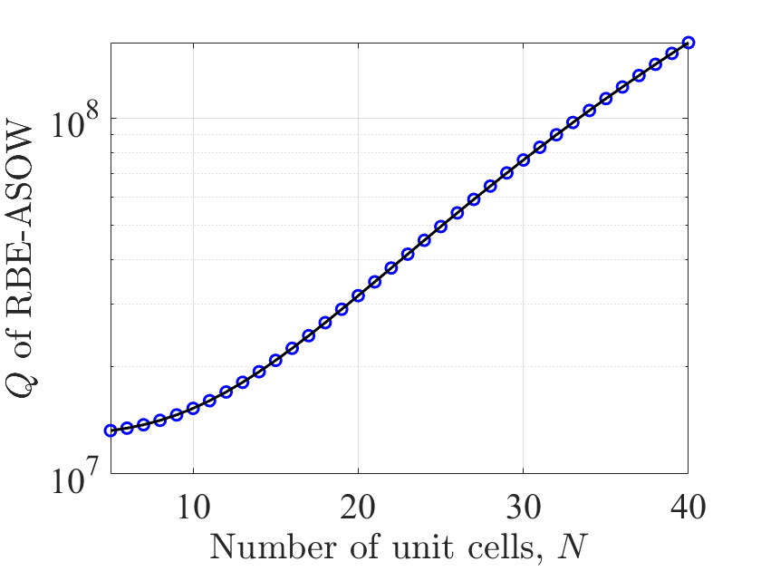
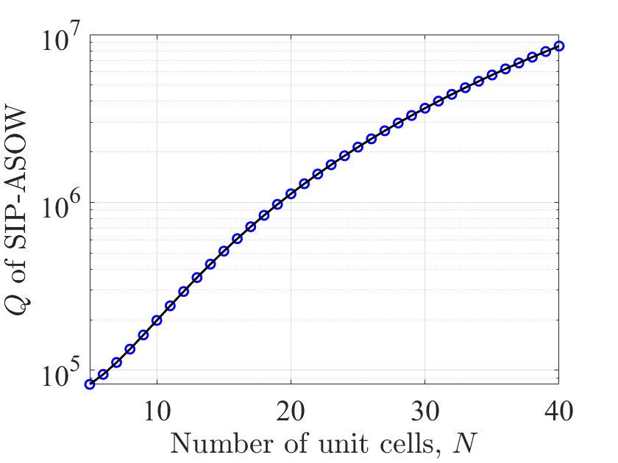
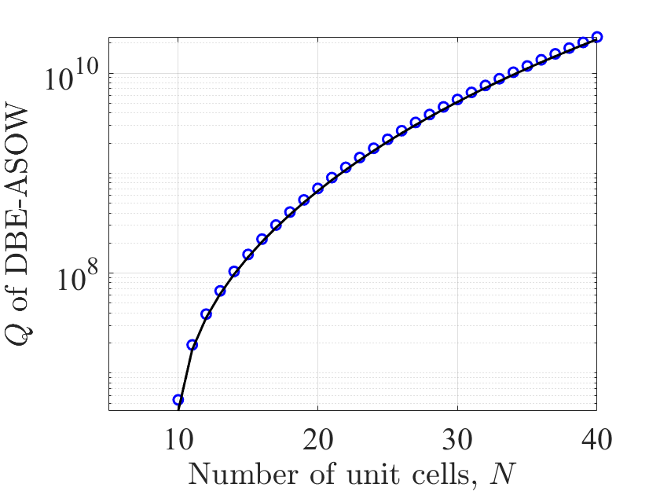
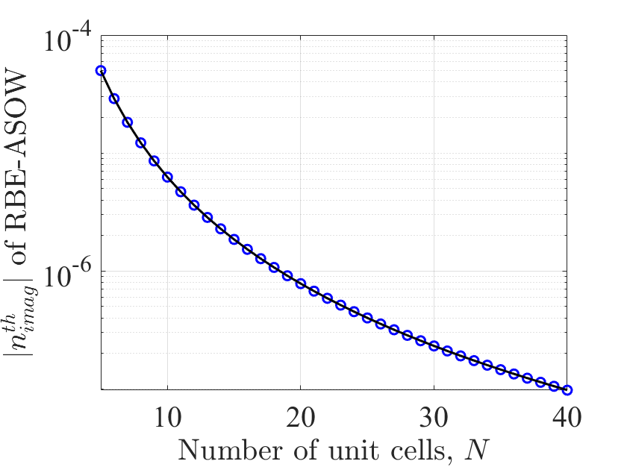
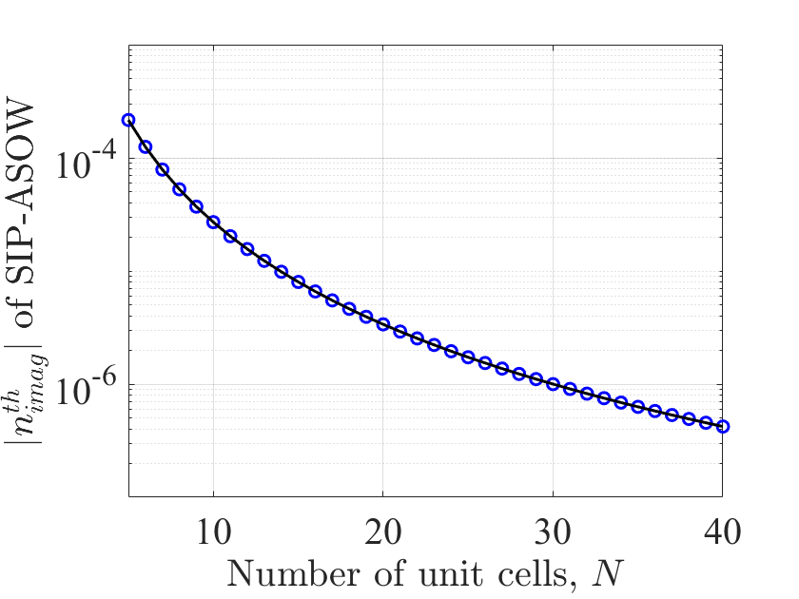
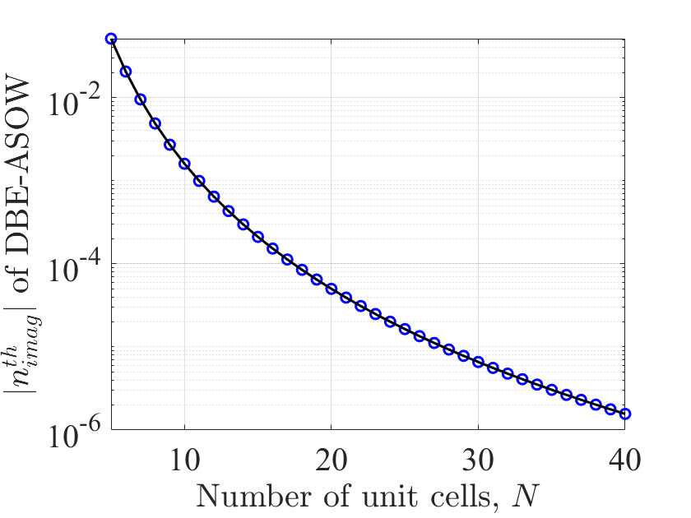
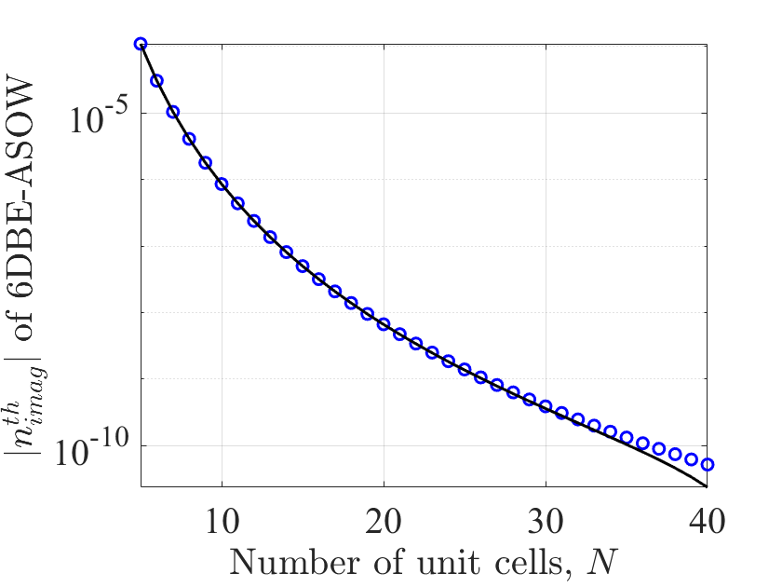


Just how good are these fittings?
RBE
SIP
DBE
6DBE
$Q=225.2×N^{5}−1.711×{10}^{7}$
$$Q=132.4×N^{3}+6.591×{10}^{4}$$
$$Q=2345×N^{3}+1.295×{10}^{7}$$
$$n_{th}^{′′}=−160×N^{−5}−1.322×{10}^{−10}$$
$n_{th}^{′′}=−8.543×N^{−7}+1.252×{10}^{−9}$
$n_{th}^{′′}=−0.00625×N^{−3}−2.319×{10}^{−10}$
$n_{th}^{′′}=−0.027×N^{−3}−2.318×{10}^{−10}$
I must improve the 6DBE fittings

Slide 6
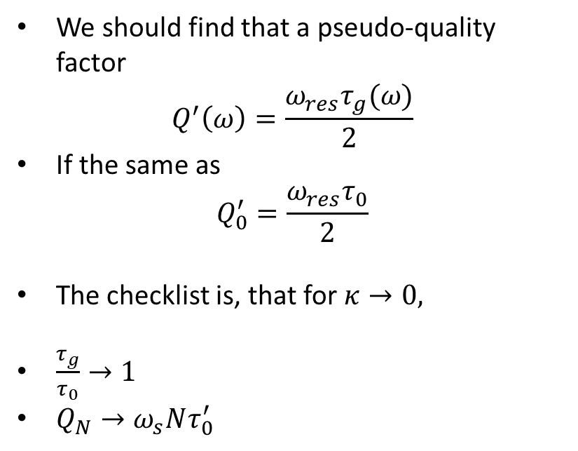
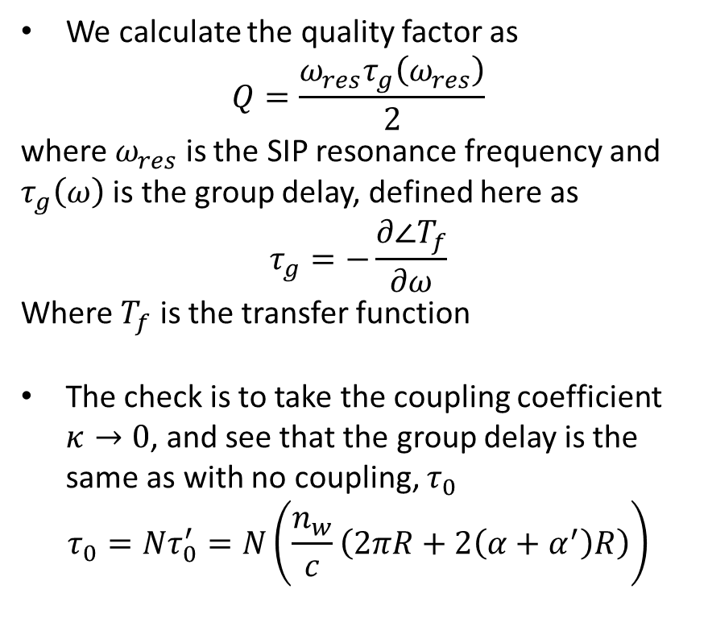
Quality factor check
We calculate the quality factor as
$$Q=\frac{ω_{res}τ_{g}\left(ω_{res}\right)}{2}$$
where $ω_{res}$ is the SIP resonance frequency and $τ_{g}\left(ω\right)$ is the group delay, defined here as
$$τ_{g}=−\frac{∂∠T_{f}}{∂ω}$$
Where $T_{f}$ is the transfer function
The check is to take the coupling coefficient $κ→0$, and see that the group delay is the same as with no coupling, $τ_{0}$
$$τ_{0}=Nτ_{0}^{′}=N\left(\frac{n_{w}}{c}\left(2πR+2\left(α+α^{′}\right)R\right)\right)$$
We should find that a pseudo-quality factor
$$Q^{′}\left(ω\right)=\frac{ω_{res}τ_{g}(ω)}{2}$$
If the same as
$$Q_{0}^{′}=\frac{ω_{res}τ_{0}}{2}$$
The checklist is, that for $κ→0,$
$\frac{τ_{g}}{τ_{0}}→1$
$Q_{N}→ω_{s}Nτ_{0}^{′}$
Now let’s check

Slide 7
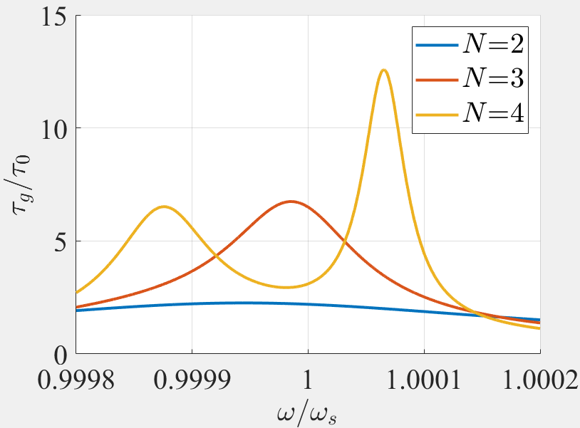
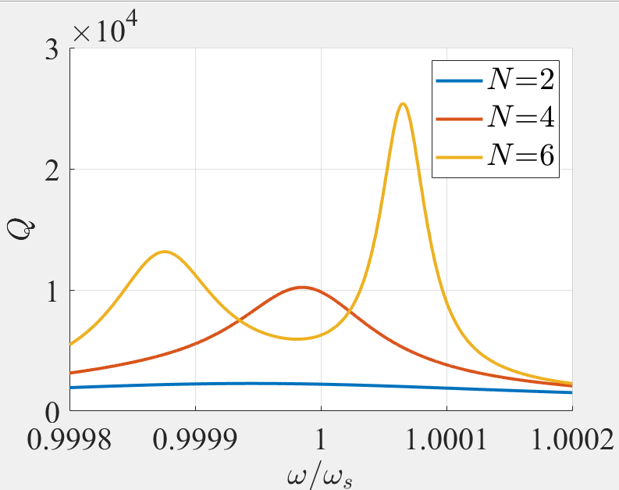
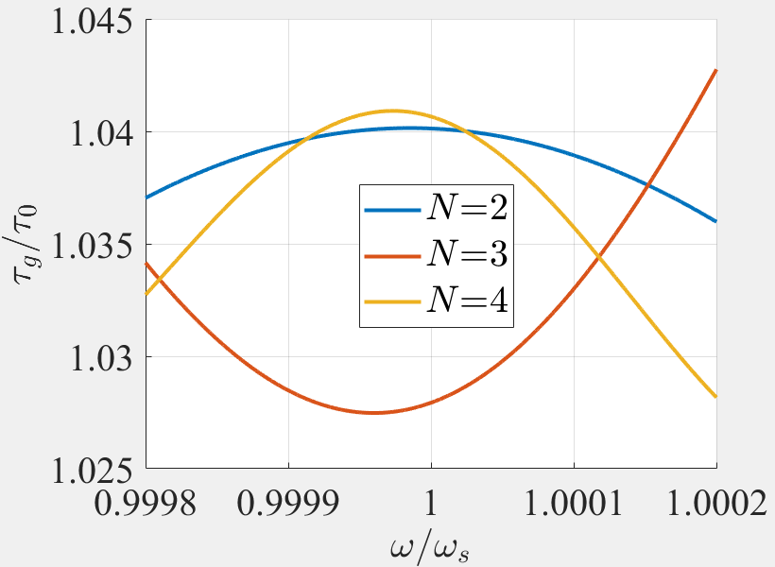
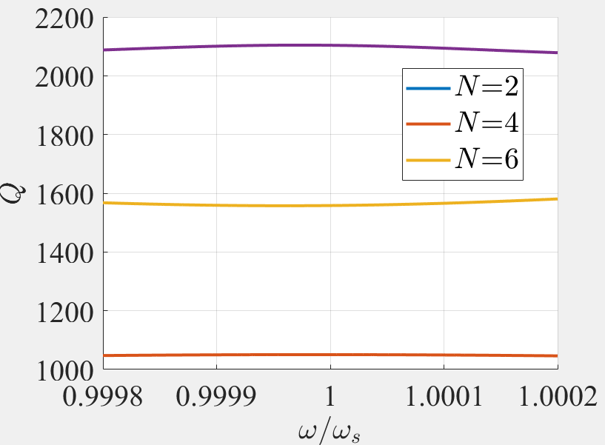


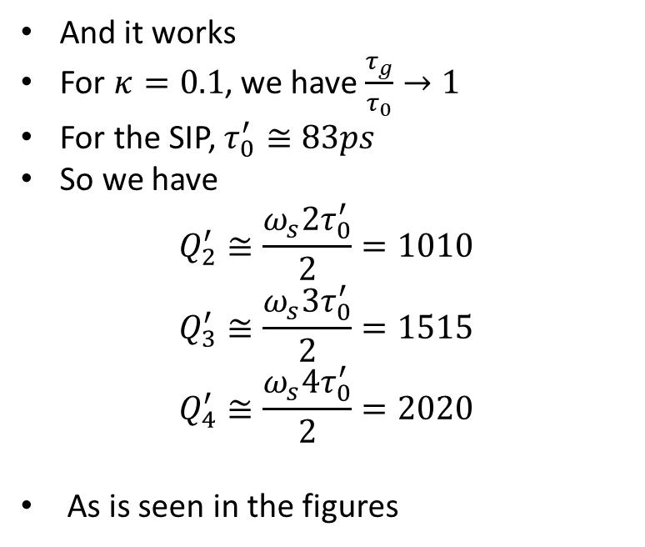
Quality factor check
And it works
For $κ=0.1$, we have $\frac{τ_{g}}{τ_{0}}→1$
For the SIP, $τ_{0}^{′}≅83ps$
So we have
$$Q_{2}^{′}≅\frac{ω_{s}2τ_{0}^{′}}{2}=1010$$
$$Q_{3}^{′}≅\frac{ω_{s}3τ_{0}^{′}}{2}=1515$$
$$Q_{4}^{′}≅\frac{ω_{s}4τ_{0}^{′}}{2}=2020$$
As is seen in the figures
$$κ=κ_s$$
$$κ=0.1$$
I believe this code to be reliable

Slide 8
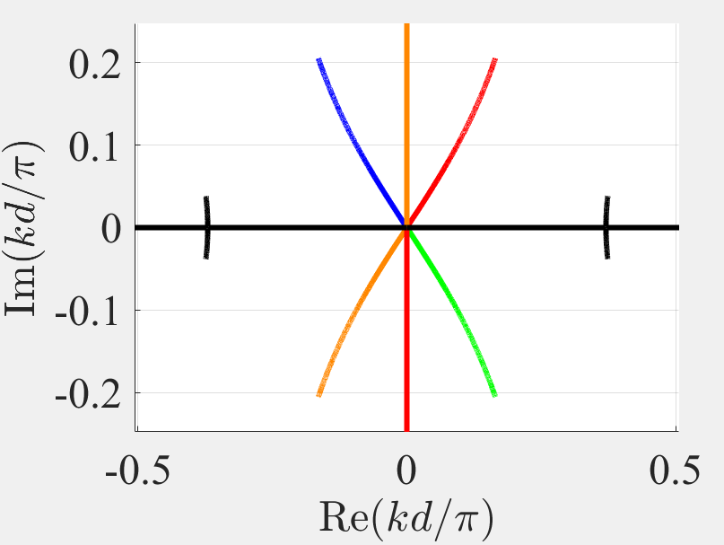
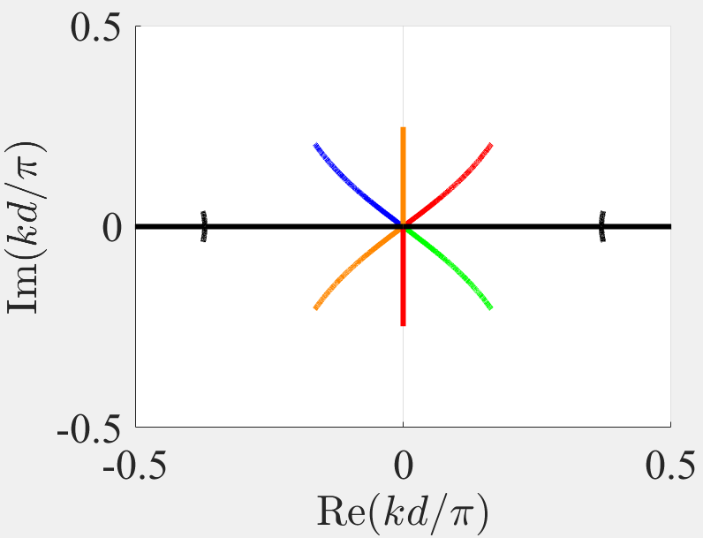
DBE dispersion diagram check
Checking in to make sure the dispersion diagram for the lossless DBE has $90º$ between eigenmodes
Nate’s save
Updated
Checks out

Slide 9
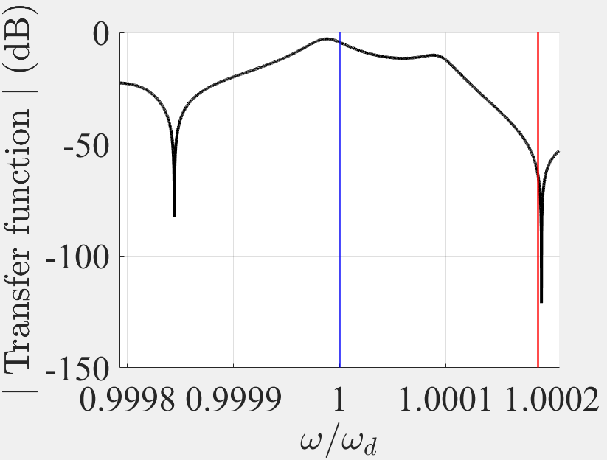
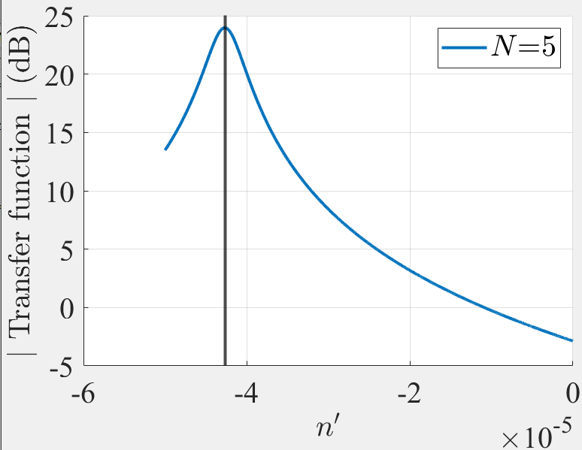
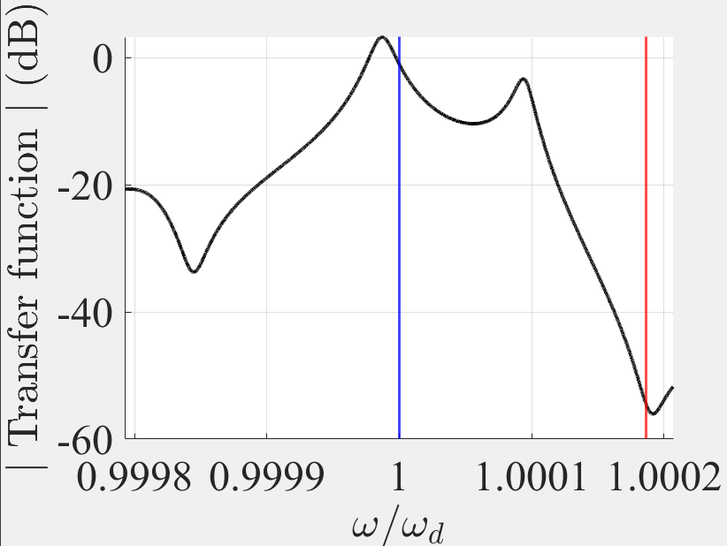
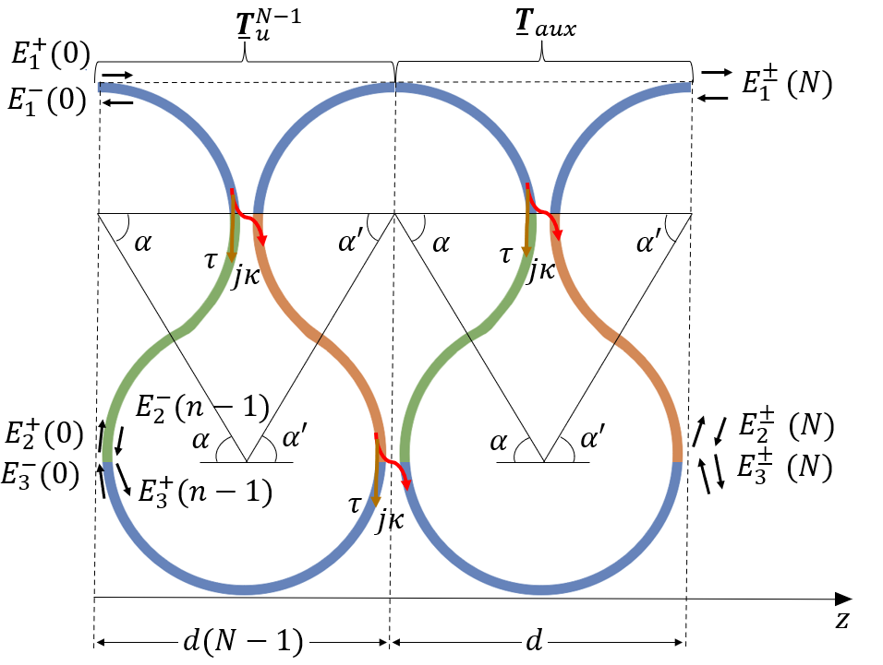
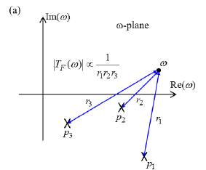


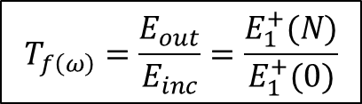
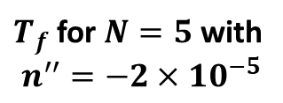
What peaks first, RBE of SIP?
Gainless $T_{f}$ for $N=5$
$n_{th}^{′′}=−4.28×{10}^{−5}$ for $N=5$
$T_{f}$ for $N=5$ with
$n^{′′}=−2×10^{−5}$
Blue line: SIP frequency
Red line: RBE frequency
$$T_{f\left(ω\right)}=\frac{E_{out}}{E_{inc}}=\frac{E_{1}^{+}(N)}{E_{1}^{+}(0)}$$
SIP has closer poles to the real axis than the RBE

Slide 10
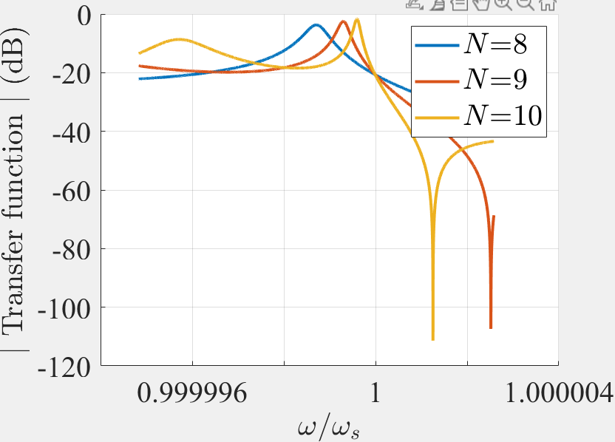
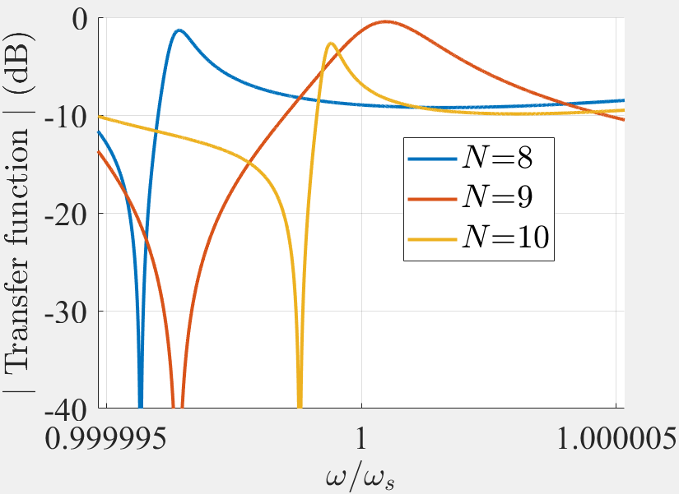
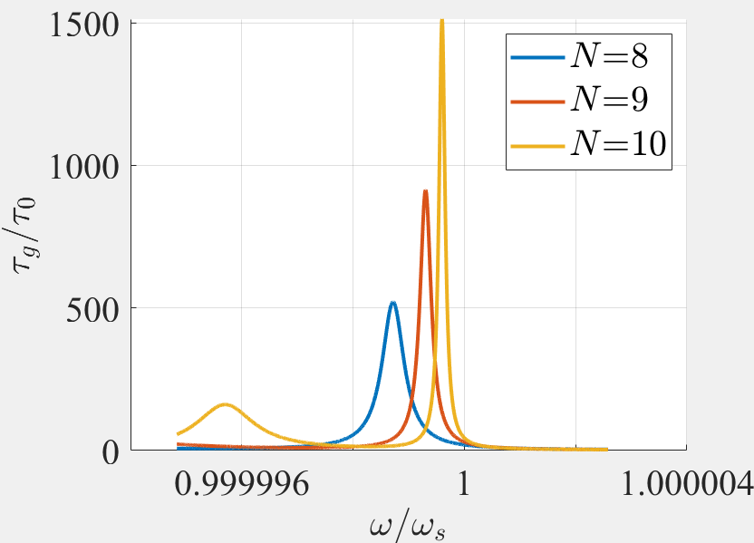
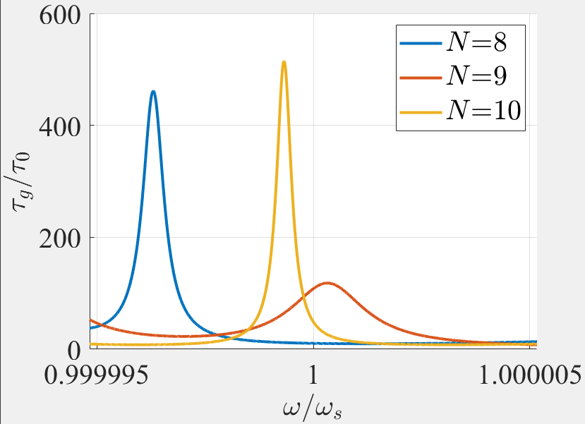
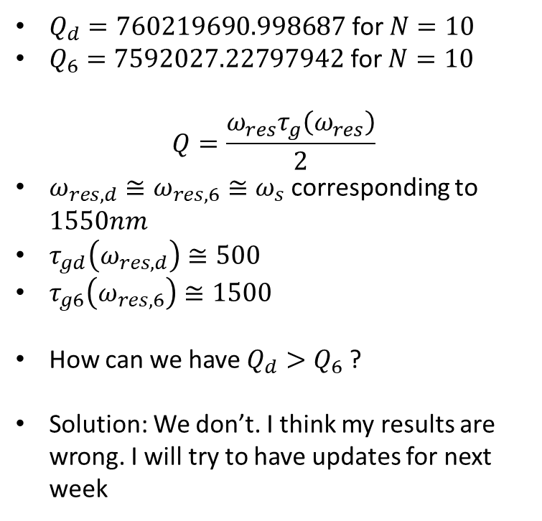
Why is $Q_{6DBE}<Q_{DBE}$ for small $N$?
6DBE
DBE
$Q_{d}=760219690.998687$ for $N=10$
$Q_{6}=7592027.22797942$ for $N=10$
$$Q=\frac{ω_{res}τ_{g}\left(ω_{res}\right)}{2}$$
$ω_{res,d}≅ω_{res,6}≅ω_{s}$ corresponding to $1550nm$
$τ_{gd}\left(ω_{res,d}\right)≅500$
$τ_{g6}\left(ω_{res,6}\right)≅1500$
How can we have $Q_{d}>Q_{6}$ ?
Solution: We don’t. I think my results are wrong. I will try to have updates for next week
☹

Slide 11
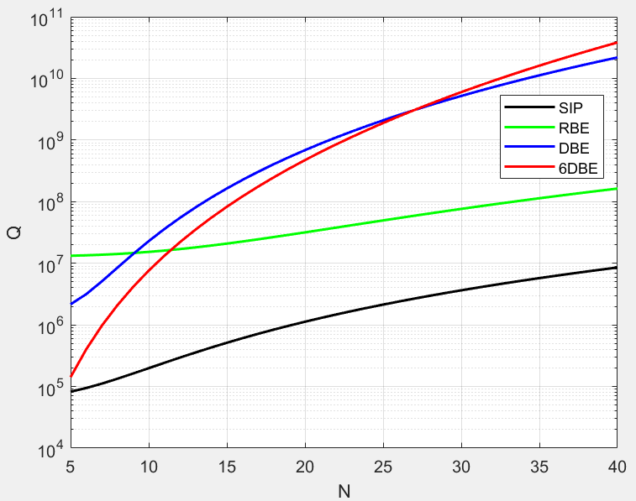
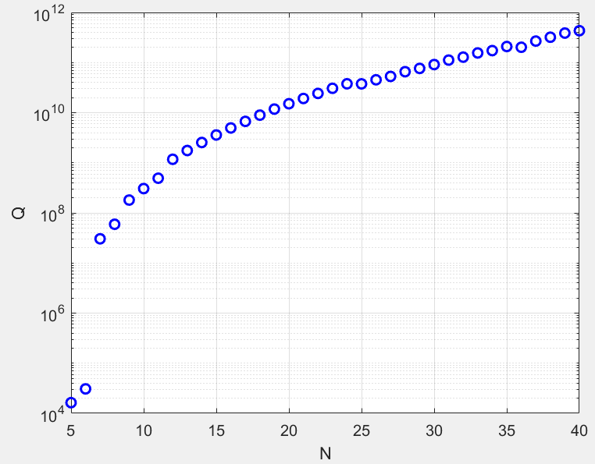
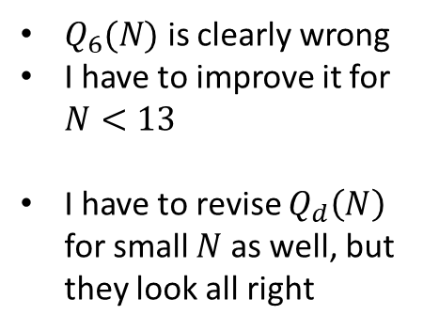
Why is $Q_{6DBE}<Q_{DBE}$ for small $N$? Raw data:
6DBE
DBE
$Q_{6}(N)$ is clearly wrong
I have to improve it for $N<13$
I have to revise $Q_{d}\left(N\right)$ for small $N$as well, but they look all right
$Q_{6}\left(N\right)$ is wrong. $Q_{d}(N)$ might be

Slide 12
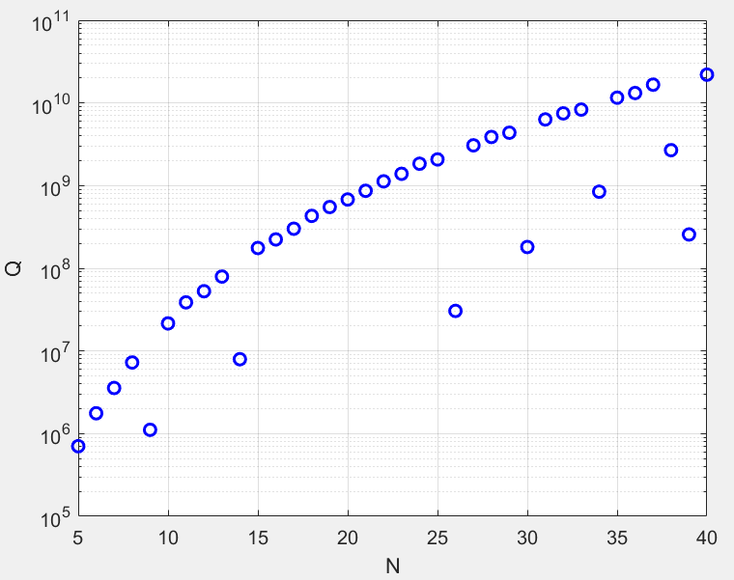
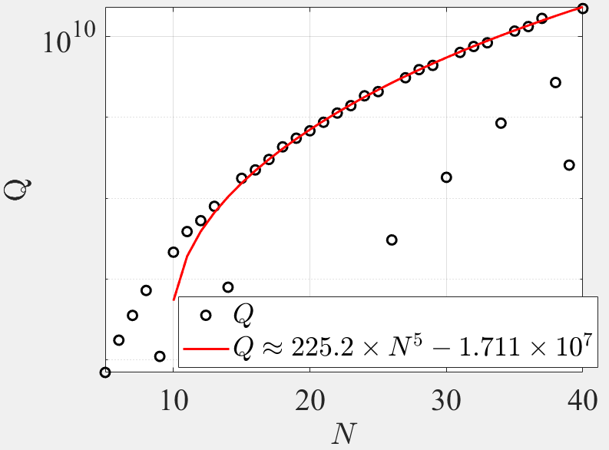
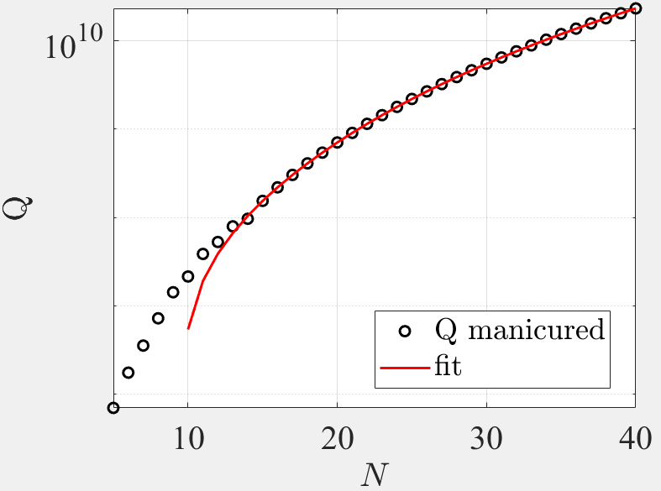
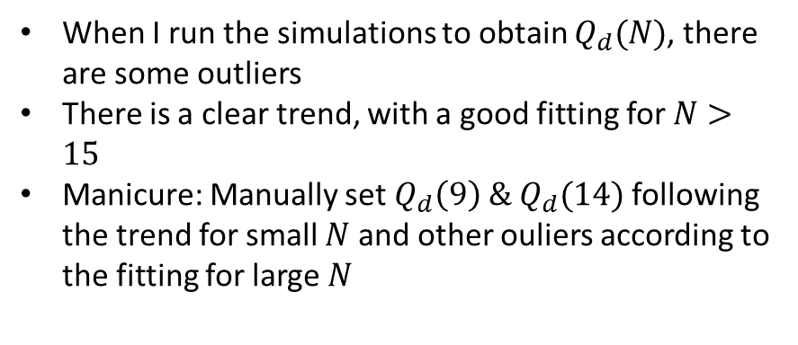
$$Q_{d}\left(N\right)?$$
When I run the simulations to obtain $Q_{d}(N)$, there are some outliers
There is a clear trend, with a good fitting for $N>15$
Manicure: Manually set $Q_{d}\left(9\right) \& Q_{d}(14)$ following the trend for small $N$ and other ouliers according to the fitting for large $N$
I think $Q_{d}(N)$ is good

Slide 13
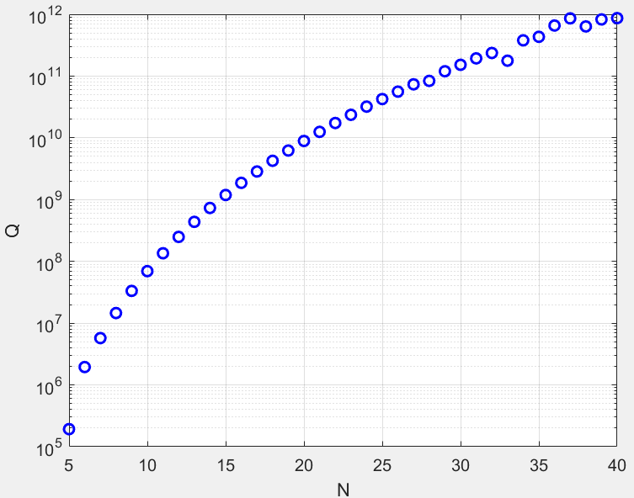
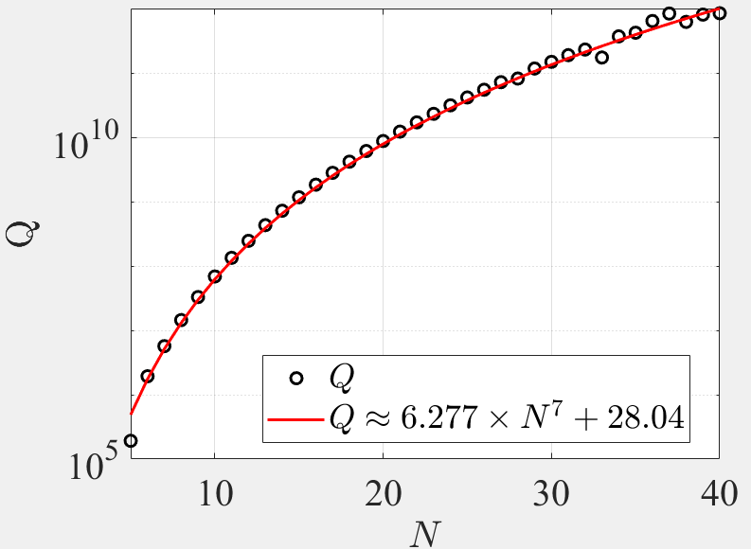
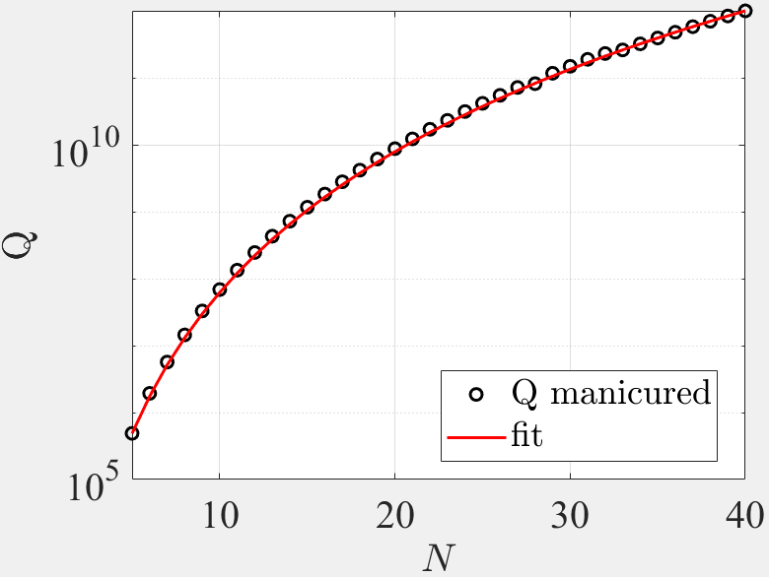
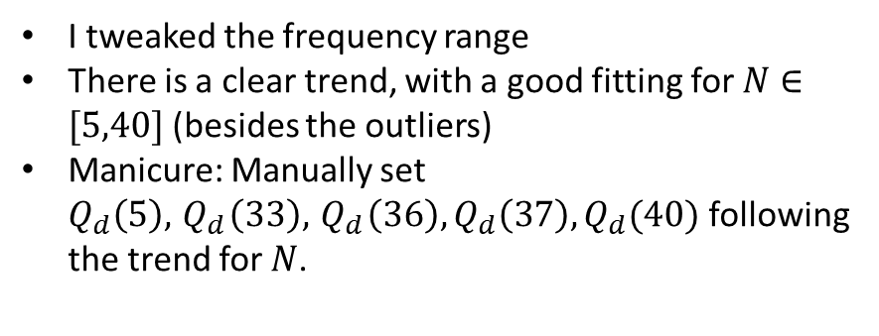
$$Q_{6}\left(N\right)?$$
I tweaked the frequency range
There is a clear trend, with a good fitting for $N∈[5,40]$ (besides the outliers)
Manicure: Manually set $Q_{d}\left(5\right), { Q}_{d}\left(33\right),{ Q}_{d}\left(36\right),Q_{d}\left(37\right),Q_{d}(40)$ following the trend for $N$.
There is a clear trend with some outliers

Slide 14
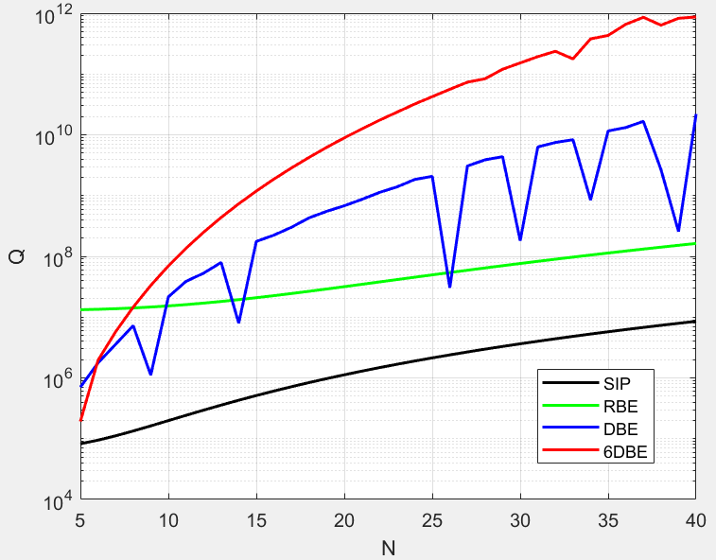
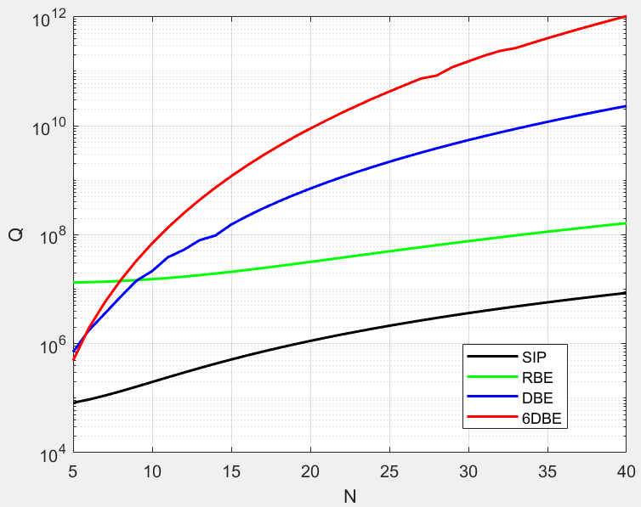
What is the end result?
Last week’s
Unmanicured data
Manicured data
Thank you for asking me to follow-up on it

Slide 15
SIP-RBE distance

Slide 16
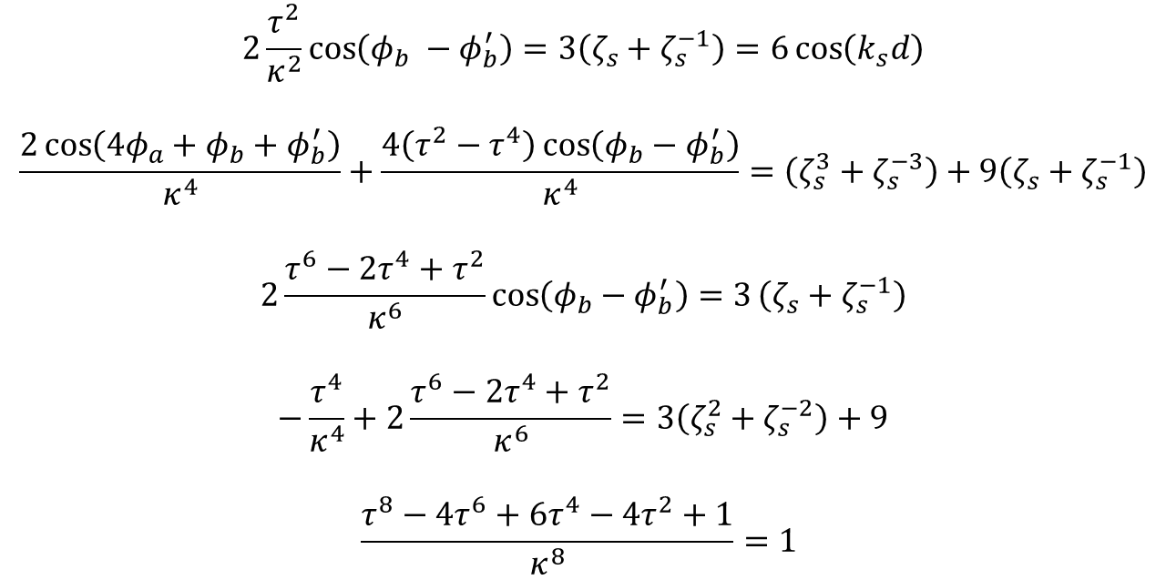
Necessary but not sufficient conditions to have SIP in ASOW
At the SIP frequency $ω_{s}$, we have the following five necessary conditions
$$2\frac{τ^{2}}{κ^{2}}\cos\left(φ_{b} −φ_{b}^{′}\right)=3\left(ζ_{s}+ζ_{s}^{−1}\right)=6\cos\left(k_{s}d\right)$$
$$\frac{2\cos\left(4φ_{a}+φ_{b}+φ_{b}^{′}\right)}{κ^{4}}+\frac{4\left(τ^{2}−τ^{4}\right)\cos\left(φ_{b}−φ_{b}^{′}\right)}{κ^{4}}=\left(ζ_{s}^{3}+ζ_{s}^{−3}\right)+9\left(ζ_{s}+ζ_{s}^{−1}\right)$$
$$2\frac{τ^{6}−2τ^{4}+τ^{2}}{κ^{6}}\cos\left(φ_{b}−φ_{b}^{′}\right)=3\left(ζ_{s}+ζ_{s}^{−1}\right)$$
$$−\frac{τ^{4}}{κ^{4}}+2\frac{τ^{6}−2τ^{4}+τ^{2}}{κ^{6}}=3\left(ζ_{s}^{2}+ζ_{s}^{−2}\right)+9$$
$$\frac{τ^{8}−4τ^{6}+6τ^{4}−4τ^{2}+1}{κ^{8}}=1$$
(1)
(2)
(3)
(4)
(5)
Using the lossless condition $τ^{2}+κ^{2}=1$, we find that the left hand side first and third are equivalent. The fifth one is equivalent to the lossless condition and the fourth one determines $k_{s}d$ from the coupling coefficient $κ$.

Slide 17



SIP solutions
Solving the system of equations, we get
$$k_{s}d=\frac{1}{2}\operatorname{acos}\left(\frac{1}{6}\left(−\frac{τ^{4}}{κ^{4}}+2\frac{τ^{6}−2τ^{4}+τ^{2}}{κ^{6}}−9\right)\right)$$
$$β=α−α^{′}=\frac{1}{2Rnk_{0}}\operatorname{acos}\left(\frac{κ^{2}}{τ^{2}}3\cos\left(k_{s}d\right)\right)=\frac{1}{2Rnk_{0}}\operatorname{acos}\left(B\right)$$
$$γ=α+α^{′}=−π+ \frac{1}{2Rnk_{0}}\operatorname{acos}\left(κ^{4}\left(\cos\left(3k_{s}d\right)+9\cos\left(k_{s}d\right)\right)−2\left(τ^{2}−τ^{4}\right)\frac{κ^{2}}{τ^{2}}3\cos\left(k_{s}d\right)\right)$$
$$α=\frac{γ+β}{2} \\ α^{′}=\frac{γ−β}{2}$$
$$κ^{2}+τ^{2}=1$$
$$B=\frac{κ^{2}}{τ^{2}}3\cos\left(k_{s}d\right)$$
For a given $κ$, we can find $α,α^{′}$ to have an SIP

Slide 18



What if we use the $κ$ from the paper?
% Parameters SIP-ASOW in the paper:
$$κ_{s}= 0.498$$
$$R_{s} = 10e−6;$$
$$α= 1.15$$
$$α′= 0.98$$
$$β_{s}=0.172 \\ γ_{s}=−3.13 \\ \frac{k_{s}d}{π}=0.469$$
% From $κ=κ_{s}$, what angles do we get?
$$κ=0.498 →τ=0.867 →\frac{k_{s}d}{π}=0.469 →β=0.0077 →γ=−3.13→α=−1.56, α^{′}=−1.57$$
Using the same radius and coupling coefficient, we get different $β, α, α^{′}$ (they are negative)
We still get an SIP

Slide 19

Dispersion Diagram of the SIP found analytically
% Parameters SIP:
Freq_Center = 193.54;
CouplCoeff_k1 = 0.498;
Radius = 10e-6;
Alpha = -1.56;
Alpha_2 = -1.57;
The SIP we find is not the same as the one in the paper
The angles are negative, which does not make physical sense

Slide 20

Negative angles and different SIP:
We get different $β$ ($β_{s}$ is the one for the SIP of the paper)
$$β_{s}=0.172 rad \\ β=0.0077 rad$$
With the same $B=0.094$. How is that? We have
$$B=\frac{κ^{2}}{τ^{2}}3\cos\left(k_{s}d\right)=\cos\left(2Rnk_{0}β\right)$$
$$B=\frac{e^{j(2Rnk_{0}β)}+e^{−j(2Rnk_{0}β)}}{2}=\frac{e^{j(2Rnk_{0}β_{s})}+e^{−j(2Rnk_{0}β_{s})}}{2}$$
$$e^{j(2Rnk_{0}\left(β_{s}−β\right))}+e^{−j(2Rnk_{0}\left(β_{s}−β\right))}=0$$
This happens with these values because $2Rnk_{0}\left(β_{s}−β\right)=31.416=10π$. Fixing $α−α^{′}=β_{s}$, we still get negative angles
$$α = −1.48 rad$$
$$α′ = −1.65 rad$$
There is the same difference in both angles between those of our SIP and these ones
$$α_{s}−α=2.633 \\ α_{s}^{′}−α^{′}=2.633$$

Slide 21









Angles and SIP
After adding these difference, we recover the SIP of the paper
We will excite an SIP if the angles $α$, $α^{′}$ satisfy $α=α_{s}± \frac{m π}{2Rnk_{0}}=1.15rad±0.053πm$ $α^{′}=α_{s}^{′}± \frac{m π}{2Rnk_{0}}=0.98rad±0.053πm$
with $m$ an integer
Trying different values of $m$, we see that it is inversely proportional to the distance between the SIP and an RBE
$$m=1$$
$$m=100$$
$$m=200$$
$$m=300$$
Smaller angles increases the distance between the RBE and the SIP

Slide 22






Why?
In Scheuer, Weiss, The serpentine optical waveguide: Engineering the dispersion relations and the stopped light points, (2011), they define the FSR as the phase accumulated by propagation along the optical length of a unit cell
The equivalent definition for the ASOW, would be:
$Δf_{FSR}=\frac{c/n_{eff}}{2R\left(π+α+α^{′}\right)}$
Which is the distance between SIPs
For the SIP values,
$\frac{Δf_{FSR}}{f_{s}}=0.00622$
Smaller angles -> Bigger FSR -> More distance between EPDs
Using “realistic” angles, with $0.9 rad<α,α^{′}<1.15 rad$, it does not really make a difference
$$m=0$$
$$m=−5$$

Slide 23


Maximum realistic distance
What is the minimum angle we can have? The gap is given by
$$d=2R\left(2\cos\left(α\right)−1\right)$$
$d=0→α_{min}=\frac{π}{3}≅1.047$
Taking $α^{′}≈α_{min}$ and the corresponding $α$, we have
$f_{r}=193.575$ THz
$f_{s}=193.54$ THz
$Δω=\frac{7π}{100}=0.2199$
We could try another SIP and minimize its angles following
$$α=α_{s}+ \frac{m π}{2Rnk_{0}}>α_{min} \\ α^{′}=α_{s}^{′}+ \frac{m π}{2Rnk_{0}}>α_{min}$$
Maximum $Δω$
We can increase $Δω$ by the proper choice of $α, α^{′}$

Slide 24
Tarek’s insight
I also want to remember Tarek’s insight:
A small gap (strong coupling) will separate the SIP and the RBE
☺

Slide 25

Enforce $Q$ in DBE,RBE-ASOW

Slide 26







$Q$ for a FPC
How can we calculate the $Q$ for regular waveguide with loads?
$$Q=2πν_{0}\frac{U_{stored}}{\left|\frac{∂U}{∂t}\right|}$$
$(1−R_{l})(1−R_{r})$is the fraction of intensity that escapes the mirrors
$R_{l},R_{r}$ are the power reflectivity of the mirrors
$u_{fwd}≅u_{bkd}$ for high-$Q$ mirrors (same amount of energy is lost on both ends)
$$Z$$
$$U=A L\left(u_{fwd}+u_{bkd}\right)=2ALu_{fwd}$$
$$\frac{∂U}{∂t}=−\left(1−R_{l}\right)(1−R_{r})I_{fwd}A$$
$$I_{fwd}=v_{g}u_{fwd}=\frac{c}{n}u_{fwd}$$
$$Q=2πν_{0}\frac{2ALu_{fwd}}{\left(1−R_{l}\right)(1−R_{r})v_{g}u_{fwd}A}=\frac{4πnL}{λ\left(1−R_{l}\right)(1−R_{r})}$$
$Q$ for the FPC with mirrors

Slide 27





Mirror reflectivities
$R_{l}={\left|\frac{Z_{l}−Z_{c}}{Z_{l}+Z_{c}}\right|}^{2}$ Power reflectivity at the left end of the cavity
$R_{r}={\left|\frac{Z_{r}−Z_{c}}{Z_{r}+Z_{c}}\right|}^{2}$ Power reflectivity at the right end of the cavity
$$Z_{l}$$
$$Z_{c}$$
$$Z_{r}$$
How do we know $Z_{c}$?
Veysi obtains it from CST simulations. However, what is the impedance of the DBE-exhibiting cavity? Is it different than for a non-EPD cavity?
$Z_{0}=\sqrt{\frac{μ_{0}}{ε_{0}}}$
$Z_{c}=\sqrt{\frac{μ_{r}μ_{0}}{ε_{r}ε_{0}}}=\frac{Z_{0}}{n_{eff}}$
Assuming $μ_{r}=1$, a non-magnetic material (as is the case)
We choose $Z_{l}, Z_{r}$ to get specific $R_{l}, R_{r}$

Slide 28








Veysi: $Q_{RBE}=Q_{DBE}$ for the same $N$
Veysi obtains the same quality factor for the same waveguide lengths for the RBE, DBE, by adding a load at the input and at the output. But how does he calculate the $Q$ for a waveguide with EPD with loads?
$$Q=2πν_{0}\frac{U_{stored}}{\left|\frac{∂U}{∂t}\right|}$$
$(1−R_{l}R_{r})$ is the fraction of intensity that escapes the mirrors
$u_{fwd}≅u_{bkd}$ for high-$Q$ mirrors (same amount of energy is lost on both ends)
$$Z$$
$$U=A L_{eff}\left(u_{fwd}+u_{bkd}\right)=2AL_{eff}u_{fwd}$$
$$τ_{g}=\frac{L}{v_{g}}$$
$$v_{g}L_{eff}=Lc$$
$$\frac{∂U}{∂t}=−\left(1−R_{l}\right)(1−R_{r})I_{fwd}A$$
$$τ_{g}=\frac{L_{eff}}{c}$$
$$I_{fwd}=v_{g}u_{fwd}$$
$$Q=2πν_{0}\frac{2AL_{eff}u_{fwd}}{\left(1−R_{l}\right)(1−R_{r})v_{g}u_{fwd}A}=4πν_{0}\frac{L_{eff}}{\left(1−R_{l}\right)(1−R_{r})v_{g}}=\frac{4πL_{eff}^{2}}{\left(1−R_{l}\right)(1−R_{r})Lλ}$$
$Q$ for the RBE, DBE-ASOW with mirrors
The units check out

Slide 29
How can I check it is right?
I have been trying to come up with ways to check this. Any ideas?

