Slide 1
SIP laser in ASOW: Update

Slide 2

Goal
Previous week:
RBE-SIP distance
Quality factor corrections & code check
Objective for this week:
SIP-RBE lasing thresholds
Control $Q$ with mirrors
Finished so far:
SIP-RBE lasing thresholds
Enforce $Q$ with mirrors (in progress, need help)
Not done yet:
Enforce $Q$ with mirrors (in progress, need help)
☺

Slide 3
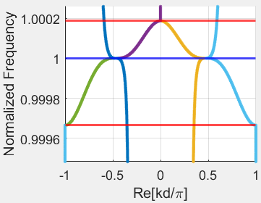
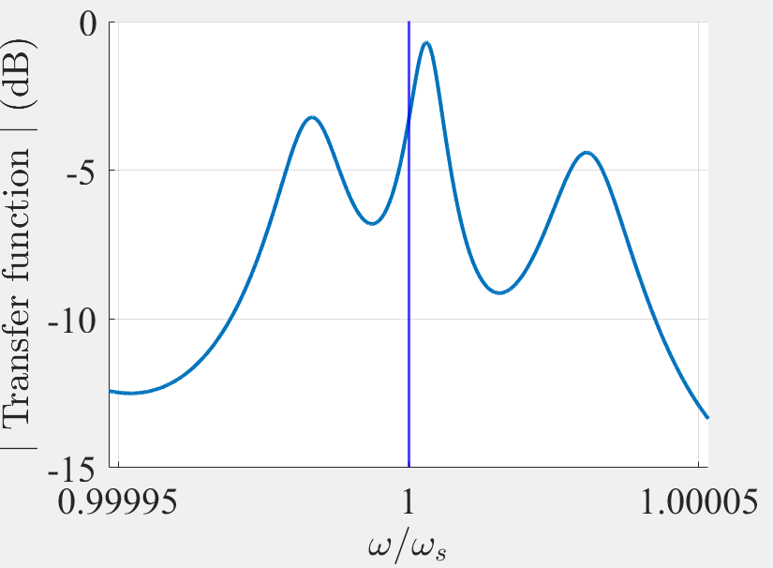
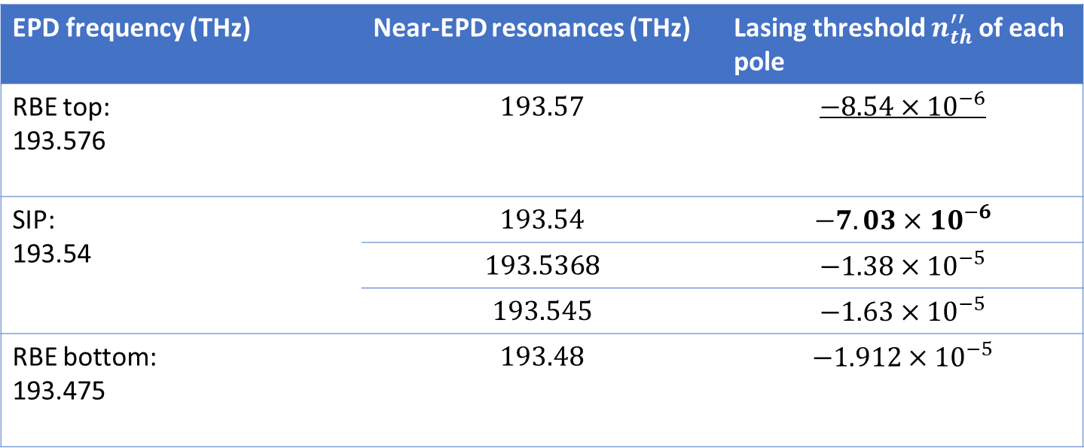

Resonances and lasing thresholds
We find the resonances and then the lasing threshold of each resonance for $N=10$
EPD frequency (THz) | Near-EPD resonances (THz) | Lasing threshold $n_{th}^{′′}$ of each pole
RBE top: 193.576 | $$193.57$$ | $$−8.54×{10}^{−6}$$
SIP: 193.54 | $$193.54$$ | $$−7.03×{10}^{−6}$$
 | $$193.5368$$ | $$−1.38×{10}^{−5}$$
 | $$193.545$$ | $$−1.63×{10}^{−5}$$
RBE bottom: 193.475 | $$193.48$$ | $$−1.912×{10}^{−5}$$
The dominance of the SIP resonance is in doubt

Slide 4
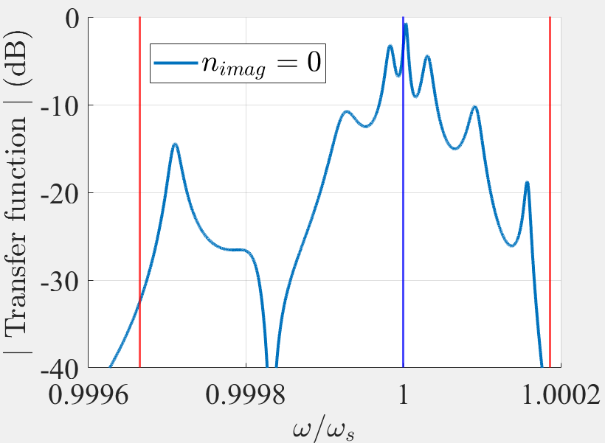
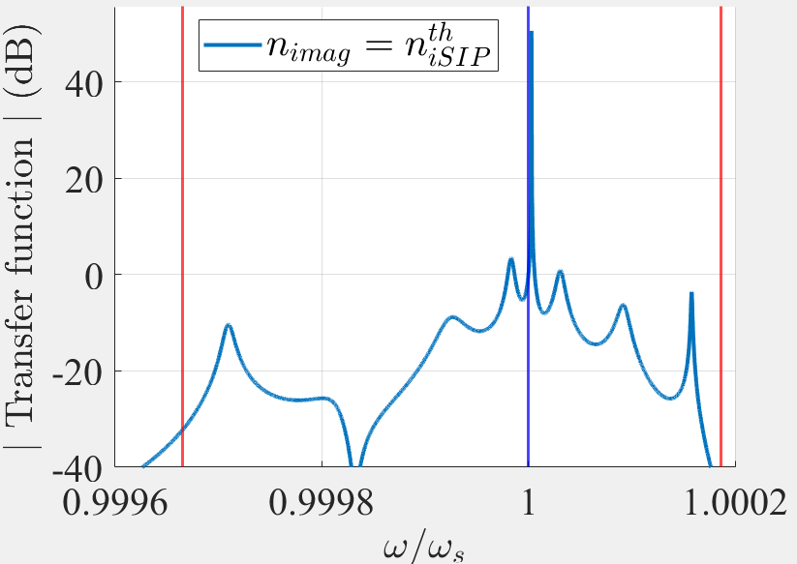
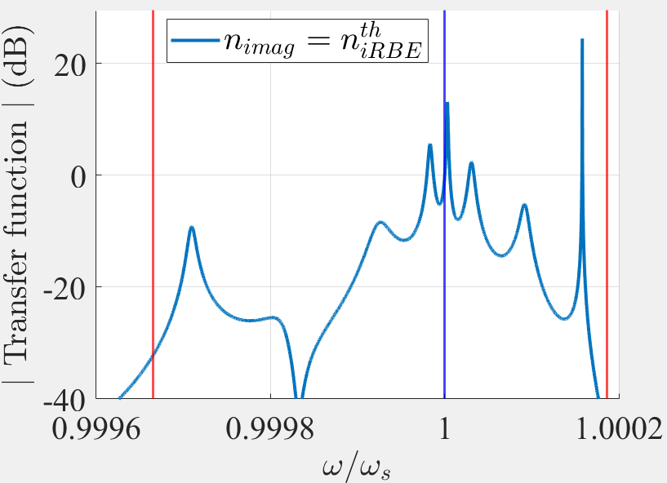







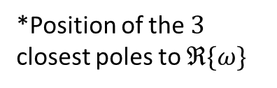
Resonances and lasing thresholds for $N=10$
$$n^{′′}=0$$
$$n^{′′}=n_{SIPth}^{′′}=\text{−7.031}\text{e}\text{−06}$$
$$n^{′′}=n_{RBEth}^{′′}=\text{−8.54}\text{e}\text{−06}$$
Marginally stable poles for increasing gain:
SIP resonance
RBE resonance
2nd SIP resonance (second resonance the closest to the SIP frequency)
$$ℑ\{ω\}$$
*Position of the $3$ closest poles to $ℜ\{ω\}$
$$x$$
$$ℜ\{ω\}$$
$$x$$
$$x$$
The second pole to become marginally stable is the RBE resonance

Slide 5
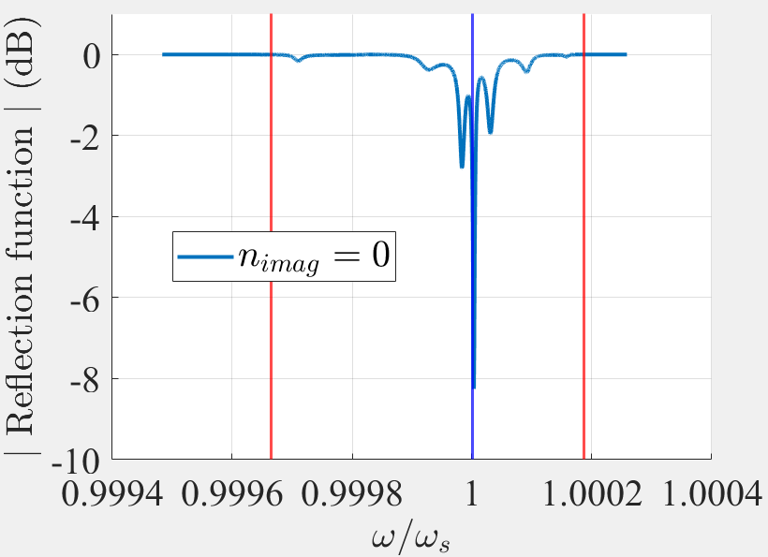
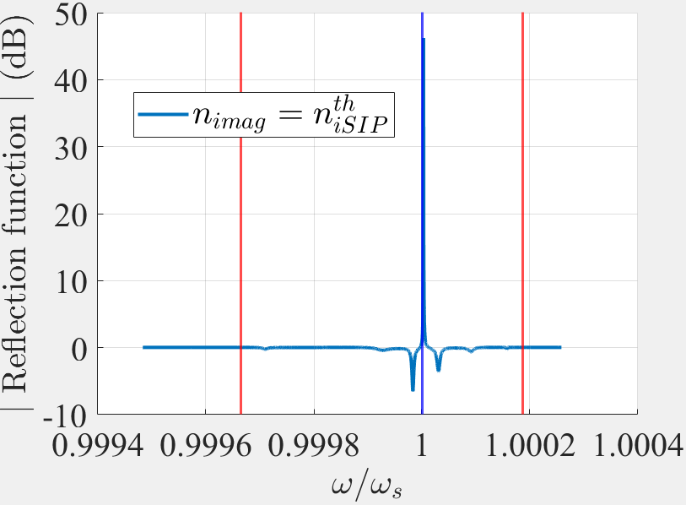
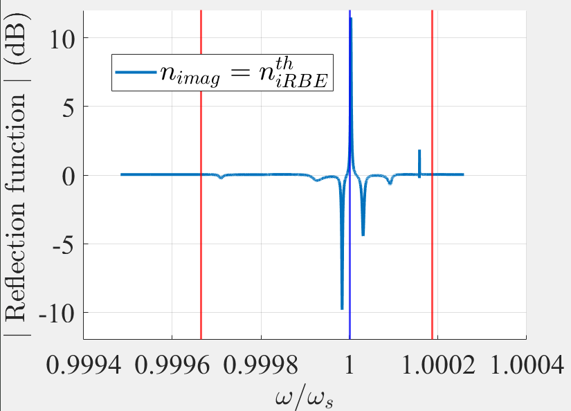





Resonances and lasing thresholds for $N=10$
$$n^{′′}=0$$
$$n^{′′}=n_{SIPth}^{′′}=\text{−7.031}×{10}^{−6}$$
$$n^{′′}=n_{RBEth}^{′′}=\text{−8.54}×{10}^{−6}$$
$${\left|T_{f}\right|}^{2}+{\left|R_{f}\right|}^{2}=1 ∀ω$$
$${\left|T_{f}\right|}^{2}+{\left|R_{f}\right|}^{2}=1.0075 ∀ω$$
$${\left|T_{f}\right|}^{2}+{\left|R_{f}\right|}^{2}=1.0091 ∀ω$$
Lossless condition
With gain
With more gain
Why isn’t there a peak for the RBE $R_{f}$?

Slide 6
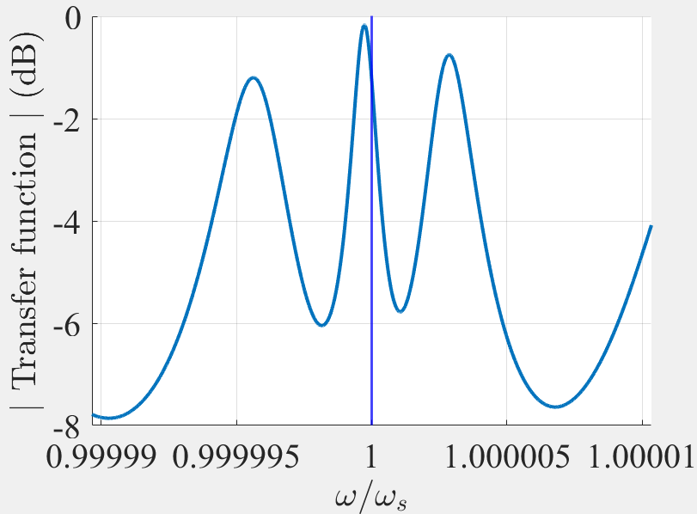
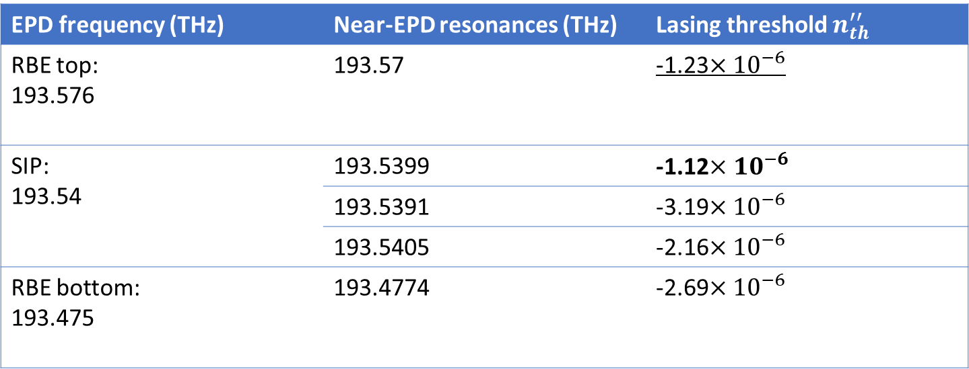

Longer waveguides
We find the resonances and then the lasing threshold of each resonance for $N=20$
EPD frequency (THz) | Near-EPD resonances (THz) | Lasing threshold $n_{th}^{′′}$
RBE top: 193.576 | 193.57 | -1.23$×{10}^{−6}$
SIP: 193.54 | 193.5399 | -1.12$×{10}^{−6}$
 | 193.5391 | -3.19$×{10}^{−6}$
 | 193.5405 | -2.16$×{10}^{−6}$
RBE bottom: 193.475 | 193.4774 | -2.69$×{10}^{−6}$
The dominance of the SIP resonance is in more doubt

Slide 7
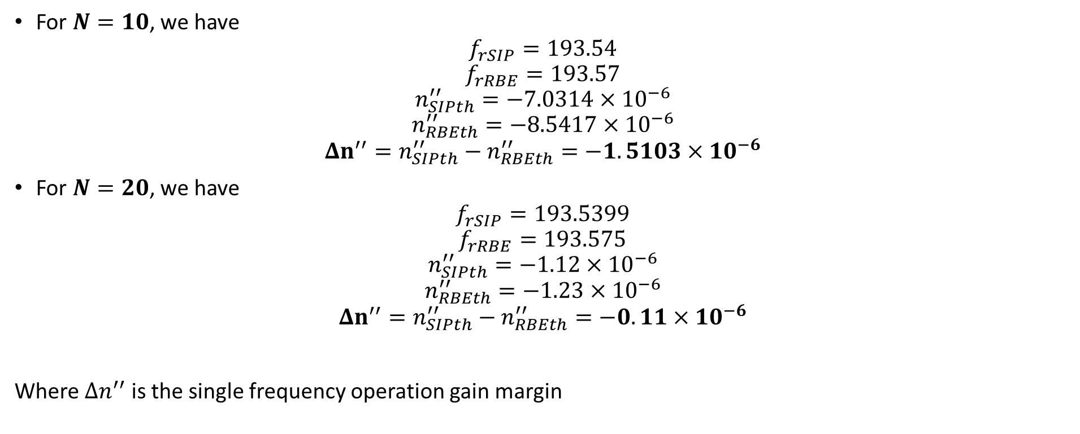
SIP resonance dominance and waveguide length
For $N=10$, we have
$$f_{rSIP}=\text{193.54}$$
$$f_{rRBE}=\text{193.57}$$
$$n_{SIPth}^{′′}=−\text{7.0314}×{10}^{−6}$$
$$n_{RBEth}^{′′}=−\text{8.5417}×{10}^{−6}$$
$$Δn^{′′}=n_{SIPth}^{′′}−n_{RBEth}^{′′}=−1.5103×{10}^{−6}$$
For $N=20$, we have
$$f_{rSIP}=\text{193.5399}$$
$$f_{rRBE}=\text{193.57}\text{5}$$
$$n_{SIPth}^{′′}=−\text{1.12}×{10}^{−6}$$
$$n_{RBEth}^{′′}=−\text{1.23}×{10}^{−6}$$
$$Δn^{′′}=n_{SIPth}^{′′}−n_{RBEth}^{′′}=−0.11×{10}^{−6}$$
Where $Δn^{′′}$ is the single frequency operation gain margin
$Δn′′$ decreases with increasing $N$

Slide 8
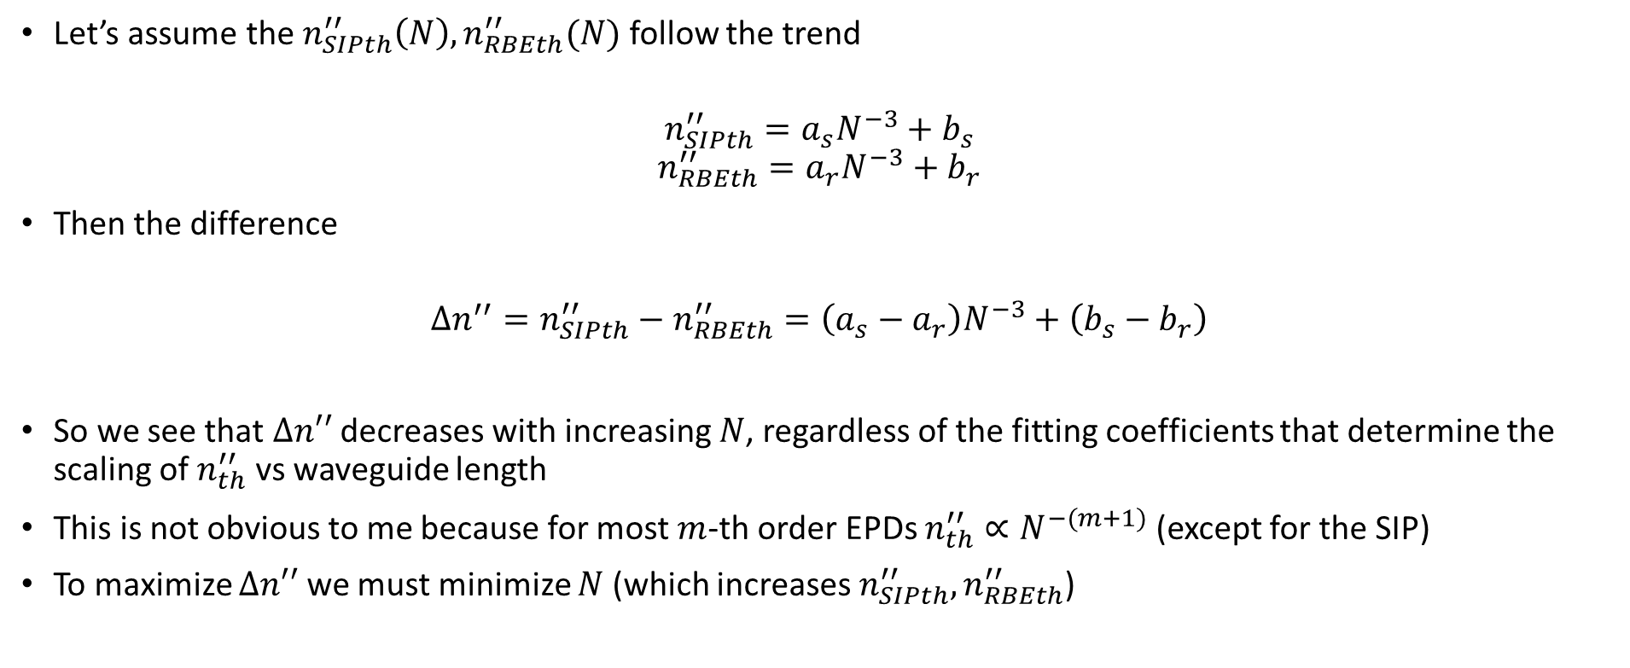
Why?
Let’s assume the $n_{SIPth}^{′′}\left(N\right), n_{RBEth}^{′′}(N)$ follow the trend
$$n_{SIPth}^{′′}=a_{s}N^{−3}+b_{s}$$
$$n_{RBEth}^{′′}=a_{r}N^{−3}+b_{r}$$
Then the difference
$$Δn^{′′}=n_{SIPth}^{′′}−n_{RBEth}^{′′}=\left(a_{s}−a_{r}\right)N^{−3}+\left(b_{s}−b_{r}\right)$$
So we see that $Δn′′$ decreases with increasing $N$, regardless of the fitting coefficients that determine the scaling of $n_{th}^{′′}$ vs waveguide length
This is not obvious to me because for most $m$-th order EPDs $n_{th}^{′′}∝N^{−(m+1)}$ (except for the SIP)
To maximize $Δn′′$ we must minimize $N$ (which increases $n_{SIPth}^{′′}, n_{RBEth}^{′′}$)
This occurs for all $Δn′′$ between an SIP and an RBE

Slide 9
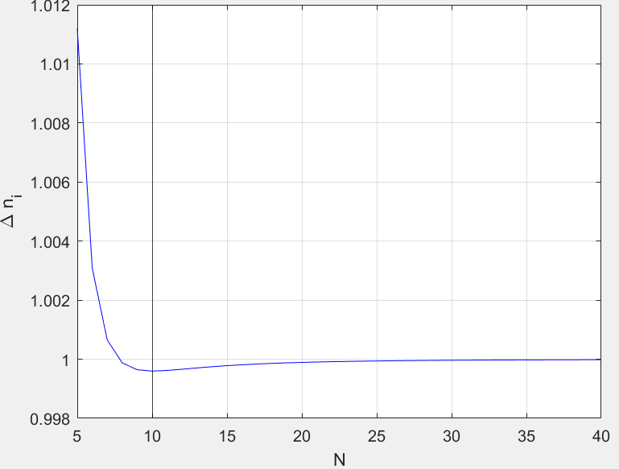
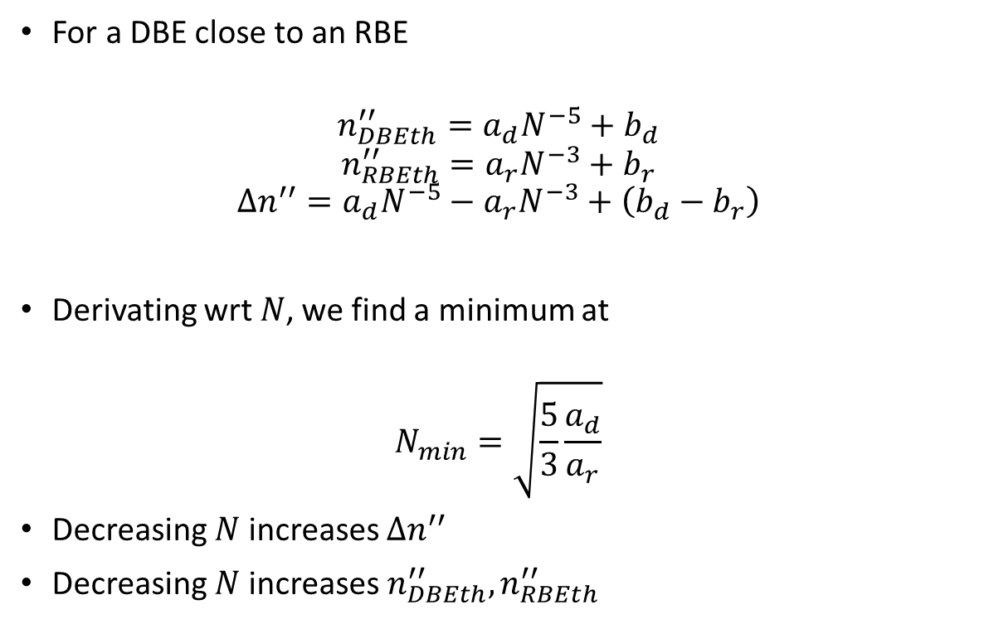

Other $Δn′′$
For a DBE close to an RBE
$$n_{DBEth}^{′′}=a_{d}N^{−5}+b_{d}$$
$$n_{RBEth}^{′′}=a_{r}N^{−3}+b_{r}$$
$$Δn^{′′}=a_{d}N^{−5}−a_{r}N^{−3}+\left(b_{d}−b_{r}\right)$$
Derivating wrt $N$, we find a minimum at
$$N_{min}=\sqrt{\frac{5}{3}\frac{a_{d}}{a_{r}}}$$
Decreasing $N$ increases $Δn^{′′}$
Decreasing $N$increases $n_{DBEth}^{′′}, n_{RBEth}^{′′}$
$Δn^{′′}$ vs $N$ with $a_{d}=60a_{r},$ $\left(b_{d}−b_{r}\right)=1,$so $N_{min}=10$
A nice little trinket of doubtful usefulness

Slide 10

Enforce $Q$ in DBE,RBE-ASOW

Slide 11
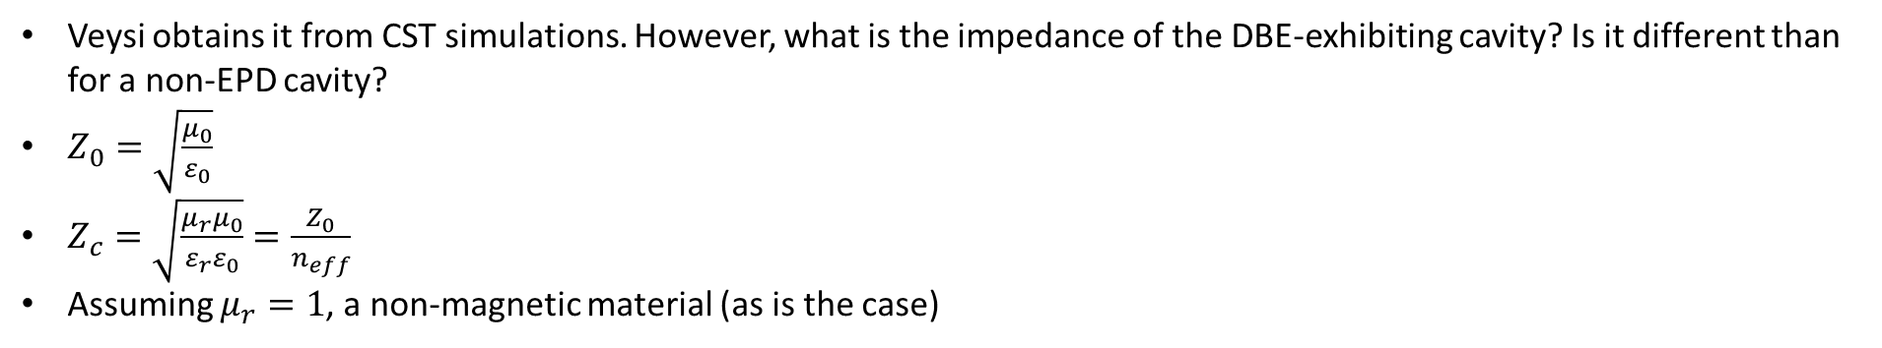

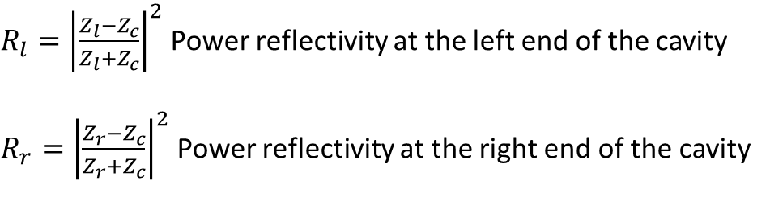


Mirror reflectivities
$R_{l}={\left|\frac{Z_{l}−Z_{c}}{Z_{l}+Z_{c}}\right|}^{2}$ Power reflectivity at the left end of the cavity
$R_{r}={\left|\frac{Z_{r}−Z_{c}}{Z_{r}+Z_{c}}\right|}^{2}$ Power reflectivity at the right end of the cavity
$$Z_{l}$$
$$Z_{c}$$
$$Z_{r}$$
How do we know $Z_{c}$?
Veysi obtains it from CST simulations. However, what is the impedance of the DBE-exhibiting cavity? Is it different than for a non-EPD cavity?
$Z_{0}=\sqrt{\frac{μ_{0}}{ε_{0}}}$
$Z_{c}=\sqrt{\frac{μ_{r}μ_{0}}{ε_{r}ε_{0}}}=\frac{Z_{0}}{n_{eff}}$
Assuming $μ_{r}=1$, a non-magnetic material (as is the case)
We choose $Z_{l}, Z_{r}$ to get specific $R_{l}, R_{r}$
*Veysi, Othman, Figotin, Capolino, DBE laser, Phys. Rev. B, 2018

Slide 12

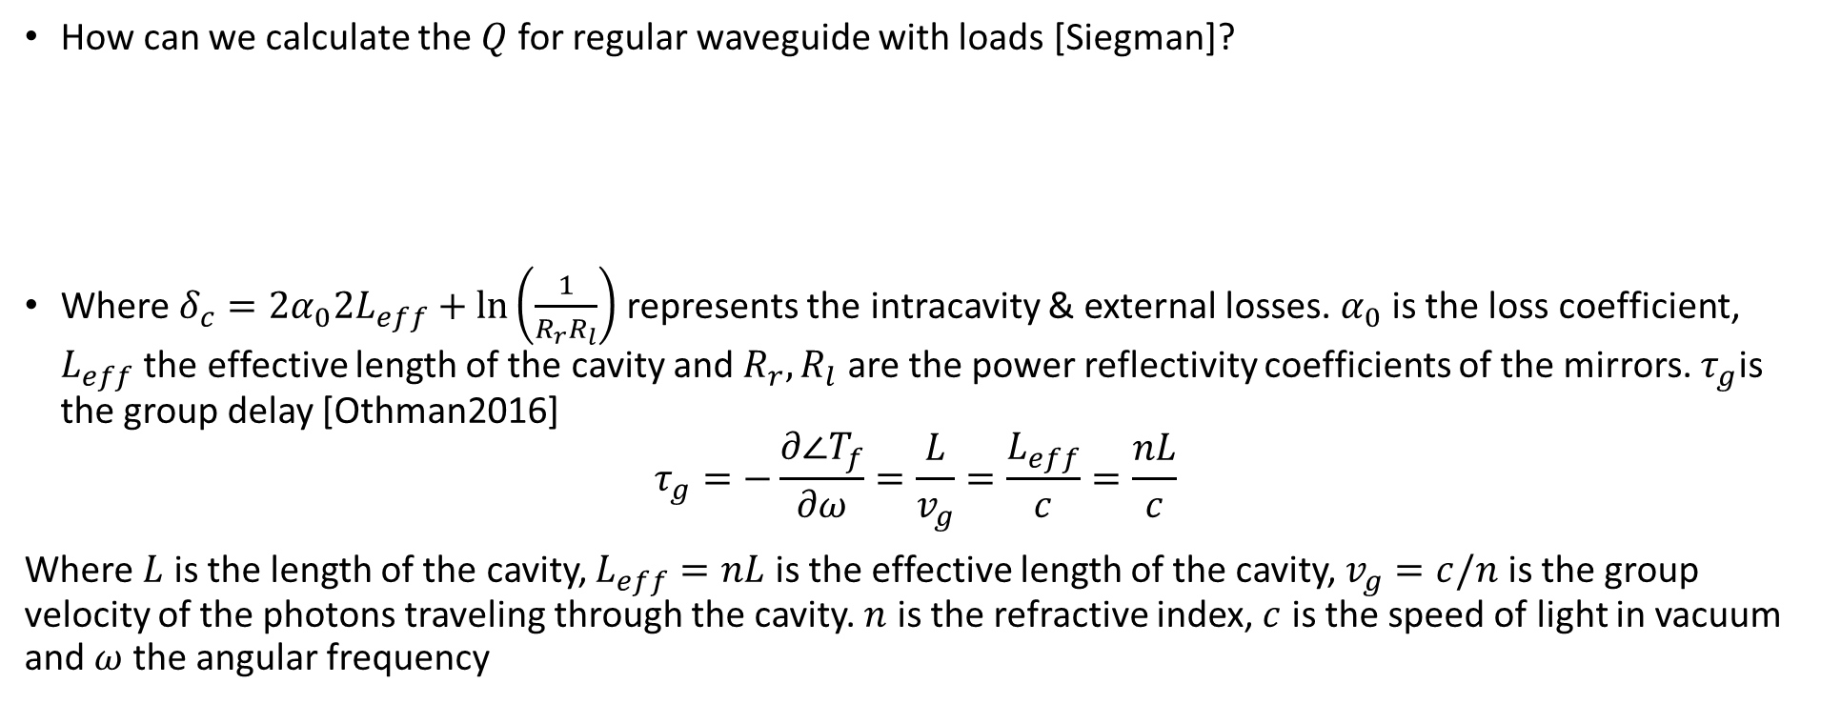



$Q$ for a FPC
How can we calculate the $Q$ for regular waveguide with loads [Siegman]?
Where $δ_{c}=2α_{0}2L_{eff}+\ln\left(\frac{1}{R_{r}R_{l}}\right)$ represents the intracavity & external losses. $α_{0}$ is the loss coefficient, $L_{eff}$ the effective length of the cavity and $R_{r},R_{l}$ are the power reflectivity coefficients of the mirrors. $τ_{g}$is the group delay [Othman2016]
$$τ_{g}=−\frac{∂∠T_{f}}{∂ω}=\frac{L}{v_{g}}=\frac{L_{eff}}{c}=\frac{nL}{c}$$
Where $L$ is the length of the cavity, $L_{eff}=nL$ is the effective length of the cavity, $v_{g}=c/n$ is the group velocity of the photons traveling through the cavity. $n$ is the refractive index, $c$ is the speed of light in vacuum and $ω$ the angular frequency
$$Q=\frac{2ω_{res}τ_{g}}{δ_{c}}$$
$$Z_{l}$$
$$Z_{c}$$
$$Z_{r}$$
$Q$ for the FPC with mirrors
* Siegman, Lasers, Univ. Science books, 1986
* Othman, Yazdi, Figotin, Capolino, Giant gain enhancement in photonic crystals with a DBE, Phys. Rev. B, 2016

Slide 13
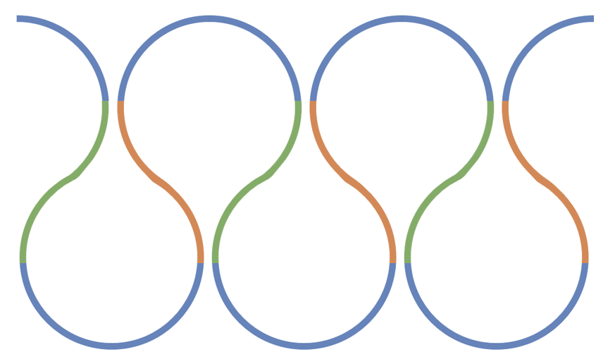



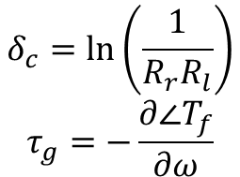

Veysi: $Q_{RBE}=Q_{DBE}$ for the same $N$
Veysi obtains the same quality factor for the same waveguide lengths for the RBE, DBE, by adding a load at the input and at the output. But how does he calculate the $Q$ for a waveguide with EPD with loads?
$$Z_{l}$$
$$Z_{r}$$
$$Q=\frac{2ω_{res}τ_{g}}{δ_{c}}$$
$$Z_{c}$$
$$δ_{c}=\ln\left(\frac{1}{R_{r}R_{l}}\right)$$
$$τ_{g}=−\frac{∂∠T_{f}}{∂ω}$$
*We consider the ASOW lossless
$Q$ for the RBE, DBE-ASOW with mirrors
The units check out

Slide 14
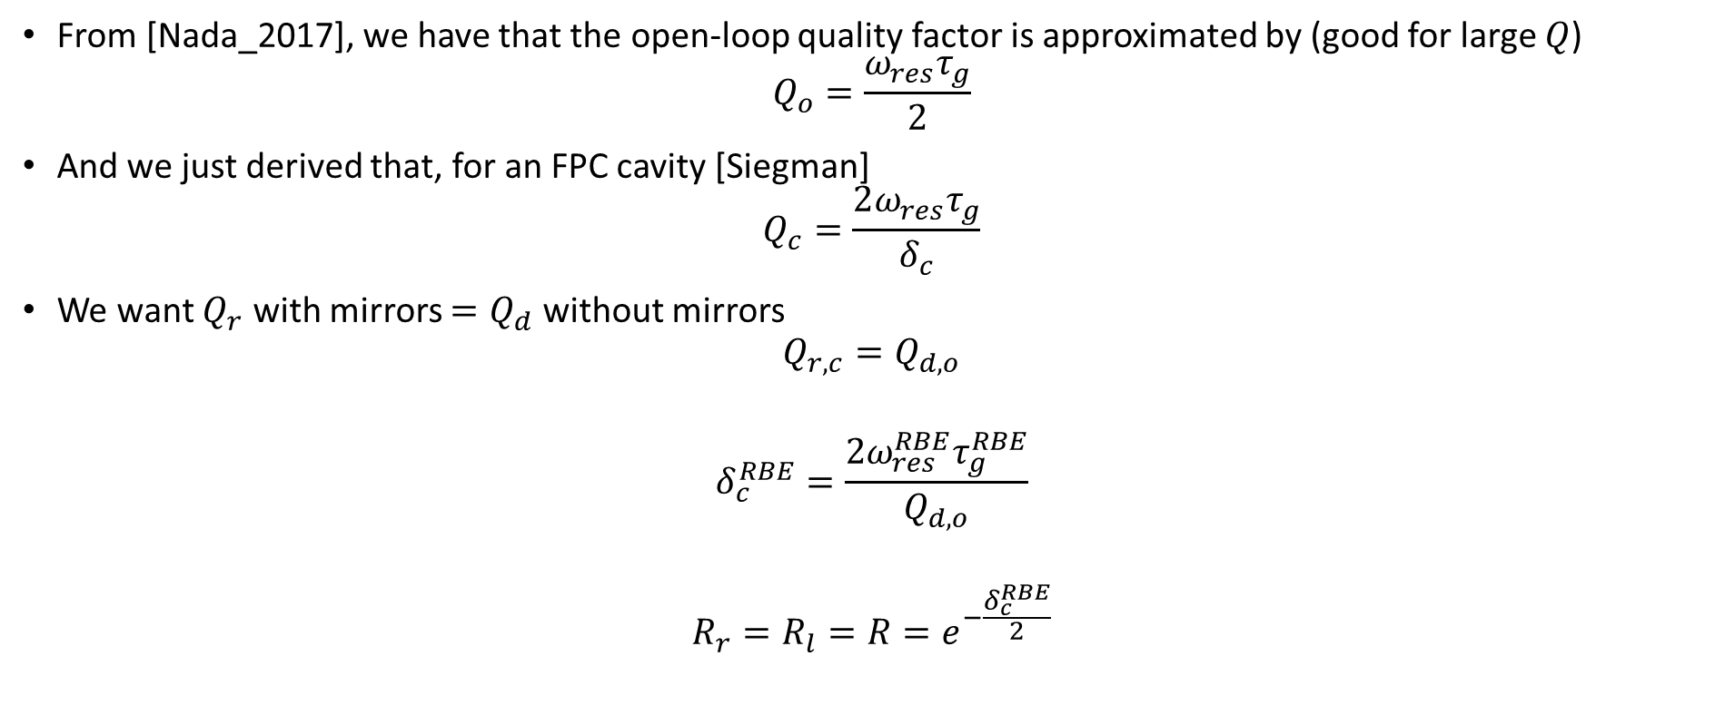
Quality factor definitions
From [Nada_2017], we have that the open-loop quality factor is approximated by (good for large $Q$)
$$Q_{o}=\frac{ω_{res}τ_{g}}{2}$$
And we just derived that, for an FPC cavity [Siegman]
$$Q_{c}=\frac{2ω_{res}τ_{g}}{δ_{c}}$$
We want $Q_{r}$ with mirrors $=Q_{d}$ without mirrors
$$Q_{r,c}=Q_{d,o}$$
$$δ_{c}^{RBE}=\frac{2ω_{res}^{RBE}τ_{g}^{RBE}}{Q_{d,o}}$$
$$R_{r}=R_{l}=R=e^{−\frac{δ_{c}^{RBE}}{2}}$$
The reflectivities depend on the $τ_{g}^{RBE}$
*Nada, Othman, Capolino, Theory of coupled resonator optical waveguides exhibiting high-order exceptional points of degeneracy, Physical Review B, 2017

Slide 15
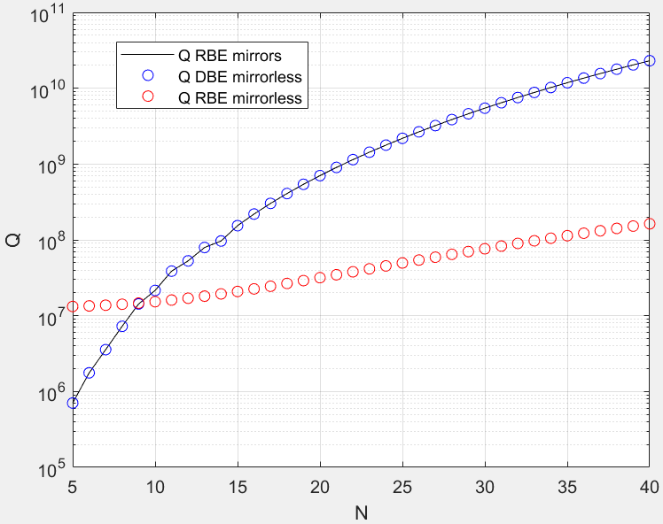
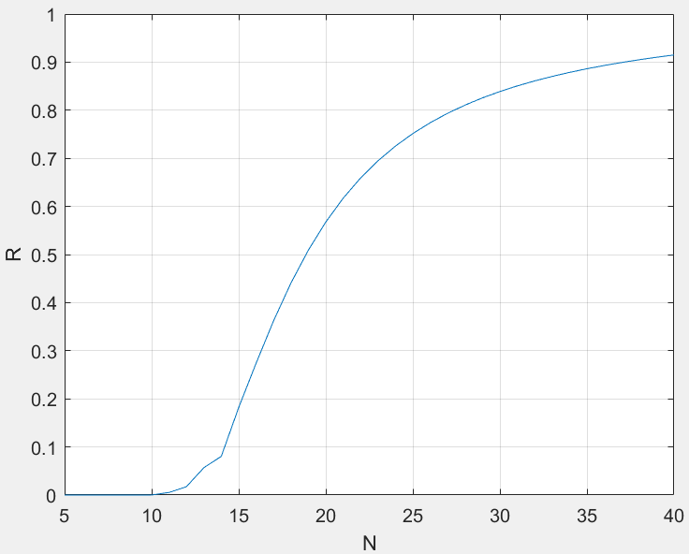
$$Q_{r}=Q_{d}$$
Using the previous result, we have the we obtain $Q_{r}^{c}\left(N\right)=Q_{d}^{o}\left(N\right)$ by changing the power reflectivity $R(N)$
I have to check $τ_{g}^{RBE}, Q_{r}(N)$

Slide 16
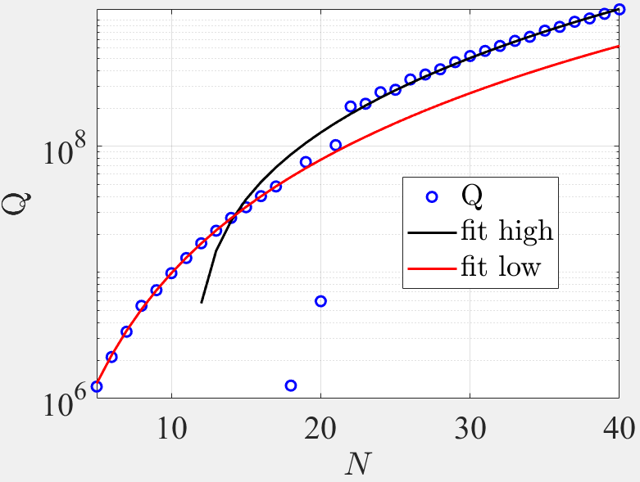
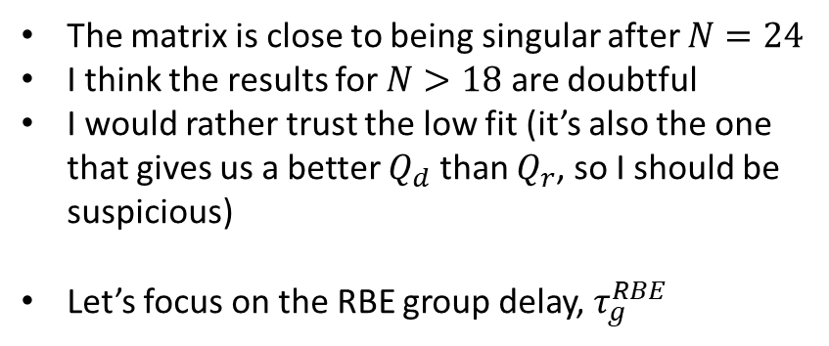
Improving $Q_{r}$ for the RBE-ASOW
The matrix is close to being singular after $N=24$
I think the results for $N>18$ are doubtful
I would rather trust the low fit (it’s also the one that gives us a better $Q_{d}$ than $Q_{r}$, so I should be suspicious)
Let’s focus on the RBE group delay, $τ_{g}^{RBE}$
☹

Slide 17
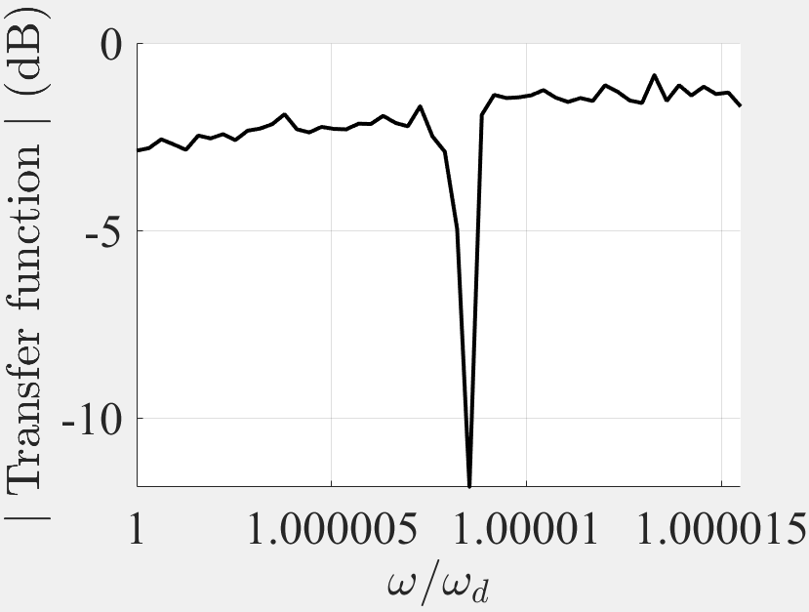
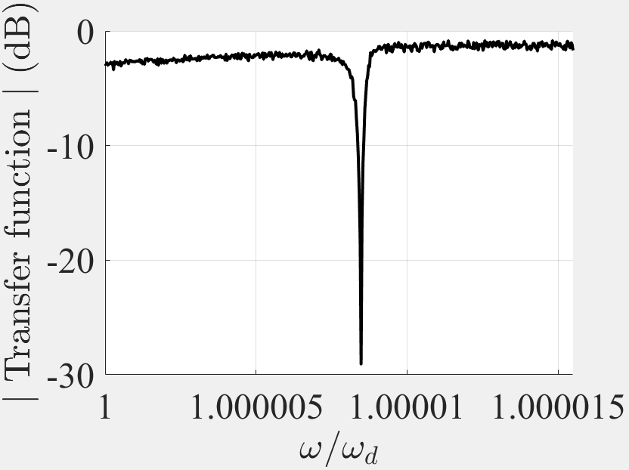
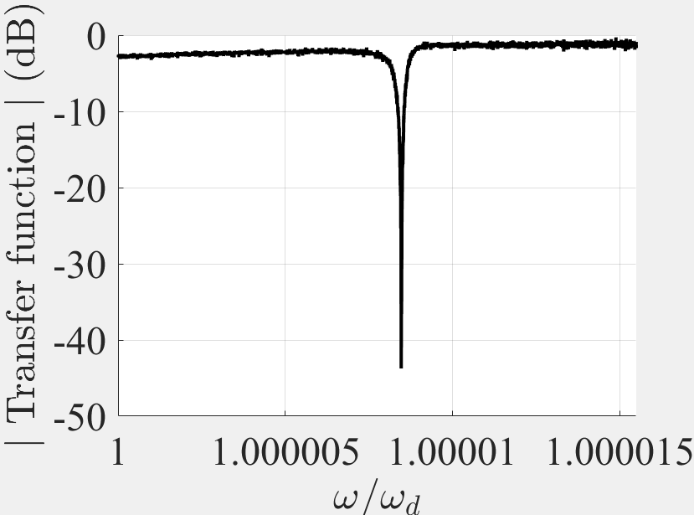
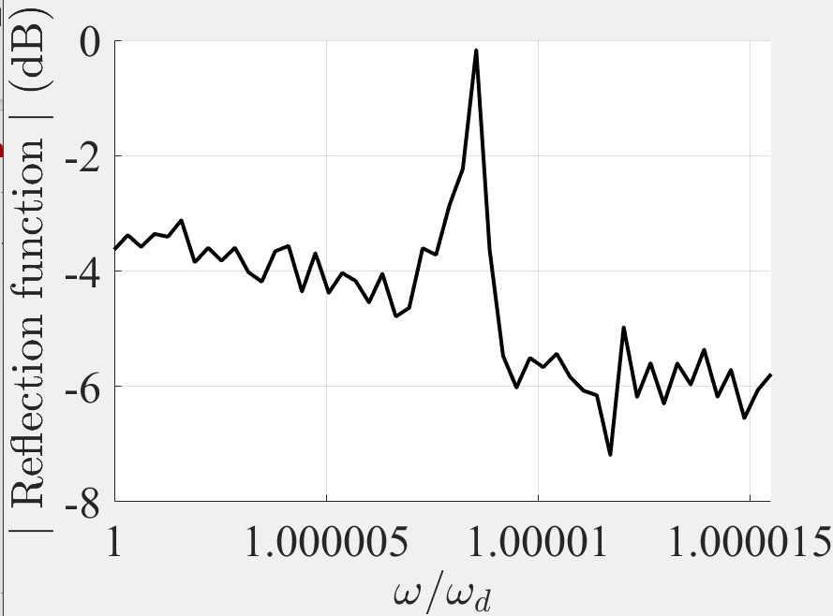
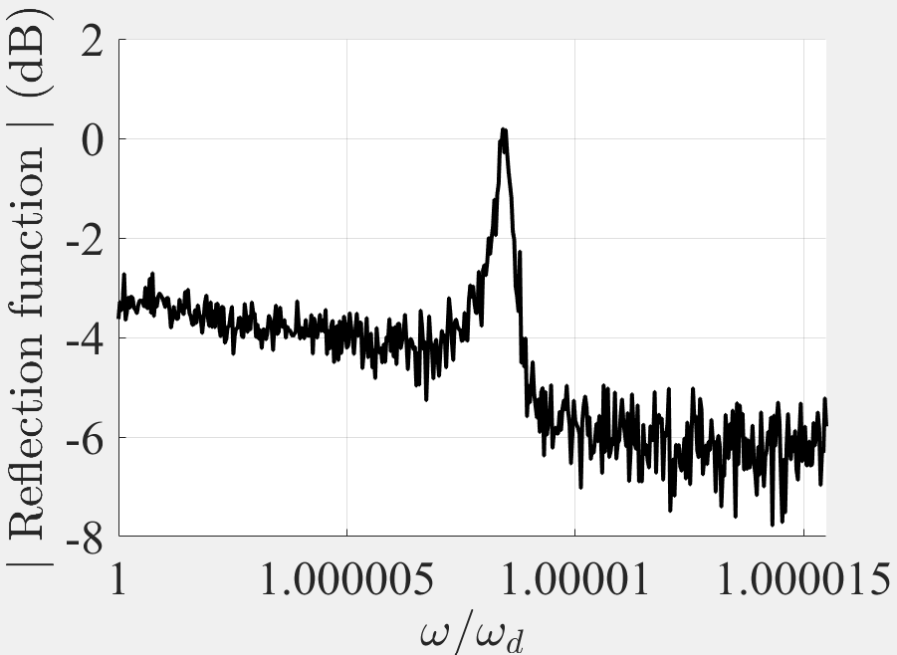
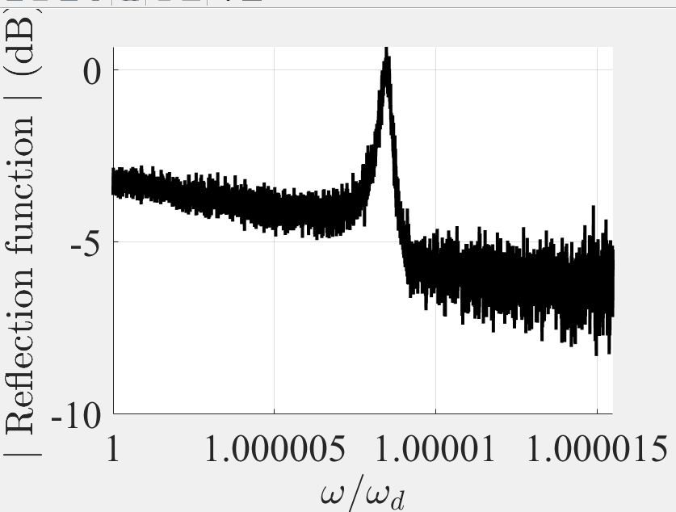
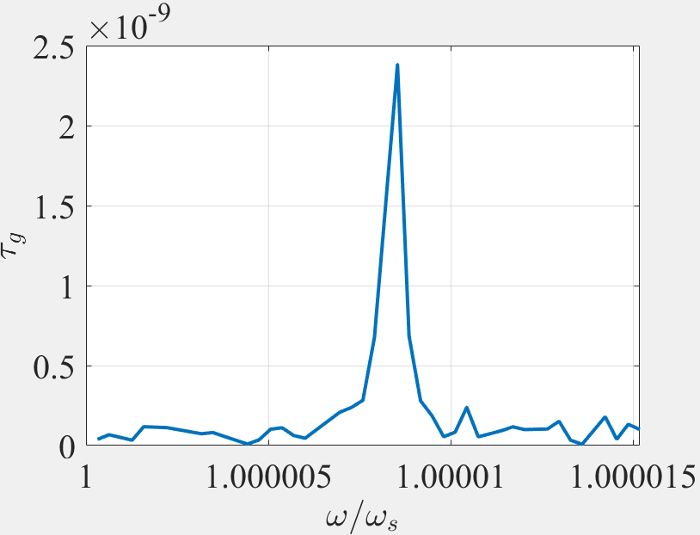
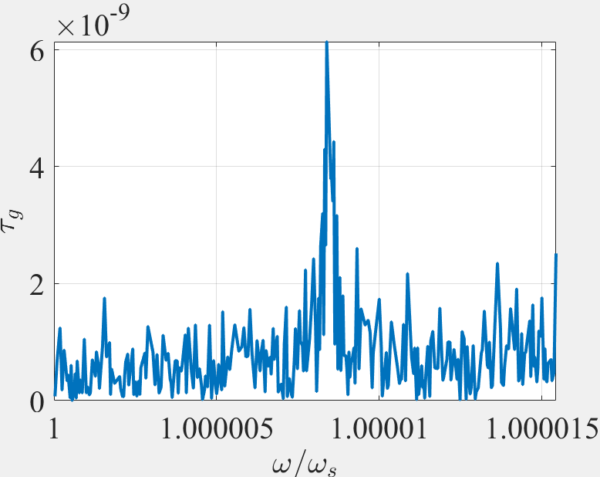
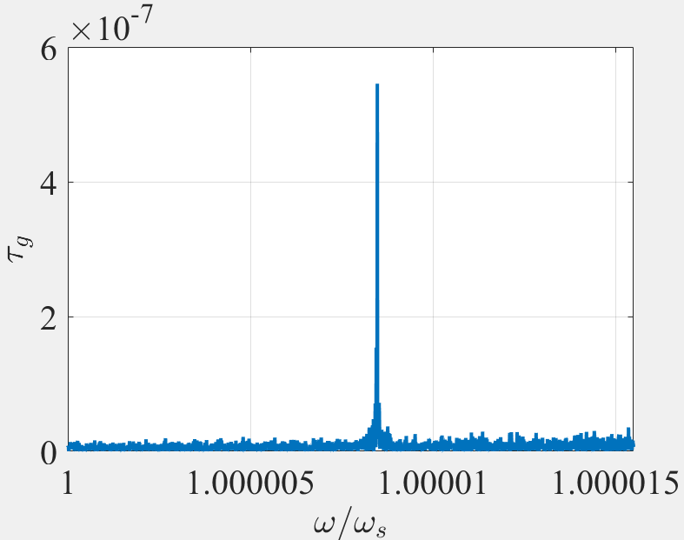


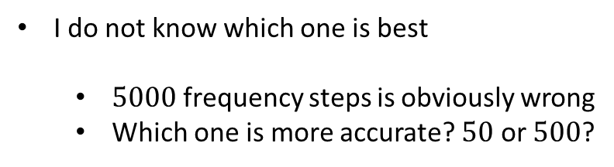


Improving $Q_{r}$ is improving $τ_{g}^{RBE}$, which is proving difficult
I am trying to manually obtain the peak of the group delay for each number of unit cells $N∈[5,40]$
It is proving increasingly difficult. For $N=23$:
I do not know which one is best
$5000$ frequency steps is obviously wrong
Which one is more accurate? $50$ or $500$?
I need help here
$50$ frequency steps
$500$ frequency steps
$5000$ frequency steps

Slide 18
The End

Slide 19
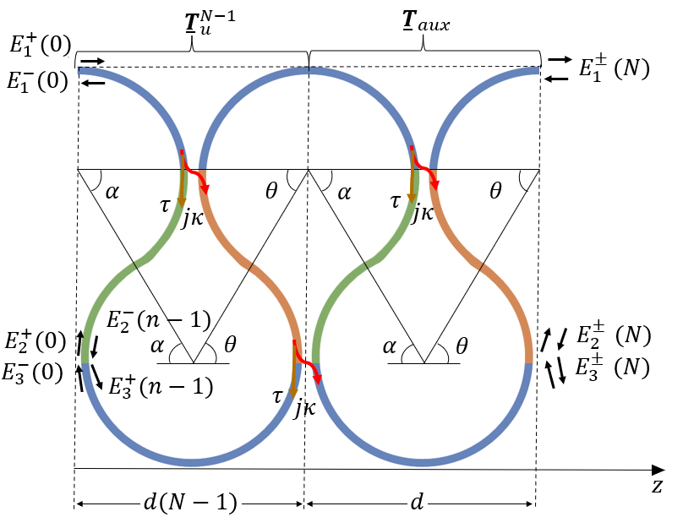
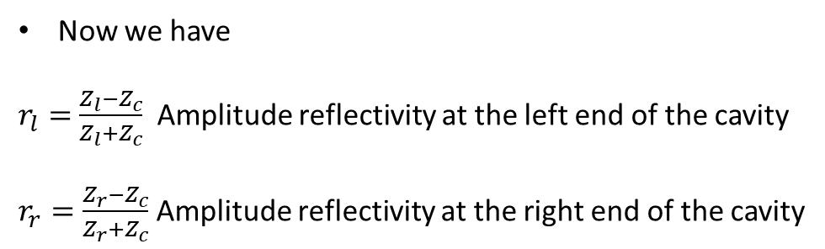
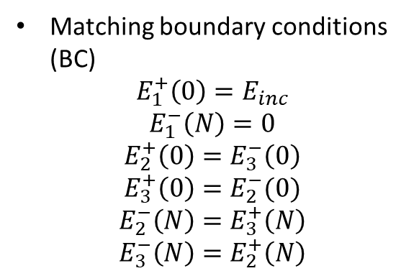
Alternative calculation of Q with mirrors
Let’s assume we have the following setup.
Matching boundary conditions (BC)
$$E_{1}^{+}\left(0\right)=E_{inc}$$
$$E_{1}^{−}\left(N\right)=0$$
$$E_{2}^{+}\left(0\right)=E_{3}^{−}\left(0\right)$$
$$E_{3}^{+}\left(0\right)=E_{2}^{−}(0)$$
$$E_{2}^{−}\left(N\right)=E_{3}^{+}\left(N\right)$$
$$E_{3}^{−}\left(N\right)=E_{2}^{+}\left(N\right)$$
$$Z_{l}$$
$$Z_{r}$$
$$Z_{c}$$
Now we have
$r_{l}=$ $\frac{Z_{l}−Z_{c}}{Z_{l}+Z_{c}}$ Amplitude reflectivity at the left end of the cavity
$r_{r}=\frac{Z_{r}−Z_{c}}{Z_{r}+Z_{c}}$ Amplitude reflectivity at the right end of the cavity
I am not sure about this

Slide 20


Alternative calculation of Q with mirrors
Now we have loads, which cause the amplitude reflection and transmission coefficients $r_{r},r_{l},t_{r}, t_{l}$, which satisfy ${\left|r_{r}\right|}^{2}+{\left|t_{r}\right|}^{2}=1,{\left|r_{l}\right|}^{2}+{\left|t_{l}\right|}^{2}=1$. The new BC are
$E_{1}^{+}\left(0\right)=E_{inc}t_{l}$
$E_{1}^{−}\left(N\right)=E_{1}^{+}\left(N\right)r_{r}$
$E_{2}^{+}\left(0\right)=E_{3}^{−}\left(0\right)$
$E_{3}^{+}\left(0\right)=E_{2}^{−}(0)$
$E_{2}^{−}\left(N\right)=E_{3}^{+}\left(N\right)$
$E_{3}^{−}\left(N\right)=E_{2}^{+}\left(N\right)$
$E_{out}=E_{1}^{+}\left(N\right)t_{r}$
$E_{refl}=E_{1}^{−}\left(N\right)t_{l}$
I am not sure about this because $Q=\frac{ω_{res}τ_{g}}{2}$ is an open-loop definition of the $Q$
Then, we have
$$T_{f}=\frac{E_{out}}{E_{inc}}=\frac{{t_{l}t}_{r}E_{1}^{+}\left(N\right)}{E_{1}^{+}(0)}$$
$$τ_{g}=−\frac{∂∠T_{f}}{∂ω}$$
$$Q=\frac{ω_{res}τ_{g}}{2}$$
I do not think this is right

