Slide 1

SIP-ASOW Laser
A. Herrero Parareda
Department of Electrical Engineering and Computer Science

Slide 2
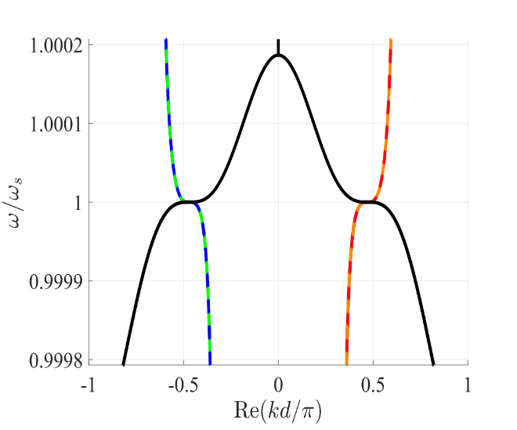
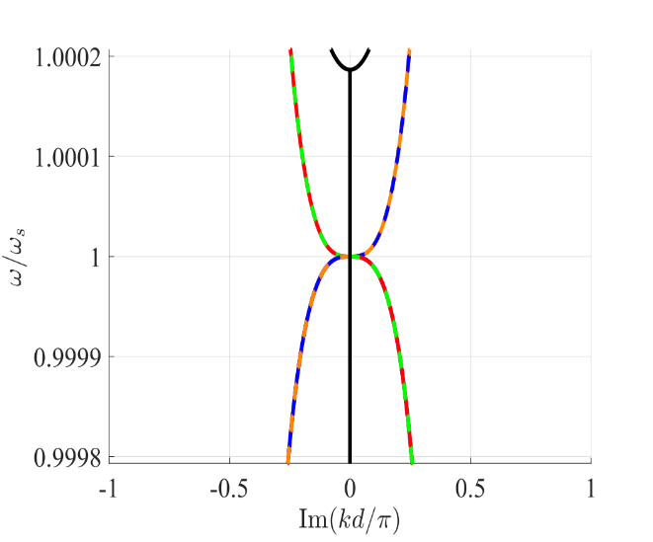
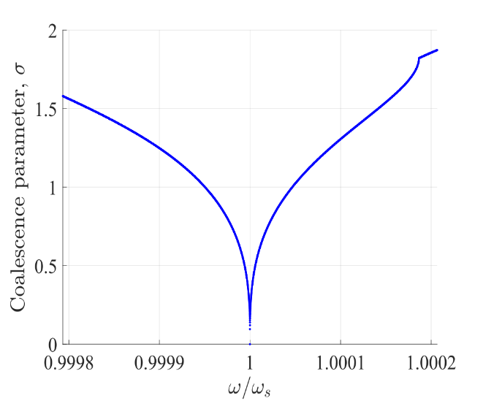
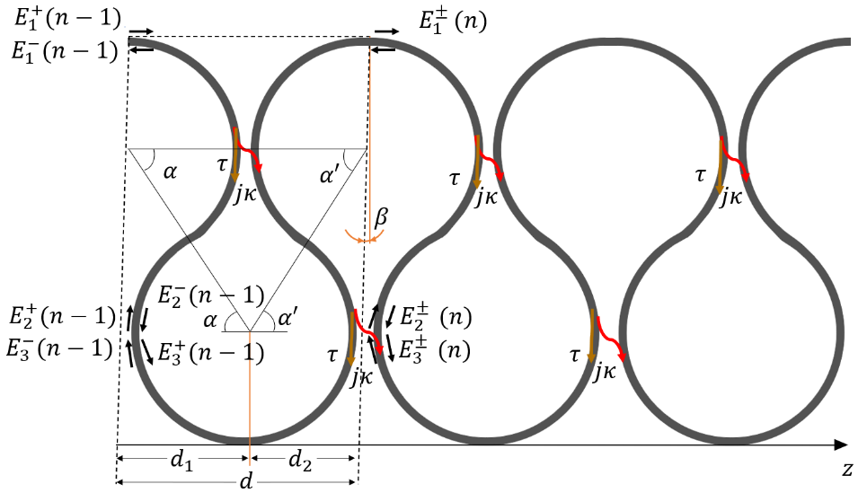
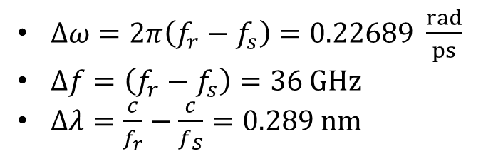
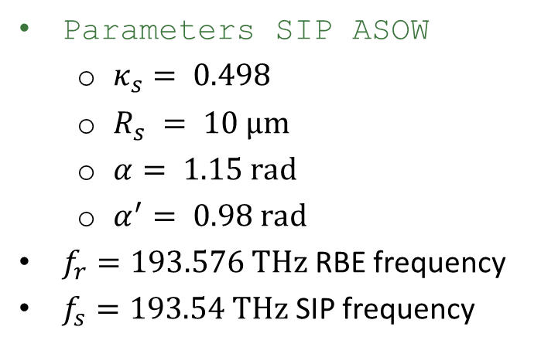
RBE-SIP distance in SIP-ASOW
Parameters SIP ASOW
$κ_{s}= 0.498$
$R_{s} = 10 μm$
$α= 1.15 rad$
$α^{′}= 0.98 rad$
$f_{r}=193.576$ THz RBE frequency
$f_{s}=193.54$THz SIP frequency
$Δω=2π\left(f_{r}−f_{s}\right)=0.22689 \frac{rad}{ps}$
$Δf=\left(f_{r}−f_{s}\right)=36 GHz$
$Δλ=\frac{c}{f_{r}}−\frac{c}{f_{S}}=0.289 nm$

Slide 3
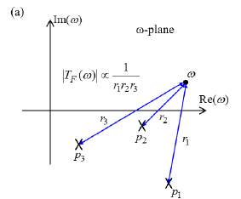
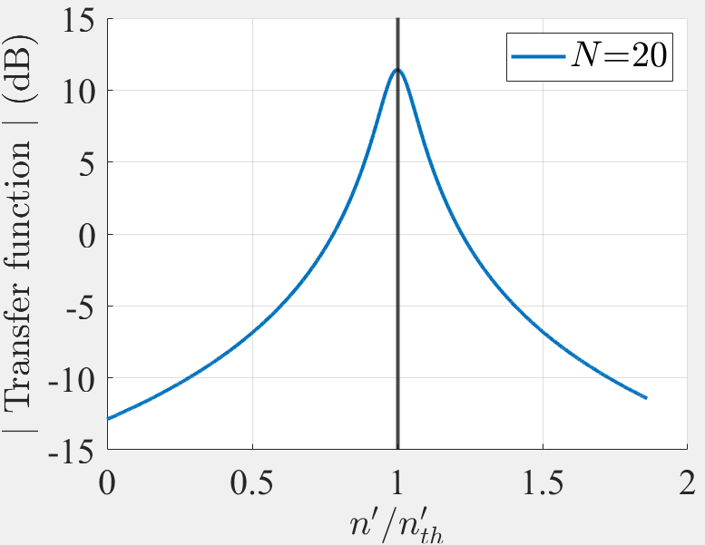
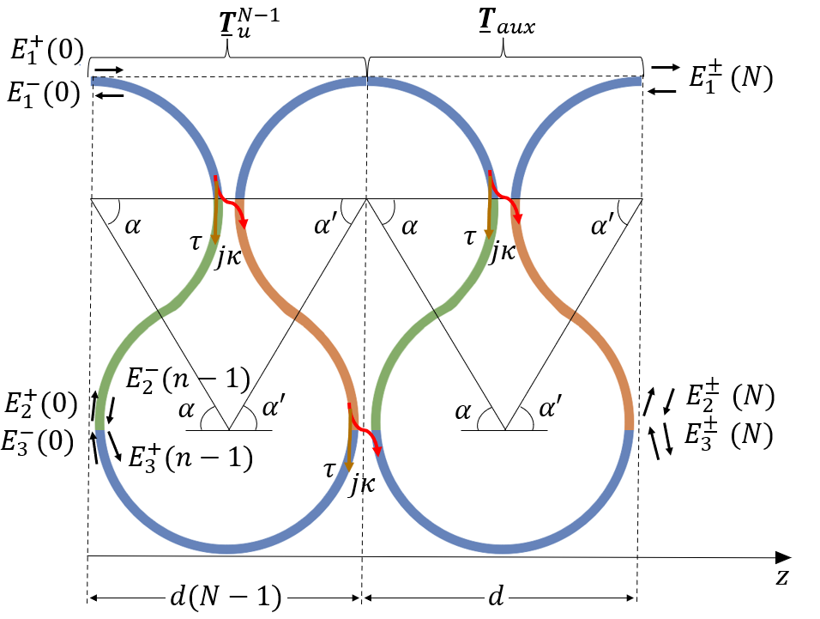
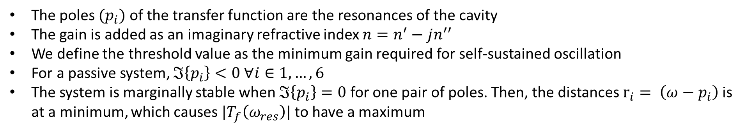

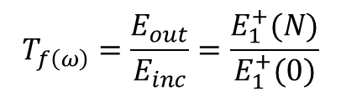
Lasing threshold
The poles $(p_{i})$ of the transfer function are the resonances of the cavity
The gain is added as an imaginary refractive index $n=n^{′}−jn^{′′}$
We define the threshold value as the minimum gain required for self-sustained oscillation
For a passive system, $ℑ\left\{p_{i}\right\}<0 ∀i∈1, …, 6$
The system is marginally stable when $ℑ\left\{p_{i}\right\}=0$for one pair of poles. Then, the distances $r_{i}= \left(ω−p_{i}\right)$ is at a minimum, which causes $|T_{f}\left(ω_{res}\right)|$ to have a maximum
$$T_{f\left(ω\right)}=\frac{E_{out}}{E_{inc}}=\frac{E_{1}^{+}(N)}{E_{1}^{+}(0)}$$
$$n_{th}^{′′}=\text{−1.12}×{10}^{−6}$$

Slide 4
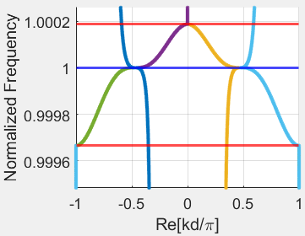
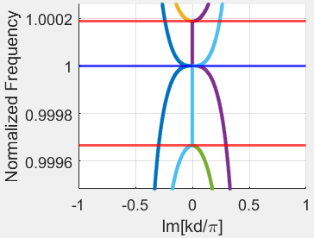
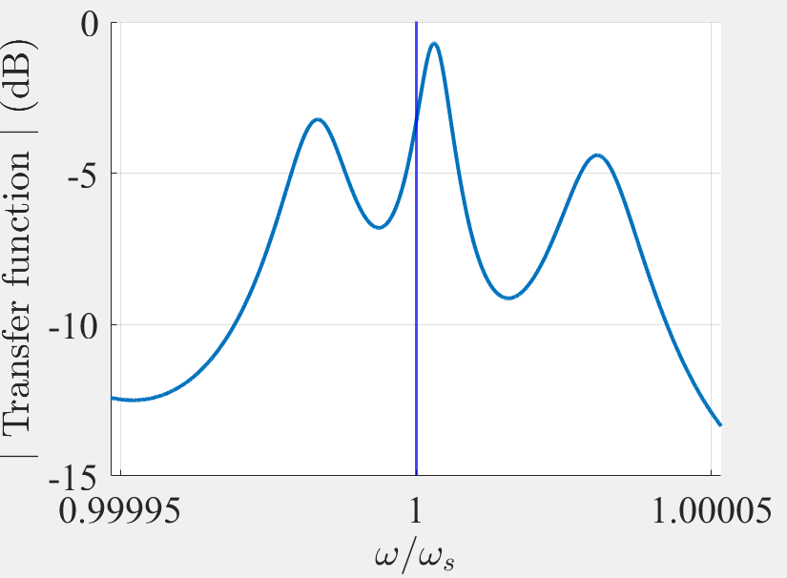
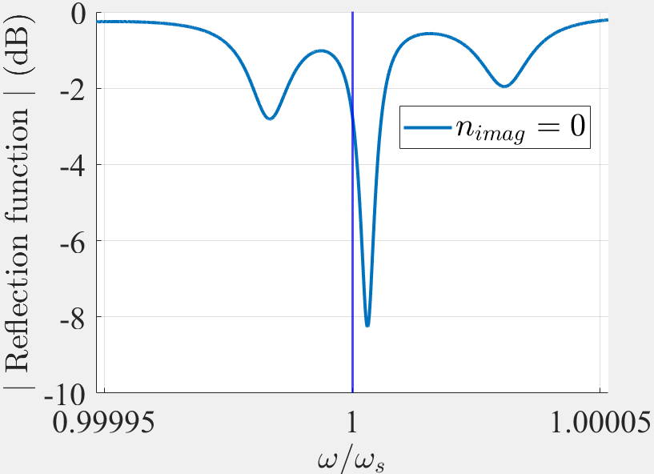
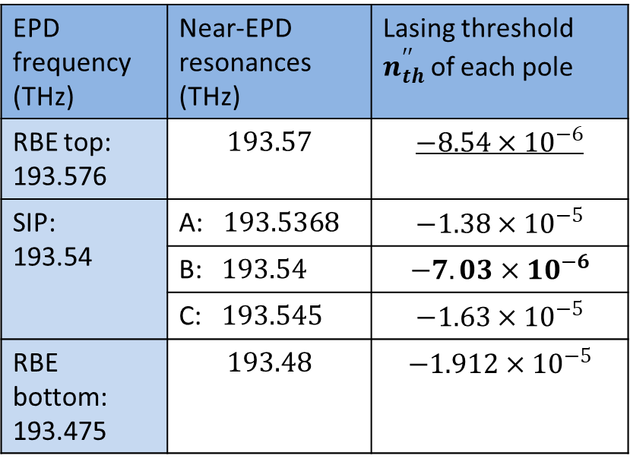
Resonances and lasing thresholds for $N=10$
We find the resonances and then the lasing threshold of each resonance for $N=10$
EPD frequency (THz) | Near-EPD resonances (THz) | Lasing threshold $n_{th}^{′′}$ of each pole
RBE top: 193.576 | $$193.57$$ | $$−8.54×{10}^{−6}$$
SIP: 193.54 | A: $193.5368$ | $$−1.38×{10}^{−5}$$
 | B: $193.54$ | $$−7.03×{10}^{−6}$$
 | C: $193.545$ | $$−1.63×{10}^{−5}$$
RBE bottom: 193.475 | $$193.48$$ | $$−1.912×{10}^{−5}$$
B
A
C
C
A
B
The second pole smallest lasing threshold is the RBE resonance

Slide 5
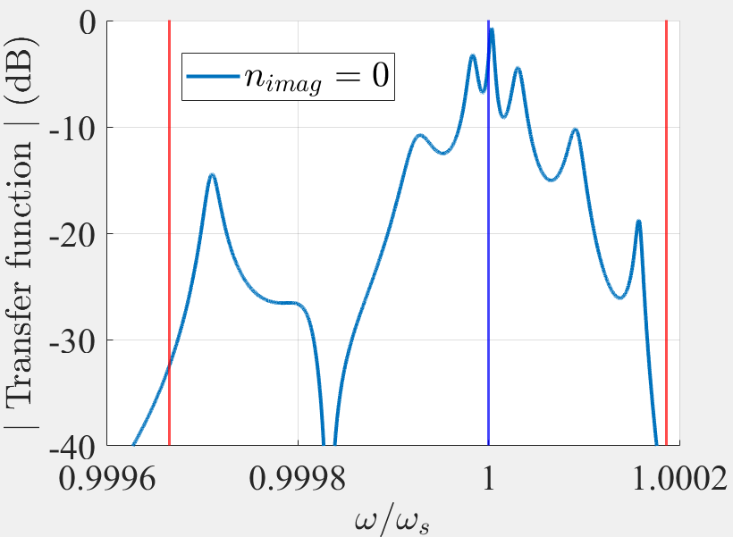
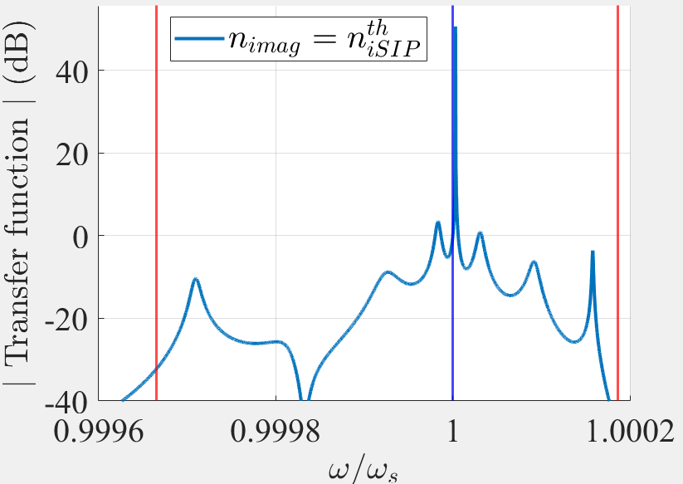
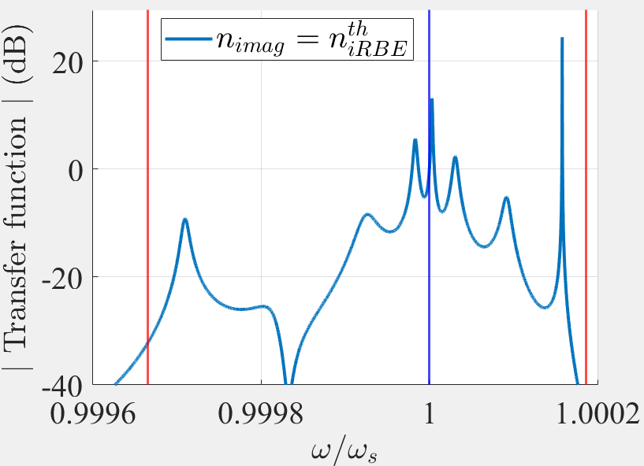








Resonances and lasing thresholds for $N=10$
$$n^{′′}=0$$
$$n^{′′}=n_{SIPth}^{′′}=\text{−7.03}×{10}^{−6}$$
$$n^{′′}=n_{RBEth}^{′′}=\text{−8.54}×{10}^{−6}$$
Marginally stable poles for increasing gain:
SIP resonance
RBE resonance
2nd SIP resonance (second resonance the closest to the SIP frequency)
$$ℑ\{ω\}$$
Blue line: SIP frequency
Red line: RBE frequency
$$x$$
$$ℜ\{ω\}$$
$$x$$
$$x$$
Position of the $3$ closest poles to $ℜ\{ω\}$
The second pole to become marginally stable is the RBE resonance

Slide 6
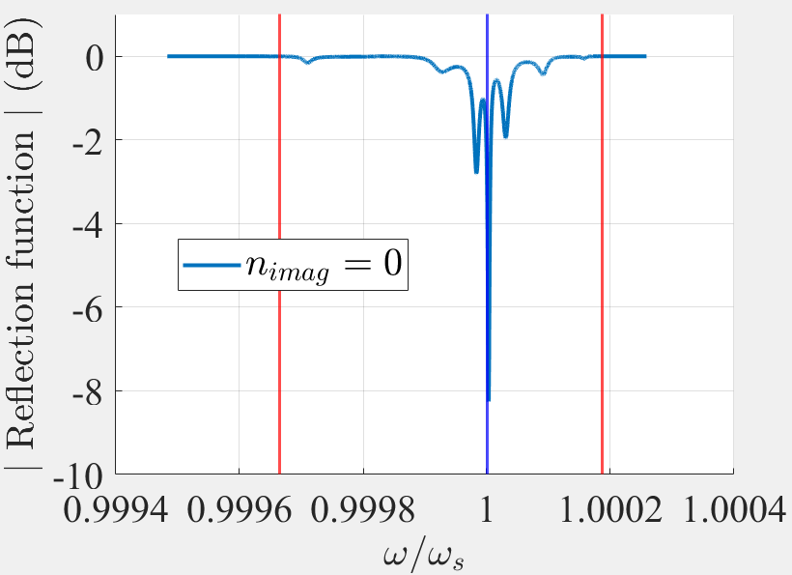
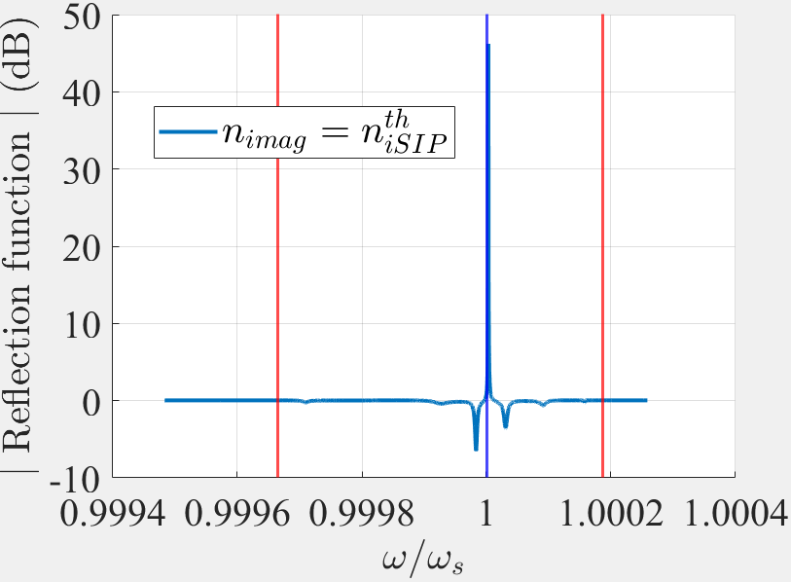
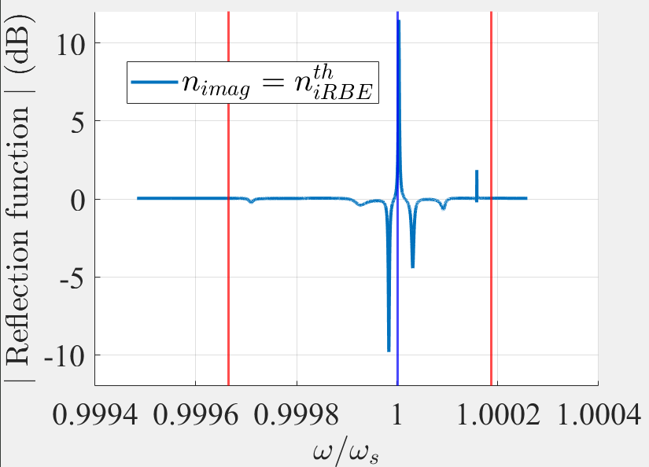



Resonances and lasing thresholds for $N=10$
$$n^{′′}=0$$
$$n^{′′}=n_{SIPth}^{′′}=\text{−7.031}×{10}^{−6}$$
$$n^{′′}=n_{RBEth}^{′′}=\text{−8.54}×{10}^{−6}$$

Slide 7
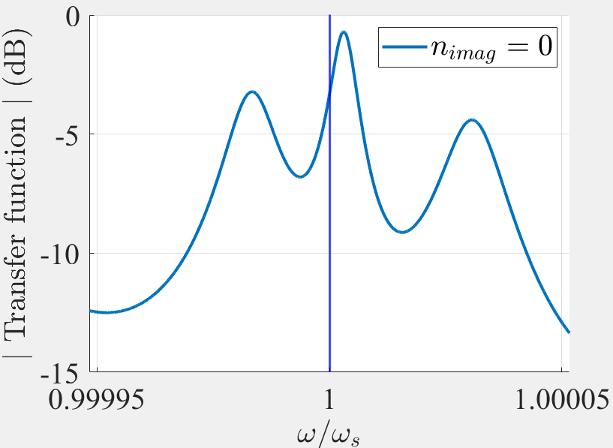
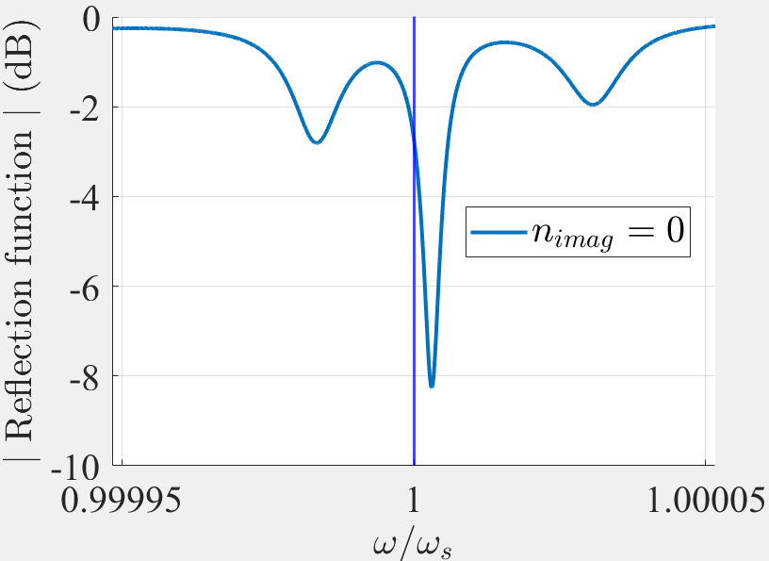

Resonances and lasing thresholds for $N=20$
We find the resonances and then the lasing threshold of each resonance for $N=20$
EPD frequency (THz) | Near-EPD resonances (THz) | Lasing threshold $n_{th}^{′′}$ of each pole
RBE top: 193.576 | $$193.57$$ | $$−1.23×{10}^{−6}$$
SIP: 193.54 | A: $193.5391$ | $$−3.19×{10}^{−6}$$
 | B: $193.5399$ | $$−1.12×{10}^{−6}$$
 | C: $193.5405$ | $$−2.16×{10}^{−6}$$
RBE bottom: 193.475 | $$193.4774$$ | $$−2.69×{10}^{−6}$$
B
A
C
C
A
B
The second pole smallest lasing threshold is the RBE resonance

Slide 8
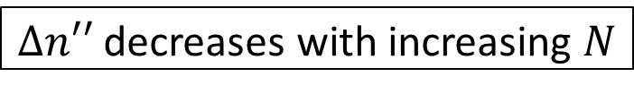

SIP resonance dominance and waveguide length
For $N=10$, we have
$$f_{rSIP}=\text{193.54}$$
$$f_{rRBE}=\text{193.57}$$
$$n_{SIPth}^{′′}=−\text{7.0314}×{10}^{−6}$$
$$n_{RBEth}^{′′}=−\text{8.5417}×{10}^{−6}$$
$$Δn^{′′}=n_{SIPth}^{′′}−n_{RBEth}^{′′}=−1.5103×{10}^{−6}$$
For $N=20$, we have
$$f_{rSIP}=\text{193.5399}$$
$$f_{rRBE}=\text{193.57}\text{5}$$
$$n_{SIPth}^{′′}=−\text{1.12}×{10}^{−6}$$
$$n_{RBEth}^{′′}=−\text{1.23}×{10}^{−6}$$
$$Δn^{′′}=n_{SIPth}^{′′}−n_{RBEth}^{′′}=−0.11×{10}^{−6}$$
Where $Δn^{′′}$ is the threshold gain difference
$Δn′′$ decreases with increasing $N$

Slide 9
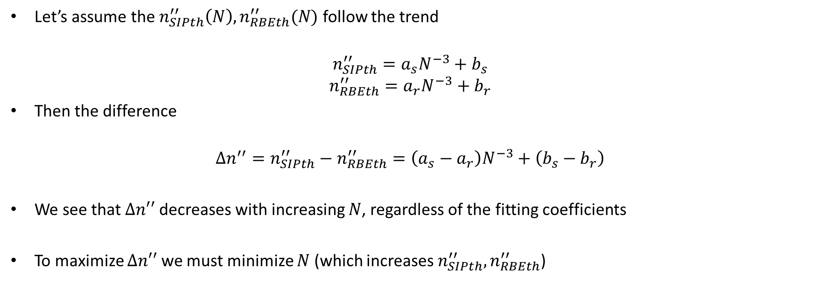
Why?
Let’s assume the $n_{SIPth}^{′′}\left(N\right), n_{RBEth}^{′′}(N)$ follow the trend
$$n_{SIPth}^{′′}=a_{s}N^{−3}+b_{s}$$
$$n_{RBEth}^{′′}=a_{r}N^{−3}+b_{r}$$
Then the difference
$$Δn^{′′}=n_{SIPth}^{′′}−n_{RBEth}^{′′}=\left(a_{s}−a_{r}\right)N^{−3}+\left(b_{s}−b_{r}\right)$$
We see that $Δn′′$ decreases with increasing $N$, regardless of the fitting coefficients
To maximize $Δn′′$ we must minimize $N$ (which increases $n_{SIPth}^{′′}, n_{RBEth}^{′′}$)
This is generic for all SIP, RBE

Slide 10
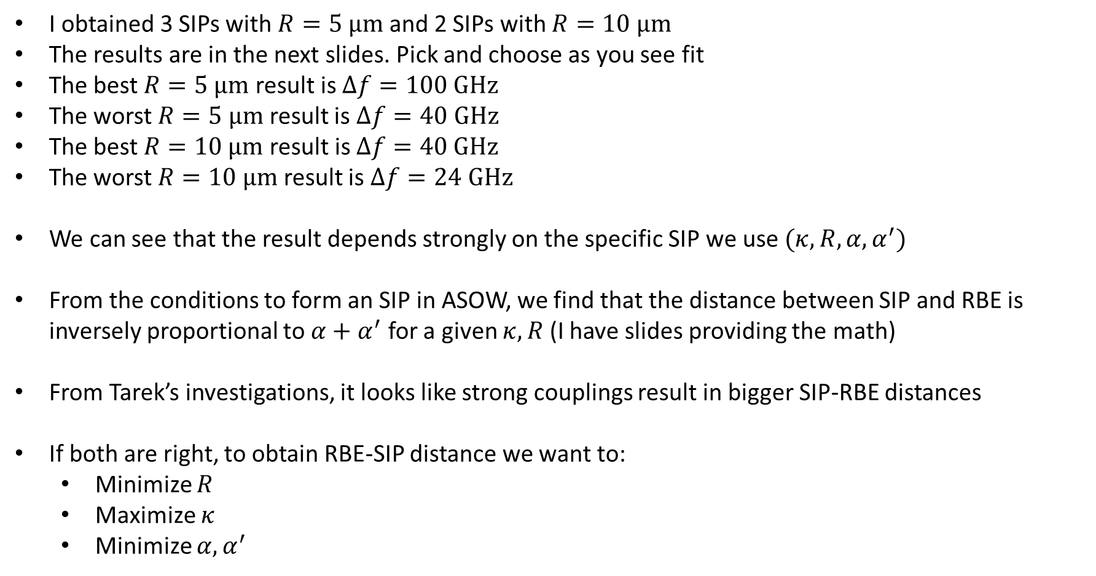
SIP-ASOW with $R=5, 10 μm$
I obtained 3 SIPs with $R=5 μm$ and 2 SIPs with $R=10 μm$
The results are in the next slides. Pick and choose as you see fit
The best $R=5 μm$ result is $Δf=100 GHz$
The worst $R=5 μm$ result is $Δf=40 GHz$
The best $R=10 μm$ result is $Δf=40 GHz$
The worst $R=10 μm$ result is $Δf=24 GHz$
We can see that the result depends strongly on the specific SIP we use $(κ,R, α,α^{′})$
From the conditions to form an SIP in ASOW, we find that the distance between SIP and RBE is inversely proportional to $α+α^{′}$ for a given $κ, R$ (I have slides providing the math)
From Tarek’s investigations, it looks like strong couplings result in bigger SIP-RBE distances
If both are right, to obtain RBE-SIP distance we want to:
Minimize $R$
Maximize $κ$
Minimize $α,α^{′}$
Optimization of the RBE-SIP distance is not as simple as decreasing $R$

Slide 11
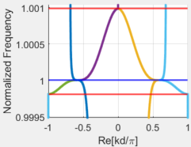
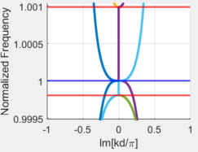
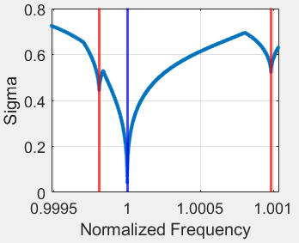
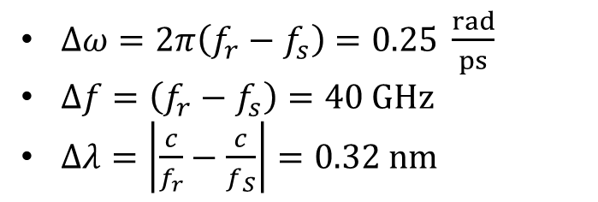
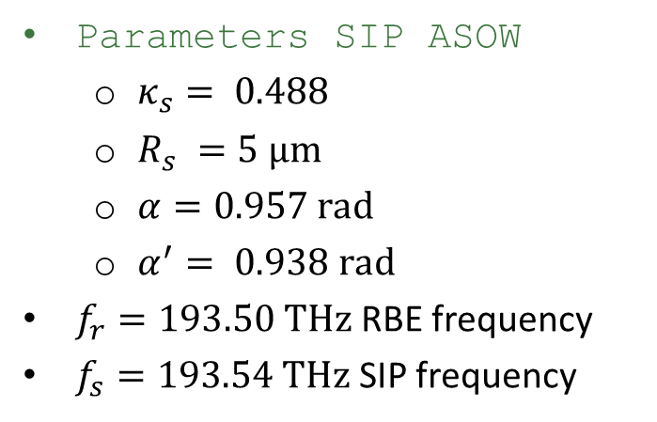
RBE-SIP distance in SIP-ASOW
Parameters SIP ASOW
$κ_{s}= 0.488$
$R_{s} =5 μm$
$α=0.957 rad$
$α^{′}= 0.938 rad$
$f_{r}=193.50$ THz RBE frequency
$f_{s}=193.54$THz SIP frequency
$Δω=2π\left(f_{r}−f_{s}\right)=0.25 \frac{rad}{ps}$
$Δf=\left(f_{r}−f_{s}\right)=40 GHz$
$Δλ=\left|\frac{c}{f_{r}}−\frac{c}{f_{S}}\right|=0.32 nm$
A smaller radius does not necessarily imply an increased SIP-RBE distance

Slide 12
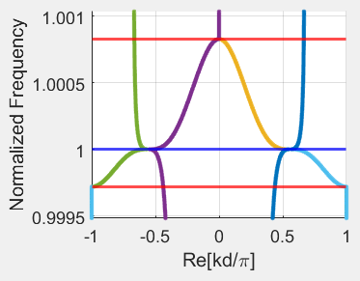
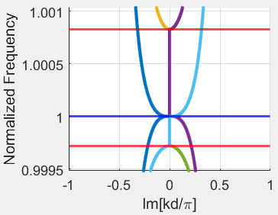
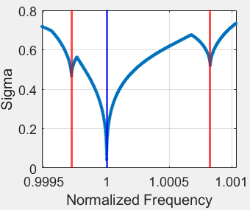
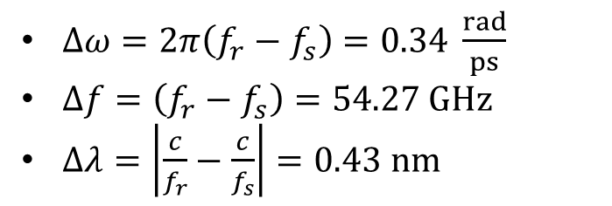


RBE-SIP distance in SIP-ASOW
Parameters SIP ASOW
$κ_{s}= 0.495$
$R_{s} =5 μm$
$α=0.957 rad$
$α^{′}= 0.938 rad$
$f_{r}=193.64$ THz RBE frequency
$f_{s}=193.54$THz SIP frequency
$Δω=2π\left(f_{r}−f_{s}\right)=0.34 \frac{rad}{ps}$
$Δf=\left(f_{r}−f_{s}\right)=54.27 GHz$
$Δλ=\left|\frac{c}{f_{r}}−\frac{c}{f_{s}}\right|=0.43 nm$
$Δf$ changes a lot from one SIP to another

Slide 13
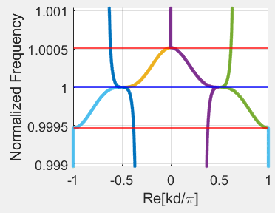
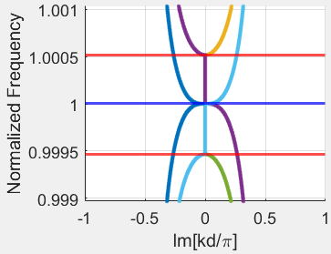
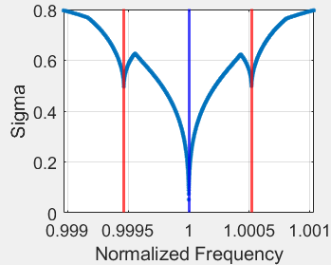
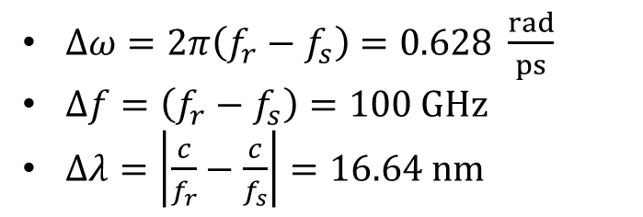


RBE-SIP distance in SIP-ASOW
Parameters SIP ASOW
$κ_{s}= 0.5$
$R_{s} =5 μm$
$α=0. 89 rad$
$α^{′}= 0.939 rad$
$f_{r}=193.64$ THz RBE frequency
$f_{s}=193.54$THz SIP frequency
$Δω=2π\left(f_{r}−f_{s}\right)=0.628 \frac{rad}{ps}$
$Δf=\left(f_{r}−f_{s}\right)=100 GHz$
$Δλ=\left|\frac{c}{f_{r}}−\frac{c}{f_{s}}\right|=16.64 nm$
Best result, $100 GHz$ difference

Slide 14
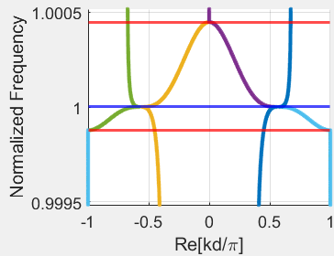
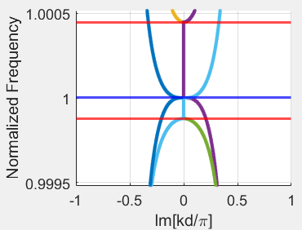
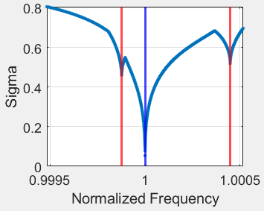
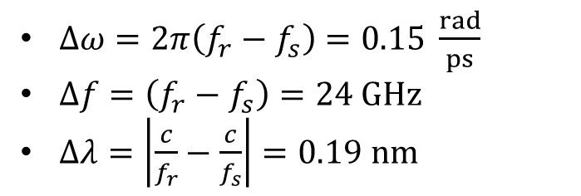

RBE-SIP distance in SIP-ASOW
Parameters SIP ASOW
$κ_{s}= 0.5$
$R_{s} =10 μm$
$α=0. 89 rad$
$α^{′}= 0.939 rad$
$f_{r}=193.516$ THz RBE frequency
$f_{s}=193.54$THz SIP frequency
$Δω=2π\left(f_{r}−f_{s}\right)=0.15 \frac{rad}{ps}$
$Δf=\left(f_{r}−f_{s}\right)=24 GHz$
$Δλ=\left|\frac{c}{f_{r}}−\frac{c}{f_{s}}\right|=0.19 nm$
$Δf$ changes a lot from one SIP to another

Slide 15
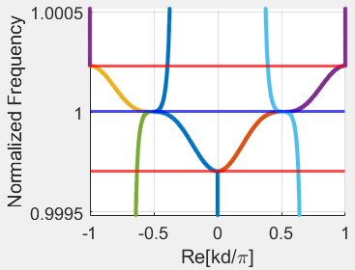
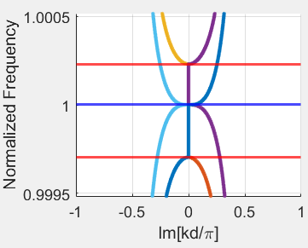
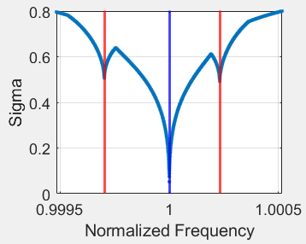
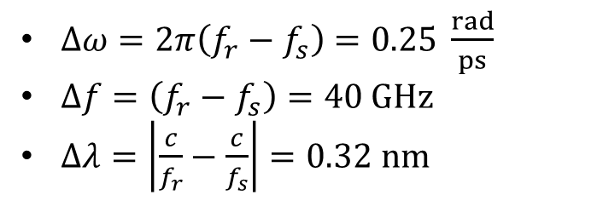


RBE-SIP distance in SIP-ASOW
Parameters SIP ASOW
$κ_{s}= 0.5$
$R_{s} =10 μm$
$α=0. 89 rad$
$α^{′}= 0.939 rad$
$f_{r}=193.5$8 THz RBE frequency
$f_{s}=193.54$THz SIP frequency
$Δω=2π\left(f_{r}−f_{s}\right)=0.25 \frac{rad}{ps}$
$Δf=\left(f_{r}−f_{s}\right)=40 GHz$
$Δλ=\left|\frac{c}{f_{r}}−\frac{c}{f_{s}}\right|=0.32 nm$
Same result as works SIP with $R=5 μm$

