Slide 1

Dispersion optimization algorithm
A. Herrero-Parareda, N. Furman
Department of Electrical Engineering and Computer Science

Slide 2
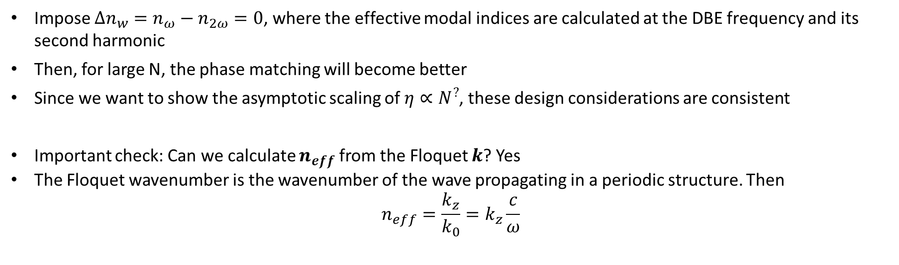
Phase matching: Same effective refractive indices
Impose $Δn_{w}=n_{ω}−n_{2ω}=0$, where the effective modal indices are calculated at the DBE frequency and its second harmonic
Then, for large N, the phase matching will become better
Since we want to show the asymptotic scaling of $η∝N^{?}$, these design considerations are consistent
Important check: Can we calculate $n_{eff}$ from the Floquet $k$? Yes
The Floquet wavenumber is the wavenumber of the wave propagating in a periodic structure. Then
$$n_{eff}=\frac{k_{z}}{k_{0}}=k_{z}\frac{c}{ω}$$

Slide 3



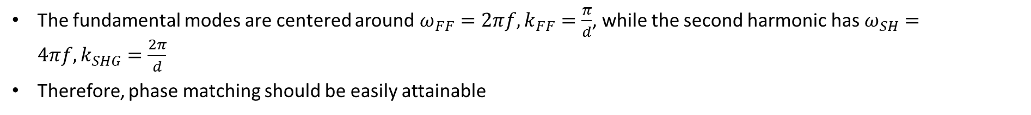






Optimizing dispersion
The fundamental modes are centered around $ω_{FF}=2πf, k_{FF}=\frac{π}{d}$, while the second harmonic has $ω_{SH}=4πf, k_{SHG}=\frac{2π}{d}$
Therefore, phase matching should be easily attainable
$$ω$$
$$n_{eff,FF}=\frac{π}{d}\frac{c}{ω}$$
$$n_{eff,SHF}=\frac{2π}{d}\frac{c}{2ω}$$
$$ω_{SHF}$$
$$Δn_{eff}=n_{eff,FF }−n_{eff,SHF}≈0$$
$$ω_{FF}$$
$$π$$
$$2π$$
$$kd$$
However, since we consider material dispersion $n=n(f)$, we need to optimize the values of the waveguide parameters, and phase matching is not the only condition we have to satisfy

Slide 4
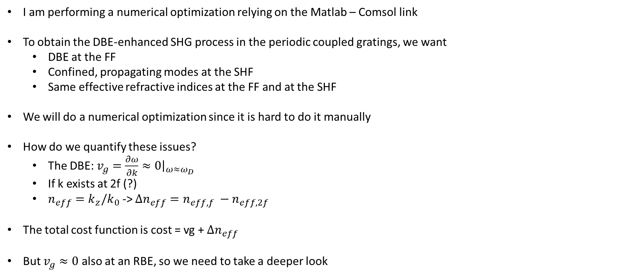
Numerical Optimization
I am performing a numerical optimization relying on the Matlab – Comsol link
To obtain the DBE-enhanced SHG process in the periodic coupled gratings, we want
DBE at the FF
Confined, propagating modes at the SHF
Same effective refractive indices at the FF and at the SHF
We will do a numerical optimization since it is hard to do it manually
How do we quantify these issues?
The DBE: $v_{g}=\frac{∂ω}{∂k}≈0{\left.​\right|}_{ω≈ω_{D}}$
If k exists at 2f (?)
$n_{eff}=k_{z}/k_{0}$ -> $Δn_{eff}=n_{eff,f} −n_{eff,2f}$
The total cost function is cost = vg + $Δn_{eff}$
But $v_{g}≈0$ also at an RBE, so we need to take a deeper look

Slide 5
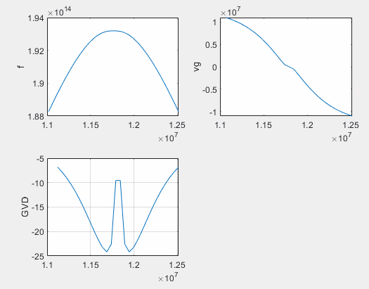
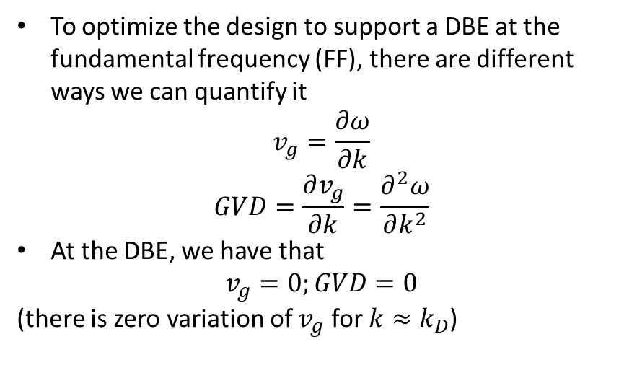
How do we optimize for a DBE?
To optimize the design to support a DBE at the fundamental frequency (FF), there are different ways we can quantify it
$$v_{g}=\frac{∂ω}{∂k}$$
$$GVD=\frac{∂v_{g}}{∂k}=\frac{∂^{2}ω}{∂k^{2}}$$
At the DBE, we have that
$$v_{g}=0;GVD=0$$
(there is zero variation of $v_{g}$ for $k≈k_{D}$)
Need more data points to better see what happens

Slide 6
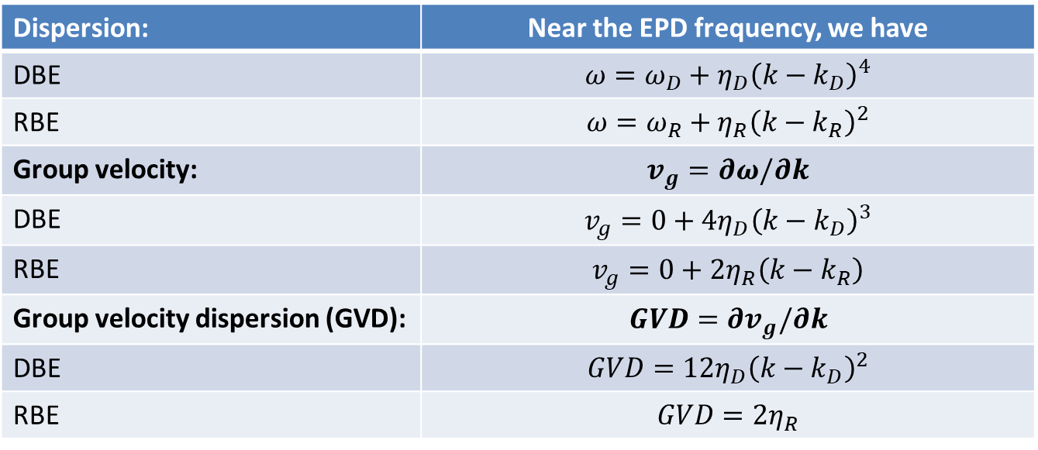
Numerical optimization: DBE or RBE?
Dispersion: | Near the EPD frequency, we have
DBE | $$ω=ω_{D}+η_{D}{\left(k−k_{D}\right)}^{4}$$
RBE | $$ω=ω_{R}+η_{R}{\left(k−k_{R}\right)}^{2}$$
Group velocity: | $$v_{g}=∂ω/∂k$$
DBE | $$v_{g}=0+4η_{D}{\left(k−k_{D}\right)}^{3}$$
RBE | $$v_{g}=0+2η_{R}\left(k−k_{R}\right)$$
Group velocity dispersion (GVD): | $$GVD=∂v_{g}/∂k$$
DBE | $$GVD=12η_{D}{\left(k−k_{D}\right)}^{2}$$
RBE | $$GVD=2η_{R}$$
Both DBE and RBE have zero group velocity at the EPD
The RBE has a GVD independent of the position in the BZ
The DBE has a GVD = 0 at the EPD

Slide 7
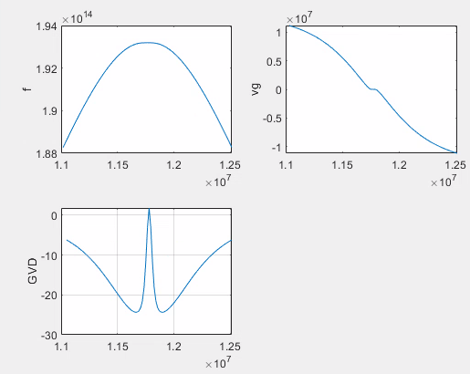
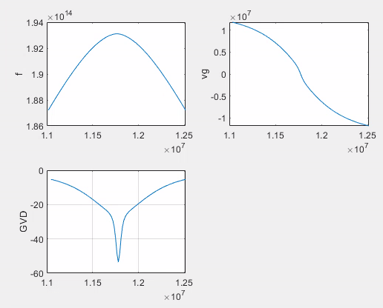
DBE vs RBE behavior
DBE
RBE
We can use the GVD to measure the DBE
Then we just need a few points around $k_{D}=\frac{π}{d}$ to calculate the GVD and impose it to go to zero

Slide 8
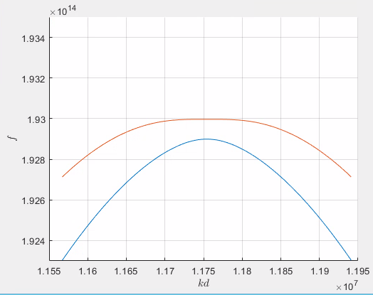
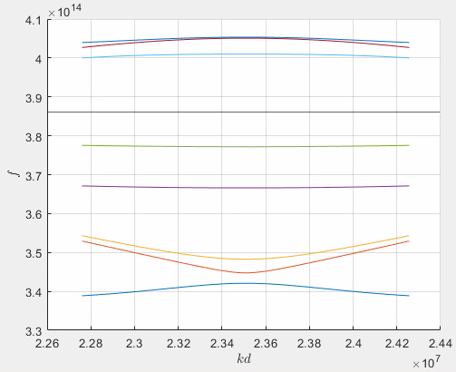
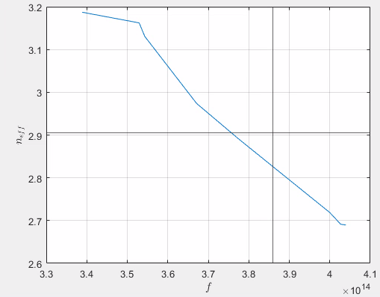
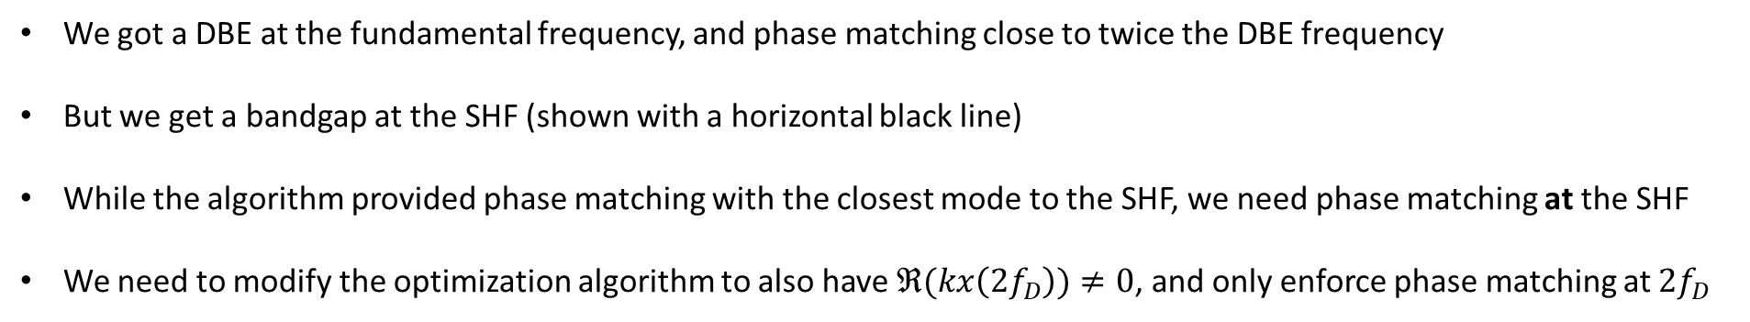
Numerical dispersion optimization results
We got a DBE at the fundamental frequency, and phase matching close to twice the DBE frequency
But we get a bandgap at the SHF (shown with a horizontal black line)
While the algorithm provided phase matching with the closest mode to the SHF, we need phase matching at the SHF
We need to modify the optimization algorithm to also have $ℜ(kx\left(2f_{D}\right))≠0$, and only enforce phase matching at $2f_{D}$
The optimizer needs to be modified

Slide 9
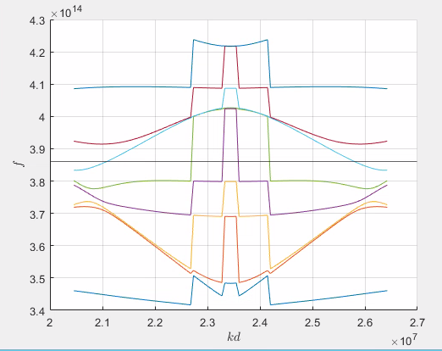
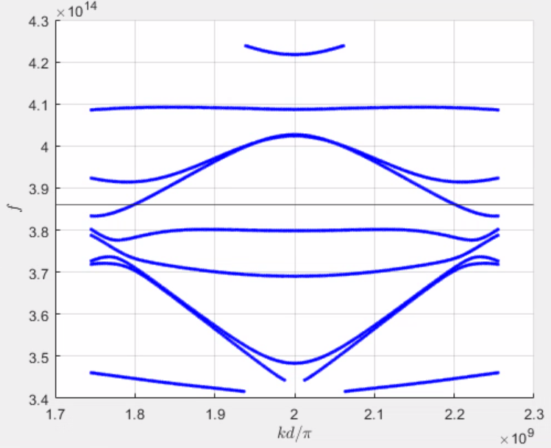
Updated optimization algorithm
If the dispersion looks weird, plot it as dots, and you will get the actual dispersion

Slide 10
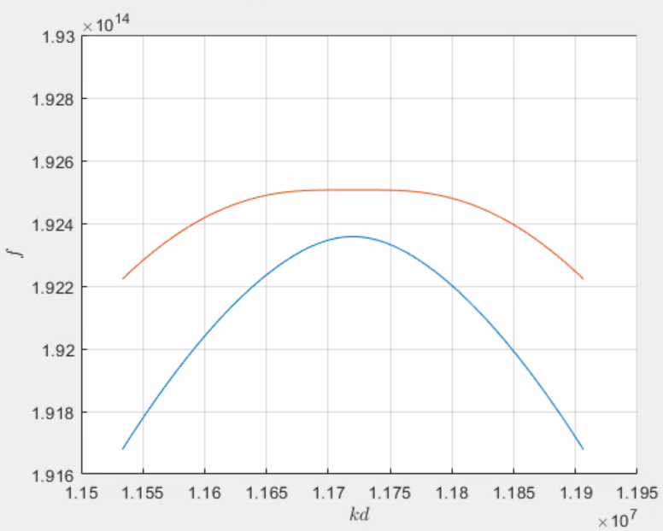
Optimization result #1
% Initial Parameters
period = 268.0579; % In nm
owgWidth = 208.0555;
gap = 181.6743;
teethWidth = 196.0664;
teethShift = period/2;
teethThickness = period/2;
claddingLength = 1500;
However, we do not achieve phase matching, i.e., $n_{f}−n_{2f}≠0$

Slide 11
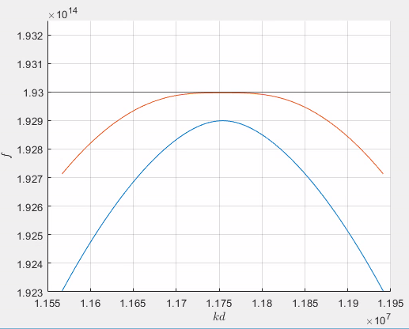
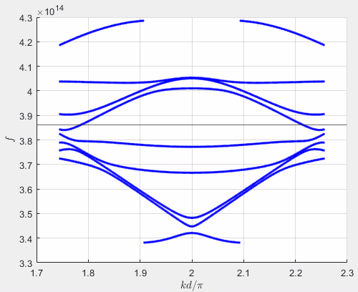
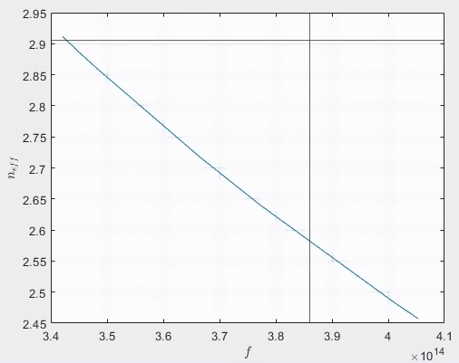
Optimization result #2
% Initial Parameters
period = 267.2766; % In nm
owgWidth = 200.1254;
gap = 196.7525;
teethWidth = 214.1481;
teethShift = period/2;
teethThickness = period/2;
claddingLength = 1500;

Slide 12
DBE & confined modes work; Phase matching does not
Problem: There are different modes at the SHF, and each has a different effective refractive index
kx crossing the SHF (black line):
20963995.0043497
26052356.6491776
freq crossing the SHF (black line):
385923718657626
385923718657626
I wrote an optimization code that will do the phase matching of the mode whose modal index is closest to the modal index at the fundamental frequency (DBE freq)

Slide 13
Optimization result #3

Slide 14
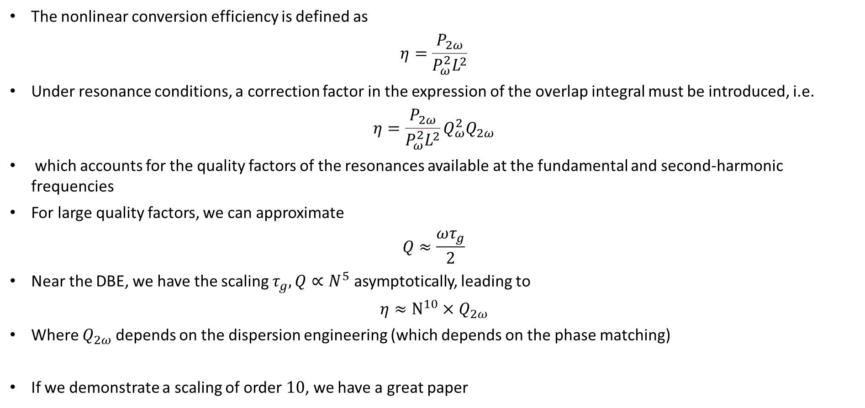
Hazy formalism for DBE-enhanced SHG
The nonlinear conversion efficiency is defined as
$$η=\frac{P_{2ω}}{P_{ω}^{2}L^{2}}$$
Under resonance conditions, a correction factor in the expression of the overlap integral must be introduced, i.e.
$$η=\frac{P_{2ω}}{P_{ω}^{2}L^{2}}Q_{ω}^{2}Q_{2ω}$$
which accounts for the quality factors of the resonances available at the fundamental and second-harmonic frequencies
For large quality factors, we can approximate
$$Q≈\frac{ωτ_{g}}{2}$$
Near the DBE, we have the scaling $τ_{g}, Q∝N^{5}$ asymptotically, leading to
$$η≈N^{10}×Q_{2ω}$$
Where $Q_{2ω}$ depends on the dispersion engineering (which depends on the phase matching)
If we demonstrate a scaling of order $10$, we have a great paper

