Slide 1

Help with Comsol
A. Herrero-Parareda, N. Furman
Department of Electrical Engineering and Computer Science

Slide 2
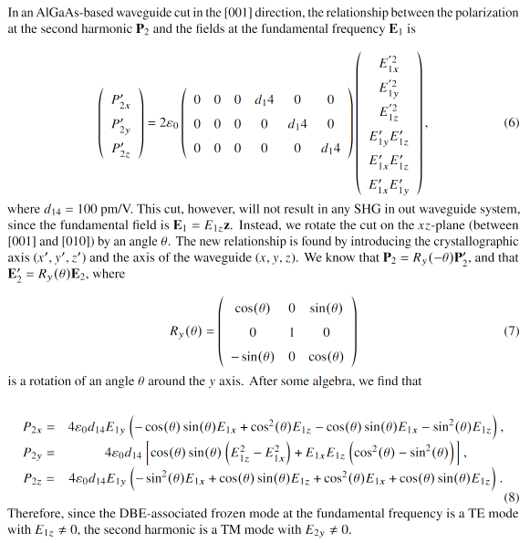
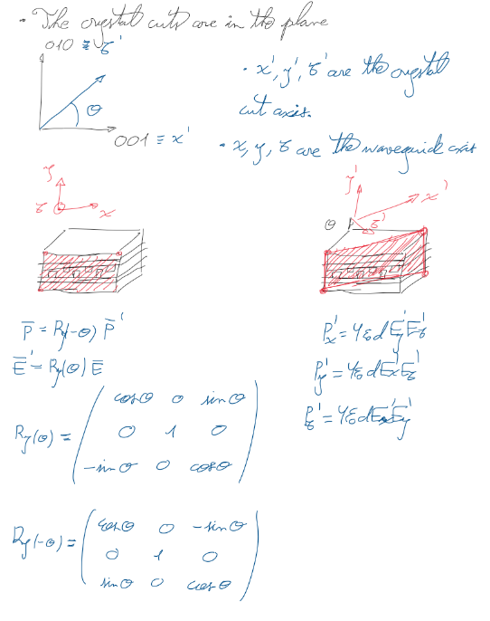
Crystal cuts and the $P_{2}∝E_{1}$ relations

Slide 3
Down-conversion
We are taking the non-depleted pump approximation, by which the down-conversion is not strong enough to perturb the second harmonic generation process

Slide 4
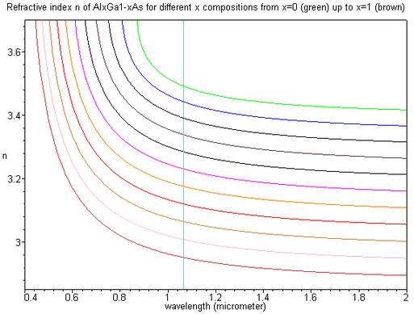
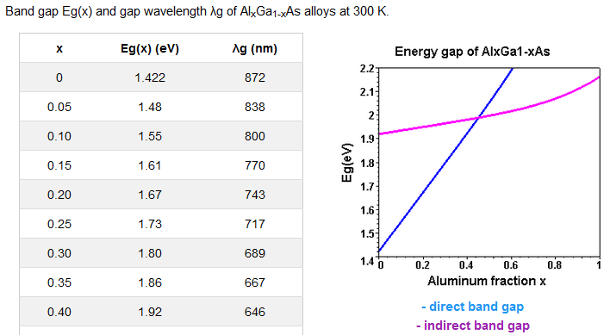
$$Al_{x}Ga_{1−x}As$$
We want the frequency of the second harmonic to fall within the band gap of the material to prevent absorption
Therefore, we have chosen to work with $x=0.2$, resulting in a refractive index of $n≈3.27 @ 1550$nm [1]
[2]
[3]
lambda_vec = linspace(800,2000,13);
n_x02_vec = [3.551 3.491 3.455 4.428 3.410 3.393 3.382 3.372 3.366 3.356 3.354 3.332 3.311];
[1] Weiqiang Xie, Lin Chang, Haowen Shu, Justin C. Norman, Jon D. Peters, Xingjun Wang, and John E. Bowers, "Ultrahigh-Q AlGaAs-on-insulator microresonators for integrated nonlinear photonics," Opt. Express 28, 32894-32906 (2020)
[2] https://batop.de/information/Eg_AlGaAs.html
[3] https://www.batop.de/information/n_AlGaAs.html

Slide 5
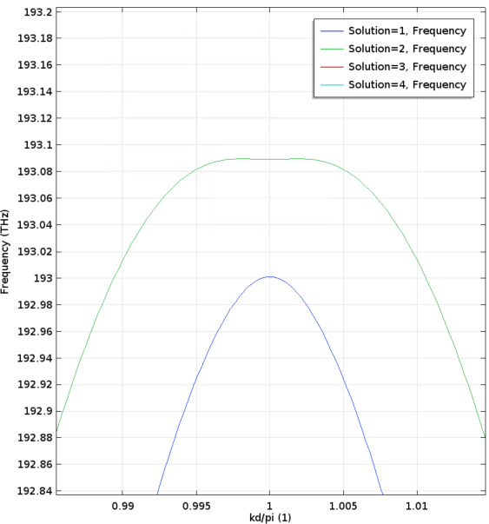
Double grating with a DBE
We have designed a double grating that supports a TE-DBE at $f_{D}=193.043$THz
Because of the tensorial nature of the SHG process in AlGaAs, we know that the second harmonic will be a TM wave
TE-dispersion diagram
TM-dispersion diagram

Slide 6
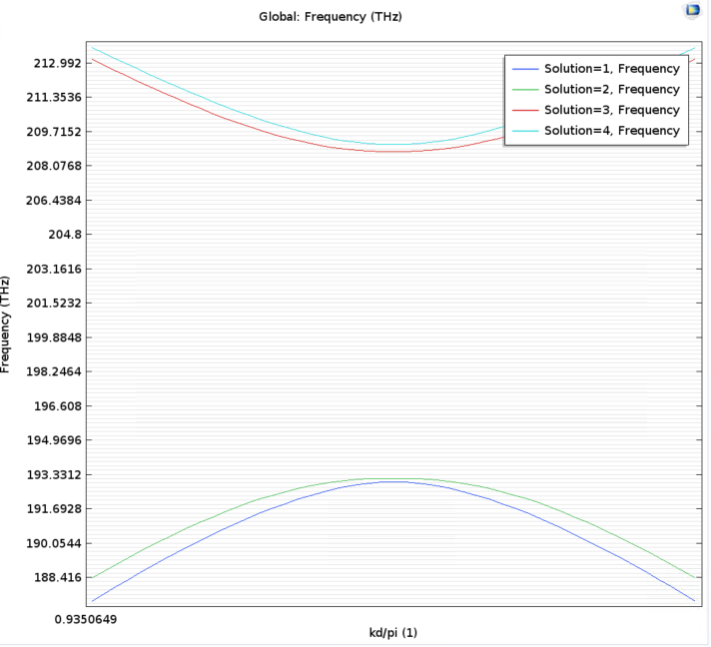
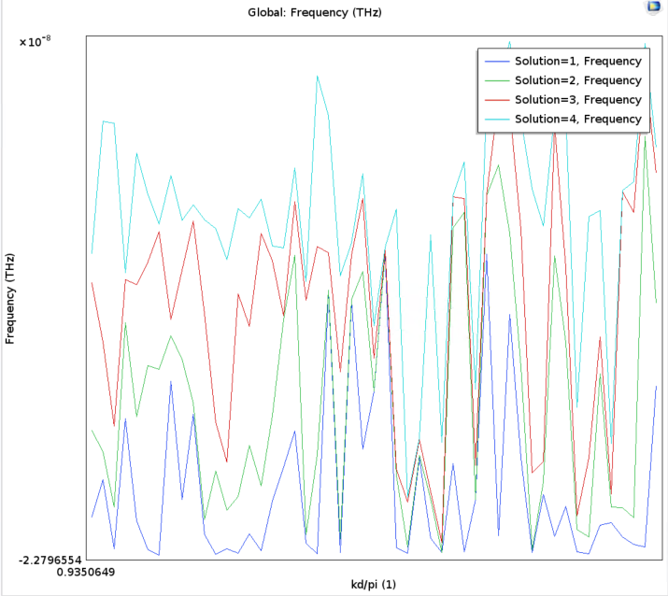
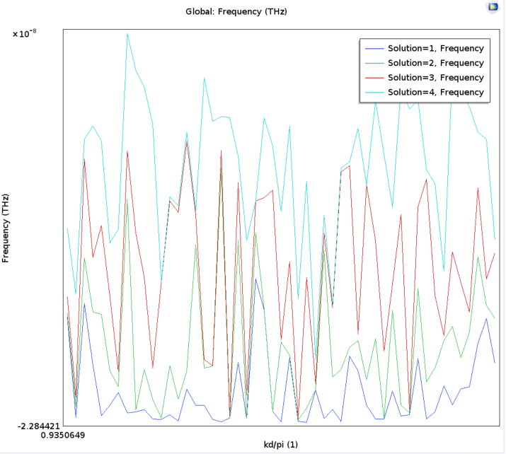



TM dispersion diagram issues
Getting the TE-dispersion diagram is straightforward
Adapting the code to obtain the TM-dispersion diagram is resulting more complicated than expected
There are three options when choosing the polarization fields are solved for. Below are the results only changing that:

Slide 7

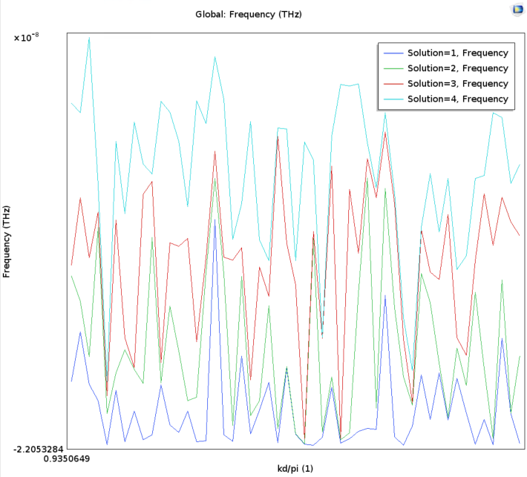
TM dispersion with PML on top and bottom
Did not work either

