Slide 1

DBE dispersion diagram
A. Herrero-Parareda, N. Furman
Department of Electrical Engineering and Computer Science

Slide 2
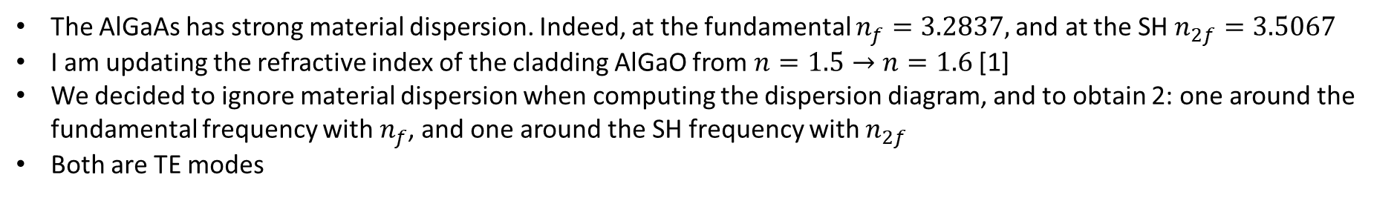
Material dispersion and dispersion diagram
The AlGaAs has strong material dispersion. Indeed, at the fundamental $n_{f}=3.2837,$and at the SH $n_{2f}=3.5067$
I am updating the refractive index of the cladding AlGaO from $n=1.5→n=1.6$[1]
We decided to ignore material dispersion when computing the dispersion diagram, and to obtain 2: one around the fundamental frequency with $n_{f}$, and one around the SH frequency with $n_{2f}$
Both are TE modes
[1] Liu, S., Vabishchevich, P.P., Vaskin, A. et al. An all-dielectric metasurface as a broadband optical frequency mixer. Nat Commun 9, 2507 (2018). https://doi.org/10.1038/s41467-018-04944-9

Slide 3

Updated refr. index
$$n_{f}=3.27→n_{f}=3.2837$$
We must optimize parameter values to have a DBE with the updated refr. index

Slide 5
Finding DBE resonance frequencies
With S-parameters
For $N=120$

Slide 6
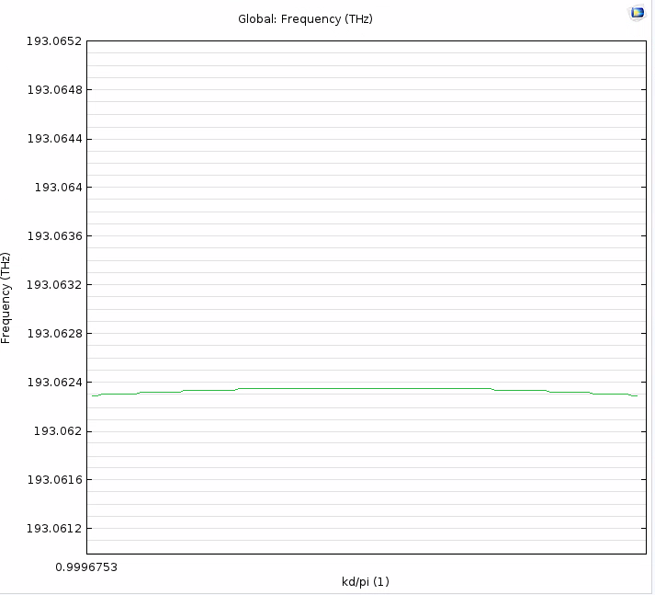
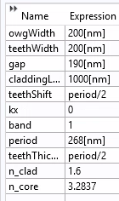
Refining DBE

Slide 7
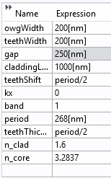
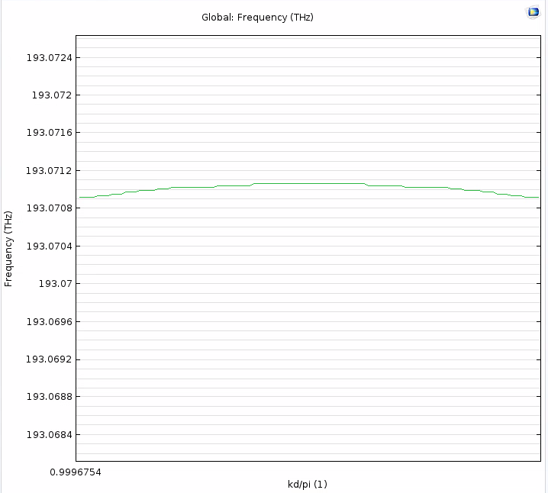

Slide 8
