Slide 1

DBE dispersion diagram
A. Herrero-Parareda, N. Furman
Department of Electrical Engineering and Computer Science

Slide 2
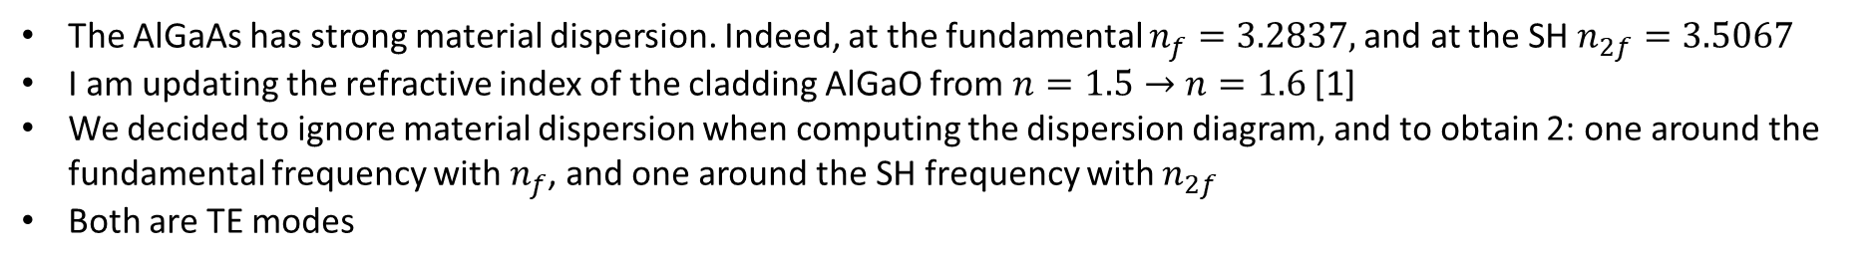
Material dispersion and dispersion diagram
The AlGaAs has strong material dispersion. Indeed, at the fundamental $n_{f}=3.2837,$and at the SH $n_{2f}=3.5067$
I am updating the refractive index of the cladding AlGaO from $n=1.5→n=1.6$[1]
We decided to ignore material dispersion when computing the dispersion diagram, and to obtain 2: one around the fundamental frequency with $n_{f}$, and one around the SH frequency with $n_{2f}$
Both are TE modes
[1] Liu, S., Vabishchevich, P.P., Vaskin, A. et al. An all-dielectric metasurface as a broadband optical frequency mixer. Nat Commun 9, 2507 (2018). https://doi.org/10.1038/s41467-018-04944-9

Slide 3
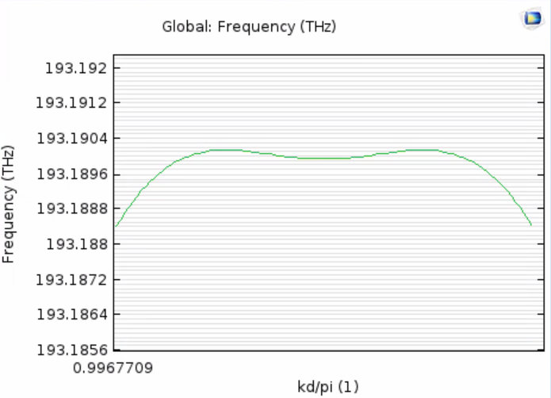
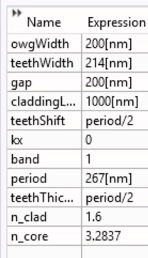
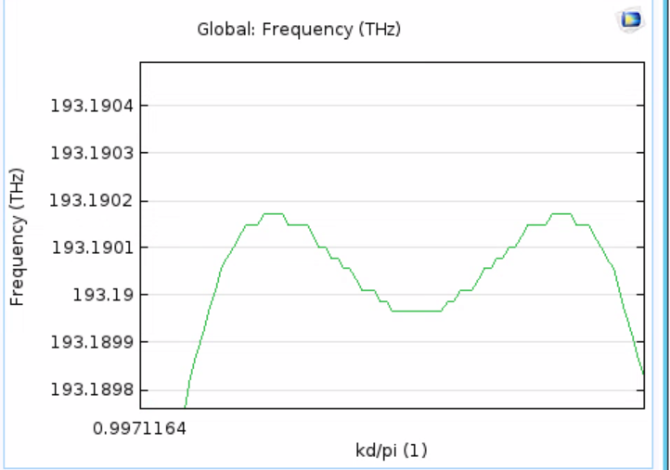
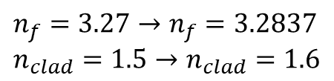

Updated refr. index; New DBE
$$n_{f}=3.27→n_{f}=3.2837 \\ n_{clad}=1.5→n_{clad}=1.6$$
We must optimize parameter values to have a DBE with the updated refr. index
$$Δf=0.0003 THz$$

Slide 4
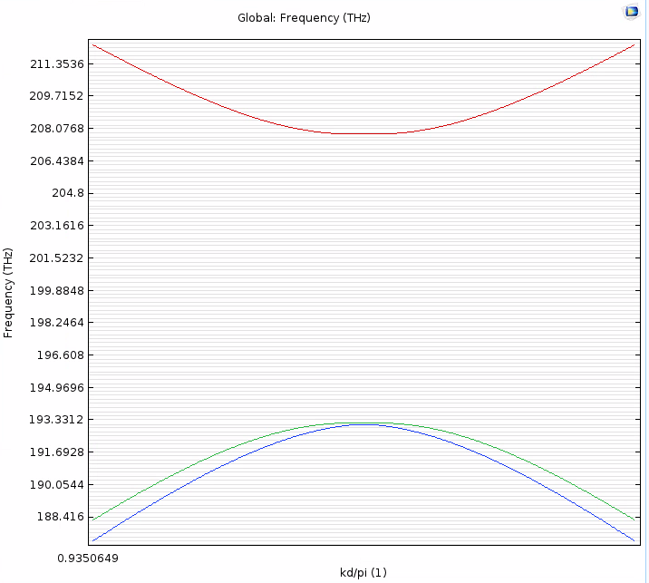

TE-dispersion at $f$ & $2f$
$$n_{f}=3.2837$$

Slide 5
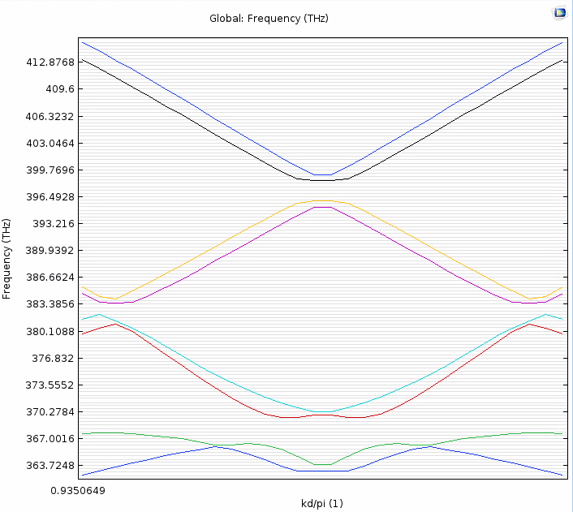
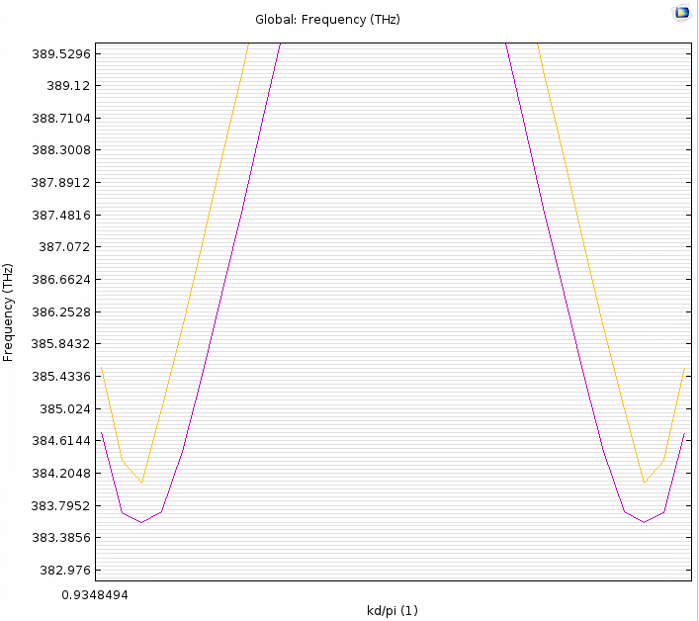

2f dispersion diagram: $f_{SH}≤2f_{DBE}=386.38$ THz
$$n_{2f}=3.5067$$
Search: 8 modes
(Kd-0.2)/pi, 30 steps

Slide 6
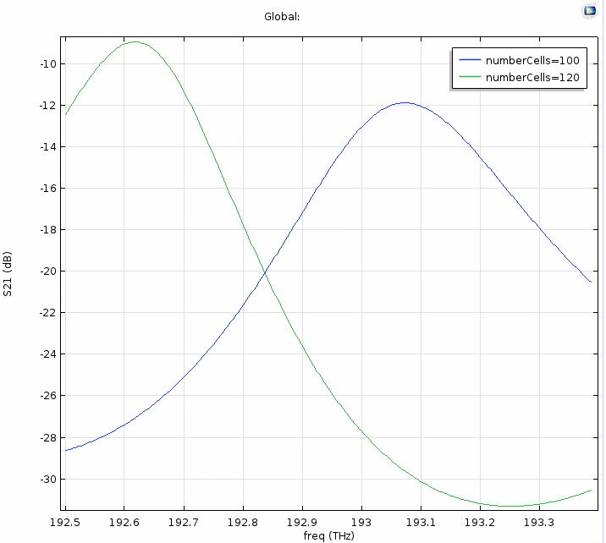
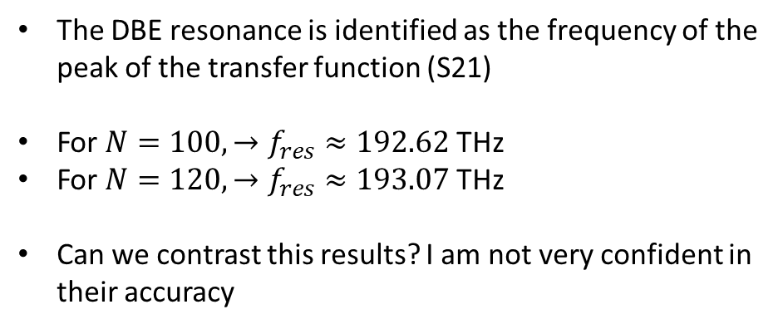
S-parameters and DBE resonance for $N=100, 120$
The DBE resonance is identified as the frequency of the peak of the transfer function (S21)
For $N=100, →f_{res}≈192.62$THz
For $N=120, →f_{res}≈193.07$ THz
Can we contrast this results? I am not very confident in their accuracy

Slide 7
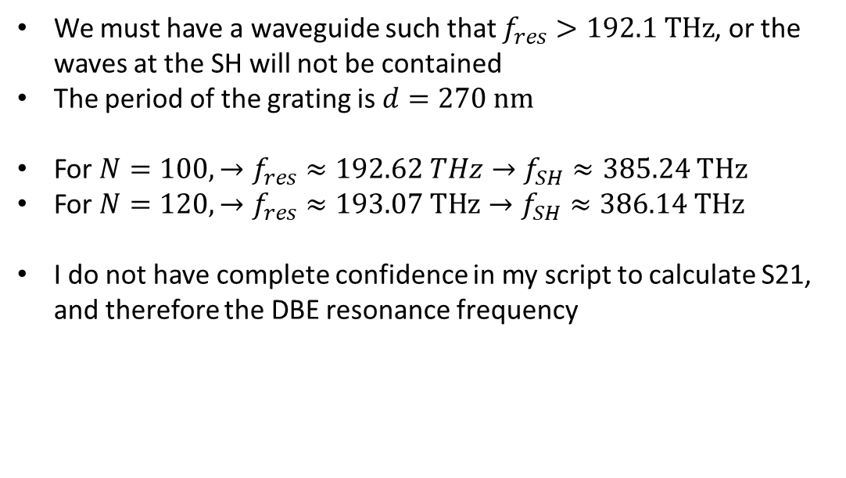
Minimum number of $N$ to see DBE-enhanced SHG
We must have a waveguide such that $f_{res}>192.1 THz$, or the waves at the SH will not be contained
The period of the grating is $d=270 nm$
For $N=100, →f_{res}≈192.62 THz→f_{SH}≈385.24 THz$
For $N=120, →f_{res}≈193.07 THz→f_{SH}≈386.14 THz$
I do not have complete confidence in my script to calculate S21, and therefore the DBE resonance frequency

