Slide 1

DBE dispersion diagram
A. Herrero-Parareda, N. Furman
Department of Electrical Engineering and Computer Science

Slide 2
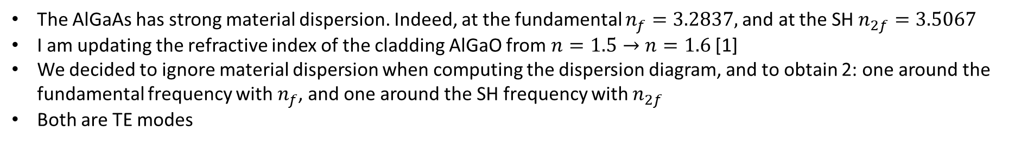
Material dispersion and dispersion diagram
The AlGaAs has strong material dispersion. Indeed, at the fundamental $n_{f}=3.2837,$and at the SH $n_{2f}=3.5067$
I am updating the refractive index of the cladding AlGaO from $n=1.5→n=1.6$[1]
We decided to ignore material dispersion when computing the dispersion diagram, and to obtain 2: one around the fundamental frequency with $n_{f}$, and one around the SH frequency with $n_{2f}$
Both are TE modes
[1] Liu, S., Vabishchevich, P.P., Vaskin, A. et al. An all-dielectric metasurface as a broadband optical frequency mixer. Nat Commun 9, 2507 (2018). https://doi.org/10.1038/s41467-018-04944-9

Slide 3
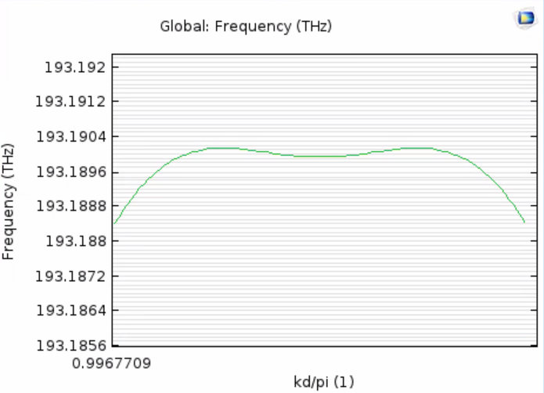
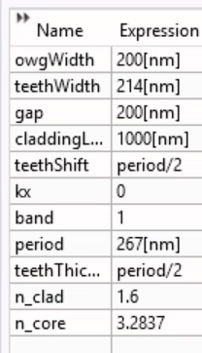
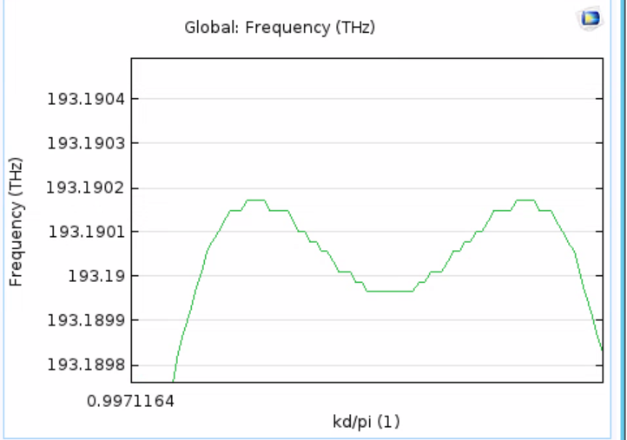
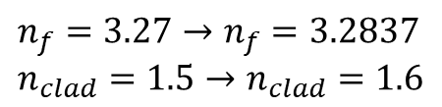

Updated refr. index; New DBE
$$n_{f}=3.27→n_{f}=3.2837 \\ n_{clad}=1.5→n_{clad}=1.6$$
We must optimize parameter values to have a DBE with the updated refr. index
$$Δf=0.0003 THz$$

Slide 4
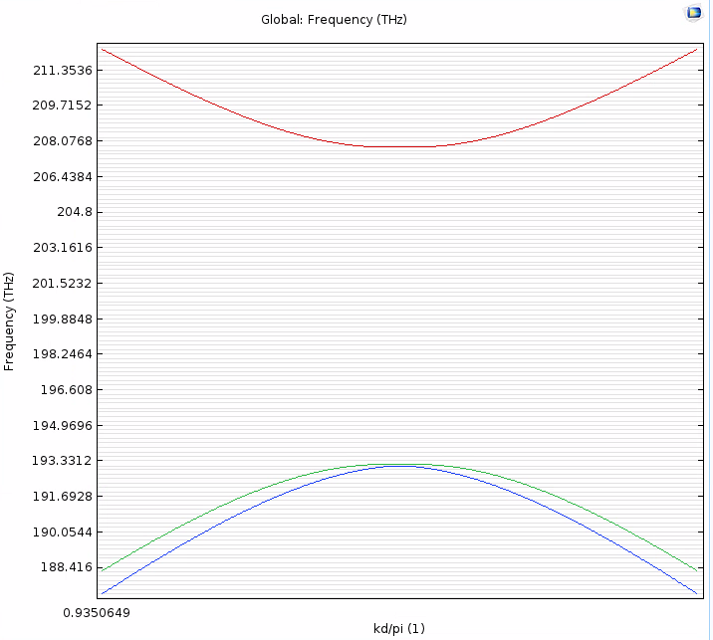

TE-dispersion at $f$ & $2f$
$$n_{f}=3.2837$$

Slide 5
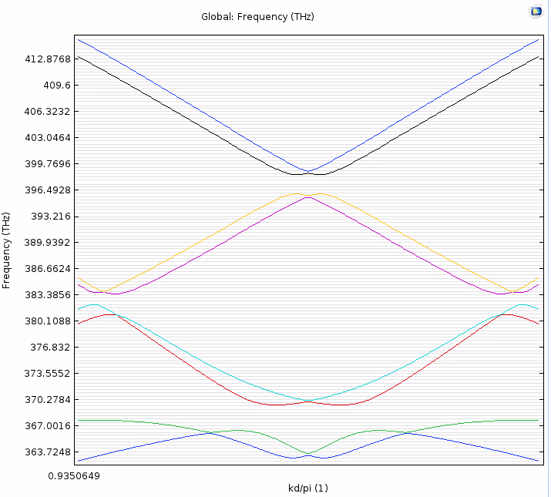
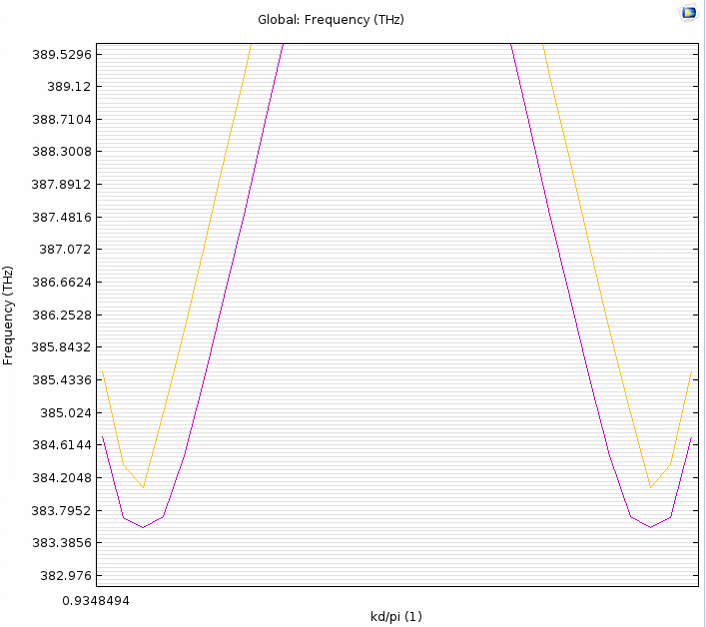

2f dispersion diagram: $f_{SH}≤2f_{DBE}=386.38$ THz
$$n_{2f}=3.5067$$
Search: 8 modes
(Kd-0.2)/pi, 30 steps

Slide 6
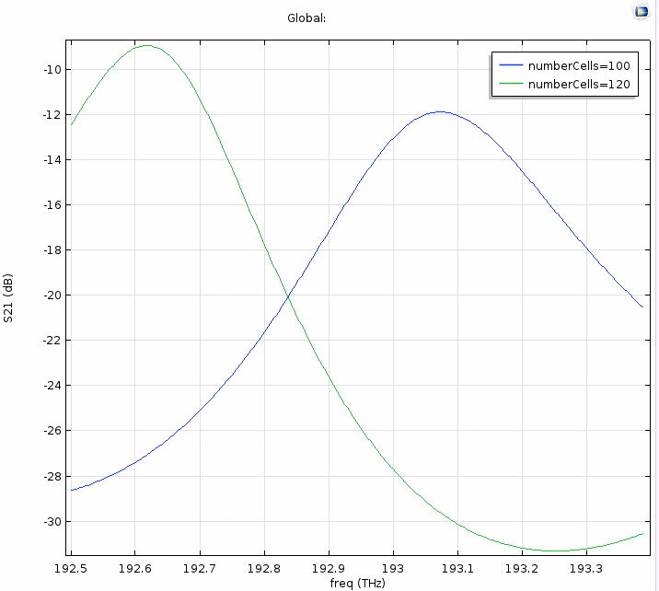
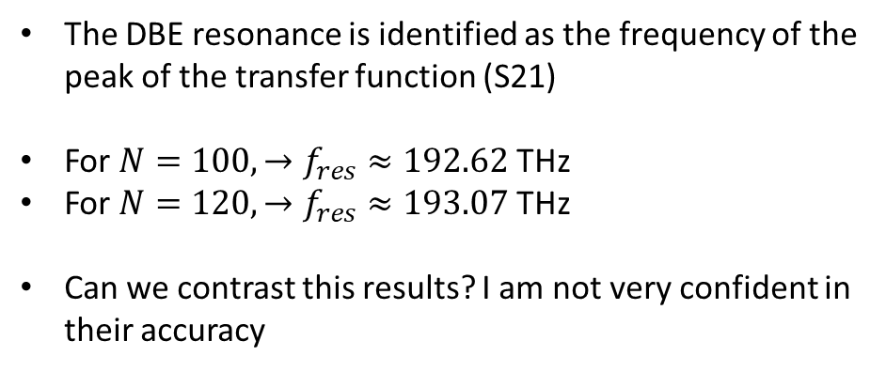
S-parameters and DBE resonance for $N=100, 120$
The DBE resonance is identified as the frequency of the peak of the transfer function (S21)
For $N=100, →f_{res}≈192.62$THz
For $N=120, →f_{res}≈193.07$ THz
Can we contrast this results? I am not very confident in their accuracy

Slide 7
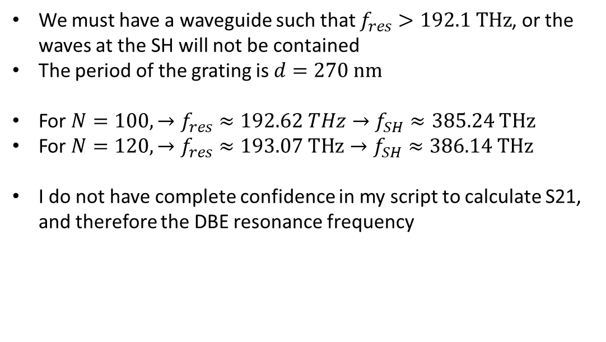
Minimum number of $N$ to see DBE-enhanced SHG
We must have a waveguide such that $f_{res}>192.1 THz$, or the waves at the SH will not be contained
The period of the grating is $d=270 nm$
For $N=100, →f_{res}≈192.62 THz→f_{SH}≈385.24 THz$
For $N=120, →f_{res}≈193.07 THz→f_{SH}≈386.14 THz$
I do not have complete confidence in my script to calculate S21, and therefore the DBE resonance frequency

Slide 8
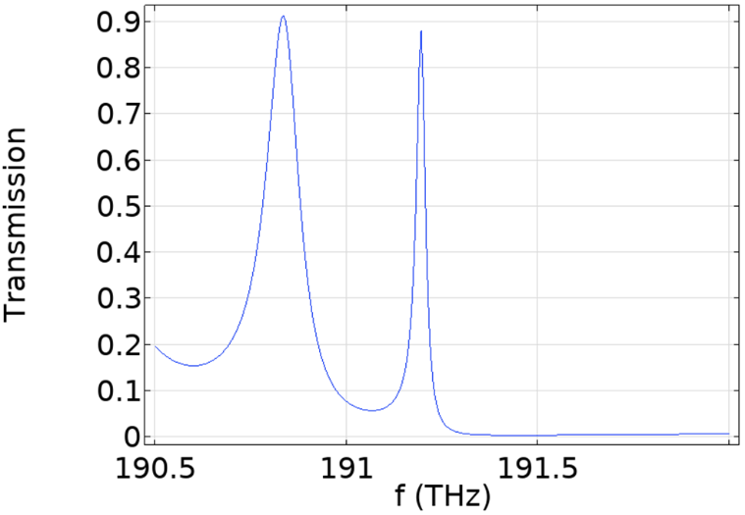
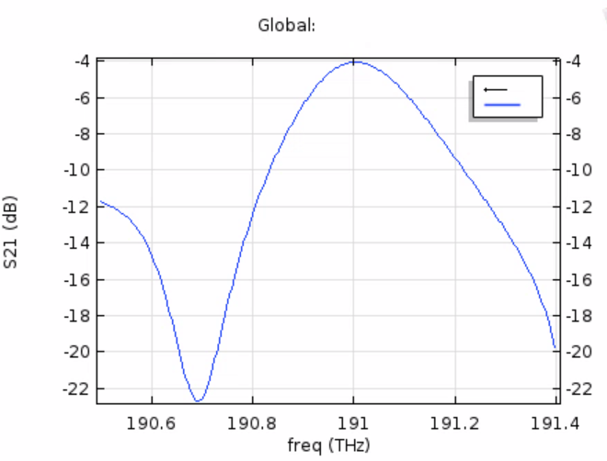
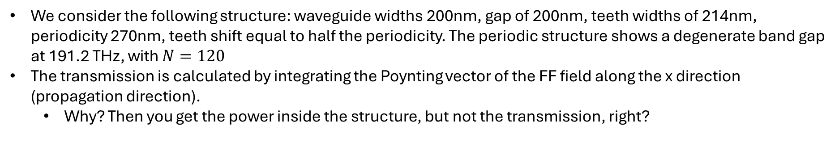
Comparison with Domenico’s transmission
We consider the following structure: waveguide widths 200nm, gap of 200nm, teeth widths of 214nm, periodicity 270nm, teeth shift equal to half the periodicity. The periodic structure shows a degenerate band gap at 191.2 THz, with $N=120$
The transmission is calculated by integrating the Poynting vector of the FF field along the x direction (propagation direction).
Why? Then you get the power inside the structure, but not the transmission, right?
We do not get the same result

Slide 9
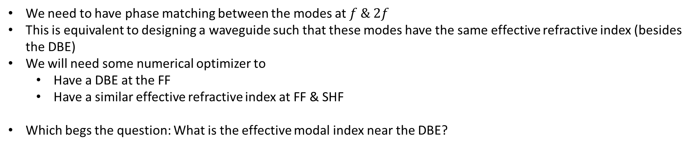
Phase Mismatch
We need to have phase matching between the modes at $f \& 2f$
This is equivalent to designing a waveguide such that these modes have the same effective refractive index (besides the DBE)
We will need some numerical optimizer to
Have a DBE at the FF
Have a similar effective refractive index at FF & SHF
Which begs the question: What is the effective modal index near the DBE?

Slide 10
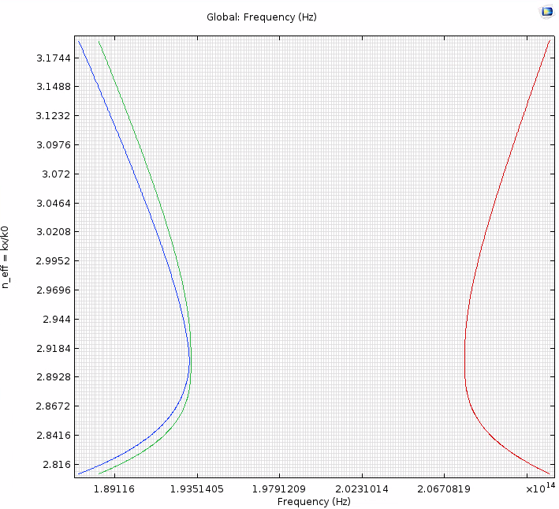
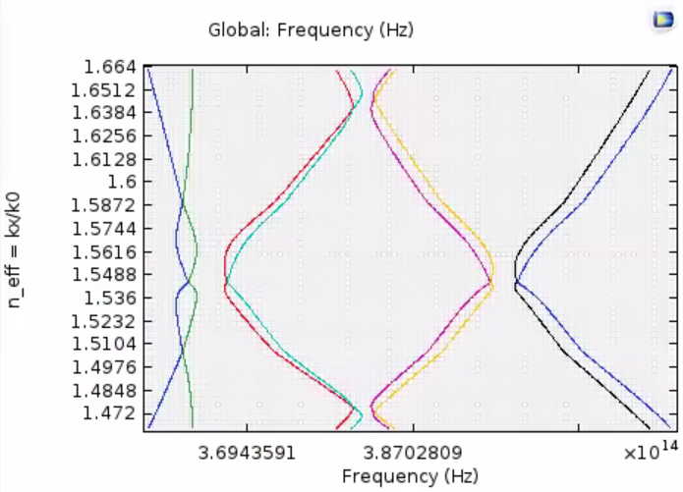
Modal index investigations
We want to achieve the same effective modal indices at f & 2f
We have approximately half, however
We need to redesign the double grating to reduce this gap

Slide 11
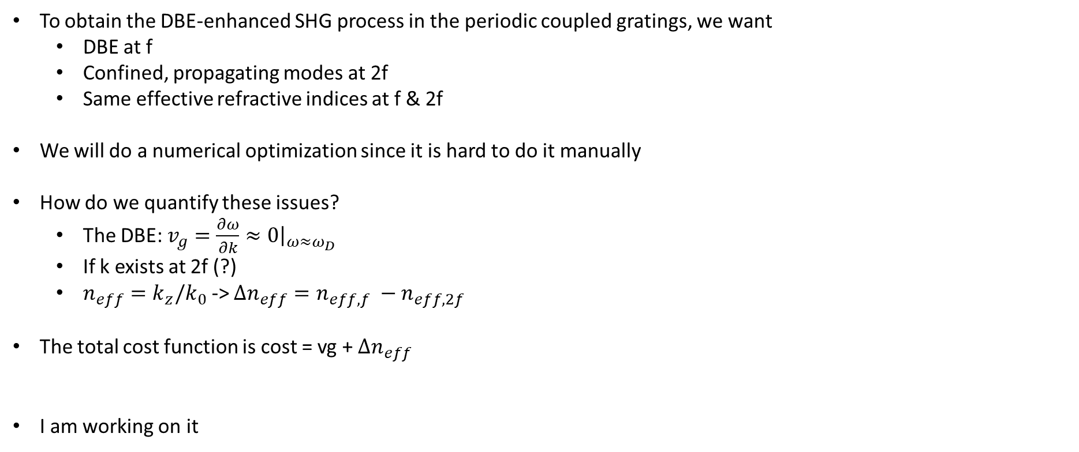
Numerical Optimization
To obtain the DBE-enhanced SHG process in the periodic coupled gratings, we want
DBE at f
Confined, propagating modes at 2f
Same effective refractive indices at f & 2f
We will do a numerical optimization since it is hard to do it manually
How do we quantify these issues?
The DBE: $v_{g}=\frac{∂ω}{∂k}≈0{\left.​\right|}_{ω≈ω_{D}}$
If k exists at 2f (?)
$n_{eff}=k_{z}/k_{0}$ -> $Δn_{eff}=n_{eff,f} −n_{eff,2f}$
The total cost function is cost = vg + $Δn_{eff}$
I am working on it

Slide 12
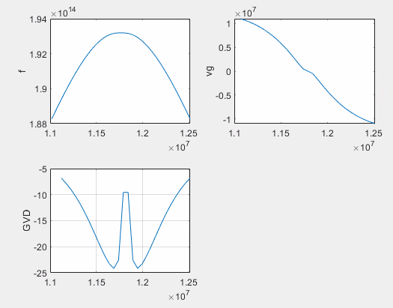
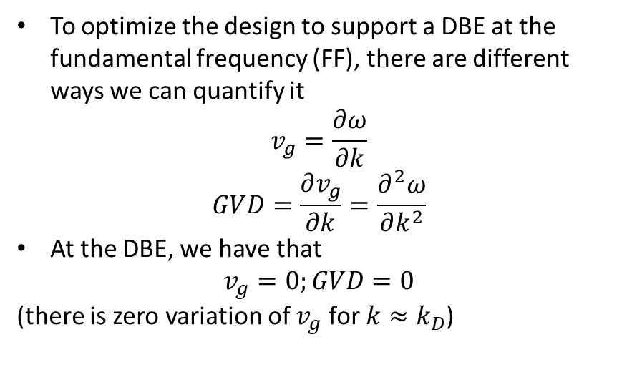
Numerical optimization prep
To optimize the design to support a DBE at the fundamental frequency (FF), there are different ways we can quantify it
$$v_{g}=\frac{∂ω}{∂k}$$
$$GVD=\frac{∂v_{g}}{∂k}=\frac{∂^{2}ω}{∂k^{2}}$$
At the DBE, we have that
$$v_{g}=0;GVD=0$$
(there is zero variation of $v_{g}$ for $k≈k_{D}$)
Need more data points to better see what happens

Slide 13
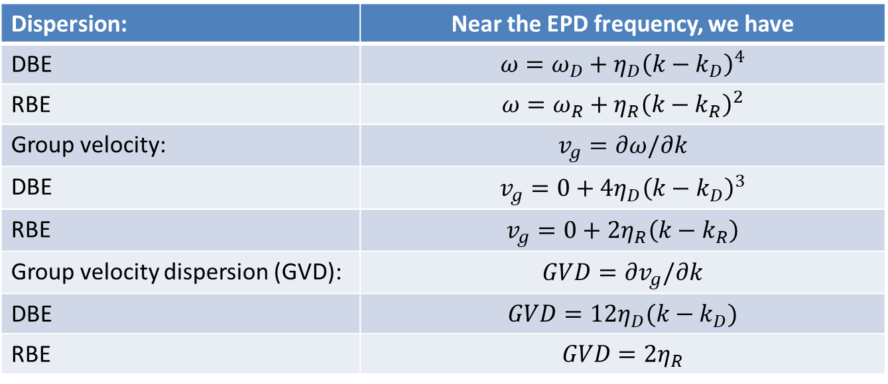
Numerical optimization: DBE or RBE?
Dispersion: | Near the EPD frequency, we have
DBE | $$ω=ω_{D}+η_{D}{\left(k−k_{D}\right)}^{4}$$
RBE | $$ω=ω_{R}+η_{R}{\left(k−k_{R}\right)}^{2}$$
Group velocity: | $$v_{g}=∂ω/∂k$$
DBE | $$v_{g}=0+4η_{D}{\left(k−k_{D}\right)}^{3}$$
RBE | $$v_{g}=0+2η_{R}\left(k−k_{R}\right)$$
Group velocity dispersion (GVD): | $$GVD=∂v_{g}/∂k$$
DBE | $$GVD=12η_{D}(k−k_{D})$$
RBE | $$GVD=2η_{R}$$
Both DBE and RBE have zero group velocity at the EPD
The RBE has a GVD independent of the position in the BZ
The DBE has a GVD = 0 at the EPD

Slide 14
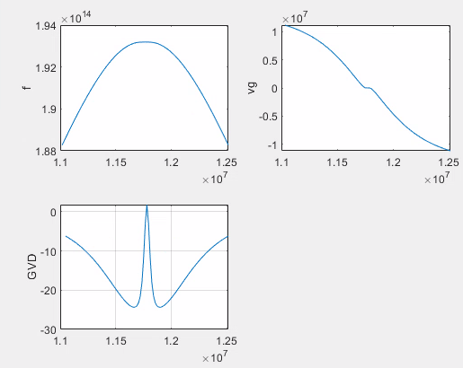
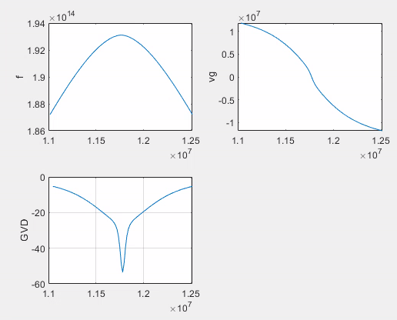
DBE vs RBE behavior
We can use the GVD to measure the DBE
Then we just need a few points around $k_{D}=\frac{π}{d}$ to calculate the GVD and impose it to go to zero

Slide 15
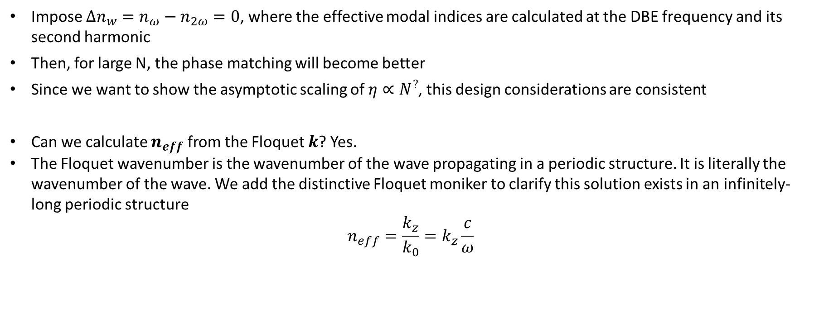
Same effective refractive indices
Impose $Δn_{w}=n_{ω}−n_{2ω}=0$, where the effective modal indices are calculated at the DBE frequency and its second harmonic
Then, for large N, the phase matching will become better
Since we want to show the asymptotic scaling of $η∝N^{?}$, this design considerations are consistent
Can we calculate $n_{eff}$ from the Floquet $k$? Yes.
The Floquet wavenumber is the wavenumber of the wave propagating in a periodic structure. It is literally the wavenumber of the wave. We add the distinctive Floquet moniker to clarify this solution exists in an infinitely-long periodic structure
$$n_{eff}=\frac{k_{z}}{k_{0}}=k_{z}\frac{c}{ω}$$

Slide 16
Optimizer:
\Delta kd = 0.1
Number of values = 31

Slide 17
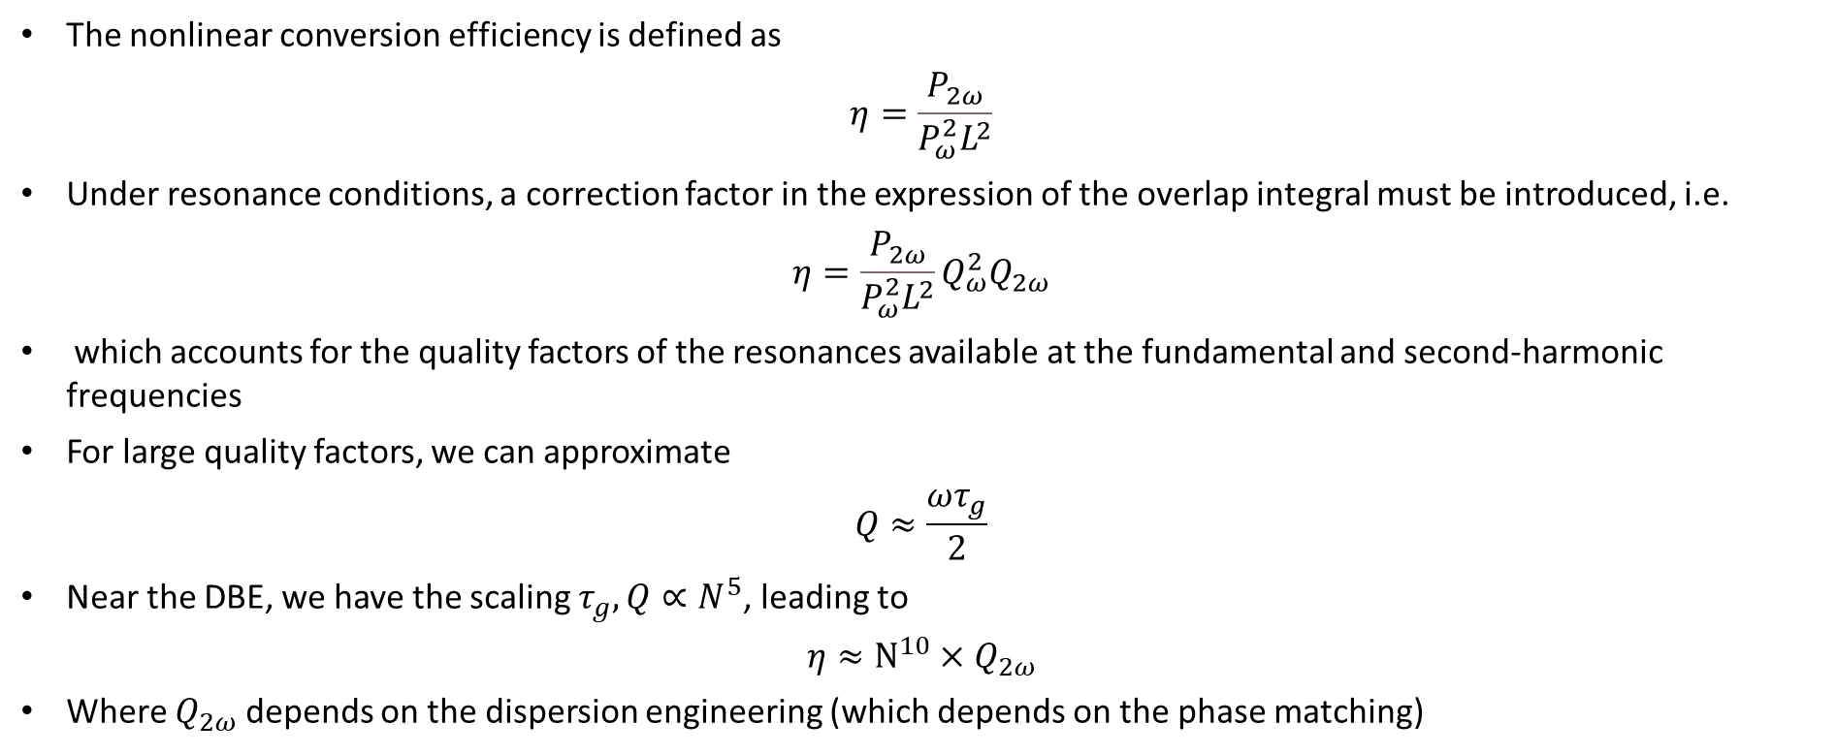
Hazy formalism for DBE-enhanced SHG
The nonlinear conversion efficiency is defined as
$$η=\frac{P_{2ω}}{P_{ω}^{2}L^{2}}$$
Under resonance conditions, a correction factor in the expression of the overlap integral must be introduced, i.e.
$$η=\frac{P_{2ω}}{P_{ω}^{2}L^{2}}Q_{ω}^{2}Q_{2ω}$$
which accounts for the quality factors of the resonances available at the fundamental and second-harmonic frequencies
For large quality factors, we can approximate
$$Q≈\frac{ωτ_{g}}{2}$$
Near the DBE, we have the scaling $τ_{g}, Q∝N^{5}$, leading to
$$η≈N^{10}×Q_{2ω}$$
Where $Q_{2ω}$ depends on the dispersion engineering (which depends on the phase matching)

