Slide 1

Collaboration ideas with Dr. Scheuer
A. Herrero-Parareda
Department of Electrical Engineering and Computer Science

Slide 2
Overview
Replace evanescent couplers with multimode interference (MMI) devices
Analyze effect of mirrors on RBE and SIP resonances
Study group index scaling near the SIP
Study light extraction from the structure
Study real-time simulations using CST (akin to Veysi). Is the laser single-mode around the SIP frequency?
Heat-perturbation analysis (Kerr effect)
Set a meeting time

Slide 3
Conclusion
(Just us) Analyze effect of mirrors on RBE and SIP resonances
(Scheuer discussion) Real-time simulations (akin to Veysi) -> Lumerical
(Scheuer discussion) Multimode Interference (MMI) devices -> New SIP device

Slide 4
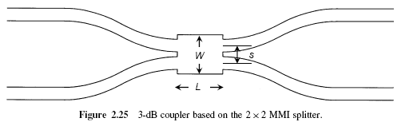
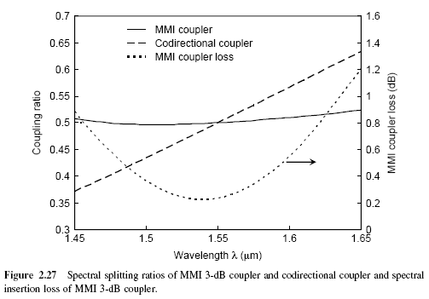
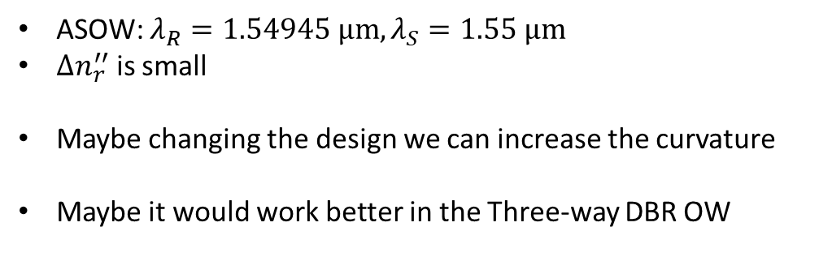


Multimode interference (MMI) couplers
Evanescent coupler
$$n_{r}^{′′}\left(λ_{R}\right)>n_{r}^{′′}\left(λ_{S}\right)→{|n}_{R,th}^{′′}|<{|n}_{S,th}^{′′}|$$
$$λ_{R}$$
$$λ_{S}$$
ASOW: $λ_{R}=1.54945 μm, λ_{S}=1.55 μm$
$Δn_{r}^{′′}$ is small
Maybe changing the design we can increase the curvature
Maybe it would work better in the Three-way DBR OW
[1] Katsunari Okamoto, Fundamentals of Optical waveguides, Academic Press, 2nd edition, 2005

Slide 5
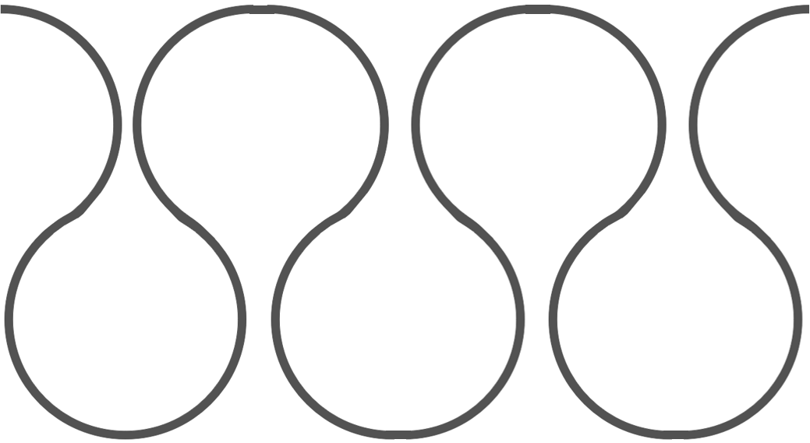

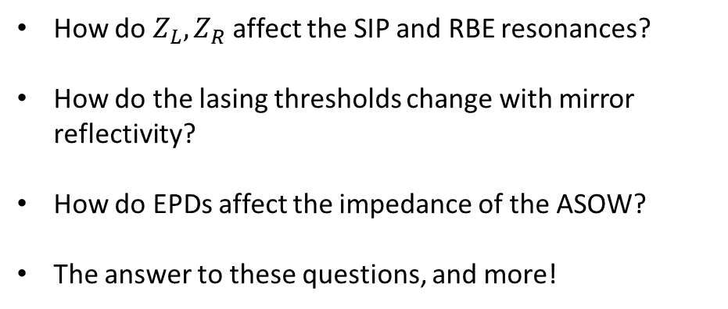


Analyze the effect of mirrors on RBE and SIP resonances
$$Z_{L}$$
$$Z_{S}/Z_{R}$$
$$Z_{R}$$
How do $Z_{L}, Z_{R}$ affect the SIP and RBE resonances?
How do the lasing thresholds change with mirror reflectivity?
How do EPDs affect the impedance of the ASOW?
The answer to these questions, and more!
…
…

Slide 6
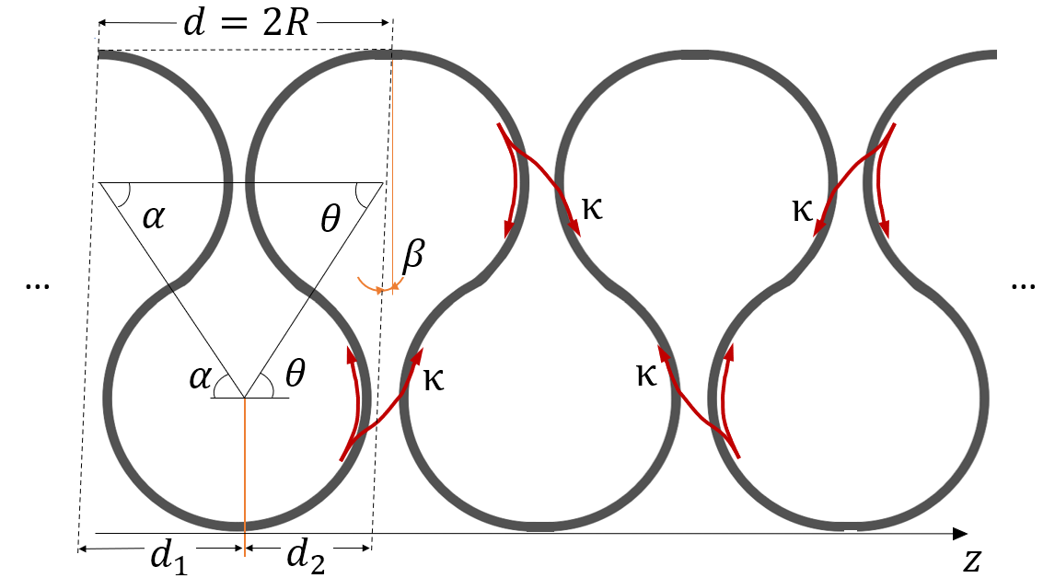
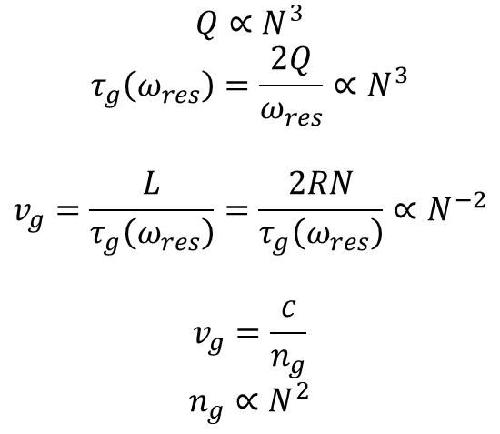
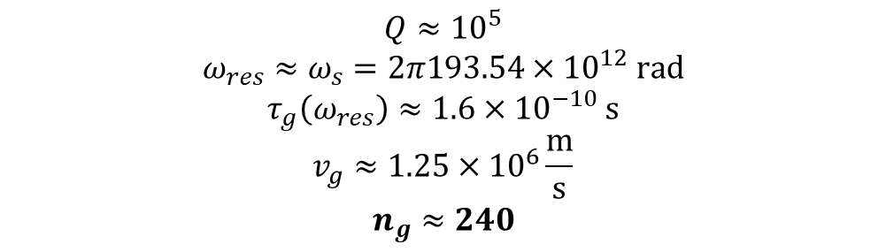
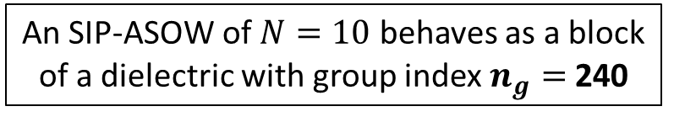

Group index scaling near an SIP
Let’s take a closer look:
$$Q∝N^{3}$$
$$τ_{g}\left(ω_{res}\right)=\frac{2Q}{ω_{res}}∝N^{3}$$
$$v_{g}=\frac{L}{τ_{g}\left(ω_{res}\right)}=\frac{2RN}{τ_{g}\left(ω_{res}\right)}∝N^{−2}$$
$$v_{g}=\frac{c}{n_{g}}$$
$$n_{g}∝N^{2}$$
$$n_{g}= ?$$
In numbers: for $N=10$
$$Q≈{10}^{5}$$
$$ω_{res}≈ω_{s}=2π193.54×{10}^{12} rad$$
$$τ_{g}\left(ω_{res}\right)≈1.6×{10}^{−10} s$$
$$v_{g}≈1.25×{10}^{6}\frac{m}{s}$$
$$n_{g}≈240$$
An SIP-ASOW of $N=10$ behaves as a block of a dielectric with group index $n_{g}=$240
Can this concept be used to study mirrors?
Can this concept be used to intuitively explain EPDs to an audience?

Slide 7
Real-time simulations using CST
Is the SIP laser single-mode?
What is the transient response?
What are the electric-field amplitudes inside the cavity?
Cons: we need a full-wave design

Slide 8
Heat-perturbation analysis
How can we model heat?
How does it change the dispersion relation? (What is the strength of the Kerr effect?)
What is the heat distribution operating the waveguide near an SIP? (What are the field amplitudes inside the cavity?)
What is the heat distribution operating the active waveguide near an SIP?
How can we make the heat distribution uniform?
Can we use heat to tune the SIP frequency? (Suggested by Ricky Gibson)

Slide 9
Let’s set a meeting time!
A. Herrero-Parareda
Department of Electrical Engineering and Computer Science

