Slide 1

SIP laser
A. Herrero-Parareda
Department of Electrical Engineering and Computer Science

Slide 2
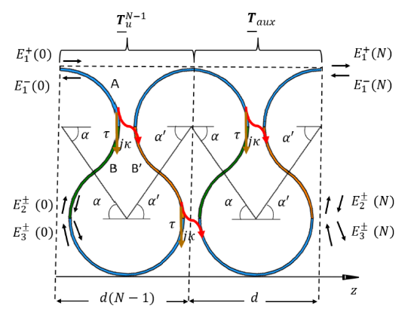
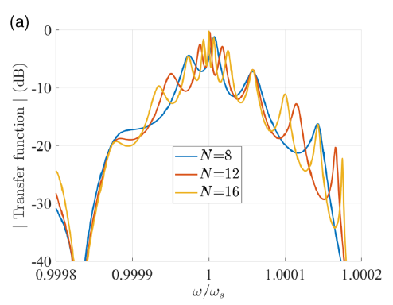
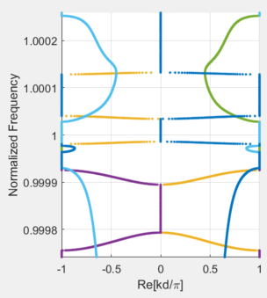
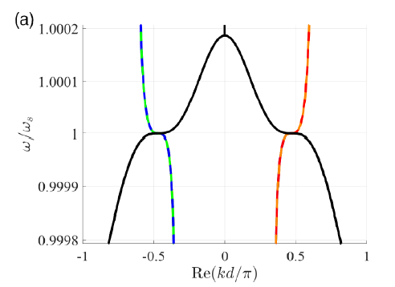
Explaining gaps (pun intended) in the knowledge
The decay of the transfer function is associated to a band edge in the $ω−k$dispersion relation of the full waveguide $8$ unit cells (including the auxiliary cell at the end)

