Slide 1

Collaboration ideas with Dr. Scheuer and Kessem
A. Herrero-Parareda
Department of Electrical Engineering and Computer Science

Slide 2
Overview
SIP in a multimode interference (MMI) device
Study real-time simulations using CST (akin to Veysi). Is the laser single-mode around the SIP frequency?

Slide 3
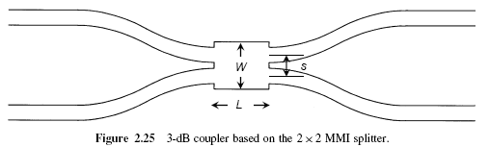
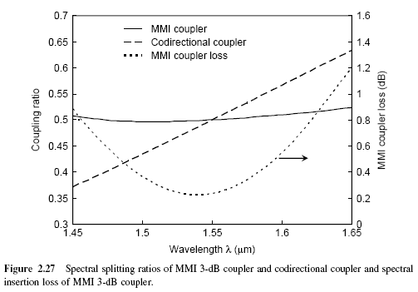
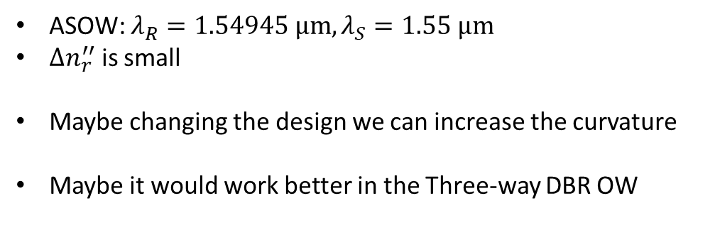


Multimode interference (MMI) couplers
Evanescent coupler
$$n_{r}^{′′}\left(λ_{R}\right)>n_{r}^{′′}\left(λ_{S}\right)→{|n}_{R,th}^{′′}|<{|n}_{S,th}^{′′}|$$
$$λ_{R}$$
$$λ_{S}$$
ASOW: $λ_{R}=1.54945 μm, λ_{S}=1.55 μm$
$Δn_{r}^{′′}$ is small
Maybe changing the design we can increase the curvature
Maybe it would work better in the Three-way DBR OW
[1] Katsunari Okamoto, Fundamentals of Optical waveguides, Academic Press, 2nd edition, 2005

Slide 4










SIP in multimode interference (MMI) devices
The idea is to find an SIP in a three-way MMI coupler
$$E_{i}$$
$$E_{o}$$
The asymmetry can be incorporated using different waveguide lengths in the ports
$$φ_{a}$$
$$φ_{d}$$
$$φ_{b}$$
$$φ_{e}$$
$$E_{i}$$
$$E_{o}$$
$$φ_{c}$$
$$φ_{f}$$

Slide 5
Real-time simulations using CST
Is the SIP laser single-mode?
What is the transient response?
What are the electric-field amplitudes inside the cavity?
We would need a full-wave design:
Nate’s DBR waveguide?

