Slide 1

Degenerate Distributed Feedback Bragg (DDFB) laser
A. Herrero-Parareda
Department of Electrical Engineering and Computer Science

Slide 2

Goals
Previous week:
Nothing, we are just getting started
Objective for this week:
Find DBE with new cladding
Figure out boundary conditions of finite-length structure
Find gainless resonances for each $N$
Simulate different values of gain at the resonance for each $N$
Finished so far:
Found DBE
Not done yet:
The rest

Slide 3
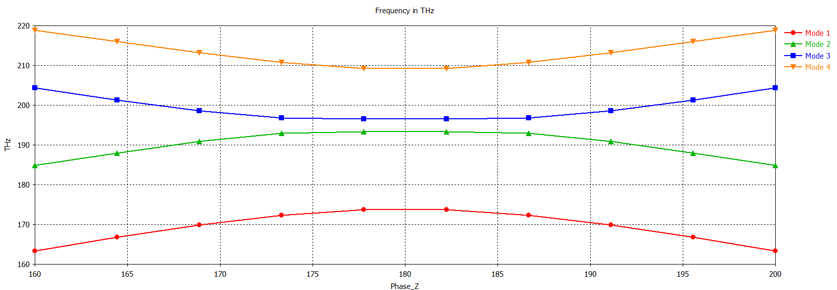
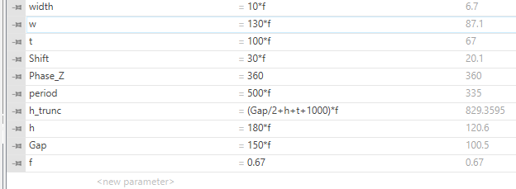
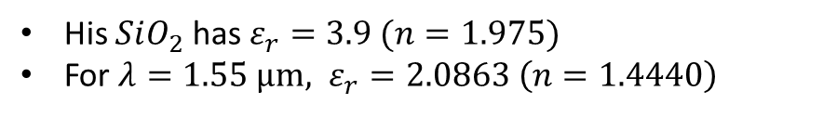
Tarek’s results as reference
His $SiO_{2}$ has $ε_{r}=3.9 (n=1.975)$
For $λ=1.55 μm, ε_{r}=2.0863 \left(n=1.4440\right)$

Slide 4
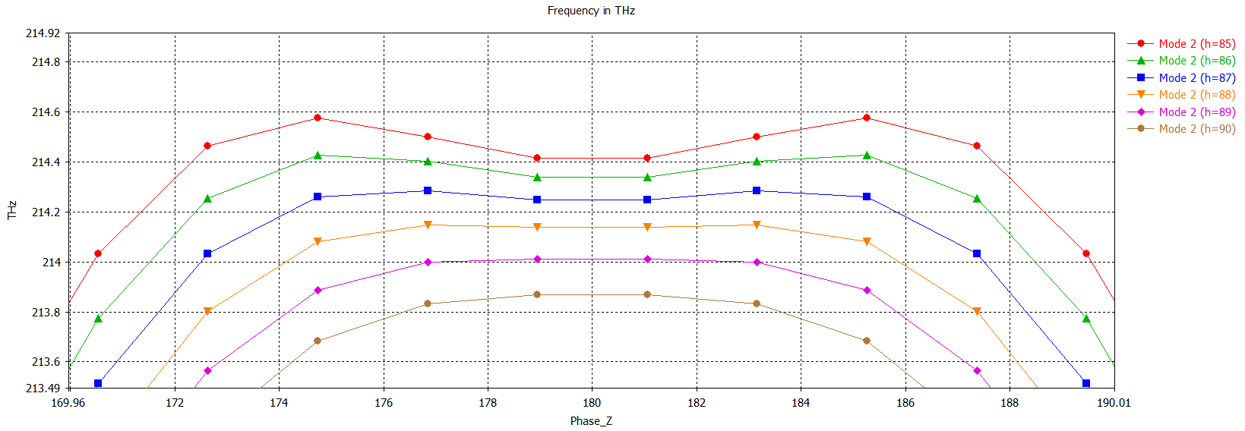
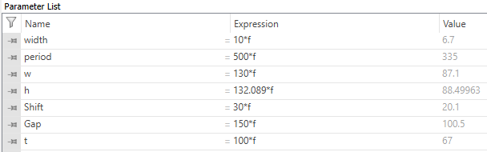
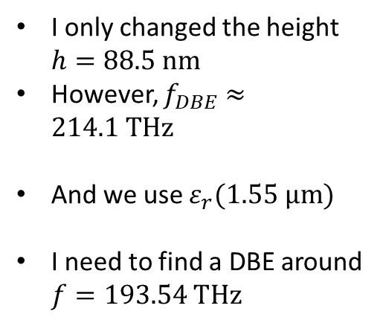
New DBE
I only changed the height $h=88.5 nm$
However, $f_{DBE}≈214.1 THz$
And we use $ε_{r}(1.55 μm)$
I need to find a DBE around $f=193.54 THz$

Slide 5
Equivalence between an SIP waveguide and a bulk dielectric
A. Herrero-Parareda
Department of Electrical Engineering and Computer Science

Slide 6
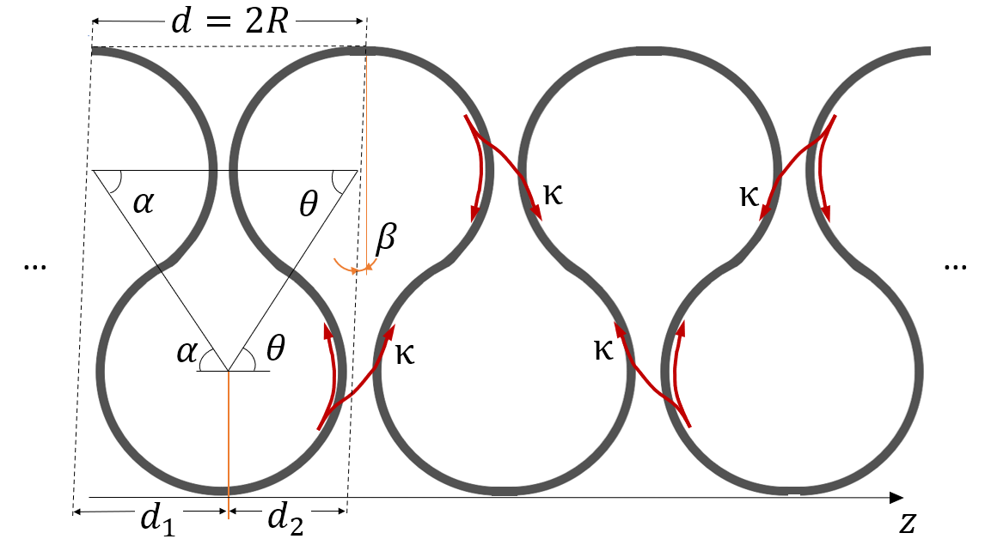
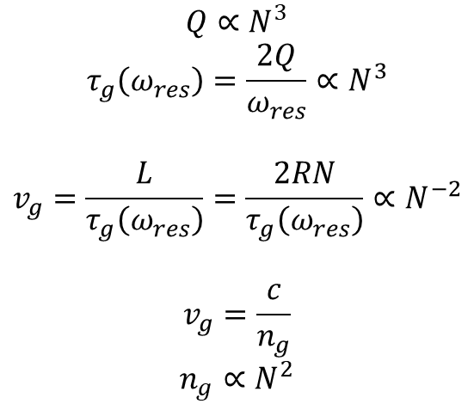
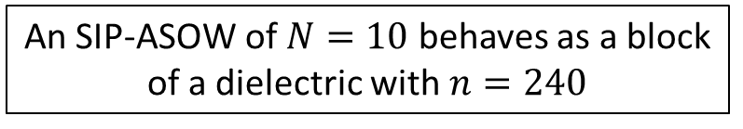

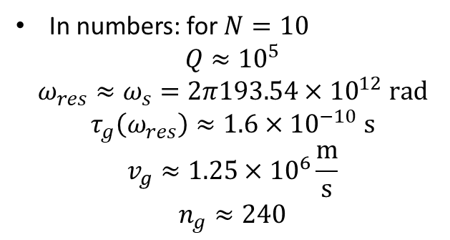
Main idea: The SIP-ASOW is equivalent to a dielectric slab
Let’s take a closer look:
$$Q∝N^{3}$$
$$τ_{g}\left(ω_{res}\right)=\frac{2Q}{ω_{res}}∝N^{3}$$
$$v_{g}=\frac{L}{τ_{g}\left(ω_{res}\right)}=\frac{2RN}{τ_{g}\left(ω_{res}\right)}∝N^{−2}$$
$$v_{g}=\frac{c}{n_{g}}$$
$$n_{g}∝N^{2}$$
$$n_{g}=240$$
In numbers: for $N=10$
$$Q≈{10}^{5}$$
$$ω_{res}≈ω_{s}=2π193.54×{10}^{12} rad$$
$$τ_{g}\left(ω_{res}\right)≈1.6×{10}^{−10} s$$
$$v_{g}≈1.25×{10}^{6}\frac{m}{s}$$
$$n_{g}≈240$$
An SIP-ASOW of $N=10$ behaves as a block of a dielectric with $n=240$

Slide 7

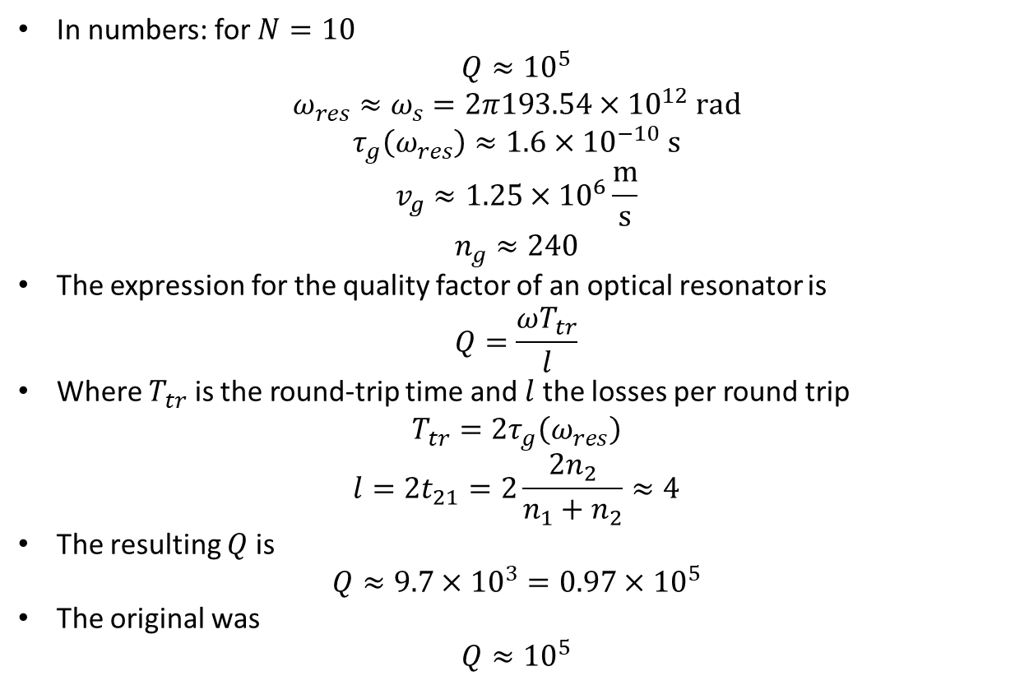
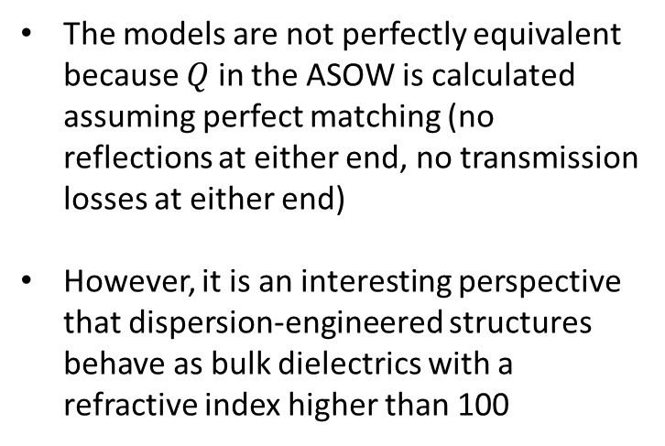

Validation: Let’s calculate the quality factor
In numbers: for $N=10$
$$Q≈{10}^{5}$$
$$ω_{res}≈ω_{s}=2π193.54×{10}^{12} rad$$
$$τ_{g}\left(ω_{res}\right)≈1.6×{10}^{−10} s$$
$$v_{g}≈1.25×{10}^{6}\frac{m}{s}$$
$$n_{g}≈240$$
The expression for the quality factor of an optical resonator is
$$Q=\frac{ωT_{tr}}{l}$$
Where $T_{tr}$ is the round-trip time and $l$ the losses per round trip
$$T_{tr}=2τ_{g}\left(ω_{res}\right)$$
$$l=2t_{21}=2\frac{2n_{2}}{n_{1}+n_{2}}≈4$$
The resulting $Q$ is
$$Q≈9.7×{10}^{3}=0.97×{10}^{5}$$
The original was
$$Q≈{10}^{5}$$
$$t_{21}$$
$$t_{21}$$
The models are not perfectly equivalent because $Q$ in the ASOW is calculated assuming perfect matching (no reflections at either end, no transmission losses at either end)
However, it is an interesting perspective that dispersion-engineered structures behave as bulk dielectrics with a refractive index higher than 100

Slide 8
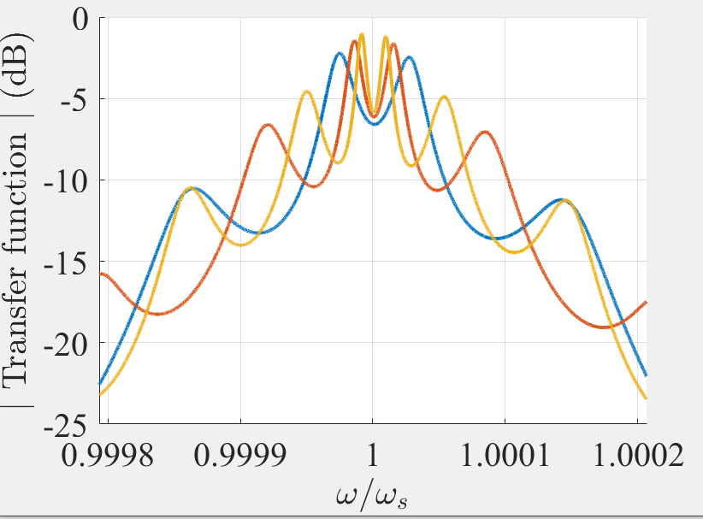
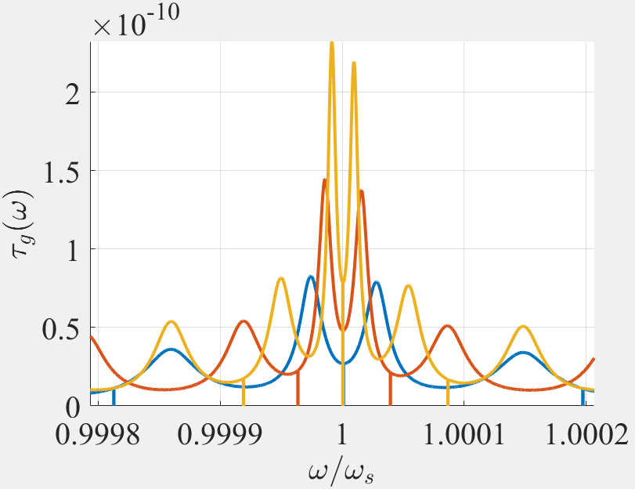
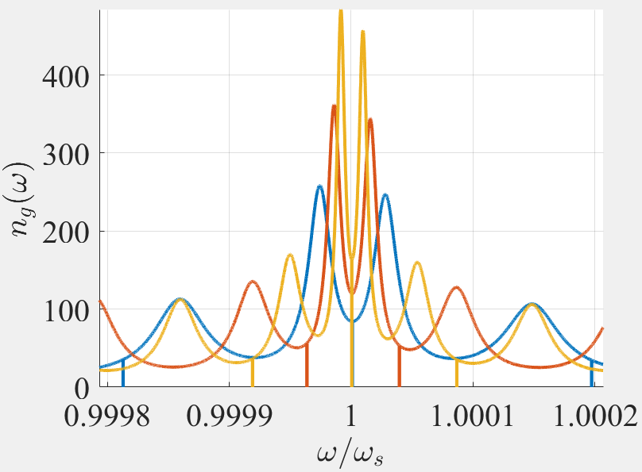
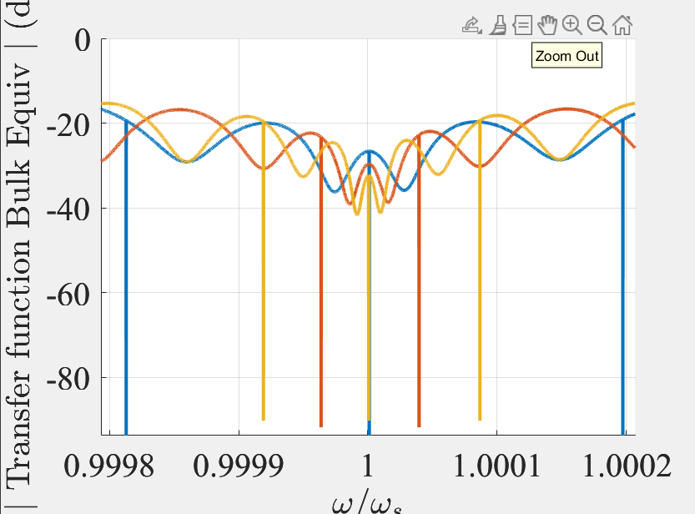
Let’s put it in practice: $N=10$ finite-length ASOW
This perspective is intuitive but not rigorous
It is a good analogy to introduce EPDs to the audience

