Slide 1

Equivalence between an SIP waveguide and a bulk dielectric
A. Herrero-Parareda
Department of Electrical Engineering and Computer Science

Slide 2
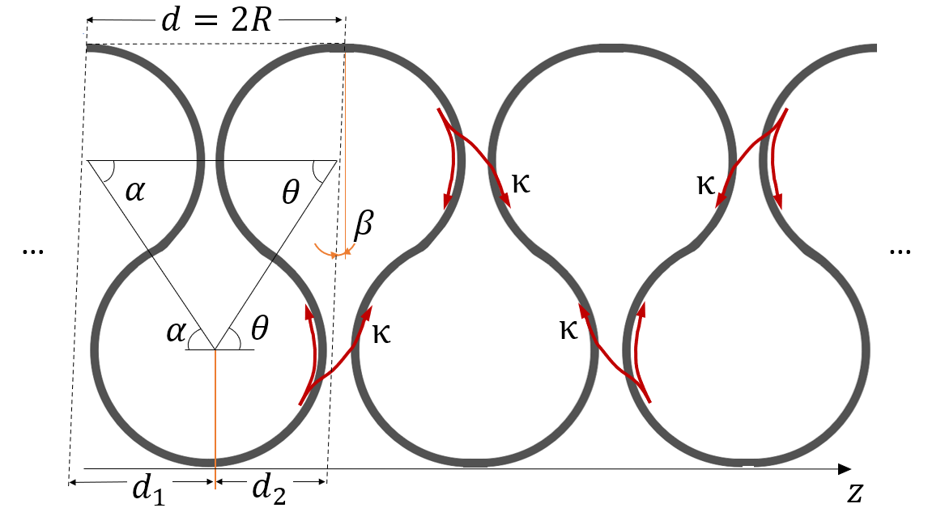
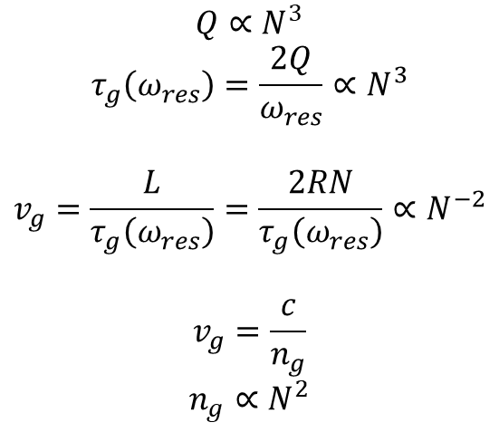
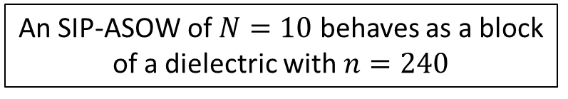

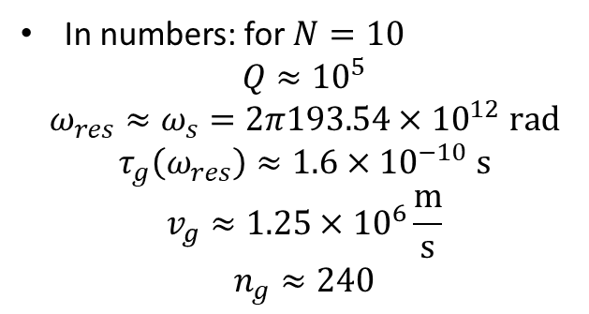
Main idea: The SIP-ASOW is equivalent to a dielectric slab
Let’s take a closer look:
$$Q∝N^{3}$$
$$τ_{g}\left(ω_{res}\right)=\frac{2Q}{ω_{res}}∝N^{3}$$
$$v_{g}=\frac{L}{τ_{g}\left(ω_{res}\right)}=\frac{2RN}{τ_{g}\left(ω_{res}\right)}∝N^{−2}$$
$$v_{g}=\frac{c}{n_{g}}$$
$$n_{g}∝N^{2}$$
$$n_{g}=240$$
In numbers: for $N=10$
$$Q≈{10}^{5}$$
$$ω_{res}≈ω_{s}=2π193.54×{10}^{12} rad$$
$$τ_{g}\left(ω_{res}\right)≈1.6×{10}^{−10} s$$
$$v_{g}≈1.25×{10}^{6}\frac{m}{s}$$
$$n_{g}≈240$$
An SIP-ASOW of $N=10$ behaves as a block of a dielectric with $n=240$

Slide 3

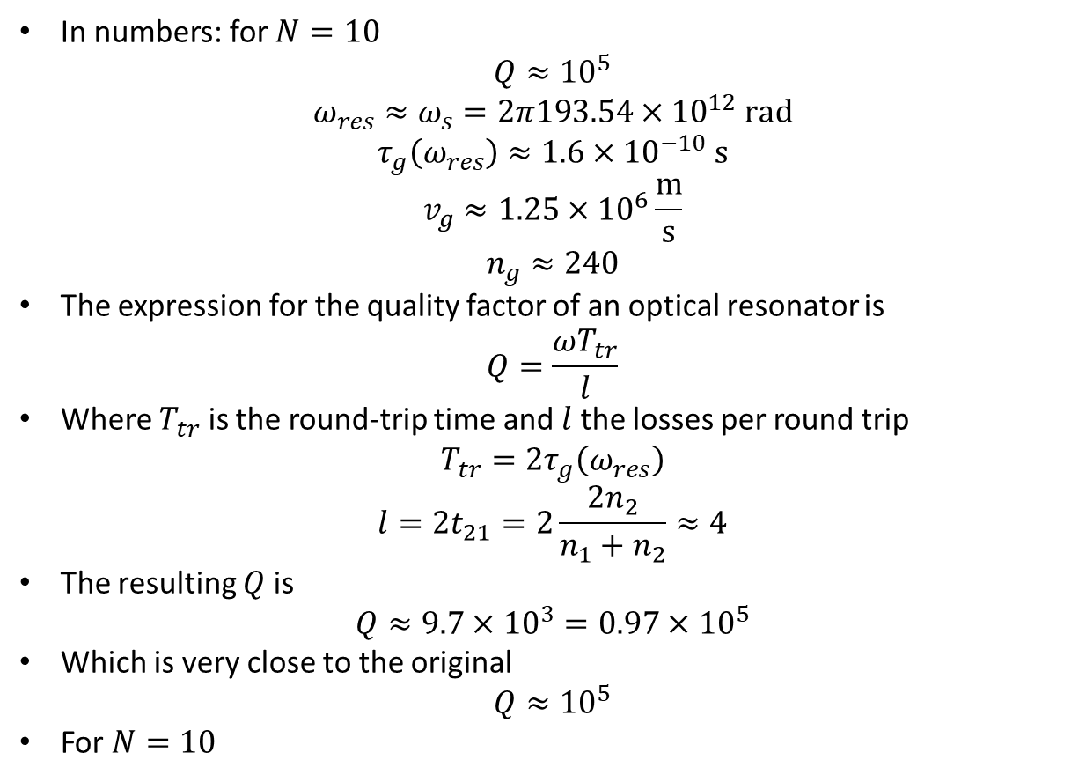

Validation: Let’s calculate the quality factor
In numbers: for $N=10$
$$Q≈{10}^{5}$$
$$ω_{res}≈ω_{s}=2π193.54×{10}^{12} rad$$
$$τ_{g}\left(ω_{res}\right)≈1.6×{10}^{−10} s$$
$$v_{g}≈1.25×{10}^{6}\frac{m}{s}$$
$$n_{g}≈240$$
The expression for the quality factor of an optical resonator is
$$Q=\frac{ωT_{tr}}{l}$$
Where $T_{tr}$ is the round-trip time and $l$ the losses per round trip
$$T_{tr}=2τ_{g}\left(ω_{res}\right)$$
$$l=2t_{21}=2\frac{2n_{2}}{n_{1}+n_{2}}≈4$$
The resulting $Q$ is
$$Q≈9.7×{10}^{3}=0.97×{10}^{5}$$
Which is very close to the original
$$Q≈{10}^{5}$$
For $N=10$
$$t_{21}$$
$$t_{21}$$

Slide 4
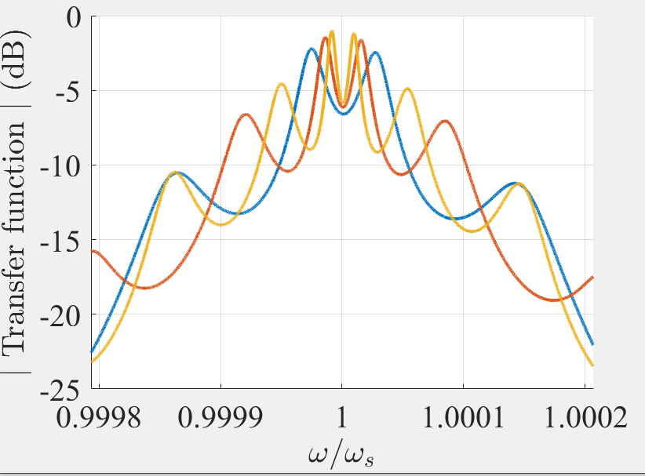
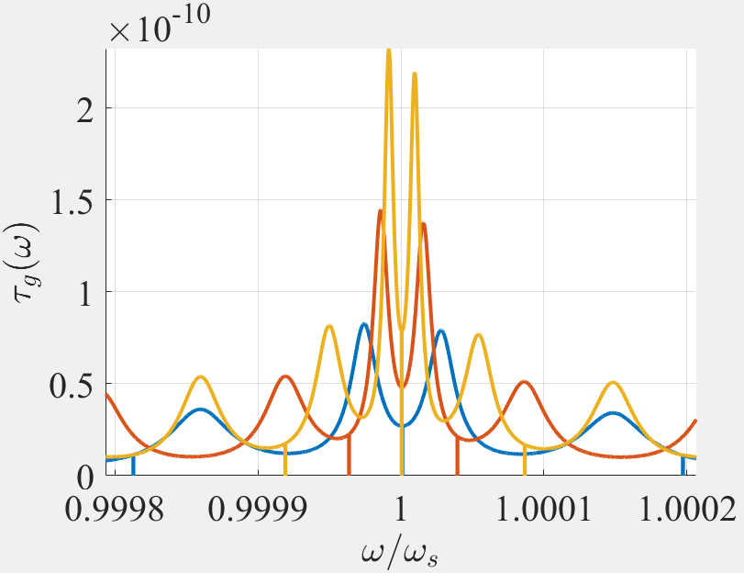
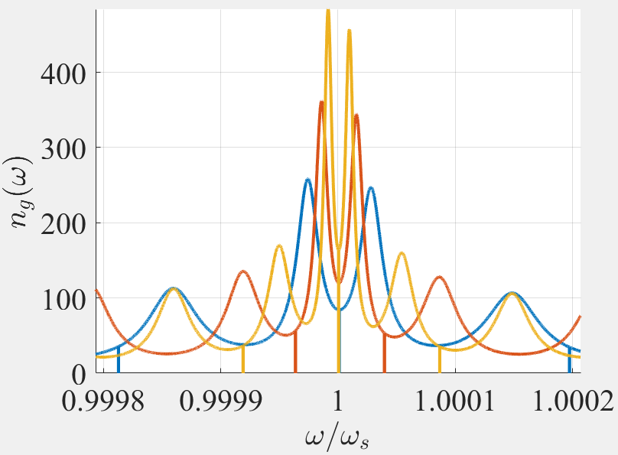
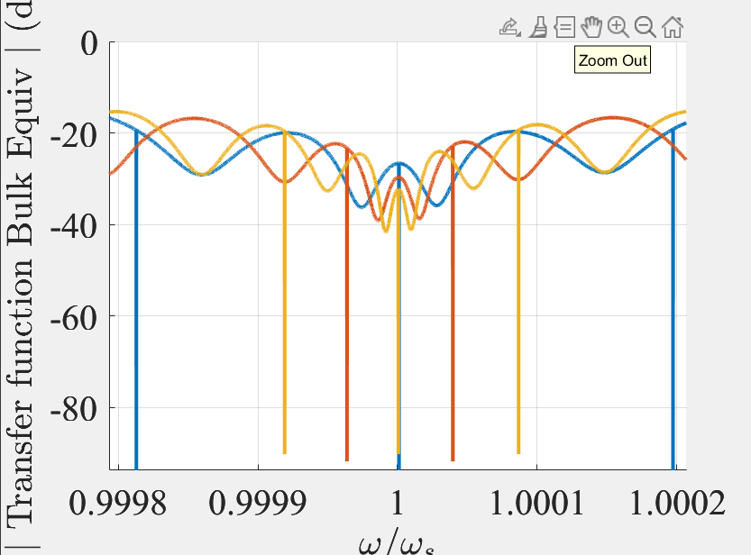
Let’s put it in practice

