Slide 1

Corrugated waveguide – SIP results
A. Herrero Parareda and F. Capolino
Department of Electrical Engineering and Computer Science

Slide 2
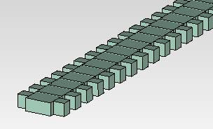
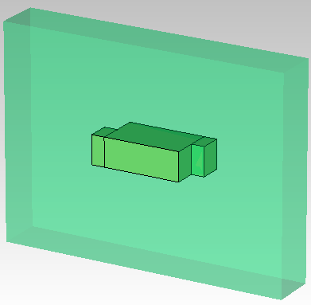
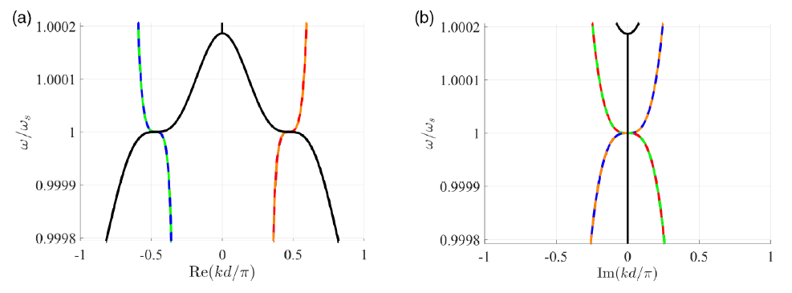

Idea
Optimize geometric parameters to have a stationary inflection point (SIP) in the dispersion relation

Slide 3
Corrugated waveguide – Course correction on Case 0: Uniform waveguide supports 2 modes
A. Herrero Parareda and F. Capolino
Department of Electrical Engineering and Computer Science

Slide 4
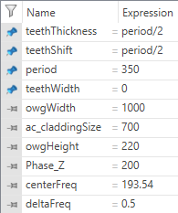
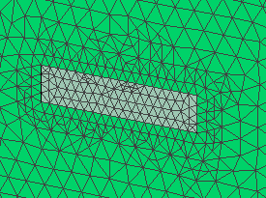
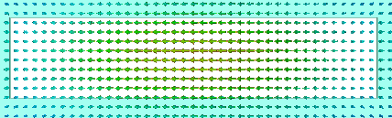
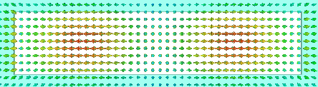
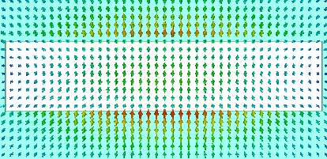
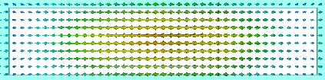
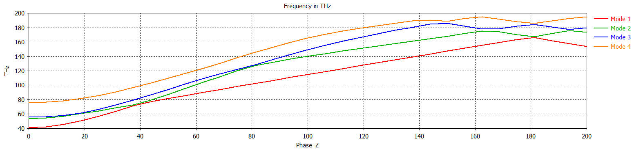
Uniform waveguide (teethWidth = 0)
Mode 1
Mode 2
Mode 3
Mode 4
BZ edge

Slide 5
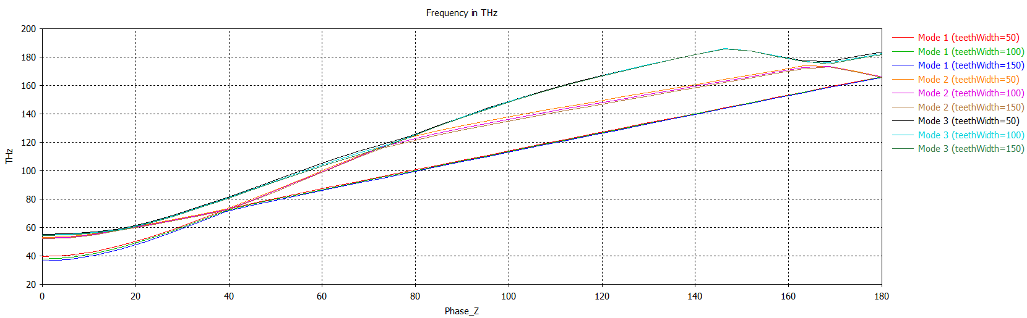
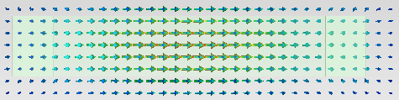

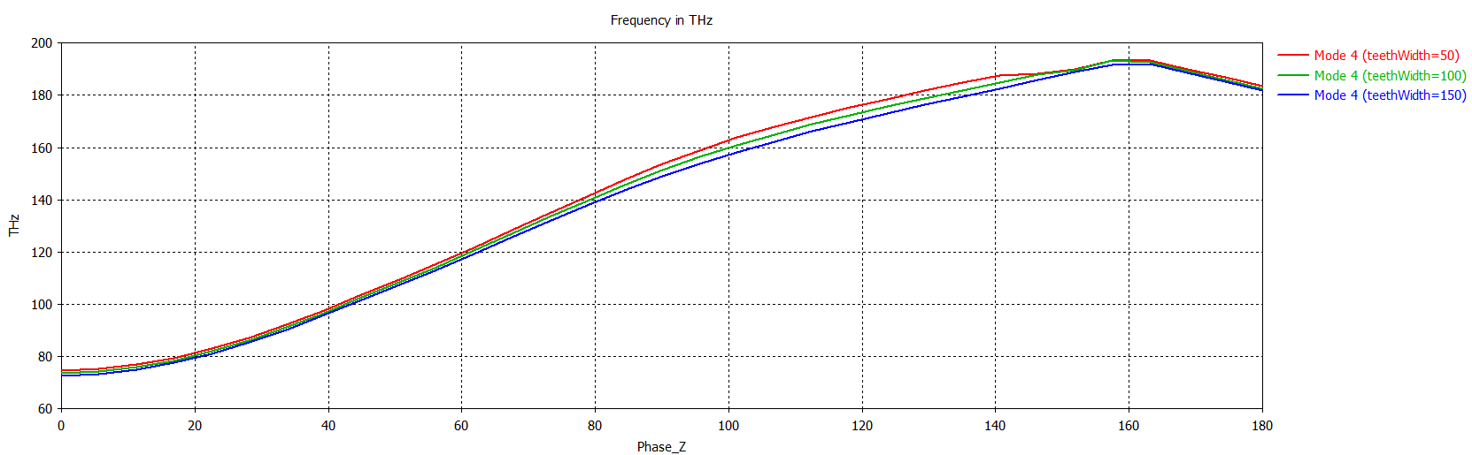
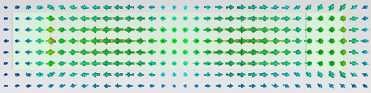
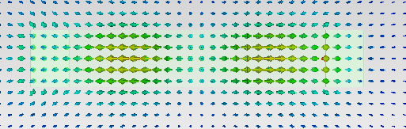
Mode perturbation due to teethWidth
Mode 1, 2 & 3 are mostly unperturbed (same curves)
Mode 4 has the most perturbation
Mode 4 is an odd mode (like Mode 3)

Slide 6
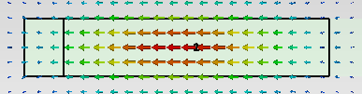
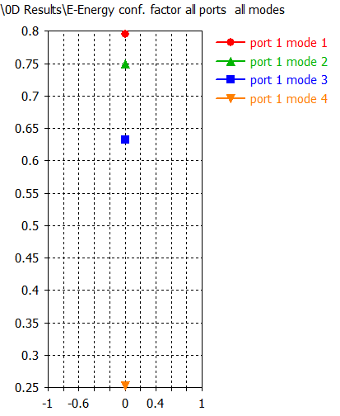
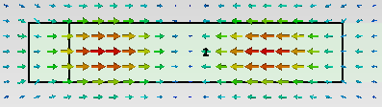
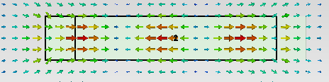
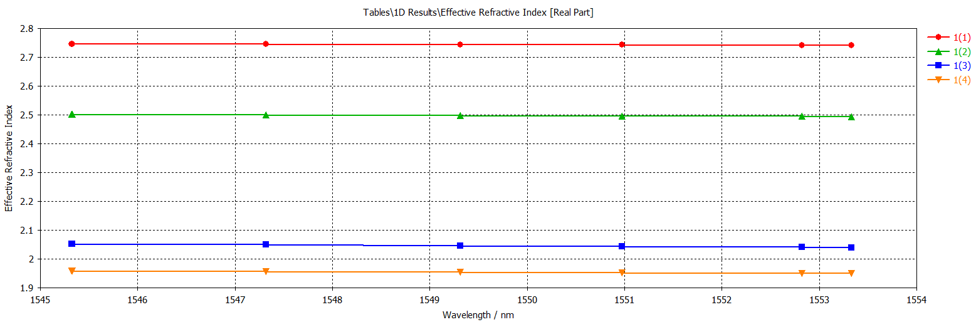
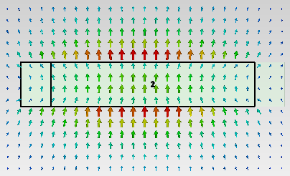
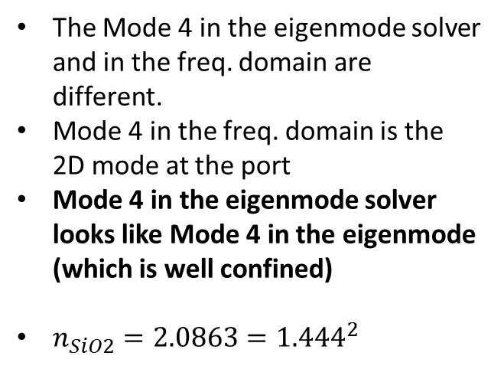
Check: Mode confinement in freq. domain
The Mode 4 in the eigenmode solver and in the freq. domain are different.
Mode 4 in the freq. domain is the 2D mode at the port
Mode 4 in the eigenmode solver looks like Mode 4 in the eigenmode (which is well confined)
$n_{SiO2}=2.0863={1.444}^{2}$

Slide 7
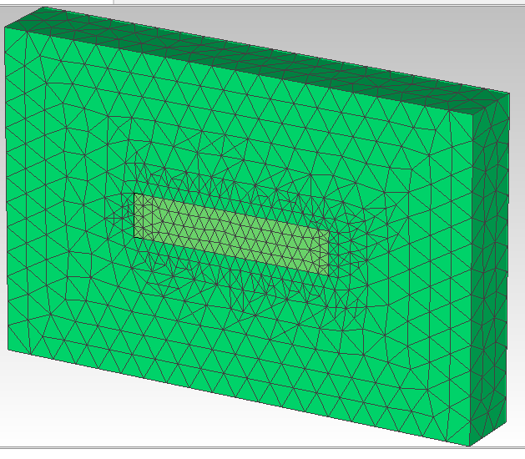
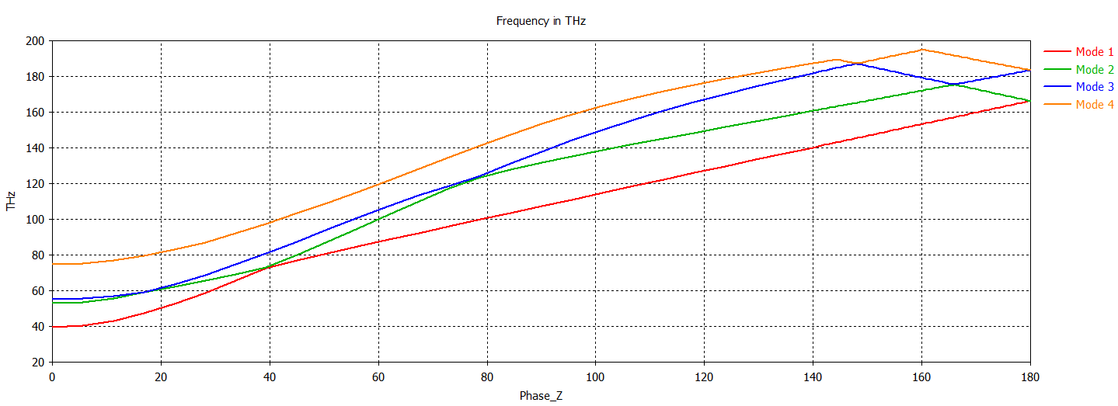
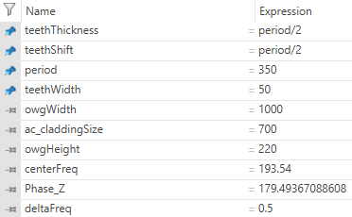
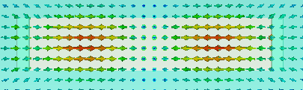
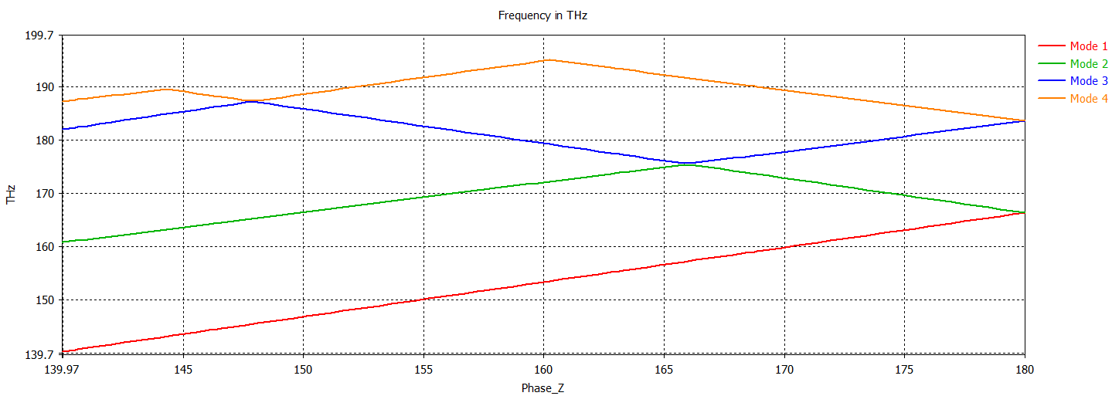
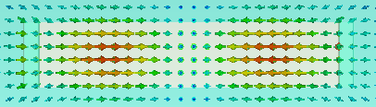
teethWidth = 50
Mode 3
Mode 4

Slide 8
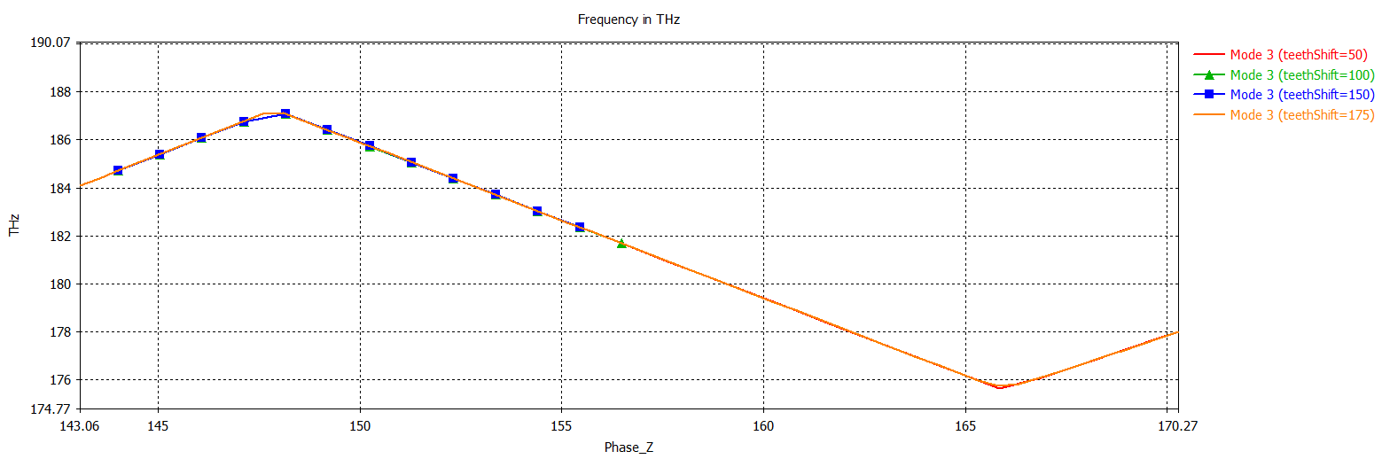
Optimizing teethShift
Changing the value of teethShift does not significantly perturb the dispersion diagram

Slide 9
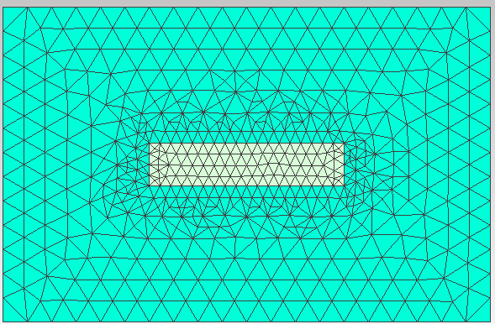

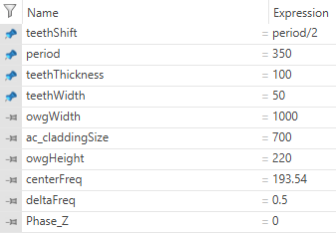
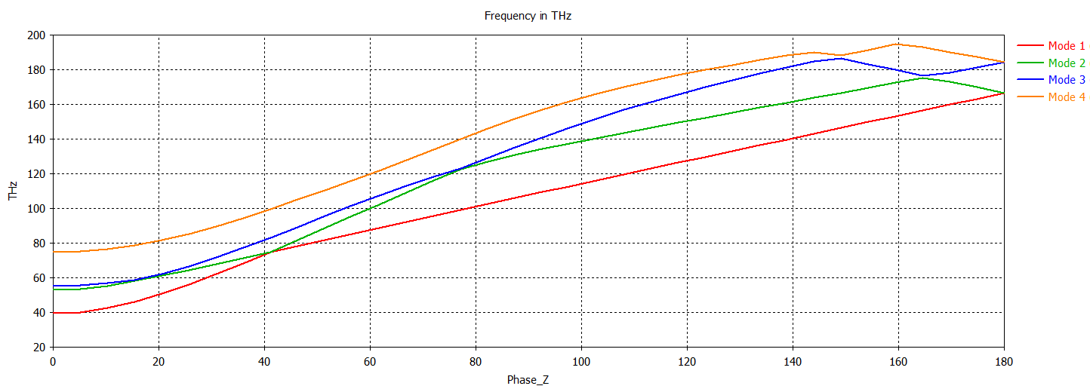
What if we change teethThickness?
Mode 3

Slide 10
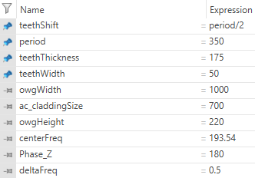
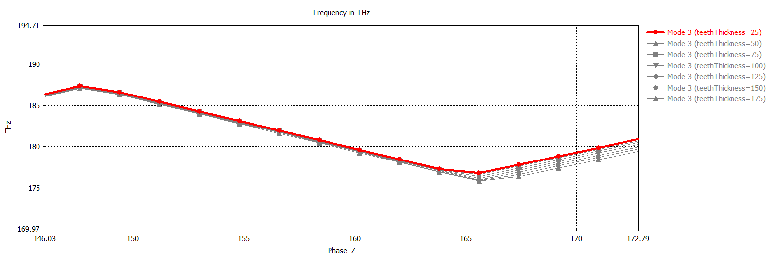
Let’s focus on Mode 3
Changing the value of teethThickness does not significantly perturb the dispersion diagram

Slide 11
Conclusions so far
Changing the teethWidth, teethThickness, teethShift alone does not change the dispersion diagram too much

Slide 12
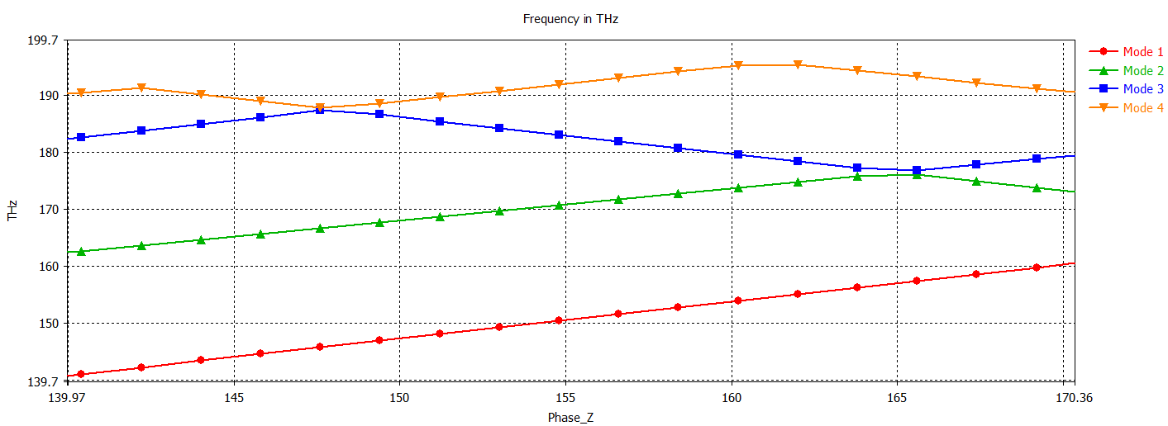
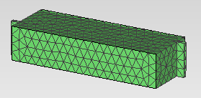
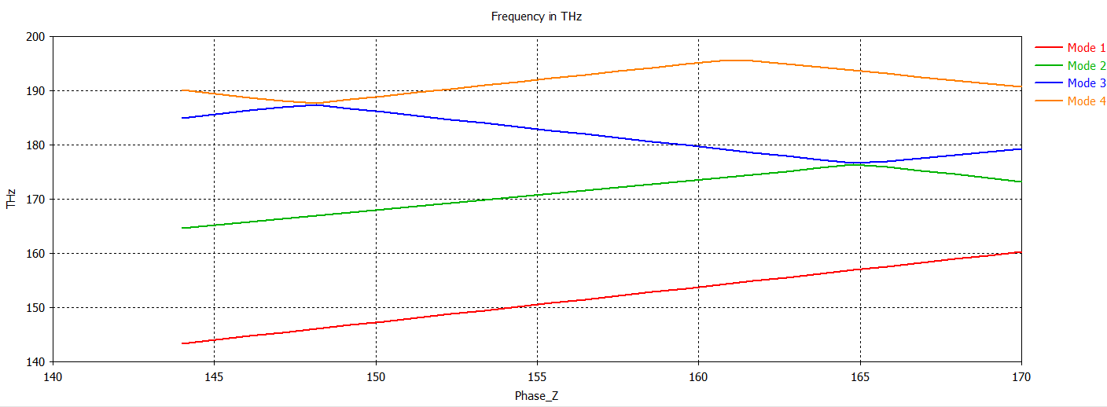
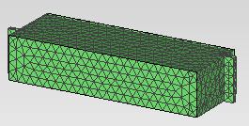
Mesh density comparison
Low density: 8 cells per wavelength
High density: 10 cells per wavelength
There is no noticeable difference

Slide 13
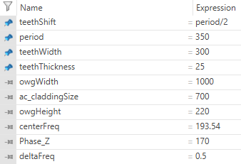
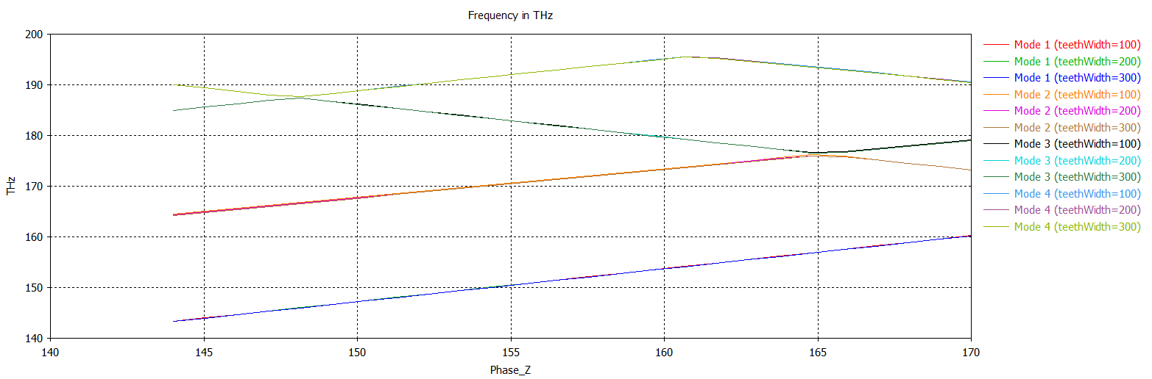
teethWidth variation
Varying teethWidth does not change it at all

Slide 14
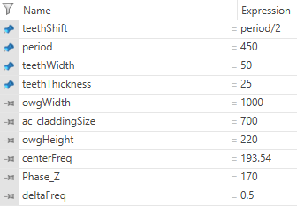
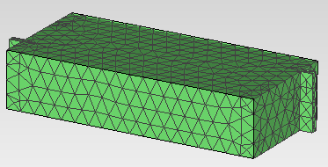
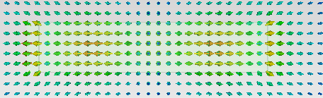
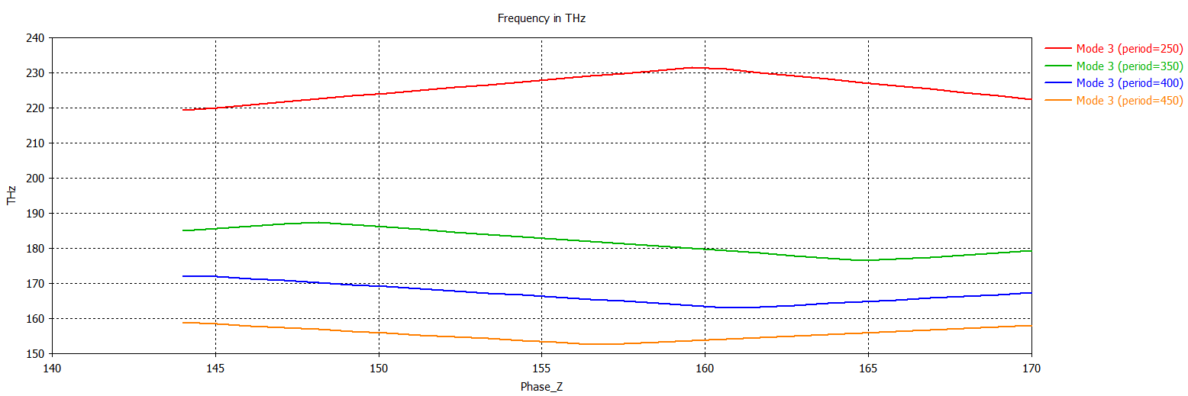
Period variation (includes teethShift)
Mode 3

Slide 15
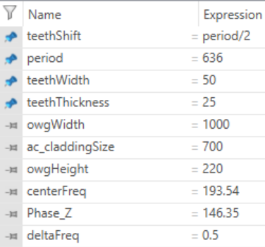
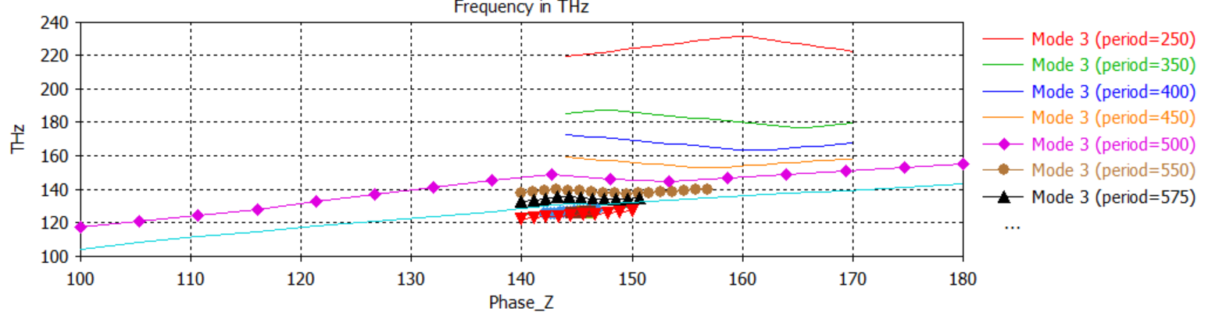
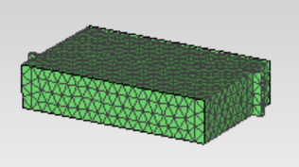
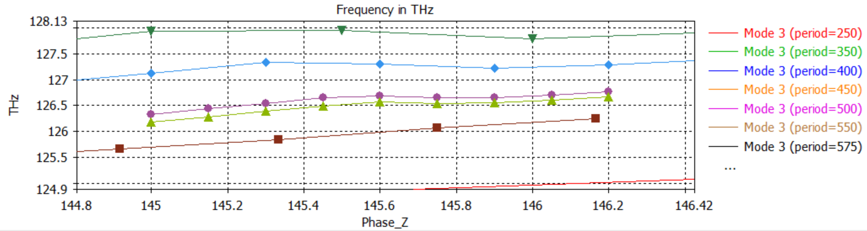
Period variation2
Too small teeth, can’t scale everything to get the SIP at 193 THz
Found an SIP!!!!

Slide 16
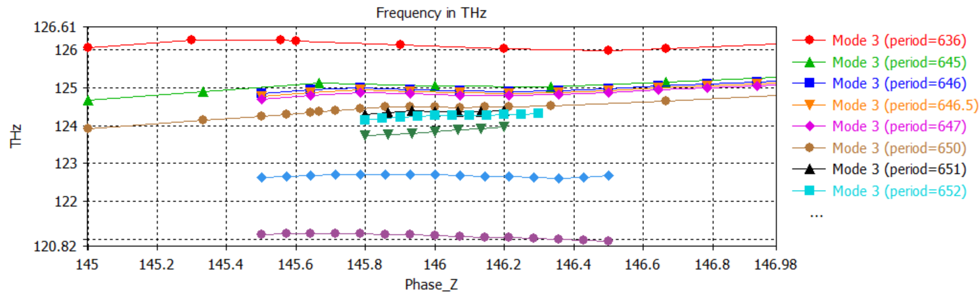
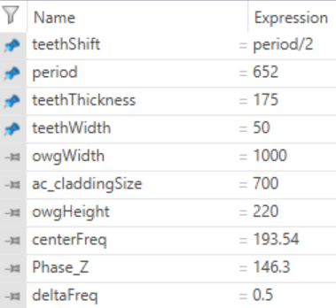
More period variation

Slide 17




I found an SIP! At the wrong frequency
I tried scaling all the geometrical parameters by $f$
It does not work

Slide 18




Adjusting owgWidth with $f$
Not a confined mode

Slide 19



Manually adjusting owgWidth
Mode 3 with owgWidth = 700

Slide 20


Let’s refine the previous result
Mode 3 with owgWidth = 650
Mode 3 with owgWidth = 600
The mode is especially present at the teeth

Slide 21



Period fine tuning

Slide 22




teethWidth fine tuning

Slide 23




SIP. Period.

Slide 24


SIP. teethWidth.

