Slide 1

Stationary inflection point in a corrugated waveguide
A. Herrero Parareda and F. Capolino
Department of Electrical Engineering and Computer Science

Slide 2
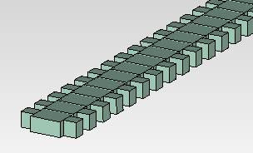
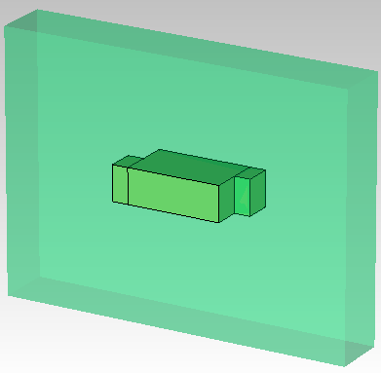
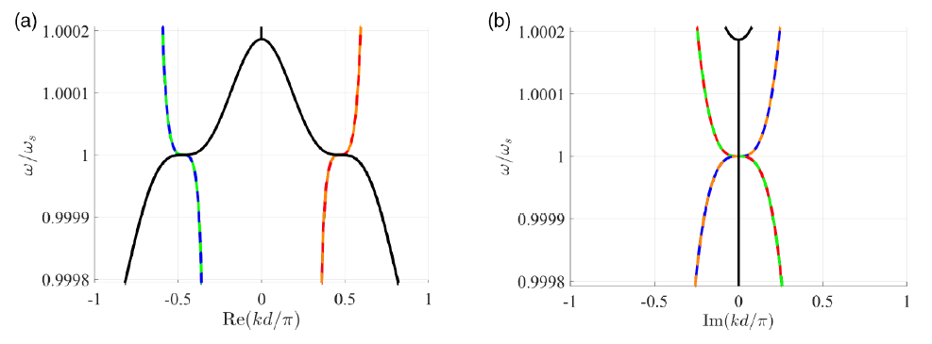

Main concept
Optimize geometric parameters to have a stationary inflection point (SIP) in the dispersion relation

Slide 3
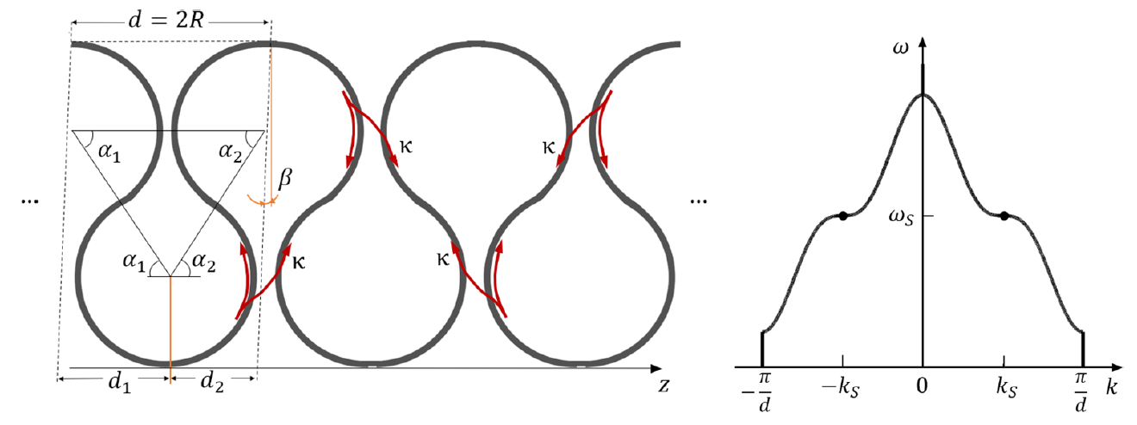
Frozen mode in optical waveguides
Generally, this is achieved by coupling 3 single-mode waveguides
Optimize geometric parameters to have a stationary inflection point (SIP) in the dispersion relation
Herrero-Parareda, Furman, Mealy, Gibson, Bedford, Vitebskiy, Capolino, Optical Materials Express, 13, 5, 2023

Slide 4
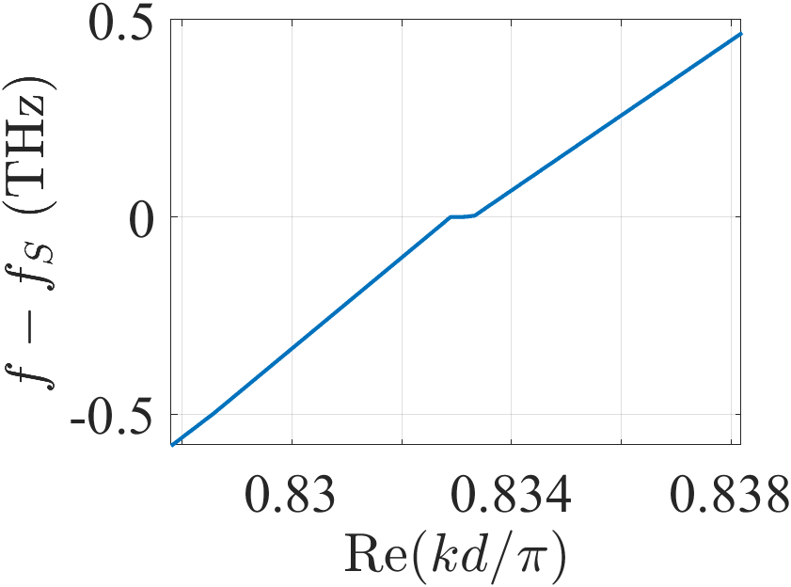
Frozen mode in optical waveguides
Instead, we achieve it with a single multi-mode waveguide
Optimize geometric parameters to have a stationary inflection point (SIP) in the dispersion relation

Slide 5




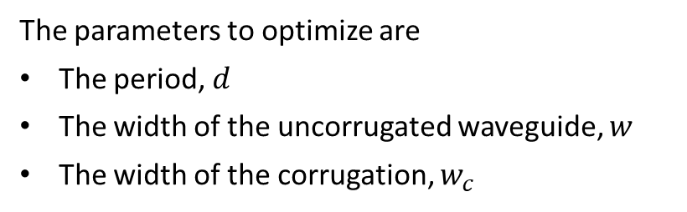

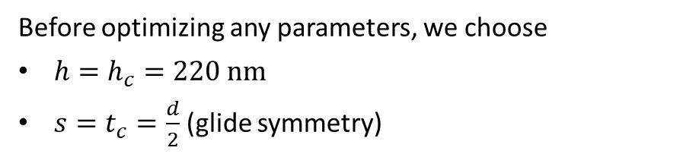


Corrugated waveguide
Before optimizing any parameters, we choose
$h=h_{c}=220 nm$
$s=t_{c}=\frac{d}{2}$ (glide symmetry)
$$s$$
$$d$$
$$t_{c}$$
$$w$$
$$w_{c}$$
The parameters to optimize are
The period, $d$
The width of the uncorrugated waveguide, $w$
The width of the corrugation, $w_{c}$
$$h=h_{c}$$

Slide 6
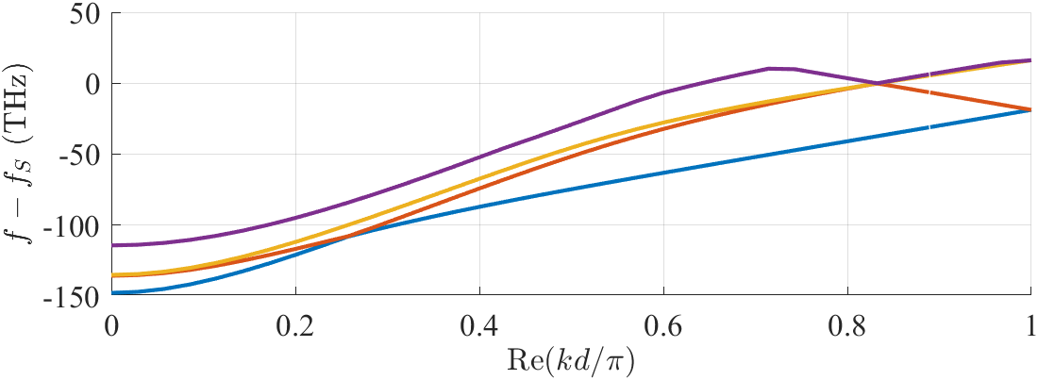




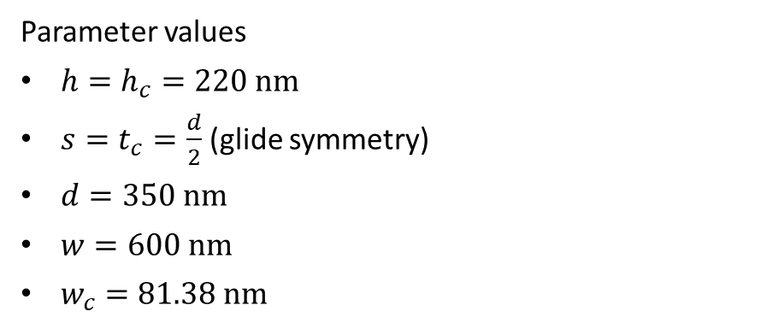

SIP #1: Adjust $w_{c}$
Parameter values
$h=h_{c}=220 nm$
$s=t_{c}=\frac{d}{2}$ (glide symmetry)
$d=350 nm$
$w=600 nm$
$w_{c}=81.38 nm$
$$s$$
$$d$$
$$t_{c}$$
$$w$$
$$w_{c}$$

Slide 7
More points, no interpolation

Slide 8
More points, no interpolation

Slide 9
More points, no interpolation

Slide 10
More points, no interpolation

Slide 11
More points, no interpolation

Slide 12
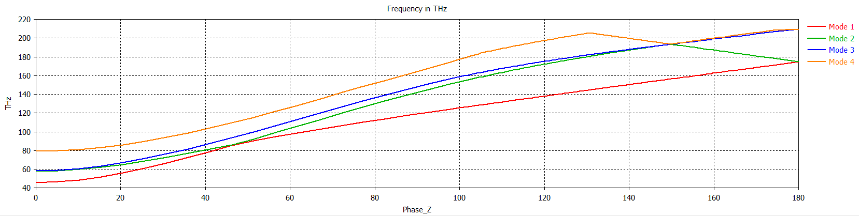
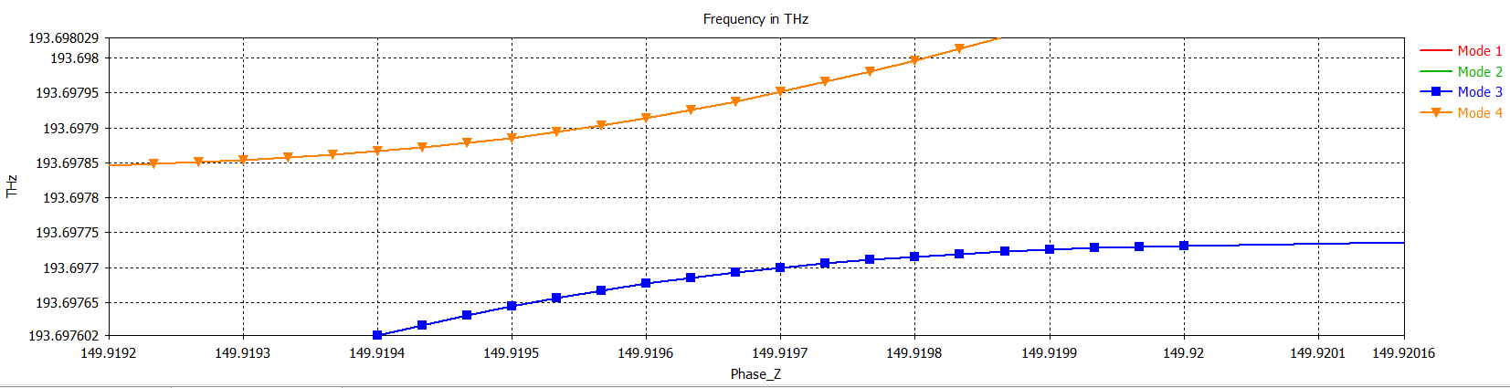
Do mode 3 & 4 touch?

