Slide 1

Tarek’s similarity transfer matrix method – Explained
A. Herrero Parareda and F. Capolino
Department of Electrical Engineering and Computer Science

Slide 2
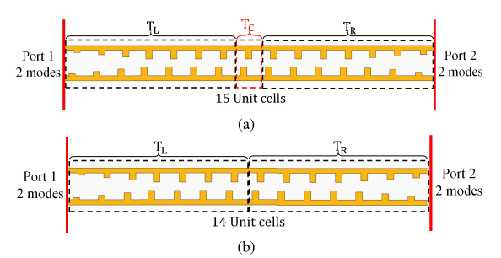

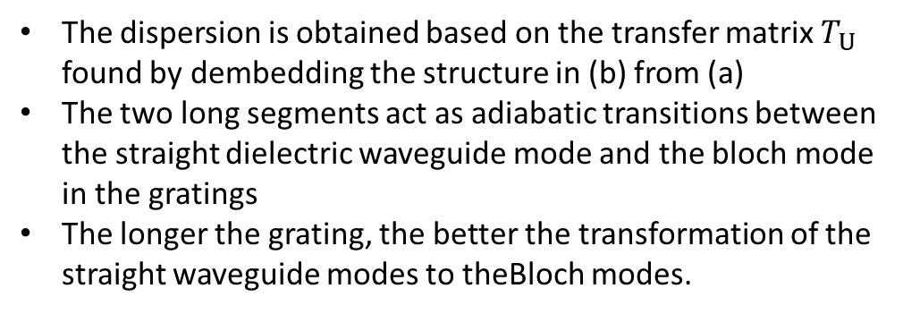
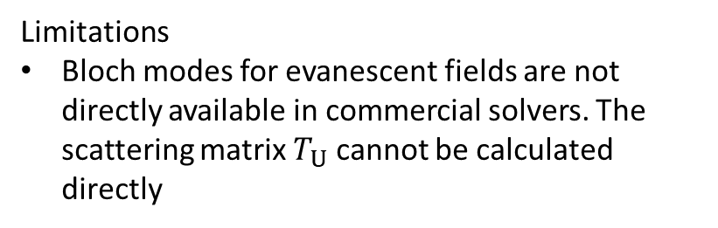
Alternative method to obtain the dispersion diagram
The eigenvalue problem is
Limitations
Bloch modes for evanescent fields are not directly available in commercial solvers. The scattering matrix $T_{U}$ cannot be calculated directly
The dispersion is obtained based on the transfer matrix $T_{U}$ found by dembedding the structure in (b) from (a)
The two long segments act as adiabatic transitions between the straight dielectric waveguide mode and the bloch mode in the gratings
The longer the grating, the better the transformation of the straight waveguide modes to theBloch modes.
Mealy, Capolino, IEEE Photonics Technology Letters, 35, 187-190 (2023)

Slide 3














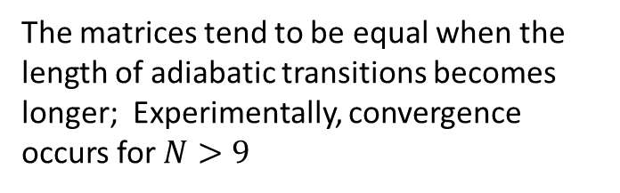
Mathematical analysis
$$F=\left(\begin{matrix}0 & I \\ I & 0\end{matrix}\right)$$
The matrices tend to be equal when the length of adiabatic transitions becomes longer; Experimentally, convergence occurs for $N>9$
Has similar eigenvalues as those of $T_{U}$
Mealy, Capolino, IEEE Photonics Technology Letters, 35, 187-190 (2023)

Slide 4
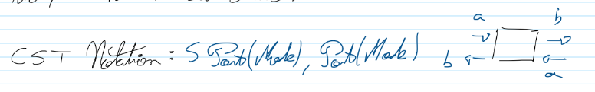
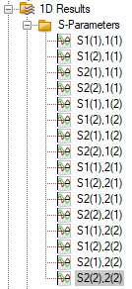
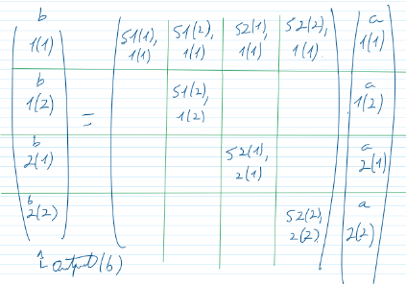
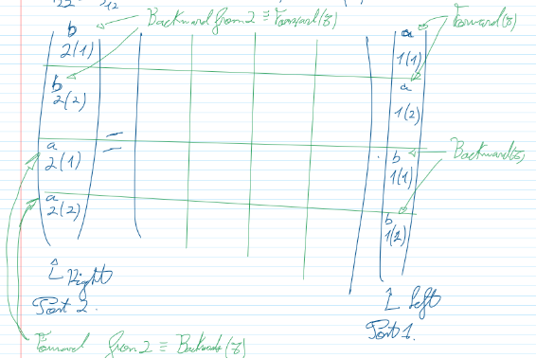
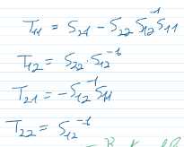
Touchstone conversion
How does CST store the scattering parameters of 2-mode ports?
Scattering matrix
Transfer matrix
S-to-T conversion

Slide 5
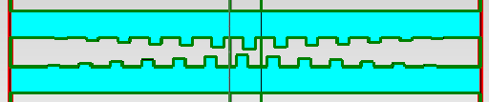
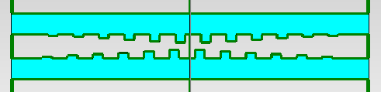
Do we recover the DBE?Yes

Slide 6
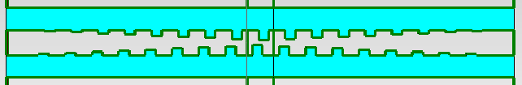
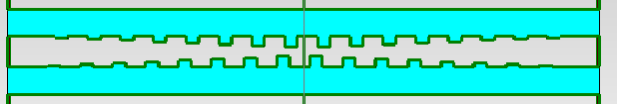


Let’s try with $N=9$
$$N=7$$
For N=9, we get a similar DBE and a new RBE at the bottom of the dispersion diagram
$$N=9$$

Slide 7
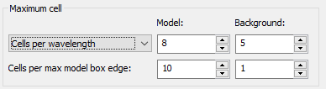
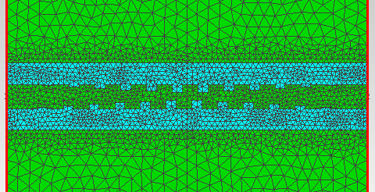
Checking the mesh
The mesh is dense
I used the same mesh for all the taper simulations

Slide 8
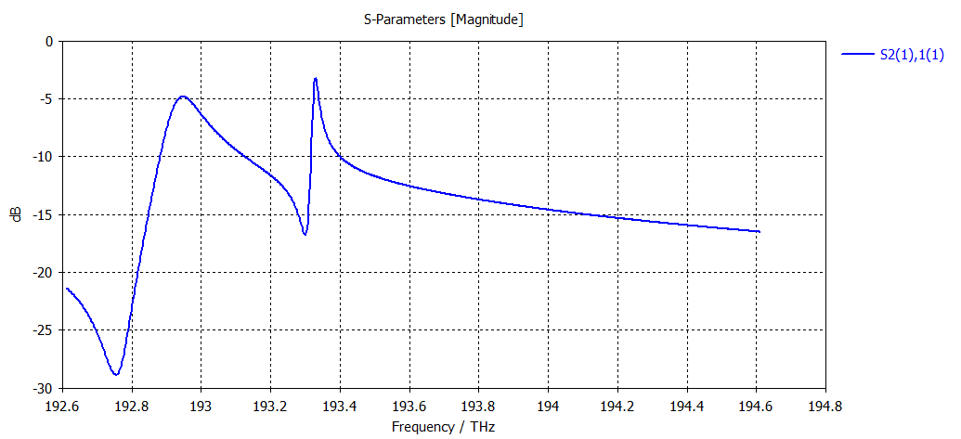
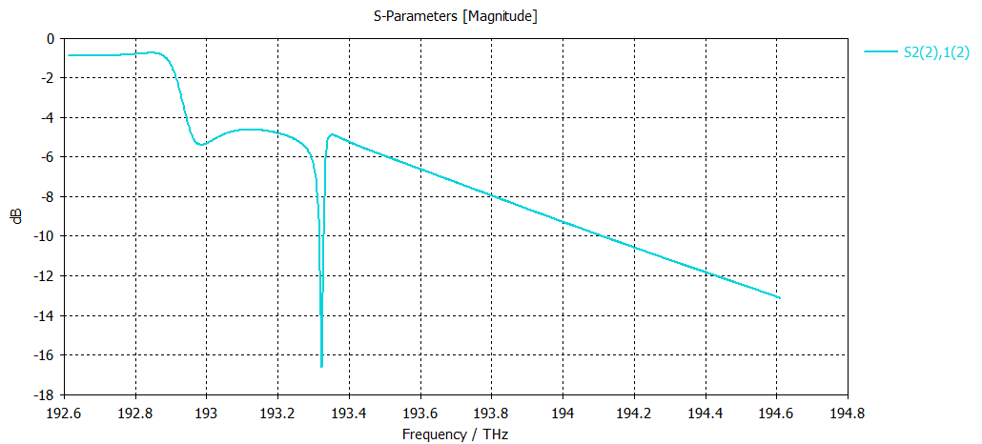

Can we do $N=40$ and get the same results?
Full simulation with ports
$T_{40}\left(1,1\right) \& T_{40}\left(2,2\right),$ where $T_{40}=T_{C}^{40}$
What BC are you considering?

Slide 9
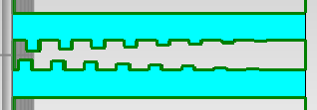


Can we obtain the transfer matrix of half a taper?
$$F=\left(\begin{matrix}0 & I \\ I & 0\end{matrix}\right)$$
This would allow us to simulate the finite-length structure from the transfer matrices
I simulated the two halves of the tapers separately
$$T_{L,7}$$

Slide 10
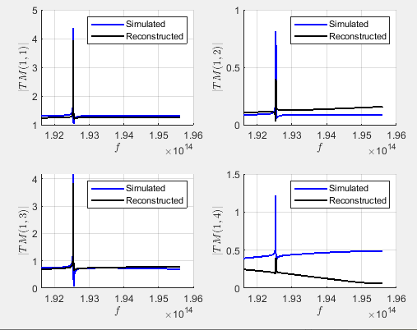
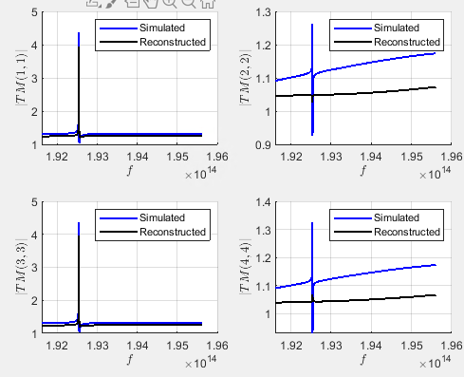

Can we recover the transfer matrix of the tapered structures?
I only used 1 tapered structure and calculated the other using:
$$F=\left(\begin{matrix}0 & I \\ I & 0\end{matrix}\right)$$

Slide 11
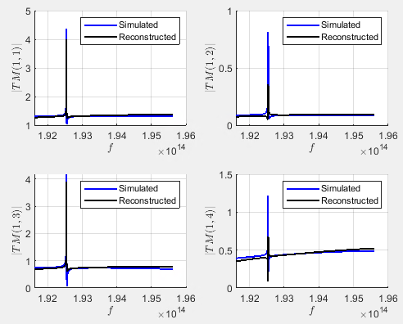
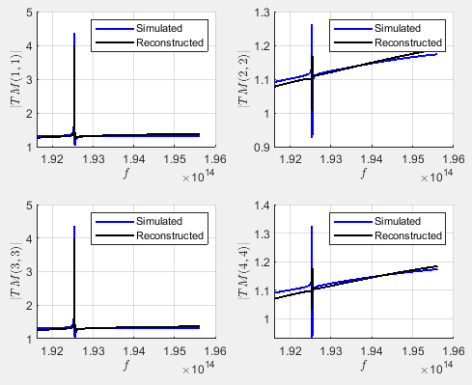
Simulating both halves separately
A lot better

Slide 12
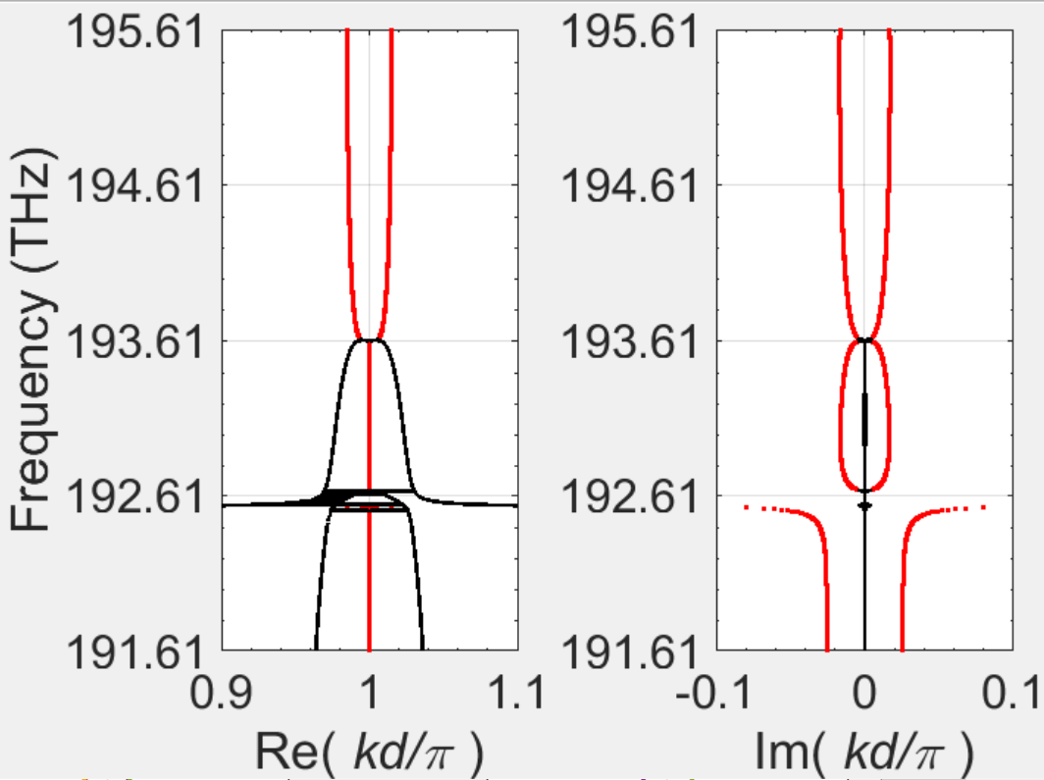
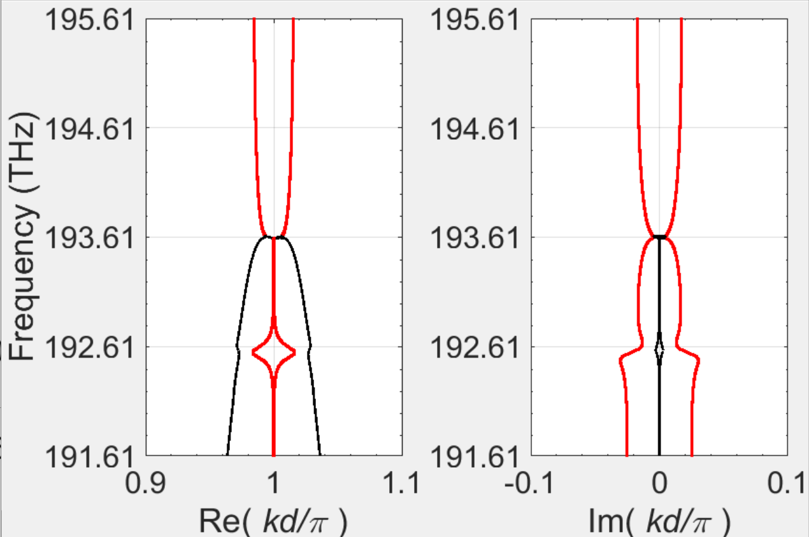
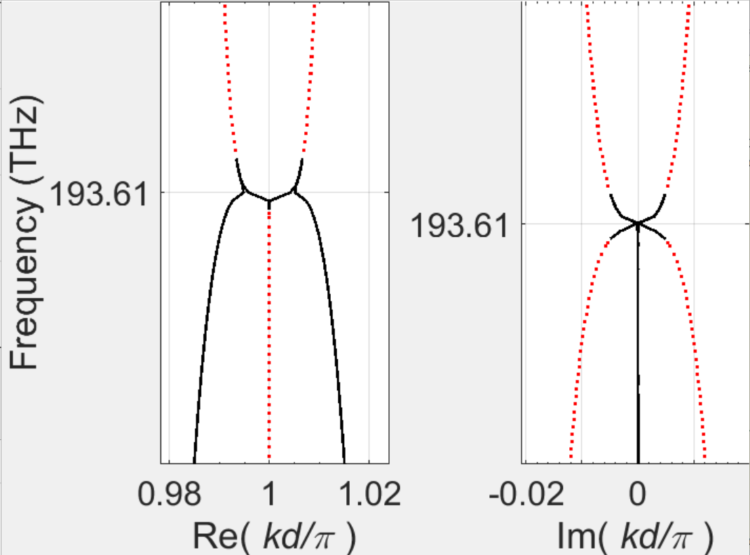
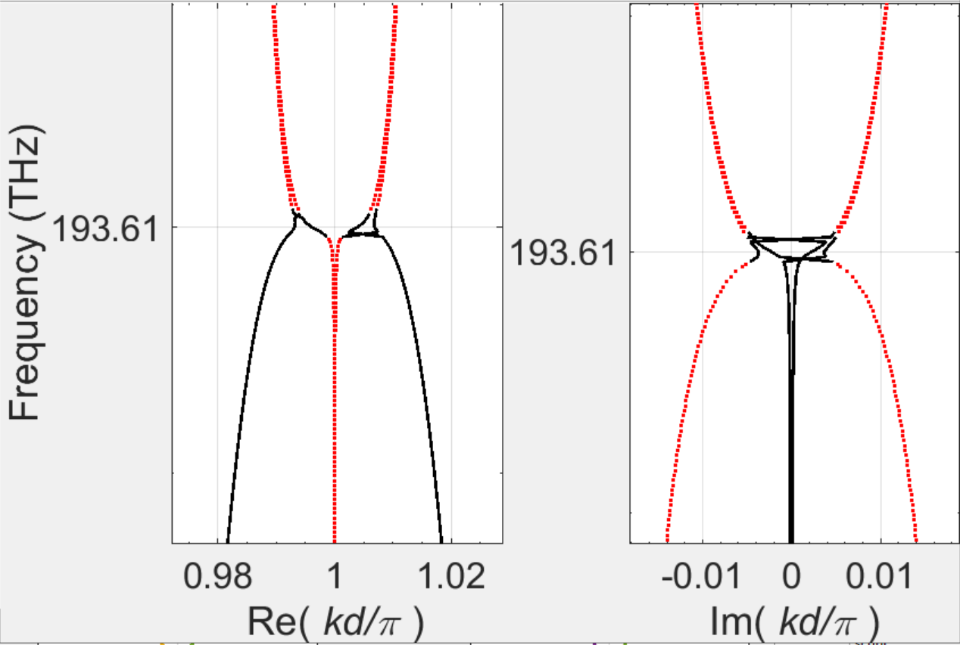


Does the dispersion diagram change with gain?
Tapering with 9 cells
$$α_{g}=0 dB/cm$$
$$α_{g}=340 dB/cm$$
There’s a change. As expected, the coalescence is worse
The DBE is not entirely perfect, which is why the difference with and without gain is not as strong

Slide 13
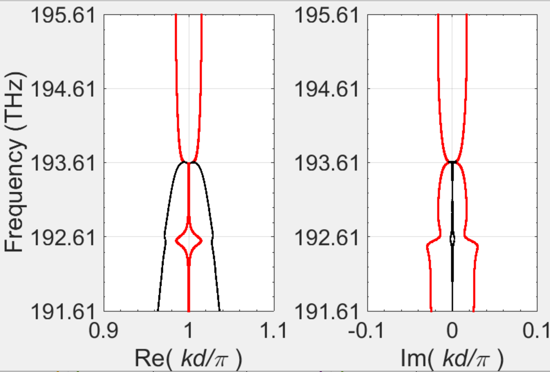
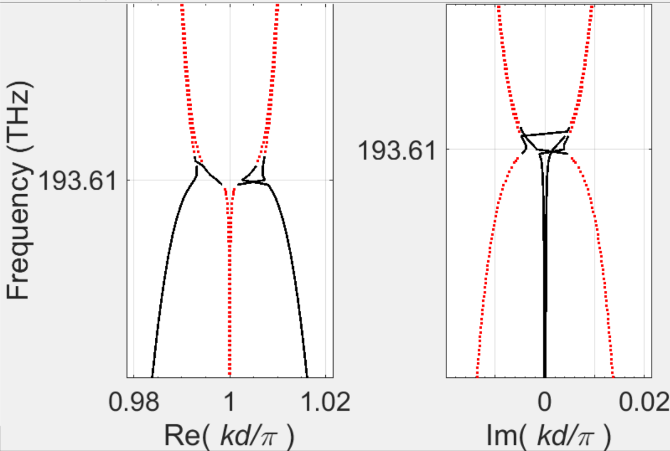


Does the dispersion diagram change with gain?
$$α_{g}=0 dB/cm$$
$$α_{g}=380 dB/cm$$

Slide 14
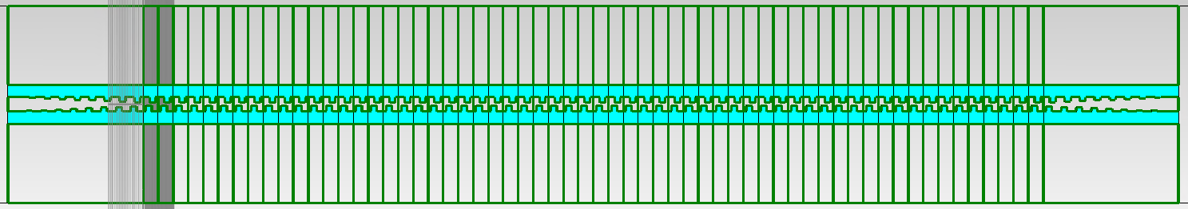
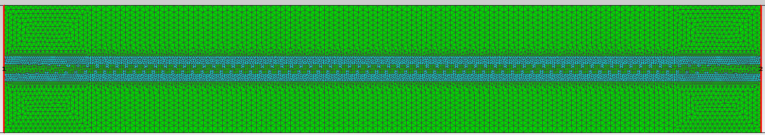
Simulate N=60 with tapers. Do we get comparable results?
I started running the simulation (not done yet as of 11/27/2023)
I will compare with the version calculated from the transfer matrices once it is done
If I get comparable results, I will start working on finding the lasing threshold this way

