Slide 1

Is it really an SIP?
A. Herrero Parareda and F. Capolino
Department of Electrical Engineering and Computer Science

Slide 2
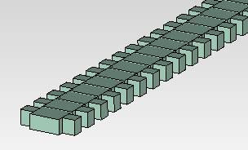
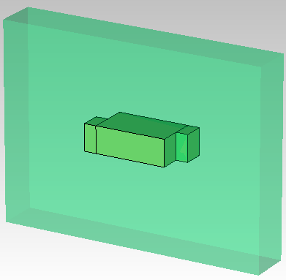

Corrugated waveguide

Slide 3
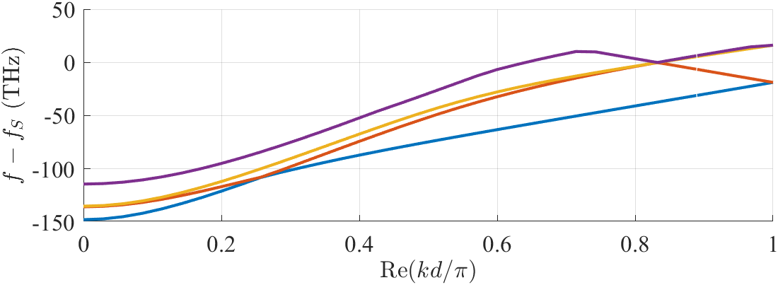




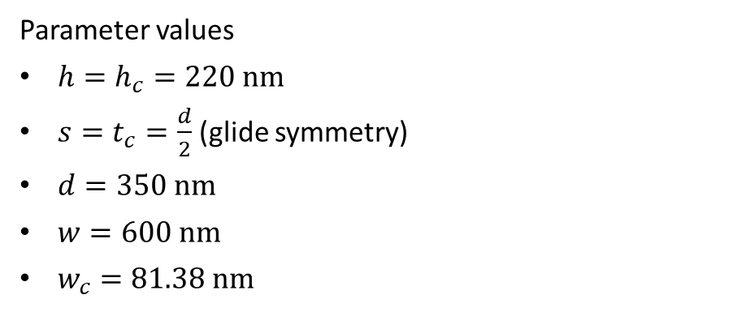

Is it really an SIP?
Parameter values
$h=h_{c}=220 nm$
$s=t_{c}=\frac{d}{2}$ (glide symmetry)
$d=350 nm$
$w=600 nm$
$w_{c}=81.38 nm$
$$s$$
$$d$$
$$t_{c}$$
$$w$$
$$w_{c}$$

Slide 4
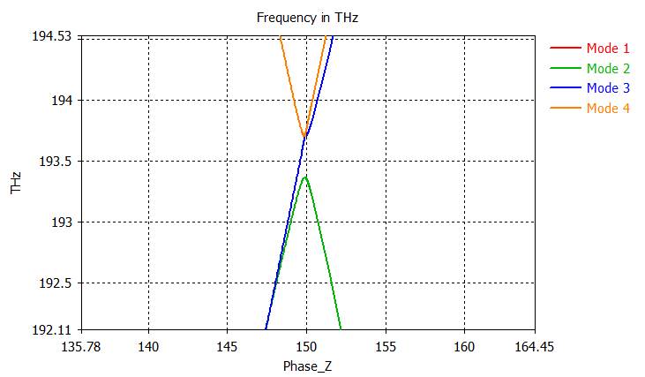
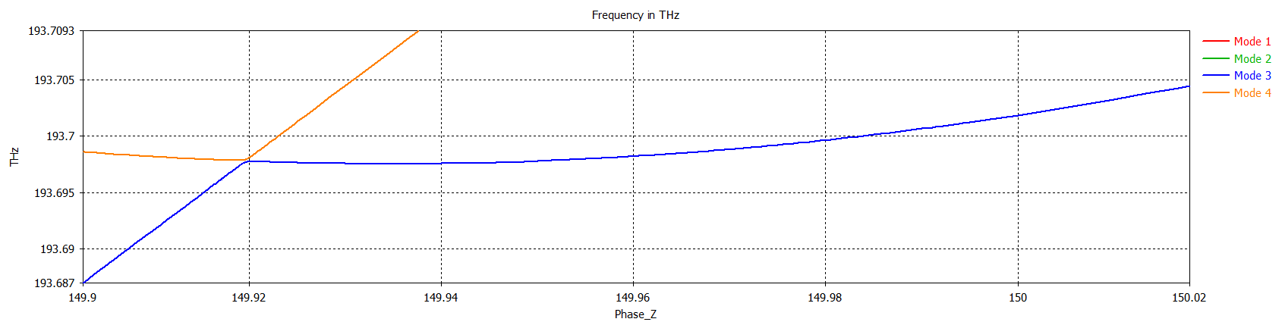
Is it really?
$$s$$
$$d$$
$$t_{c}$$
$$w$$
$$w_{c}$$
It is not

Slide 5
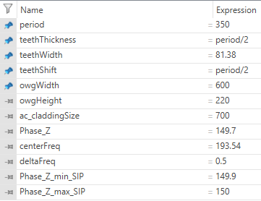
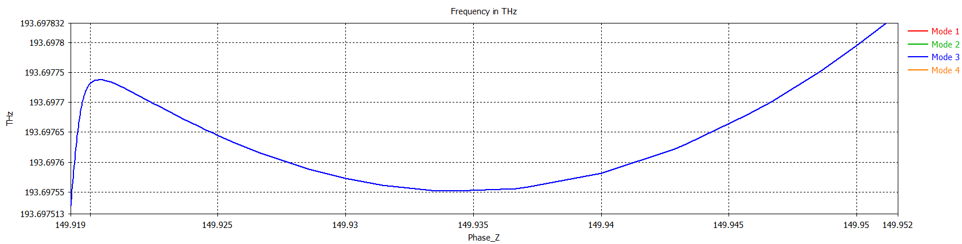
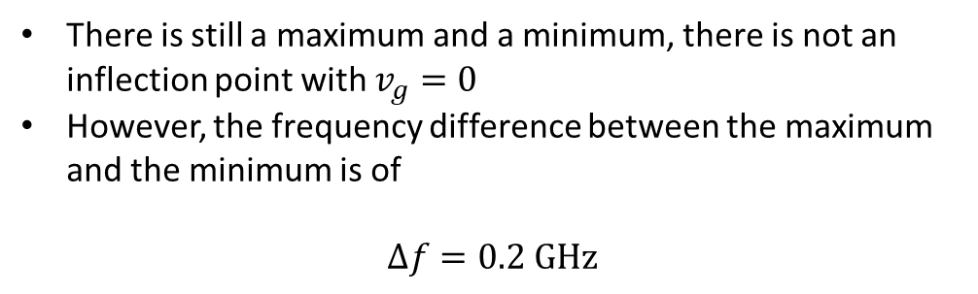
There is still a maximum and a minimum
There is still a maximum and a minimum, there is not an inflection point with $v_{g}=0$
However, the frequency difference between the maximum and the minimum is of
$$Δf=0.2 GHz$$
I can still look for a better SIP, it’s just putting in the hours

Slide 6
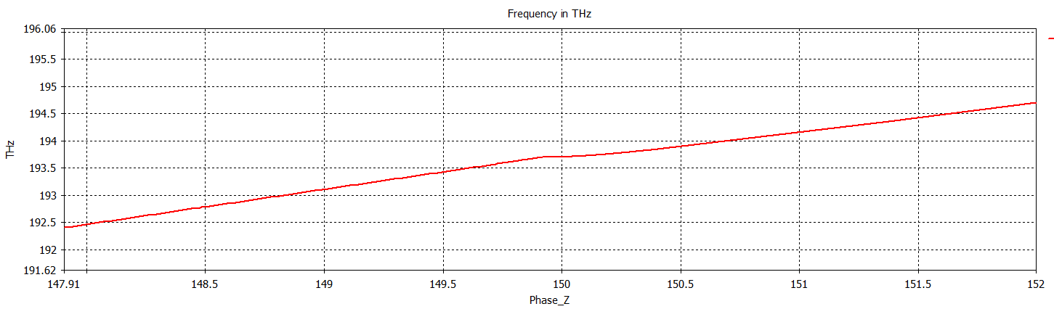
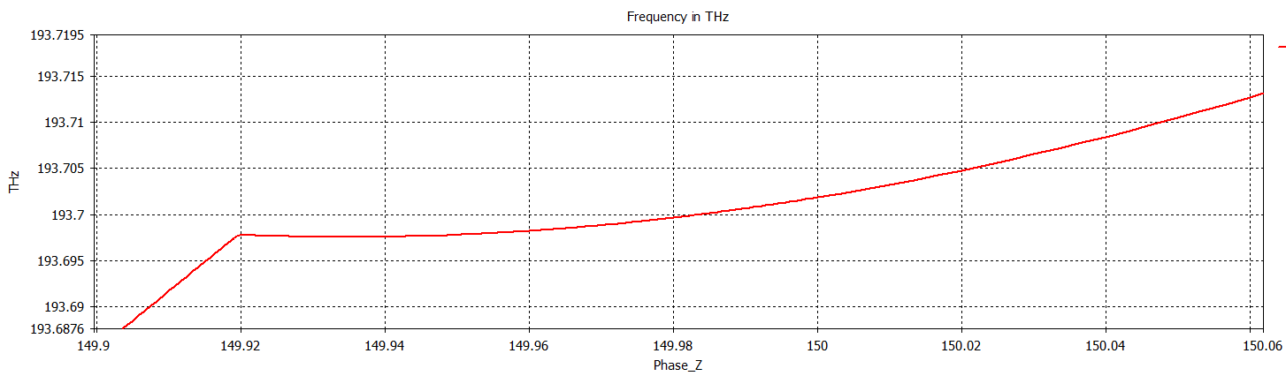
Let’s see if I can refine it further
Area of interest: 149.917 – 149.95

Slide 7
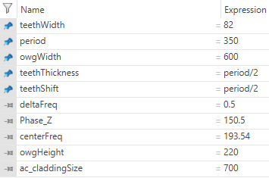
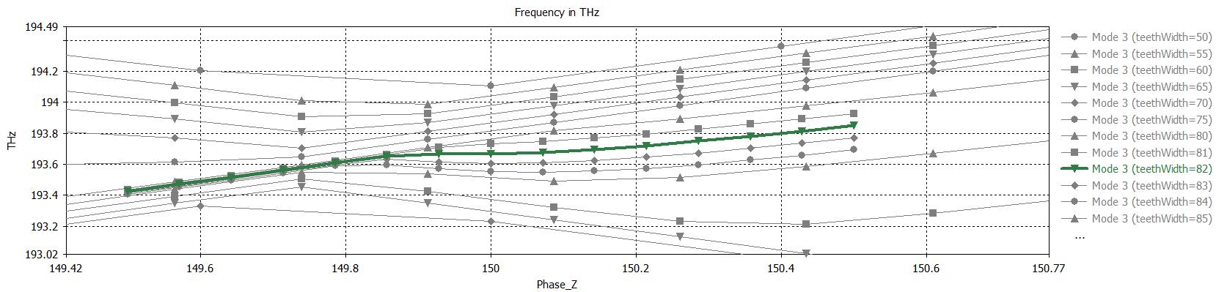
Does the dispersion diagram vary with teethWidth? (old slide)

Slide 8
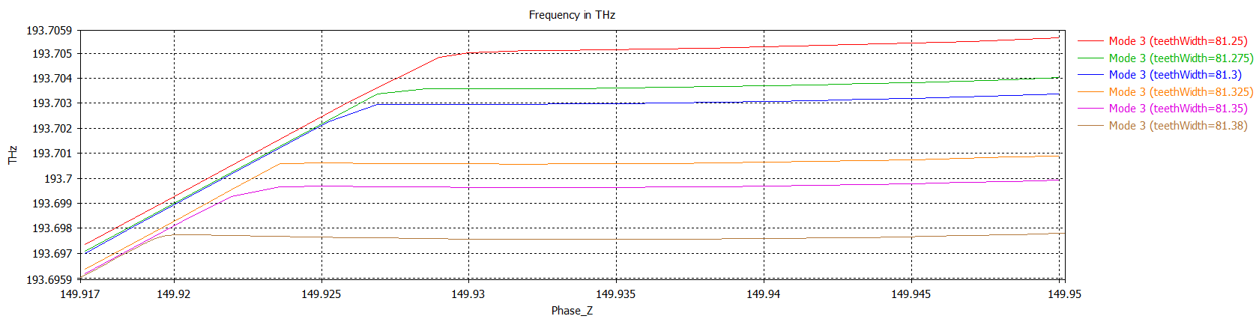
Dispersion variation with teethWidth
The jump in “SIP” frequency between 81.3 & 81.325 is interesting, because it indicates that we are closer to an SIP (the perturbation is stronger)
I’m doing a finer mesh

