Slide 1

Is it really an SIP?
A. Herrero Parareda and F. Capolino
Department of Electrical Engineering and Computer Science

Slide 2

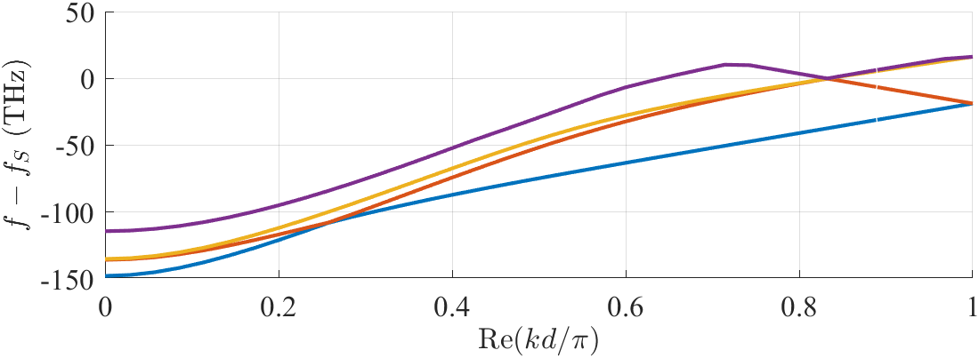




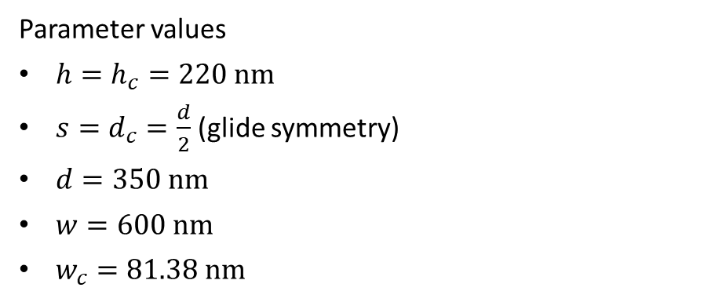

Is it really an SIP?
Parameter values
$h=h_{c}=220 nm$
$s=d_{c}=\frac{d}{2}$ (glide symmetry)
$d=350 nm$
$w=600 nm$
$w_{c}=81.38 nm$
$$s$$
$$d$$
$$d_{c}$$
$$w$$
$$w_{c}$$

Slide 3
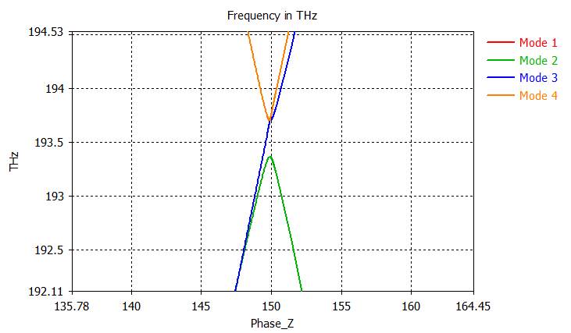
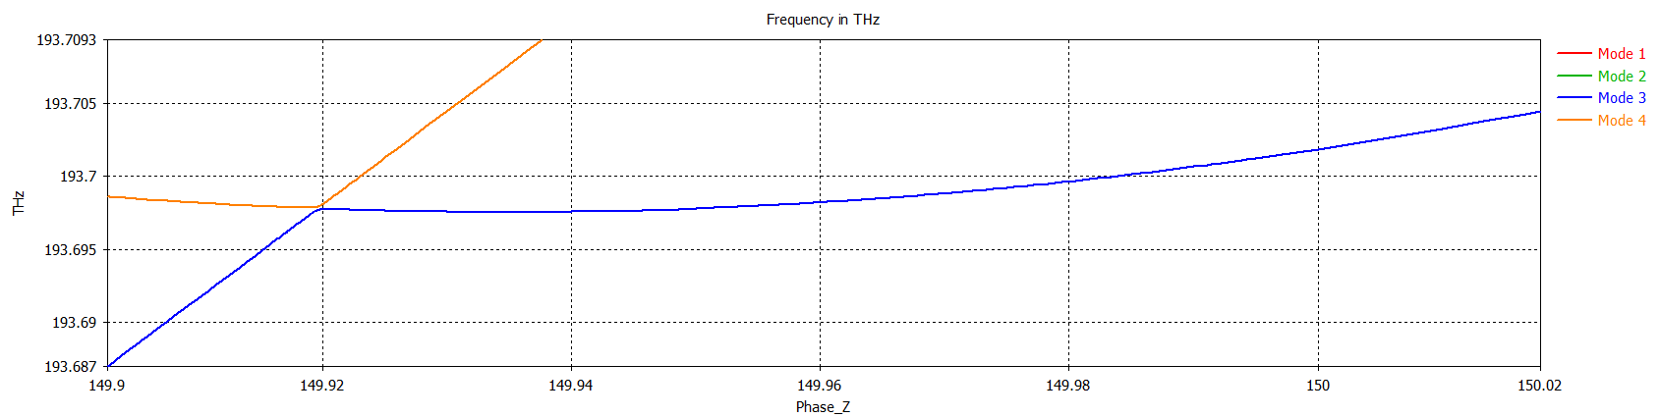

Is it really?
$$s$$
$$d$$
$$d_{c}$$
$$w$$
$$w_{c}$$
It is not

Slide 4
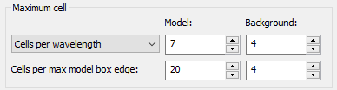
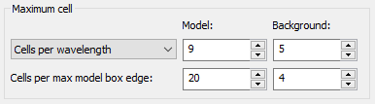
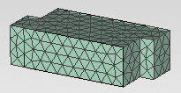
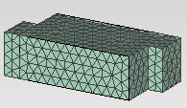
Do we keep the SIP with different meshes?

Slide 5






How is the SIP formed?
The SIP is formed through the interaction between 3 modes
Is this what happens?
$$f$$
$$f$$
$$f$$
$$kd/π$$
$$kd/π$$
$$kd/π$$
Do we see that for our “SIP”?

Slide 6
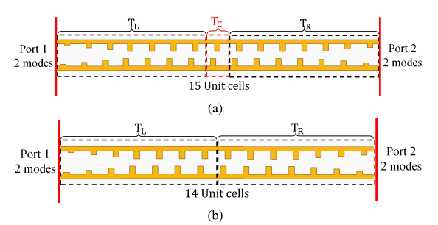






Tarek’s tapering similarity method
$$F=\left(\begin{matrix}0 & I \\ I & 0\end{matrix}\right)$$
;
;
$$T_{C}=T_{15}T_{14}^{−1}$$
Mealy, Capolino, IEEE Photonics Technology Letters, 35, 187-190 (2023)
Dr. Tarek Mealy figured out how to calculate the complex dispersion diagram of a periodic waveguide from freq. domain simulations
The tapering creates an adiabatic transition between the port modes of the freq. domain with the Bloch modes of the infinite periodic structure. The larger the tapering, the better the transformation.
This is necessary because Bloch modes for evanescent fields are not directly available in commercial solvers.

Slide 7
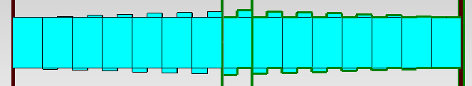
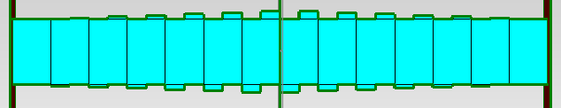
Dispersion diagram retrieval
I have run the simulations with 2, 3, and 4 port modes
I have not been able to obtain a decent dispersion diagram
I need to think about it. More work will follow

Slide 8
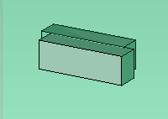

Updated code
Instead of a core and movable teeth, since we are glide symmetric, the waveguide is made of two blocks
It’s just code cleanup to prevent small, silly, preventable mistakes

Slide 9
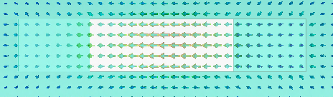
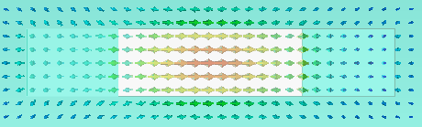
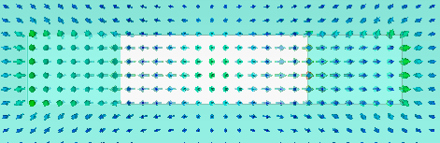
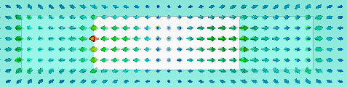
New attempt
Let us try to find a waveguide that has 3 horizontally-polarized modes that interact with each other
Since Mode 1 does not seem to interact, we look at higher modes
Need teethWidth = 300 nm, owgWidth = 600 nm
Mode 1
Mode 2
Mode 4
Mode 3

Slide 10
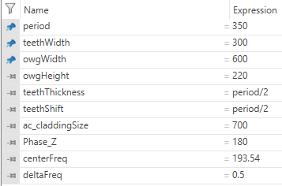
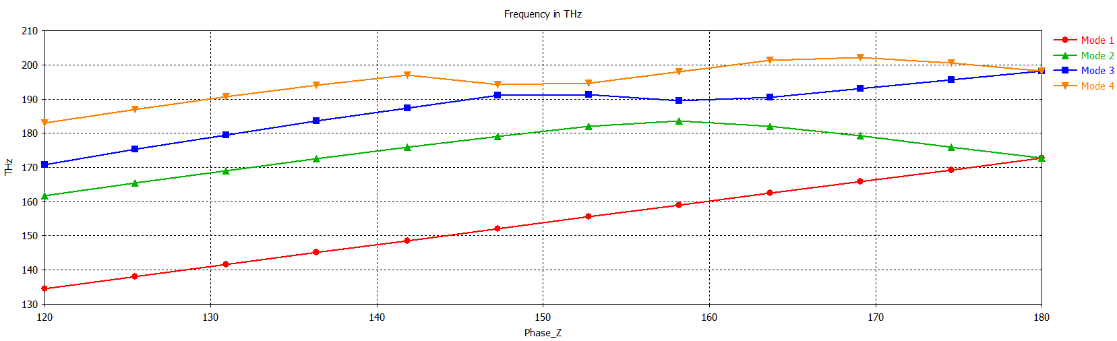
BigTeeth
Can we close Mode 3 into an SIP while keeping Mode 2,3, and 4 physical?
Mode 1
Mode 2
Mode 3
Mode 4

Slide 11
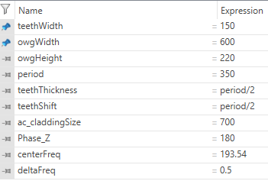
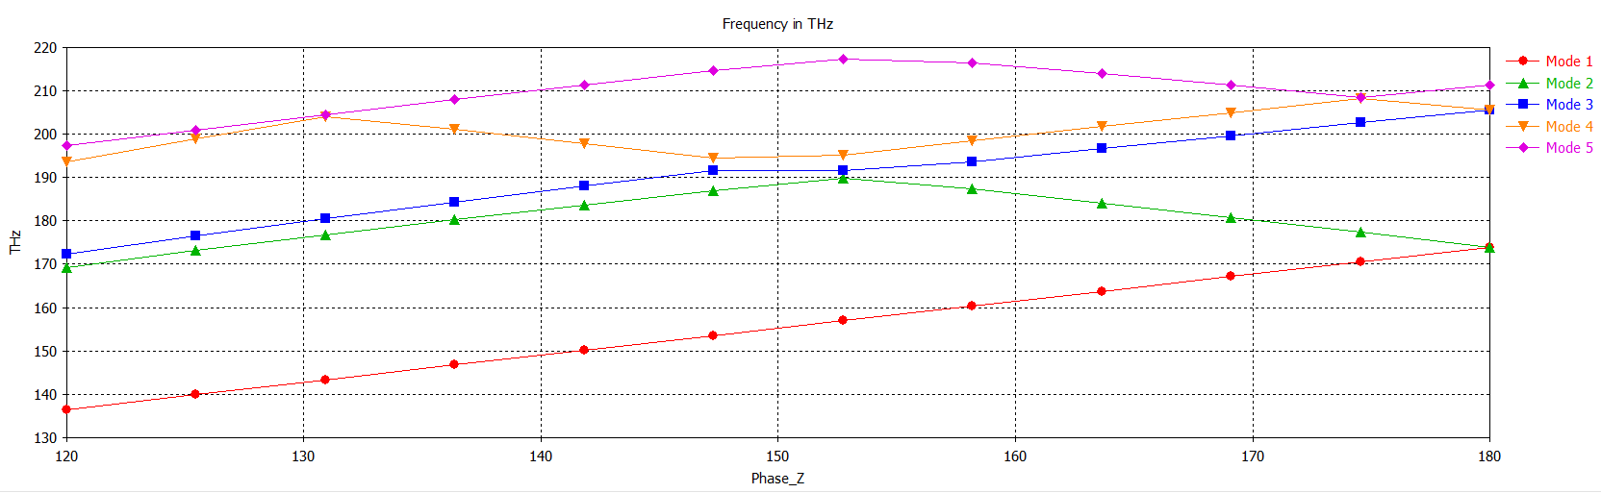
Can we reduce teethWidth without losing the modes?
No. If you have the owgWidth = 600, the teethWidth that gives you an “SIP” is around 80
And then Mode 3 is not physical

Slide 12
Let’s try with other owgWidth
Mode 2,3,4 are physical for owgWidth = 1000, teethWidth = 150
What if we change the period?

Slide 13




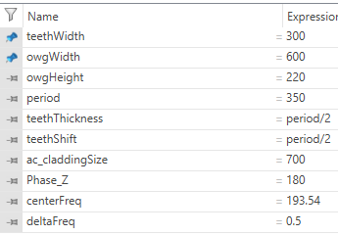
owgWidth = 600, teethWidth = 300. Vary period

