Slide 1

Stationary inflection point in a corrugated waveguide
A. Herrero Parareda and F. Capolino
Department of Electrical Engineering and Computer Science

Slide 2
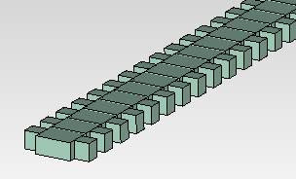
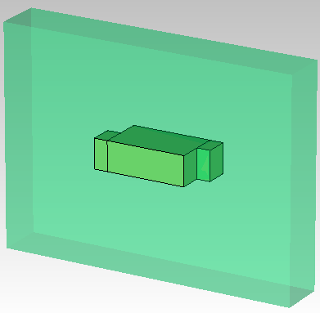
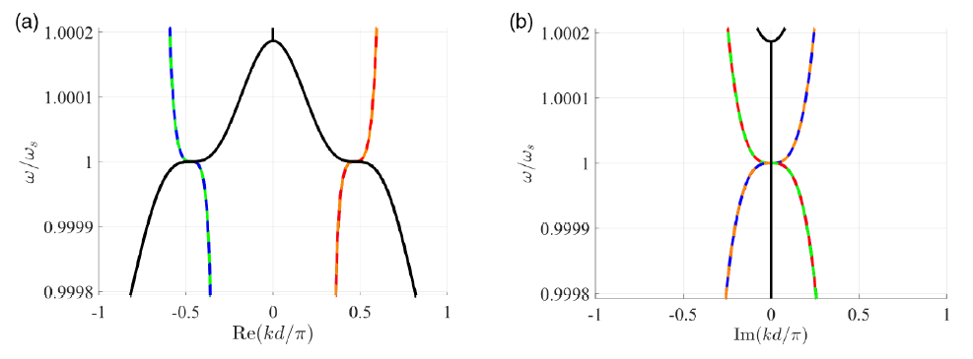

Main concept
Optimize geometric parameters to have a stationary inflection point (SIP) in the dispersion relation
(We want to find something like this)

Slide 3
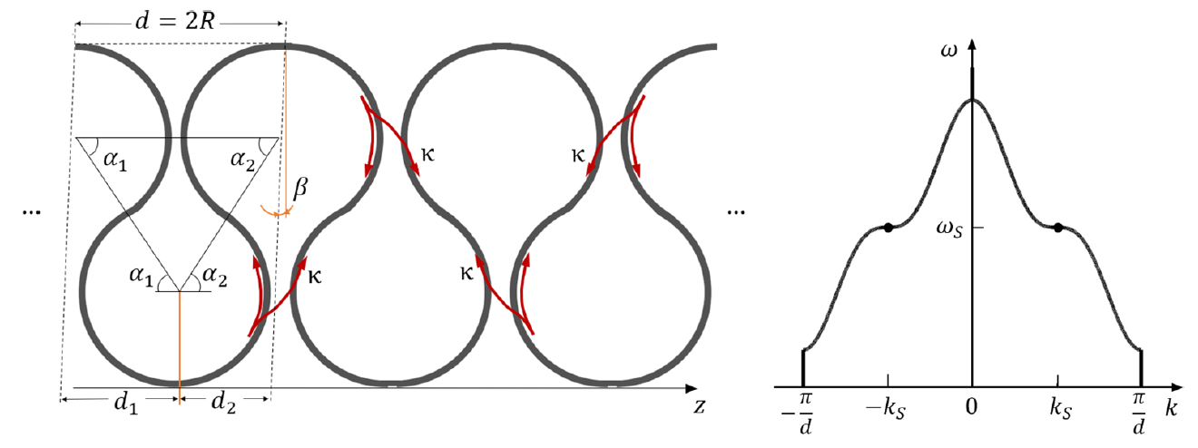
Frozen mode in optical waveguides
Generally, an SIP is achieved by coupling 3 single-mode waveguides
Optimize geometric parameters to have a stationary inflection point (SIP) in the dispersion relation
Herrero-Parareda, Furman, Mealy, Gibson, Bedford, Vitebskiy, Capolino, Optical Materials Express, 13, 5, 2023

Slide 4
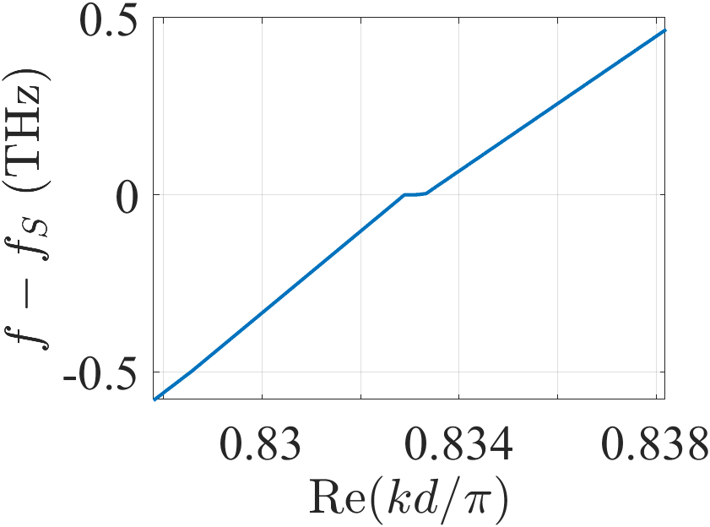
Frozen mode in optical waveguides
Instead, we want to achieve it with a single multi-mode waveguide
Optimize geometric parameters to have a stationary inflection point (SIP) in the dispersion relation

Slide 5
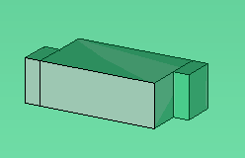




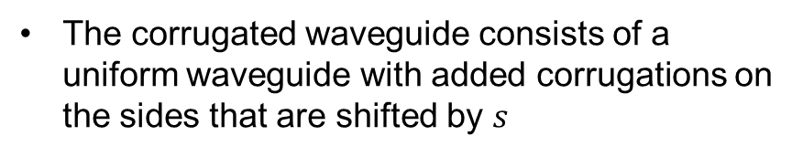



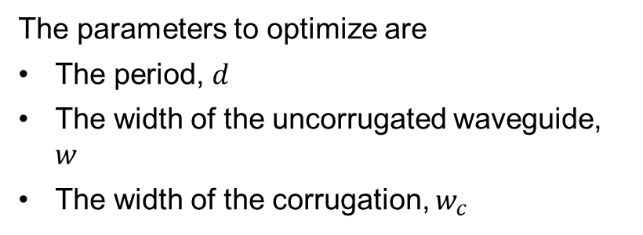

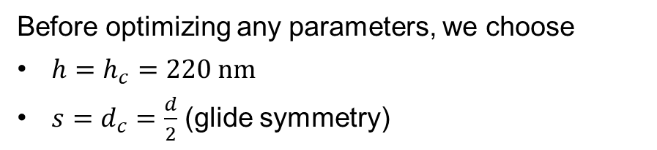


Corrugated waveguide
The corrugated waveguide consists of a uniform waveguide with added corrugations on the sides that are shifted by $s$
Before optimizing any parameters, we choose
$h=h_{c}=220 nm$
$s=d_{c}=\frac{d}{2}$ (glide symmetry)
$$s$$
$$d$$
$$d_{c}$$
$$w$$
$$w_{c}$$
The parameters to optimize are
The period, $d$
The width of the uncorrugated waveguide, $w$
The width of the corrugation, $w_{c}$
$$h=h_{c}$$

Slide 6
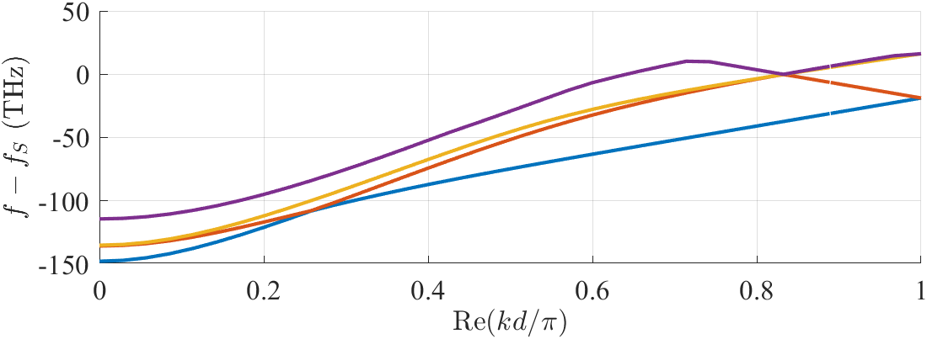




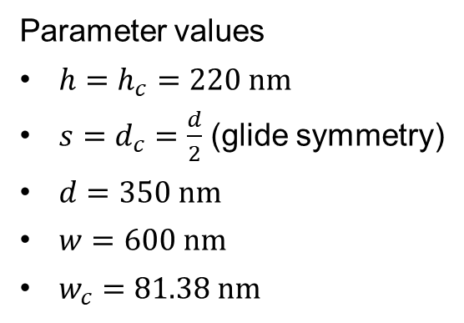

Results
Parameter values
$h=h_{c}=220 nm$
$s=d_{c}=\frac{d}{2}$ (glide symmetry)
$d=350 nm$
$w=600 nm$
$w_{c}=81.38 nm$
We optimize the parameters to flatten a mode with a local maximum and minimum close to each other
$$s$$
$$d$$
$$d_{c}$$
$$w$$
$$w_{c}$$

Slide 7
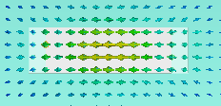
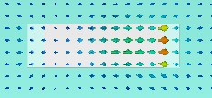
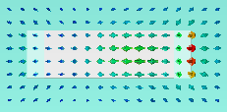
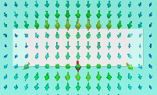
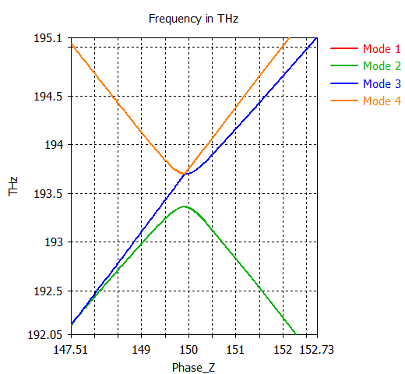
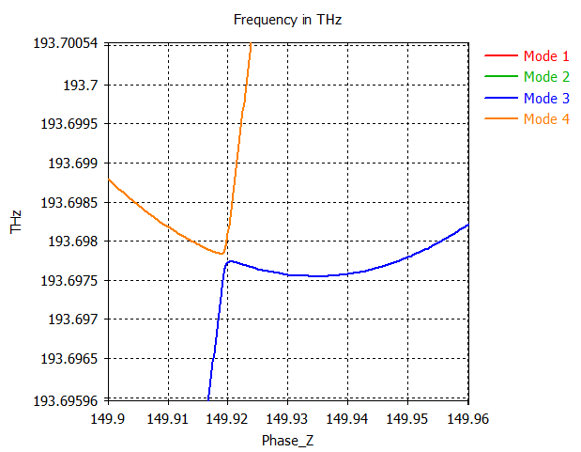


Is it an SIP?
$$s$$
$$d$$
$$d_{c}$$
$$w$$
$$w_{c}$$
Mode 1
Mode 2
Mode 3
Mode 4

Slide 8






How is the SIP formed?
The SIP is formed through the interaction between 3 modes
$$f$$
$$f$$
$$f$$
$$kd/π$$
$$kd/π$$
$$kd/π$$
Do we see that in our previous results?

Slide 9
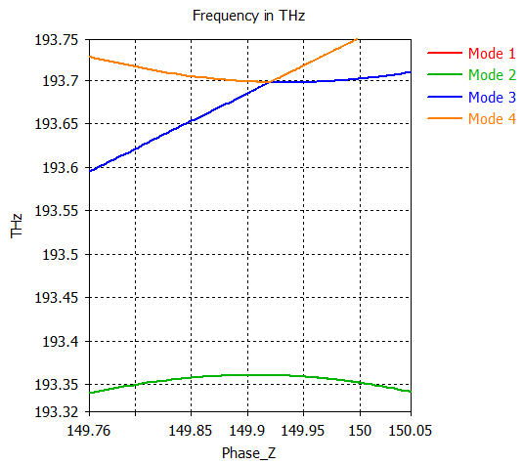
What is the behavior before and after the SIP?
I believe this is not an SIP

Slide 10
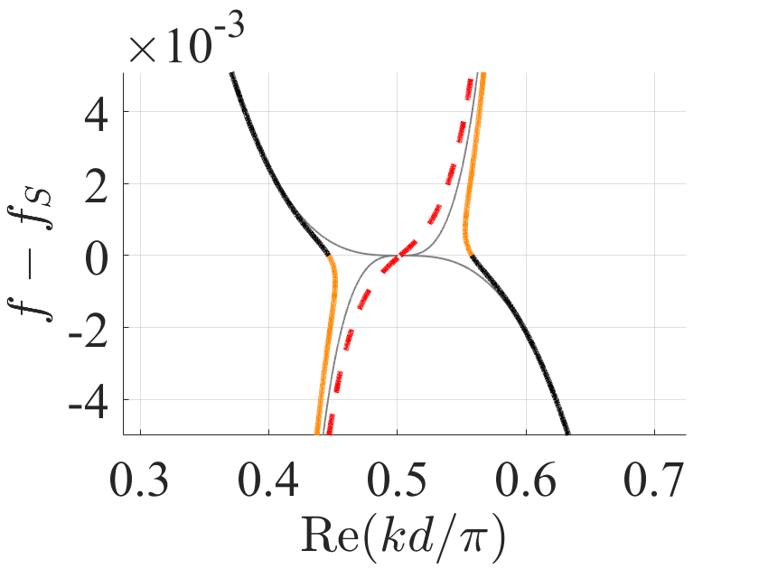
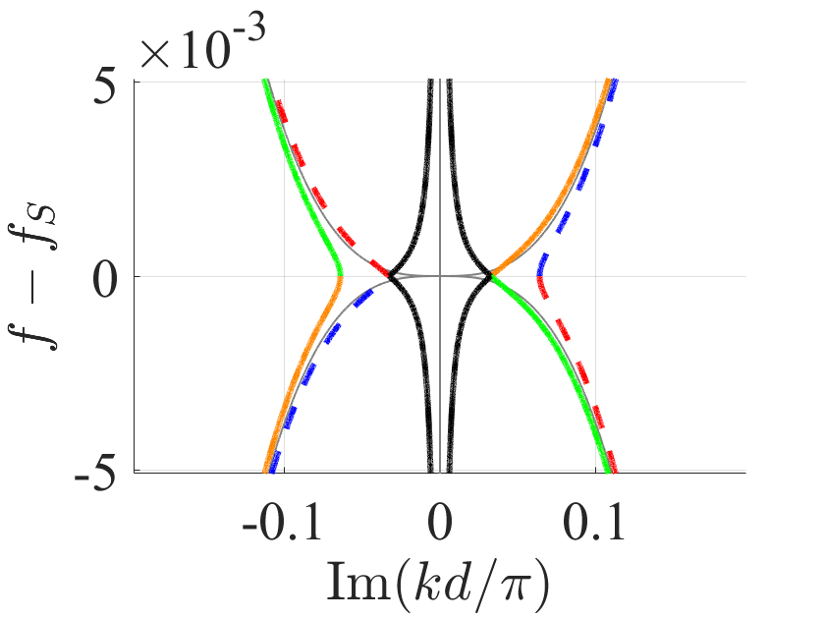
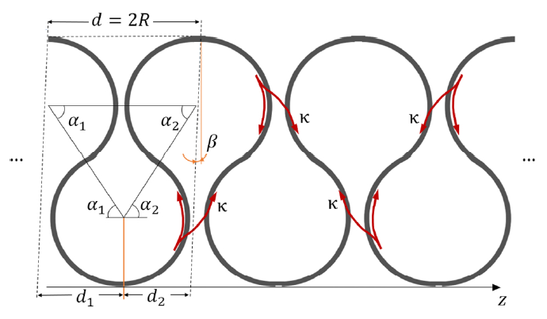
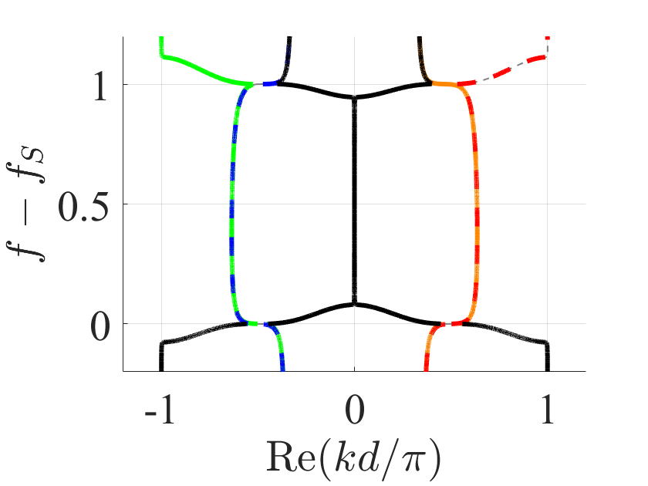
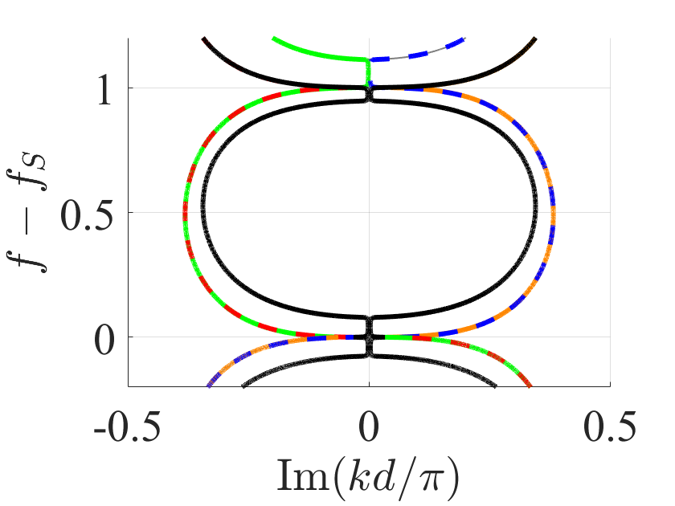
What occurs for the ASOW?
Perturbed ASOW by the presence of gain
The evanescent modes (dashed colors) start and end at consecutive SIPs

Slide 11
Considerations
We want three modes to coalesce
We need one of them to be a backwards mode, which requires a stronger corrugation
We can implement an algorithm to numerically optimize the existence of an SIP; it will require time (CST full-wave simulations ran from a matlab optimization algorithm)

