Slide 1

Stationary inflection point in a corrugated waveguide
A. Herrero Parareda and F. Capolino
Department of Electrical Engineering and Computer Science

Slide 2
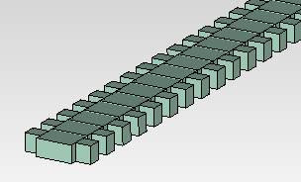
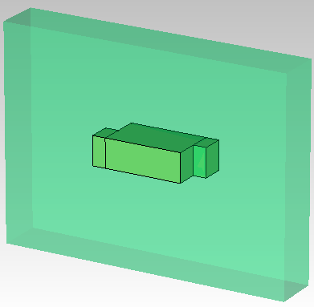
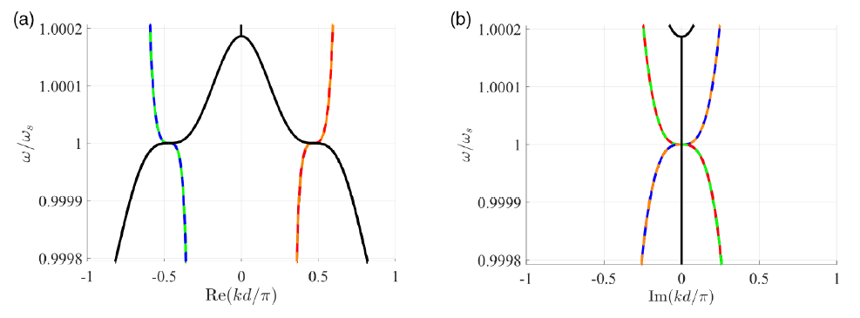

Main concept
Optimize geometric parameters to have a stationary inflection point (SIP) in the dispersion relation
(We want to find something like this)

Slide 3
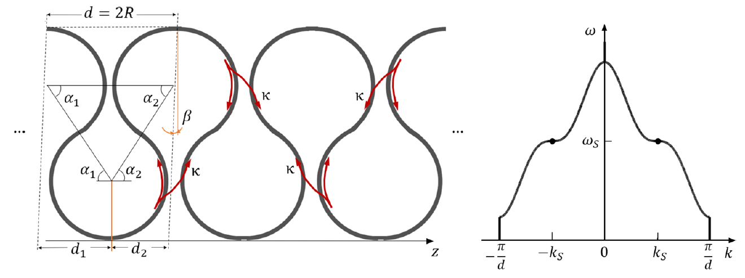
Frozen mode in optical waveguides
Generally, an SIP is achieved by coupling 3 single-mode waveguides
Optimize geometric parameters to have a stationary inflection point (SIP) in the dispersion relation
Herrero-Parareda, Furman, Mealy, Gibson, Bedford, Vitebskiy, Capolino, Optical Materials Express, 13, 5, 2023

Slide 4
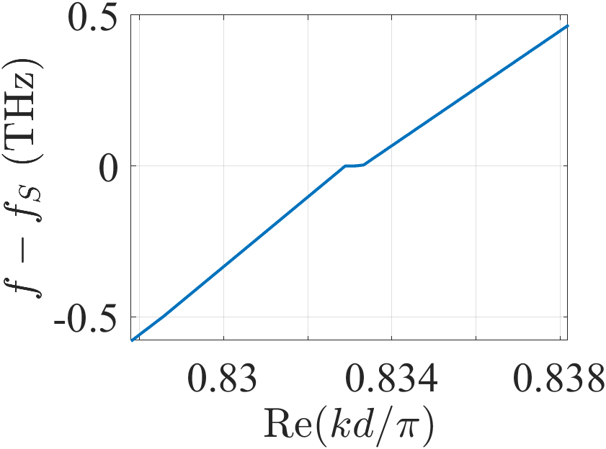
Frozen mode in optical waveguides
Instead, we want to achieve it with a single multi-mode waveguide
Optimize geometric parameters to have a stationary inflection point (SIP) in the dispersion relation

Slide 5
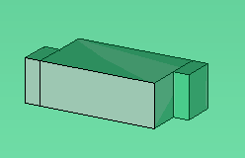




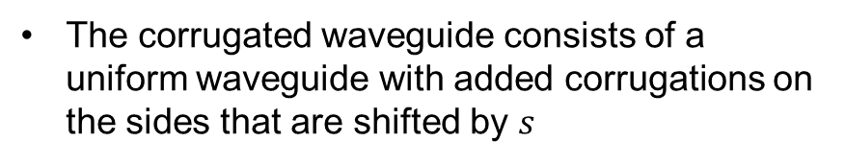



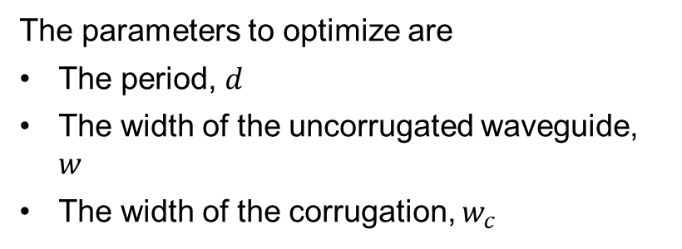

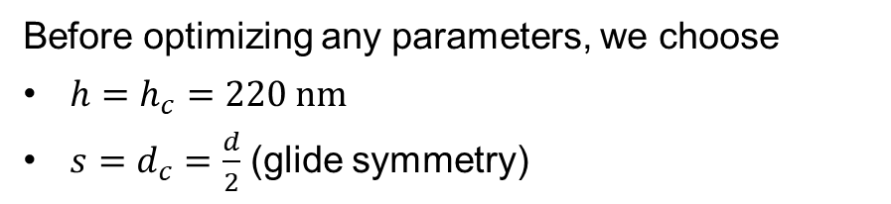


Corrugated waveguide
The corrugated waveguide consists of a uniform waveguide with added corrugations on the sides that are shifted by $s$
Before optimizing any parameters, we choose
$h=h_{c}=220 nm$
$s=d_{c}=\frac{d}{2}$ (glide symmetry)
$$s$$
$$d$$
$$d_{c}$$
$$w$$
$$w_{c}$$
The parameters to optimize are
The period, $d$
The width of the uncorrugated waveguide, $w$
The width of the corrugation, $w_{c}$
$$h=h_{c}$$

Slide 6




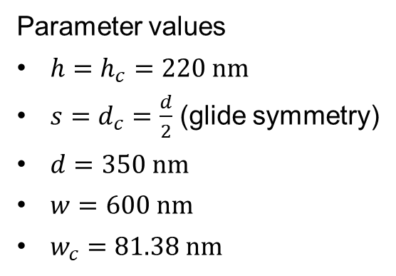

Results
Parameter values
$h=h_{c}=220 nm$
$s=d_{c}=\frac{d}{2}$ (glide symmetry)
$d=350 nm$
$w=600 nm$
$w_{c}=81.38 nm$
We optimize the parameters to flatten a mode with a local maximum and minimum close to each other
$$s$$
$$d$$
$$d_{c}$$
$$w$$
$$w_{c}$$

Slide 7






How is the SIP formed?
The SIP is formed through the interaction between 3 modes
$$f$$
$$f$$
$$f$$
$$kd/π$$
$$kd/π$$
$$kd/π$$
Do we see that in our previous results?

Slide 8
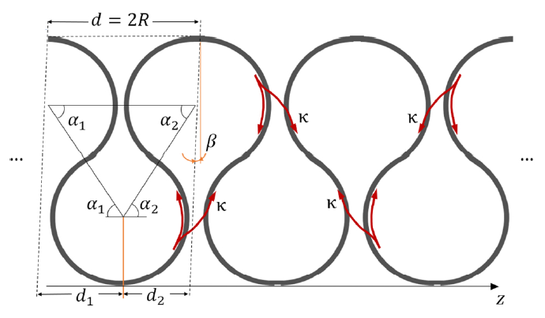
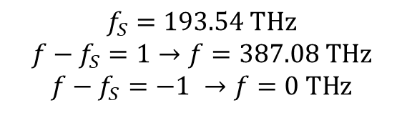
What occurs for the ASOW?
The evanescent modes (in red) start and end at consecutive SIPs
The frequencies are
$$f_{S}=193.54 THz$$
$$f−f_{S}=1→f=387.08 THz$$
$$f−f_{S}=−1 →f=0 THz$$

Slide 9
Considerations
We want three modes to coalesce
We need one of them to be a backwards mode, which requires a stronger corrugation
We can implement an algorithm to numerically optimize the existence of an SIP (next slides)

Slide 10
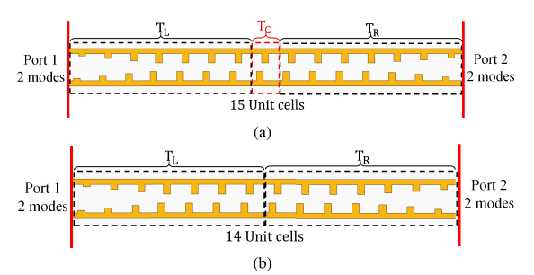






Dispersion diagram retrieval with the tapering similarity method
$$F=\left(\begin{matrix}0 & I \\ I & 0\end{matrix}\right)$$
;
;
$$T_{C}=T_{15}T_{14}^{−1}$$
Mealy, Capolino, IEEE Photonics Technology Letters, 35, 187-190 (2023)
Dr. Tarek Mealy figured out how to calculate the complex dispersion diagram of a periodic waveguide from freq. domain simulations
The tapering creates an adiabatic transition between the port modes of the freq. domain with the Bloch modes of the infinite periodic structure. The larger the tapering, the better the transformation.
This is necessary because Bloch modes for evanescent fields are not directly available in commercial solvers.

Slide 11
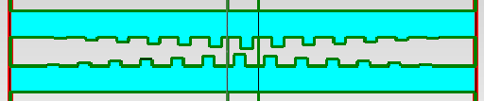

Applied to a double grating with DBE
This method allows us to retrieve the complex dispersion diagram from frequency domain simulations
We can write a MATLAB code that runs the CST simulations automatically to optimize the parameters to find an SIP

