Slide 1

Is it really an SIP?
A. Herrero Parareda and F. Capolino
Department of Electrical Engineering and Computer Science

Slide 2
Mesh comparison
Compare the mode coalescence with different meshes to see whether the “SIP” we saw was due to mesh asymmetry
We will be using 3 meshes:
Coarse
Finer
Finest

Slide 3
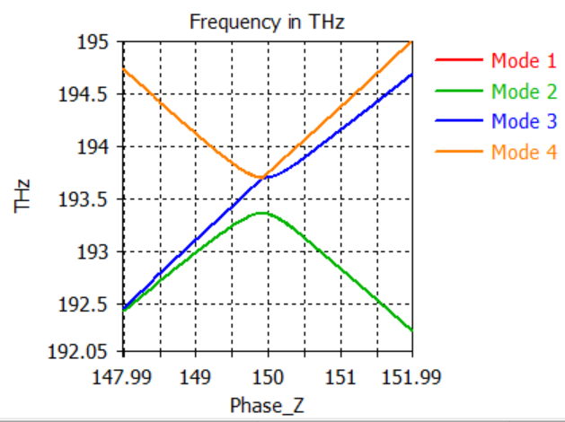
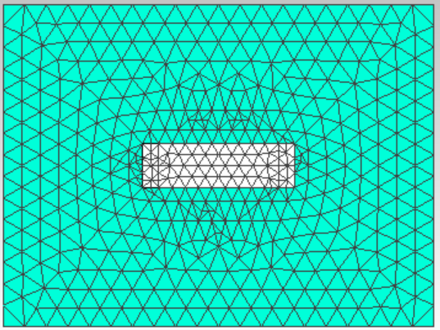
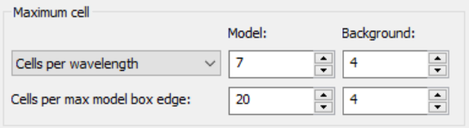
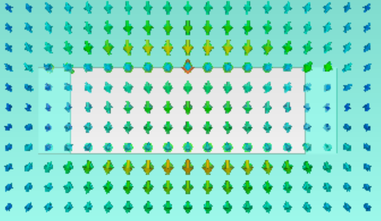
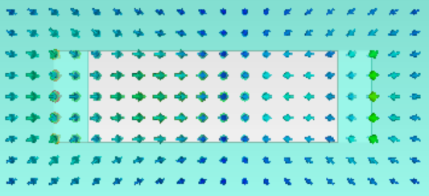
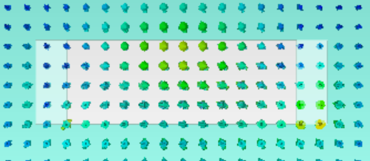
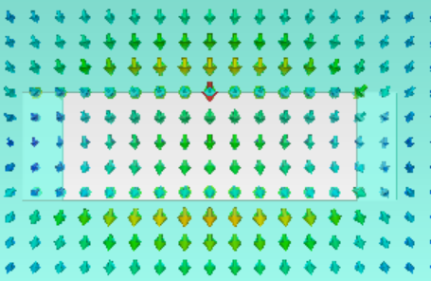
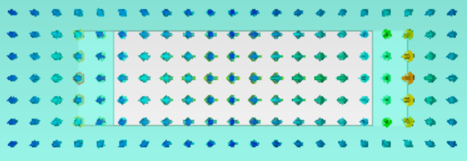
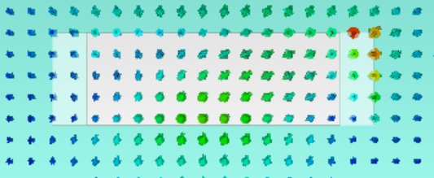
Coarse mesh: Mode 3 and Mode 4
Phase_Z Before Coalescence = 149.85
Phase_Z @ Coalescence = 149.9196
Phase_Z After Coalescence = 150

Slide 4
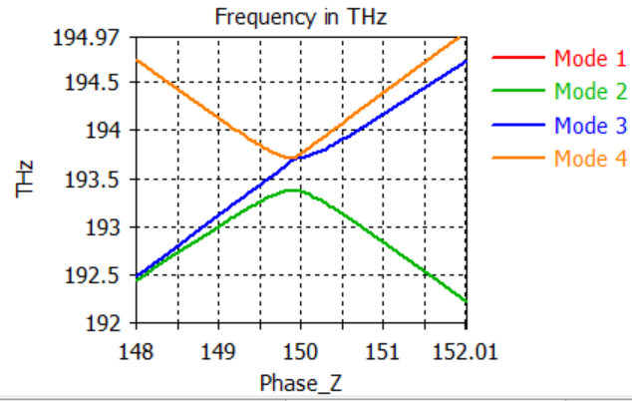
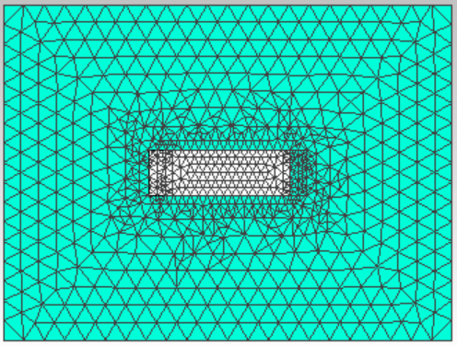
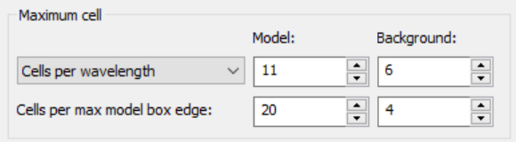
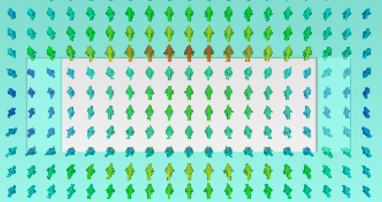
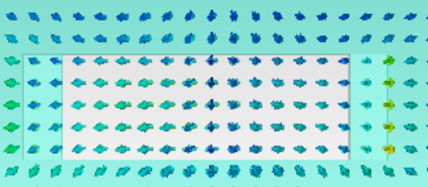
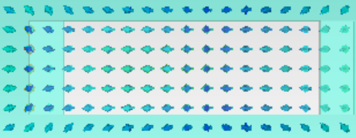
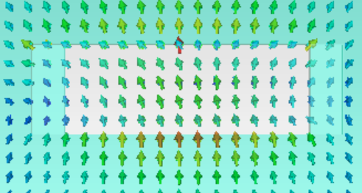
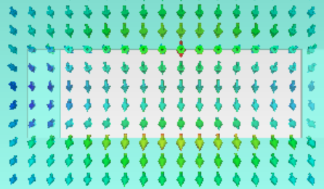
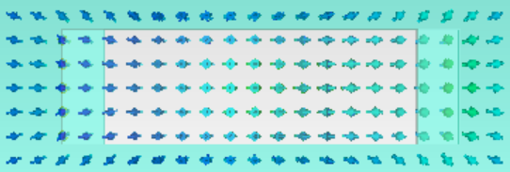
Finer mesh : Mode 3 and Mode 4
Phase_Z Before Coalescence = 149.9296
Phase_Z @ Coalescence = 149.9196
Phase_Z After Coalescence = 149.935

Slide 5
Finest mesh : Mode 3 and Mode 4
Phase_Z Before Coalescence = 149.85
Phase_Z @ Coalescence = 149.9196
Phase_Z After Coalescence = 149.935

Slide 6
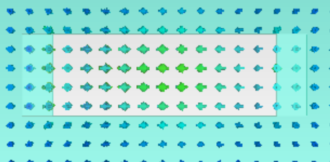
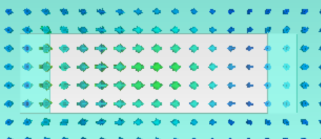
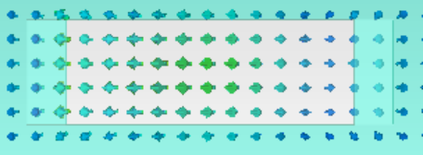
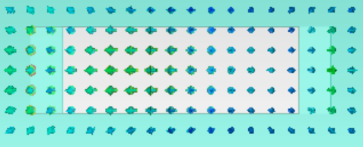
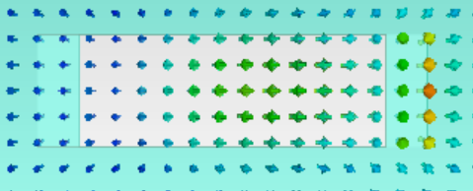
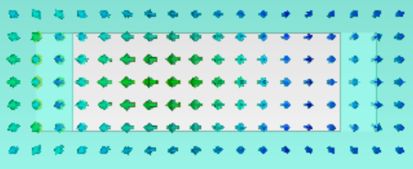
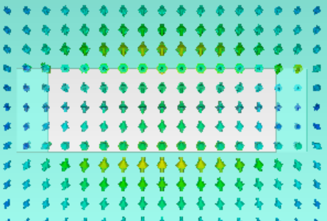
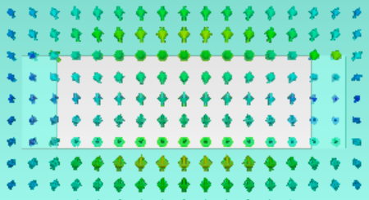
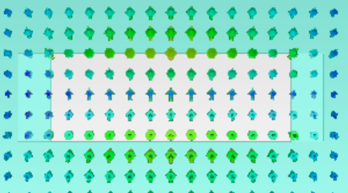
Coarse mesh: Mode 2 and Mode 3
Phase_Z Before Coalescence = 149.925
Phase_Z @ Coalescence = 149.935
Phase_Z After Coalescence = 149.945

