Slide 1

SIP in CW – PMC edition
A. Herrero Parareda and F. Capolino
Department of Electrical Engineering and Computer Science

Slide 2
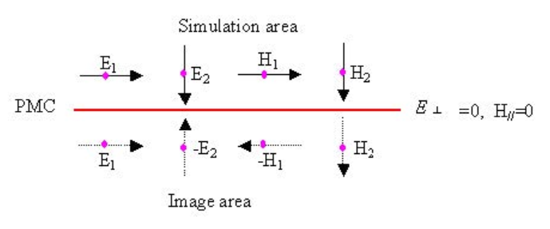
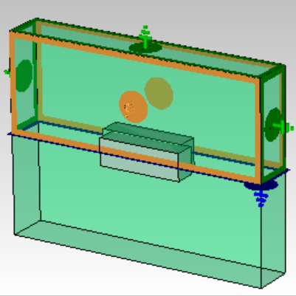
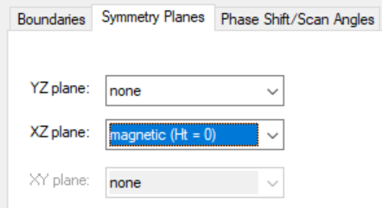
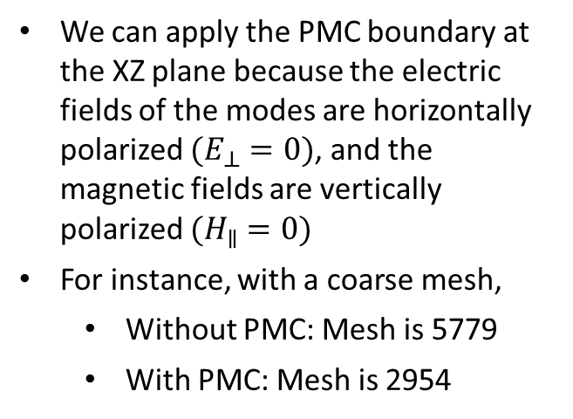
Exploiting symmetries
When the modes are horizontally polarized, the corrugated waveguide (CW) displays a symmetry around the XZ plane
By placing a perfectly magnetic conductor (PMC) boundary at that plane, we cut the mesh size approximately in half, and therefore, the matrix to solve to a fourth of its original size
We can apply the PMC boundary at the XZ plane because the electric fields of the modes are horizontally polarized $(E_{⊥}=0)$, and the magnetic fields are vertically polarized $(H_{∥}=0)$
For instance, with a coarse mesh,
Without PMC: Mesh is 5779
With PMC: Mesh is 2954

Slide 3
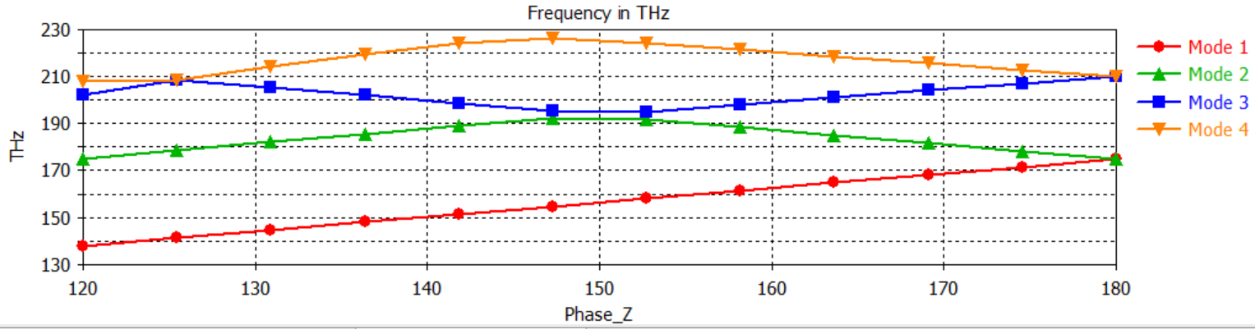
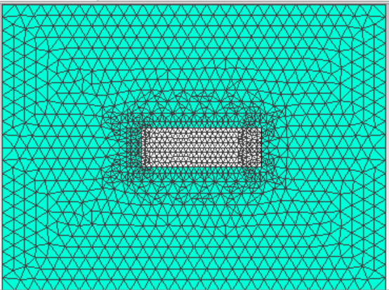
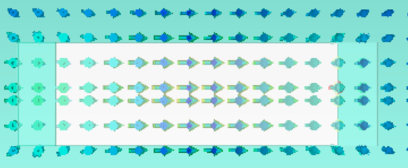
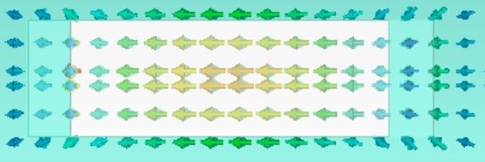
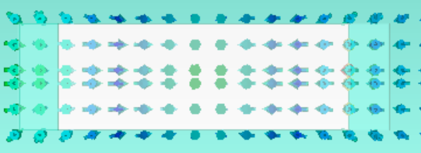
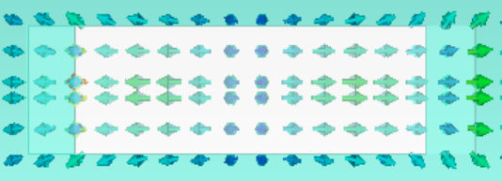
With PMC: Good mesh, coarse sweep

Slide 4
When can we use the PMC symmetry?
When it has been confirmed that the CW with those specific parameters supports 4 horizontally-polarized modes (because the lowest-order mode refuses to interact with the other modes, and you need 3 coalescing modes to achieve an SIP)
The PMC-symmetry trick can be used to reduce to 1/4th the simulation time when doing the parametric sweep of Phase_Z

