Slide 1

SIP in CW – SIP Search
A. Herrero Parareda and F. Capolino
Department of Electrical Engineering and Computer Science

Slide 2
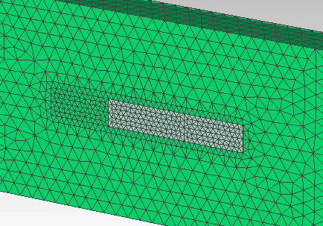
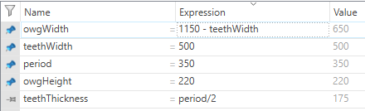
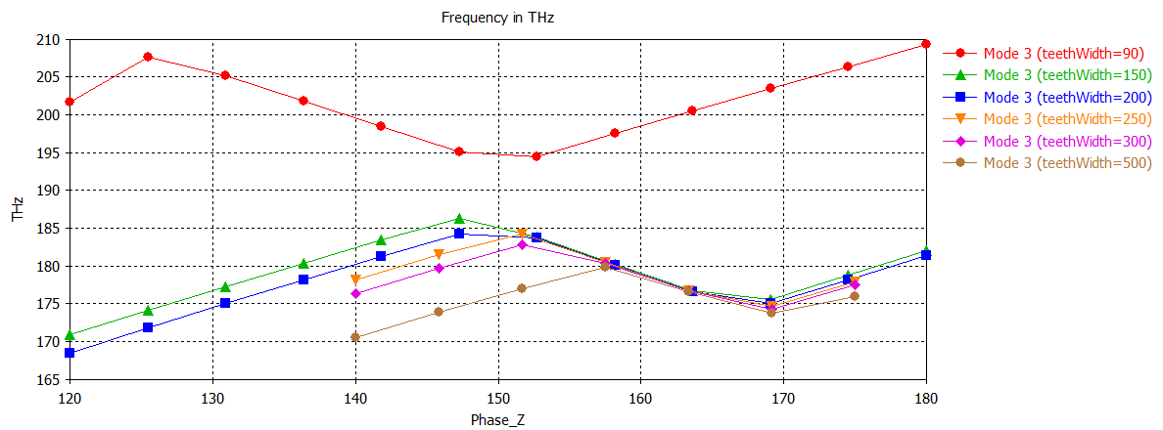
Some runs
1000

Slide 3

Let’s try larger teethWidth, smaller owgWidth
I have found that there are 4 horizontally polarized modes if teethWidth + owgWidth >= 1150
- owgWidth = 1000; teethWidth = 200; Yes
- owgWidth = 1000; teethWidth = 150; Yes
- owgWidth = 1050; teethWidth = 100; Yes
- owgWidth = 1100; teethWidth = 50; Yes
- owgWidth = 950; teethWidth = 300; Yes
- owgWidth = 850; teethWidth = 200; Yes
- owgWidth = 650; teethWidth = 500; Yes
- owgWidth = 450; teethWidth = 700; Yes
- owgWidth = 250; teethWidth = 900; Yes
- owgWidth = 150; teethWidth = 1000; Yes
- owgWidth = 0; teethWidth = 1150; Yes!
- owgWidth = 1150; teethWidth = 0; Yes!
- owgWidth = 1000; teethWidth = 100; No
- owgWidth = 1050; teethWidth = 50; No
Let’s start plotting with teethWidth = 1150/2, owgWidth = 1150 – teethWidth (with the PMC)

Slide 4
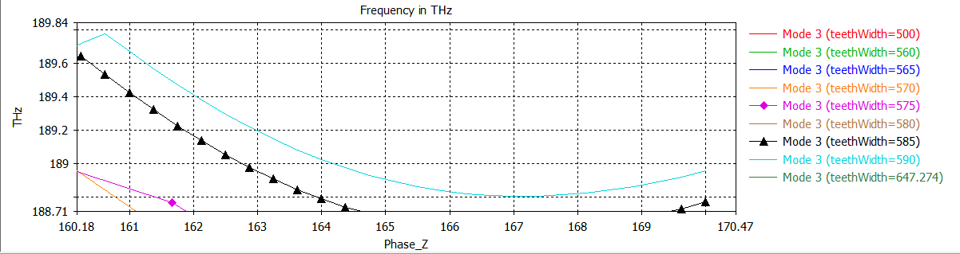
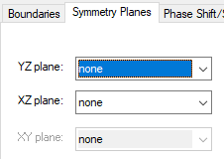
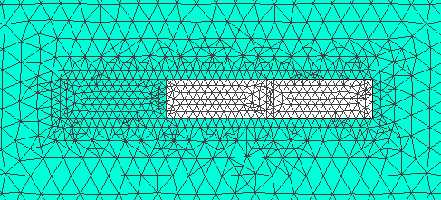




How is the mode coalescence?
Mode 3
Mode 4
Max: Phase_Z=160.625
Min:
Phase_Z=167

