Slide 1

SIP laser updates
A. Herrero-Parareda
Department of Electrical Engineering and Computer Science

Slide 2
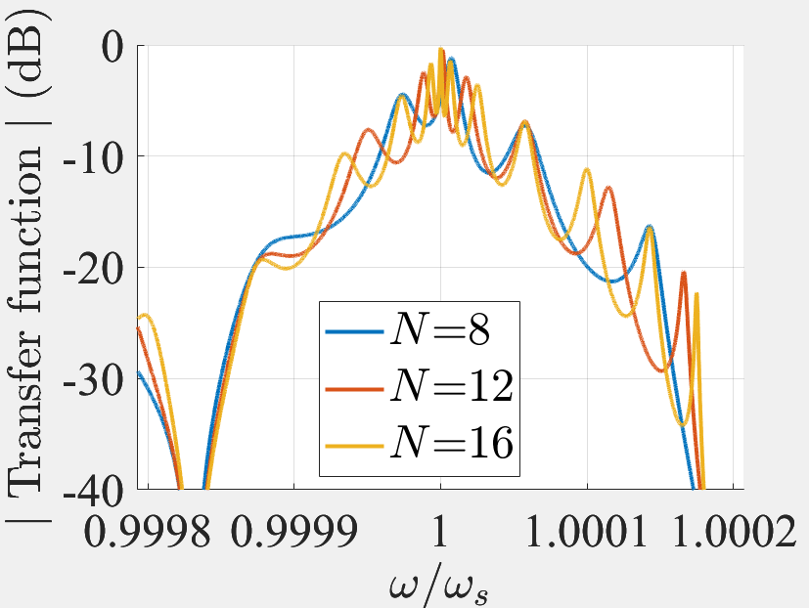
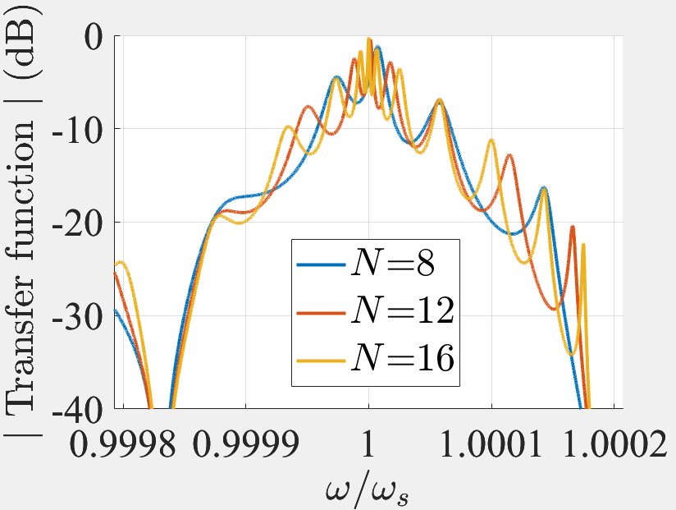
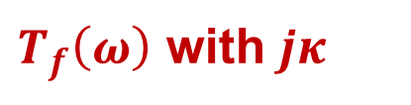
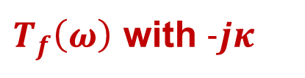
$T_{f}\left(ω\right)$ with $−jκ$ ?
$T_{f}\left(ω\right)$ with $jκ$
$T_{f}\left(ω\right)$ with $−jκ$

Slide 3
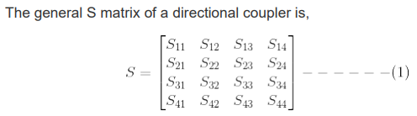
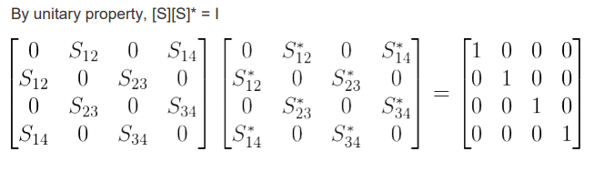
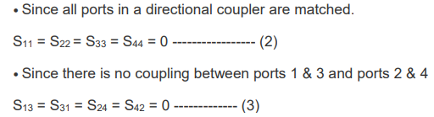

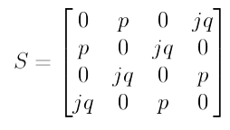

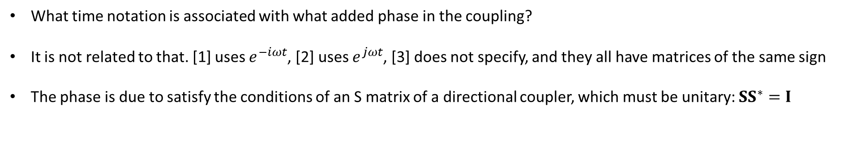
Time notation conundrum
What time notation is associated with what added phase in the coupling?
It is not related to that. [1] uses $e^{−iωt}$, [2] uses $e^{jωt}$, [3] does not specify, and they all have matrices of the same sign
The phase is due to satisfy the conditions of an S matrix of a directional coupler, which must be unitary: $SS^{∗}=I$
[1] Nada, Othman, Capolino, Theory of coupled resonator optical waveguides exhibiting high-order exceptional points of degeneracy, Physical Review B, 2017
[2] A. V. Raisanen, Radio Engineering for Wireless Communication and Sensor Applications, Artech House, 2003
[3] Landobasa, Darmawan, Chin, Matrix analysis of 2-D microresonator lattice optical filters, IEEE Quantum Electronics, 2005

