Slide 1

SIP laser updates
A. Herrero-Parareda
Department of Electrical Engineering and Computer Science

Slide 2
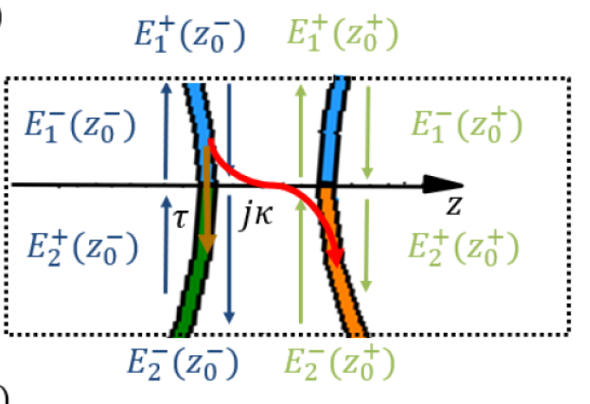

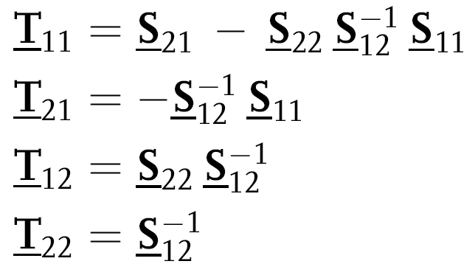



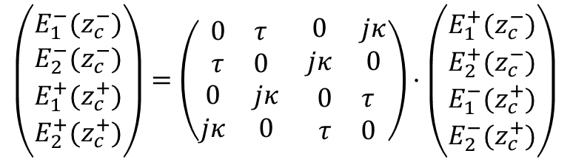
Check point-coupling transfer matrix
Scattering Matrix:
$$\left(\begin{matrix}\begin{matrix}E_{1}^{−}(z_{c}^{−}) \\ E_{2}^{−}(z_{c}^{−})\end{matrix} \\ \begin{matrix}E_{1}^{+}(z_{c}^{+}) \\ E_{2}^{+}(z_{c}^{+})\end{matrix}\end{matrix}\right)=\left(\begin{matrix}\begin{matrix}0 & τ \\ τ & 0\end{matrix} & \begin{matrix}0 & jκ \\ jκ & 0\end{matrix} \\ \begin{matrix}0 & jκ \\ jκ & 0\end{matrix} & \begin{matrix}0 & τ \\ τ & 0\end{matrix}\end{matrix}\right)·\left(\begin{matrix}\begin{matrix}E_{1}^{+}(z_{c}^{−}) \\ E_{2}^{+}(z_{c}^{−})\end{matrix} \\ \begin{matrix}E_{1}^{−}(z_{c}^{+}) \\ E_{2}^{−}(z_{c}^{+})\end{matrix}\end{matrix}\right)$$
S to T transformation:
[1] Nada, Capolino, Theory of coupled resonator optical waveguides exhibiting high-order exceptional points of degeneracy, Phys. Rev. B, 2017

Slide 3
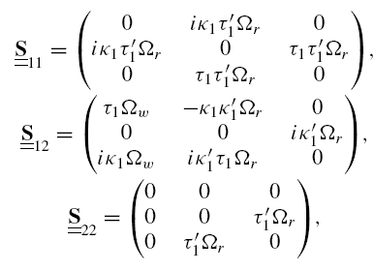
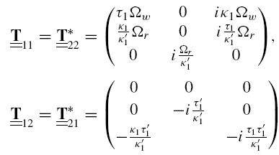


S to T transformations
[1] Nada, Capolino, Theory of coupled resonator optical waveguides exhibiting high-order exceptional points of degeneracy, Phys. Rev. B, 2017

Slide 4
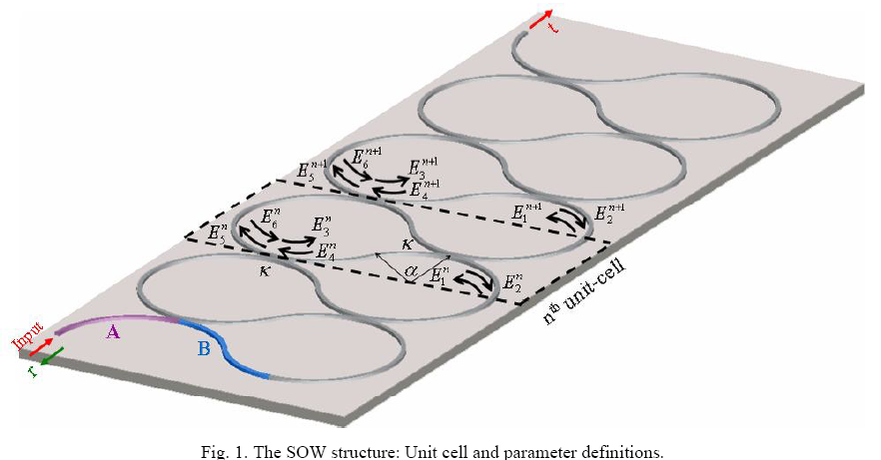


Extra step: Change in notation
We changed the notation to follow Scheuer’s
Adds permutations of rows and columns
[2] Scheuer, Weiss, The Serpentine Optical Waveguide: engineering the dispersion relations and the stopped light points, Optics Express, 2011

Slide 5
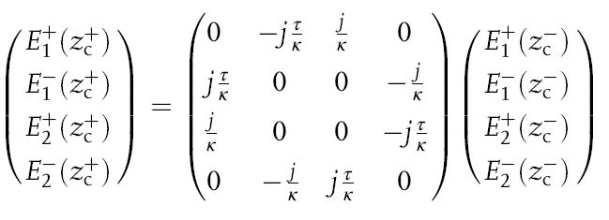
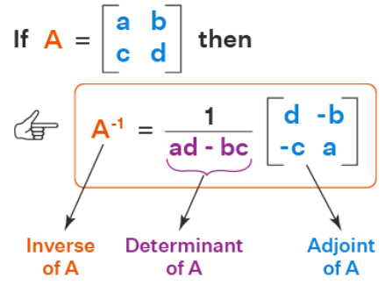
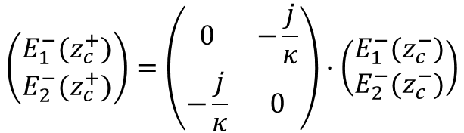
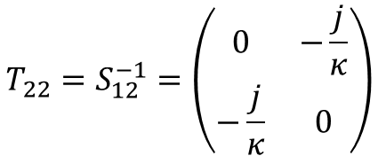
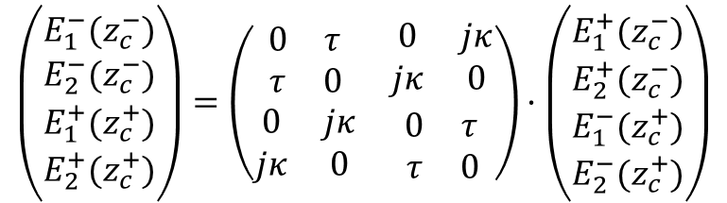
Example: $S_{12}→T_{22}$
$$\left(\begin{matrix}\begin{matrix}E_{1}^{−}(z_{c}^{−}) \\ E_{2}^{−}(z_{c}^{−})\end{matrix} \\ \begin{matrix}E_{1}^{+}(z_{c}^{+}) \\ E_{2}^{+}(z_{c}^{+})\end{matrix}\end{matrix}\right)=\left(\begin{matrix}\begin{matrix}0 & τ \\ τ & 0\end{matrix} & \begin{matrix}0 & jκ \\ jκ & 0\end{matrix} \\ \begin{matrix}0 & jκ \\ jκ & 0\end{matrix} & \begin{matrix}0 & τ \\ τ & 0\end{matrix}\end{matrix}\right)·\left(\begin{matrix}\begin{matrix}E_{1}^{+}(z_{c}^{−}) \\ E_{2}^{+}(z_{c}^{−})\end{matrix} \\ \begin{matrix}E_{1}^{−}(z_{c}^{+}) \\ E_{2}^{−}(z_{c}^{+})\end{matrix}\end{matrix}\right)$$
$$\left(\begin{matrix}E_{1}^{−}(z_{c}^{+}) \\ E_{2}^{−}(z_{c}^{+})\end{matrix}\right)=\left(\begin{matrix}0 & −\frac{j}{κ} \\ −\frac{j}{κ} & 0\end{matrix}\right)·\left(\begin{matrix}E_{1}^{−}(z_{c}^{−}) \\ E_{2}^{−}(z_{c}^{−})\end{matrix}\right)$$
$$T_{22}=S_{12}^{−1}=\left(\begin{matrix}0 & −\frac{j}{κ} \\ −\frac{j}{κ} & 0\end{matrix}\right)$$

Slide 6
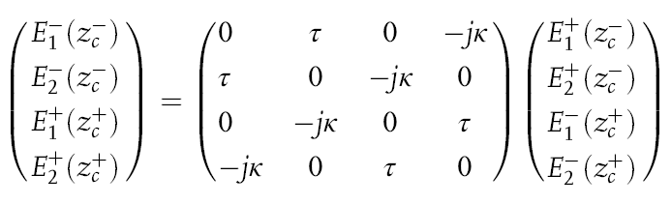
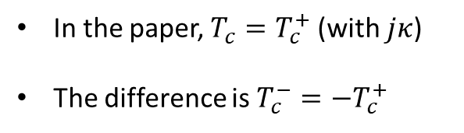


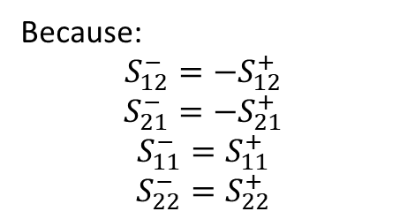
There is an error; it does not change the results
$$\left(\begin{matrix}\begin{matrix}E_{1}^{−}(z_{c}^{−}) \\ E_{2}^{−}(z_{c}^{−})\end{matrix} \\ \begin{matrix}E_{1}^{+}(z_{c}^{+}) \\ E_{2}^{+}(z_{c}^{+})\end{matrix}\end{matrix}\right)=\left(\begin{matrix}\begin{matrix}0 & τ \\ τ & 0\end{matrix} & \begin{matrix}0 & jκ \\ jκ & 0\end{matrix} \\ \begin{matrix}0 & jκ \\ jκ & 0\end{matrix} & \begin{matrix}0 & τ \\ τ & 0\end{matrix}\end{matrix}\right)·\left(\begin{matrix}\begin{matrix}E_{1}^{+}(z_{c}^{−}) \\ E_{2}^{+}(z_{c}^{−})\end{matrix} \\ \begin{matrix}E_{1}^{−}(z_{c}^{+}) \\ E_{2}^{−}(z_{c}^{+})\end{matrix}\end{matrix}\right)$$
$$S^{+}$$
But in the paper I wrote
$$S^{−}$$
Because:
$$S_{12}^{−}=−S_{12}^{+}$$
$$S_{21}^{−}={−S}_{21}^{+}$$
$$S_{11}^{−}=S_{11}^{+}$$
$$S_{22}^{−}=S_{22}^{+}$$
In the paper, $T_{c}=T_{c}^{+}$ (with $jκ$)
The difference is $T_{c}^{−}={−T}_{c}^{+}$
It does not change the results. We should change (A5), the 4x4 Scattering Matrix from $S^{−}→S^{+}$

Slide 7
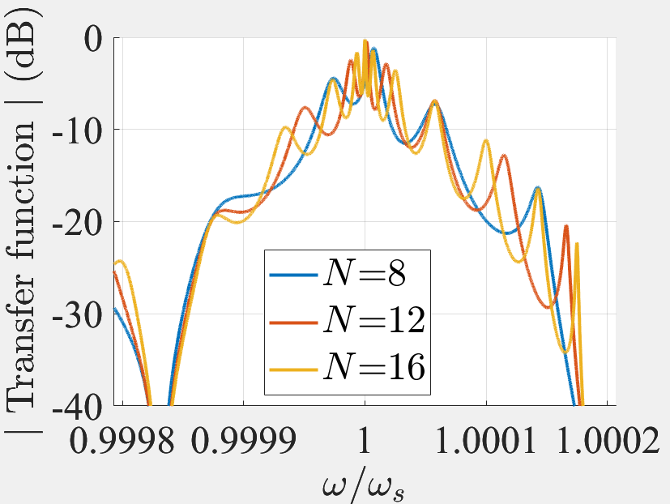
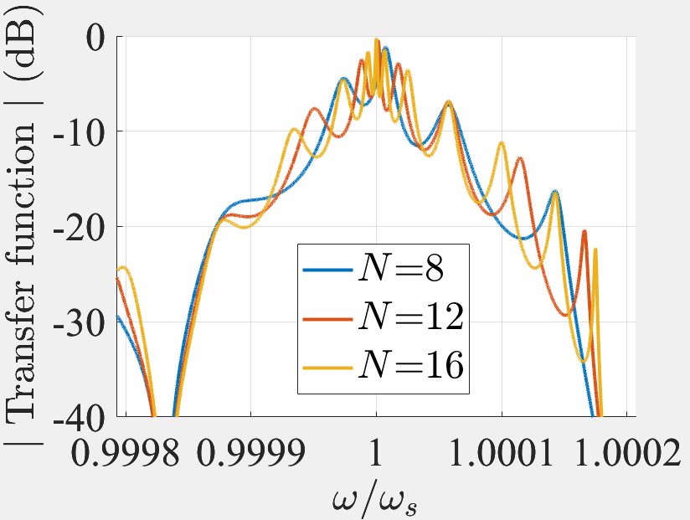
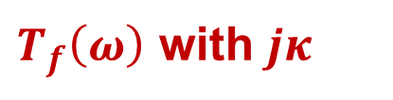
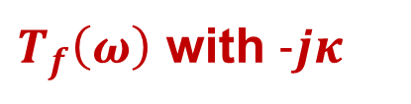
$T_{f}\left(ω\right)$ with $−jκ$ ?
$T_{f}\left(ω\right)$ with $jκ$
$T_{f}\left(ω\right)$ with $-jκ$

Slide 8
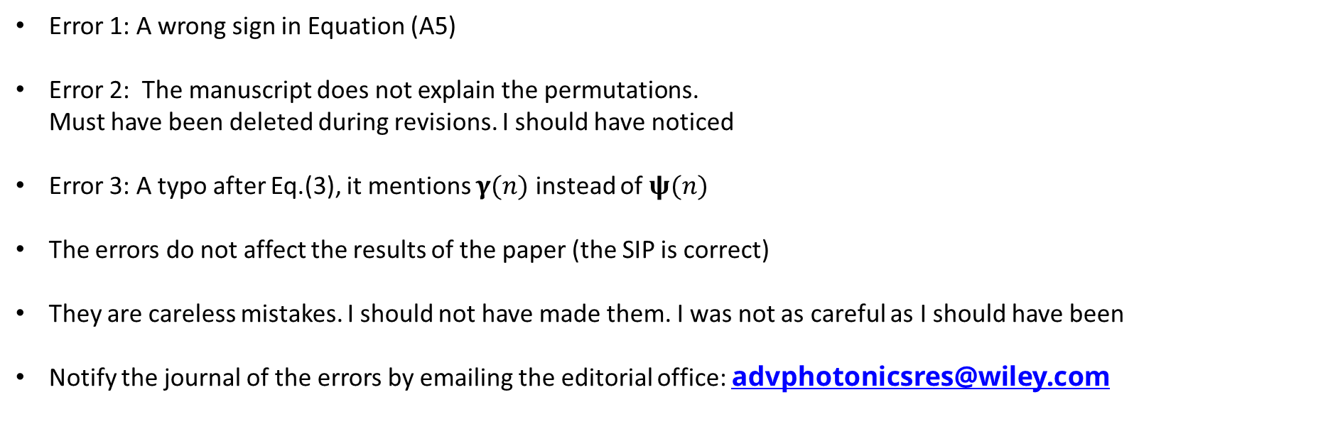
Next steps
Error 1: A wrong sign in Equation (A5)
Error 2: The manuscript does not explain the permutations. Must have been deleted during revisions. I should have noticed
Error 3: A typo after Eq.(3), it mentions $γ(n)$ instead of $ψ(n)$
The errors do not affect the results of the paper (the SIP is correct)
They are careless mistakes. I should not have made them. I was not as careful as I should have been
Notify the journal of the errors by emailing the editorial office: advphotonicsres@wiley.com

Slide 9
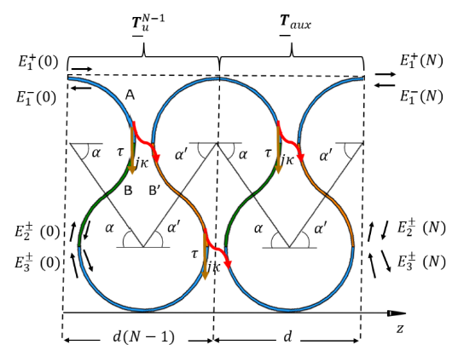
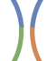















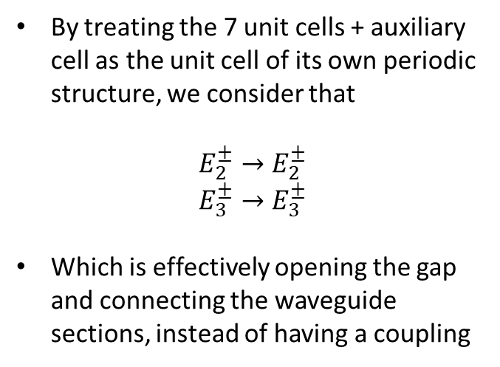



Finite-length structure as unit cell: Terminations
By treating the 7 unit cells + auxiliary cell as the unit cell of its own periodic structure, we consider that
$$E_{2}^{±}→E_{2}^{±}$$
$$E_{3}^{±}→E_{3}^{±}$$
Which is effectively opening the gap and connecting the waveguide sections, instead of having a coupling
$$E_{2}^{+}(z_{0}^{−})$$
$$E_{2}^{+}(z_{0}^{+})$$
$$E_{2}^{−}(z_{0}^{−})$$
$$E_{2}^{−}(z_{0}^{+})$$
$$E_{2}^{+}(z_{0}^{−})$$
$$E_{2}^{+}(z_{0}^{+})$$
$$E_{2}^{−}(z_{0}^{−})$$
$$E_{2}^{−}(z_{0}^{+})$$
$$z$$
$$E_{3}^{+}(z_{0}^{−})$$
$$E_{3}^{+}(z_{0}^{+})$$
$$z$$
$$E_{3}^{+}(z_{0}^{−})$$
$$E_{3}^{+}(z_{0}^{+})$$
$$E_{3}^{−}(z_{0}^{−})$$
$$E_{3}^{−}(z_{0}^{+})$$
$$E_{3}^{−}(z_{0}^{−})$$
$$E_{3}^{−}(z_{0}^{+})$$
Inifinitessimal length

Slide 10
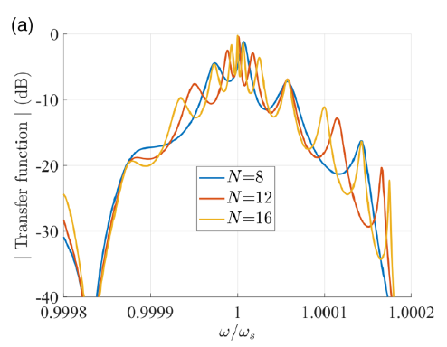

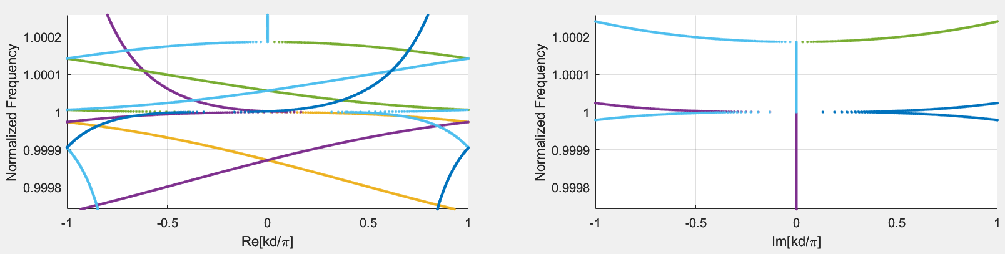
8 unit cells as a periodic structure: No auxiliary cell, no gap
There is coupling now!
No auxiliary matrix, no gap

