Slide 1

SIP laser updates
A. Herrero-Parareda
Department of Electrical Engineering and Computer Science

Slide 2
Non-resonant nature
I added it on Nov. 28th 2022 at 10:50 am
It is part of the abstract suggested by Ilya:
“The concept of lasers based on the frozen mode regime in active periodic optical waveguide with the 3d-order exceptional point degeneracy (EPD) is advanced. The frozen mode regime is associated with a stationary inflection point (SIP) in the Bloch dispersion relation, where three Bloch eigenmodes coalesce forming the frozen mode with a strong scaling of the amplitude and group delay with the waveguide length. As a practical example, we consider an asymmetric serpentine optical waveguide (ASOW). At the SIP frequency, the passive ASOW is characterized by a non-diagonalizable transfer matrix. An active ASOW operating near the SIP frequency displays a large group delay of a non-resonant nature, leading to strong gain enhancement. A laser operating in the vicinity of a SIP has a gain threshold that scales as a negative cube of the waveguide length. Practical considerations such as lasing threshold variation due to losses and SIP degradation due to gain and loss are examined. For comparison, the potential lasing in the vicinity of a photonic band edge close to a SIP is analyzed.”
I think the point is the properties of the frozen mode are not those of a common FPC resonance. In [1]
“The frozen mode regime is a qualitatively new wave phenomenon – it does not reduce to any known electromagnetic resonance. Formally, the frozen mode regime is not a resonance, in a sense that it is not particularly sensitive to the size and shape of the photonic crystal. The frozen mode regime is more robust and powerful, compared to any known slow-wave resonance.”
[1] Figotin, Vitebskiy, Slow wave phenomena in photonic crystals, Laser & Photonics Reviews, 2011

Slide 3
Sentence:
“In fact, we demonstrate that even though small values of gain and loss distort the dispersion diagram of the modes near the SIP, due to the exceptional sensitivity of the mode wavenumbers at an EPD \cite{figotin_slow_2006}, they remain in close proximity.”
[1] shows a generic Puiseux series
[2] cites [1,3]
[3] shows frequency splitting at a 3rd-order EPD in a PT-symmetric system balancing gain and loss
On the “mode distortion” section we cite [1,2,4,5,6,7]
[6] mentions gain induced mode distortion although only for an RBE (no Puiseux series)
[7] mentions gain perturbation for SIP in TWT amplifiers, does not show Puiseux series
[1] Figotin, Vitebskiy, Slow light in photonic crystals, Waves in Random and Complex Media, 2006
[2] Nada, Capolino, Theory of coupled resonator optical waveguides exhibiting high-order exceptional points of degeneracy, Phys. Rev. B, 2017
[3] Hodaei, Christodoulides, Enhanced sensitivity at higher-order exceptional points, Nature, 2017
[4] Kato, Perturbation theory for linear operators (Springer Berlin Heidelberg, 1966), chap. 2
[5] Welters, On Explicit Recursive Formulas in the Spectral Perturbation Analysis of a Jordan Block, SIAM J. Matrix Anal. & Appl., 2011
[6] Grgic, Mortensen, Fundamental Limitations to Gain Enhancement in Periodic Media and Waveguides, Phys. Rev. Letters, 2012
[7] Yazdi, Capolino, A New Amplification Regime for Traveling Wave Tubes With Third-Order Modal Degeneracy, IEEE Transactions on Plasma Science, 2018

Slide 4
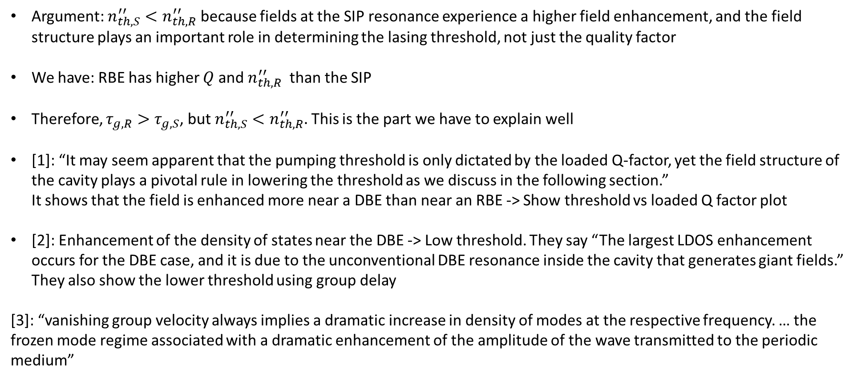
Field enhancement
Argument: $n_{th,S}^{′′}<n_{th,R}^{′′}$ because fields at the SIP resonance experience a higher field enhancement, and the field structure plays an important role in determining the lasing threshold, not just the quality factor
We have: RBE has higher $Q$ and $n_{th,R}^{′′}$ than the SIP
Therefore, $τ_{g,R}>τ_{g,S}$, but $n_{th,S}^{′′}<n_{th,R}^{′′}.$ This is the part we have to explain well
[1]: “It may seem apparent that the pumping threshold is only dictated by the loaded Q-factor, yet the field structure of the cavity plays a pivotal rule in lowering the threshold as we discuss in the following section.” It shows that the field is enhanced more near a DBE than near an RBE -> Show threshold vs loaded Q factor plot
[2]: Enhancement of the density of states near the DBE -> Low threshold. They say “The largest LDOS enhancement occurs for the DBE case, and it is due to the unconventional DBE resonance inside the cavity that generates giant fields.” They also show the lower threshold using group delay
[3]: “vanishing group velocity always implies a dramatic increase in density of modes at the respective frequency. … the frozen mode regime associated with a dramatic enhancement of the amplitude of the wave transmitted to the periodic medium”
[1] Veysi, Capolino, The degenerate band edge laser: a new paradigm for coherent light-matter interaction, Phys. Rev. B, 2018
[2] Othman, Capolino, Giant gain enhancement in photonic crystals with a degenerate band edge, Phys. Rev. B, 2016
[3] Figotin, Vitebskiy, Slow wave phenomena in photonic crystals, Laser & Photonics Reviews, 2011

Slide 5
Revise all the comments
Make sure all the comments are accounted for and that you are on the same page

