Slide 1

2D DDFB Updates
A. Herrero-Parareda
Department of Electrical Engineering and Computer Science

Slide 2
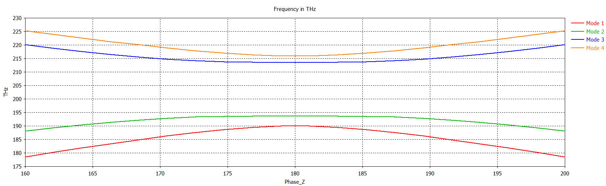
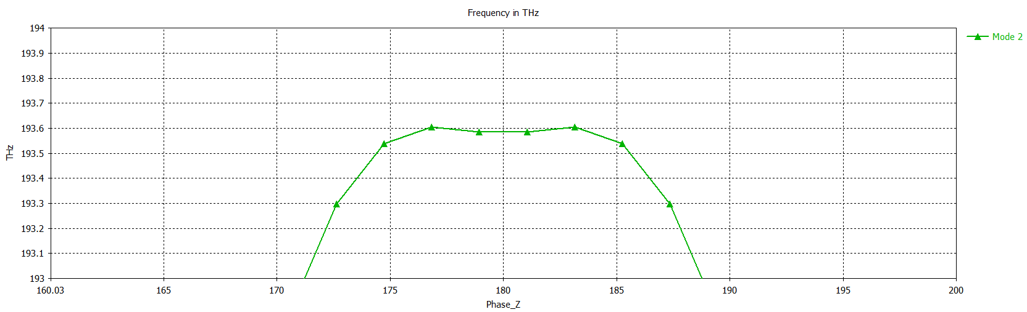
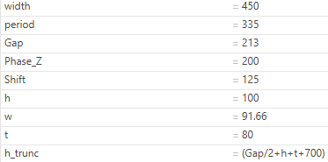

Big Width DBE

Slide 3
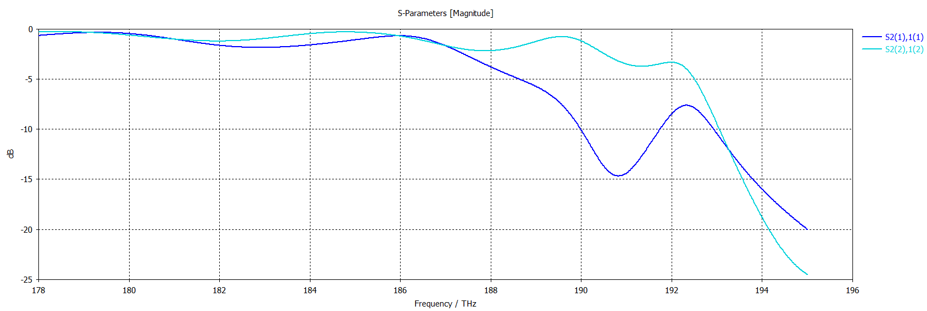
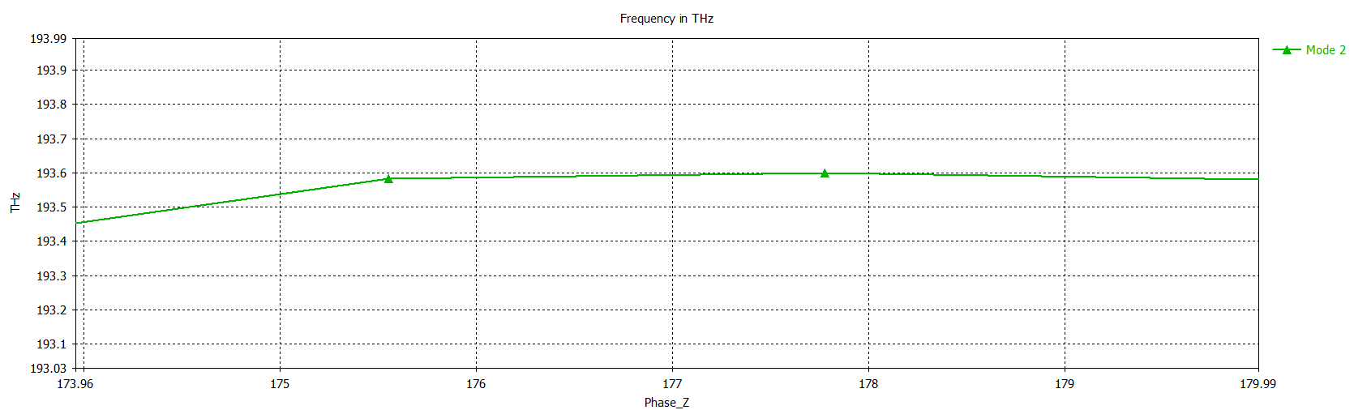
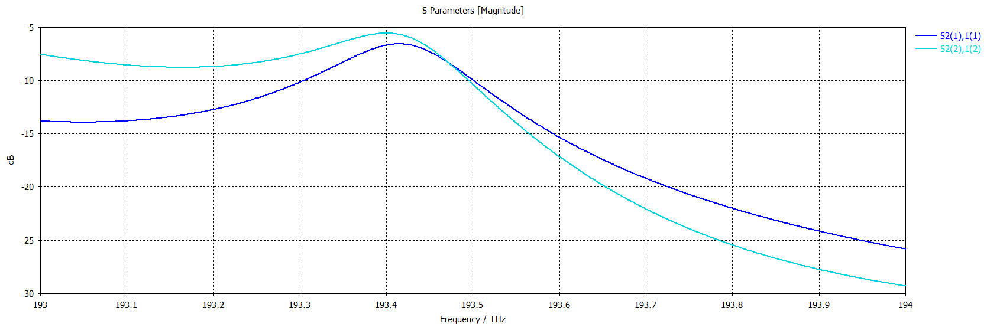
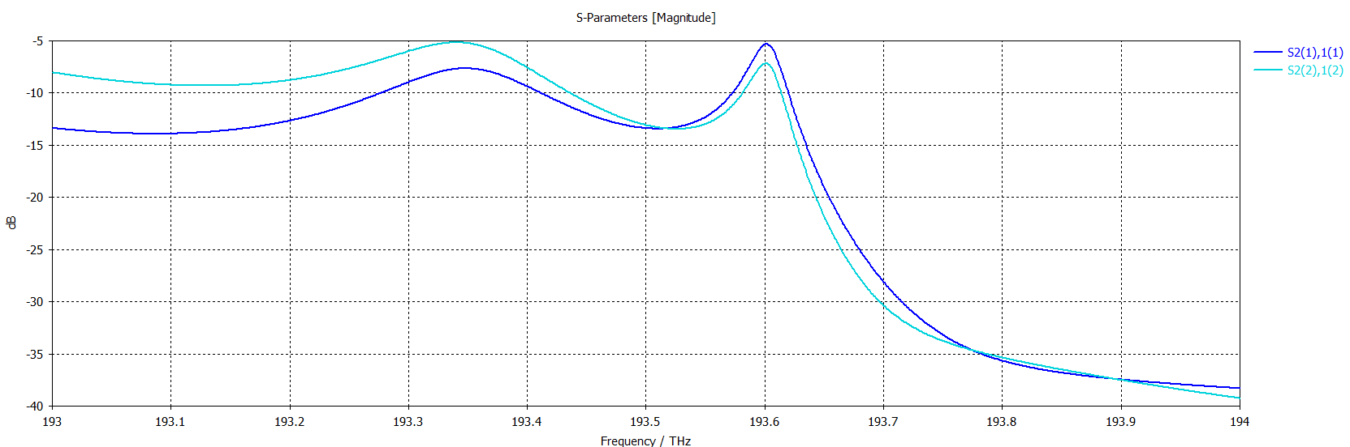
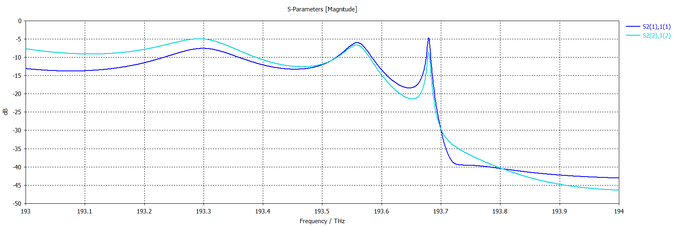
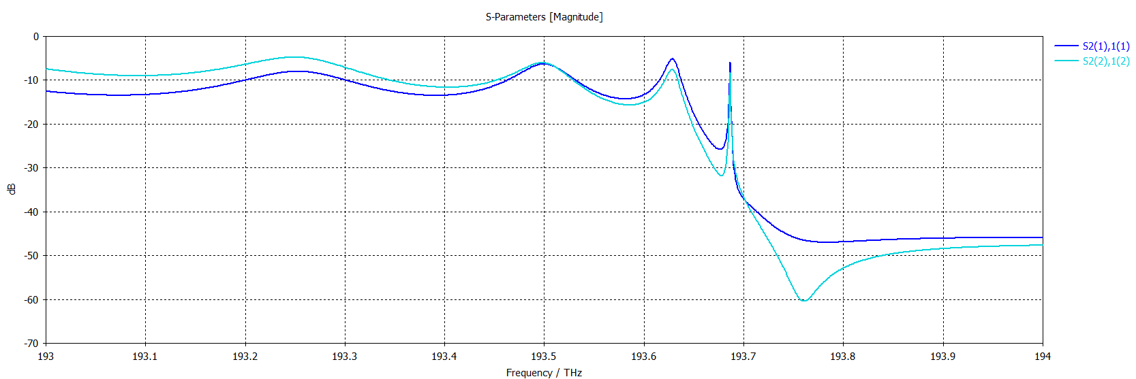





Tracking the DBE resonance
N
20 | 192.6
40 | 193.4
60 | 193.601
80 | 193.68
100 | 193.685
DBE at $f=193.6 THz$
$$N=20$$
$$N=40$$
$$N=60$$
$$N=80$$
$$N=100$$

Slide 4

Why is there a resonance above the DBE frequency?
To check:
Are the modes in the freq. domain and in the eigenmode the same?
In eigenmode, the y BC are PEC, and in freq domain, they are open -> Is the cladding to small?
Maybe the freq. domain results are wrong? -> Deembedding length, y-BC: PEC
Are the results consistent with different $N$ ?

Slide 5


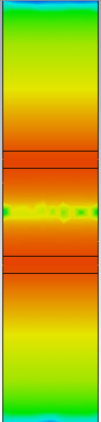
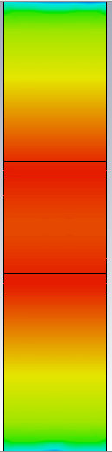
Modes
Freq. domain
Eigenmode
Freq. domain “Mode 1” is the DBE mode (eigenmode “Mode 2”)
Mode 1
Mode 2
Mode 1
Mode 2 (DBE)

Slide 6
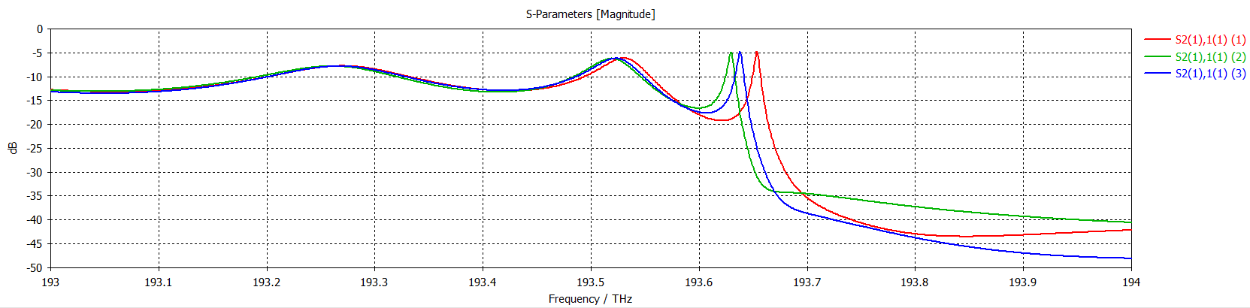

Cladding increase: Freq. domain
h_trunc = 1200, h_trunc = 1700, h_trunc = 2000
There is a difference even though the field is not very strong in the cladding
Increasing the cladding does not necessarily translate into an improvement

Slide 7
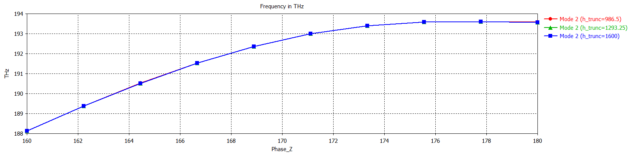
Cladding increase: Eigenmode
Not an issue

Slide 8
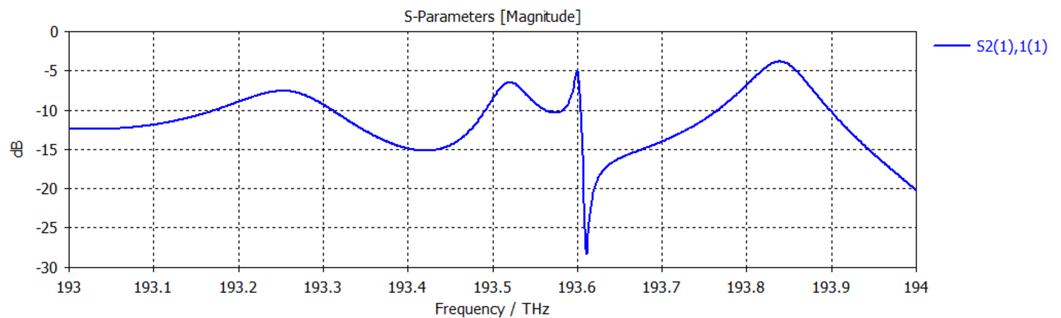
Try N=80 with PEC in the y direction as well (as the eigenmode)
The resonance is at 193.6 THz
But there seems to be another resonance at 193.85 THz, which is weird

Slide 9
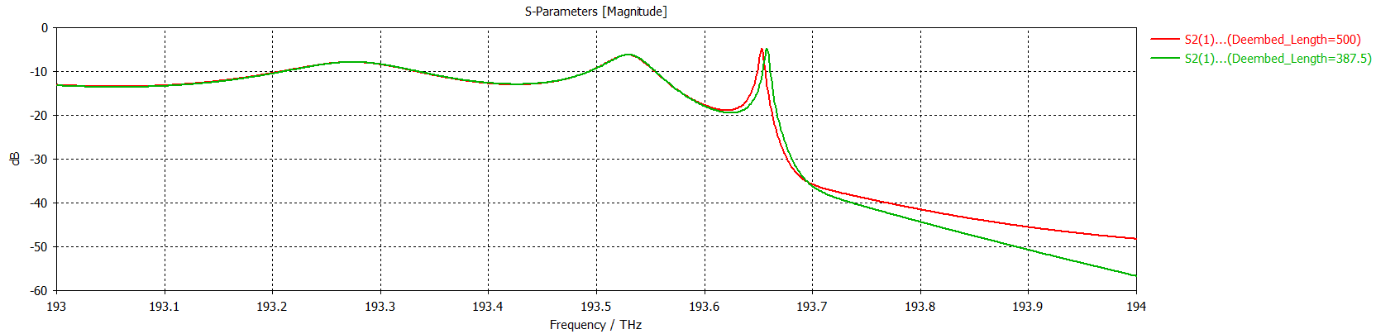
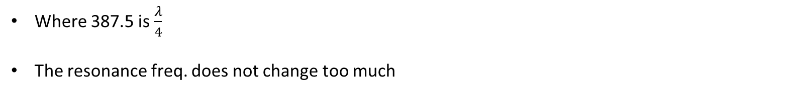
Deembedding length
Where 387.5 is $\frac{λ}{4}$
The resonance freq. does not change too much

Slide 10
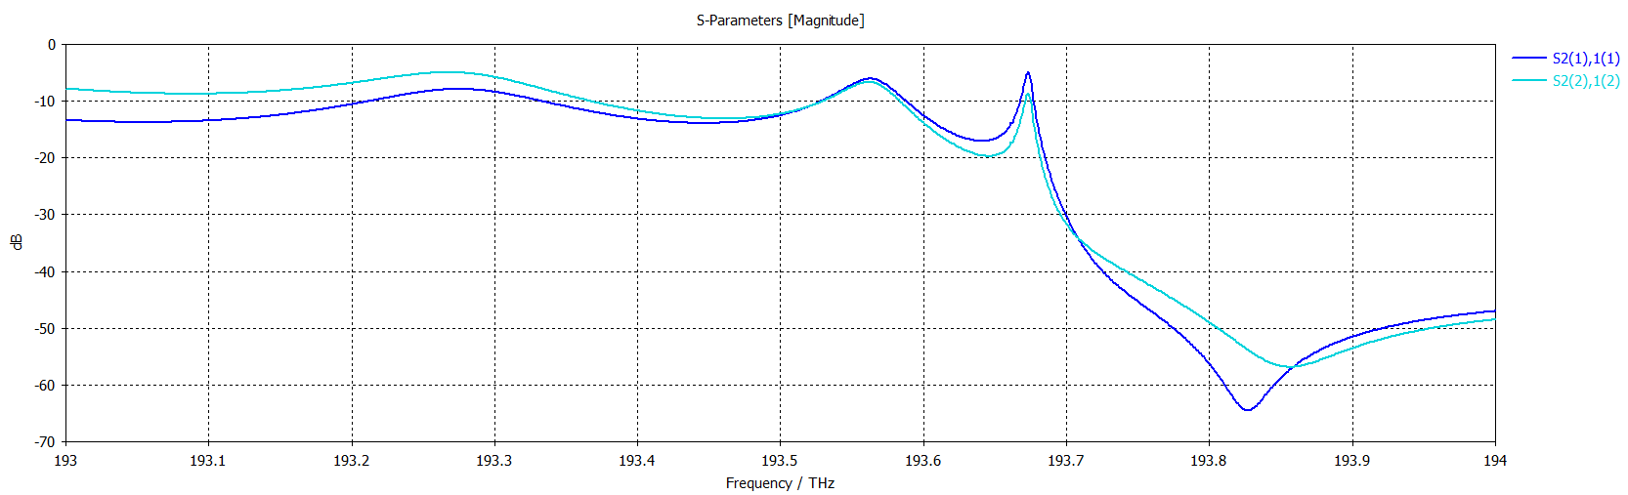
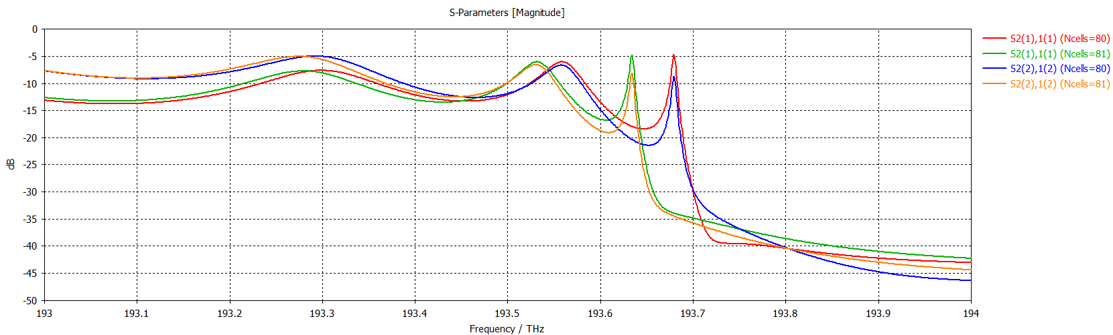
Try $N=79,80,81$
N=80 is the one with the furthest peak from 193.6 THz

Slide 11
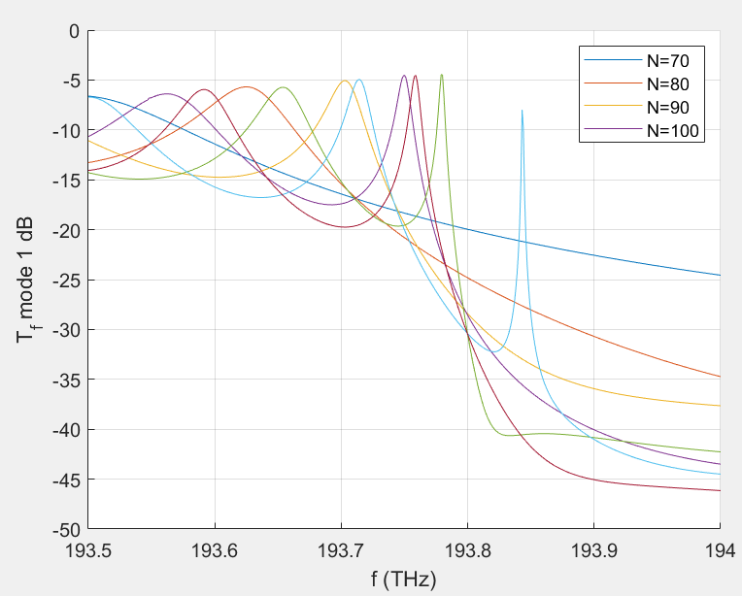
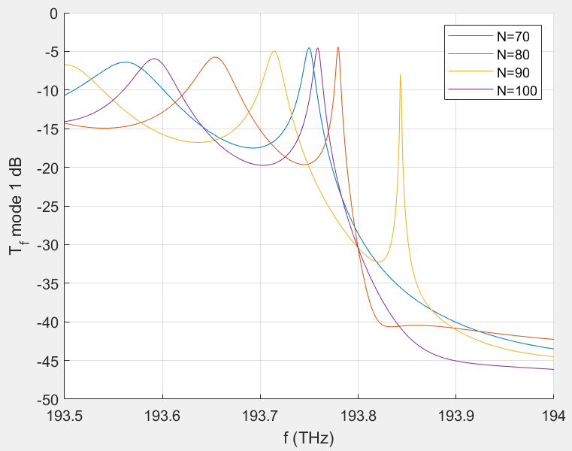

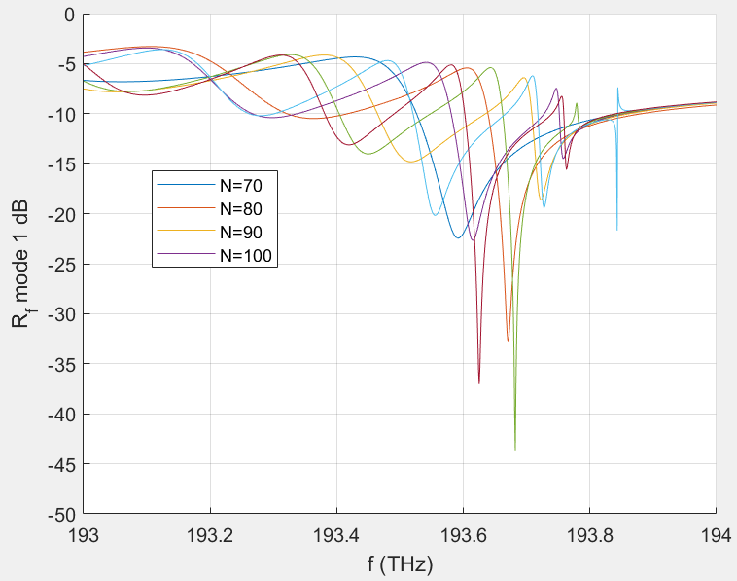
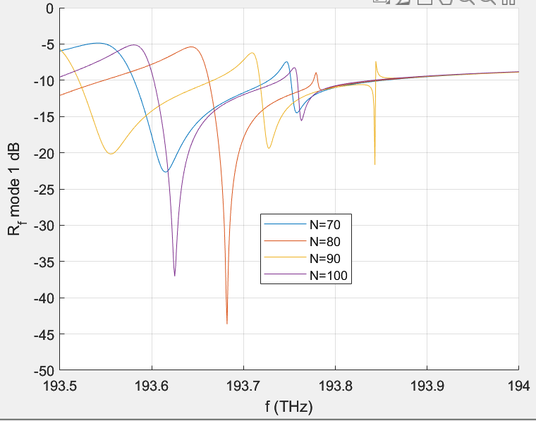
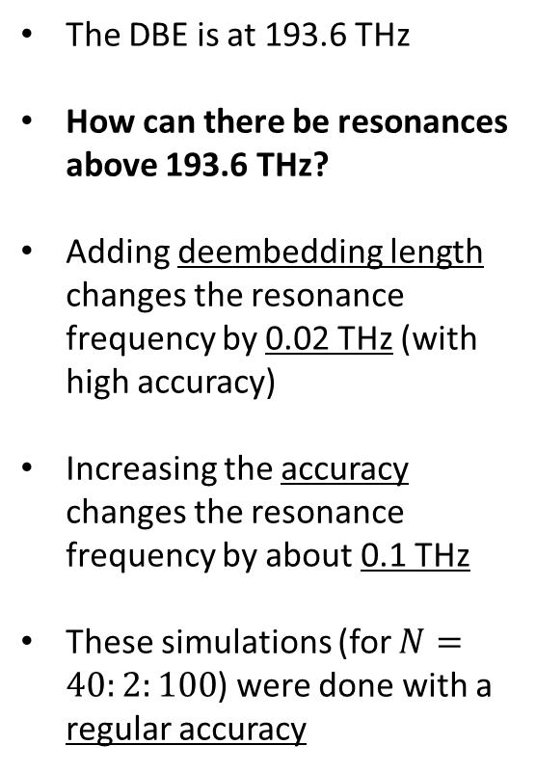
$N=40:2:100$ (31 runs)
The DBE is at 193.6 THz
How can there be resonances above 193.6 THz?
Adding deembedding length changes the resonance frequency by 0.02 THz (with high accuracy)
Increasing the accuracy changes the resonance frequency by about 0.1 THz
These simulations (for $N=40:2:100$) were done with a regular accuracy

Slide 12
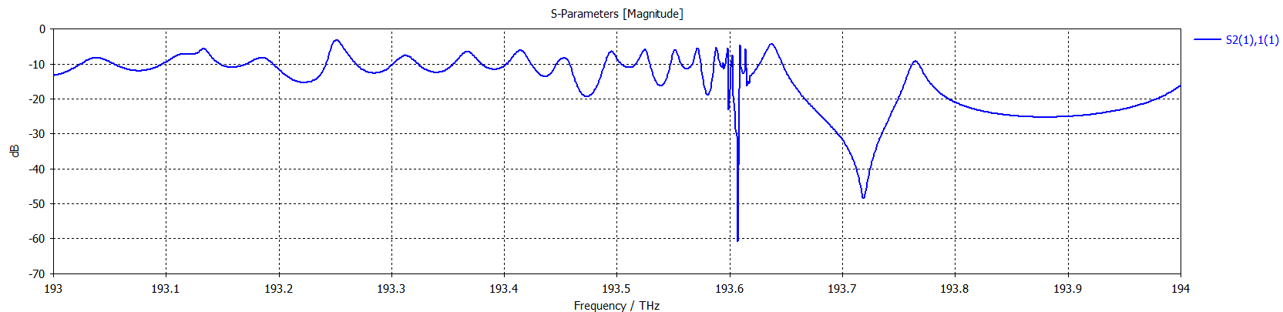
$N=500$, what is the asymptotic behavior?

Slide 13
Shcherbakov’s meeting
A. Herrero-Parareda
Department of Electrical Engineering and Computer Science

Slide 14
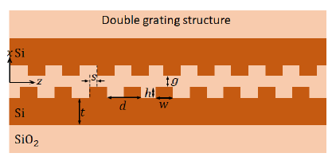
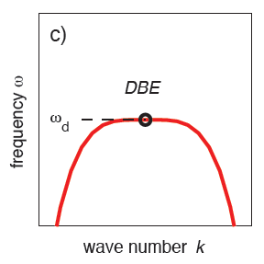
Idea
Material: AlGaAs, only has $χ^{(2)}≠0$in different polarizations
Claddings: AlGaO and SiOx such that it all has the same $n$
$$@ ω$$
$$@ ω/2$$
Structure: Degenerate diffraction feedback gratings
Pump at twice the DBE frequency $ω_{D}=\frac{ω_{p}}{2}$
The resulting photon pair is
Frequency degenerate
Polarization degenerate
But $k_{1}=−k_{2}$ (the SPDC photon pair moves in opposite directions)
It doesn’t matter if the input frequency is a propagating mode, an RBE or inside a bandgap
There is a range $δk$ for which $ω≈ω_{D}$, so many different photon pairs will be generated
They can be separated with a grating out of the structure
SiOx
AlGaAs
AlGaO
Conversion efficiency
$$δk$$
Do you think it will work?
$$ω_{D}$$
$$ω$$

Slide 15
LWA
A. Herrero-Parareda
Department of Electrical Engineering and Computer Science

Slide 16
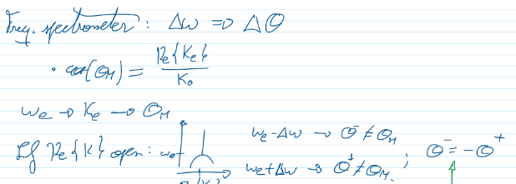
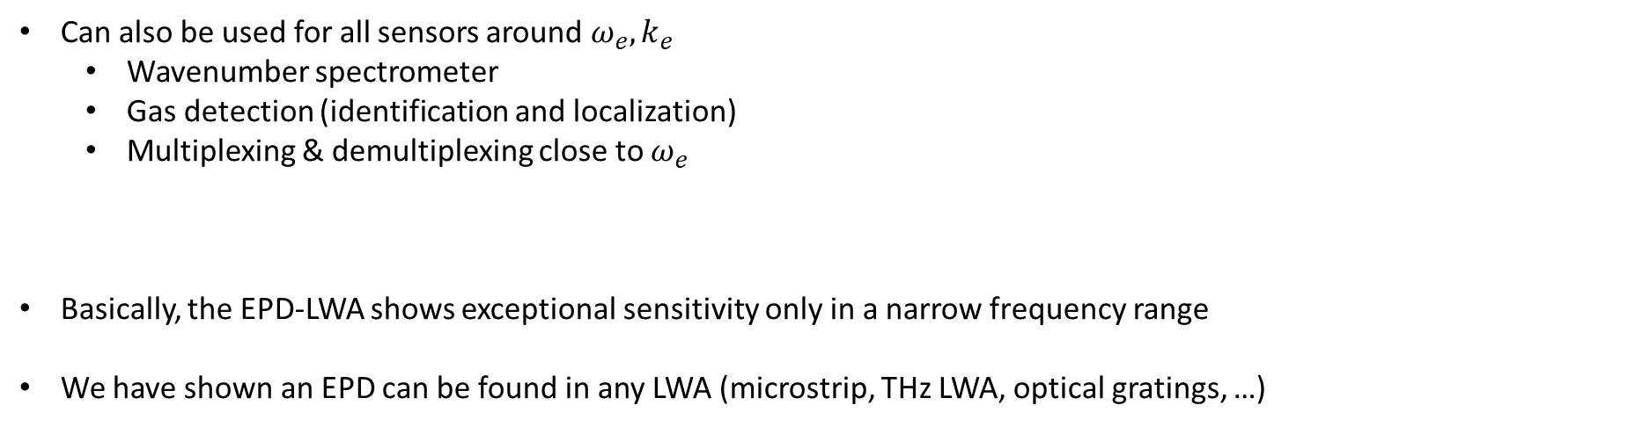
Applications for the EPD-LWA
The EPD-LWA shows exceptional sensitivity to a variation of parameters
Can also be used for all sensors around $ω_{e}, k_{e}$
Wavenumber spectrometer
Gas detection (identification and localization)
Multiplexing & demultiplexing close to $ω_{e}$
Basically, the EPD-LWA shows exceptional sensitivity only in a narrow frequency range
We have shown an EPD can be found in any LWA (microstrip, THz LWA, optical gratings, …)

Slide 17
Miscellanea
Found a US patent application Latex template
Should we write a sort of paper and add it to the bottom? What structure should it have?
Master graduation: I will start steps to graduate from the master
What is my Master thesis? Introduction – Papers – Conclusion ?
I won’t attend the next Thursday meeting as I start my Spring Break

Slide 18
Results for the EPD-LWA
What kind of simulations will we have?

