Slide 1

Compact grating: DDFB lasing
A. Herrero-Parareda
Department of Electrical Engineering and Computer Science

Slide 2

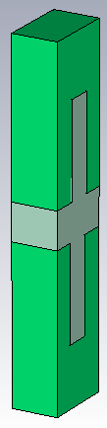

Double grating $−>$ Compact Grating

Slide 3
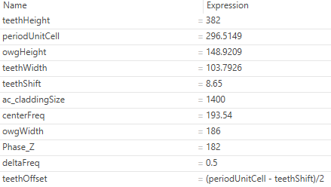
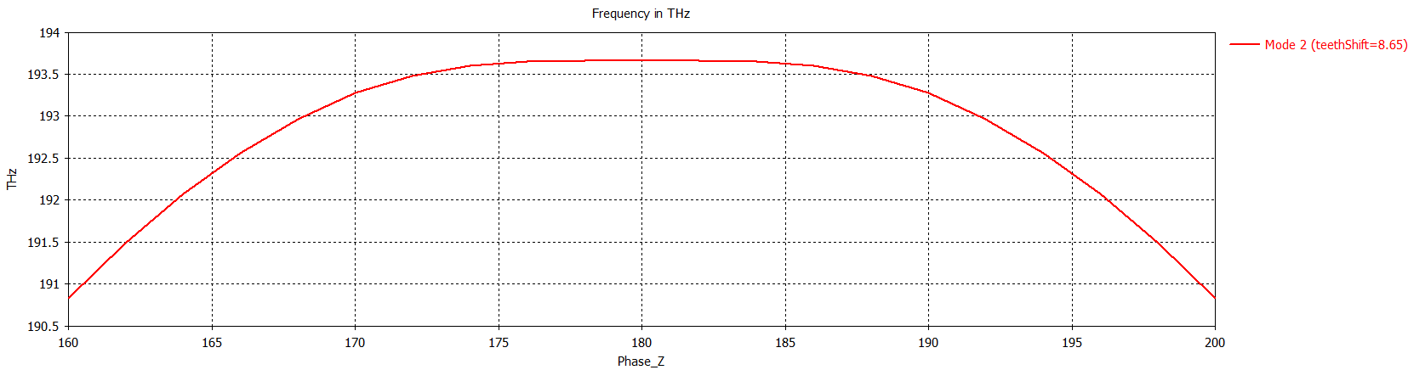

New DBE
Combination between numerical methods and trial and error
$Δf=0.0000995$ THz
At 193.663 THz

Slide 4
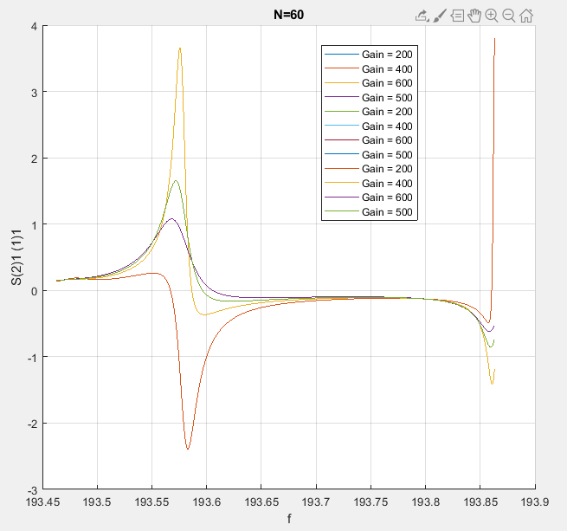
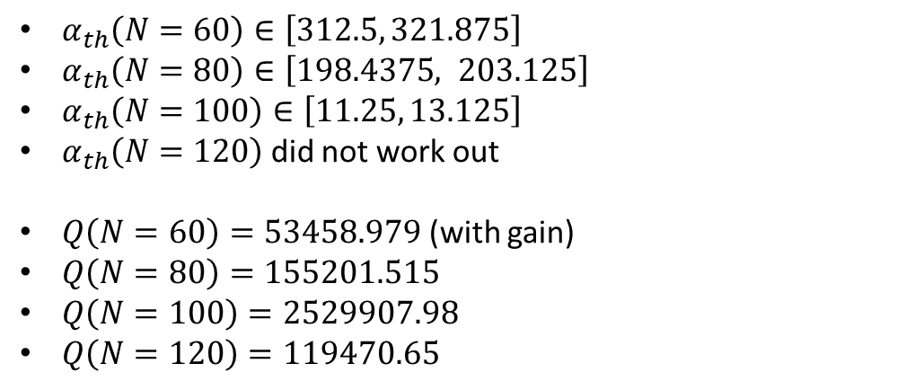
CG_Threshold_Finding_Loop_v3.m
I wrote a matlab code that finds the lasing threshold given $N$, step gain, and a tolerance
$α_{th}\left(N=60\right)∈\left[312.5, 321.875\right]$
$α_{th}\left(N=80\right)∈\left[198.4375, 203.125\right]$
$α_{th}\left(N=100\right)∈\left[11.25, 13.125\right]$
$α_{th}\left(N=120\right)$ did not work out
$Q\left(N=60\right)=53458.979$ (with gain)
$Q\left(N=80\right)=155201.515$
$Q\left(N=100\right)=2529907.98$
$Q\left(N=120\right)=119470.65$
The idea is to run this code several times varying:
Frequency range
Deembedding length
Cladding size
Once I get consistent results, I will let you know

Slide 5
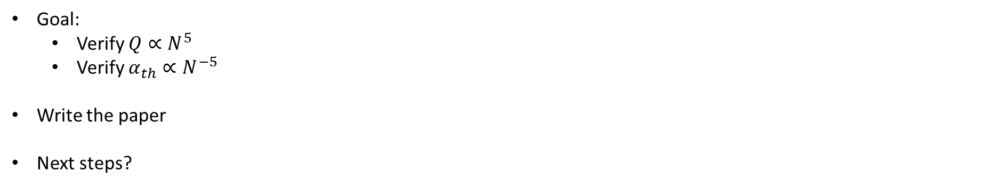
Goals:
Goal:
Verify $Q∝N^{5}$
Verify $α_{th}∝N^{−5}$
Write the paper
Next steps?

Slide 6
Compact grating: Nonlinear optics
A. Herrero-Parareda
Department of Electrical Engineering and Computer Science

Slide 7
COMSOL version
Show
Goals:
Get DBE
Get SHG at DBE
Get SHG at RBE
Compare
Then write the paper
On the white paper:
Do some back-of-envelope calculations
Work on text and figures following Dr. Shcherbakov’s suggestions

Slide 8
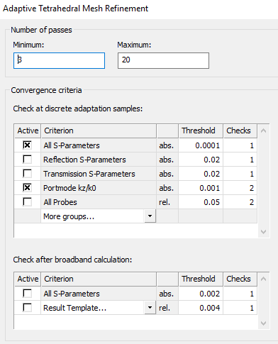
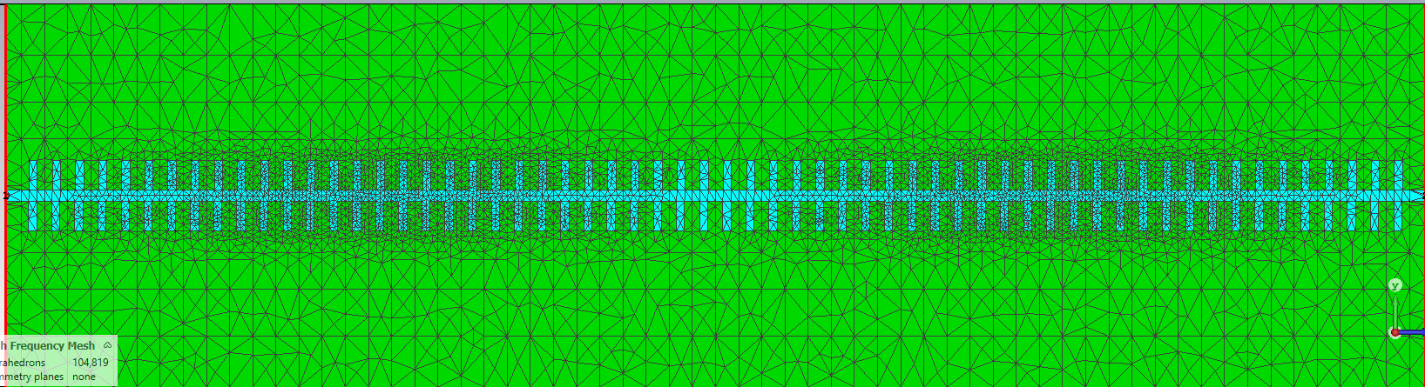
Meshes & accuracy

