Slide 1

Updated ASOW
A. Herrero Parareda, N. Furman, R. Gibson and F. Capolino
Department of Electrical Engineering and Computer Science

Slide 2
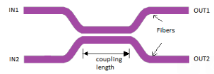
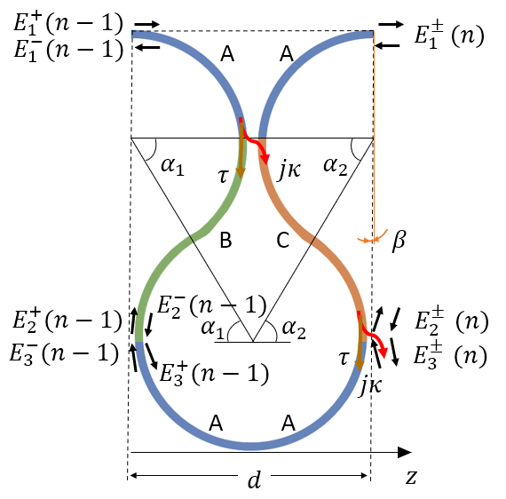
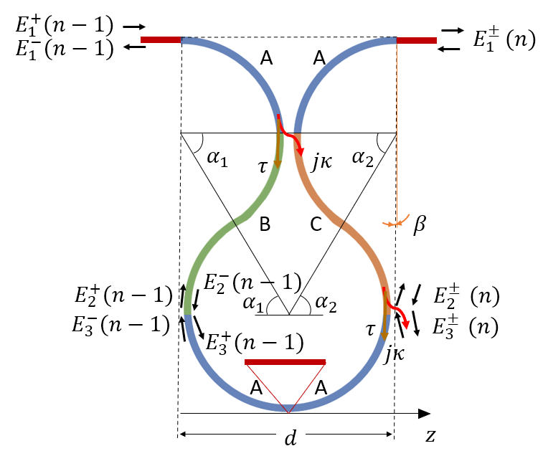
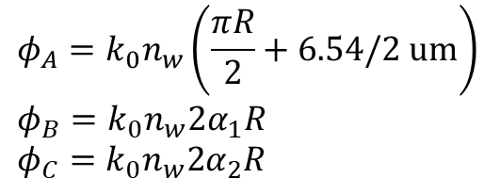
Concept
Find an SIP in ASOW using $κ=\sqrt{0.5}$ from a standard directional coupler and a waveguide width of $480$nm ($n_{w}=2.412)$
The modification is
This extra length can be added to the section A of the unit cell
It only changes that part of the model
The accumulated phases in section A, B, and C are
$$φ_{A}=k_{0}n_{w}\left(\frac{πR}{2}+6.54/2 um\right) \\ φ_{B}=k_{0}n_{w}2α_{1}R \\ φ_{C}=k_{0}n_{w}2α_{2}R$$

Slide 3
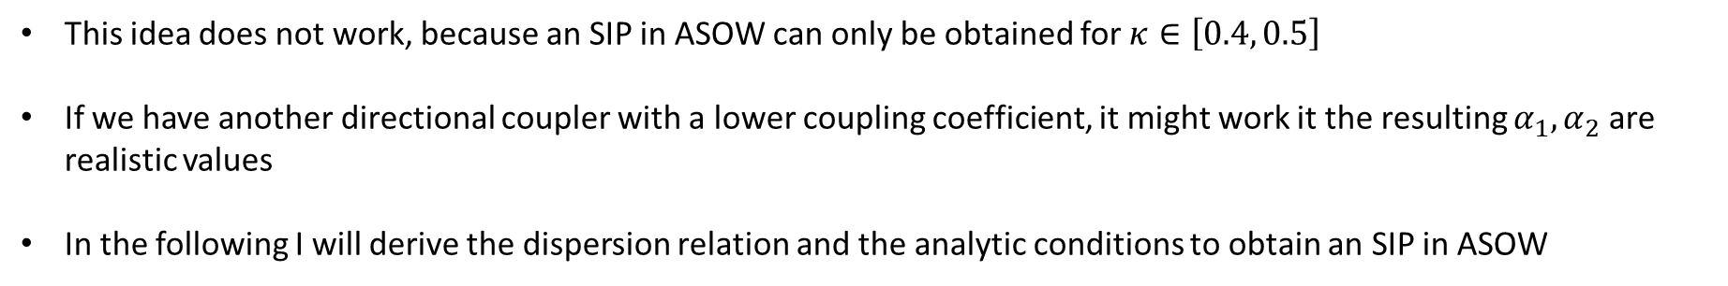
Conclusion
This idea does not work, because an SIP in ASOW can only be obtained for $κ∈\left[0.4, 0.5\right]$
If we have another directional coupler with a lower coupling coefficient, it might work it the resulting $α_{1},α_{2}$ are realistic values
In the following I will derive the dispersion relation and the analytic conditions to obtain an SIP in ASOW

Slide 4
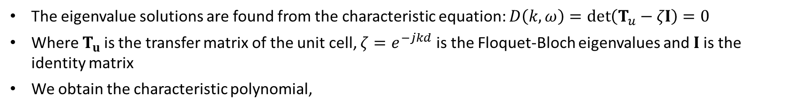
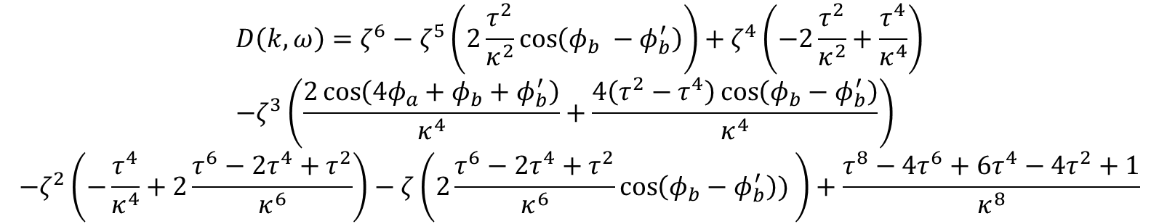
Dispersion relation
The eigenvalue solutions are found from the characteristic equation: $D\left(k,ω\right)=\det\left(T_{u}−ζI\right)=0$
Where $T_{u}$ is the transfer matrix of the unit cell, $ζ=e^{−jkd}$ is the Floquet-Bloch eigenvalues and $I$is the identity matrix
We obtain the characteristic polynomial,
$$D\left(k,ω\right)=ζ^{6}−ζ^{5}\left(2\frac{τ^{2}}{κ^{2}}\cos\left(φ_{b} −φ_{b}^{′}\right)\right)+ζ^{4}\left(−2\frac{τ^{2}}{κ^{2}}+\frac{τ^{4}}{κ^{4}}\right) \\ −ζ^{3}\left(\frac{2\cos\left(4φ_{a}+φ_{b}+φ_{b}^{′}\right)}{κ^{4}}+\frac{4\left(τ^{2}−τ^{4}\right)\cos\left(φ_{b}−φ_{b}^{′}\right)}{κ^{4}}\right)$$
$$−ζ^{2}\left(−\frac{τ^{4}}{κ^{4}}+2\frac{τ^{6}−2τ^{4}+τ^{2}}{κ^{6}}\right)−ζ\left(2\frac{τ^{6}−2τ^{4}+τ^{2}}{κ^{6}}\cos\left(φ_{b}−φ_{b}^{′}\right)) \right)+\frac{τ^{8}−4τ^{6}+6τ^{4}−4τ^{2}+1}{κ^{8}}$$

Slide 5

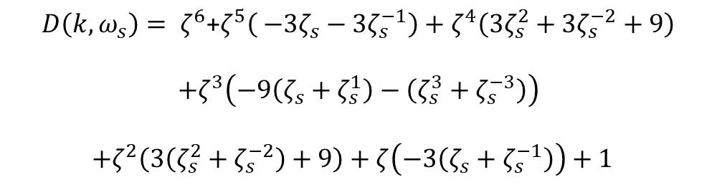

Dispersion relation at the SIP frequency
Evaluated at the SIP frequency, $ω_{s}$, the characteristic equation must be have the form
$$D\left(k,ω_{s}\right)={\left(ζ−ζ_{s}\right)}^{3}{\left(ζ−ζ_{s}^{−1}\right)}^{3}$$
Because it has 6 modes that coalesce into two modes that propagate in opposite directions
Expanding this polynomial, we get
$$D\left(k,ω_{s}\right)= ζ^{6}\text{+}ζ^{5}\left( −3ζ_{s}−3ζ_{s}^{−1}\right)+ζ^{4}\left(3ζ_{s}^{2}+3ζ_{s}^{−2}+9\right)$$ $$+ζ^{3}\left(−9\left(ζ_{s}+ζ_{s}^{1}\right)−\left(ζ_{s}^{3}+ζ_{s}^{−3}\right)\right)$$
$$+ζ^{2}\left(3\left(ζ_{s}^{2}+ζ_{s}^{−2}\right)+9\right)+ζ\left(−3\left(ζ_{s}+ζ_{s}^{−1}\right)\right)+1$$
where we have that
$$ζ_{s}+ζ_{s}^{−1}=2cos\left(k_{s}d\right) \\ ζ_{s}^{2}+ζ_{s}^{−2}=2cos\left(2k_{s}d\right) \\ ζ_{s}^{3}+ζ_{s}^{−3}=2cos\left(3k_{s}d\right)$$

Slide 6
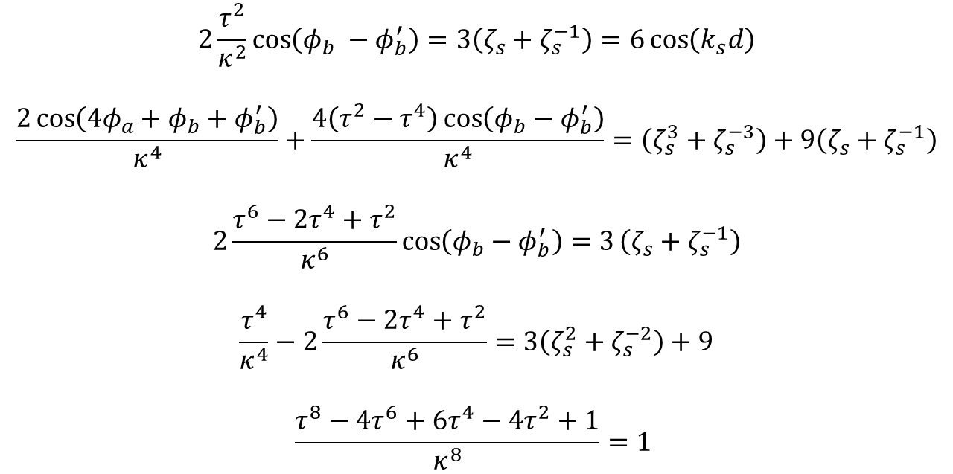
Necessary but not sufficient conditions to obtain an SIP in ASOW
Equating the coefficients of both polynomials when evaluated at $ω_{s}$, we obtain the following five necessary conditions
$$2\frac{τ^{2}}{κ^{2}}\cos\left(φ_{b} −φ_{b}^{′}\right)=3\left(ζ_{s}+ζ_{s}^{−1}\right)=6\cos\left(k_{s}d\right)$$
$$\frac{2\cos\left(4φ_{a}+φ_{b}+φ_{b}^{′}\right)}{κ^{4}}+\frac{4\left(τ^{2}−τ^{4}\right)\cos\left(φ_{b}−φ_{b}^{′}\right)}{κ^{4}}=\left(ζ_{s}^{3}+ζ_{s}^{−3}\right)+9\left(ζ_{s}+ζ_{s}^{−1}\right)$$
$$2\frac{τ^{6}−2τ^{4}+τ^{2}}{κ^{6}}\cos\left(φ_{b}−φ_{b}^{′}\right)=3\left(ζ_{s}+ζ_{s}^{−1}\right)$$
$$\frac{τ^{4}}{κ^{4}}−2\frac{τ^{6}−2τ^{4}+τ^{2}}{κ^{6}}=3\left(ζ_{s}^{2}+ζ_{s}^{−2}\right)+9$$
$$\frac{τ^{8}−4τ^{6}+6τ^{4}−4τ^{2}+1}{κ^{8}}=1$$
Using the lossless condition $τ^{2}+κ^{2}=1$, we find that the left hand side first and third are equivalent. The fifth one is equivalent to the lossless condition and the fourth one determines $k_{s}d$ from the coupling coefficient $κ$.

Slide 7
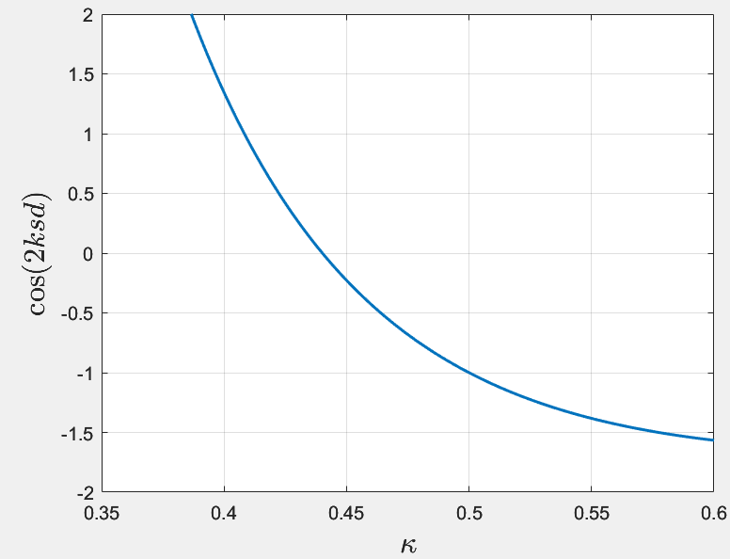
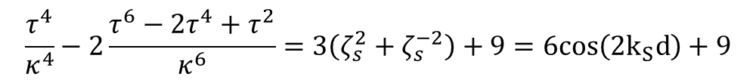

$k_{S}d$ is solely determined by $κ$
We have that
$$\frac{τ^{4}}{κ^{4}}−2\frac{τ^{6}−2τ^{4}+τ^{2}}{κ^{6}}=3\left(ζ_{s}^{2}+ζ_{s}^{−2}\right)+9=6cos\left(2k_{S}d\right)+9$$
For an SIP to be formed, $k_{S}d$ must be a real number between $±π$
Therefore, $−1<cos\left(2k_{S}d\right)<1$
Only $κ∈\left[0.4,0.5\right]$ satisfy this condition
We cannot find an SIP in ASOW for $κ=\sqrt{0.5}$

Slide 8
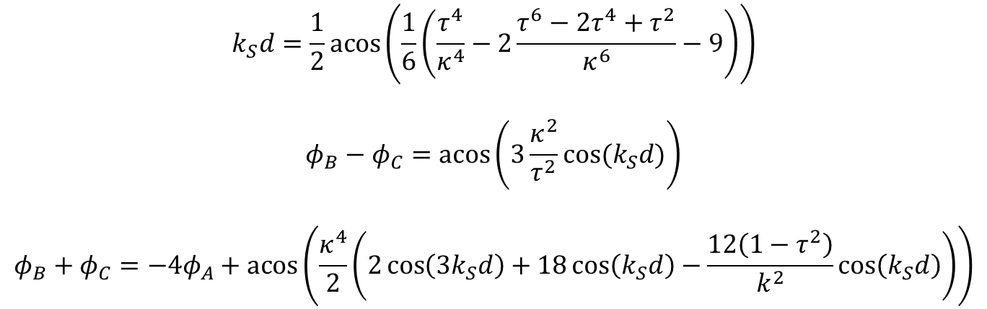


If we have a valid $κ$
The calculations are:
$$k_{S}d=\frac{1}{2}\operatorname{acos}\left(\frac{1}{6}\left(\frac{τ^{4}}{κ^{4}}−2\frac{τ^{6}−2τ^{4}+τ^{2}}{κ^{6}}−9\right)\right)$$
$$φ_{B}−φ_{C}=\operatorname{acos}\left(3\frac{κ^{2}}{τ^{2}}cos⁡(k_{S}d)\right)$$
$$φ_{B}+φ_{C}=−4φ_{A}+\operatorname{acos}\left(\frac{κ^{4}}{2}\left(2\cos\left(3k_{S}d\right)+18\cos\left(k_{S}d\right)−\frac{12\left(1−τ^{2}\right)}{k^{2}}\cos\left(k_{S}d\right)\right)\right)$$
Kappa
Alpha1
Alpha2
Extralength
$$2R\left(cos⁡(α_{1}\right)+cos⁡(α_{2}))=ExtraLength+2R$$
If we fix $κ, R,$ and the extra length added at each quarter of a circle, we must find $α_{1}, α_{2}$
$$α_{1}=\frac{φ_{B}}{k_{0}n_{w}2R}+\frac{mπ}{k_{0}n_{w}2R}$$
$$α_{2}=\frac{φ_{C}}{k_{0}n_{w}2R}+\frac{mπ}{k_{0}n_{w}2R}$$
Where $m$ is an integer

