Slide 1

Characterization of uniform waveguides
A. Herrero Parareda and F. Capolino
Department of Electrical Engineering and Computer Science

Slide 2

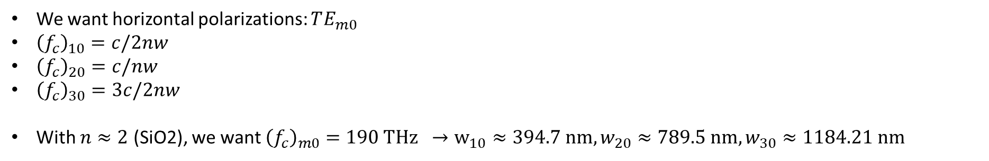
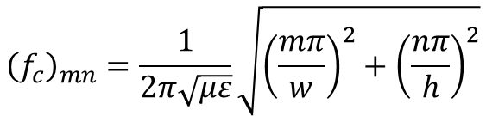


Uniform waveguide
Waveguide modes:
$${\left(f_{c}\right)}_{mn}=\frac{1}{2π\sqrt{με}}\sqrt{{\left(\frac{mπ}{w}\right)}^{2}+{\left(\frac{nπ}{h}\right)}^{2}}$$
$$h$$
$$w$$
Where $m, n$cannot be zero simultaneously
We want horizontal polarizations: $TE_{m0}$
${\left(f_{c}\right)}_{10}=c/2nw$
${\left(f_{c}\right)}_{20}=c/nw$
${\left(f_{c}\right)}_{30}=3c/2nw$
With $n≈2$ (SiO2), we want ${\left(f_{c}\right)}_{m0}=190 THz →w_{10}≈394.7 nm, w_{20}≈789.5 nm, w_{30}≈1184.21 nm$
We consider a mode as physical if
Its confinement factor is high
Its effective refractive index is larger than in the cladding ($n_{SiO2}≈2$)
$$cf=\frac{\iint_{core}{u_{e}}}{\iint_{core+cladding}{u_{e}}}$$
Let’s check

Slide 3
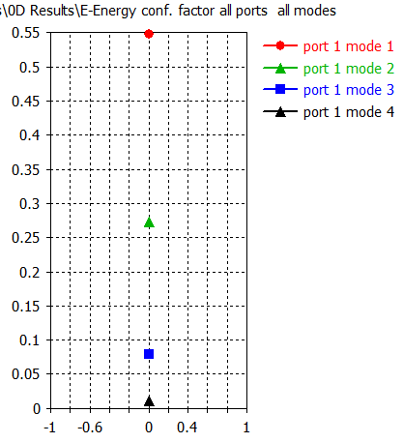
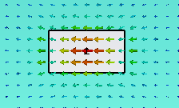



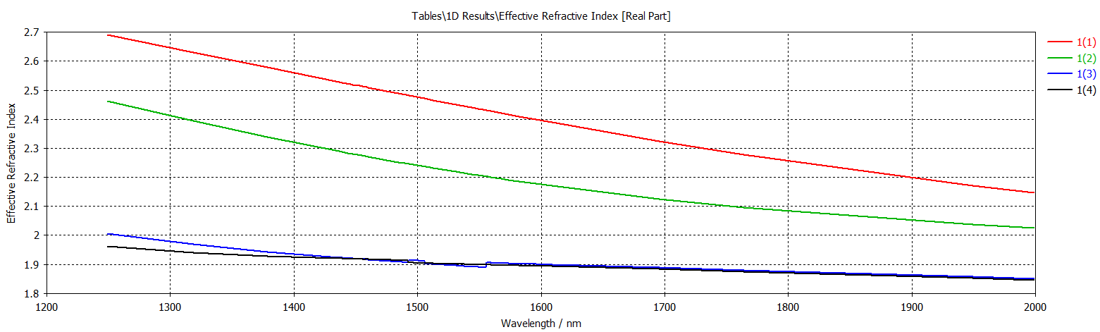

$$h=220;w=400$$
Only mode 1 is a physical mode
Similar results for $w=450$instead (higher $n_{eff}$ of mode 1)

Slide 4
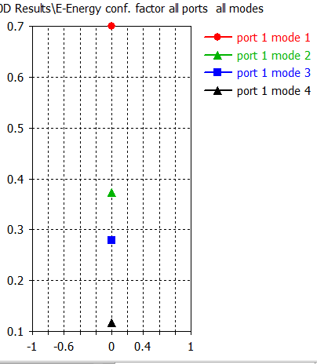


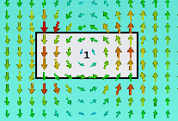
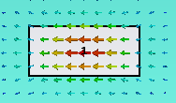
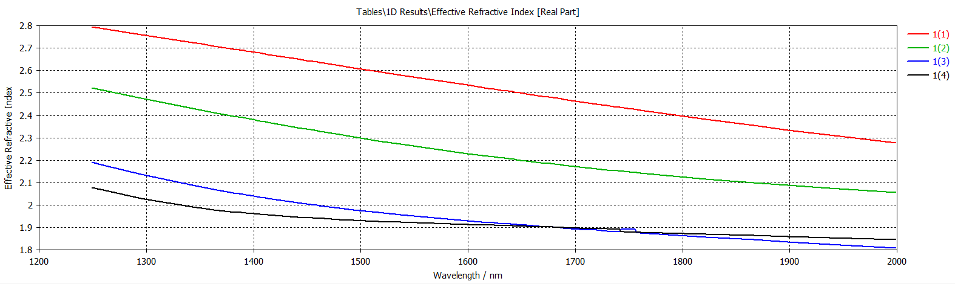

$$h=220;w=500$$
Only mode 1 is a physical mode
Similar results with $w=550$

Slide 5
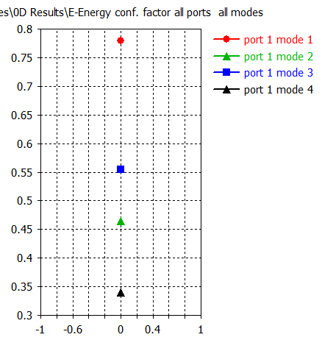




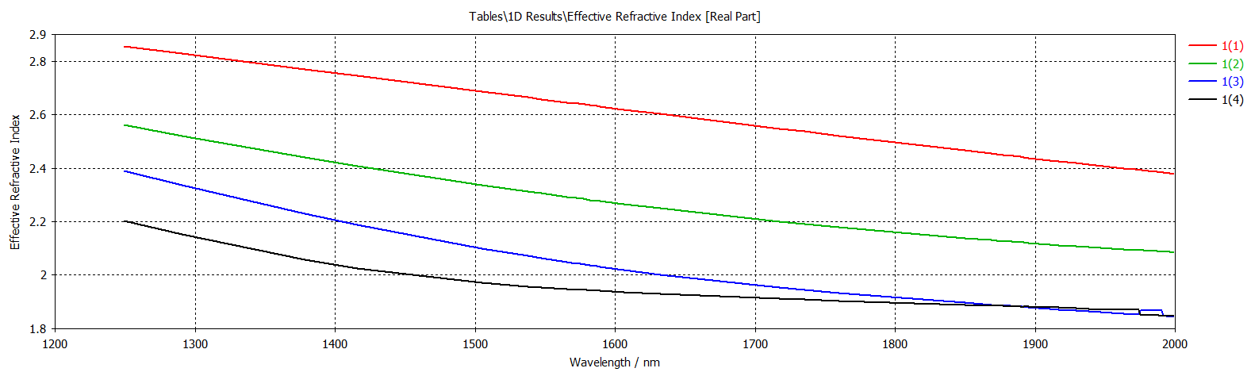
$$h=220;w=600$$
Only mode 1 is a physical mode

Slide 6
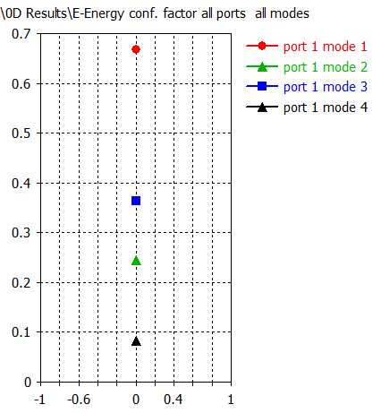
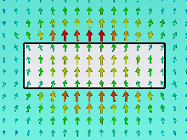
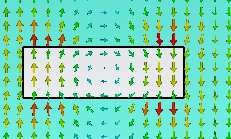
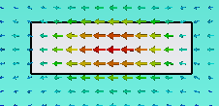

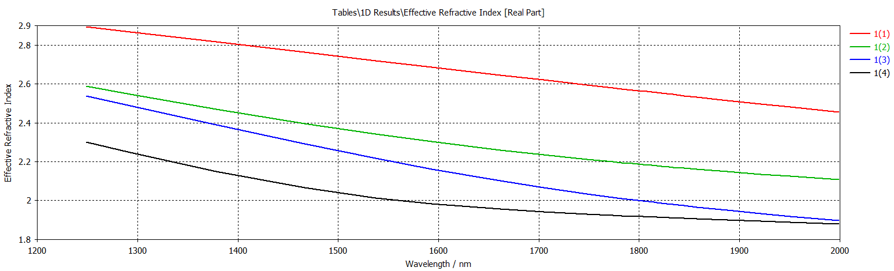
$$h=220;w=700$$
Only mode 1 is a physical mode

Slide 7
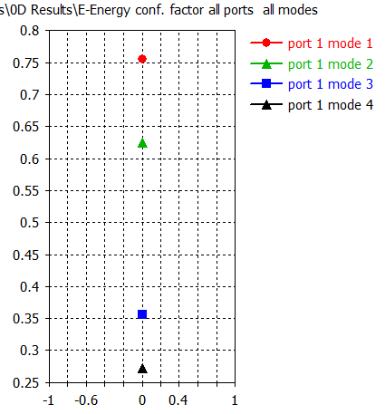
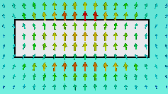
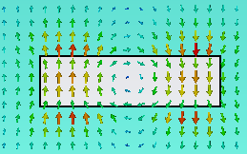


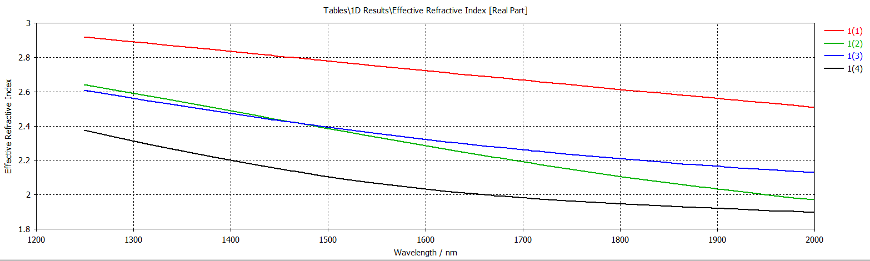
$$h=220;w=800$$
Mode 1 and 2 are physical modes

Slide 8
$$h=220;w=900$$
Mode 1 and 2 are physical modes

Slide 9
$h=220;w=1000$ (figures from 900)
Mode 1 and 2 are physical modes

Slide 10
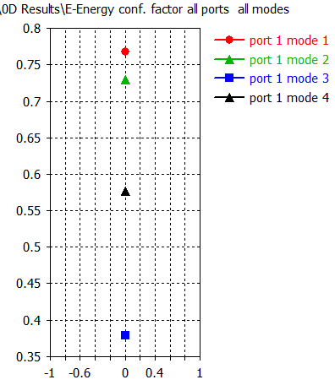




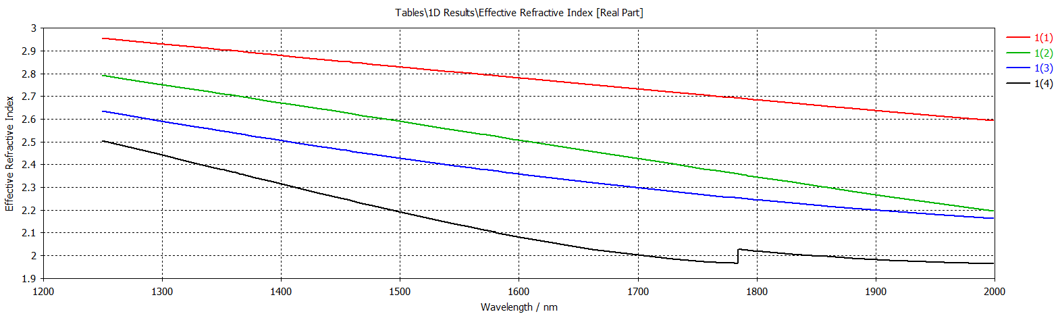
$$h=220;w=1050$$
Mode 1, 2 and 4 are physical modes

Slide 11
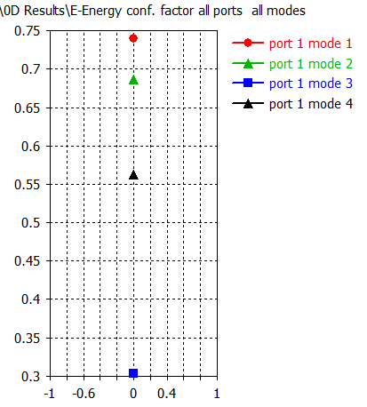




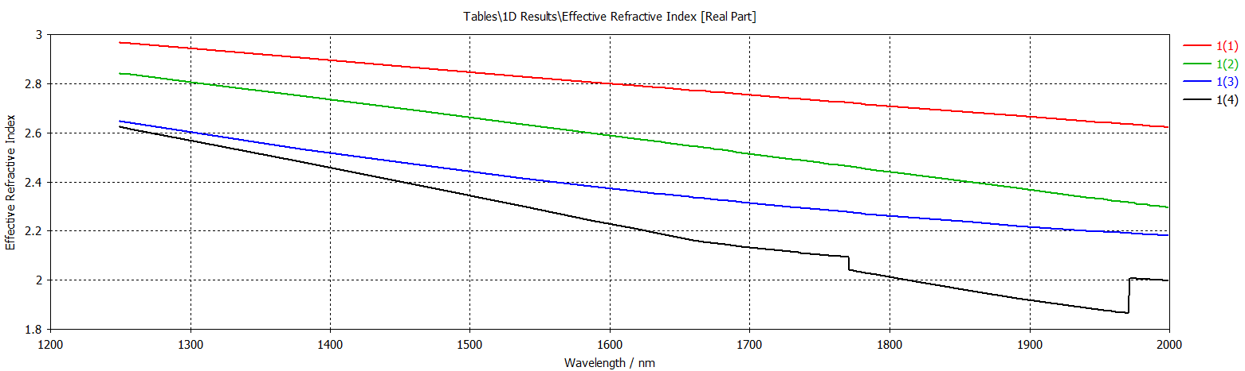
$h=220;w=1100$(figures from 1200)
Mode 1, 2 and 3 are physical modes

Slide 12
$$h=220;w=1200$$
Mode 1, 2 and 3 are physical modes

Slide 13
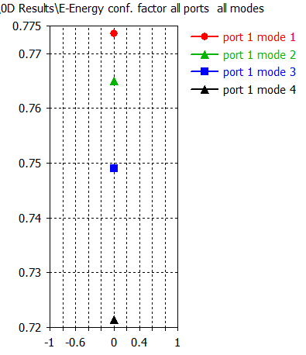




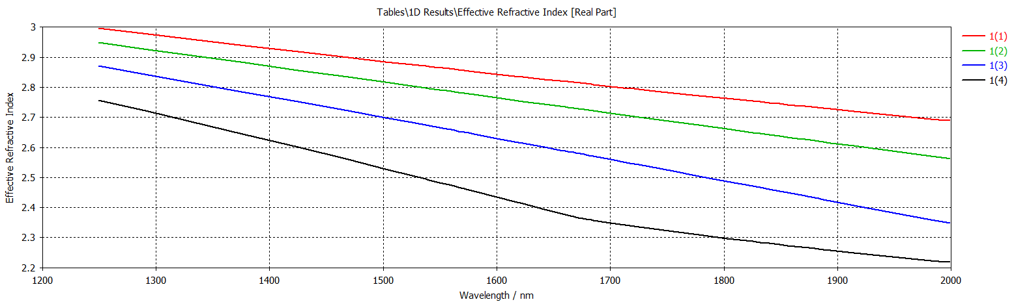
$$h=220;w=2000$$
Mode 1, 2, 3 and 4 are physical modes

