Slide 1

Characterization of uniform waveguides
A. Herrero Parareda and F. Capolino
Department of Electrical Engineering and Computer Science

Slide 2

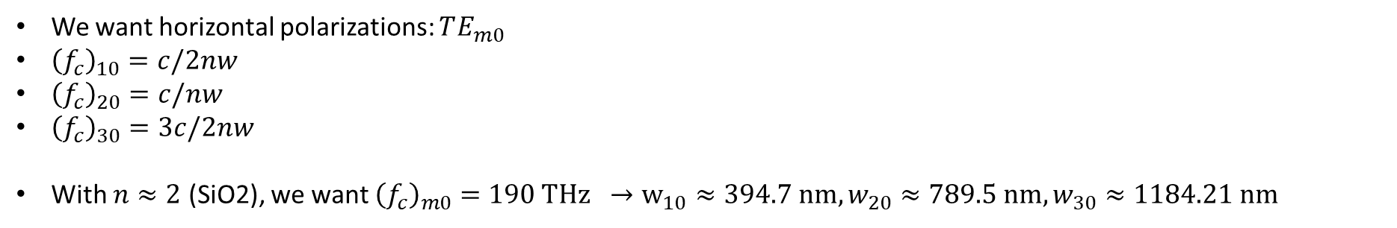
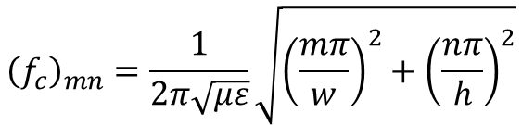


Uniform waveguide
Waveguide modes:
$${\left(f_{c}\right)}_{mn}=\frac{1}{2π\sqrt{με}}\sqrt{{\left(\frac{mπ}{w}\right)}^{2}+{\left(\frac{nπ}{h}\right)}^{2}}$$
$$h$$
$$w$$
Where $m, n$cannot be zero simultaneously
We want horizontal polarizations: $TE_{m0}$
${\left(f_{c}\right)}_{10}=c/2nw$
${\left(f_{c}\right)}_{20}=c/nw$
${\left(f_{c}\right)}_{30}=3c/2nw$
With $n≈2$ (SiO2), we want ${\left(f_{c}\right)}_{m0}=190 THz →w_{10}≈394.7 nm, w_{20}≈789.5 nm, w_{30}≈1184.21 nm$
We consider a mode as physical if
Its confinement factor is high
Its effective refractive index is larger than in the cladding ($n_{SiO2}≈2$)
$$cf=\frac{\iint_{core}{u_{e}}}{\iint_{core+cladding}{u_{e}}}$$
Let’s check

Slide 3
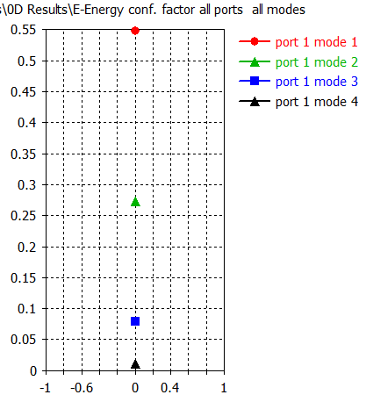
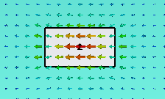
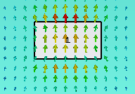
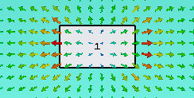

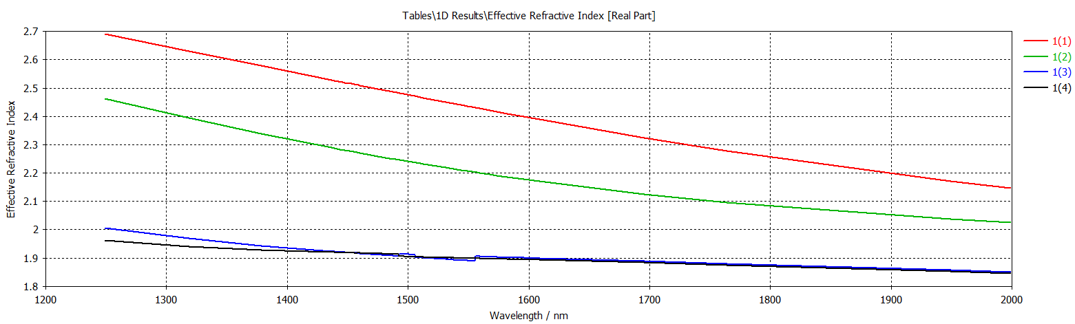

$$h=220;w=400$$
Only mode 1 is a physical mode
Similar results for $w=450$instead (higher $n_{eff}$ of mode 1)

Slide 4
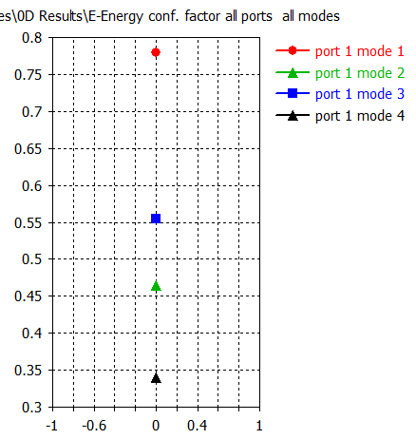



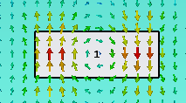
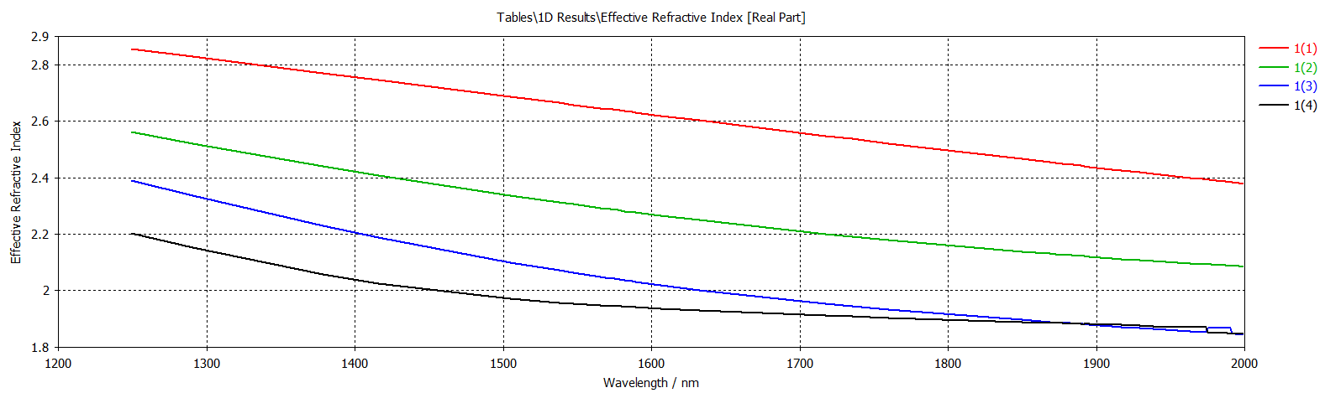
$$h=220;w=600$$
Only mode 1 is a physical mode

Slide 5
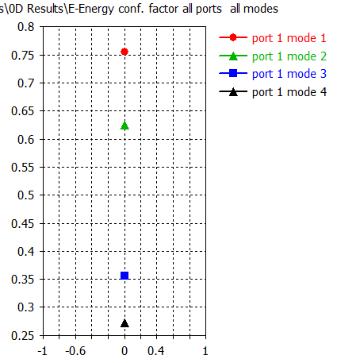
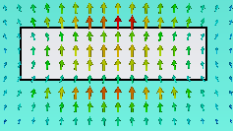
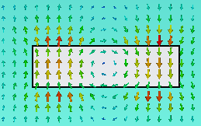


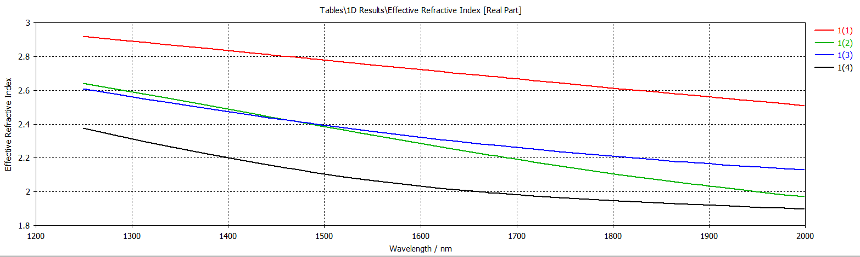
$$h=220;w=800$$
Mode 1 and 2 are physical modes

Slide 6
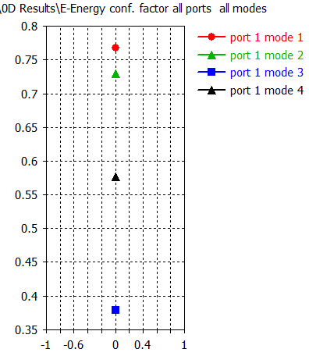




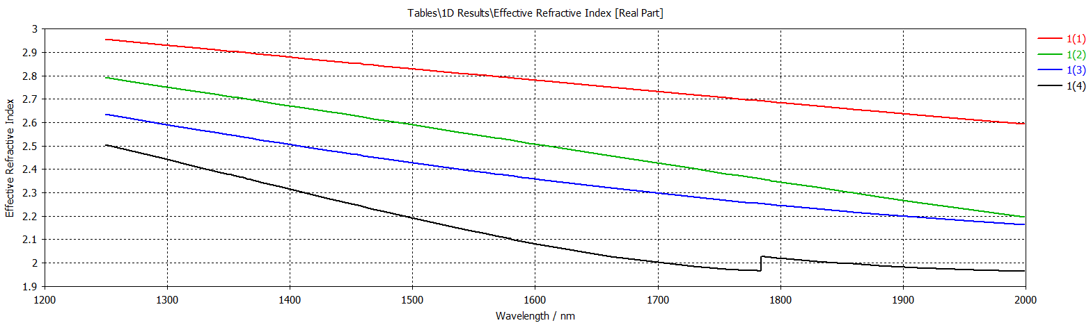
$$h=220;w=1050$$
Mode 1, 2 and 4 are physical modes

Slide 7
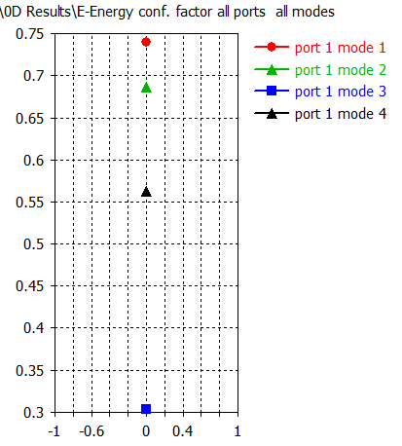
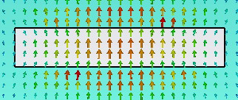
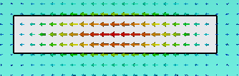
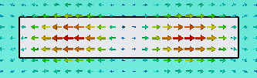

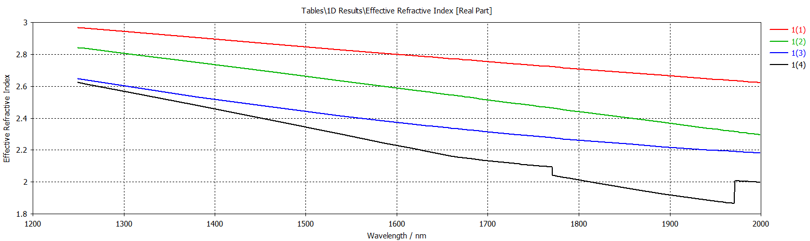
$$h=220;w=1200$$
Mode 1, 2 and 4 are physical modes

Slide 8
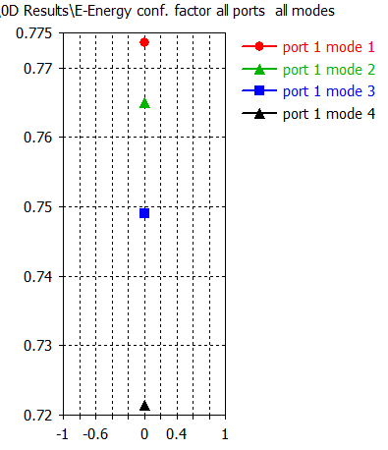




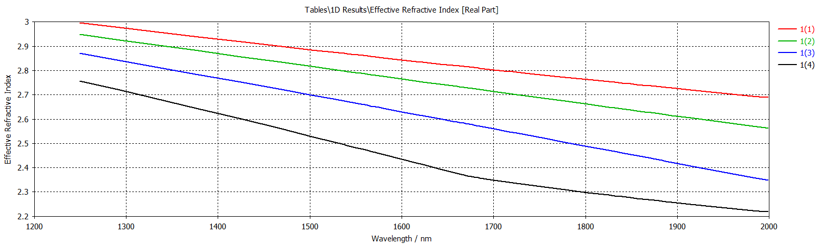
$$h=220;w=2000$$
Mode 1, 2, 3 and 4 are physical modes

Slide 9
SIP in ASOW
A. Herrero Parareda and F. Capolino
Department of Electrical Engineering and Computer Science

Slide 10
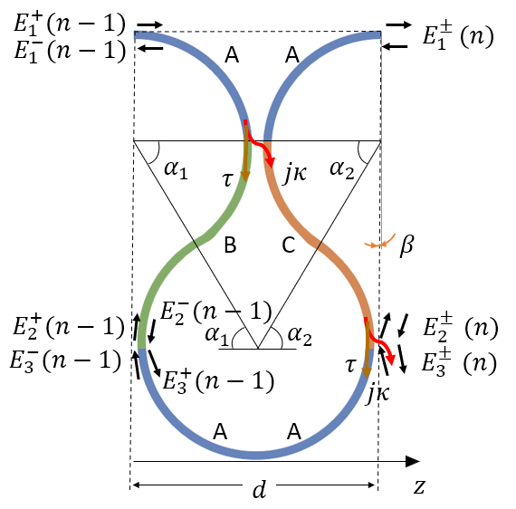
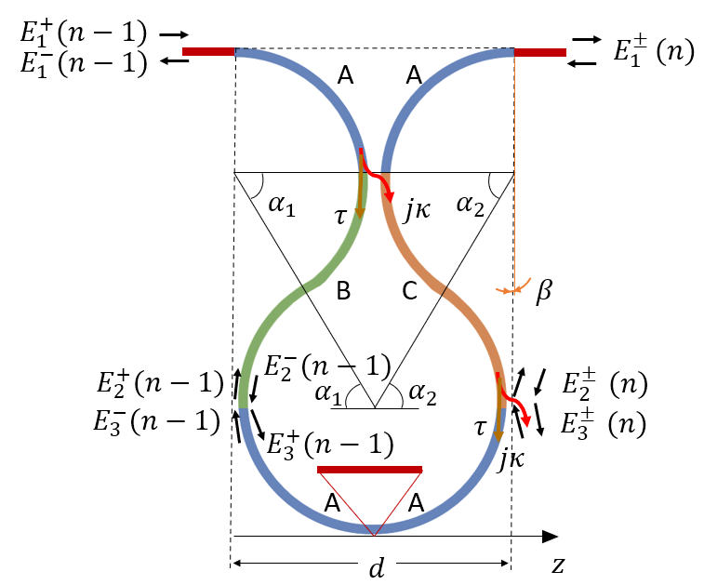
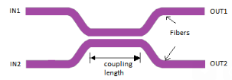
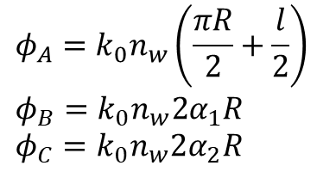
Concept
Find an SIP in ASOW where we add a horizontal extra length $l$ to substitute the point coupling with a directional coupler
The modification is
$$φ_{A}=k_{0}n_{w}\left(\frac{πR}{2}+\frac{l}{2}\right) \\ φ_{B}=k_{0}n_{w}2α_{1}R \\ φ_{C}=k_{0}n_{w}2α_{2}R$$
This extra length can be added to the section A of the unit cell
It only changes that part of the model
The accumulated phases in section A, B, and C are

Slide 11
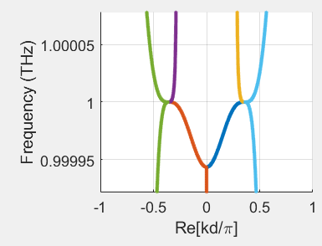
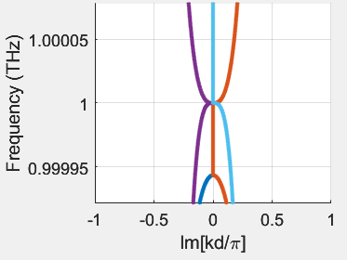
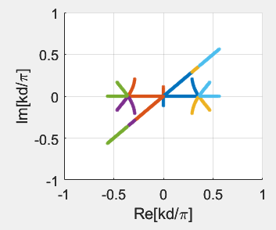
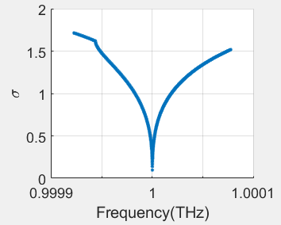
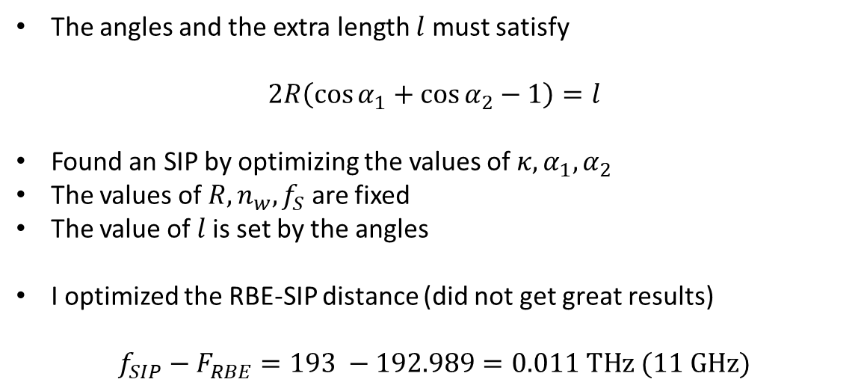
Angle restriction
The angles and the extra length $l$ must satisfy
$$2R\left(\cos{α_{1}}+\cos{α_{2}}−1\right)=l$$
Found an SIP by optimizing the values of $κ, α_{1},α_{2}$
The values of $R, n_{w}, f_{S}$ are fixed
The value of $l$is set by the angles
I optimized the RBE-SIP distance (did not get great results)
$$f_{SIP}−F_{RBE}=193 −192.989=0.011 THz (11 GHz)$$

Slide 12
SIP in Nate’s structure
A. Herrero Parareda and F. Capolino
Department of Electrical Engineering and Computer Science

Slide 13
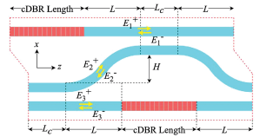
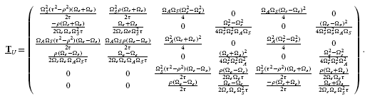
Analytic constraints to obtain an SIP
I accidentally deleted my slides (my bad)
I got the dispersion relation (symbolic matlab), compared it to the one at the SIP, and found the system of equations
Cannot find an analytic solution
Finding a numerical solution is more cost-intensive than using optimization algorithms to find the SIP
Cannot show whether the SIP can only be created close to the center of the Brillouin Zone
We cannot obtain analytic constraints to have an SIP in the 3PD

Slide 14
Corrugated Waveguide
A. Herrero Parareda and F. Capolino
Department of Electrical Engineering and Computer Science

Slide 15
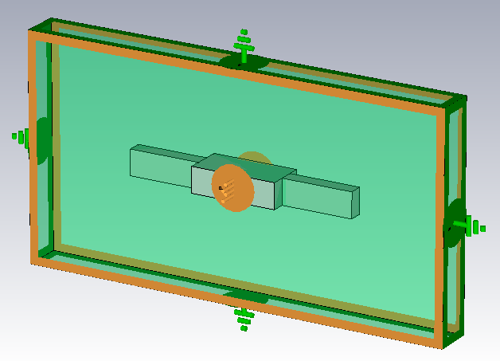

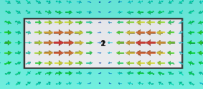
SIP in the corrugated waveguide
Modes with different polarization profile cannot coalesce
We need to couple waveguides that support the same fundamental mode, as in the double grating
I do not think we can get an SIP in this corrugated waveguide

Slide 16
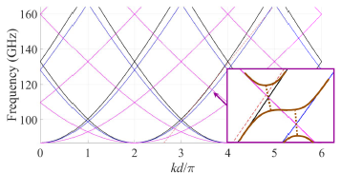
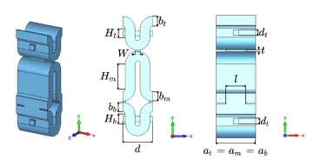
How Robert found an SIP
In [1], Robert designs two waveguides to have dispersion diagrams with perpendicular modes, and then coupled these waveguides. Where the modes cross, he finds RBEs and SIPs
He couples three waveguides each of which sustains the same fundamental mode
[1] Marosi, Mealy, Figotin, Capolino, Three-Way Serpentine Slow Wave Structures With Stationary Inflection Point and Enhanced Interaction Impedance, IEEE Trans. Plasma Sci., 50 (12), 2022

Slide 17
Double grating for DDFB lasing
A. Herrero Parareda and F. Capolino
Department of Electrical Engineering and Computer Science

Slide 18
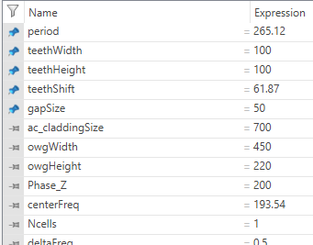
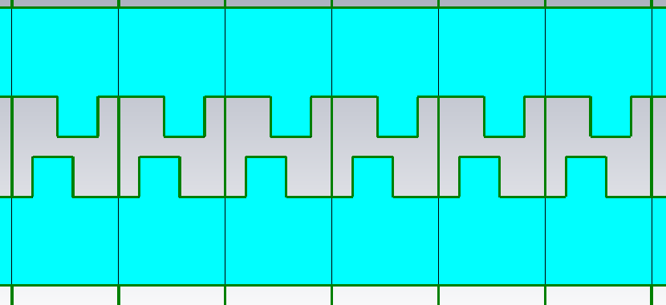
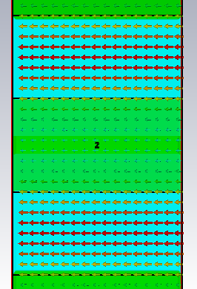
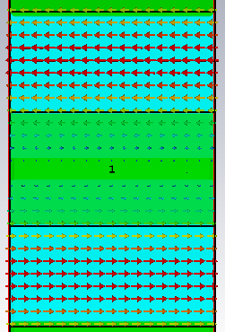
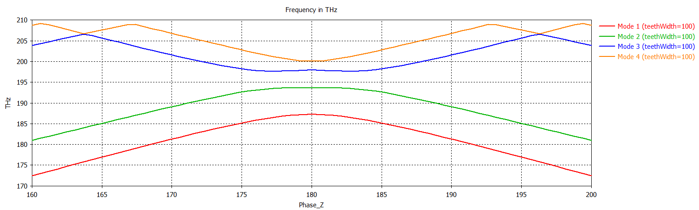
Current DBE

Slide 19

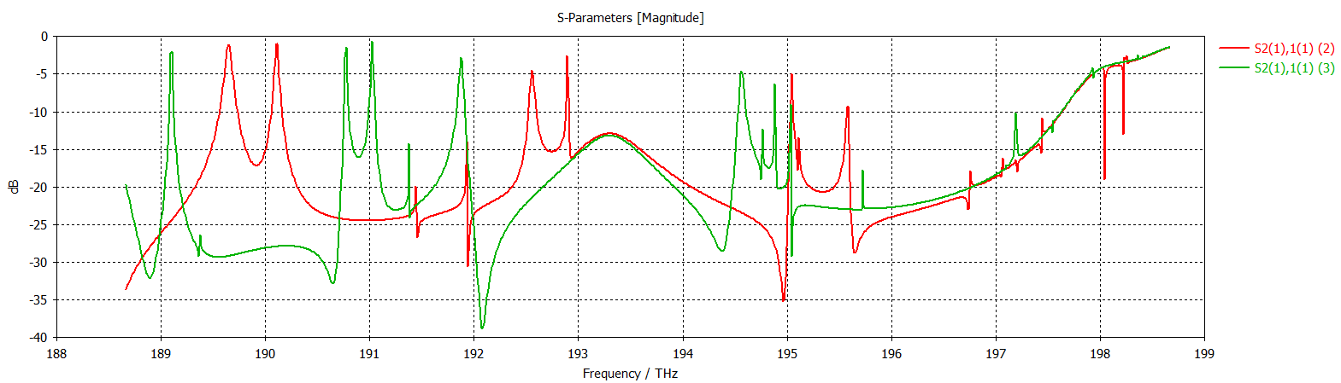
Tried to automate the threshold search
It did not go well
For N=60, without gain
S21 changing the length at the ends of the waveguide
Length = 200 nm Length = 600 nm
Identifying the DBE resonance is tricky

