Slide 1

Characterization of uniform waveguides
A. Herrero Parareda and F. Capolino
Department of Electrical Engineering and Computer Science

Slide 2
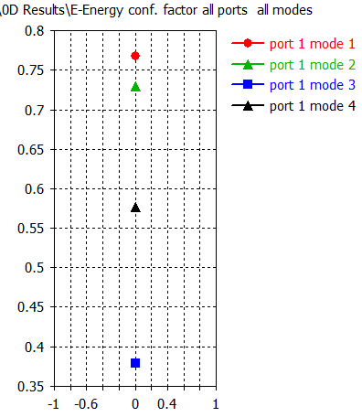




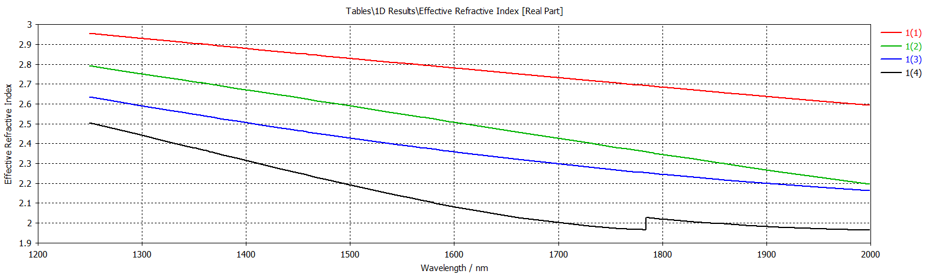
$$h=220;w=1050$$
Mode 1, 2 and 4 are physical modes

Slide 3
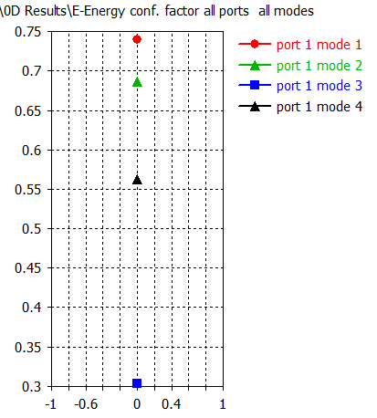
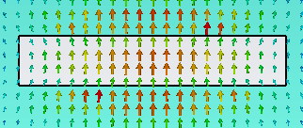
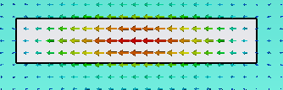


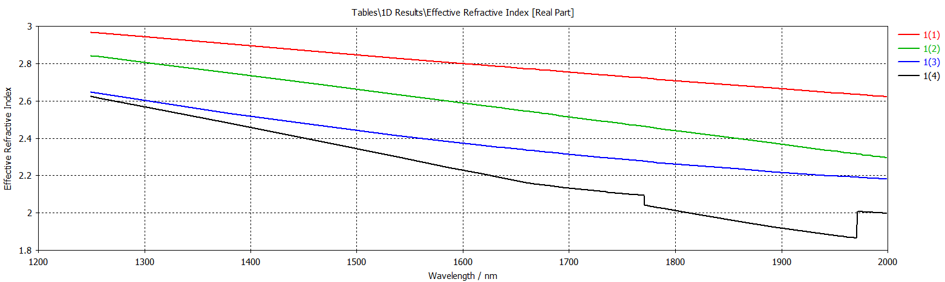
$$h=220;w=1200$$
Mode 1, 2 and 4 are physical modes

Slide 4
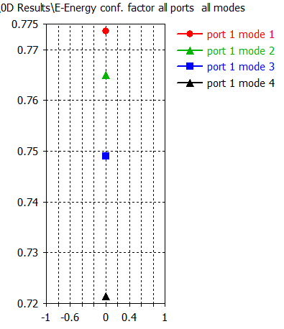




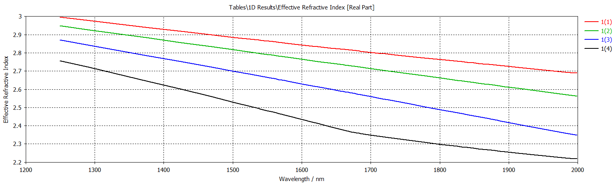
$$h=220;w=2000$$
Mode 1, 2, 3 and 4 are physical modes

Slide 5
DDFB laser
A. Herrero Parareda and F. Capolino
Department of Electrical Engineering and Computer Science

Slide 6
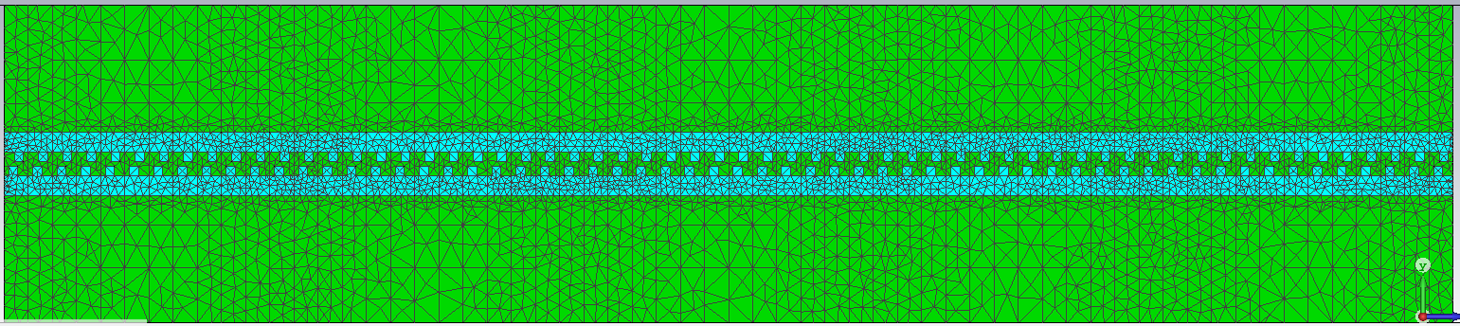
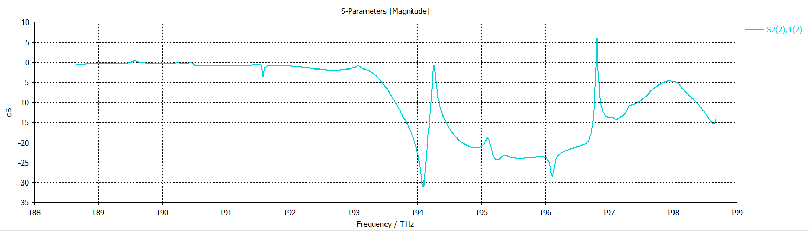

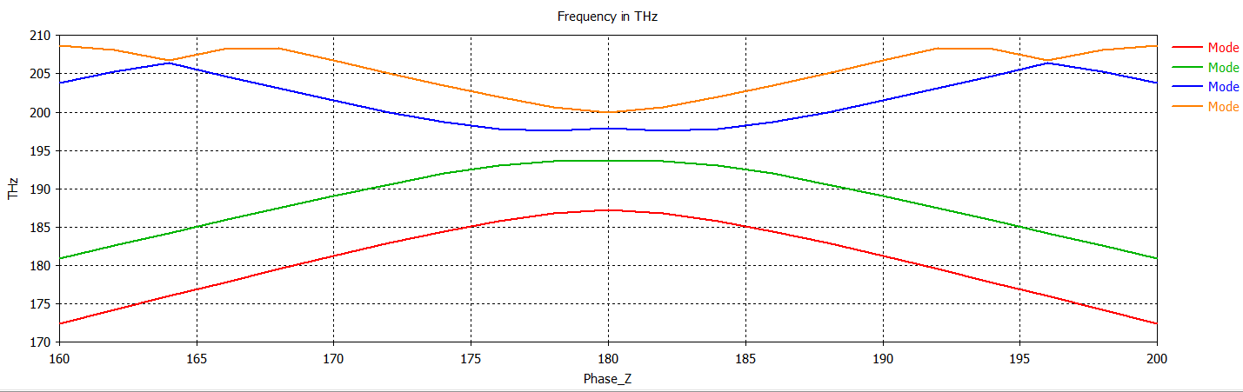
Eigenmode vs Freq dom mesh
746 tetrahedrons
DBE mode is mode 2: Odd mode

Slide 8
Corrugated Waveguide
A. Herrero Parareda and F. Capolino
Department of Electrical Engineering and Computer Science

Slide 9
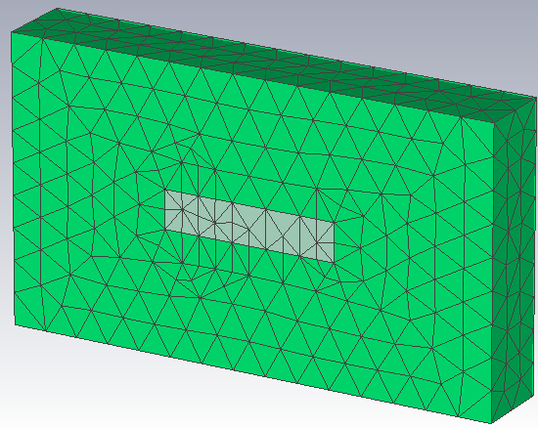
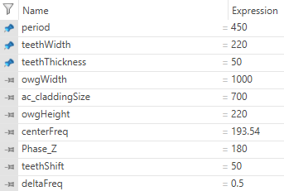


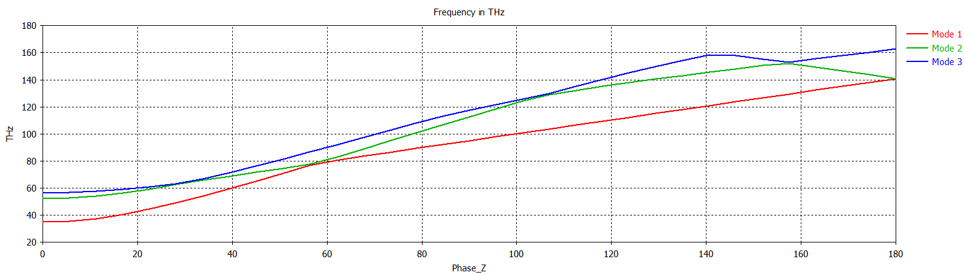
No teeth: $h=220, w=1000$
33 data points

Slide 10
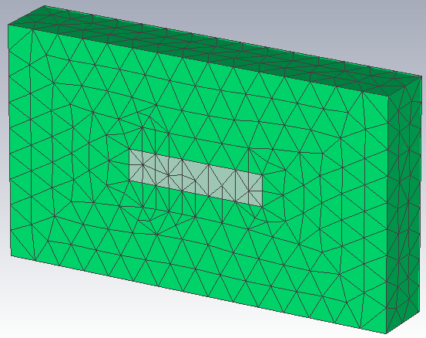
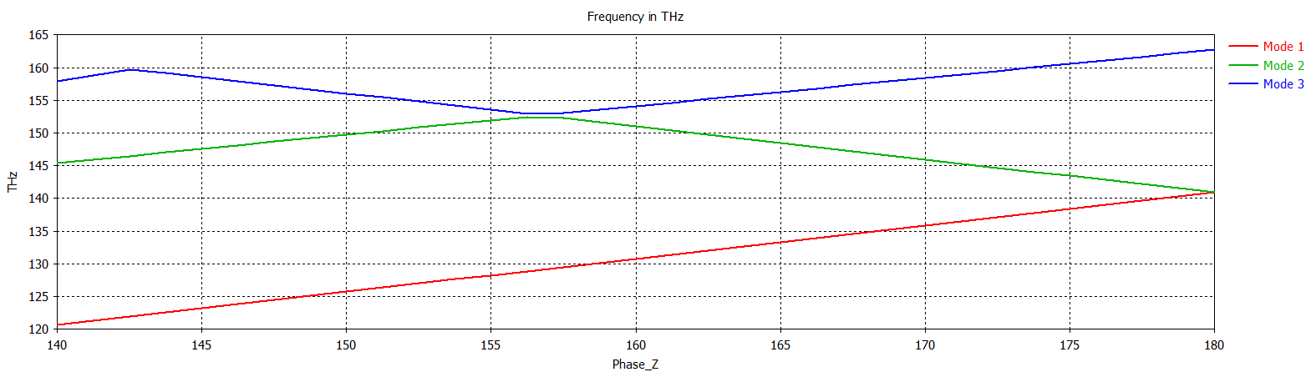
No teeth: $h=220, w=1000$
33 data points

Slide 11
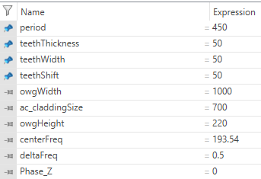

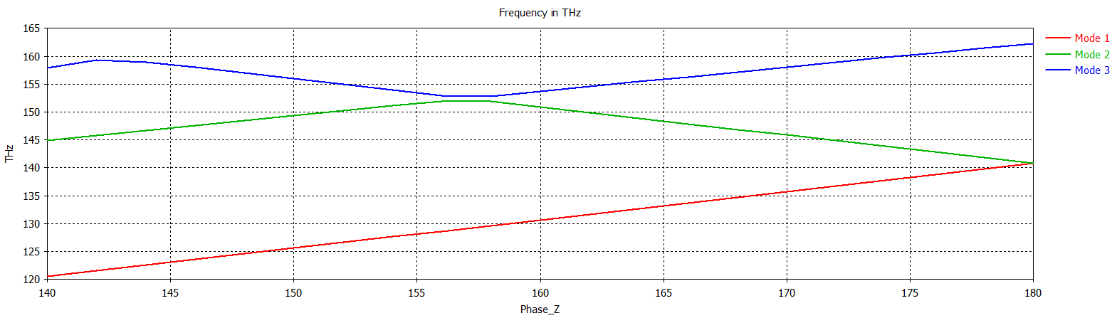
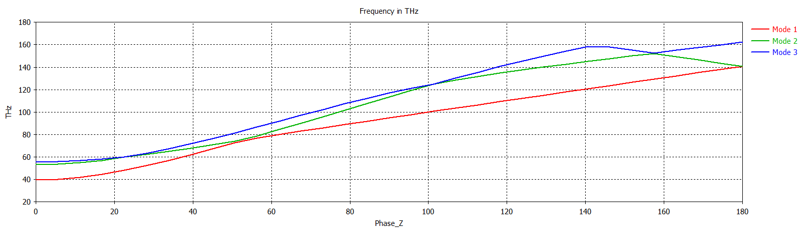
Small teeth
3 modes start at w=1050

Slide 12
Small teeth made absolutely no difference

Slide 13
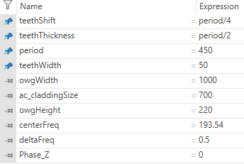

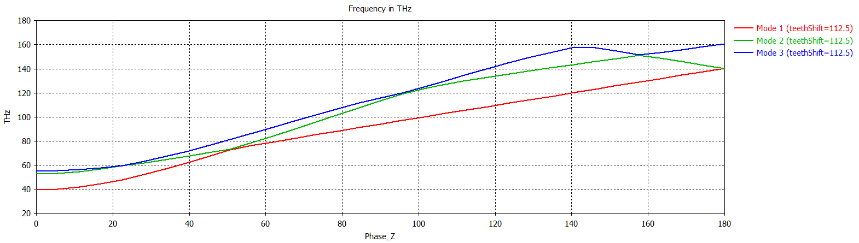
Bigger teeth
Increased teethShift, teethThickness, not teethWidth yet

Slide 14
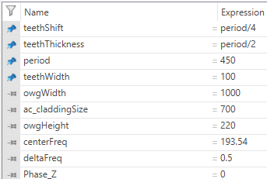
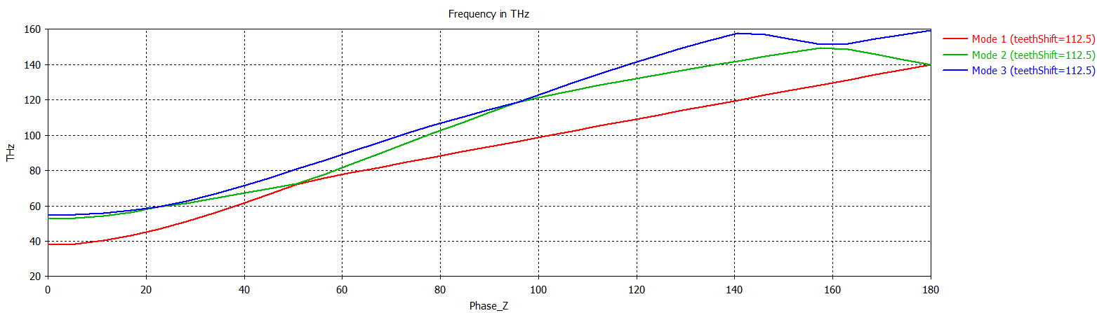
Longer teeth

Slide 15
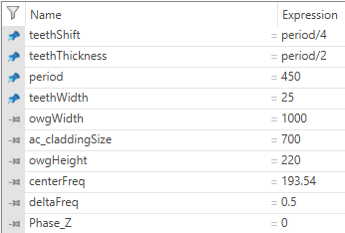
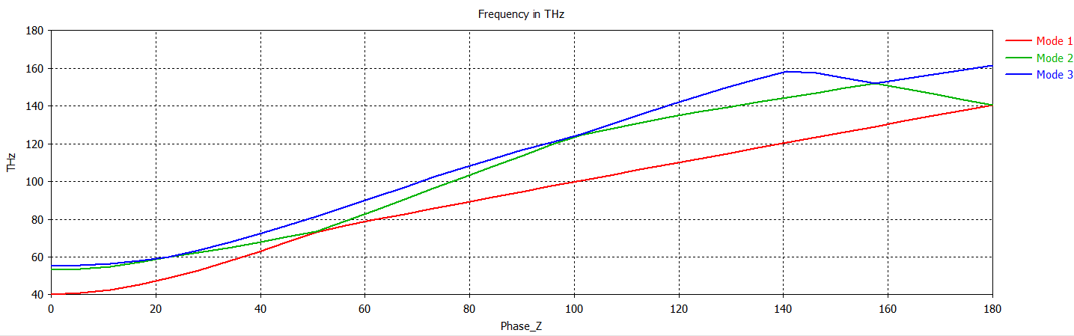
Shorter teeth

Slide 16
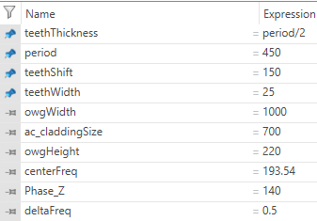
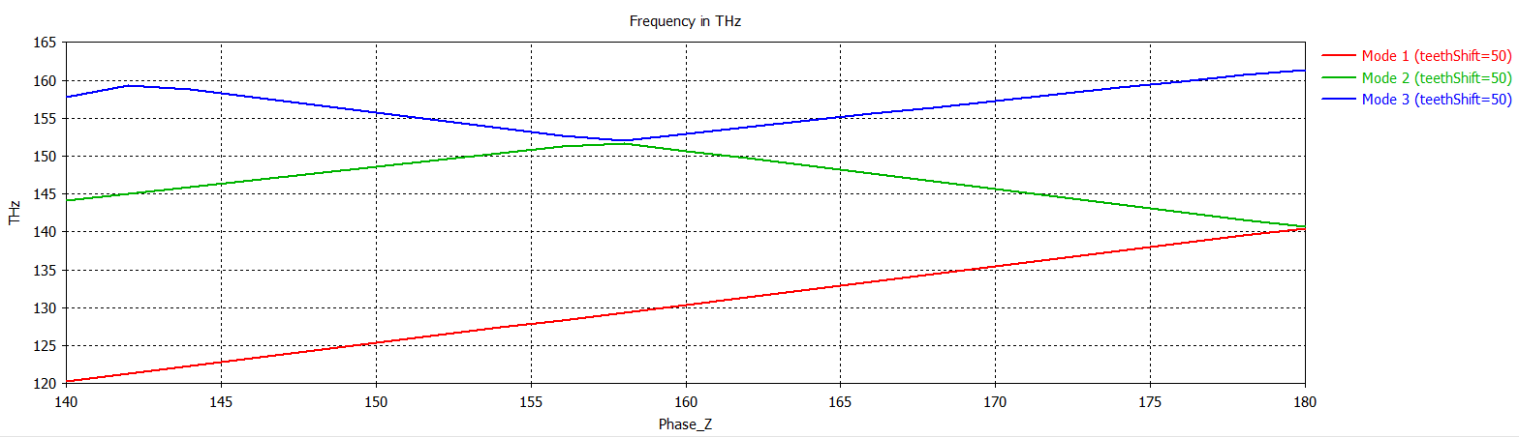

Slide 17
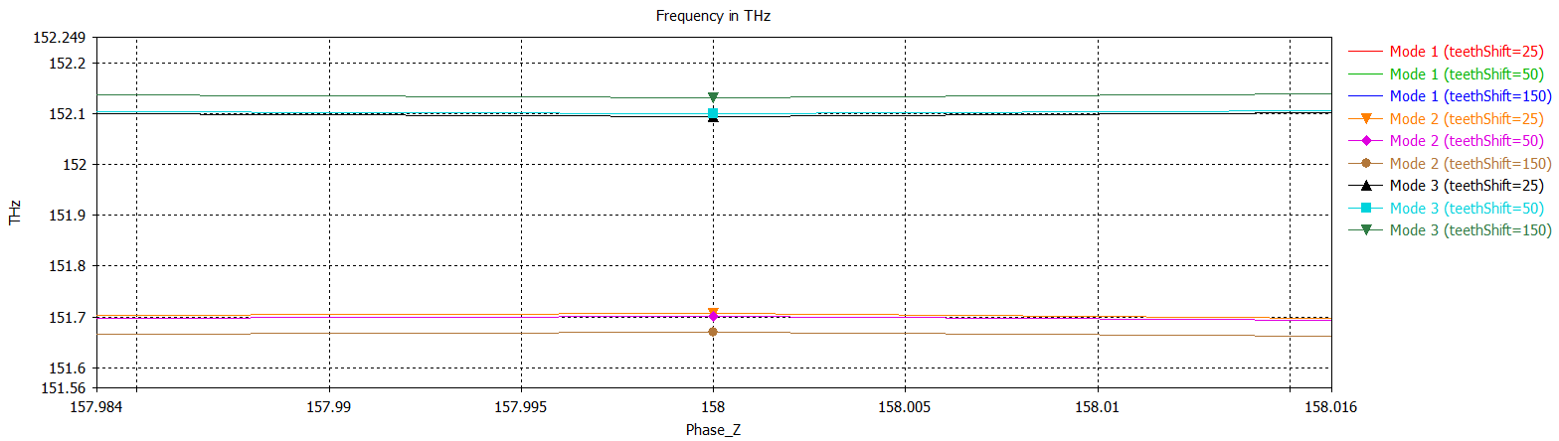
It improves as the shift gets smaller. But not enough

Slide 18
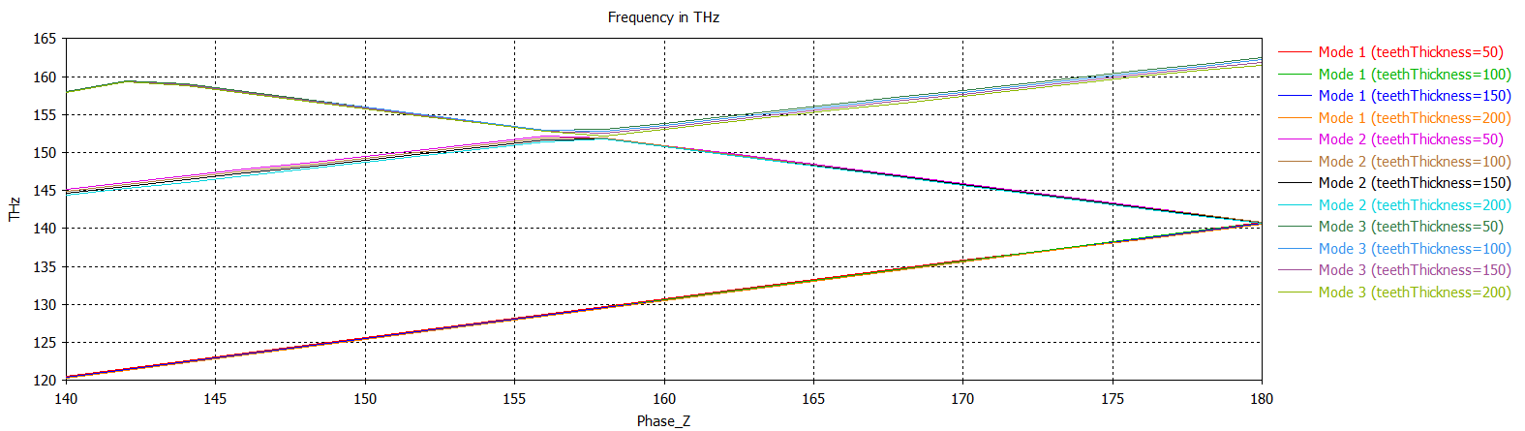
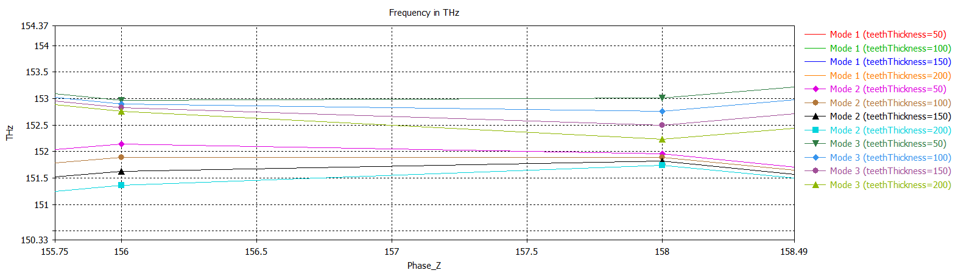
Check changes with the teethThickness

Slide 19
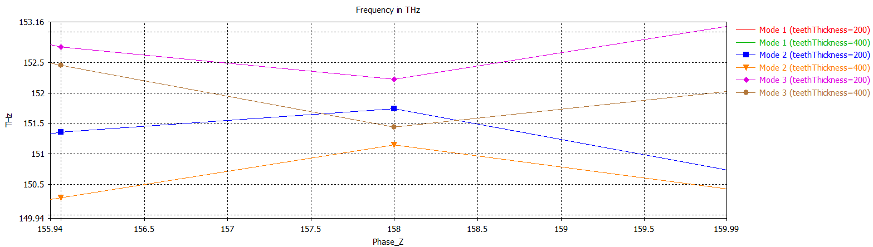

Slide 20
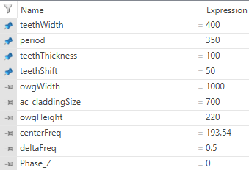
Let’s make wide teeth. Let’s try to get a backwards mode

Slide 21
Single-mode grating
A. Herrero Parareda and F. Capolino
Department of Electrical Engineering and Computer Science

Slide 22
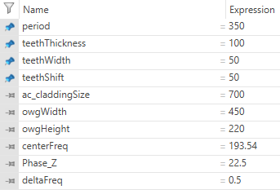

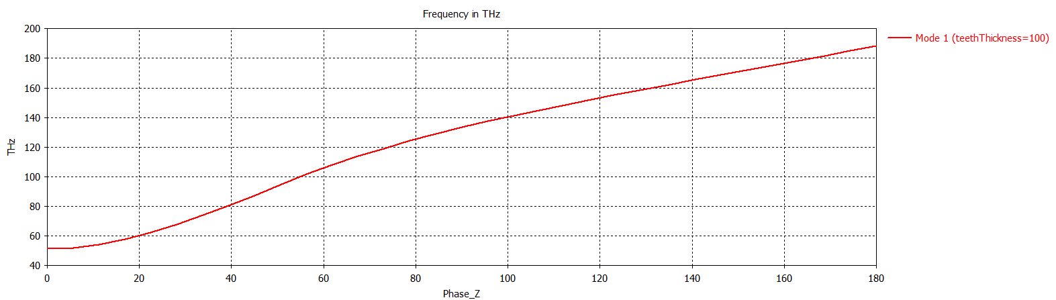
Let’s start at the beginning: Single-mode, no teeth
No teeth
Single-mode width
Let’s characterize it without teeth, and they play with teeth
Lowered the accuracy in favor of speed

Slide 23
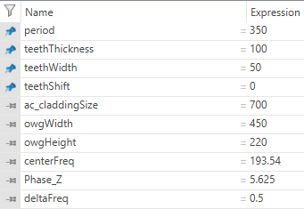

Single-mode, teeth (no shift)
I need to research gratings. Make sure it has a backwards mode. What does it need to have?

