Slide 1

Updates
A. Herrero-Parareda
Department of Electrical Engineering and Computer Science

Slide 2
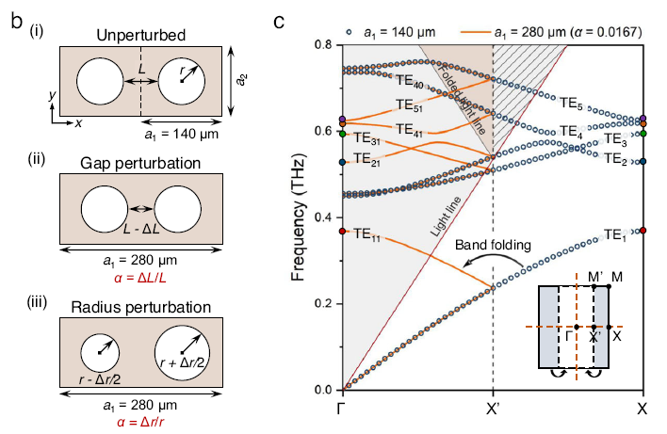
SIP in corrugated waveguide
I do not have found an SIP yet
I have found a technique called “band folding” that might be useful
In consists of applying a periodic perturbation to a periodic structure
It is what we were already trying to do but in a more formal approach
I am reading papers on the topic to better understand this method
Wang et al, Nature Communications, 14, 1, 2023

Slide 3
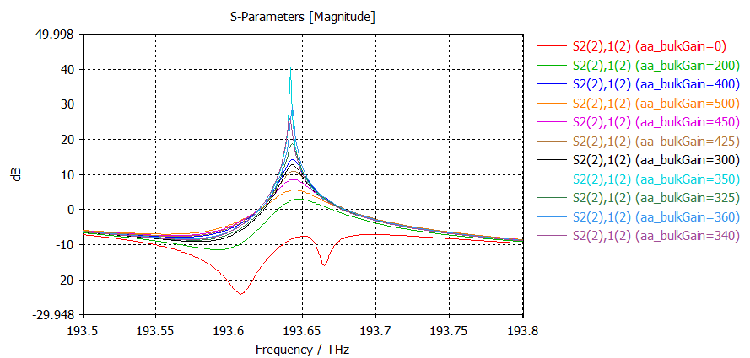
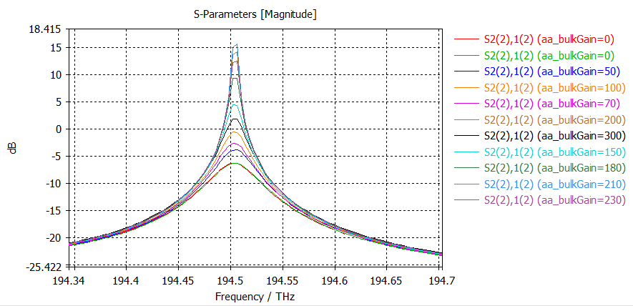
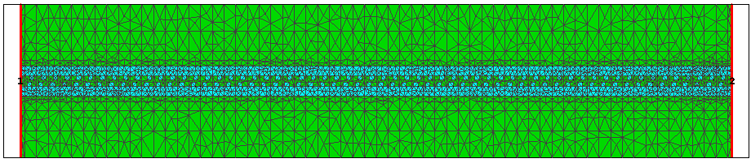
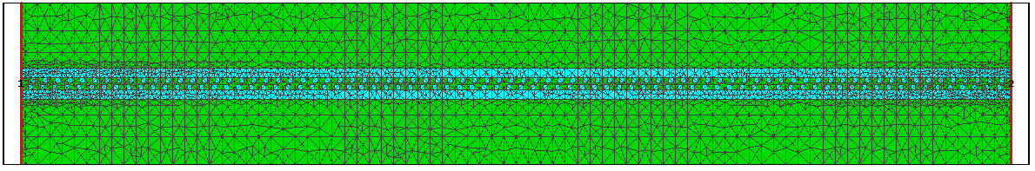


DDFB laser: Lasing thresholds
I have found some lasing threholds $(N=60,80,100,120,140)$
I want to do more simulations to make sure these numbers are correct
$$N=60;α_{th}≈350\frac{dB}{cm}$$
$$N=80;α_{th}≈210\frac{dB}{cm}$$

Slide 4
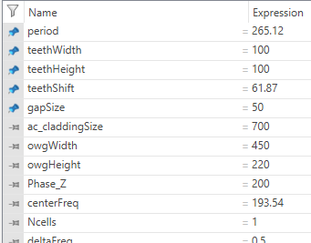
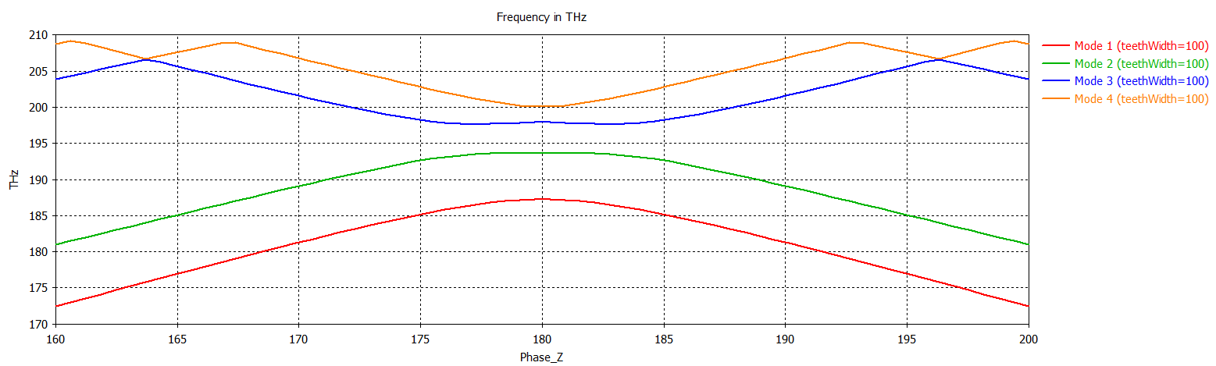
The DBE

Slide 5
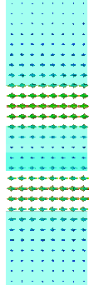


What Freq. Dom. Mode is the Eigenmode DBE mode?
Eigenmode: DBE mode is the odd mode
Freq. Dom: Mode 1 is even mode
Freq. Dom: Mode 2 is odd mode
In Freq Dom, the DBE mode is Mode 2 (the odd mode)

Slide 6
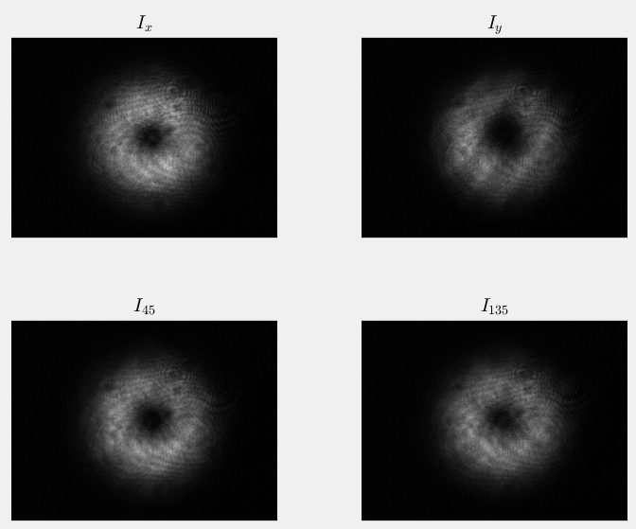
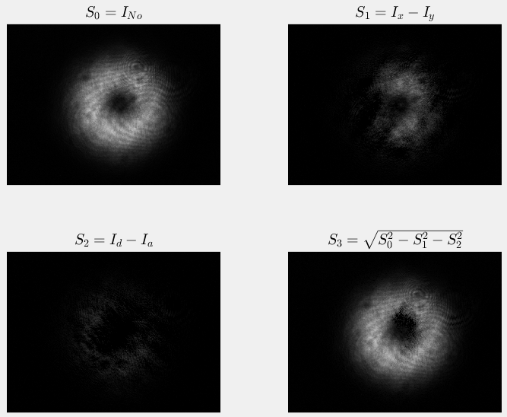
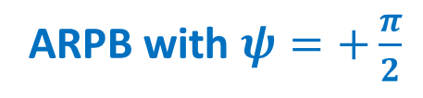
ARPB
Advanced Photonics Research:
Adapted the overleaf project according to their template
Wrote the cover letter
With Daryl and Nick (his PhD student):
We built the ARPB using a spatial light modulator (SLM)
The results are in other slides (below is an example)
ARPB with $ψ=+\frac{π}{2}$

Slide 7
Chiral metamaterials for enantioseparation
I met with Daryl and decided on what changes to make and what kind of calculations are required
I made those changes and calculations
Now that you are here, I will send I reminder so you can revise it
SPDC near EPDs
I met with Maxim and decided on what changes to make and what kind of calculations are required
I made those changes and calculations
Now that you are here, I will send I reminder so you can revise it

Slide 8
SPIE reimbursement
SPIE financial aid took care of transportation and accommodations (about $700)
I request that you reimburse me for the meals ($169.35)
I send you an email with a detailed breakdown and all the receipts
Please let me know if I can move forward with the paperwork

Slide 9
Future work
SIP corrugated waveguide: Read papers on band folding and implement it
DDFB laser: Find lasing thresholds, generate figures, add them to the paper draft
SPDC near EPDs: I am having trouble with the COMSOL file that plots the dispersion diagram -> Talk to Attilio
ARPB: Do more experiments with Daryl and Nick. We should have a meeting with them
Chiral metamaterials: Design and optimize a metamaterial that is optimally chiral. I need help, because I do not know how to do it. Who could I ask for help?
There is a SPIE Photonics Europe 2024 conference in April 2024. The call for papers is open. Should I write an abstract about something? What?
Chiral metamaterials
DDFB laser
Enhancing nonlinearities with EPDs
Band folding techniques to obtain an SIP

