Slide 1

Corrugated waveguide – After summer summary
A. Herrero Parareda and F. Capolino
Department of Electrical Engineering and Computer Science

Slide 2
Outline
Characterization of the uniform waveguide
Case 0: shift = period/2, thickness = period/2, width < waveguide width. Boundaries at half the teeth
Case 1: Uniform waveguide supports 2 modes; add corrugation
Case 2: Uniform waveguide supports 3 modes; add corrugation
Bonus #1: Why is the cutoff at very low frequencies?
Bonus #2: Optimization techniques
Bonus #3: Band folding technique

Slide 3
Characterization of uniform waveguides
A. Herrero Parareda and F. Capolino
Department of Electrical Engineering and Computer Science

Slide 4
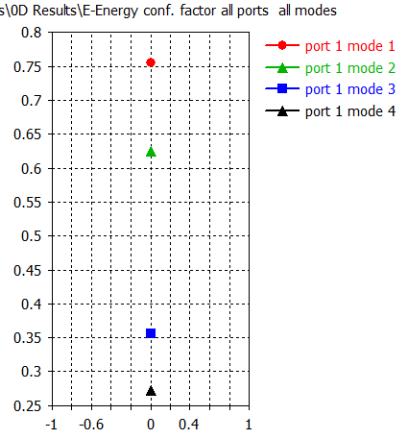
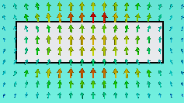
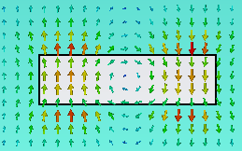


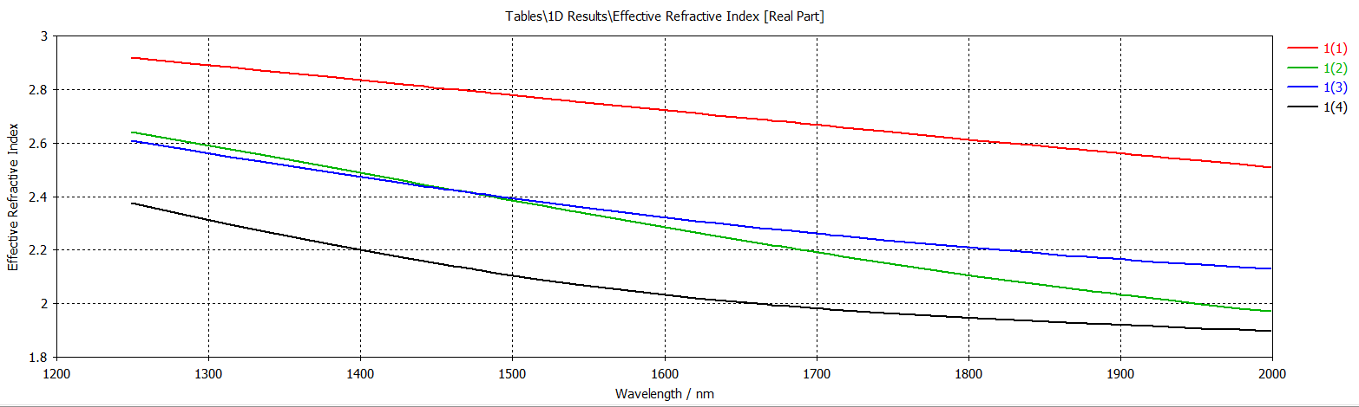
$$h=220;w=900 (2 modes)$$
Mode 1 and 2 are physical modes

Slide 5
$$h=220;w=1000 (2 modes)$$
Mode 1 and 2 are physical modes

Slide 6
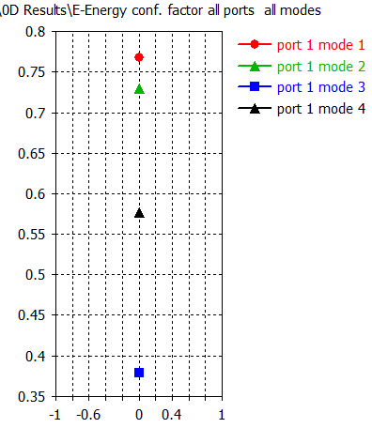




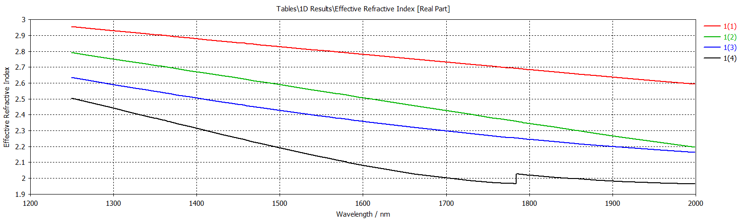
$$h=220;w=1050 (3 modes)$$
Mode 1, 2 and 4 are physical modes

Slide 7
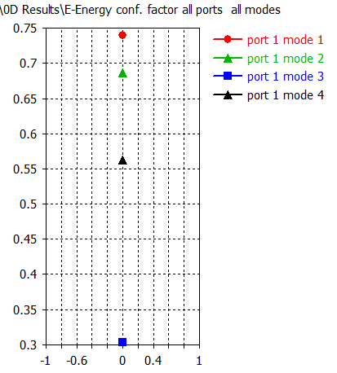
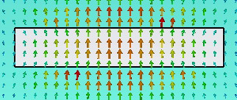
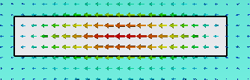
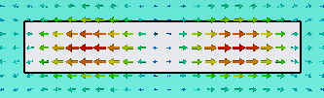

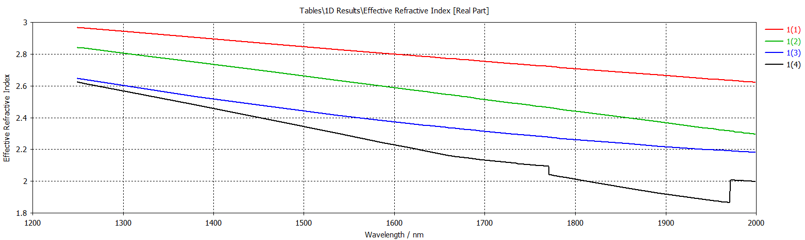
$$h=220;w=1200 (3 modes)$$
Mode 1, 2 and 4 are physical modes

Slide 8
Case 0: shift = period/2, thickness = period/2, width < waveguide width. Boundaries at half the teeth
A. Herrero Parareda and F. Capolino
Department of Electrical Engineering and Computer Science

Slide 9


Filippo design
Fixed: teethShift = period/2, teethThickness = period/2
Variables: period, teethWidth

Slide 10
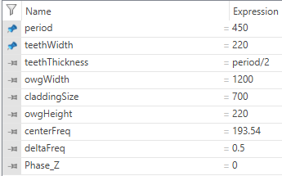
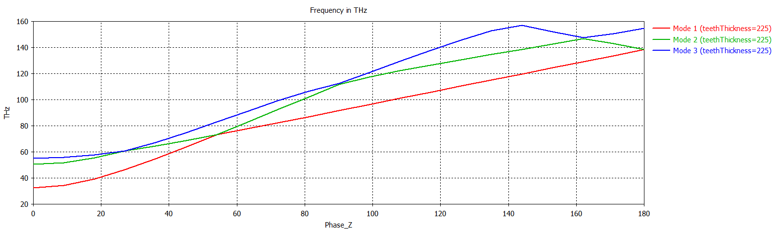
FD without teeth
Tried varying the period and the teethWidth
Period variation: Move branches upwards or downwards
teethWidth: There is not a lot of variation

Slide 11
Case 1: Uniform waveguide supports 2 modes
Add corrugation
A. Herrero Parareda and F. Capolino
Department of Electrical Engineering and Computer Science

Slide 12
$$h=220;w=1000 (2 modes)$$
Mode 1 and 2 are physical modes

Slide 13
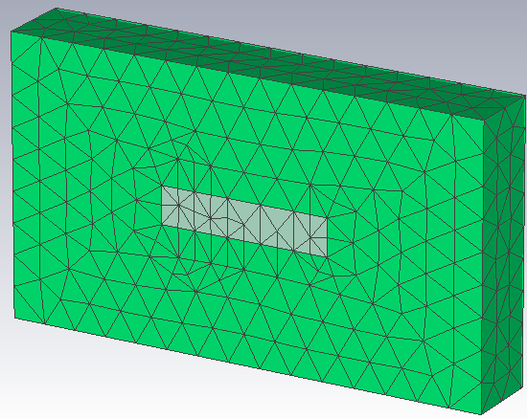
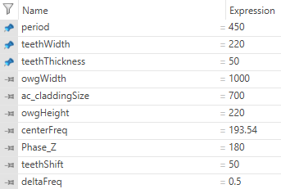
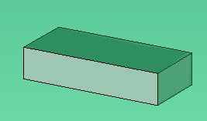

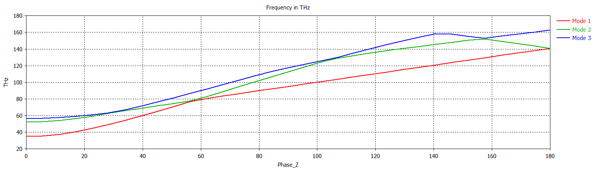
No teeth: $h=220, w=1000$
33 data points

Slide 14
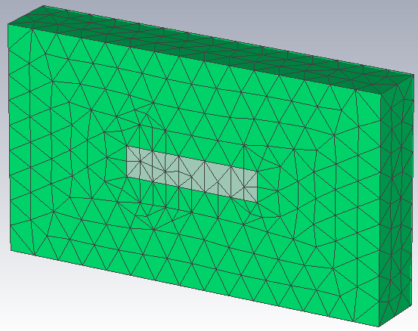
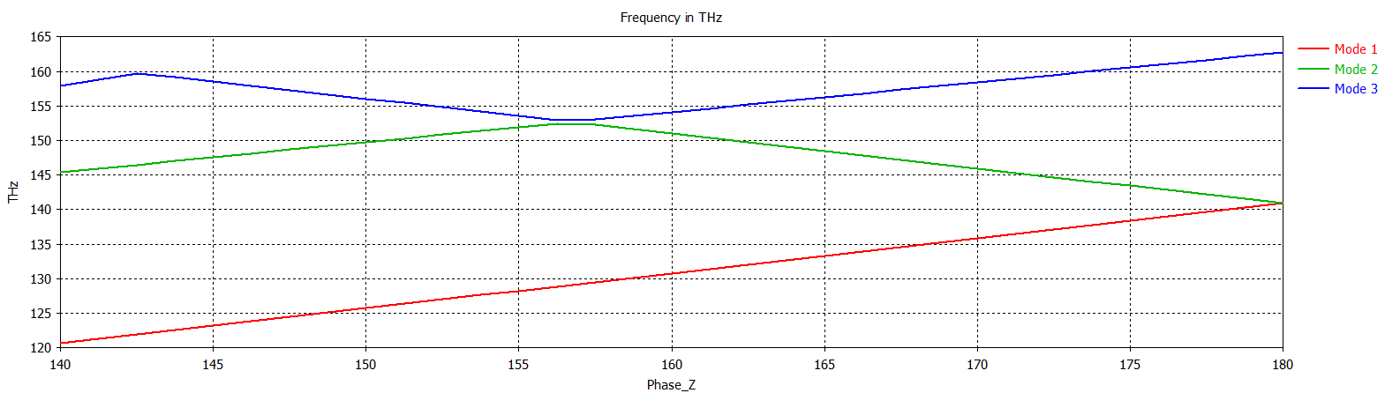
No teeth: $h=220, w=1000$
33 data points

Slide 15
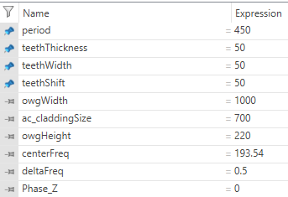
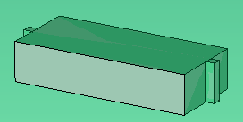
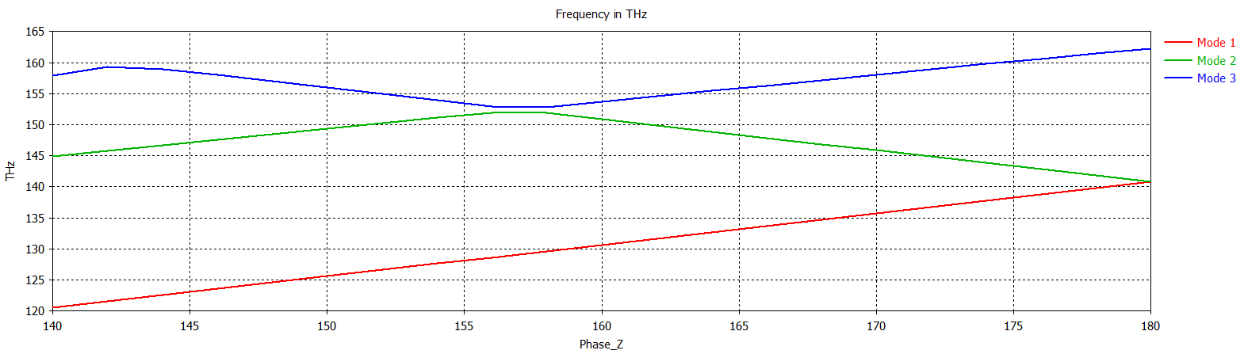
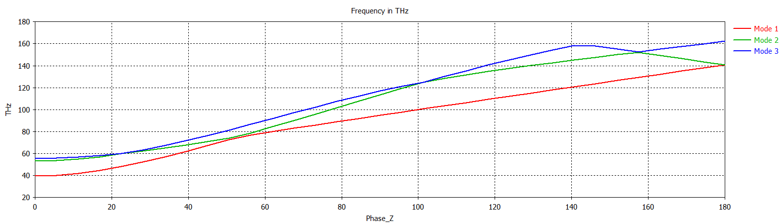
Small teeth
3 modes start at w=1050
Small teeth makes no difference

Slide 16
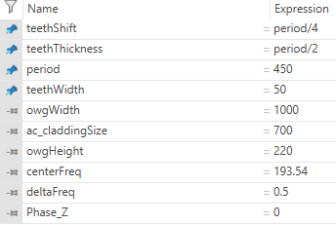
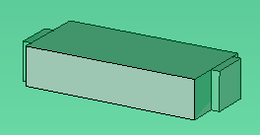
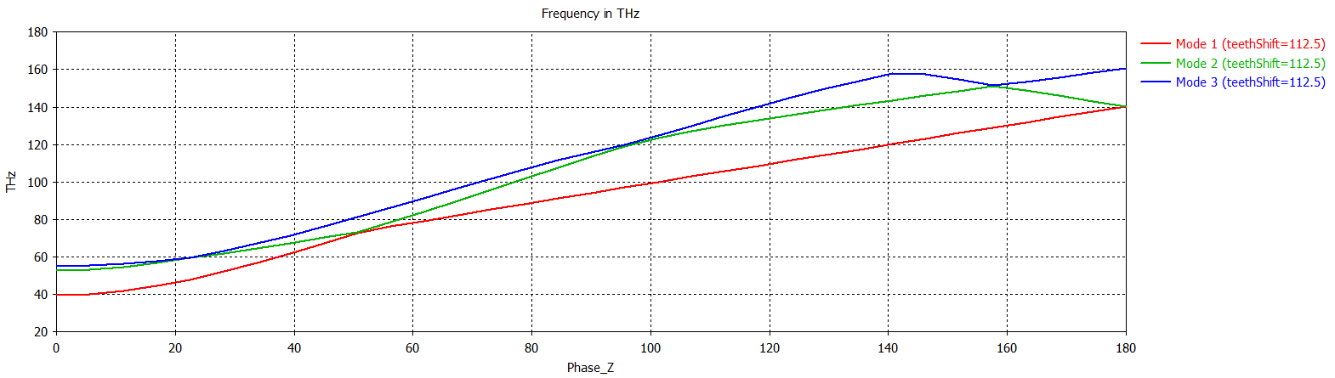
Bigger teeth

Slide 17
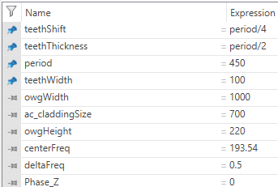
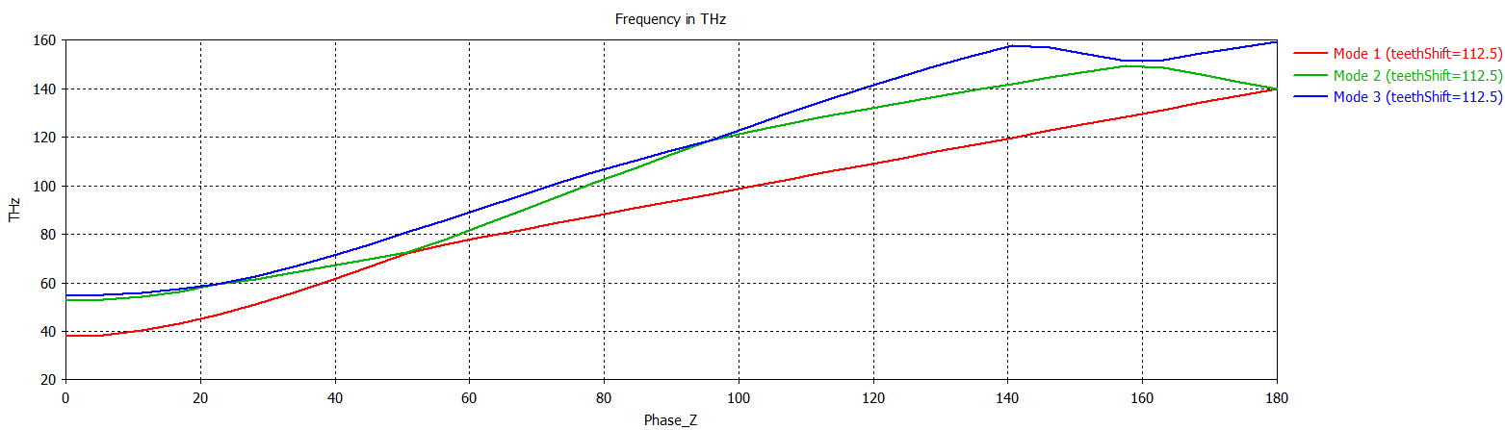
Longer teeth

Slide 18
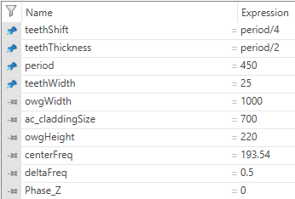
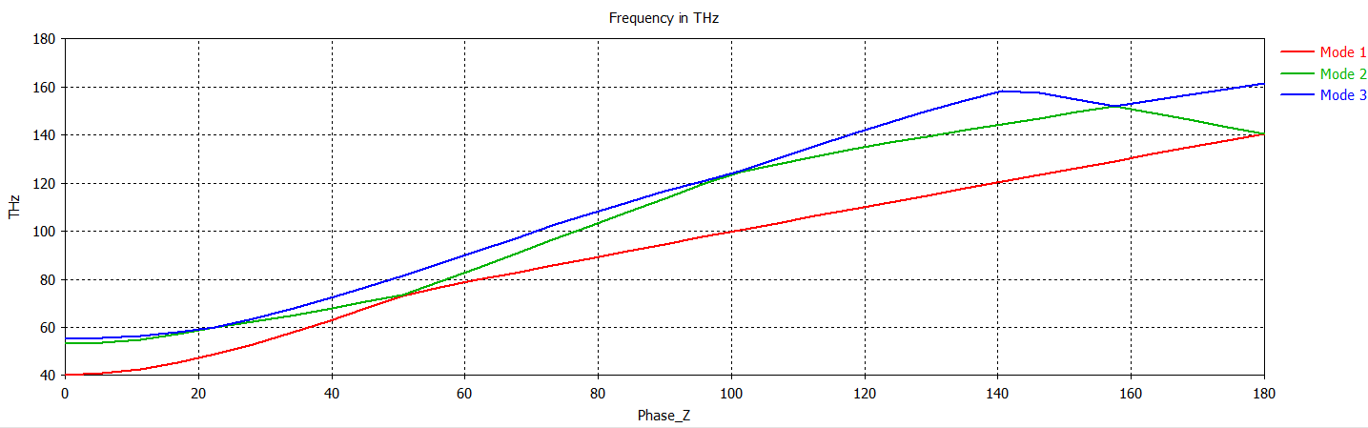
Shorter teeth

Slide 19
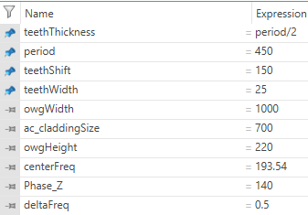
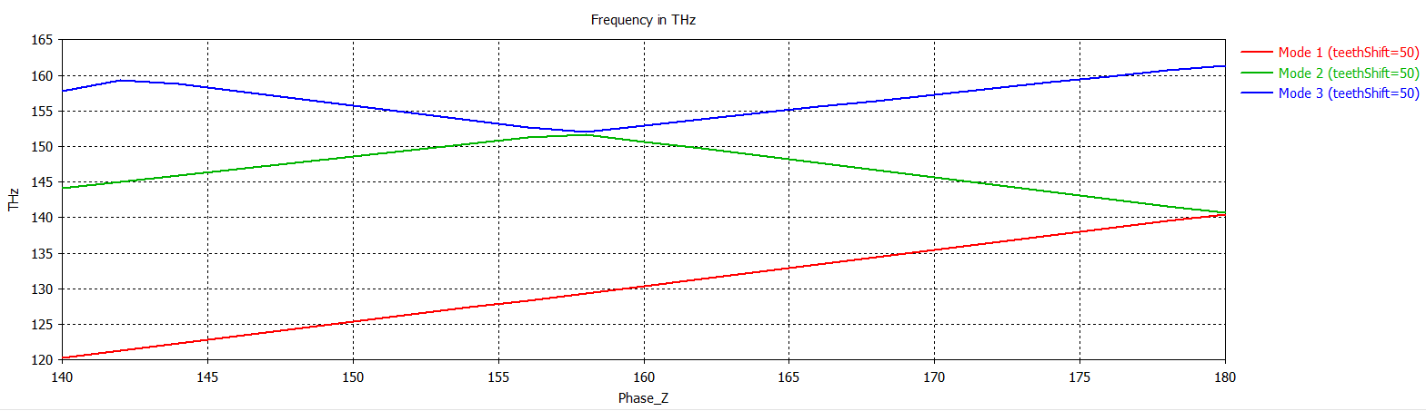
Let’s focus

Slide 20
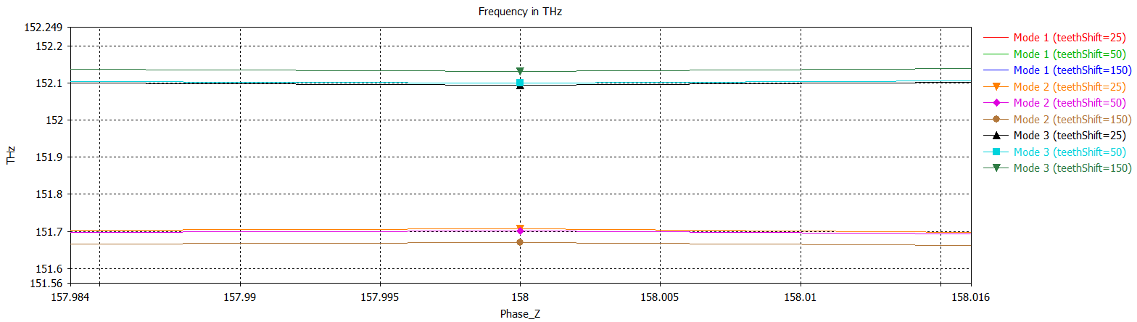
Do modes get close when varying the teethShift?
Modes get closer as the shift gets smaller, but not enough as to overlap

Slide 21
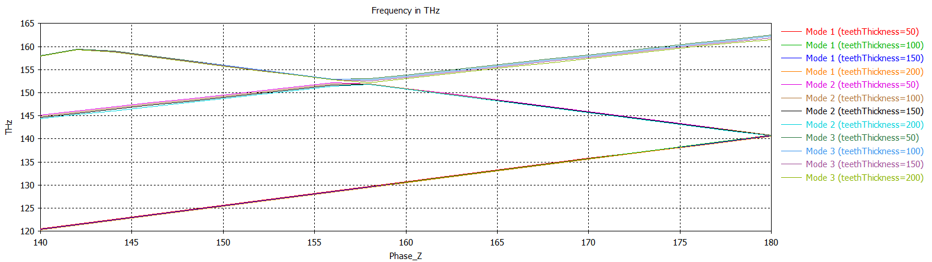
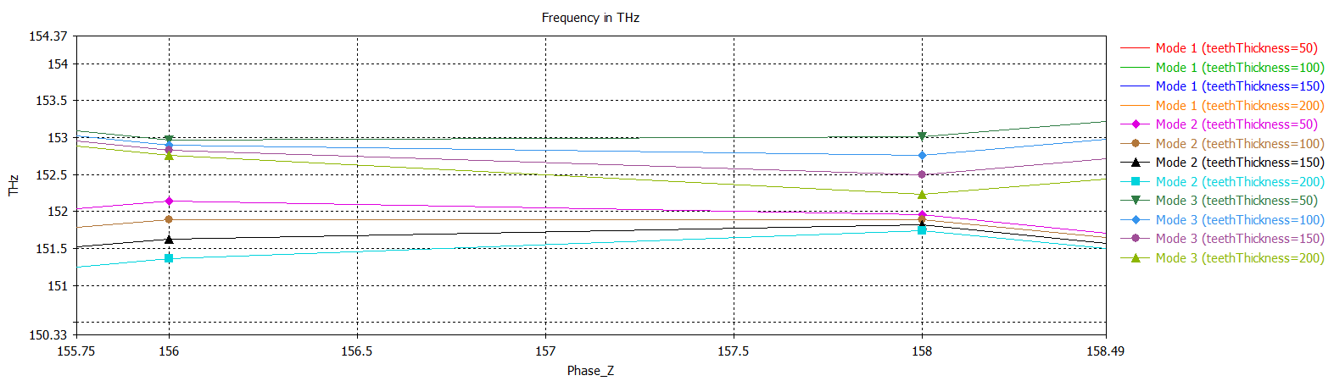
Check changes with the teethThickness

Slide 22
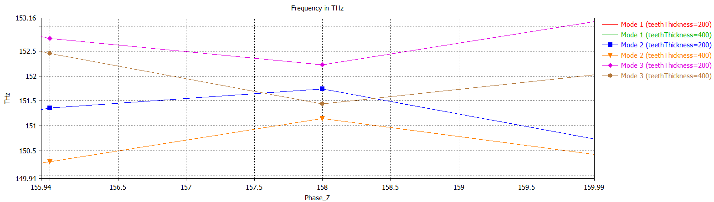
Do modes get close when varying the teethThickness?
The modes approach each other as teethThickness increases
Limitation: teethThickness < period

Slide 23
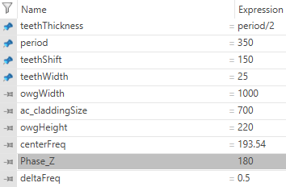
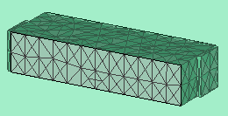
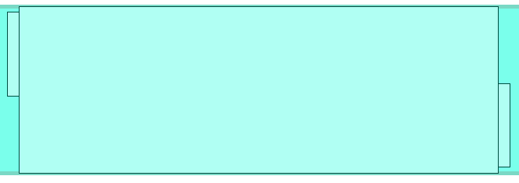
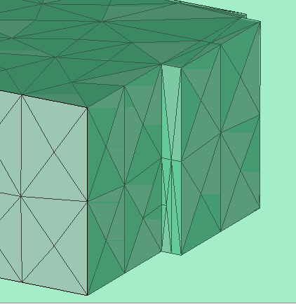
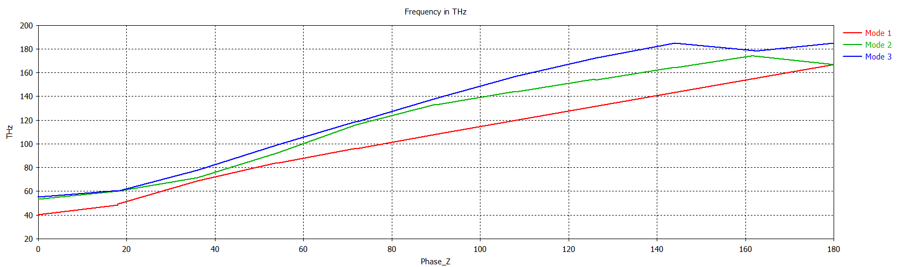
Repeat

Slide 24
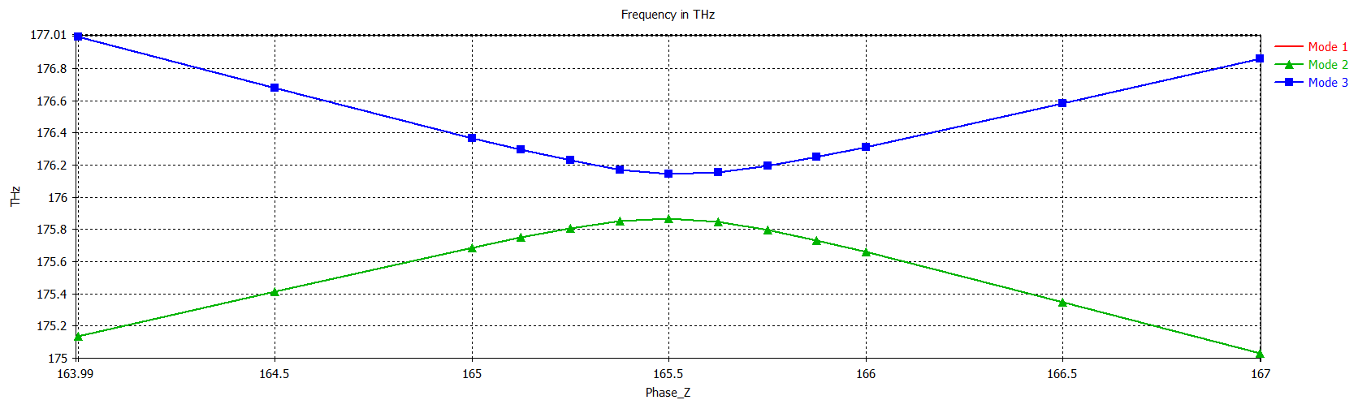
Repeat: Close to the off-center RBE

Slide 25
Repeat: Varying teethShift

Slide 26
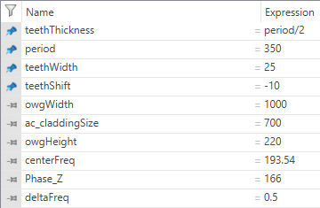
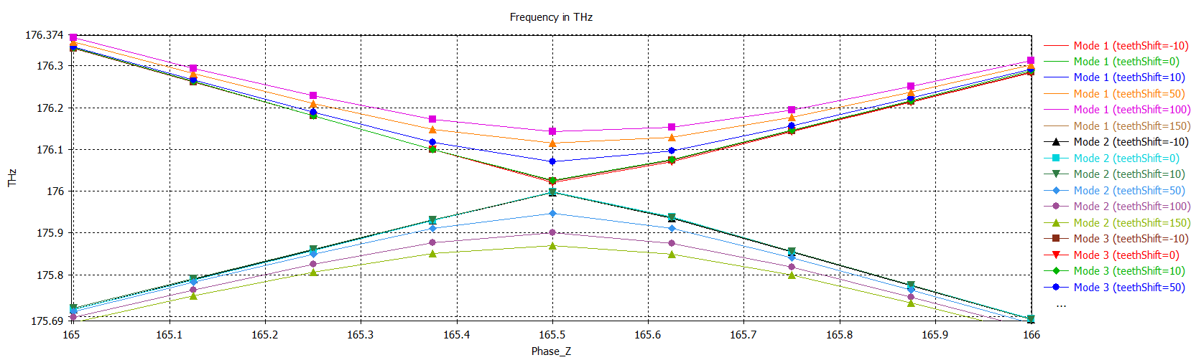
Varying teethShift
The curves never touch

Slide 27
Varying teethThickness

Slide 28
Case 2: Uniform waveguide supports 3 modes
Add corrugation
A. Herrero Parareda and F. Capolino
Department of Electrical Engineering and Computer Science

Slide 29
$$h=220;w=1200 (3 modes)$$
Mode 1, 2 and 4 are physical modes

Slide 30
$$h=220;w=1200$$
Mode 1, 2 and 3 are physical modes

Slide 31
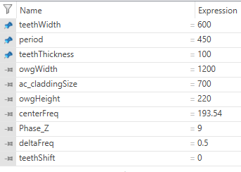
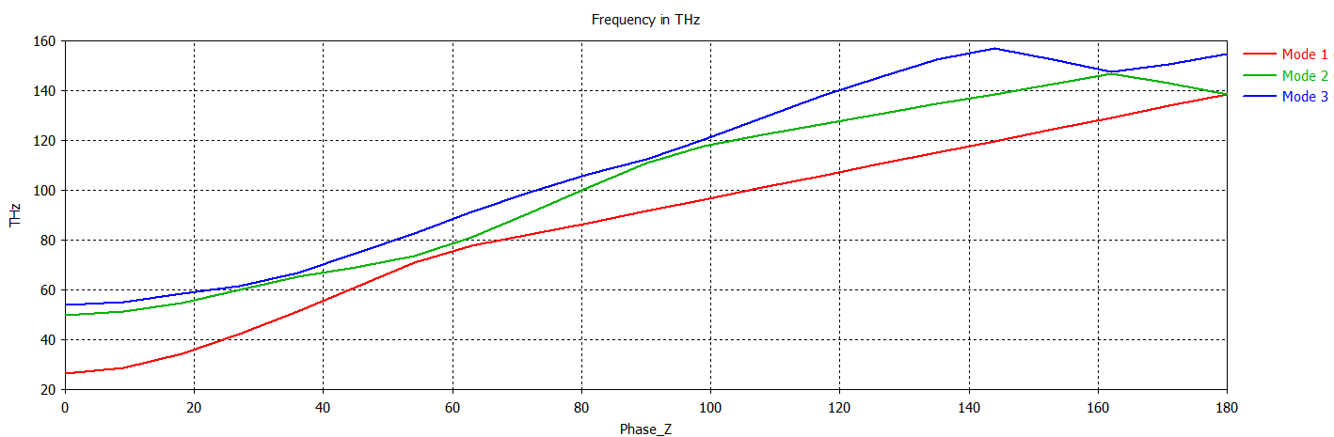
Dispersion diagram without teeth
The field of the three modes is horizontally-polarized

Slide 32
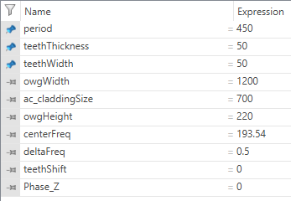
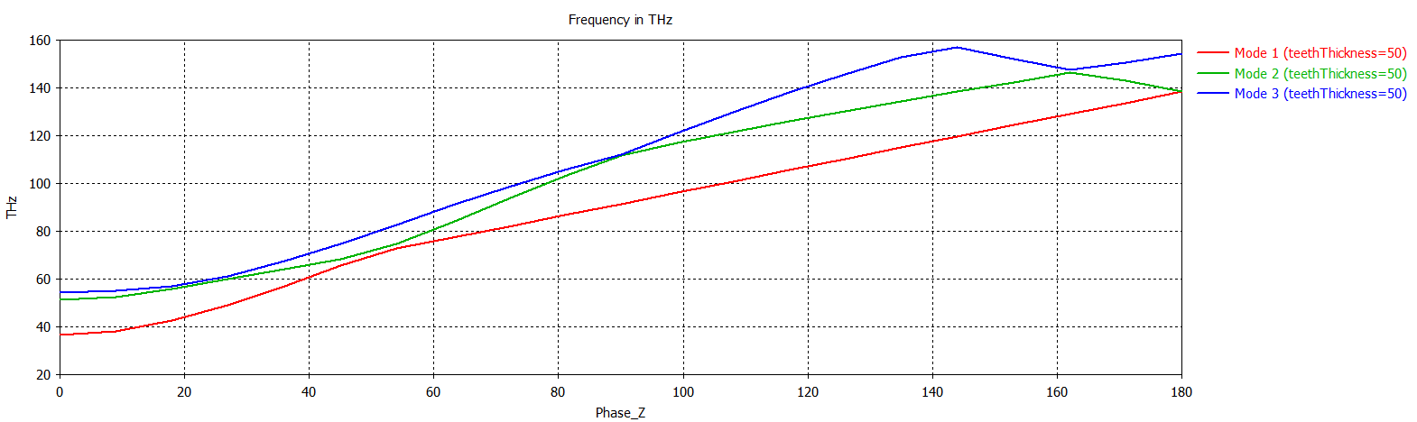
Small teeth

Slide 33
Bonus #1: Why is the cutoff at very low frequencies?
A. Herrero Parareda and F. Capolino
Department of Electrical Engineering and Computer Science

Slide 34
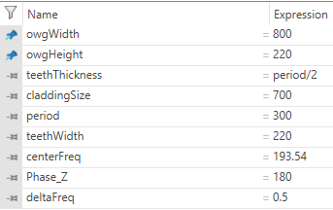
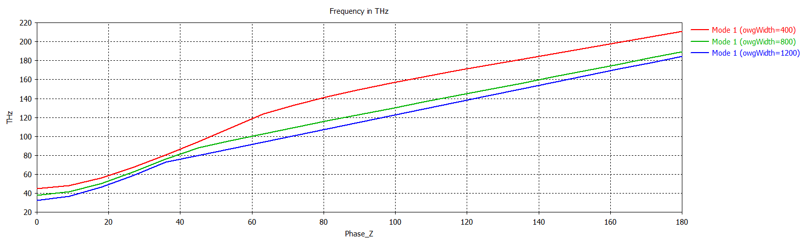
Why is the cutoff at 40?

Slide 35












Freq Domain: $450×220$
CST finds you port modes at any frequency
But that does not mean these modes are physical ( have to check the confinement factor)
$$f=50 THz$$
$$f=190 THz$$

Slide 36


What does that mean in the eigenmode solver?
It seems to show that the modes that CST finds at very low frequencies are not physical
Does that mean that no modes propagate for small values of Phase_Z? That does not make sense
Mode 1 at 50.2 THz
Mode 1 at 189.34 THz

Slide 37



Does it occur for the 2D double grating? No.

Slide 38



Does it occur for the 3D double grating? Yes.

Slide 39
Bonus #2: Optimization techniques
A. Herrero Parareda and F. Capolino
Department of Electrical Engineering and Computer Science

Slide 40


Optimization goal and method
The dispersion diagram around the SIP is approximated as a cubic curve
$$ω≈ω_{S}+α{\left(k−k_{S}\right)}^{3}$$
Its group velocity, however
$$v_{g}=\frac{∂ω}{∂k}≈3α{\left(k−k_{S}\right)}^{2}$$
And its group velocity dispersion (GVD),
$$GVD=\frac{∂v_{g}}{∂k}=\frac{∂^{2}ω}{∂k^{2}}≈6α(k−k_{S})$$
$$ω$$ | $$ω<ω_{S}$$ | $$ω=ω_{S}$$ | $$ω>ω_{S}$$
$$v_{g}$$ | $$v_{g}>0$$ | $$v_{g}=0$$ | $$v_{g}>0$$
$$GVD$$ | $$GVD<0$$ | $$GVD=0$$ | $$GVD>0$$

Slide 41




Optimization code
Eigenmode_CW_SIP_Script_teethShift_teethThickness_v1: Minimizes the output $σ$ from the function Eigenmode_CW_SIP_Function_teethShift_teethThickness_v1 by optimizing the values of teethShift and teethThickness
Eigenmode_CW_SIP_Function_teethShift_teethThickness_v1 : Runs a parametric sweep of $φ$, the phase shit at the Z-boundaries, stores the values of the frequency of the modes and calculates the “group velocity” and the “GVD” of each mode as:
$$v_{g}=\frac{∂ω\left(φ\right)}{∂φ}$$
$$GVD=\frac{∂v_{g}}{∂φ^{2}}$$
The coalescence parameter $σ=\left|v_{g}\right|$ or $σ=\left|GVD\right|$
I have tried both and none has worked out so far
$σ=\left|v_{g}\right|$ does not work because $σ=0$ could be an RBE as well
$σ=\left|GVD\right|$ is either and SIP or a DBE, but we only sweep on one side of the BZ

Slide 42



Starting point

Slide 43
Bonus #3: Band folding technique
A. Herrero Parareda and F. Capolino
Department of Electrical Engineering and Computer Science

Slide 44



SIP in corrugated waveguide
I do not have found an SIP yet
I have found a technique called “band folding” that might be useful
Jannesari, IEEE Sensors, Sydney Australia, 2021
The band folding technique consists on superposing a secondary periodic structure your initial structure
To fold the band in the middle, the secondary structure should have twice the period of the initial structure
The two structures must have slightly different unit cells, otherwise it becomes just a different structure
Wang et al, Nature Communications, 14, 1, 2023

Slide 45



First: Grating with one teeth

Slide 46



First check: Do we get the same dispersion diagram with two unit cells?

Slide 47


Second check: Do we get the same dispersion diagram with the bottom tooth?
We do not
Mode 2 & 3 change especially near the edge of the BZ

Slide 48



Second: With twice the period, add the second teeth (no shift)
Adding the bottom teeth does not change the dispersion diagram

Slide 49



Different attempt #1

Slide 50



Different attempt #2 (more similar to band folding)

Slide 51




Different attempt #2 (with 1% teethWidth variation)

Slide 52

Different attempt #2 (with 1% teethWidth variation)

Slide 53

Different attempt #2 (with 2% teethWidth variation)
I am abandoning the band folding project

