Slide 1
Hydra: Automated Plant Watering System
An Internet-of-Things Automated Plant Watering System based from Arduino and C#
Argumido | Bohol | Depanzo
BSCS 2

Slide 2
Introduction
Most people are too lazy to water their gardens or potted plants every day. Whenever we go out of town for few days, we always used to worry about our plants as they need water on regular basis. This could result to catastrophic outcomes to the plants.
The researchers came up with a solution to automate the watering process so that gardeners, hobbyists, plant collectors – or the user him/herself would not to worry about watering or getting up early in bed to just to water his/her plants. This could lessen the effort and time of the user to maintain and water the plants.
A system will be developed and implanted that will automatically manages and controls the watering process. The system includes a reservoir or a tank where water is being stored when main source of water is unavailable. The user will be notified based from his/her preferences and interaction with the system.

Slide 3
Methodology
The device and the application will be called “HYDRA” – a serpentine water monster in Greek and Roman mythology. The Hydra System will be written in the Arduino-C programming language that controls the onsite controller functions and C# that serves as the main interface to the Hydra System.

Slide 4
Methodology
The Hydra is further subdivided into two applications, the Hydra Root and the Hydra Leaf. The Hydra Root manages and controls all valves, water distribution lines (distro lines), sensors, the main pump and the main water source in the Root Distribution Line. The Hydra Leaf manages its specific distribution branch that includes its connected sensors, valves and water drip irrigation system, its built-in devices and the battery that will power the Leaf device.

Slide 5
Methodology
Hydra consist of two main functions, the Water Reservoir Filling Process and the Water Distribution Process. The Water Reservoir Filling Process manages and checks the filling of the water storage tank while the Water Distribution Process manages and controls the distribution of water to the specific distribution line.

Slide 6
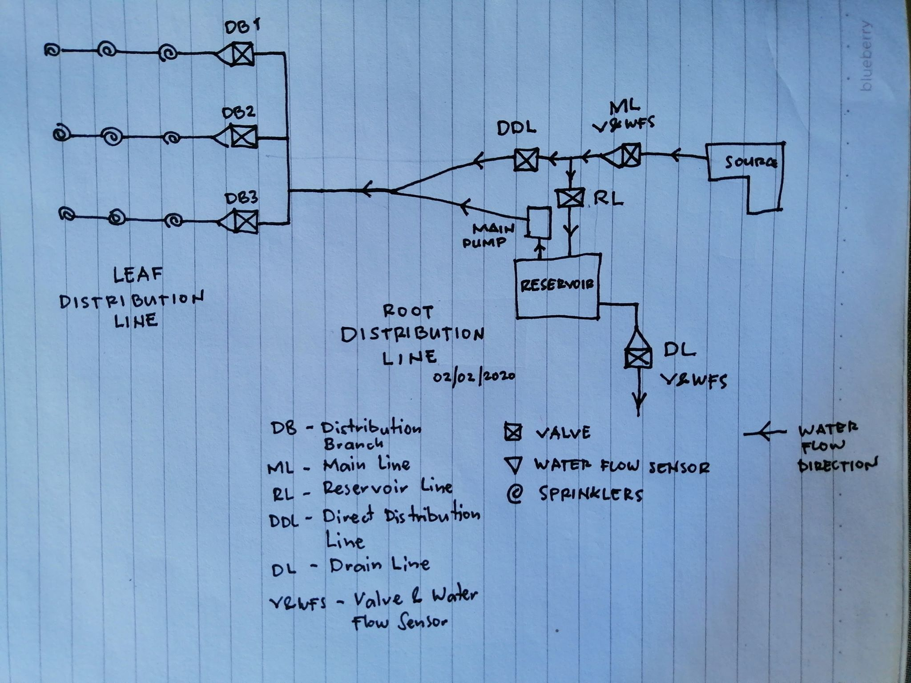
The Hydra Onsite Setup

Slide 7
Water Reservoir Filling Process
The Water Reservoir Filling Process includes 3 sub-processes:

Slide 8
Filling Status
Filling status means the current water reservoir filling status of the tank which further subdivided into:
Empty. The tank is empty or near-to empty.
Filling. Water is currently filling into the tank.
Discharging. Water is currently distributed to the distro lines.

Slide 9
Water Level
Water Level. This tells the current water level present in the tank. This includes:
Max Full. The maximum water level the tank could store water which value is set predefined at 95%.
Critical. The maximum lowest level of the water present in the tank which is set predefined at 20%.
Empty. The water tank is currently having no water set to the constant value of 0%.

Slide 10
Water Level
Water Level. This tells the current water level present in the tank. This includes:
Max Full. The maximum water level the tank could store water which value is set predefined at 95%.
Critical. The maximum lowest level of the water present in the tank which is set predefined at 20%.
Empty. The water tank is currently having no water set to the constant value of 0%.

Slide 11
Routines
Are methods, modes or protocols in which how the system will handle the water tank filling. Routines are classified into two:
Normal and Irregular Routines

Slide 12
Normal routines
These routines are first executed by the system based from the preferences set by the user. This is further sub divided into three sub routines:

Slide 13
Normal routines
Simultaneous Water Discharge-Refill routine. The water discharge and refill are done simultaneously.
Refill After Water Discharge routine. Discharges water first then refills the reservoir.
Refill then Discharge routine (Second Priority). Refills the reservoir first before water discharge. This requires an n time before a scheduled water discharge.

Slide 14
Irregular Routine
These routines are executed by the system only when the system detects irregularities in the water discharge-refill process which normally occurs when the main water source is currently unavailable.

Slide 15
Always open Main-to-Reservoir Line
By default, the water valve is a NC-type (Normally Closed) which means when there is no electricity feed to the valve the valve is normally closed. In this routine, the Main Line and the Reservoir Line is open for easy refilling of the tank when water from the main source is now available but closes when the tank reaches its full capacity.

Slide 16
The Water Distribution Process
The water distribution process is being activated when the system reaches a certain value called the trigger.

Slide 17
Normal routines
Time. The water distribution is activated when it reaches a time first set by the user.
Soil Moisture. The water distribution is activated when it reaches the trigger level of the soil moisture sensor first set by the user.
Manual. A manual water distribution is carried out by the user him/herself.

Slide 18
The Hydra Setup (Onsite)

Slide 19
ROOT CONTROLLER (HYDRA ROOT NODE)
The Hydra Root Node controls and manages the overall function the system. It controls the:
[1] Main Pump
[2] Reservoir
[3] Main Line
[4] Distribution Line
[5] Drain Line
[6] Hydra Nodes (Hydra Leaf Nodes)
[7] Main WiFi Controller (MWS)
[8] Data Logging Service (DLS)
[9] Notification Service (NotifS)
[10] Leaf Node Hibernate Sequence Service (LNHSS)

Slide 20
LEAF CONTROLLER (HYDRA LEAF NODE)
The Hydra Leaf Node controls and manages a specific distribution line. It controls its specific:
[1] Distribution Valve
[2] Distribution Water Flow Sensor
[3] Child Soil Moisture Sensor
[4] On-module WiFi Controller (OMWS)
[5] On-module Data Logging Service (ODLS)
[6] On-module Notification Service (NotifS)
[7] On-module Hibernate Sequence (OMHS)

Slide 21
The Hydra Onsite Setup

