Slide 1
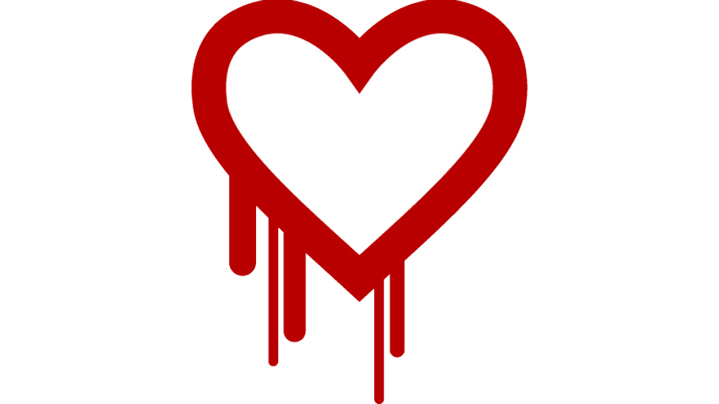
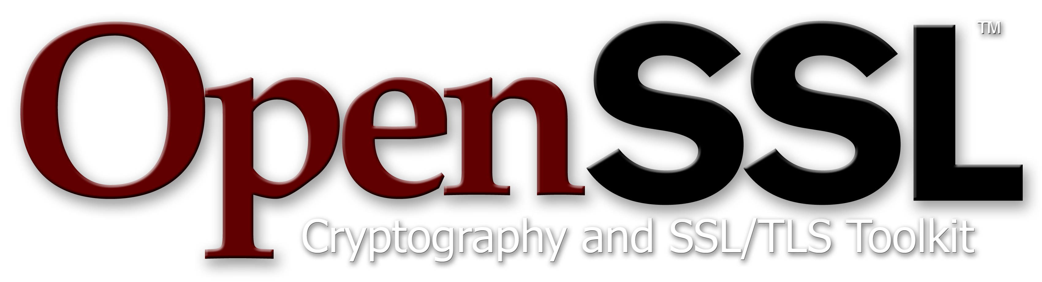
Heartburn from Heartbleed forces wide- ranging rethink in open source world
By Alex Hesselgrave

Slide 2
What is OpenSSL?
Backbone of Internet Encryption
SSL: Secure Sockets Layer
TLS: Transport Layer Security
OpenSSL implements both in a convenient toolkit library
Most importantly, FREE and OPEN SOURCE

Slide 3
What is Heartbleed?
Heartbeat feature of OpenSSL 1.0.1
Length = number of bytes received
Payload = number of bytes to send back
struct
{
HeartbeatMessageType type;
uint16 payload_length; //Important!!!!
opaque payload[HeartbeatMessage.payload_length];
opaque padding[padding_length];
} HeartbeatMessage;
struct ssl3_record_st
{
unsigned int length; /* How many bytes available */
[...]
unsigned char *data; /* pointer to the record data */
[...]
} SSL3_RECORD;
Notes:
64 kb max per heartbeat

Slide 4
Discovery of the bug
Discovered by Google and Codenomicon in the beginning of April
Critical testing led to the discovery of information leak
Publicly reported by OpenSSL on April 7th

Slide 5
Popularization
Www.heartbleed.com
Codenomicon Heartbleed logo and site
Extremely quick media coverage

Slide 6
The Future of Open Source
Core Infrastructure Initiative
Google, Facebook, Microsoft, IBM, Cisco, etc.
OpenSSL alone is the backbone for about 500k websites
“We use a lot of open-soure software because we hope that […] somebody has spent the time to make sure their investment is protected.”
Need for funding and rigorous code review

