Slide 1
SleepTalk
your sleep in a dream-like sentence
Ashley Hetrick

Slide 2

Vision
SleepTalk is a program that takes sleep data provided by the user—like how many hours she moved during sleep and how many hours she remained still—and generates a random sentence in response to those data.
The random sentence is comprised of the most popular words in the English language. It is meant to approximate dreams, where experiences can be nonsensical and language enigmatic.
Sleep for a total of 0 hours = receive a message that, in order for the program to work, users need to sleep.
Sleep for fewer than 4 hours = receive a message that, in order for the program to work, users need more restful sleep.
Sleep for 4 or more hours but move less than 1 hour during sleep = user may have sleep paralysis, and so will receive a random sentence comprised of words describing common experiences of sleep paralysis.
Frederic Leighton, Flaming June, 1895. Image courtesy of http://artvienna.blogspot.com/2010/06/sleeping-beauty-in-vienna.html.

Slide 3
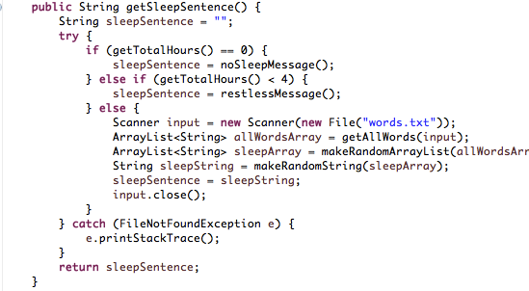
Production Code
SleepTalkUser class
5 instance variables
Constructors – no argument & fully overloaded
Getters & setters for 5 instance variables
toString method
Hash & Equals
11 worker methods – getSleepSentence() is the primary method
File Scanners for each message (no sleep, restless sleep, sleep paralysis, and primary)
ArrayLists, Strings, one Random object

Slide 4
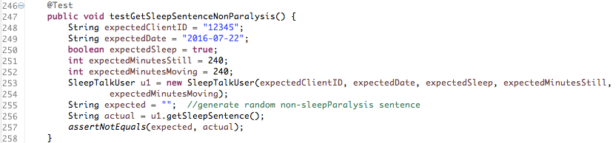
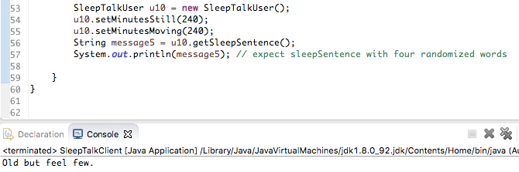
Test Code
JUnit & Client
JUnit
Constructors
toString
EqualsAll
Different instance variables
Worker methods
Messages
Client
Constructors
toString
Equals
Worker methods
Messages (esp. random)

Slide 5

Next Steps
Connect to FitBit API using OAuth2.
Populate instance variables with real data drawn from FitBit account, like clientID.
Create a method getFitBitSleep() that reads sleep data tracked by FitBit and returns an ArrayList populated with minute-by-minute breakdown of sleep activity per mainSleep session.
Image courtesy of http://www.marketingtechnews.net/news/2015/aug/21/big-data-and-personalisation-truly-comes-age-next-steps-cmo/

