Slide 1
Enterprise Application Integration patterns
for Java EE cloud applications
JavaOne 2012
Alexander Heusingfeld
Stefan Reuter

Slide 2
Speakers
Alexander Heusingfeld
  Senior Consultant, Cyber:con GmbH & Freelancer
  @goldstift, alex(at)firstpoint.de
Stefan Reuter
  Software Architect, Freelancer
  @stefanreuter, stefan.reuter(at)reucon.com

Slide 3
Handling the buzz
Cloud
SOA
Enterprise Application Integration
BPM
Topics
Pipes
Broker
Async
Filter
ESB

Slide 4
Real life scenario – a logistics service provider
external
business partner
REST
order
management
system
forwarder
FTP-Server

Slide 5
Definition of 'Enterprise Application Integration'
“Enterprise application integration (EAI) is defined as the use of software and computer systems architectural principles to integrate a set of enterprise computer applications.”
- Wikipedia

Slide 6
Enterprise Application Integration
set of “computer applications” a.k.a. “information silos”
CRM
ERP

Slide 7
Enterprise Application Integration
linking 'information silos' via mediation
Mediation
CRM
ERP

Slide 8
Enterprise Application Integration
external
application
providing access via federation
Federation
Mediation
CRM
ERP

Slide 9
Real life scenario – a logistics service provider
external
business partner
REST
order
management
system
forwarder
FTP-Server

Slide 10
Enterprise Application Integration
linking 'information silos' via
  mediation – explicitly connecting multiple applications
  federation – providing access for external applications
“Various technologies have been around (…). We all believe that asynchronous messaging carries the greatest promise.”
- Martin Fowler (Enterprise Integration Patterns, 2003)

Slide 11
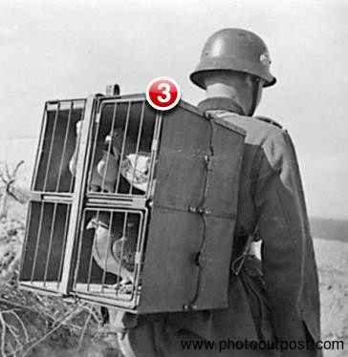
Ok, it's about asynchronous messaging
one message per delivery
messages can be queued
exchangeable transport

Slide 12
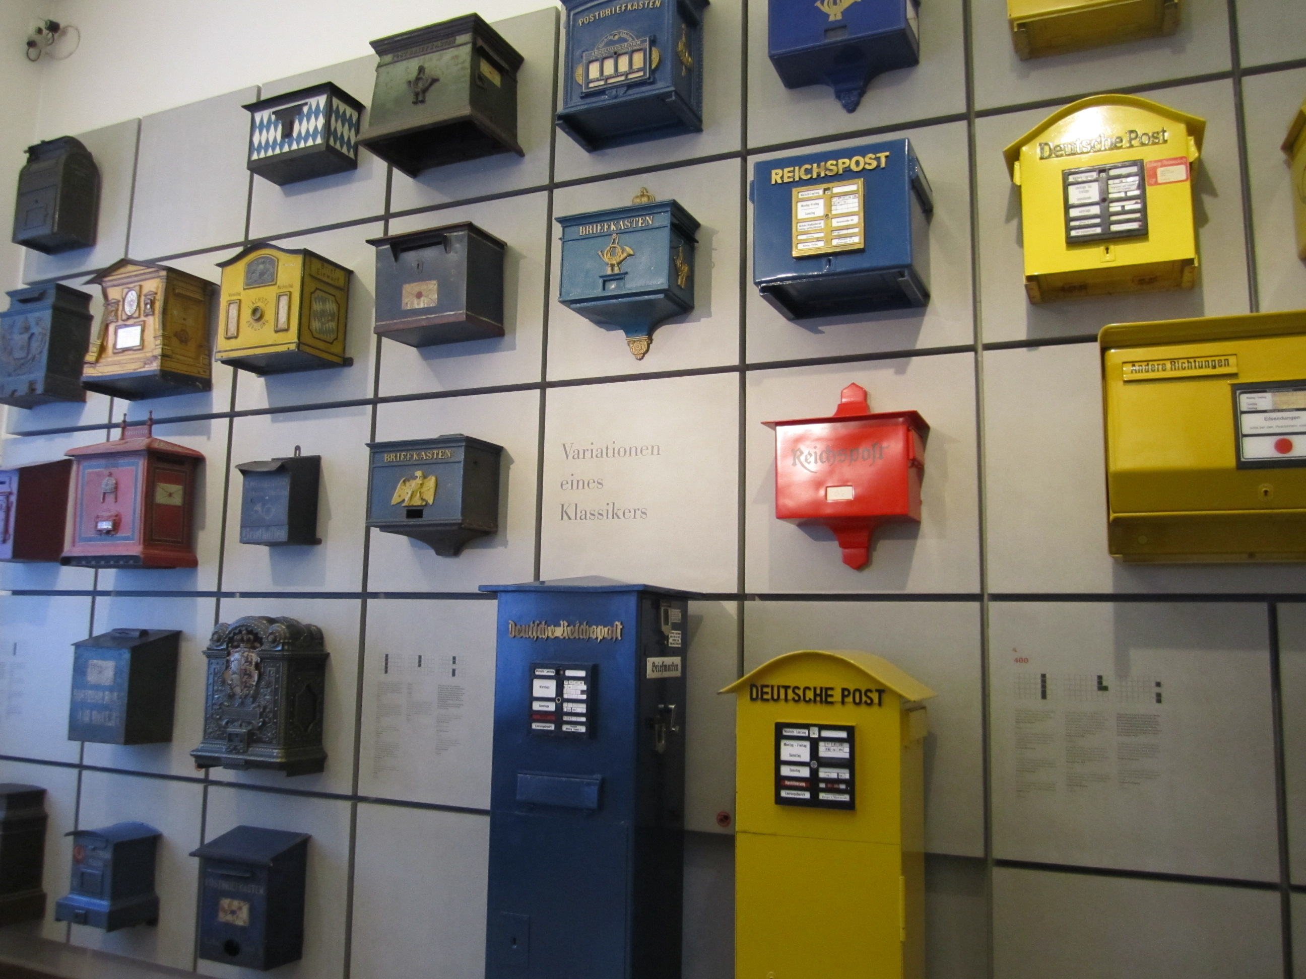
EAI in the real world
As every application has a kind of mailbox imagine a …
... reliable postal service

Slide 13
Benefits of using messaging
message-based communication allows decoupling
integrate heterogenous platforms/ languages
variable timing & throttling – every application works at its pace
reliable communication
disconnected operation
Notes:
http://eaipatterns.com/ramblings/74_messaging.html
Remote Communication. Messaging enables separate applications to communicate and transfer data.
Platform/Language Integration. A messaging system can be a universal translator between the applications that works with different languages and platforms.
Variable Timing . Asynchronous communication allows the sender fire off requests to the receiver at its pace, and for the receiver to consume the requests at its own different pace. This allows both applications to run at maximum throughput and not waste time waiting on each other.
Throttling. A problem with remote procedure calls is that too many of them on a single receiver at the same time can overload the receiver. This can cause performance degradation and even cause the receiver to crash. Asynchronous communication enables the receiver to control the rate at which it consumes requests, so as not to become overloaded by too many simultaneous requests. The adverse effect on callers caused by this throttling is minimized because the communication is asynchronous, so the callers are not blocked waiting on the receiver.
Reliable Communication. Messaging provides reliable delivery because it can use a store and forward approach to transmitting messages with automatic retry.
Disconnected Operation. Some applications are specifically designed to run disconnected from the network, yet to synchronize with servers when a network connection is available. Messaging is ideal for these applications.

Slide 14

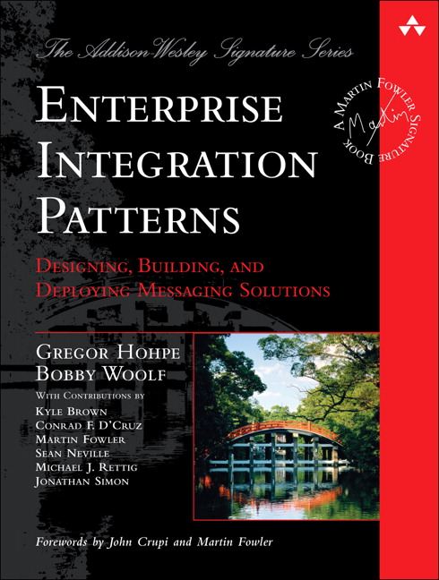
Patterns applied to EAI
Design Patterns (Gamma et al), 1994
Proven solutions for common problems
Enterprise Integration Patterns (Hohpe & Woolf), 2003
Swiss-army knife for asynchronous messaging

Slide 15


How to use EAI patterns in JavaEE
Multiple approaches possible
Do-it-yourself by leveraging the JEE 6 APIs
Use a mediation framework
Apache Camel Spring Integration
http://camel.apache.org/ http://www.springsource.org/spring-integration

Slide 16

Samples for common EAI patterns
adapters
pipes and filters
router
transformer
splitter
aggregator
...and many more

Slide 17
EAI in real life – domain model
external
business partner
REST
order
management
system
forwarder
FTP-Server

Slide 18
EAI Pattern: Inbound- and Outbound-Adapter (Scenario)
every application has a specific interface
  business partner's system provides data via FTP
  forwarder's system only provides SOAP WSSE for tracking data
  forwarder's system sends E-Mail notification for successful shipping

Slide 19
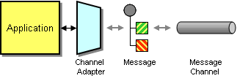
EAI Pattern: Inbound- and Outbound-Adapter
adapter = endpoint fitting the specific capabilities of the remote system's API
inbound adapter = from application to EAI system
outbound adapter = from EAI system to application
http://www.eaipatterns.com/ChannelAdapter.html

Slide 20
EAI Pattern: Pipes and Filters (Scenario)
decouple processing into simple steps unaware of each other
  new purchase order arrives as a message
    order is encrypted to insure integrity → decrypt
    trusted customer's deserve special treating → authenticate
    we don't want duplicated orders → check

Slide 21

EAI Pattern: Pipes and Filters
divide complex processing tasks into simple steps
easier maintenance, reusable and exchangeable
steps (Filters) are connected by channels (Pipes)
http://www.enterpriseintegrationpatterns.com/PipesAndFilters.html

Slide 22
EAI Pattern: Gateway Sample
Demo
  configuration of pipes and filters and howto use in your application
  see “gateway-sample.xml” for details

Slide 23
EAI Pattern: Message Router (Scenario)
forward messages depending on conditions
  product type: downloadable software cannot be shipped
  payment method: credit card transactions vs. direct debit

Slide 24
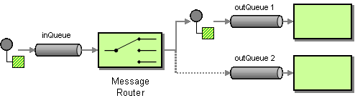
EAI Pattern: Message Router
a message router forwards but doesn't modify message
a message router can have multiple output channels (difference to filter)
decoupled: surrounding components are unaware of its existence
http://www.enterpriseintegrationpatterns.com/MessageRouter.html

Slide 25
EAI Pattern: Transformer (Scenario)
communicating applications have a different data model
  customer data from ERP (A) needs to be send to Forwarder (B)
    different data model
    fields have different semantics
    fields have different length

Slide 26
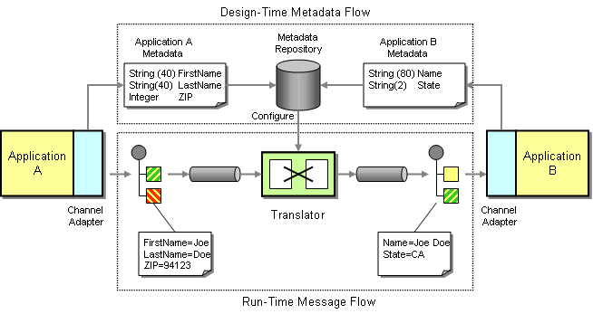
EAI Pattern: Transformer
http://www.enterpriseintegrationpatterns.com/MessageTransformationIntro.html

Slide 27
EAI Pattern: Splitter (Scenario)
message shall be split for further processing
  a CSV file shall be imported line by line
    warehouse system sends picking information for orders in a large CSV file

Slide 28
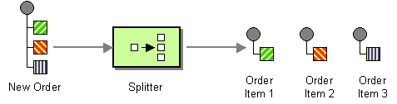
EAI Pattern: Splitter
splitter publishes one message for each item of the original message
http://www.enterpriseintegrationpatterns.com/Sequencer.html

Slide 29
EAI Pattern: Aggregator (Scenario)
single messages shall be combined for further processing
  state of order positions is aggregated to report order state
    aggregate order state depending on shipping state of order positions

Slide 30
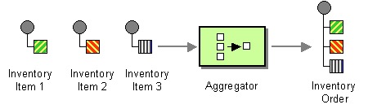
EAI Pattern: Aggregator
aggregator collects messages until a set of related messages is complete
http://www.enterpriseintegrationpatterns.com/Aggregator.html

Slide 31
EAI Pattern: Demo
Demo
  scenario: an importer for CSV files with different content
  configuration of file to string transformer
  configuration of a router
  configuration of an expression based splitter
  see “csv2db-route-context.xml” for details

Slide 32
Real life scenario – the cloud
external
business partner
REST
order
management
system
forwarder
FTP-Server

Slide 33
EAI in the cloud
specific environment
limited number of I/O gateways
  no filesystem → need specific storage adapter
  mostly no open ports → no basic TCP to custom ports
scalable but unique endpoints are needed
  transport mostly via JMS, AMQP or HTTP
keep an eye on traffic and network I/O

Slide 34
Q & A
Feel free to
ask questions now
contact us on twitter @goldstift & @stefanreuter
post issues on github: https://github.com/aheusingfeld/javaone2012/issues

Slide 35

Thanks for your attention
If you have any questions afterwards
contact us on twitter
  @goldstift
  @stefanreuter
post issues on github so everyone can benefit: https://github.com/aheusingfeld/javaone2012/issues

Slide 36
Image copyrights
USB Power adapter courtesy of ChinBuye Limited. http://bit.ly/xBKwGw
3newmessages.jpg from http://www.photooutpost.com
Deutsche Post postboxes by http://bit.ly/PtrhWy
EAI pattern graphics are courtesy of Addison Wesley (http://eaipatterns.com)
Photo of Lego bricks by http://www.sxc.hu/photo/109896
Photo of LEGO candles by http://www.livbit.com/article/2009/06/11/brighten-it-up-with-colorful-lego-candles/
LEGO is a trademark of The Lego Group (http://aboutus.lego.com/en-us/legal-notice )

Slide 37
What does it mean to use messaging at all?
There are at least three different levels for messaging
programming model
  define interaction between different parts of an application
event-based applications
  see http://martinfowler.com/eaaDev/EventSourcing.html
transport mechanism
Notes:
Event-sourced Applications (http://martinfowler.com/eaaDev/EventSourcing.html) by consistently handling changes to the system's state as a sequence of events/ messages, it is possible to replay any previous state.

Slide 38
Backup

Slide 39
Gotchas of EAI in the cloud
limited number of I/O gateways → e.g. no filesystem
  No FTP, no Hot Folder
mostly no open ports → no basic TCP to custom ports
scalable but unique endpoints are needed → everything via HTTP
keep an eye on traffic and network I/O

