Slide 1
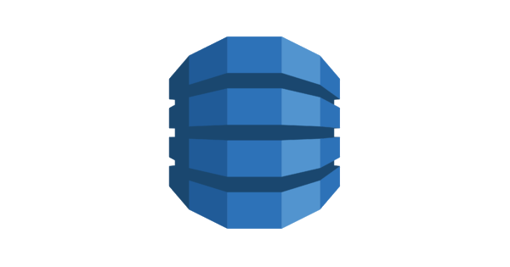
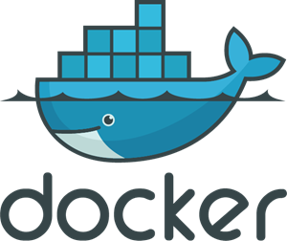


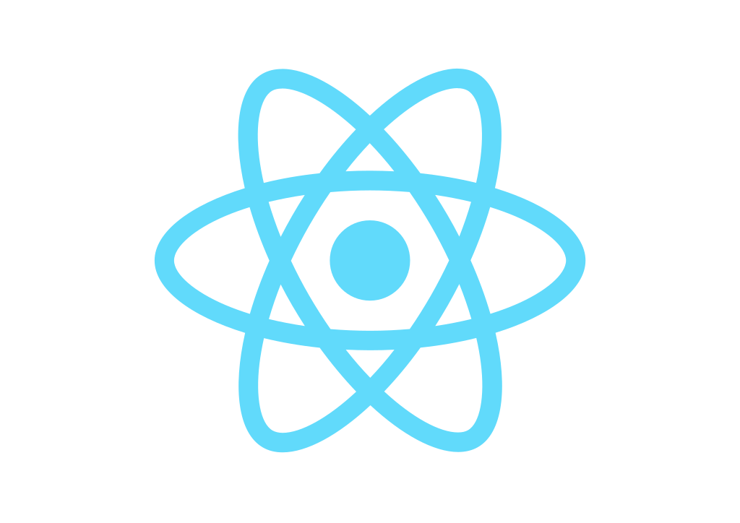


Slide 2

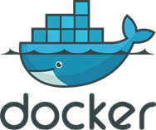
Trigger
test files
Rebuild
S3
test files
ECS Container
Test results
startTest
AWS CLI
DynamoDB

