Slide 1

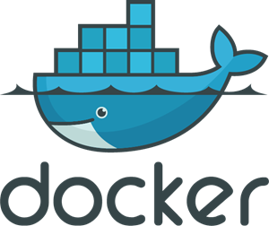





Slide 2




Trigger
ECS Container
1
6
Response Metrics
AWS CLI
startTest
DynamoDB
Response
metrics
5
2
test file
locations
test files
4
DynamoDB
response
Rebuild
test files
3
S3

Slide 3
